Slide 1

博弈论启蒙
Notes:
This chapter builds on the previous two (supply & demand and elasticity). Students who learned those chapters well usually do not have much difficulty with the material in Chapter 6. This chapter can usually be covered in about 90 minutes of class time.
I have combined the analysis of price ceilings with the rent control example, and I’ve combined the analysis of price floors with the minimum wage example. (In contrast, the textbook presents a generic analysis of price ceilings, then the rent control example, then a generic analysis of price floors, then the minimum wage). Most students learn new concepts better in the context of a specific example rather than a generic analysis, and combining them in this way saves class time.
Here’s an idea you might consider:
At the end of the class session just prior to the one in which you begin to cover this chapter, ask students to take out a piece of blank paper, and write down whether they think the minimum wage should be increased, and their reason(s). Tell them not to write their names (you want them to be candid), and have them leave their pieces of paper in a pile as they exit the classroom. Later, divide the papers into two groups based on whether they support or oppose increasing the minimum wage. In this PowerPoint file, immediately after this slide, insert new two slides, titling them “Your reasons for raising the minimum wage” and “Your reasons for not raising the minimum wage.” Summarize on each slide the most common reasons students gave. Begin the class session by showing them the results of this impromptu survey (how many students responded each way, and the most common reasons). Tell those students that support a minimum wage increase that their thinking represents that of many educated non-economists. But tell them that economics offers another perspective, and this is something they will learn in this chapter.
If you do this, then I recommend rearranging the slides a bit so that the price floor/minimum wage slides come BEFORE the price ceiling/rent control slides.

Slide 2
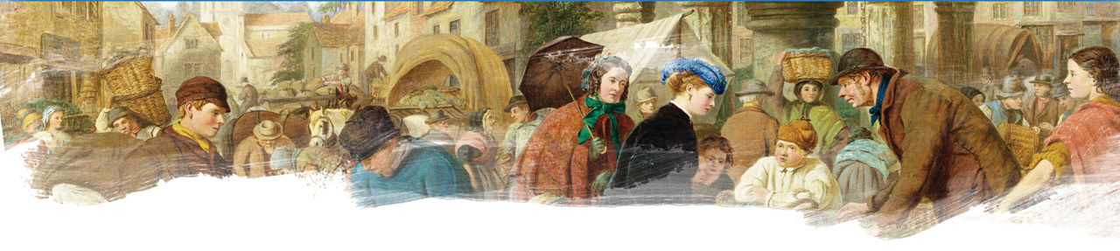
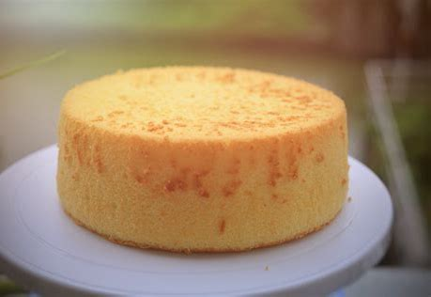
第一节 生活中的博弈问题
引例
两兄弟分蛋糕，该怎么分？
“先切后选”就能解决所有问题吗？
1

Slide 3

引例
两兄弟分蛋糕，该怎么分？
“如果是这块蛋糕，该怎么切，才能让两兄弟都满意呢？
2

Slide 4
“我切你选”与公平
零和博弈与最小最大解
零和博弈的内涵
冯诺依曼与最小最大解
三大难题
价值观不同
“一样大”未必能公平
实际执行问题
某些东西并不可分
如何让人们接受这个结果

Slide 5
理解博弈的前提
人是经济理性的，以最大化自身效用来选择自己的行为。
个人的利益会受到他人行为的影响。
通过了解他人的偏好并保持对他人偏好的信念，来完成预测。

Slide 6
囚徒困境的例子
0
警察抓住了两个抢劫银行的嫌疑犯Bonnie和Clyde，但只有足够的证据让两人在狱里度过一年
警察分别审问了Bonnie和Clyde，向他们每个人提出以下的交易：
如果你承认银行抢劫案，并供出合伙者，你就可以得到自由
如果你不承认银行抢劫案，但你的合伙者供出了你，你将被判处20年的监禁
如果你们两个都承认银行抢劫案，那你们两个都将被判处8年的监禁
OLIGOPOLY
5
Notes:
5
5
SUGGESTION: Instead of showing this slide, ask for two volunteers to be your prisoners. You should pick two students that sit in different parts of the classroom, who are less likely to know each other. Tell them they will be playing bank robbers who have been caught. You are going to interrogate each one separately, like they do on police dramas (have any 20-year-olds heard of NYPD Blue?).
Ask Student #2 to step out of the room for a few moments. Offer to Student #1 the deal described on this slide. Make a note of his or her choice, but do not write it on the board.
Have Student #2 step into the room, and ask Student #1 to wait outside. Offer to Student #2 the deal described on this slide. Ask the class not to give any hints about the decision that Student #1 made. Make a note of Student #2’s choice.
Invite Student #1 back into the room. Write down both of their choices on the board and reveal to each of them their fate.
Hopefully, each student plays the “confess” strategy, so that the outcome of this role-play is the classic Prisoner’s Dilemma Nash Equilibrium. But even if the outcome is different, that’s okay. Ask each student to give the reasons for the strategy he or she chose. Explain why you would have expected both to play the “confess” strategy, and show the payoff matrix on the next slide.
I’m telling you, students LOVE this. It takes a little longer to get through the material, but the material has much more impact then merely lecturing on the Bonnie and Clyde example.

Slide 7
囚徒困境的例子
0
对两人而言，承认罪行是占优策略
纳什均衡：
两人都认罪
Bonnie的决策
坦白
保持沉默
Bonnie 8 年
Bonnie 20年
坦白
Clyde 8 年
Clyde 获得自由
Clyde的决策
Bonnie 获得自由
Bonnie 1 年
保持沉默
Clyde 20 年
Clyde 1 年
OLIGOPOLY
6
Notes:
6
6
This slide is animated carefully as follows:
1) If Clyde confesses, then Bonnie gets 8 years if she confesses or 20 years if she does not.
2) If Clyde remains silent, Bonnie goes free if she confesses or gets 1 year if she does not.
At this point, it may be worth mentioning that Bonnie’s best move is to confess, regardless of Clyde’s decision – hence, “confess” is Bonnie’s dominant strategy.
3) If Bonnie confesses, Clyde gets 8 years if he confesses or 20 years if he does not.
4) If Bonnie remains silent, Clyde goes free if he confesses or gets 1 year if he does not.
Regardless of Bonnie’s decision, Clyde’s best move is to confess.
Both players have a dominant strategy of confessing.

Slide 8
囚徒困境博弈的三要素及纳什均衡
参与者
Bonnie和Clyde
策略
坦白VS保持沉默
收益
自由/1年/8年/20年
纳什均衡
占优决策
非零和博弈

Slide 9
囚徒困境的例子
0
结果： Bonnie 和 Clyde 两人都坦白，都得到8年的刑期
如果两人都保持沉默，他们将更好
但甚至他们在被捕之前就已经对保持沉默达成协议，自利的逻辑仍会起主导作用，并使他们坦白
OLIGOPOLY
8
Notes:
8
8
The prisoners’ dilemma illustrates why cooperation is so difficult even when it is in both players’ mutual interest.

Slide 10
囚徒困境的解决方案
Step1 找到方式达成协议
Step2 找到方式确保协议执行
Sol 1 改变态度
Sol 2 诉诸善意的权威人士
Sol 3 制定能够自行运作的策略
博弈论的应用

Slide 11
主动学习 机票战争游戏
参与者：美国航空公司与联合航空公司
选择：机票降价 50% 或者不变
如果两家航空公司都降价，每家航空公司的
利润= $400 million
如果两家航空公司都不降价，每家航空公司的
利润 = $600 million
如果只有一家航空公司降价，那它的
利润 = $800 million，另外一家航空公司的
利润 = $200 million
画出支付矩阵，并找到纳什均衡
10
Notes:
10
The title I have given this game (the “fare wars” game) might be too much of a hint about what happens in the Nash equilibrium. Feel free to change it to something like “airfare pricing strategies.”

Slide 12
主动学习 参考答案
0
纳什均衡： 两家公司都降价
美国航空公司
降价
不降价
$400 百万
$200 百万
降价
联合航空公司
$400 百万
$800 百万
$800 百万
$600 百万
不降价
$200 百万
$600 百万
11

Slide 13
囚徒困境的其他例子
0
广告战争
军备竞赛
碳排放
OLIGOPOLY
12
Notes:
12
12
The first example, “ad wars,” is not mentioned in the textbook.
An interesting note: When Congress banned cigarette advertising on television in 1971, cigarette manufacturers’ profits rose. Prior to the ban, cigarette companies were stuck in a Nash equilibrium in which all were spending heavily on TV ads to steal business from each other. The ban, in effect, forced cigarette manufacturers to switch to the cooperative outcome in which none advertises on TV.
The next three examples (OPEC on this slide, arms race & common resources on the next slide) are discussed in much more detail in the textbook. Instead of covering these same examples in detail in this PowerPoint, I chose to present different examples, so that students who read the book still have a reason to attend class (and vice versa).
However, it’s still useful to mention the book’s examples here, and briefly discuss them if you wish, so they will be familiar to students when students read the chapter.

Slide 14
博弈问题
囚徒困境
公地悲剧
搭便车
懦夫博弈
志愿者困境
两性战争
猎鹿问题

Slide 15
公地悲剧
多人的囚徒困境
解决方案
明确产权

Slide 16
搭便车
公地悲剧的变形
解决方案
让搭便车的风险和代价提高

Slide 17
懦夫博弈
例如，交通问题，不退让的一方会获得更高的收益
解决方案
改变效用的衡量方式
鹰鸽策略搭配
限制自己的行为

Slide 18
志愿者困境
第一只牛羚的故事
帮助陌生人
解决方案
谢林点：每个人在面对他人期待自己怎么回应的期待时，心中所产生的那个期望。

Slide 19
两性战争
双方的冲突并不是致命的
解决方案
抛硬币——奥曼
在解开僵局的过程当中，关键在于双方要同意以某种方式随机选择策略。

Slide 20
猎鹿问题
猎鹿需要团结协作，且可能存在不确定性。猎兔容易，但将丧失猎到鹿的可能性。
解决方案
拒绝低风险的诱惑

Slide 21
沟通和信任
构建信任的策略
反悔的代价极高
令对方无法改变心意
慷慨之心和利他主义
Notes:
当你遇到困难的时候，试着用常见的困境去套路一下，明确自己处在什么情况中，使自己尽量成为一个明智的博弈参与者。

