Slide 1
总供给与总需求
© 2015 Cengage Learning. All Rights Reserved. May not be copied, scanned, or duplicated, in whole or in part, except for use as permitted in a license distributed with a certain product or service or otherwise on a password-protected website for classroom use.

Slide 2
本章我们将探索这些问题的答案：
经济波动
用AS-AD模型表示以及解释经济波动
AD曲线
LAS以及SAS曲线
AS-AD的均衡
总需求以及总供给变动的影响

Slide 3

经济波动
经济活动
每年经济波动
衰退
经济紧缩
真实收入下降和失业率上升时期
萧条
严重衰退
“你被解雇了，把这个决定传达下去。”
© 2015 Cengage Learning. All Rights Reserved. May not be copied, scanned, or duplicated, in whole or in part, except for use as permitted in a license distributed with a certain product or service or otherwise on a password-protected website for classroom use.

Slide 4
经济波动
© 2015 Cengage Learning. All Rights Reserved. May not be copied, scanned, or duplicated, in whole or in part, except for use as permitted in a license distributed with a certain product or service or otherwise on a password-protected website for classroom use.
关于经济波动的三个事实
经济波动是无规律的且不可预测的
经济周期
大多数宏观经济变量同时变动
衰退: 经济广泛现象
随着产量减少，失业增加

Slide 5
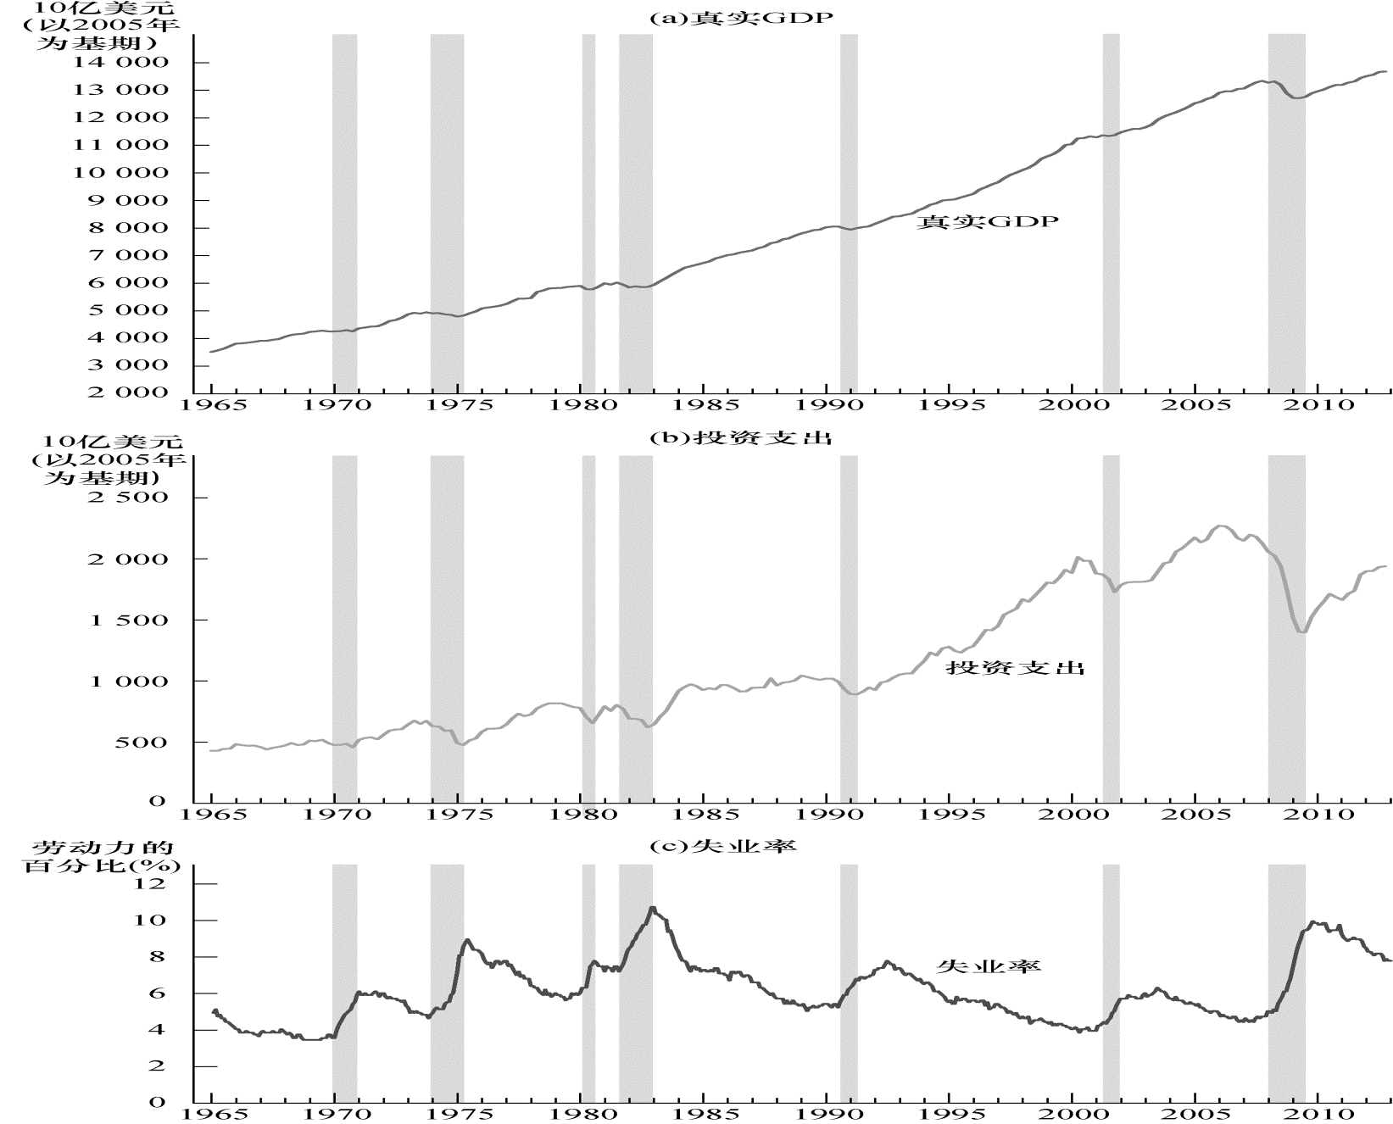
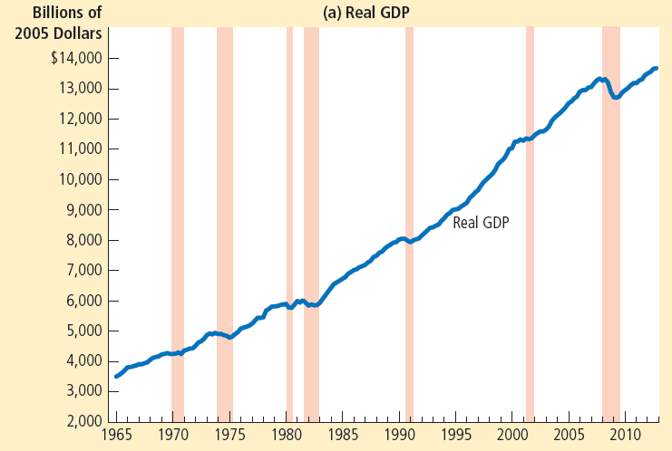

图 1
短期经济波动 (a)
该图a幅、b幅和c幅分别显示了1965年以来用季度数据表示的美国经济的真实GDP、投资支出以及失业率。阴影面积表示衰退。要注意的是，在衰退期间，真实GDP和投资支出的时间少的，而失业是上升的。
© 2015 Cengage Learning. All Rights Reserved. May not be copied, scanned, or duplicated, in whole or in part, except for use as permitted in a license distributed with a certain product or service or otherwise on a password-protected website for classroom use.

Slide 6

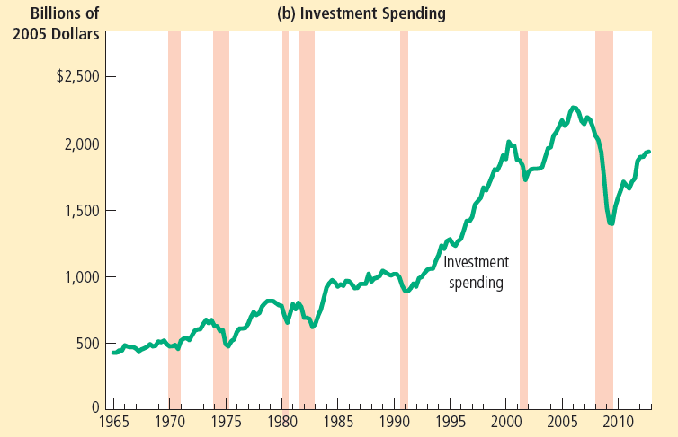
图 1
短期经济波动 (b)
该图a幅、b幅和c幅分别显示了1965年以来用季度数据表示的美国经济的真实GDP、投资支出以及失业率。阴影面积表示衰退。要注意的是，在衰退期间，真实GDP和投资支出的时间少的，而失业是上升的。
© 2015 Cengage Learning. All Rights Reserved. May not be copied, scanned, or duplicated, in whole or in part, except for use as permitted in a license distributed with a certain product or service or otherwise on a password-protected website for classroom use.

Slide 7

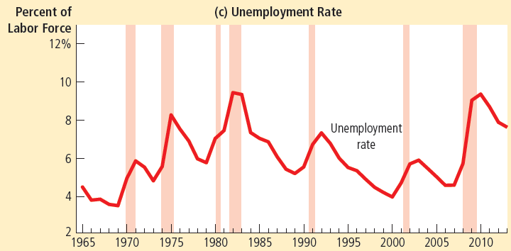
图 1
短期经济波动 (c)
该图a幅、b幅和c幅分别显示了1965年以来用季度数据表示的美国经济的真实GDP、投资支出以及失业率。阴影面积表示衰退。要注意的是，在衰退期间，真实GDP和投资支出的时间少的，而失业是上升的。
© 2015 Cengage Learning. All Rights Reserved. May not be copied, scanned, or duplicated, in whole or in part, except for use as permitted in a license distributed with a certain product or service or otherwise on a password-protected website for classroom use.

Slide 8
短期经济波动
© 2015 Cengage Learning. All Rights Reserved. May not be copied, scanned, or duplicated, in whole or in part, except for use as permitted in a license distributed with a certain product or service or otherwise on a password-protected website for classroom use.
古典二分法
经济变量可以分为:
真实变量
名义变量
货币中性
货币供给的变化
影响名义变量
不影响真实变量

Slide 9
短期经济波动
© 2015 Cengage Learning. All Rights Reserved. May not be copied, scanned, or duplicated, in whole or in part, except for use as permitted in a license distributed with a certain product or service or otherwise on a password-protected website for classroom use.
长期中的古典理论
货币供给的变化
影响物价和其他名义变量
不影响实际GDP, 失业或者其他真实变量

Slide 10
短期经济波动
© 2015 Cengage Learning. All Rights Reserved. May not be copied, scanned, or duplicated, in whole or in part, except for use as permitted in a license distributed with a certain product or service or otherwise on a password-protected website for classroom use.
短期
货币中性假设: 不再适用
真实和名义变量是高度相关的
货币供给的变化
可以暂时推动GDP偏离长期趋势

Slide 11
短期经济波动
AD-AS模型
总需求(AD)和总供给(AS)
大多数经济学家用来解释经济活动的短期波动
围绕其长期趋势
© 2015 Cengage Learning. All Rights Reserved. May not be copied, scanned, or duplicated, in whole or in part, except for use as permitted in a license distributed with a certain product or service or otherwise on a password-protected website for classroom use.

Slide 12
短期经济波动
总需求曲线
表示物品和服务的数量
家庭, 政府, 政府和外国消费者
想在每个价格水平上购买的
向下方倾斜
© 2015 Cengage Learning. All Rights Reserved. May not be copied, scanned, or duplicated, in whole or in part, except for use as permitted in a license distributed with a certain product or service or otherwise on a password-protected website for classroom use.

Slide 13
总需求曲线
Y = C + I + G + NX
三种效应解释为什么AD曲线向右下方倾斜:
财富效应 (C )
利率效应(I)
汇率效应(NX)
假设:政府购买 (G)
固定不变
© 2015 Cengage Learning. All Rights Reserved. May not be copied, scanned, or duplicated, in whole or in part, except for use as permitted in a license distributed with a certain product or service or otherwise on a password-protected website for classroom use.

Slide 14
总需求曲线
物价水平和消费 (C): 财富效应
物价水平下降
提高了货币的真实价值
消费者更富有
提高了消费者、支出
增加物品和服务的需求
© 2015 Cengage Learning. All Rights Reserved. May not be copied, scanned, or duplicated, in whole or in part, except for use as permitted in a license distributed with a certain product or service or otherwise on a password-protected website for classroom use.

Slide 15
总需求曲线
物价水平和投资(I): 利率效应
物价水平下降
降低了利率
增加了在投资品上的支出
增加物品和服务的需求
© 2015 Cengage Learning. All Rights Reserved. May not be copied, scanned, or duplicated, in whole or in part, except for use as permitted in a license distributed with a certain product or service or otherwise on a password-protected website for classroom use.

Slide 16
总需求曲线
物价水平和净出口(NX): 汇率效应
美国的物价水平下降
降低了利率
美元贬值
刺激出口需求增加物品和服务的需求
© 2015 Cengage Learning. All Rights Reserved. May not be copied, scanned, or duplicated, in whole or in part, except for use as permitted in a license distributed with a certain product or service or otherwise on a password-protected website for classroom use.

Slide 17
总需求曲线
价格水平下降
增加物品和服务的需求
因为:
消费者更富有: 刺激了消费物品的需求
利率下降: 刺激了投资品的需求
通货贬值: 刺激了净出口的需求
© 2015 Cengage Learning. All Rights Reserved. May not be copied, scanned, or duplicated, in whole or in part, except for use as permitted in a license distributed with a certain product or service or otherwise on a password-protected website for classroom use.

Slide 18
总需求曲线
物价水平上升
降低了物品和服务的需求
因为:
消费者变穷了: 降低了消费者的购买
高的利率: 降低了投资支出
通货升值: 降低了净出口
© 2015 Cengage Learning. All Rights Reserved. May not be copied, scanned, or duplicated, in whole or in part, except for use as permitted in a license distributed with a certain product or service or otherwise on a password-protected website for classroom use.

Slide 19
图 3
总需求曲线
物价
水平
1. 物价水平下降 . . .
P₁
2. . . . 物品与劳务的需求量增加。
P₂
总需求
Y₁
Y₂
产量
物价水平从 P₁ 下降到 P₂ 。这使得物品与服务需求量从 Y₁ 增加到Y₂. 这种负相关关系有三个原因. 当物价水平下降时, 真实财富增加, 利率下降和汇率下降。这些效应刺激了消费、投资和净出口的支出。这些GDP组成部分中任意一个或所有部分支出的增加意味着物品与服务的需求量更大了。
© 2015 Cengage Learning. All Rights Reserved. May not be copied, scanned, or duplicated, in whole or in part, except for use as permitted in a license distributed with a certain product or service or otherwise on a password-protected website for classroom use.

Slide 20
总需求曲线
AD曲线移动:
消费变化, C
投资变化, I
政府支出的变化, G
净出口的变化, NX
© 2015 Cengage Learning. All Rights Reserved. May not be copied, scanned, or duplicated, in whole or in part, except for use as permitted in a license distributed with a certain product or service or otherwise on a password-protected website for classroom use.

Slide 21
总需求曲线
消费变化, C
在给定一个价格水平上改变消费者购买数量的事件
税收和财富的变化
增加消费者支出
总需求曲线: 向右移动
© 2015 Cengage Learning. All Rights Reserved. May not be copied, scanned, or duplicated, in whole or in part, except for use as permitted in a license distributed with a certain product or service or otherwise on a password-protected website for classroom use.

Slide 22
总需求曲线
投资变化, I
在给定一个价格水平上改变企业投资数量的事件
更好的技术
税收政策
货币政策
增加投资
总需求曲线: 向右移动
© 2015 Cengage Learning. All Rights Reserved. May not be copied, scanned, or duplicated, in whole or in part, except for use as permitted in a license distributed with a certain product or service or otherwise on a password-protected website for classroom use.

Slide 23
总需求曲线
政府购买的变化, G
政策制定者 – 在给定每一个价格水平改变投资
修建公路
增加政府购买
总需求曲线: 向右移动
© 2015 Cengage Learning. All Rights Reserved. May not be copied, scanned, or duplicated, in whole or in part, except for use as permitted in a license distributed with a certain product or service or otherwise on a password-protected website for classroom use.

Slide 24
总需求曲线
净出口的变化, NX
在给定一个价格水平上改变净出口数量的事件
欧洲的衰退
国际投机者 – 汇率的变化
净出口的增加
总需求曲线: 向右移动
© 2015 Cengage Learning. All Rights Reserved. May not be copied, scanned, or duplicated, in whole or in part, except for use as permitted in a license distributed with a certain product or service or otherwise on a password-protected website for classroom use.

Slide 25
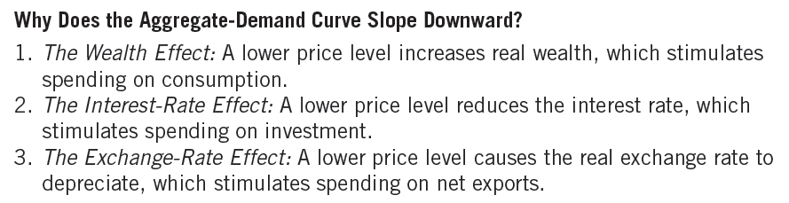
表1
总需求曲线: 总结
© 2015 Cengage Learning. All Rights Reserved. May not be copied, scanned, or duplicated, in whole or in part, except for use as permitted in a license distributed with a certain product or service or otherwise on a password-protected website for classroom use.

Slide 26
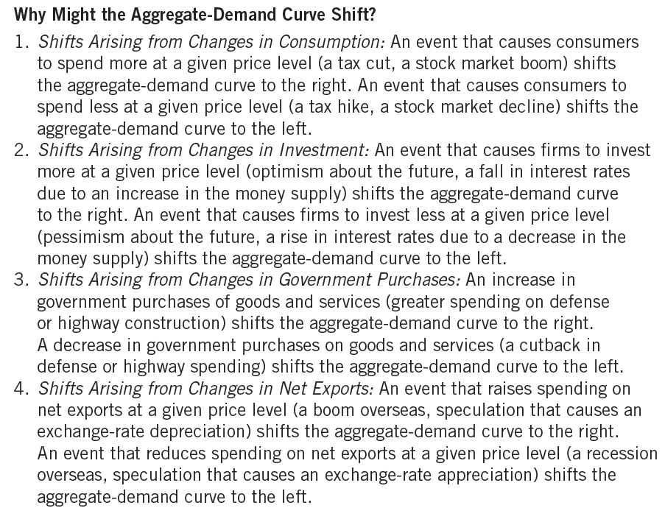
表 1
总需求曲线: 总结
© 2015 Cengage Learning. All Rights Reserved. May not be copied, scanned, or duplicated, in whole or in part, except for use as permitted in a license distributed with a certain product or service or otherwise on a password-protected website for classroom use.

Slide 27
总供给曲线
© 2015 Cengage Learning. All Rights Reserved. May not be copied, scanned, or duplicated, in whole or in part, except for use as permitted in a license distributed with a certain product or service or otherwise on a password-protected website for classroom use.
长期总供给曲线, LRAS
总供给曲线是一条垂线
物价水平不是GDP的长期决定因素:
劳动、资本和自然资源的供给
可利用的技术
短期
总供给曲线是向上倾斜的

Slide 28
图 4
长期总供给曲线
物价水平
长期总供给
P₁
1.物价水平的一个变动 . . .
P₂
2.不影响长期中物品与服务的供给。
自然产出水平
产出数量
在长期中，供给量取决于劳动、资本和自然资源量，以及把这些投入变为产出的技术。因为供给量并不取决于物价总水平，所以长期总供给曲线是在自然水平上的一条垂线。
© 2015 Cengage Learning. All Rights Reserved. May not be copied, scanned, or duplicated, in whole or in part, except for use as permitted in a license distributed with a certain product or service or otherwise on a password-protected website for classroom use.

Slide 29
总供给曲线
© 2015 Cengage Learning. All Rights Reserved. May not be copied, scanned, or duplicated, in whole or in part, except for use as permitted in a license distributed with a certain product or service or otherwise on a password-protected website for classroom use.
自然产出水平
物品和服务的产出
长期中经济获得的
当失业达到自然率状态
潜在产量
充分就业产量

Slide 30
总供给曲线
© 2015 Cengage Learning. All Rights Reserved. May not be copied, scanned, or duplicated, in whole or in part, except for use as permitted in a license distributed with a certain product or service or otherwise on a password-protected website for classroom use.
总供给曲线可以移动
自然产出的变化
劳动的变化
资本的变化
自然资源的变化
技术知识的变化

Slide 31
总供给曲线
© 2015 Cengage Learning. All Rights Reserved. May not be copied, scanned, or duplicated, in whole or in part, except for use as permitted in a license distributed with a certain product or service or otherwise on a password-protected website for classroom use.
劳动的变化
劳动数量 – 增加
总供给曲线: 向右移动
自然失业率– 增加
总供给曲线: 向左移动
资本的变化
资本存量 – 增加
总供给曲线: 向右移动
实物和人力资本

Slide 32
总供给曲线
© 2015 Cengage Learning. All Rights Reserved. May not be copied, scanned, or duplicated, in whole or in part, except for use as permitted in a license distributed with a certain product or service or otherwise on a password-protected website for classroom use.
自然资源的变化
自然资源的新发现
总供给曲线: 向右移动
天气
自然资源的可获得性

Slide 33
总供给曲线
© 2015 Cengage Learning. All Rights Reserved. May not be copied, scanned, or duplicated, in whole or in part, except for use as permitted in a license distributed with a certain product or service or otherwise on a password-protected website for classroom use.
技术的变化
新技术, 在给定的劳动、资本和资源下
总供给曲线: 向右移动
国际贸易
政府规制

Slide 34
长期增长与通货膨胀
© 2015 Cengage Learning. All Rights Reserved. May not be copied, scanned, or duplicated, in whole or in part, except for use as permitted in a license distributed with a certain product or service or otherwise on a password-protected website for classroom use.
在长期: AD 和 LRAS 曲线都会移动
LRAS 曲线不断向右移动
技术进步
AD 曲线向右移动
货币政策
美联储一直在增加货币供给
结果:
持续的产出增加
持续的通货膨胀

Slide 35
图 5
总需求与总供给模型中的长期增长与通货膨胀
物价水平
LRAS₁₉₉₀
LRAS₂₀₀₀
LRAS₂₀₁₀
2. . . 以及货币供给增长使总需求曲线的移动 . . .
1. 在长期中，技术进步使长期总供给曲线移动…
P₂₀₁₀
3. . . . 引起产量增长 . . .
P₂₀₀₀
P₁₉₉₀
AD₂₀₁₀
4. . . 及持续的通货膨胀。
AD₁₉₉₀
AD₂₀₀₀
Y₁₉₉₀
Y₂₀₀₀
Y₂₀₁₀
产量
主要由于技术进步，随着时间的推移，经济中生产物品与服务的能力提高了，长期总供给曲线向右移动。同时，随着美联储增加货币供给,总需求曲线也向右移动。在该图中，产量从 Y₁₉₉₀ 增长到Y₂₀₀₀，然后又增长到 Y₂₀₁₀, 而且物价水平也从 P₁₉₉₀ 上升到 P₂₀₀₀ 然后又上升到 P₂₀₁₀. 因此，总需求与总供给模型提供了描述增长与通货膨胀的古典分析的一种方法。
© 2015 Cengage Learning. All Rights Reserved. May not be copied, scanned, or duplicated, in whole or in part, except for use as permitted in a license distributed with a certain product or service or otherwise on a password-protected website for classroom use.

Slide 36
总供给曲线
© 2015 Cengage Learning. All Rights Reserved. May not be copied, scanned, or duplicated, in whole or in part, except for use as permitted in a license distributed with a certain product or service or otherwise on a password-protected website for classroom use.
在短期:
经济总体价格水平的增加
倾向于增加物品与服务的供给
物价水平的下降
倾向于减少物品与服务的供给

Slide 37
图 6
短期总供给曲线
物价水平
短期总供给
1. 物价水平下降 . . .
P₁
P₂
2. . . . 减少了短期中物品与劳务的供给量。
Y₂
Y₁
产量
在短期中，物价水平从 P₁ t下降到P₂ ，使得供给量从Y₁ 减少为 Y₂。两者之中的这种正相关关系可能由于黏性工资、黏性价格或错觉的存在。随着时间的推移，工资、物价和感觉得到调整，因此这种正相关关系只是暂时的。
© 2015 Cengage Learning. All Rights Reserved. May not be copied, scanned, or duplicated, in whole or in part, except for use as permitted in a license distributed with a certain product or service or otherwise on a password-protected website for classroom use.

Slide 38
总供给曲线
© 2015 Cengage Learning. All Rights Reserved. May not be copied, scanned, or duplicated, in whole or in part, except for use as permitted in a license distributed with a certain product or service or otherwise on a password-protected website for classroom use.
解释短期总供给曲线向上倾斜的理论:
黏性工资理论
黏性价格理论
错觉理论

Slide 39
总供给曲线
© 2015 Cengage Learning. All Rights Reserved. May not be copied, scanned, or duplicated, in whole or in part, except for use as permitted in a license distributed with a certain product or service or otherwise on a password-protected website for classroom use.
黏性工资理论
名义工资 – 对经济状况变动的缓慢调整
长期合同: 工人和企业
缓慢变化的社会规范
公正的概念 – 影响工资确定
名义工资 – 基于预期的物价
当实际物价水平的结果不同于预期水平时，名义工资并不会立即对此做出反应。

Slide 40
总供给曲线
© 2015 Cengage Learning. All Rights Reserved. May not be copied, scanned, or duplicated, in whole or in part, except for use as permitted in a license distributed with a certain product or service or otherwise on a password-protected website for classroom use.
黏性工资理论
如果价格水平< 预期
企业 – 减少长量供给
如果价格水平>预期
企业 – 增加长量供给

Slide 41
总供给曲线
© 2015 Cengage Learning. All Rights Reserved. May not be copied, scanned, or duplicated, in whole or in part, except for use as permitted in a license distributed with a certain product or service or otherwise on a password-protected website for classroom use.
黏性价格理论
一些物品与服务的价格
对经济状况变动的缓慢调整
菜单成本
调节价格的成本

Slide 42
总供给曲线
© 2015 Cengage Learning. All Rights Reserved. May not be copied, scanned, or duplicated, in whole or in part, except for use as permitted in a license distributed with a certain product or service or otherwise on a password-protected website for classroom use.
错觉理论
经济总体价格水平的变动
可以暂时误导供给者
关于个别市场的变化
相对价格的变化
供给者 – 对物价水平价格变化的反应
改变供给的物品和服务数量

Slide 43
总供给曲线
© 2015 Cengage Learning. All Rights Reserved. May not be copied, scanned, or duplicated, in whole or in part, except for use as permitted in a license distributed with a certain product or service or otherwise on a password-protected website for classroom use.
产出的供给数量 =
= 自然产出 +
+ a(实际价格水平– 预期物价水平)
A代表产出对未预期到的物价变动的反应

Slide 44
总供给曲线
© 2015 Cengage Learning. All Rights Reserved. May not be copied, scanned, or duplicated, in whole or in part, except for use as permitted in a license distributed with a certain product or service or otherwise on a password-protected website for classroom use.
短期总供给曲线可以移动:
劳动、资本、自然资源和技术的变化
预期物价水平的下降
总供给曲线: 向左移动

Slide 45
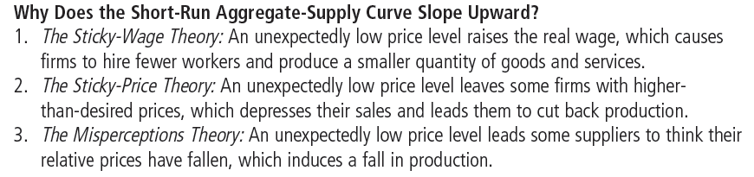
表 2
短期总供给曲线: 总结
© 2015 Cengage Learning. All Rights Reserved. May not be copied, scanned, or duplicated, in whole or in part, except for use as permitted in a license distributed with a certain product or service or otherwise on a password-protected website for classroom use.

Slide 46
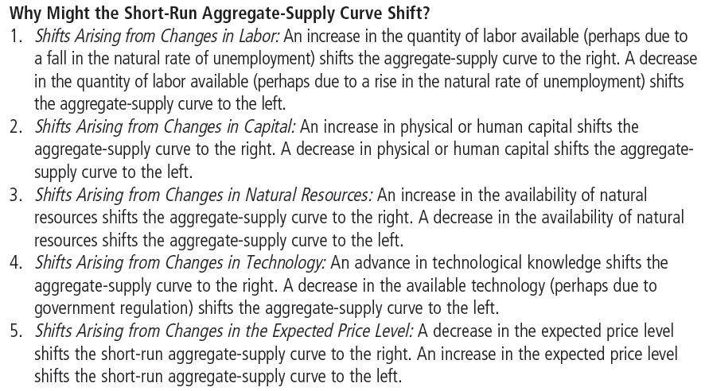
表 2
短期总供给曲线: 总结
© 2015 Cengage Learning. All Rights Reserved. May not be copied, scanned, or duplicated, in whole or in part, except for use as permitted in a license distributed with a certain product or service or otherwise on a password-protected website for classroom use.

Slide 47
经济波动的原因
© 2015 Cengage Learning. All Rights Reserved. May not be copied, scanned, or duplicated, in whole or in part, except for use as permitted in a license distributed with a certain product or service or otherwise on a password-protected website for classroom use.
假设
经济开始处于长期均衡
长期均衡:
AD 与 LRAS 曲线的交点
自然产出水平
实际物价水平
AD 与 AS 曲线的交点
预期物价水平 = 实际物价水平

Slide 48
图 7
长期均衡
物价水平
长期总供给
短期总供给
均衡价格
A
总需求
自然产出水平
产量
经济的长期均衡是总需求曲线与长期总供给曲线的交点。当经济达到这种长期均衡时，预期物价水平将调整为等于实际物价水平。因此，短期总供给曲线也相交于这一点。
© 2015 Cengage Learning. All Rights Reserved. May not be copied, scanned, or duplicated, in whole or in part, except for use as permitted in a license distributed with a certain product or service or otherwise on a password-protected website for classroom use.

Slide 49
经济波动的原因
© 2015 Cengage Learning. All Rights Reserved. May not be copied, scanned, or duplicated, in whole or in part, except for use as permitted in a license distributed with a certain product or service or otherwise on a password-protected website for classroom use.
总需求的移动
悲观情绪的波动: AD移动
短期
产出下降
物价水平下降
长期
短期总供给曲线向右移动
产出 – 自然水平
价格水平 – 下降

Slide 50
表 3
分析宏观经济波动的四个步骤
1. 确定某个事件是使总需求曲线移动，还是使总供给曲线移动（或者两条曲线都移动）.
2. 确定曲线移动的方向.
3. 用总需求和总供给图说明这种移动如何影响短期产量和物价水平.
4. 用总需求和总供给图分析经济如何从新的短期均衡变动到其长期均衡.
© 2015 Cengage Learning. All Rights Reserved. May not be copied, scanned, or duplicated, in whole or in part, except for use as permitted in a license distributed with a certain product or service or otherwise on a password-protected website for classroom use.

Slide 51
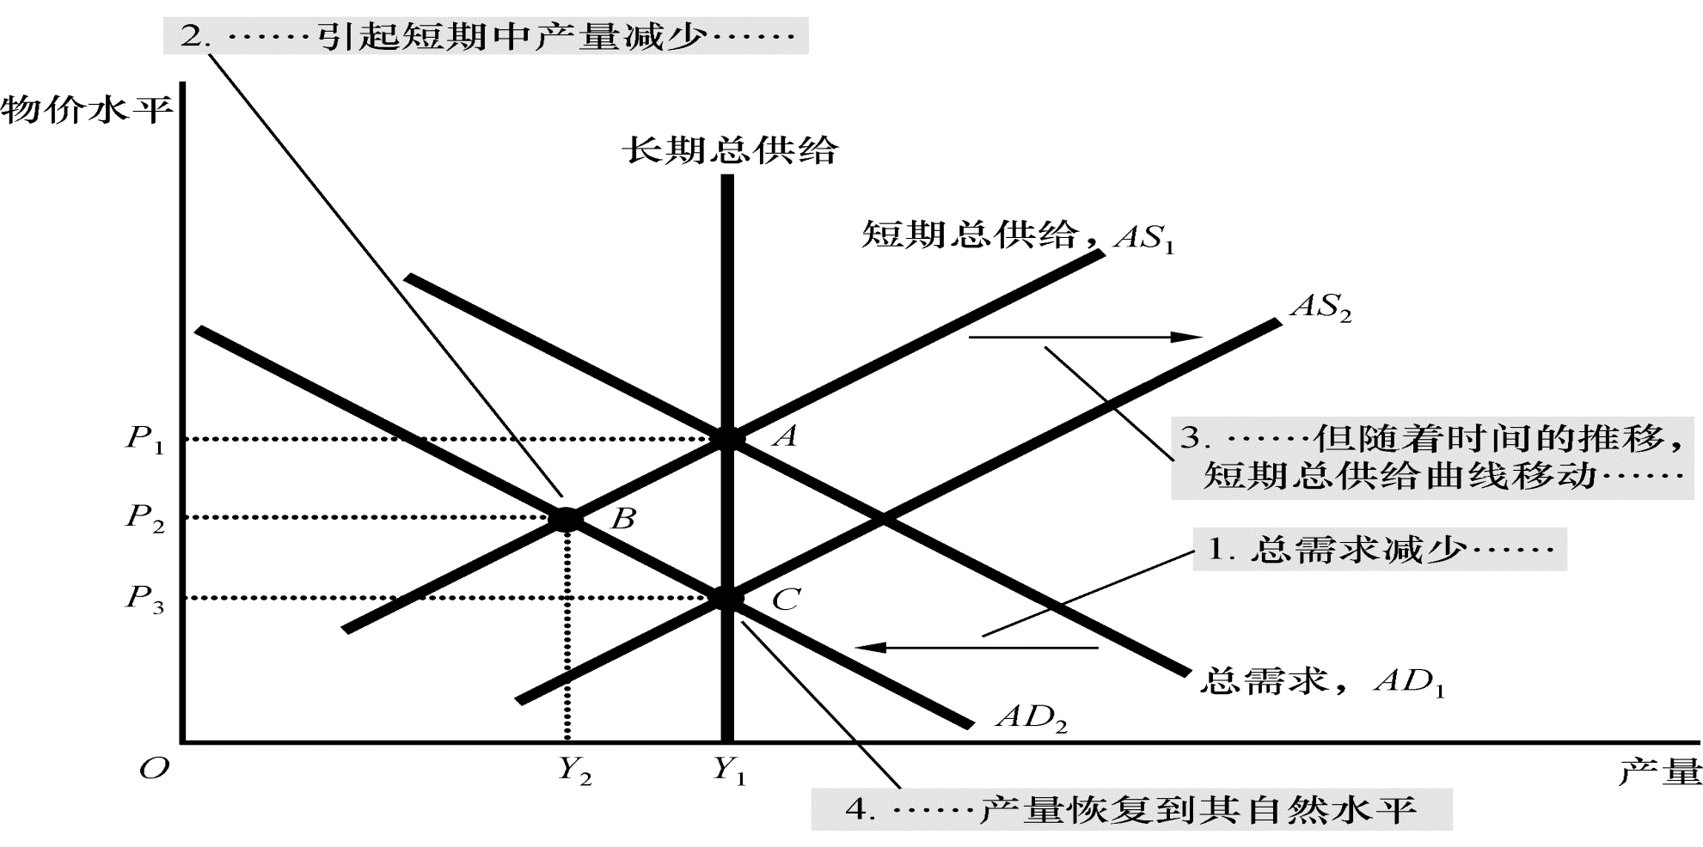
图 8
总需求减少
Price
Level
Long-run aggregate supply
Short-run aggregate supply, AS₁
3. . . . but over time, the short-run aggregate-supply curve shifts . . .
AS₂
P₁
A
B
4. . . . and output returns to its natural level.
P₂
C
P₃
1. A decrease in aggregate demand . . .
AD₂
Aggregate demand, AD₁
Y₂
Y₁
Quantity of Output
2. . . . causes output to fall in the short run . . .
总需求曲线从 AD₁ 向左 AD₂代表了总需求减少。在短期中，经济从 A 移动到 B，产量从Y₁ 减少到Y₂, 物价水平从P₁ 下降到 P₂。 随着时间的推移，当预期物价水平调整时，短期总供给曲线从AS₁ 调整到 AS₂, 经济会移动到C, 在这个新的一点新的需求曲线与长期总供给相交。在长期中，物价水平下降到P₃, 产量恢复到其自然水平 Y₁.
© 2015 Cengage Learning. All Rights Reserved. May not be copied, scanned, or duplicated, in whole or in part, except for use as permitted in a license distributed with a certain product or service or otherwise on a password-protected website for classroom use.

Slide 52
总需求的两次重大的移动：大萧条与第二次世界大战
1930年代早期: 真实GDP大幅下降
大萧条
美国历史上最大的经济衰退
从1929到1933年
真实GDP下降27%
失业率 从3% 上升到 25%
物价水平下降到 22%
© 2015 Cengage Learning. All Rights Reserved. May not be copied, scanned, or duplicated, in whole or in part, except for use as permitted in a license distributed with a certain product or service or otherwise on a password-protected website for classroom use.

Slide 53
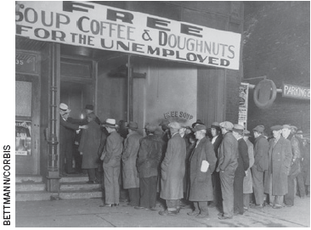
总需求的两次重大的移动：大萧条与第二次世界大战
1930年代早期: 真实GDP大幅下降
原因:总需求下降
货币供给下降 ( 28%)
减少: C 和 I
总需求大幅减少的结果
© 2015 Cengage Learning. All Rights Reserved. May not be copied, scanned, or duplicated, in whole or in part, except for use as permitted in a license distributed with a certain product or service or otherwise on a password-protected website for classroom use.

Slide 54
总需求的两次重大的移动：大萧条与第二次世界大战
1940年代早期: 真实GDP大幅下降
经济繁荣
第二次世界大战
更多的资源用于军事
政府购买增加
总需求– 1939 到1944一直增加
经济中的物品和服务翻倍
物价水平增加了20%
失业率从17%下降到1%
© 2015 Cengage Learning. All Rights Reserved. May not be copied, scanned, or duplicated, in whole or in part, except for use as permitted in a license distributed with a certain product or service or otherwise on a password-protected website for classroom use.

Slide 55
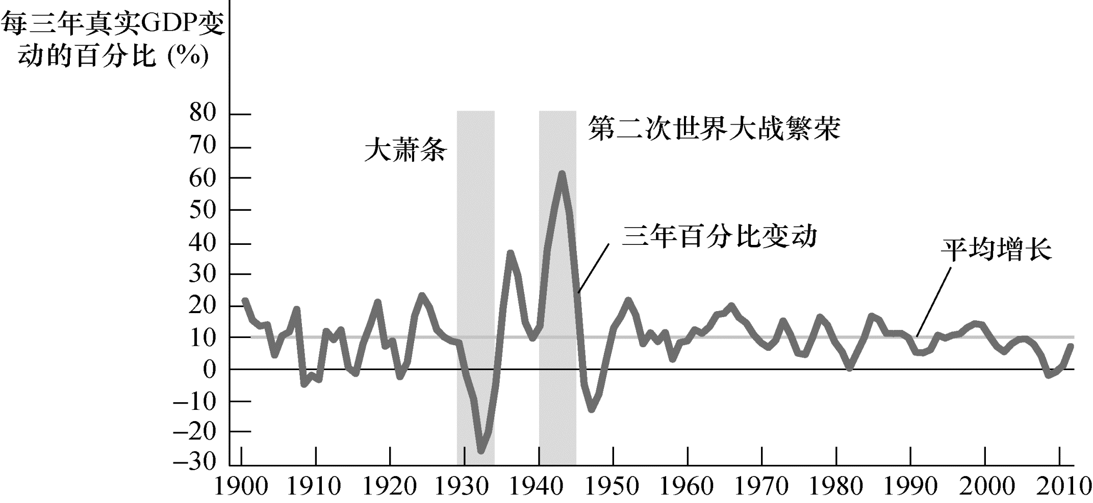
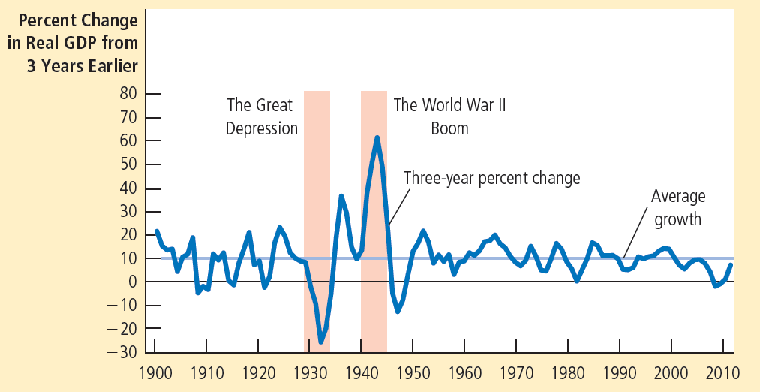
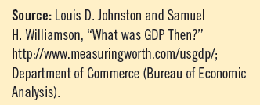
图 9
1900年以来美国的真实GDP增长
在美国经济史上，两次经济波动特别剧烈。在20世纪30年代初，经济经历了大萧条，当时物品与服务的生产严重萎缩。在20世纪40年代初，美国加入第二次世界大战，这使得经济中的生产迅速增加。通常用总需求的大幅移动来解释这两个事件。
© 2015 Cengage Learning. All Rights Reserved. May not be copied, scanned, or duplicated, in whole or in part, except for use as permitted in a license distributed with a certain product or service or otherwise on a password-protected website for classroom use.

Slide 56
2008–2009年的衰退
2008-2009, 金融危机, 经济活动的严重下降
半个多世纪中最坏的宏观经济事件
几年前: 房地产市场繁荣
由低利率引起的
房地产价格上涨
抵押贷款市场的发展
其他问题
© 2015 Cengage Learning. All Rights Reserved. May not be copied, scanned, or duplicated, in whole or in part, except for use as permitted in a license distributed with a certain product or service or otherwise on a password-protected website for classroom use.

Slide 57
2008–2009年的衰退
抵押贷款市场的发展
使次级借款者借钱更容易
借款者有着高度的违约风险(收入和信贷历史)
证券化
金融机构进行贷款(抵押贷款的创办人)
(投资银行) 将贷款捆绑成住房抵押贷款支持证券
© 2015 Cengage Learning. All Rights Reserved. May not be copied, scanned, or duplicated, in whole or in part, except for use as permitted in a license distributed with a certain product or service or otherwise on a password-protected website for classroom use.

Slide 58
2008–2009年的衰退
抵押贷款市场的发展
住房抵押贷款支持证券
卖给其他机构,他们并没有充分评估这些证券的风险
其他问题
对这些高风险贷款监管不充分
误导的政府政策
鼓励高风险贷款
© 2015 Cengage Learning. All Rights Reserved. May not be copied, scanned, or duplicated, in whole or in part, except for use as permitted in a license distributed with a certain product or service or otherwise on a password-protected website for classroom use.

Slide 59
2008–2009年的衰退
1995-2006
住房需求增加
住房价格增加
超过两倍
2006-2009, 住房价格下降30%
抵押贷款违约和住房被收回大幅上升
拥有住房贷款支持证券的金融机构
巨额损失
© 2015 Cengage Learning. All Rights Reserved. May not be copied, scanned, or duplicated, in whole or in part, except for use as permitted in a license distributed with a certain product or service or otherwise on a password-protected website for classroom use.

Slide 60
2008–2009年的衰退
总需求大幅收缩
真实GDP大幅下降
2007第四季度到2009第二季度下降4%
就业大幅下降
失业率从2007年的4.4%上升到2009年的10.1%
© 2015 Cengage Learning. All Rights Reserved. May not be copied, scanned, or duplicated, in whole or in part, except for use as permitted in a license distributed with a certain product or service or otherwise on a password-protected website for classroom use.

Slide 61
2008–2009年的衰退
三项政策旨在把GDP恢复到以前的水平
美联储
消减联邦基金目标利率
从2007年9月的 5.25%下降到2008年10月的接近于o
开始购买住房贷款支持证券和其他证券
通过公开市场操作
向银行提供额外资金
© 2015 Cengage Learning. All Rights Reserved. May not be copied, scanned, or duplicated, in whole or in part, except for use as permitted in a license distributed with a certain product or service or otherwise on a password-protected website for classroom use.

Slide 62
2008–2009年的衰退
三项政策
2008年10月, 国会批准了7000亿美元的救助资金
批准财政部用于救援金融体系
阻止华尔街的金融危机
使贷款更容易获得
注入银行作为股本
美国政府– 暂时成为这些银行的所有者
© 2015 Cengage Learning. All Rights Reserved. May not be copied, scanned, or duplicated, in whole or in part, except for use as permitted in a license distributed with a certain product or service or otherwise on a password-protected website for classroom use.

Slide 63
2008–2009年的衰退
三项政策
2009年1月, 巴拉克 奥巴马
大幅增加政府购买
7870亿美元的刺激法案, 2009年2月17日
2009年6月, 衰落开始复苏
从2010 到 2012
真实GDP年均增长2.1%
失业下降, 但是依然很高
2013年4月为7.5%
© 2015 Cengage Learning. All Rights Reserved. May not be copied, scanned, or duplicated, in whole or in part, except for use as permitted in a license distributed with a certain product or service or otherwise on a password-protected website for classroom use.

Slide 64
经济波动的原因
© 2015 Cengage Learning. All Rights Reserved. May not be copied, scanned, or duplicated, in whole or in part, except for use as permitted in a license distributed with a certain product or service or otherwise on a password-protected website for classroom use.
总供给的移动
企业 – 生产成本增加
总供给曲线: 向左移动
短期 – 滞胀
产出下降
物价水平上升
长期, 如果总需求保持不变
短期总供给曲线向右移动
产出 – 自然水平
物价水平 – 下降

Slide 65
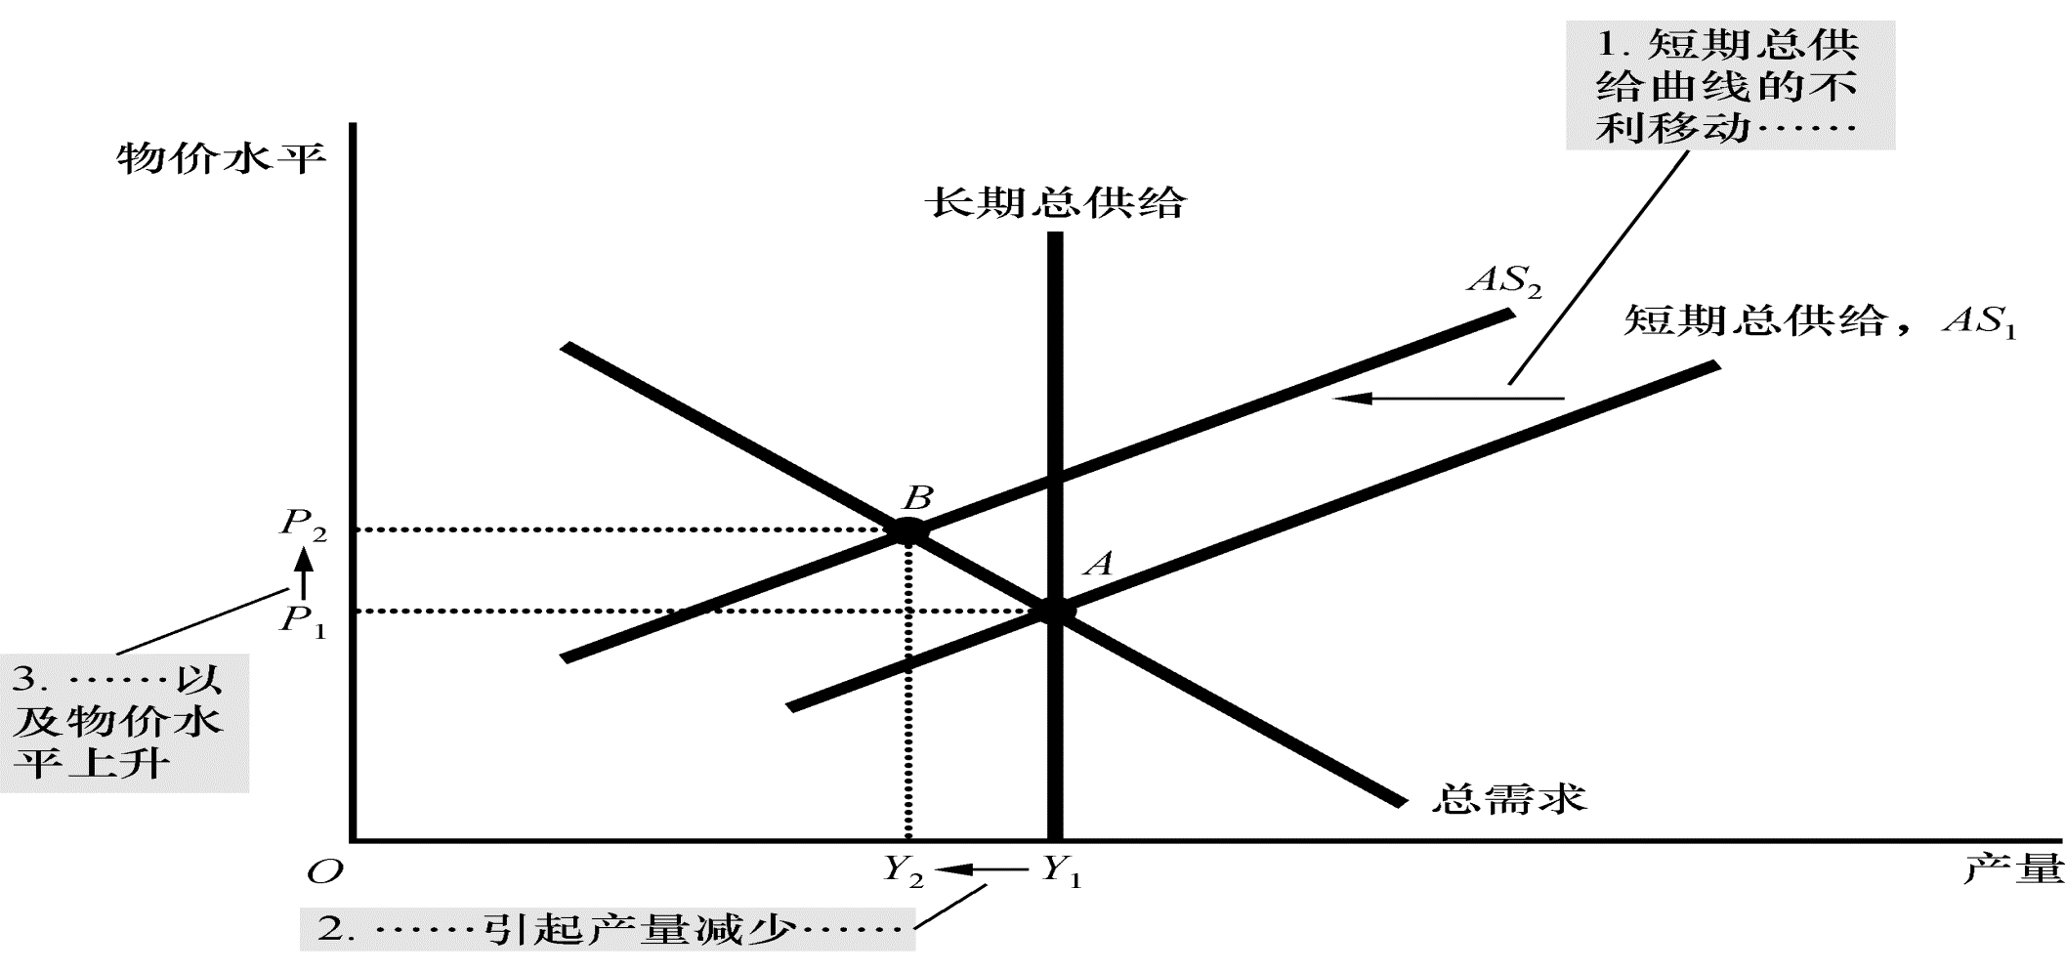
图 10
总供给的不利移动
Price
Level
1. An adverse shift in the short-run aggregate-supply curve . . .
Long-run
aggregate
supply
AS₂
Short-run aggregate
supply, AS₁
B
3. . . . and
the price
level to rise
P₂
P₁
A
Aggregate demand
Y₂
Y₁
Quantity of Output
2. . . . causes output to fall . . .
当某个事件增加了企业的成本时，短期总供给曲线从AS₁ 向左移动到 AS₂. 经济从A移动到B。结果出现了滞涨：产量从Y₁ 减少到 Y₂, 而物价水平从 P₁ 上升到P₂.
© 2015 Cengage Learning. All Rights Reserved. May not be copied, scanned, or duplicated, in whole or in part, except for use as permitted in a license distributed with a certain product or service or otherwise on a password-protected website for classroom use.

Slide 66
经济波动的原因
© 2015 Cengage Learning. All Rights Reserved. May not be copied, scanned, or duplicated, in whole or in part, except for use as permitted in a license distributed with a certain product or service or otherwise on a password-protected website for classroom use.
总供给的移动
企业 – 生产成本增加
总供给曲线: 向左移动
短期
产出下降
物价水平上升
长期, 如果总需求保持不变
产出 – 自然水平
物价水平 – 下降

Slide 67
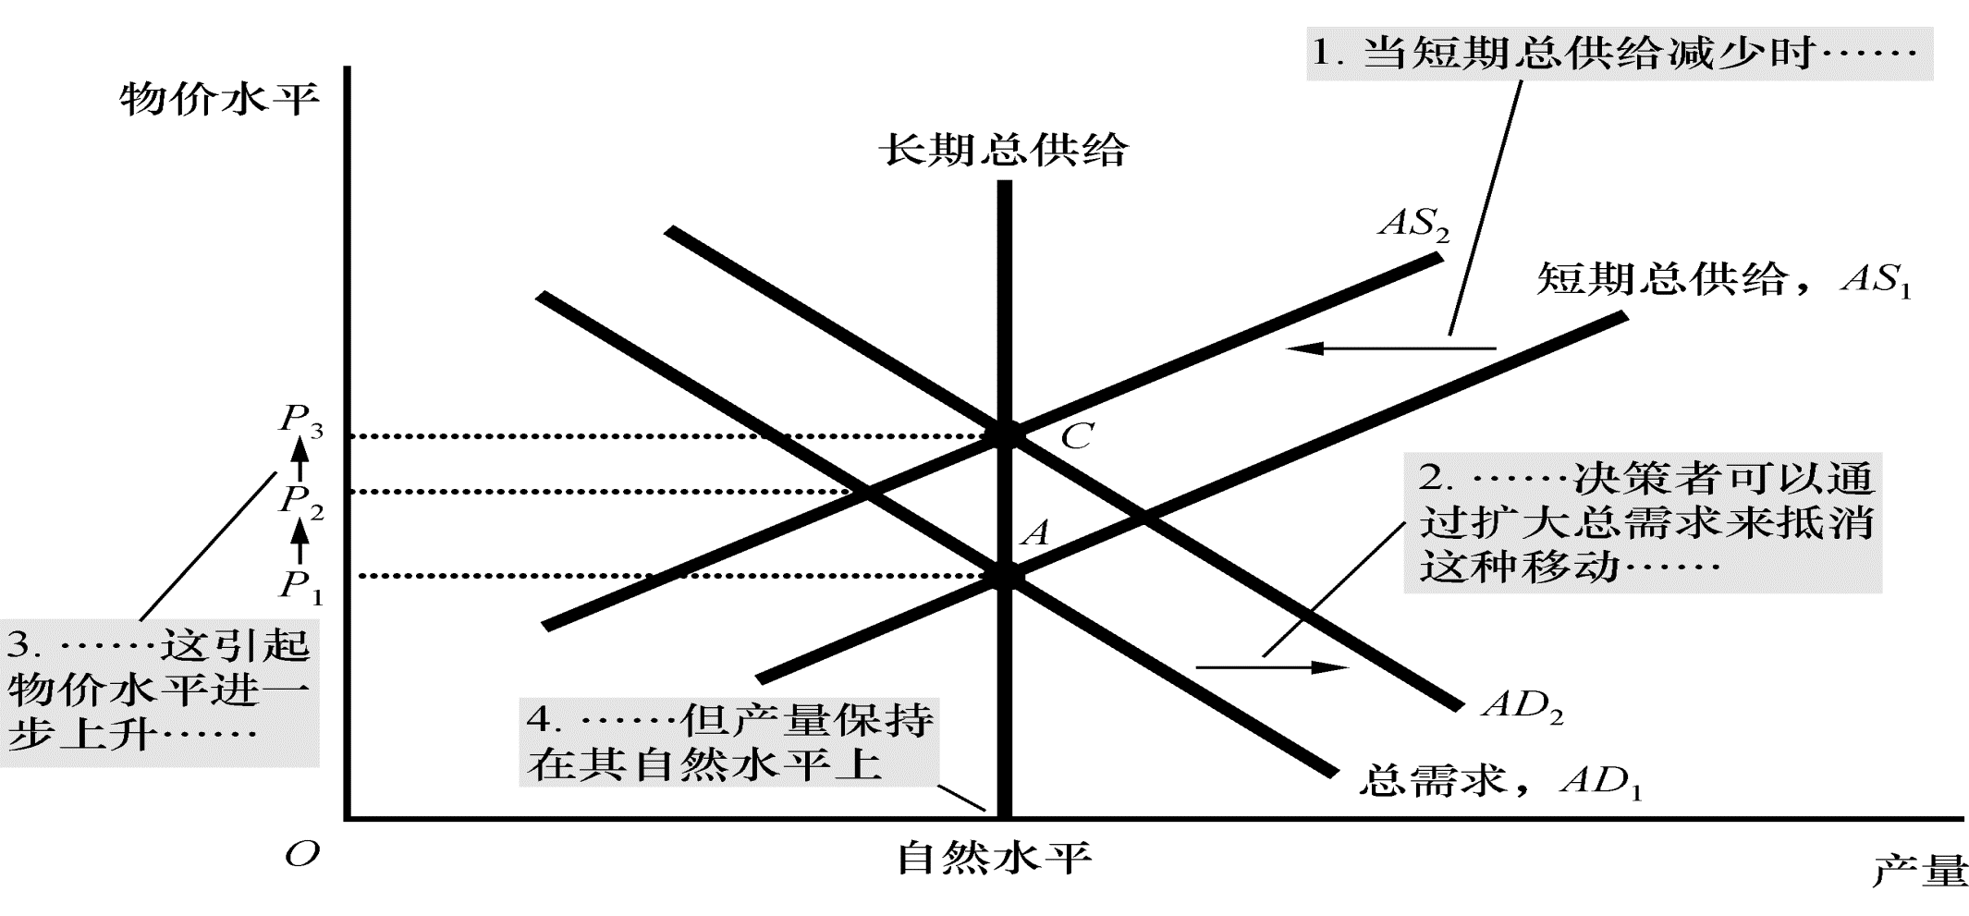
图 11
抵消总供给的不利移动
Price
Level
Long-run
aggregate
supply
1. When short-run aggregate supply falls . . .
AS₂
Short-run
aggregate
supply, AS₁
3. . . . which
causes the
price level
to rise
further . . .
P₃
C
P₂
2. . . . policymakers can accommodate the shift by expanding aggregate demand . . .
P₁
A
AD₂
Aggregate demand, AD₁
Natural level
of output
Quantity of Output
4. . . . but keeps output
at its natural level.
面对总供给从AS₁ AS₂的不利移动，可以影响总需求的决策者会努力使总需求曲线从AD₁ 向右移动到 AD₂. 经济从A点移动到 C. 这种政策在短期内会阻止供给移动带来的产量减少，但物价水平将永久性的从P₁ 上升到 P₃.
© 2015 Cengage Learning. All Rights Reserved. May not be copied, scanned, or duplicated, in whole or in part, except for use as permitted in a license distributed with a certain product or service or otherwise on a password-protected website for classroom use.

Slide 68
石油与经济
美国的经济波动
自从1970年, 源于中东石油地区
某个事件 – 减少了来自于中东的石油输入
世界范围内石油价格上升
总供给曲线向左移动
滞涨
1970年代中期
1970年代后期
© 2015 Cengage Learning. All Rights Reserved. May not be copied, scanned, or duplicated, in whole or in part, except for use as permitted in a license distributed with a certain product or service or otherwise on a password-protected website for classroom use.

Slide 69
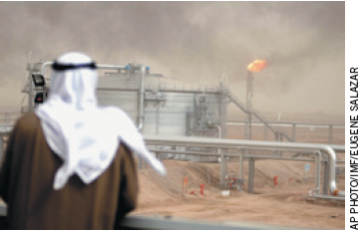
石油与经济
某个事件 – 1986年中东增加石油供给
石油价格下降
总供给曲线 – 向右移动
产量 – 快速增加
失业率 – 下降
通货膨胀率 – 下降
中东石油生产量的变化是美国经济波动的影响因素之一。
© 2015 Cengage Learning. All Rights Reserved. May not be copied, scanned, or duplicated, in whole or in part, except for use as permitted in a license distributed with a certain product or service or otherwise on a password-protected website for classroom use.

Slide 70
石油与经济
近几年
世界石油市场– 并没有成为经济波动的重要来源
节油的努力
技术的变革
生产一单位真实GDP所需的石油量
1970年代以来的OPEC冲击以来已经下降了40%
© 2015 Cengage Learning. All Rights Reserved. May not be copied, scanned, or duplicated, in whole or in part, except for use as permitted in a license distributed with a certain product or service or otherwise on a password-protected website for classroom use.

Slide 71
总供给曲线
© 2015 Cengage Learning. All Rights Reserved. May not be copied, scanned, or duplicated, in whole or in part, except for use as permitted in a license distributed with a certain product or service or otherwise on a password-protected website for classroom use.
黏性价格理论
一些物品与服务的价格
对经济状况变动的缓慢调整
菜单成本
调节价格的成本

