Slide 1

코로나 타임캡슐
TCO : TimeCapsule Corona
주거니박거니 팀

Slide 2

1
Problem

Slide 3




2
How do we solve?

Slide 4


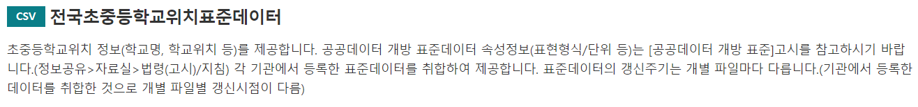
3
Public Data

Slide 5
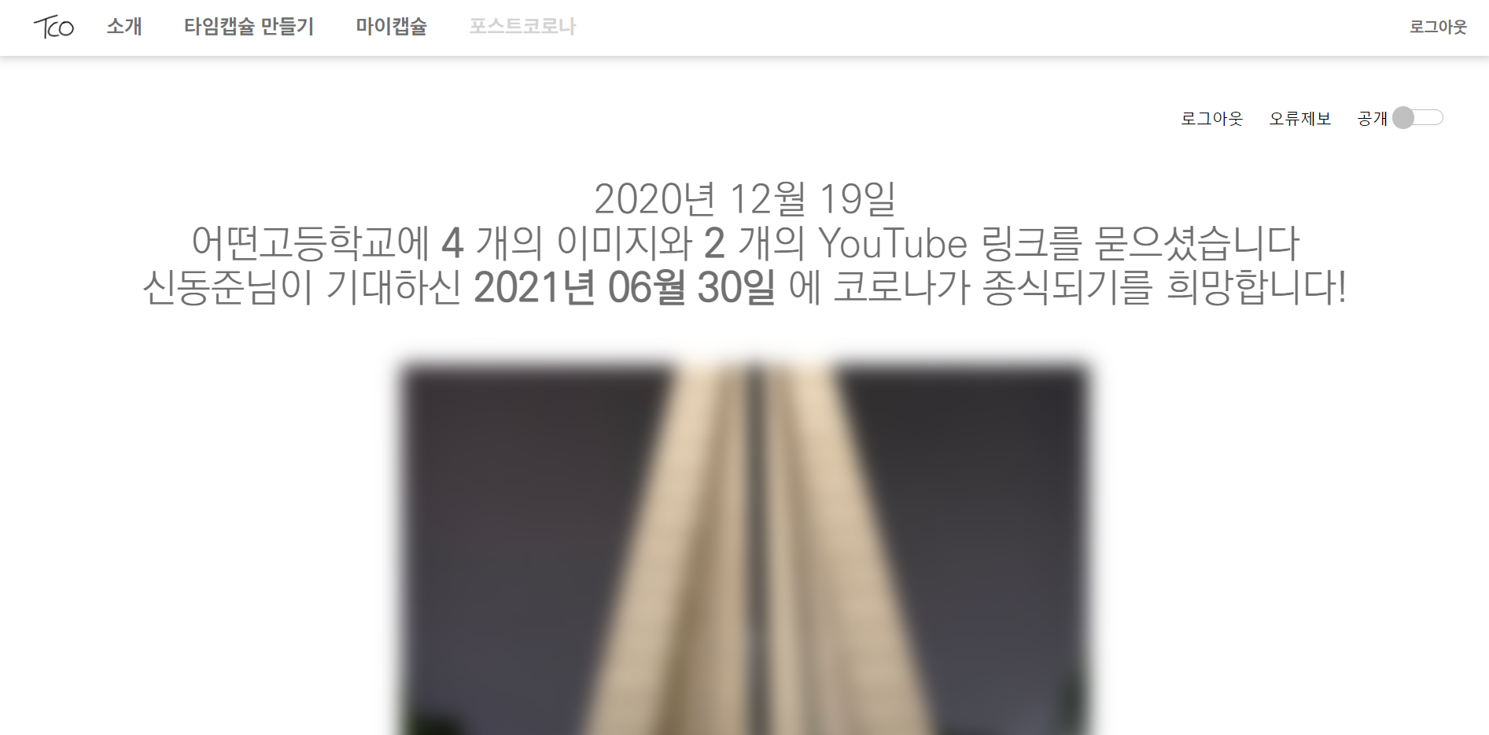
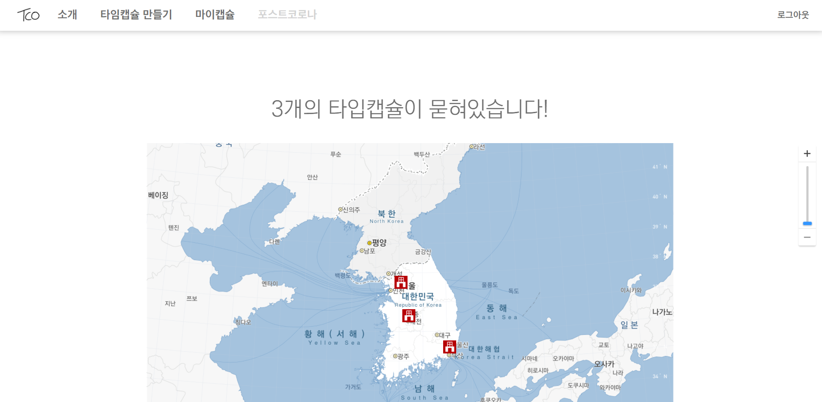
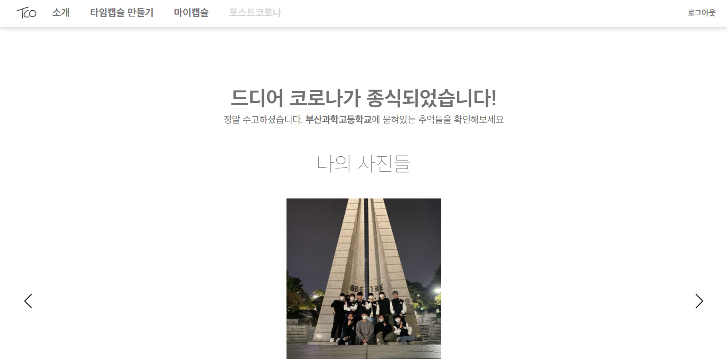
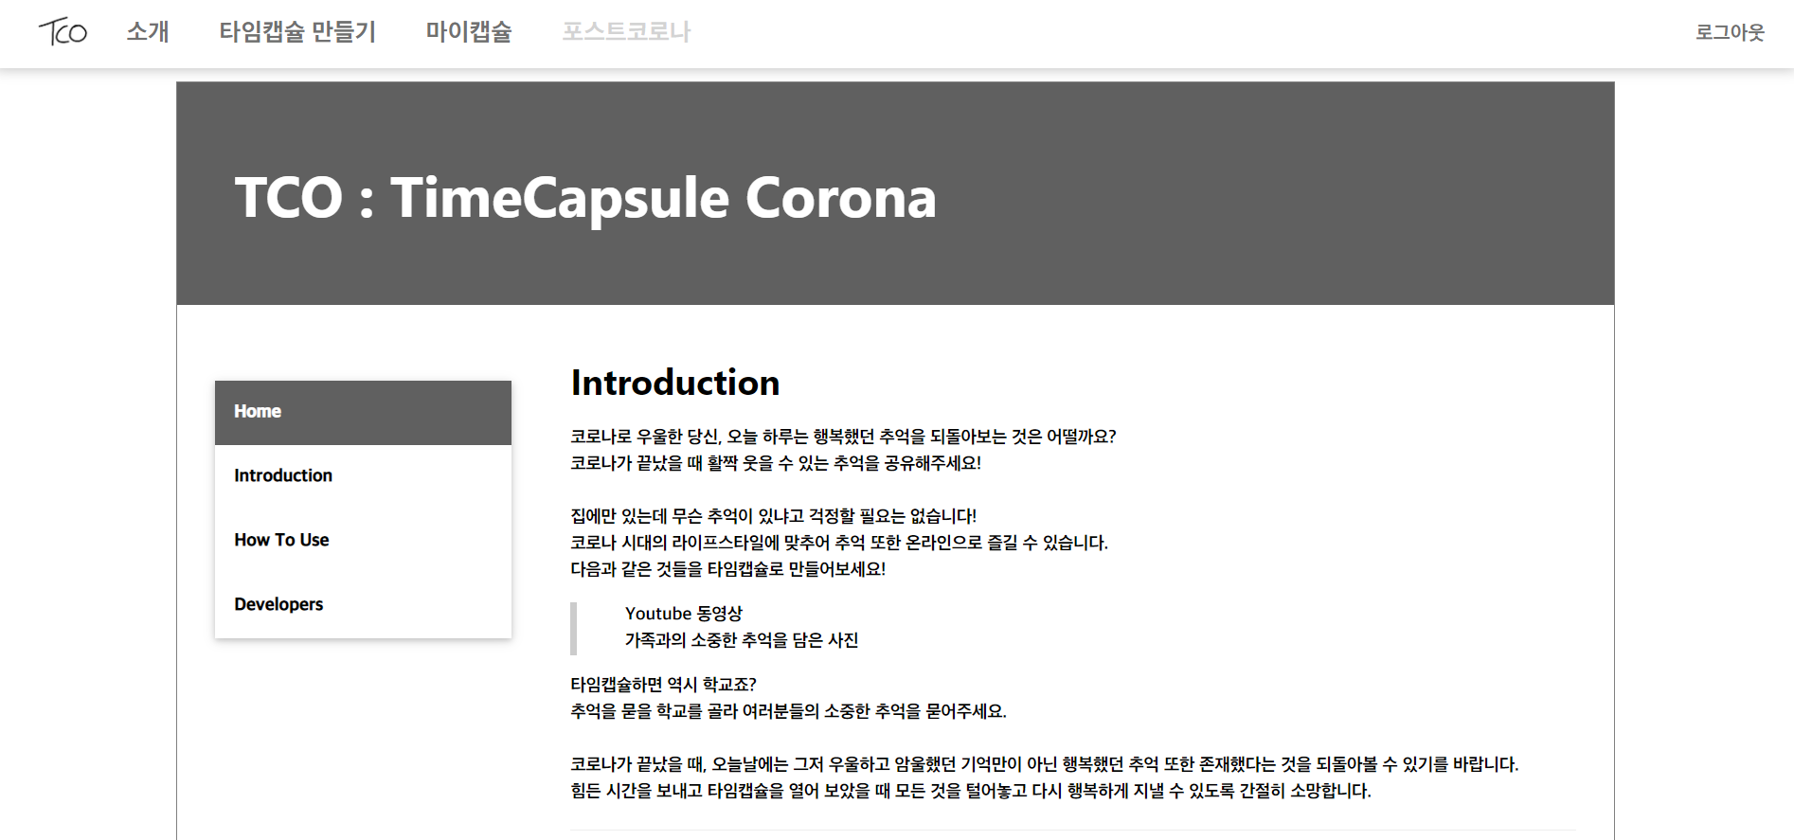
4
Introduce our site

Slide 6


5
End

