Slide 1

Web-based Collaborative 3D Scene Modeling System
Wang Zhenhai
School of Software
Shanghai Jiaotong University
Notes:
Hello, everyone!
I’m Wang Zhenhai from School of Softeware, Shanghai Jiaotong University
First, I’m sorry that I can’t attend the 4th International Conference on virtual Reality and Visualization at Shenyang.
So I record this video of presentation for Nonlinear Revision Control for Web-based 3D Scene Editor.

Slide 2
Outline
Scene Graph
System Architecture
  Synchronous Collaboration
  Asynchronous Collaboration
Revision Control
Prototype System
Summary

Slide 3
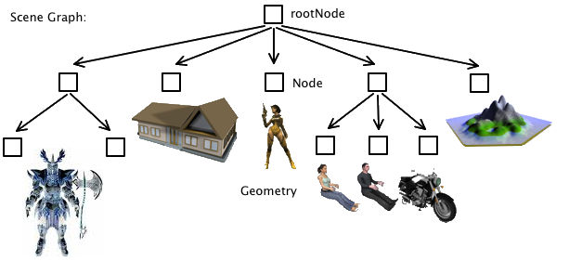
Scene Graph

Slide 4
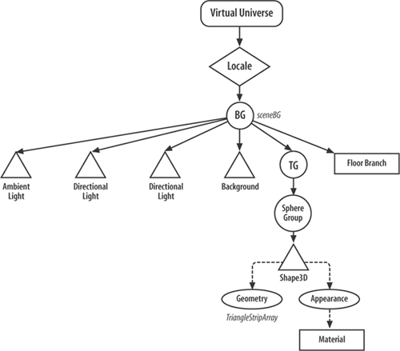
Scene Graph

Slide 5
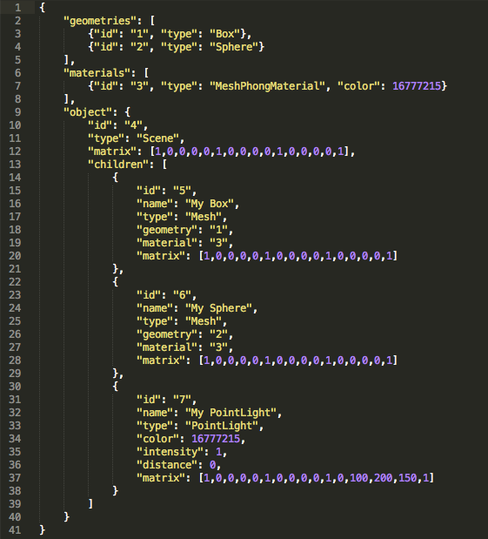
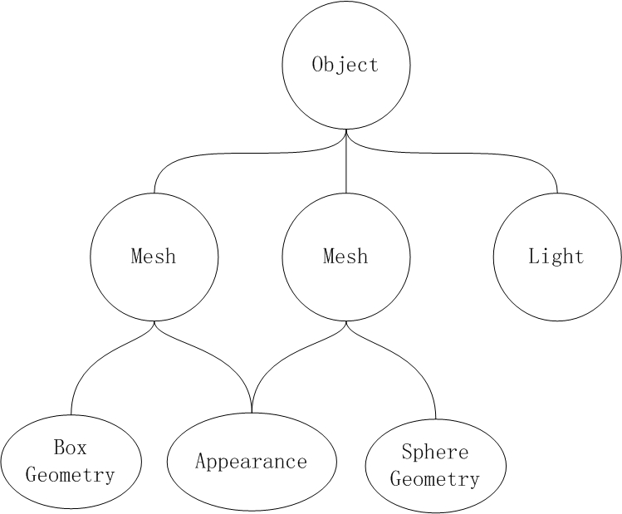
Scene Graph

Slide 6
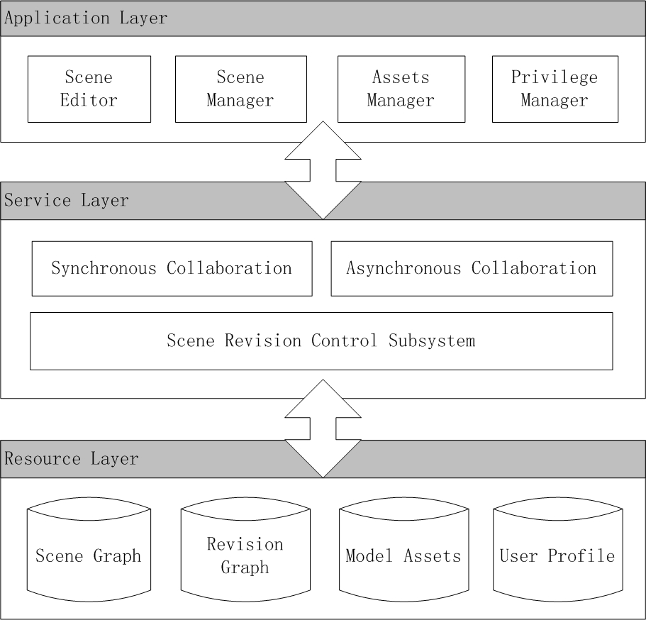
System Architecture

Slide 7
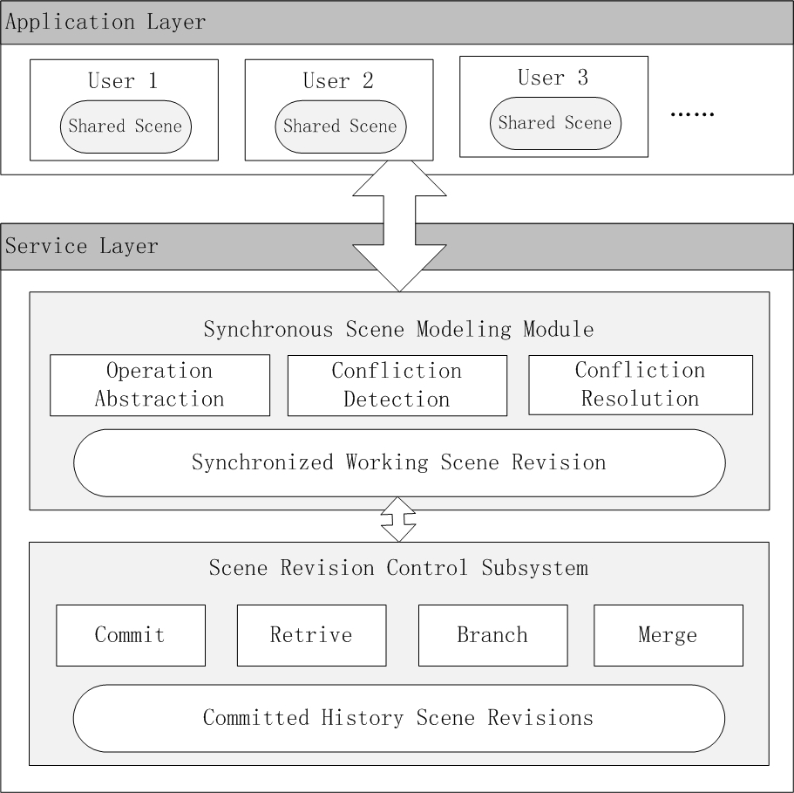
Synchronous Collaboration

Slide 8
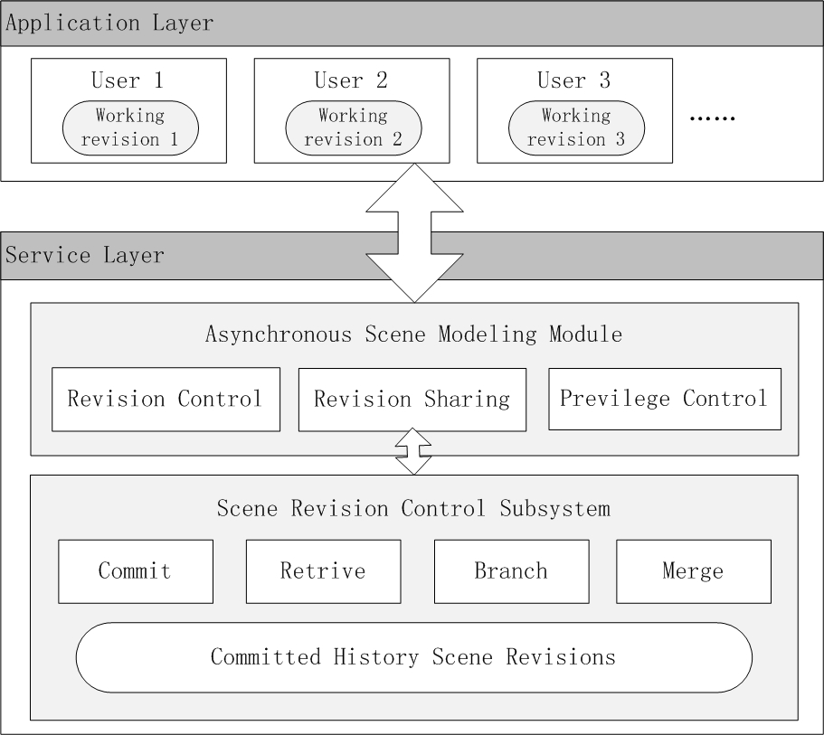
Asynchronous Collaboration

Slide 9
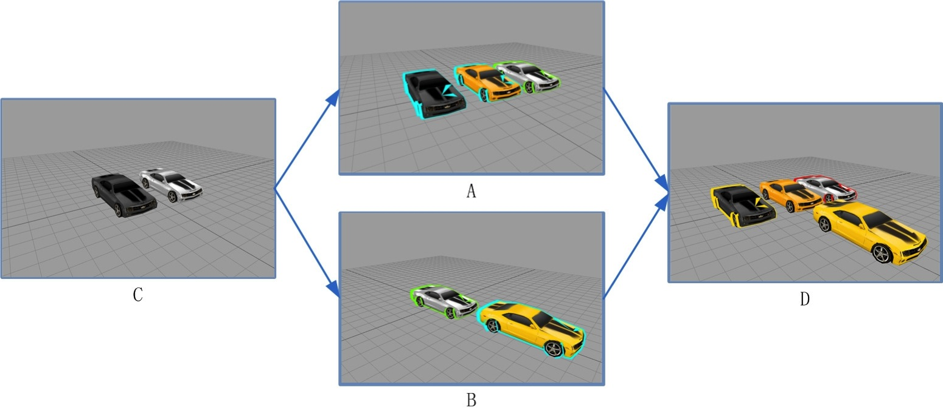
Revision Control for 3D Scene
Notes:
With WebGL,many Web applications for 3D scene modeling have emerged.
Over the Internet, 3D scenes can be easily shared and collaboratively edited.
But concurrent editing on the same scene would bring conflicts.
So, Revision Control System is needed.

Slide 10
Problem
Problem
  Existing revision control mechanisms focus more on text than binary files.
  The diff algorithm is based on line-by-line comparison, but this is not fit for binary files.
Approach:
  Represent 3D scene as a general scene graph.
  The differences between versions can be calculated through changes in scene graph.

Slide 11
Core Idea
Scene Graph
  Each 3D scene is represented and stored as a scene graph.
Notes:
The core idea of our methods is to represent and store every 3D scene as a scene graph.
As we all know, scene graph is generally a directed acyclic graph(有向无环图), here is a simple example.

Slide 12
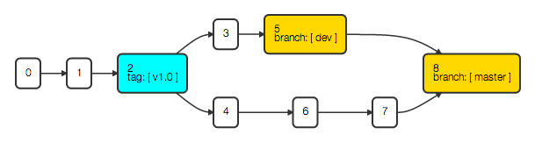
Core Idea
Revision History Graph
  Each node represent an individual version
  The directed edges represent the dependency relationships between these versions.
Notes:
Another type of our core data structure is the Revision History Graph.
Through this graph, the relationship of different scene versions is clearly depicted and stored.
Here, from this graph, we can see that.
Node 0 is the first version.
And new branches of version are added at version 2.
Finally version 5 and version 7 are merged together to make the version 8.

Slide 13
Methods
Revision Control
  Commit
  Retrieve (Checkout)
  Branch and Tag
  Diff and Merge
    Most challenging part
Notes:
Then, we will talk about the basic function of our revision control system.
How to commit a new version
How to retrieve or checkout another version or branch.
How to make a branch, and add a version tag.
Finally the most challenging part, how to diff between versions to see the changes and merge different versions.

Slide 14
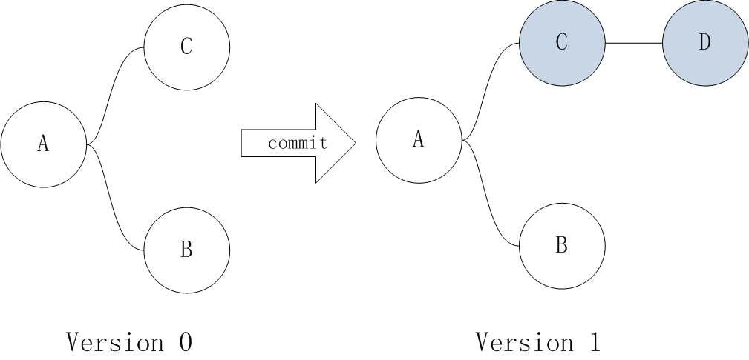
Methods
Commit
  Every commit makes a new version of SG.
  Only delta nodes are stored with new version number.
Notes:
Let’s take a look at the Commit
Every commit makes a new version of the Scene graph.
For example, in this picture.
Based on Version 0, we have committed the version 1.
As we can see, only node C and D are changed
So, there is no need to store all the scene nodes of version 1.
And only the delta nodes, such as C and D here, are stored with the version number 1.
After this commit. There are only 5 nodes stored in our database.
Node A, B and C with version number 0
And Another two node C and D with version 1.

Slide 15
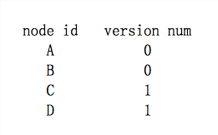
Methods
Retrieve
  Every scene node can be uniquely identified by the pair of node id and version number.
  <node id, version number>
  a node-version mapping is added for each version, thus the SG can be easily retrieved.
Notes:
To retrieve or checkout a version is very easy.
As a scene node may have different versions, so every scene node can be uniquely identified by the pair of node id and version number.
So, in order to successfully retrieve all the nodes of each version, we have added a node-version mapping for each version.

Slide 16
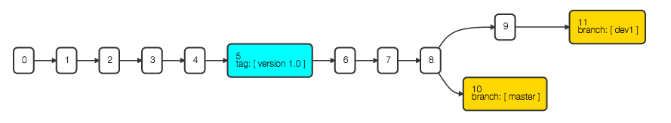
Methods
Tag and Branch
  A tag is stored as a simple object with a name and a fixed pointer to a version.
  But the branch is a movable pointer, which always point at the head version.
Notes:
By default, each scene version is identified with the unique version number. With tag, we can specify more meaningful names for these versions, such as version v1.0
A tag is stored as a simple object with a name and a fixed pointer to a version.
But the branch is a movable pointer, which always point at the head version.
For example, in this picture, the head of branch dev is at version 5, while the head of branch master is at version 8.

Slide 17
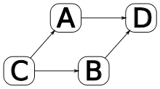
Methods
Diff and Merge
  Differences between Scene Graphs
    State Difference
      Changes in node properties
    Structure Difference
      Changes in node relationships
  3-way-merge
    Automatic differencing
    Selective merging
Notes:
The most challenging part is Diff and Merge.
In a nonlinear revision control system, we can check the differences between two versions and merge different versions together.
The differences between scene graphs can be divided into state difference and structure difference.
State Difference is caused by changes in node properties
Such as add, edit or remove properties
While Structure Difference is caused by changes in node relationships
Such as add, remove or reparent a node in the scene graph.
the method of 3-way-merge is adopted to merge two versions.
In 3-way-merge, the common ancestor is also considered.
For example, if we want to merge version A and B here, their common ancestor, version C is also considered.
With the help of version C, a lot of ambiguities between version A and B can be resolved, thus the merging algorithm can be more accurate.

Slide 18
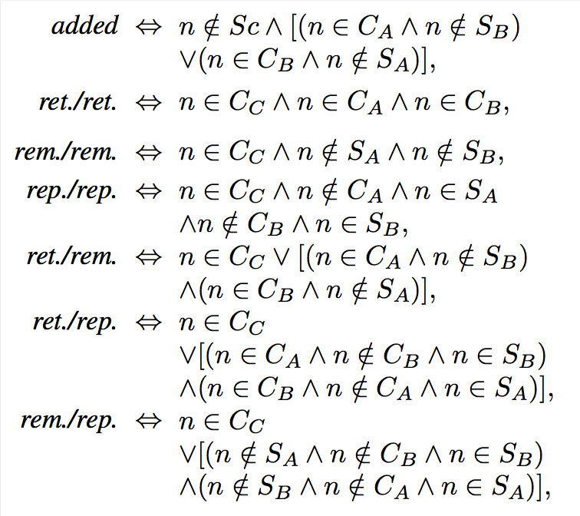
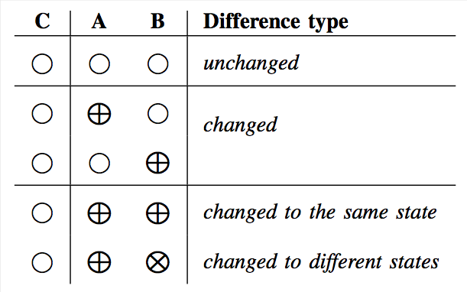
Methods
Automatic Differencing
  State and Structure differences between version A and B are identified.
Notes:
The first step of merging is to automatically calculate the differences between version A and B.
Including state and structure differences.
Some complicated screenshot is presented bellow, you can understand in the first glimpse, but never mind.

Slide 19
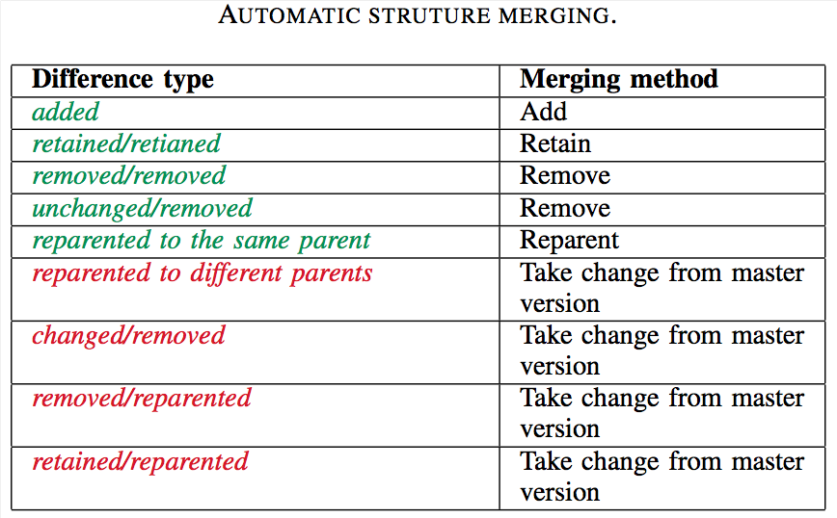
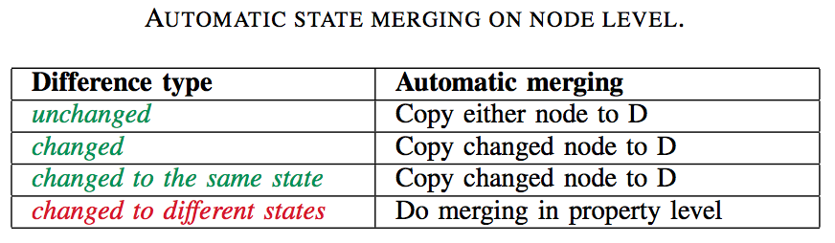
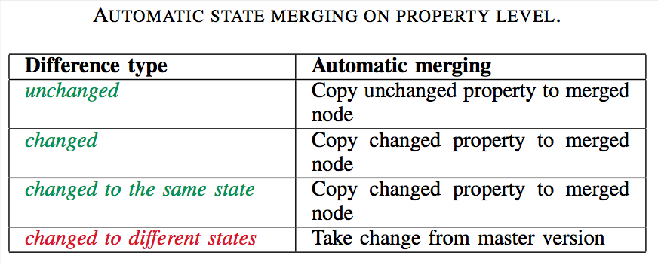
Methods
Selective Merging
  Auto-merged first, get a default merged version.
  then presented to user for adjusting.
Notes:
Then ,selective merging.
First, based on the differences we get in previous step. we can automatically merge the two versions.
the difference types and the related merge methods are presented here.
The green items means no conflict, that can be successfully merged.
While the red ones are conflicted, and some default actions are taken.
After this, the default merged version is presented to the user for adjusting

Slide 20
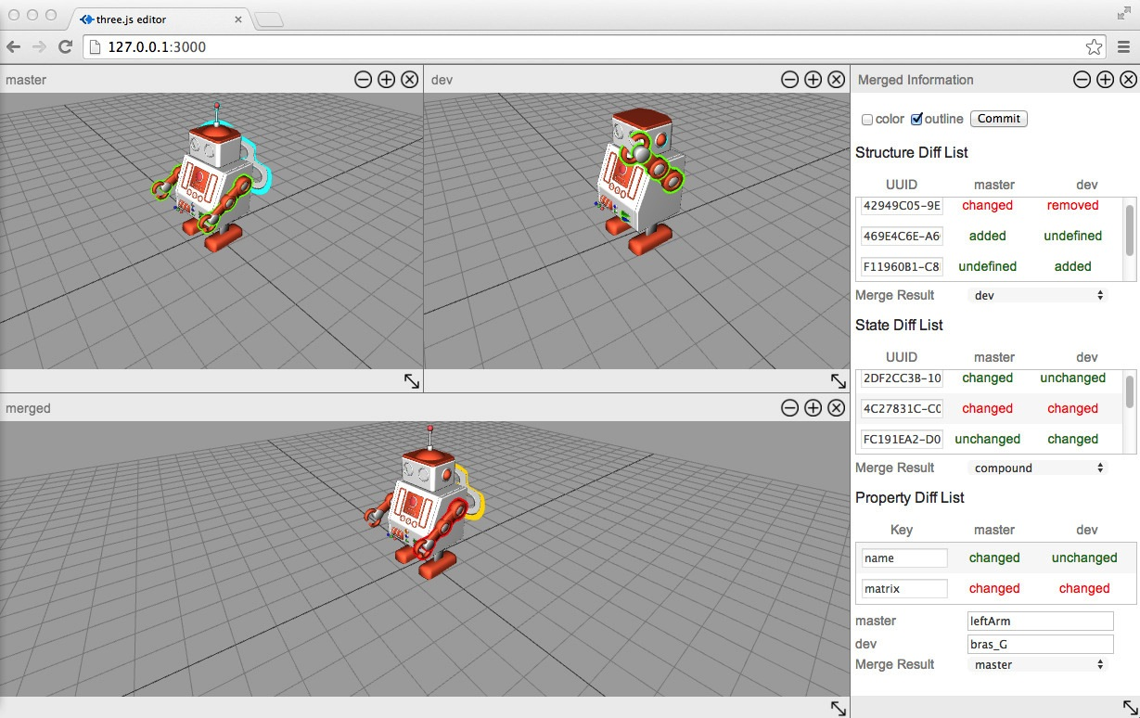
Methods
Selective Merging
Notes:
This is the interface for selective merging.
As we can see, there are three robots here.
The top two are the ones need to be merged together.
The bottom one is the auto-merged version.
On the right side, all the identified differences are listed here,
and the user is free to change the merge result through this panel.
And then commit merging action by clicking the commit button.

Slide 21
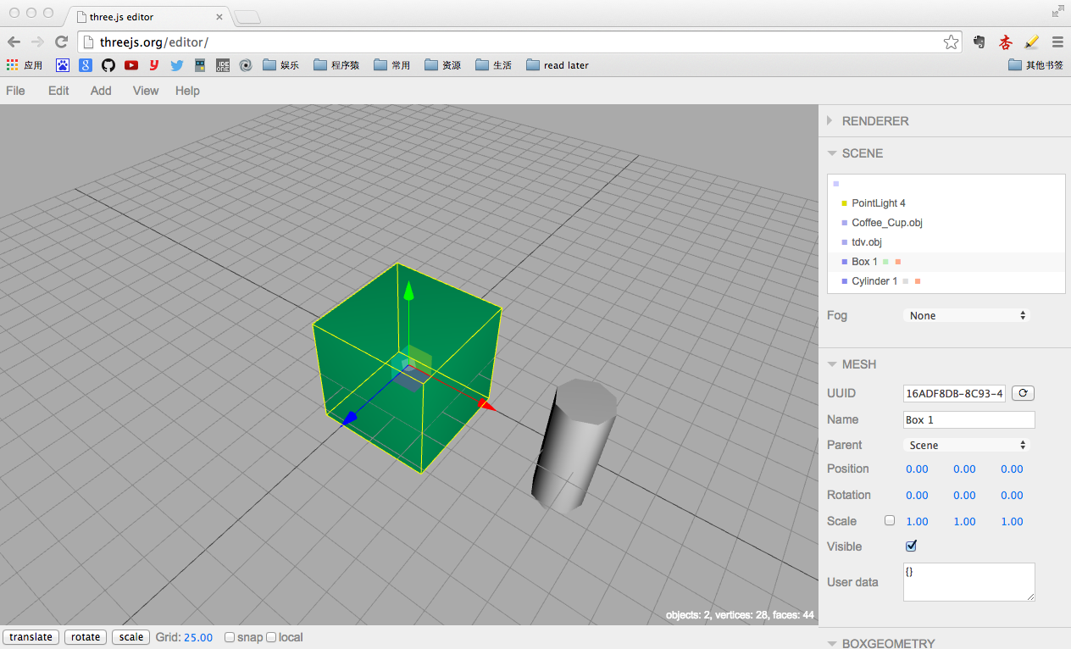
Prototype System
Based on the open sourced Three.js Editor
Notes:
This is the structure of our prototype system.
This system is based on the open sourced TE, Three.js Editor.
Three.js is a javascript library, which make it much more easier to make web-based 3D applications.
Here in this system.
We adopt the TE as the front-side web-based 3D scene editor
And We have modified the TE core and added two main components: AMM (Asset Management Module) and RCM (Revision Control Module).
Revision Control Module is responsible for scene revision control
Assets Management Module is responsible for some other 3D assets management.
The managed assets, RHG and SG are stored in server side.

Slide 22
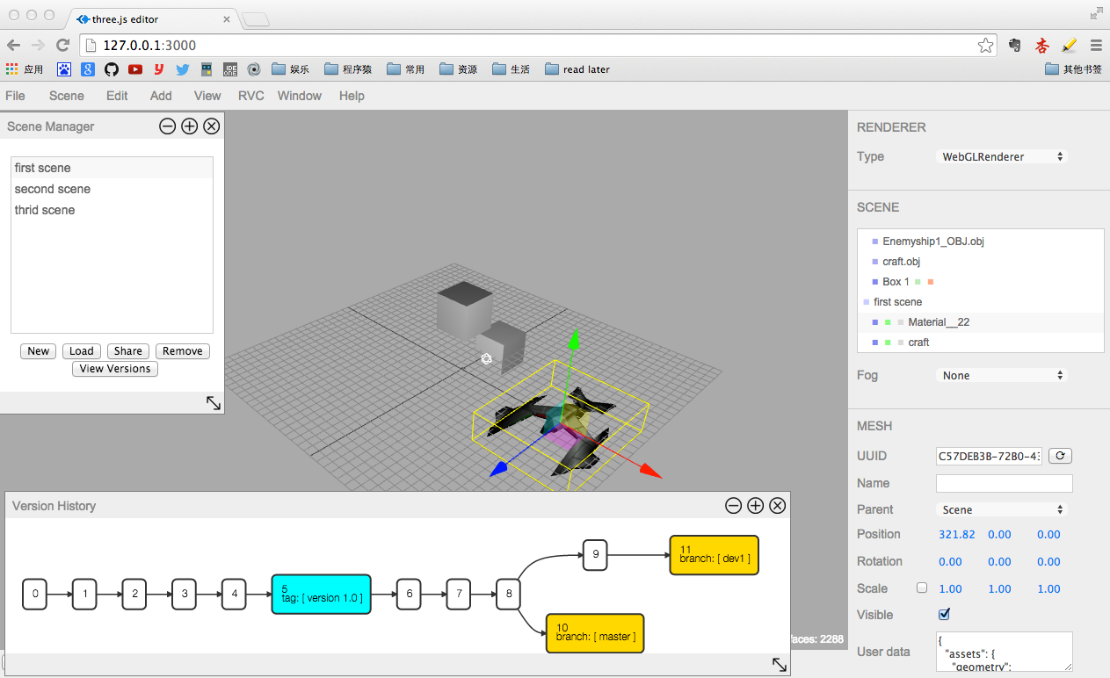
Prototype System
Revision Control Module

Slide 23
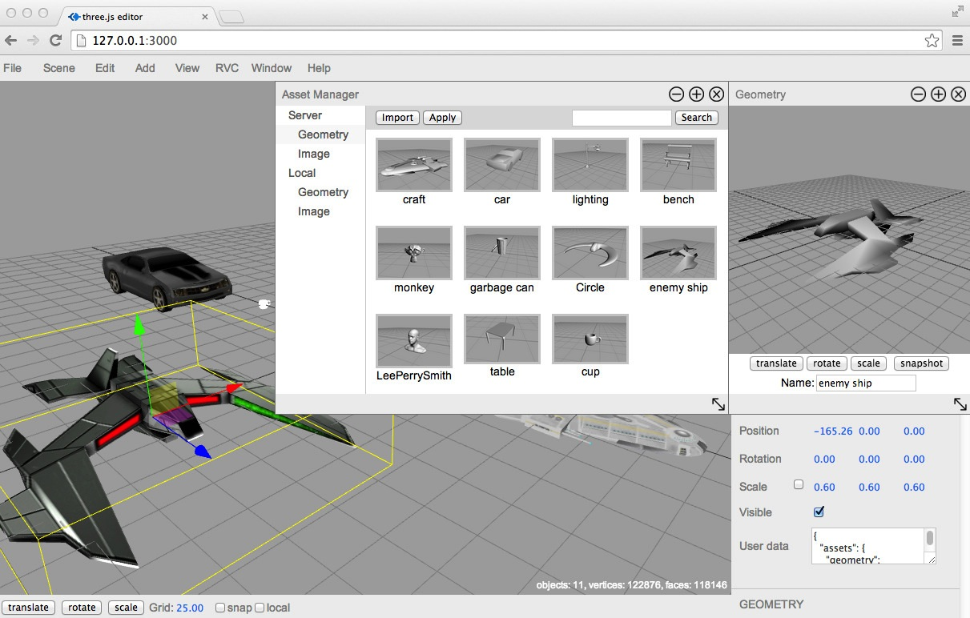
Prototype System
Assets Management Module
Notes:
This is the screenshot of our assets management browser
Through this, we can easily manage the geometry and image assets of 3D scenes.

Slide 24
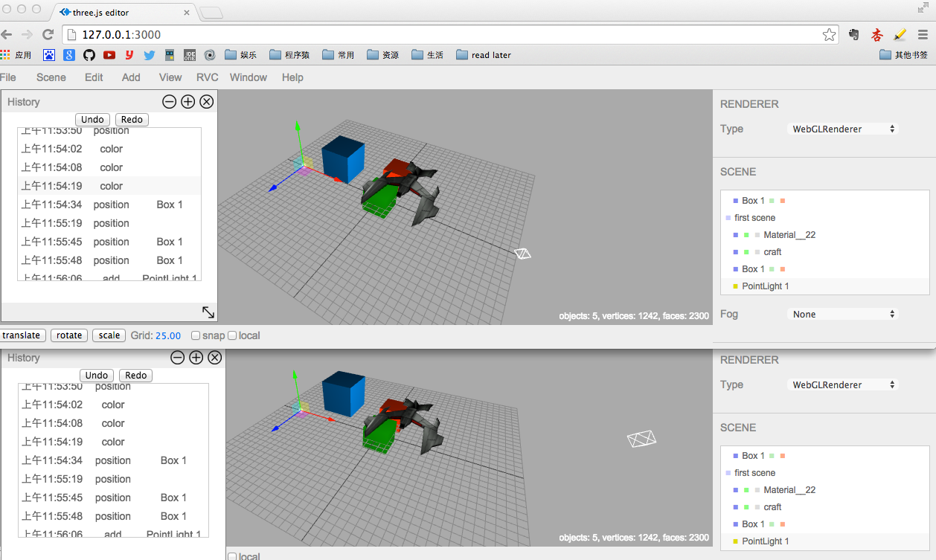
Prototype System
Synchronized Collaboration

Slide 25
Summary
We have presented:
  An architecture for web-based collaborative scene modeling system.
  A nonlinear revision control system for 3D scene.
  A prototype system based on three.js editor.

Slide 26
Thanks!
Any questions?

