Slide 1
Machine Learning exercise 2
Dante Godolja (11929150),
Lukas Burtscher (11925939)
Ardit Luzi (12226089),
Notes:
NOTE:
To change the image on this slide, select the picture and delete it. Then click the Pictures icon in the placeholder to insert your own image.

Slide 2
Classification Algorithm: Naïve Bayes
Dataset
Naïve Bayes Algorithm
Gaussian Naïve Bayes
Efficency

Slide 3
Dataset
WineQuality Dataset
Nominal and Categorical Data
Indipendendent and
Dependendt features
Removed outliers
Dropped high correlating features

Slide 4
Naïve Bayes Algorithm
The Naive Bayes assumption is that each feature makes an:
independent
equal
contribution to the outcome.
Bayes’ Theorem finds the probability of an event occurring given the probability of another event that has already occurred.
The fundamental Naive Bayes assumption is that each feature makes an:
independent
equal
contribution to the outcome.
he fundamental Naive Bayes assumption is that each feature makes an:
independent
equal
contribution to the outcome.

Slide 5
Gaussian Naïve Bayes Algorithm
Subtype of Naïve Bayes
Assumes that each class follow a Gaussian distribution.
Performs better on continuous data

Slide 6
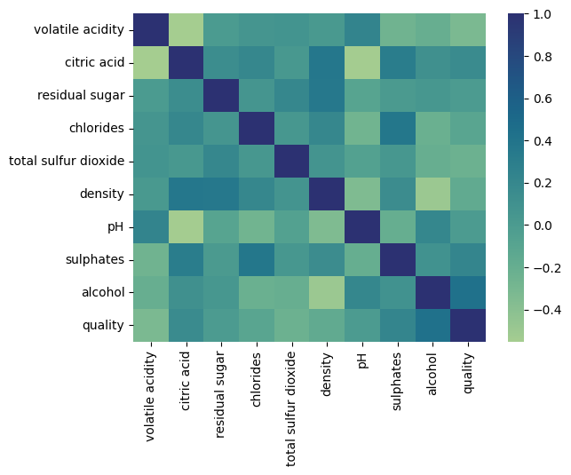
Heatmaps before and after dropping features (fixed acidity,free sulfur dioxide)

Slide 7
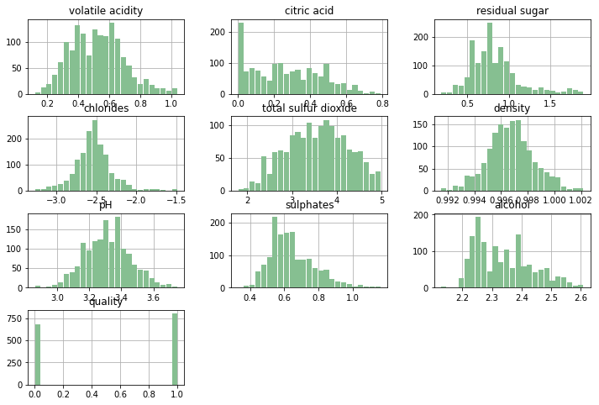
Data Transformation
Based on what we can identufy here is that the citric acid does not have a Gaussian distribution so
We have dropped it.

Slide 8
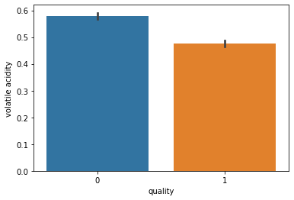
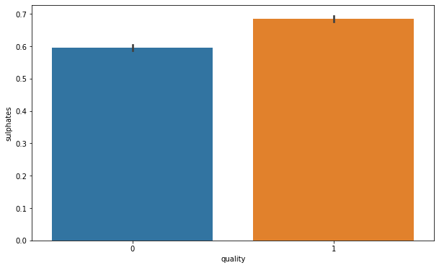
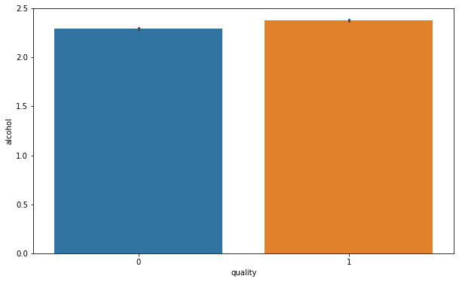
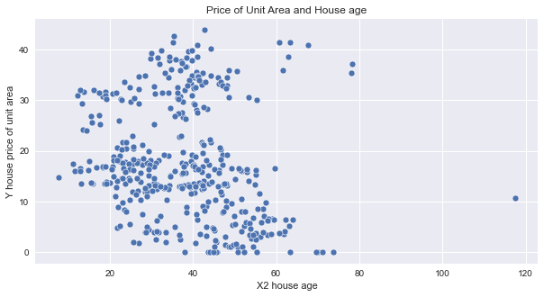
Feature influence on Wine Quality
•Downing trend in the volatile acidity as we go higher the quality
•Sulphates level goes higher with the quality of wine
•Alcohol level also goes higher as the quality of wine increases

Slide 9
Efficency
The F1 scores and Accuracy for each Algorithm
Algorithm | F1 Score | Accuracy
Naïve Bayes | 0.7068 | 0.7008196721311475
Sk Learn Naïve Bayes | 0.7068 | 0.7008196721311475

Slide 10
Linear Regression
Regression type of Algorithm
is an analysis that assesses whether one or more
predictor variables explain the dependent variable.
Multivariate normality
Linear relationship
In [ ]:

Slide 11
Dataset
Real Estate Dataset
Dropped outliers
Displayed correlating features
Compressions before and after outlier removals per feature

Slide 12
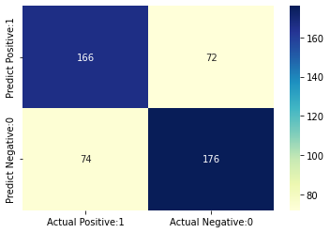
Confussion Matrix for the two classifiers
As we can see from this confussion matrix between two classifiers
they perform exactly the same.

Slide 13
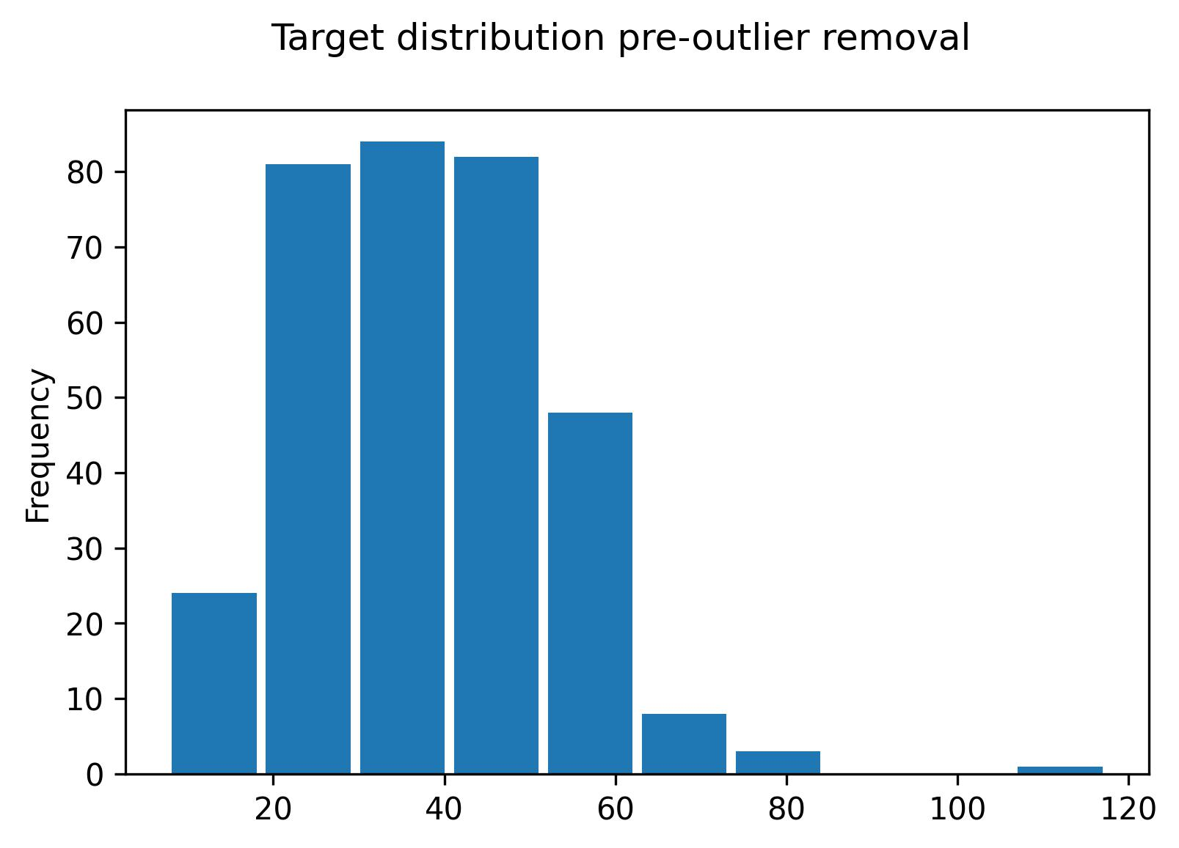
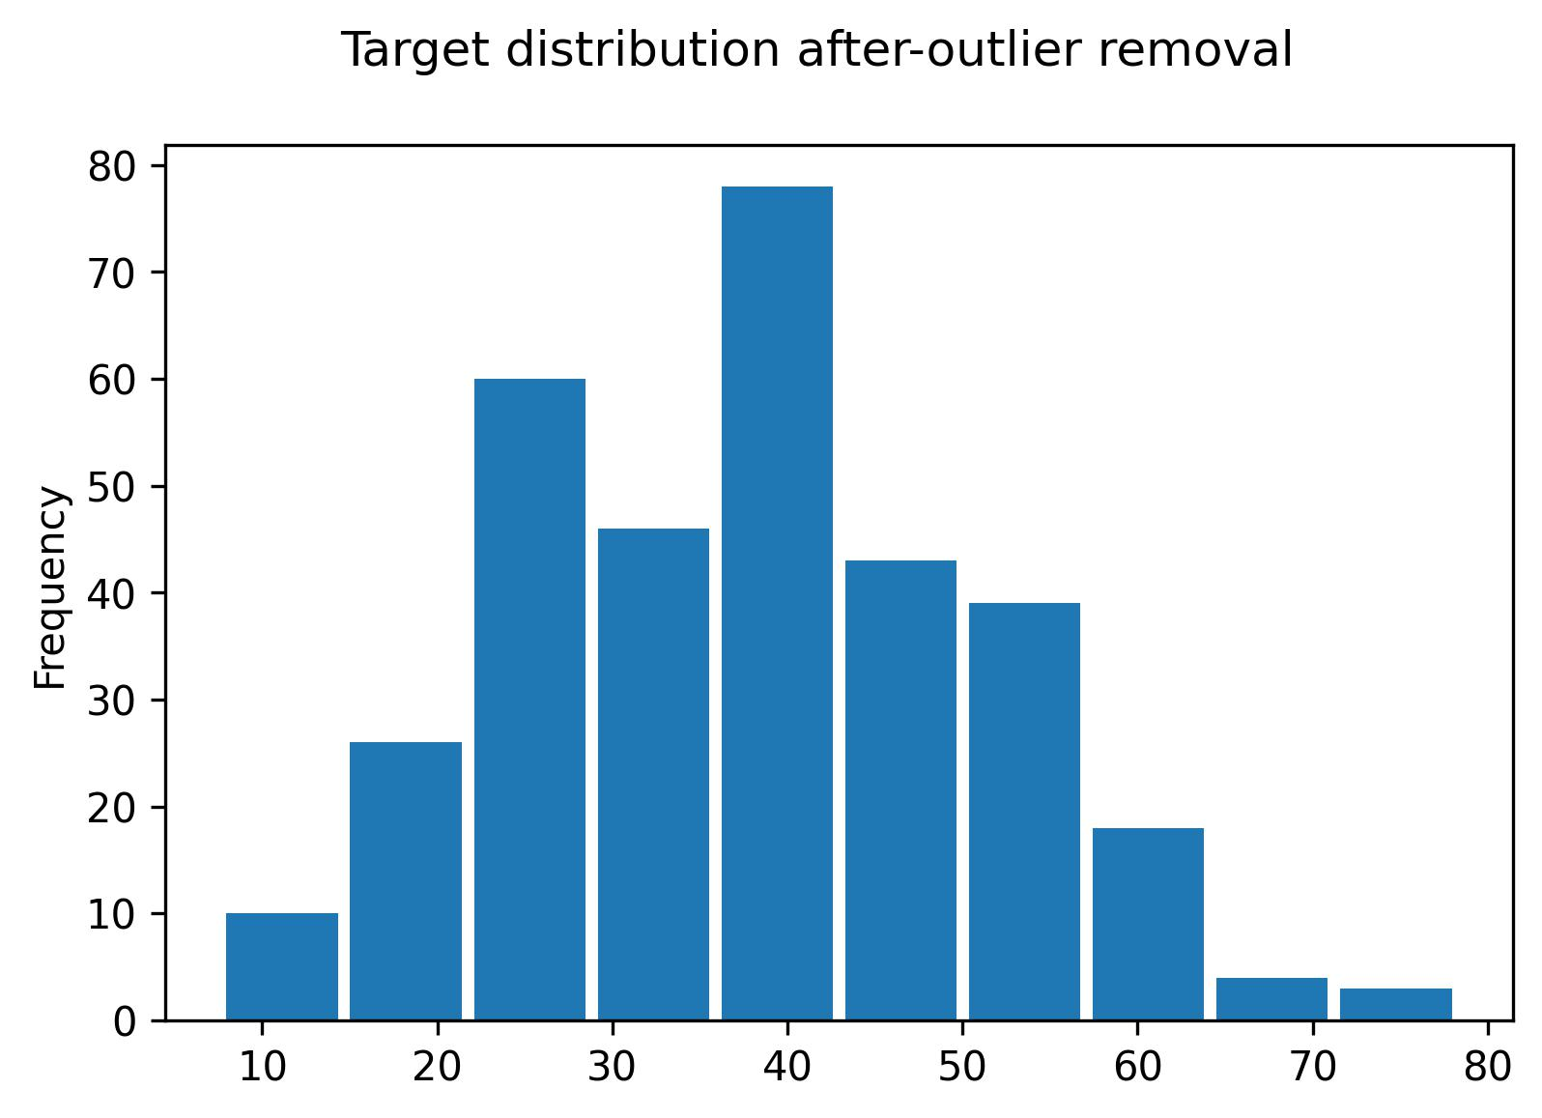
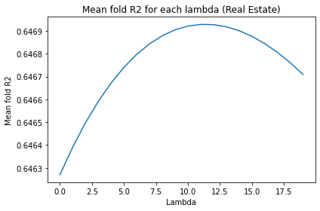
Differences pre and after outlier removal
Target feature: house price of unit area

Slide 14
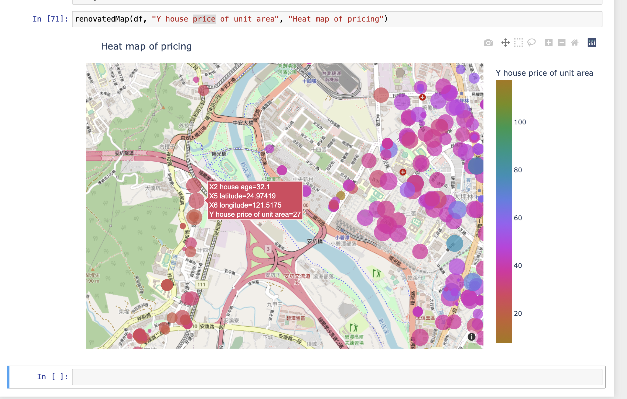
Feature visualization
•House price unit area and house age relationship
•Dynamic map to express the House price and location

Slide 15
Efficency
The efficency for each Algorithm based on R2, MAE, and RMSE,
Best hyperparameter: 11, and the Highest R2 Score on the folds: 0.6469289355500194
Algorithm | R2 | MAE | RMSE
Manual Linear Regression | 0.697428066158382 | 4.432079085527504 | 5.891202699857207
Sk Linear Regression | 0.697428066158379 | 4.432079085527506 | 5.891202699857205
Manual Ridge Regression | 0.6974584605943213 | 4.436143767402327
Sk Ridge | 0.697458460594319 | 4.436143767402351 | 5.890906796205769

Slide 16

QUESTIONS

