Slide 1

Workie
Presented by: Donika Markova

Slide 2


About me
Interests
Working out
Watching TV series
Spending time in nature
Education
New Bulgarian University
Software University
Skills
.NET
C#
MSSQL
Entity Framework
Goals
Improve my skills
Growing in software development field

Slide 3
App Overview
Book various workouts at different locations
Training sessions led by different trainers
Includes practice schedules and bookings

Slide 4




Features
Customer
Register and login
Manage personal data
View trainer and workout details
Book workouts, specifying city, address, trainer and schedule

Slide 5
Architecture Overview
Domain Layer
Entities, enum types, constants and custom exceptions
Application Layer
Specifies business logic handled by services
Defines Data Transfer Objects (DTOs)
Infrastructure Layer
Manages data and persistence
Uses Repository pattern, holds database context, data migrations and options
Presentation Layer
Implements RESTful API
HTTP Requests and Responses

Slide 6






Technology Stack
Backend:
.NET 8.0
Entity Framework Core: Code-first approach with EF migrations for data modeling
ASP.NET Core: High-performance Web API leveraging middleware pipeline for handling HTTP requests
Frontend:
React with TypeScript
Axios: For handling HTTP requests
Material UI: For consistent and responsive design
Database:
MSSQL Server: Reliable relational database for data storage
Tools:

Slide 7

Let’s go to the Demo

Slide 8
Future Refactoring and Code Changes
Add Problem Details
Implement encryption in service layer
Use Dapper for read operations
Implement CQRS (Command Query Responsibility Segregation)
Refine Admin and Trainer actions
Connect booking with the customer
Implement Ratings and Tags

Slide 9

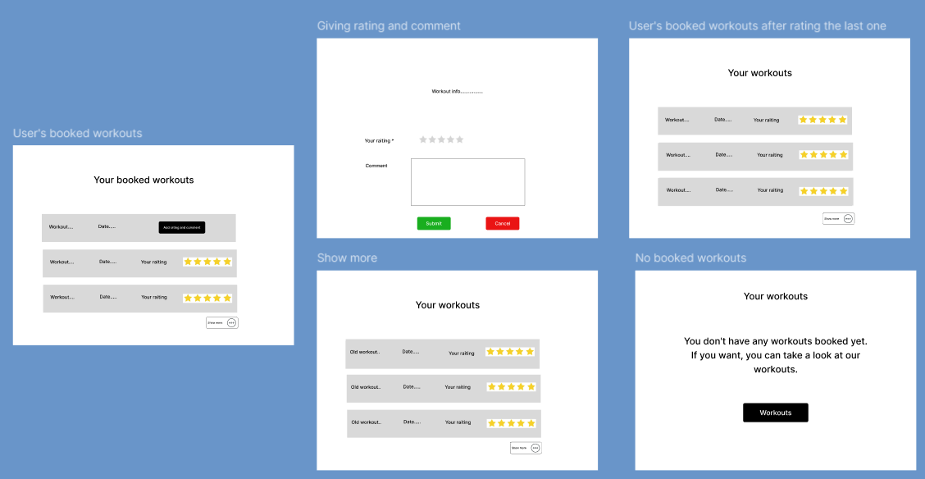
Figma in the Development Process

Slide 10

Questions?

