Slide 1
Introduction to HTML. Basic tags
Exercise 1

Slide 2
HTML
Hyper Text Markup Language
A standard markup language for creating HTML pages
Describes the structure of a web page
Consists of multiple elements that "tell" the browser how to display the content
Example: website

Slide 3
Creation of HTML pages
Text editor (eg Notepad)
Other editors (Notepad++, SublimeText, CuteHTML…)
WYSIWYG editors (Adobe Dreamweaver, Microsoft Visual Studio…)
You are free to work with the editor of your choice. In the lab – VS Code.

Slide 4
HTML elements
Every page consists of HTML elements
Structure:
<tag> Element content </tag>
<tag> - opening tag </tag> - closing tag
Example: <p> Aida Confectionery was established in 1992. </p>
Empty element – ​​no content <hr />, <br />

Slide 5
Attributes
attribute=“value"
<p align="justify"> Aida Confectionery was established in 1992.</p>
<img src= "cat.jpg" alt=“Picture with cat” />
<h2 class="myclass">About us</h2>
<div id="someid"></div>

Slide 6
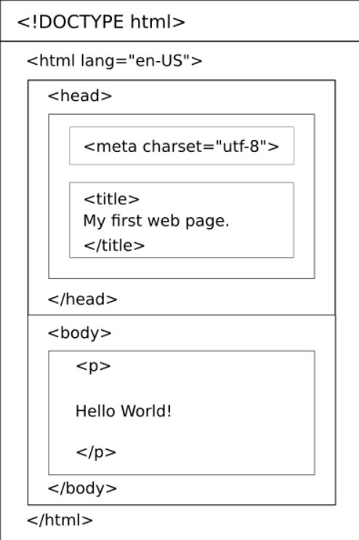
Structure of an HTML document

Slide 7
Document type declaration
HTML 5:
<!DOCTYPE html>
HTML 4.01:
<!DOCTYPE HTML PUBLIC "-//W3C//DTD HTML 4.01 Transitional//EN" "http://www.w3.org/TR/html4/loose.dtd">
XHTML 1.1:
<!DOCTYPE html PUBLIC "-//W3C//DTD XHTML 1.1//EN" "http://www.w3.org/TR/xhtml11/DTD/xhtml11.dtd">

Slide 8
HEAD – metadata container
<meta charset="utf-8">
<meta name="description" content="Description of page content.">
<meta name="keywords" content="keyword 1, keyword 2, keyword 3">
<meta name="author" content="Donika Stoyanova">
<meta name="viewport" content="width=device-width, initial-scale=1.0">
<title> The title of the page </title>
<link rel="stylesheet" href="style.css">

Slide 9
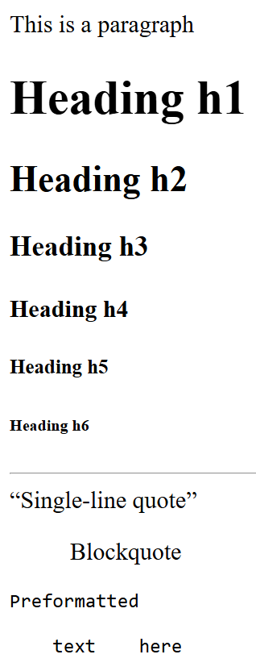
Basic tags (exercise 1)
<p></p> - paragraph
<h1></h1>, <h2></h2>…<h6></h6> - headings
<br /> - single line break
<hr /> - horizontal line
<div></div> - division or a section in an HTML document
<q></q>, <blockquote></blockquote> - quote
<pre></pre> - preformatted text
<!-- Comment -->
<span></span> - inline container

Slide 10
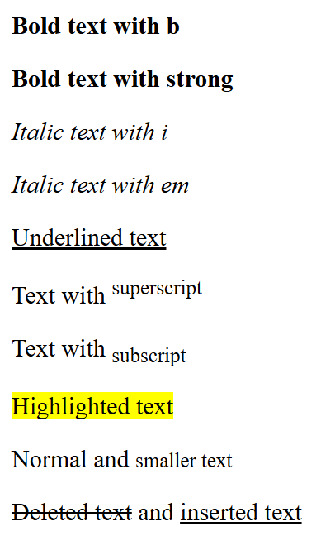
Formatting tags
<b></b>, <strong></strong> - bold
<i></i>, <em></em> - italic
<u></u> - underline
<sup></sup> - superscript
<sub></sub> - subscript
<mark></mark> - marked text
<small></small> - smaller text
<del></del> - deleted text
<ins></ins> - inserted text

Slide 11
Formatting attributes ! CSS
align=“left | right | center | justify”
<p align=“left”>Paragraph</p>
width=“50% | 200px”
size=“2”
<hr width=“50% size=“2” color=“red”/>
bgcolor=“white | #FFFFFF | rgb(255,255,255)”
background=“myimage.jpg“

Slide 12
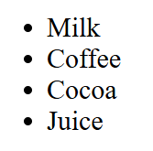
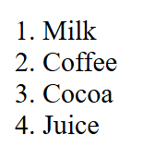
Lists in HTML
Allow web developers to group a set of related items into lists

Slide 13
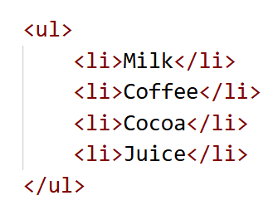
Неномерирани списъци

Slide 14
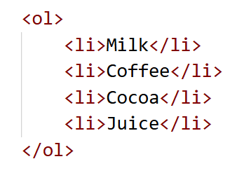
Ordered lists

Slide 15
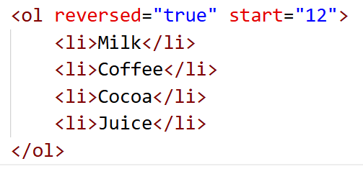
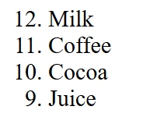
Ordered lists - attributes
reversed="true“ – reverses the order of the enumeration
start=“12” – sets the number from which to start counting

Slide 16
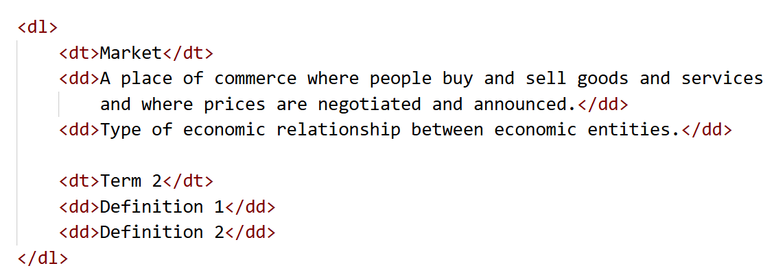
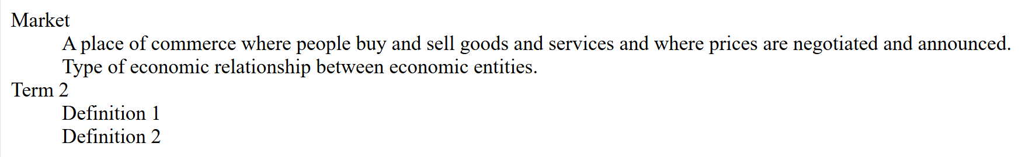
Description lists
Used to display definitions of terms

Slide 17
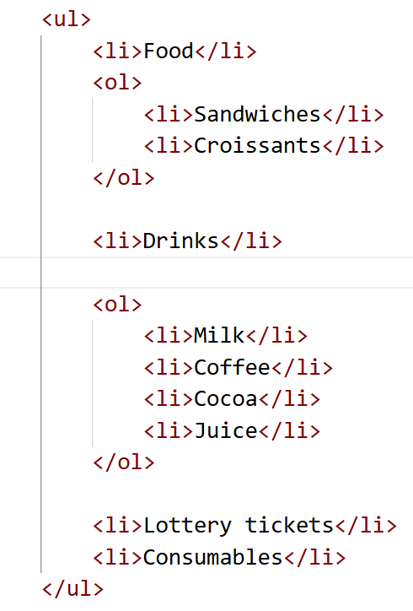
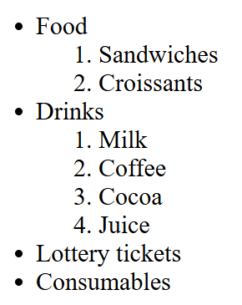
Nested lists

