Slide 1
JAVA MINI PROJECT
BLOOD BANK
INVENTORY AND
DONOR MATCHER
✚
A simple system to manage blood stock
and identify compatible donors.
BLACK × YELLOW
PRESENTED BY
M. Shiva Rama Krishna • 2620030344
Ganesh • 26200371

Slide 2
01 • INTRODUCTION
Project Abstract
THE NEED
THE SOLUTION
THE OUTCOME
Blood availability must be checked quickly during emergencies. Manual records can be slow and difficult to maintain.
A Java-based application stores blood stock and donor details, then searches for a suitable blood group.
Clear records, faster searching, and a simple way to view available units and possible donor matches.
BLOOD BANK INVENTORY & DONOR MATCHER • JAVA PROJECT
02

Slide 3
02 • WHY THIS PROJECT?
Problem Statement
• Paper-based records can become outdated or duplicated.
• Searching donor details manually takes time.
• Blood group and available-unit information must be easy to check.
• A simple system can organize records and reduce avoidable mistakes.
Goal: make blood inventory and donor lookup simple, organized, and fast.
BLOOD BANK INVENTORY & DONOR MATCHER • JAVA PROJECT
03

Slide 4
03 • GOALS
Project Objectives
01 Manage stock
02 Register donors
03 Find matches
Store blood group and unit count.
Keep donor name, group, and contact.
Search by required blood group.
04 Validate input
05 Save records
06 Apply Java
Reject invalid units or missing values.
Use files for basic data persistence.
Demonstrate core course outcomes.
BLOOD BANK INVENTORY & DONOR MATCHER • JAVA PROJECT
04

Slide 5
04 • HOW IT WORKS
System Workflow
01
02
03
04
05
Start
→
Choose action
→
Enter details
→
Process
→
Show result
Open the application
Stock / donor / search
Validate user input
Update or search records
Display match or stock
Input → Validation → Processing → Output
BLOOD BANK INVENTORY & DONOR MATCHER • JAVA PROJECT
05

Slide 6
05 • APPLICATION CAPABILITIES
Key Features
Blood stock
Donor records
Group search
View and update available units.
Register and display donor details.
Find donors with the requested group.
Input checks
File storage
Simple output
Check values before saving.
Save and load basic records.
Show clear messages to the user.
BLOOD BANK INVENTORY & DONOR MATCHER • JAVA PROJECT
06

Slide 7
06 • MAIN COMPONENTS
System Design
USER INTERFACE
BUSINESS LOGIC
DATA STORAGE
Menu
Input prompts
Result messages
Blood group search
Stock update
Validation
Donor records
Blood unit counts
Text files
User Interface → Java Logic → Stored Records
BLOOD BANK INVENTORY & DONOR MATCHER • JAVA PROJECT
07

Slide 8
07 • COURSE OUTCOME 1
CO1 — Data Types
Concept
Java data types define what kind of value a variable can store.
JAVA EXAMPLE
String donorName = "Ravi";
String bloodGroup = "O+";
int availableUnits = 12;
boolean eligible = true;
System.out.println(bloodGroup + ": " + availableUnits);
Project use: names and groups use String, unit counts use int, and yes/no flags use boolean.
BLOOD BANK INVENTORY & DONOR MATCHER • JAVA PROJECT
08

Slide 9
08 • COURSE OUTCOME 2
CO2 — If-Else, Switch & Loops
JAVA EXAMPLE
if (units > 0) {
System.out.println("Stock available");
} else {
System.out.println("Out of stock");
}
switch (choice) {
case 1: System.out.println("View stock"); break;
case 2: System.out.println("Search donor"); break;
default: System.out.println("Invalid choice");
}
If-else makes decisions • switch handles menu choices • loops repeat menu or search tasks.
BLOOD BANK INVENTORY & DONOR MATCHER • JAVA PROJECT
09

Slide 10
09 • COURSE OUTCOME 3
CO3 — Methods & Arrays
JAVA EXAMPLE
static int totalUnits(int[] stock) {
int total = 0;
for (int units : stock) {
total += units;
}
return total;
}
int[] stock = {8, 12, 5, 4};
System.out.println(totalUnits(stock));
Methods organize reusable logic. A 1D array can hold unit counts; a 2D array can represent group-by-location stock.
BLOOD BANK INVENTORY & DONOR MATCHER • JAVA PROJECT
10

Slide 11
10 • COURSE OUTCOME 4
CO4 — OOP & Exceptions
CLASS
OBJECT
EXCEPTION
Donor describes the data and actions for a donor.
Each donor record is an object created from Donor.
try-catch can handle invalid number input.
JAVA EXAMPLE
try {
int units = Integer.parseInt(input);
if (units < 0) throw new IllegalArgumentException();
} catch (NumberFormatException e) {
System.out.println("Enter a valid number.");
} catch (IllegalArgumentException e) {
System.out.println("Units cannot be negative.");
}
BLOOD BANK INVENTORY & DONOR MATCHER • JAVA PROJECT
11

Slide 12
11 • COURSE OUTCOME 5
CO5 — Strings, Files & Libraries
JAVA EXAMPLE
String group = "O+";
if (group.equalsIgnoreCase(requiredGroup)) {
System.out.println("Possible group match");
}
// Example file-writing idea
try (java.io.FileWriter writer =
new java.io.FileWriter("donors.txt", true)) {
writer.write("Ravi,O+\n");
} catch (java.io.IOException e) {
System.out.println("Could not save record.");
}
Strings compare names and blood groups. File handling saves records. Java libraries provide ready-made classes.
BLOOD BANK INVENTORY & DONOR MATCHER • JAVA PROJECT
12

Slide 13
12 • COURSE OUTCOME 6
CO6 — Collections & Streams
JAVA EXAMPLE
import java.util.ArrayList;
import java.util.List;
List<String> donors = new ArrayList<>();
donors.add("Ravi - O+");
donors.add("Maya - A+");
donors.add("Arun - O+");
donors.stream()
.filter(d -> d.endsWith("O+"))
.forEach(System.out::println);
Collections store a flexible number of donor records. Streams filter and process matching entries.
BLOOD BANK INVENTORY & DONOR MATCHER • JAVA PROJECT
13

Slide 14
13 • CORE PROJECT LOGIC
Donor Matching Logic
• Read the required blood group from the user.
• Check each donor record in the stored list.
• Compare the donor group with the requested group.
• Display records that meet the matching rule.
• In a real blood bank, compatibility must be verified by qualified medical staff.
Educational prototype only — not a substitute for clinical compatibility testing.
BLOOD BANK INVENTORY & DONOR MATCHER • JAVA PROJECT
14

Slide 15
14 • IMPROVEMENTS
Benefits & Future Scope
BENEFITS
FUTURE SCOPE
• Faster record lookup
• Organized stock information
• Basic input validation
• Clear menu-driven workflow
• Database integration
• Secure staff login
• Donor eligibility reminders
• Search by location and availability
BLOOD BANK INVENTORY & DONOR MATCHER • JAVA PROJECT
15

Slide 16
CONCLUSION
A SIMPLE IDEA.
A USEFUL IMPACT.
✓
The project demonstrates how Java can organize blood stock, store donor details, and help users search records. It applies the six course outcomes in one practical example.
THANK YOU
Questions?
BLOOD BANK INVENTORY & DONOR MATCHER

Slide 17
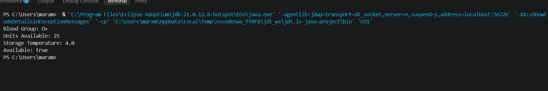
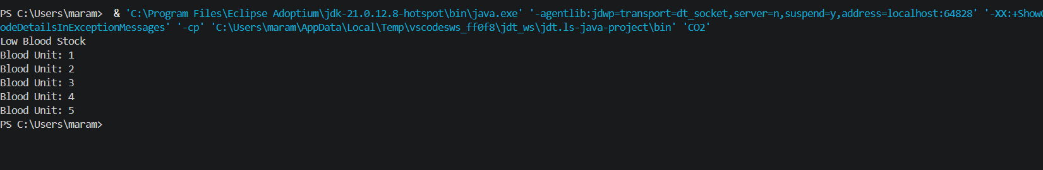
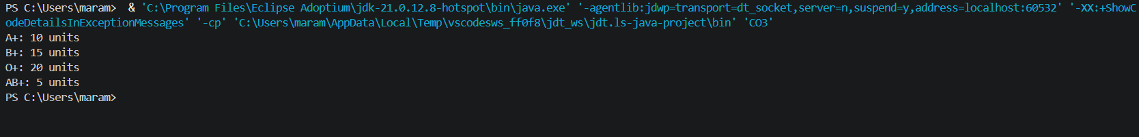
Output Screenshots

Slide 18
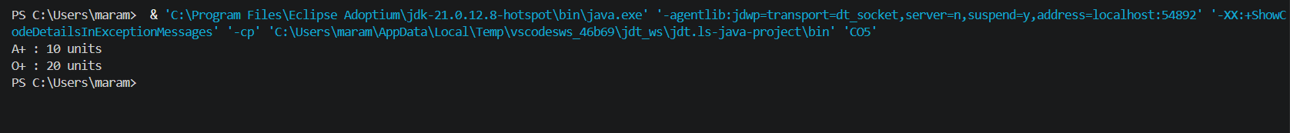
Group Photo

