Slide 1

The Great Adventure
Doni Setiawan
Rakha Farhan Vahdaputra
4SC2

Slide 2
Fundamentals Software Engineering

Slide 3
Software
Software is developed or engineered, it is not manufactured in the classical sense.  Software doesn't "wear out."  Although the industry is moving toward componentbased construction, most software continues to be custom-built.

Slide 4
INTRODUCTION SOFTWARE

Slide 5
INTRODUCTION SOFTWARE
Software development life cycle. It is a process that describes how to develop, design and maintain the software project ensuring that all the functional & user requirement, goals and objective are met. This methodology improves the quality of the software project and over all process of software development.
Different stages of SDLC:
Requirement Gathering & Analysis phase: and important phase of SDLC for the success of software. This phase includes communication between project stakeholders, end users and project team, as requirements (both Functional & non functional) are being gathered from clients.
Developments Phase: – This is the longest phase of SDLC as in this phase of SDLC actual project is developed and build.

Slide 6
Software development life cycle

Slide 7
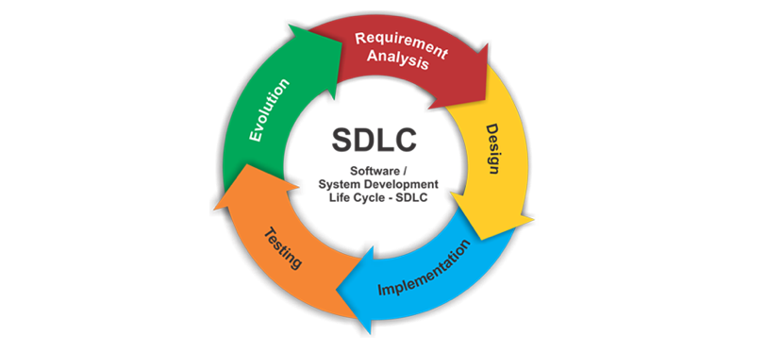
In systems engineering, information systems and software engineering, the systems development life cycle, also referred to as the application development life-cycle, is a process for planning, creating, testing, and deploying an information system.

Slide 8
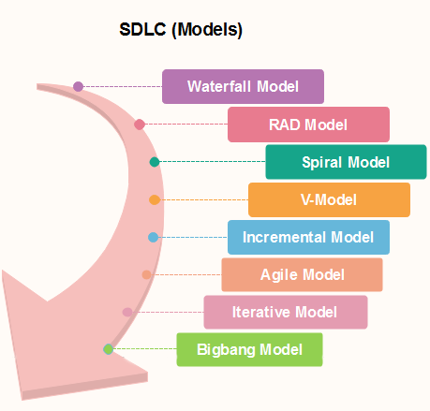
SDLC Models
There are various SDLC models that are defined and designed to follow in software development process. These models are also called as Software development process models. Each model follows a series of steps ensuring the success of the project. Following are the list of most popular SDLC models used for software development:-
Waterfall Model
Iterative & incremental Model
Spiral Model
Agile development
Rapid Action development (RAD) model

Slide 9
Black Box Testing

Slide 10
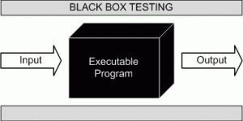
Black Box Testing
also known as Behavioral Testing, is a software testing method in which the internal structure/design/implementation of the item being tested is not known to the tester. These tests can be functional or non-functional, though usually functional.
This method is named so because the software program, in the eyes of the tester, is like a black box; inside which one cannot see. This method attempts to find errors in the following categories:
Incorrect or missing functions
Interface errors
Errors in data structures or external database access
Behavior or performance errors
Initialization and termination errors

Slide 11
System Analysis

Slide 12
System Summary :
In the project this time we created a website that we named The Great Adventure.This project is created by using Eclipse IDE, We used Bootstrap 3 and our custom CSS files to design our application. This web was implemented with a realtime database firebase for store data booking and also we used Goole Map API’s to show our location, And to be able to access our website from the browser we used the google app engine.
For mobile appswas created by using Android Studio, in this mobile apps we also implemented with a realtime database firebase, where later users could book travel.

Slide 13
Implementation

Slide 14
Implementation in this project :
Home : Implement Bootstrap 3 and Media Query for responsive web design. In Home, it have a brief explaination about the great adventure, and also impelement Parsley.js to validate the contact form.
Detail : Implement Bootstrap 3 and Media Query for responsive web design. In detail, it have explanation about our details tour package.
Booking : Implement Modal Bootstrap to show booking menu, and implement Create function to add the data to firebase.
API : Implement API to use MAPS in detail.jsp
Admin page (list_booking) : Implement CRUD to modify booking data. In this page used for look all data booking from user
Admin Page (list_comment) : Implement CRUD to modify feedback. In this page used for look all data feedback from user
Awesome Validation : Implement Library Awesome Validation on Mobile Apps for Validating Form Booking and Form Feedback

Slide 15
Black Box Testing

Slide 16
WEBSITE
No. | Test Case | Test Data | Expected Result | Actual Result | Result
1. | Delete data from Table (index.jsp) | Delete data by Choosing data on Table | Delete data in Firebase and Table | Delete data in Firebase and Table | Pass
2. | Delete data from Table (index.jsp) | Delete data by Not Choosing data on Table | Delete data in Firebase and Table | Not delete data in Firebase and Table | Failed
3. | Update data from Table (index.jsp) | Change valid data for modify booking data user | Update data to Firebase | Update data to Firebase | Pass
4. | Update data from Table (index.jsp) | Change not valid data for modify booking data user | Update data to Firebase | Not Update data to Firebase | Failed
5. | Show all records in Table from Firebase (index.jsp) | Get all records from Firebase | Show all Records from Firebase in Table | Show all Records from Firebase in Table | Pass
6. | Delete data from Table (comment.jsp) | Delete data by Choosing data on Table | Delete data in Firebase and Table | Delete data in Firebase and Table | Pass
7. | Delete data from Table (comment.jsp) | Delete data by Not Choosing data on Table | Delete data in Firebase and Table | Not delete data in Firebase and Table | Failed
8. | Show all records in Table from Firebase (comment.jsp) | Get all records from Firebase | Show all Records from Firebase in Table | Show all Records from Firebase in Table | Pass
9. | Login Admin | Login admin with valid Email and Password | Login Succesfull and link to index,jsp | Login Succesfull and link to index,jsp | Pass
10. | Login Admin | Login admin with not valid Email and Password | Login Succesfull and link to index,jsp | Login Failed and cannot link to index,jsp | Failed

Slide 17
MOBILE APPS
No. | Test Case | Test Data | Expected Result | Actual Result | Result
1. | Add data booking | Input valid data for add data booking | Data succesfully added to Firebase | Data succesfully added to Firebase | Pass
2. | Add data booking | Input not valid data for add data booking | Data succesfully added to Firebase | Data cant’t be added to the Firebase | Failed
3. | Add data feedback | Input valid data for add data booking | Data succesfully added to Firebase | Data succesfully added to Firebase | Pass
4. | Add data feedback | Input not valid data for add data feedback | Data succesfully added to Firebase | Data cant’t be added to the Firebase | Failed

Slide 18
Thank you
Any Question?

