Slide 1


Ensemble-Based Deepfake
Detection Using Multi- Backbone CNNs & Meta-
Learning
M.Tech Mini Project in Information Security & Privacy
Doni Singh Agrawal (P24IS006) | Guide: Dr. Mukesh A. Zaveri SVNIT Surat, Dept. of CSE

Slide 2
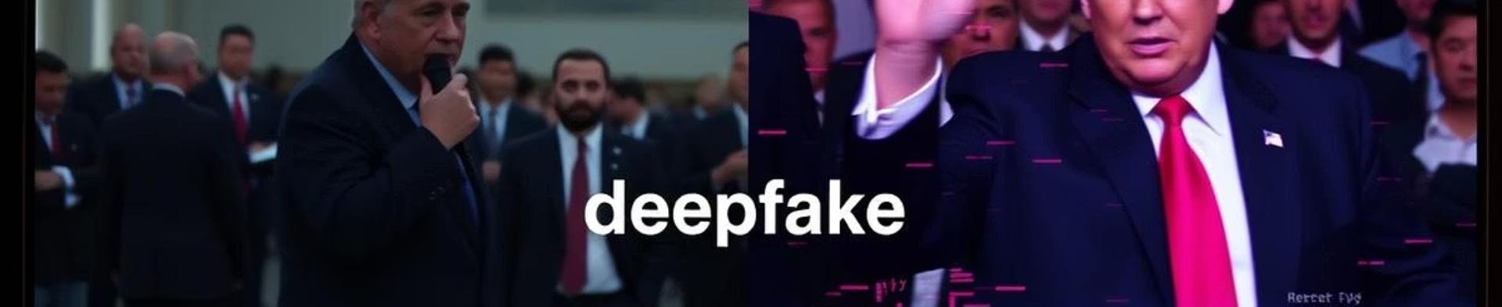




Motivation
Deepfake Proliferation
Easy generation with open-source tools
Model Limitations
Single-model detectors lose 30pp accuracy on new data
Ensemble Advantage
Mitigates individual bias patterns
Real-world Challenges
Videos undergo compression, blur, color jitter

Slide 3


Project Objectives
Fine-tune CNNs
Five backbones on FaceForensics++
Build Ensembles
Soft-voting baseline and stacking framework
Compare Meta-learners
Logistic Regression, Random Forest, XGBoost, MLP
Release Resources
Reproducible scripts & checkpoints

Slide 4

Real-World Applications
Social Media
Auto-flagging manipulated videos before upload
Digital Forensics
Validating video evidence in courts
Electoral Security
Detecting deepfake campaign ads
Finance (KYC)
Preventing face-swap fraud in remote onboarding

Slide 5





Dataset & Preprocessing
FaceForensics++ Dataset
~10,560 frames from "Deepfakes" subset
Frame Extraction
1 frame every 30 frames via OpenCV
Resize & Normalize
299×299 for Xception; 224×224 for others
Augmentation
On-the-fly rotation, flips, shifts

Slide 6

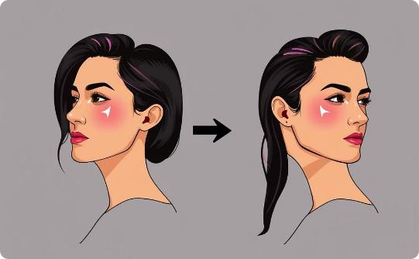

Data Augmentation Techniques
Random Rotation
±20° to simulate camera tilt
Horizontal Flip
Mirror face orientation
Noise & Jitter
Simulate compression artifacts

Slide 7










CNN Backbones Overview
EfficientNetB0
Compound scaling; 224×224 input
Xception
Depthwise separable convolutions;
299×299 input
MobileNetV2
Inverted residuals; resource- efficient
ResNet50
Residual connections; 50-layer
bottlenecks
VGG19
Stack of 3×3 conv layers

Slide 8




Fine-Tuning Strategy
Layer Freezing
Freeze 70-85% of pretrained layers
Unfreeze Top Layers
Adapt high-level filters to forgery cues
Hyperparameter Tuning
LR: 1×10⁻⁴ to 1×10⁻³, Adam optimizer
Regularization
Dropout(0.5) in classifier head

Slide 9
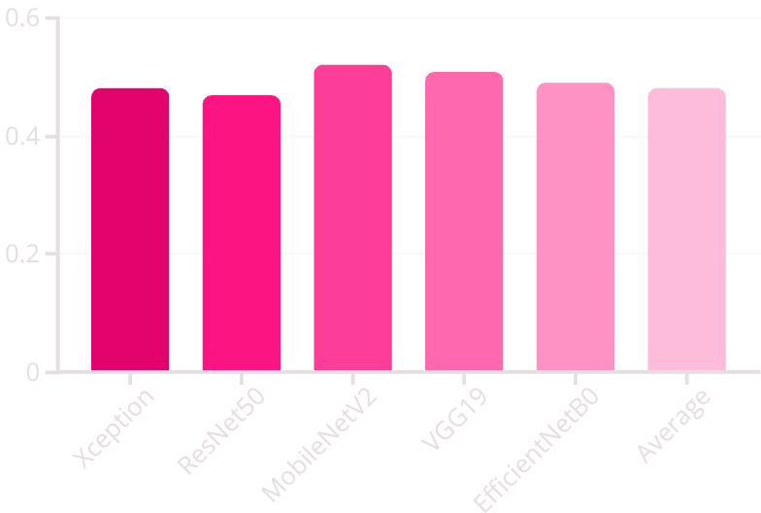
Soft-Voting Ensemble
Formula: pₛ(x)= (1/5)∑₁⁵ pᵢ(x)
Decision: Fake if pₛₒᵥₜ(x)>0.5, else Real
Result: 47.0% accuracy, AUC=0.50 on hold-out set

Slide 10

Stacking Ensemble Concept
Meta-Features
Five CNN probabilities form vector [p₁,…,p₅]
Meta-Learner
Learns nonlinear fusion weights
Cross-Validation
5-fold stacking prevents label leakage
Key Insight
Stacking outperforms soft-voting

Slide 11


Meta-Feature Construction
Preprocess frame
Per-CNN requirements
Obtain probabilities
pᵢ(x) ∈ [0,1] from sigmoid outputs
Concatenate
x′=[p₁, p₂, p₃, p₄, p₅]
Standardize
Zero mean, unit variance

Slide 12
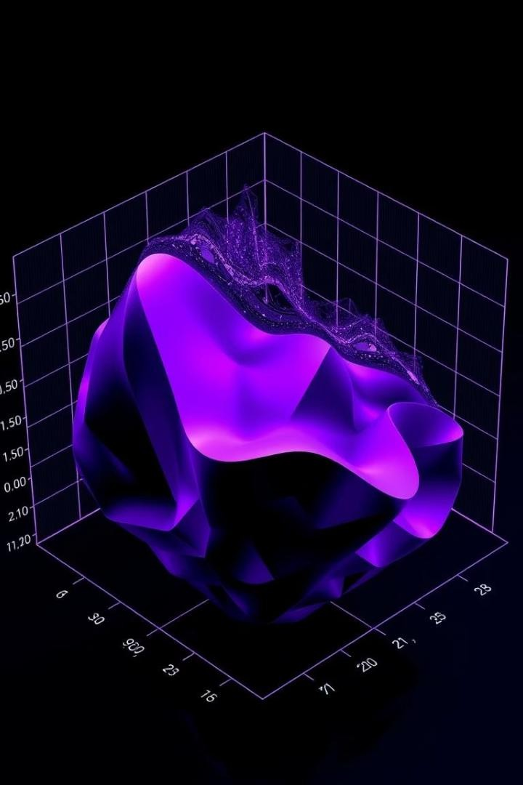
Meta-Learners & Hyperparameters
Logistic Regression
L2 penalty, C=1.0, solver='lbfgs'
Random Forest
200 trees, max_depth=10, balanced sampling
XGBoost
300 rounds, max_depth=5, η=0.1
Neural Network
[64, 32] units, ReLU, dropout=0.5

Slide 13
Ensemble Performance Comparison
Meta-Model | Accuracy (%) | AUC
Soft Voting | 47.0 | 0.50
Logistic Regression | 57.6 | 0.59
Random Forest | 65.5 | 0.65
XGBoost | 64.9 | 0.72
Neural Network | 66.4 | 0.67
RF (5-Fold CV) | 67.1 | 0.68

Slide 14








Confusion Matrix & Calibration
RF & XGBoost
Balanced FP & FN (<120 each)
Neural Network
Overconfident predictions near 0/1
Confidence Histograms
RF bimodal peaks near extremes
Logistic Regression
Ambiguous outputs → higher FN

Slide 15








Conclusion & Future Directions
Best Model
RF stacked with 5-fold CV
Key Takeaway
Meta-ensembles boost accuracy 15-20 pp
Future Work
Domain-specific augmentations, multi-modal fusion
Long-Term Goal
Real-time, edge-deployable detector with ≥90% accuracy

Slide 16

Thank You
We appreciate your attention and interest. Please feel free to ask any questions or reach out for further discussion.

