Slide 1

Detecting Bot-Controlled Accounts on Social Media
This project explores machine learning techniques to detect bots on Instagram and Twitter. The growing bot threat manipulates opinions, spreads fake news, and commits fraud. Traditional methods struggle, so adaptive models using behavioral and content features are needed.
Himanshu Sawle P24IS006
SVNIT Surat
Guide: Dr. Mukesh Zaveri

Slide 2


Background & Motivation
Vulnerabilities in Social Media
Limitations of Rule-Based
Systems
Need for ML-Based Detection
Bots infiltrate platforms, mimicking humans for manipulation.
Traditional detection struggles with evolving bot behaviors.
Automated, adaptive, interpretable methods are essential.

Slide 3


Problem Statement & Objectives
Challenge
Detect bots on diverse platforms with distinct data types.
Instagram focuses on visual content.
Twitter relies on text-heavy data.
Approach and Goals
Extract platform-specific behavioral and content features.
Train Random Forest classifiers for robust prediction.
Use TF-IDF for nuanced Twitter text analysis.
Evaluate with Accuracy, Precision, Recall, F1, ROC-AUC.

Slide 4

Significance of the Project
Growing Threat
Cross-Platform Complexity
Social bots increasingly influence politics, scams, and misinformation.
Detection needs tailored strategies for Instagram and Twitter.
Impactful Contribution
Future Potential
Combines text processing with behavioral analytics.
Foundation for real-time, cross- platform bot detection systems.

Slide 5

Dataset: Cresci 2017
Instagram Data
Twitter Data
Labels
Profile metadata and activity logs.
Tweets, metadata, and network information.
Bot and genuine accounts labeled for supervised learning.

Slide 6


Data Preprocessing
Clean and Normalize
Handle missing values; apply Min-Max scaling on features.
Label Encoding
Encode targets: 0 for humans, 1 for bots.
Twitter-Specific Cleaning
Remove links, mentions, and punctuation from tweets.
Train-Test Split
80/20 stratified split ensures balanced evaluation.

Slide 7



Feature Engineering
Instagram Features
Follower-to-following ratio
Post frequency and bio length
Media counts per user
Twitter Features
Retweet and reply ratios
Hashtag and URL mentions
Average tweet timing (intertime)

Slide 8

TF-IDF: Text Feature Extraction
TF (Term Frequency)
Counts word occurrence in user tweets
TF-IDF Calculation
Highlights words unique to bots or humans
IDF (Inverse Document Frequency)
Downweights common words across users
Application
Captures spammy/repetitive bot language on Twitter

Slide 9




Random Forest Classifier
Ensemble Learning
Random Subsets
Combines predictions from multiple
decision trees.
1
Trees trained on random data and feature subsets.
2
Benefits
Majority Voting
Reduces overfitting and improves generalization on metadata and text.
4
Final prediction based on majority vote
of trees.
3

Slide 10

How Decision Trees Work
Node Condition
Data Splitting
Leaf Nodes
Random Forest
Tests attributes like follower ratio > 3?
Branches data to child nodes based on condition
Assign class label: Bot or Human
Hundreds of trees, majority voting for final decision

Slide 11

Training and Evaluation
Cross-Validation
5-fold to ensure model generalization
Platform-Specific Models
Separate models for Instagram and Twitter
Hyperparameters
Tuned trees=300, depth=30, criterion=gini
Metrics
Accuracy, Precision, Recall, F1, ROC-AUC

Slide 12
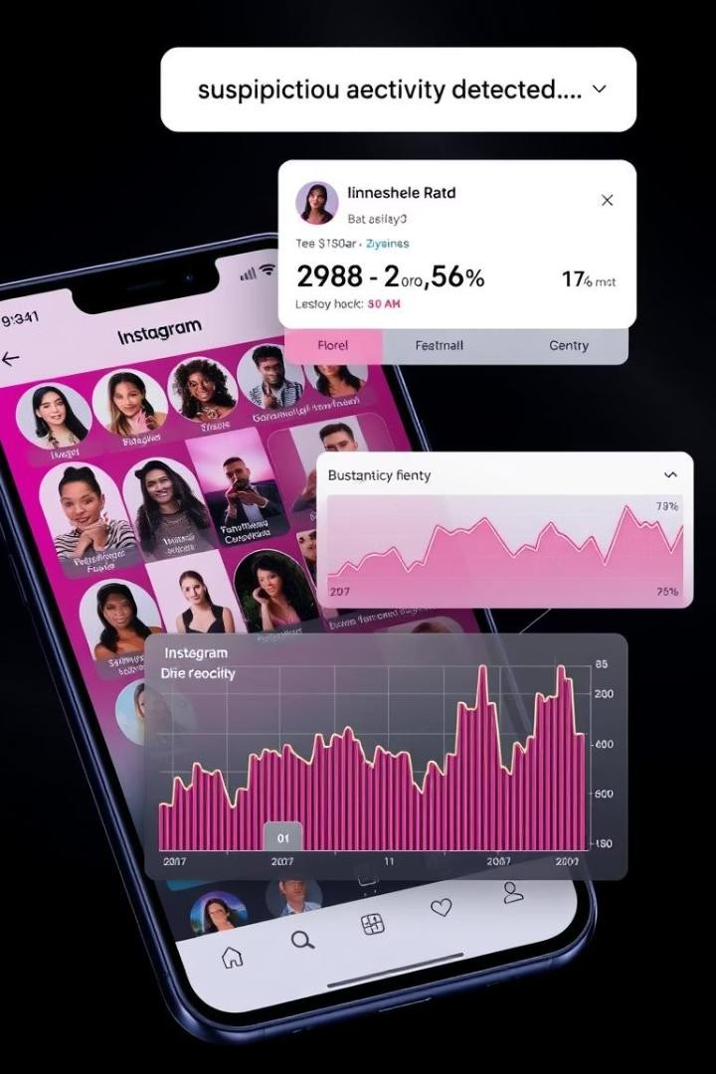
Instagram Detection Results
94.2%
Accuracy
93.7%
Precision
94.5%
Recall
96.3%
ROC-AUC
Indicators: Low follower/following ratio, unusual posting frequency

Slide 13
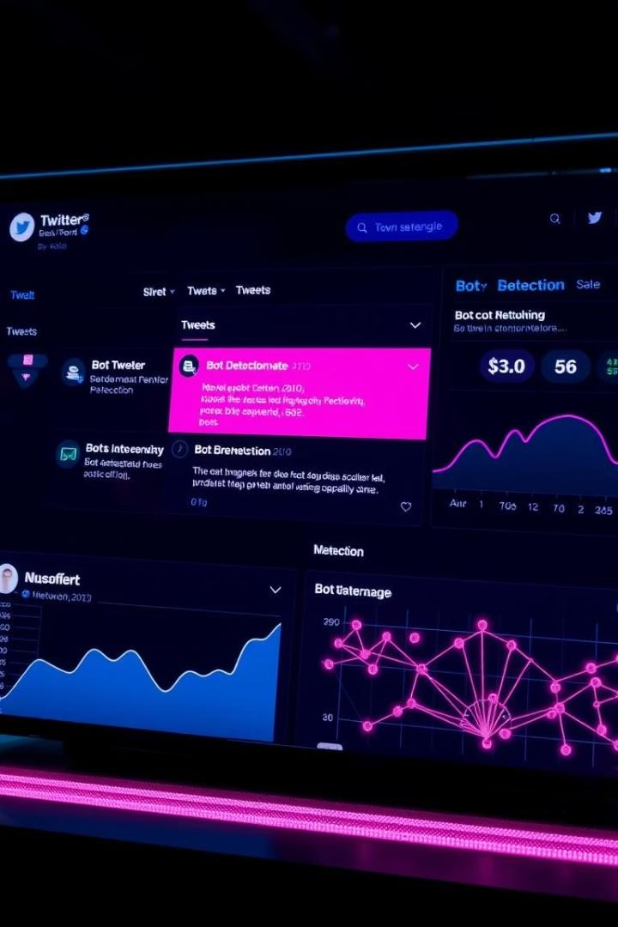
Twitter Detection Results
98.8%
Accuracy
98.5%
Precision
99.0%
Recall
99.2%
ROC-AUC
TF-IDF features greatly enhance detection of spammy language

Slide 14

Comparison & Analysis
Twitter
Better due to rich textual analysis using TF-IDF
Instagram
Relies mainly on behavior-based metadata
Twitter Bots
Spammy language patterns detected
Instagram Bots
Abnormal post timing, URL usage, username length

Slide 15

Conclusions and Future Scope
Conclusion
Platform-aware ML with behavioral + content features effective
Future Deep Learning
Incorporate LSTM, BERT, and Graph Networks
Real-time Detection
Deploy live bot detection pipelines
Explainability
Integrate Explainable AI for model transparency

