Slide 1

DEPARTMENT OF COMPUTER SCIENCE AND ENGINEERING
PROJECT NAME: SMART WATER SYSTEM
TEAM NAME : Proj_224784_Team_5
TEAM MEMBERS :
Dharshini.R (113321104017)
Dhivya Lakshmi(113321104018)
Donkala Kamakshi Harshitha(113321104019)
Duvvuru Bhavana Reddy(113321104022)

Slide 2
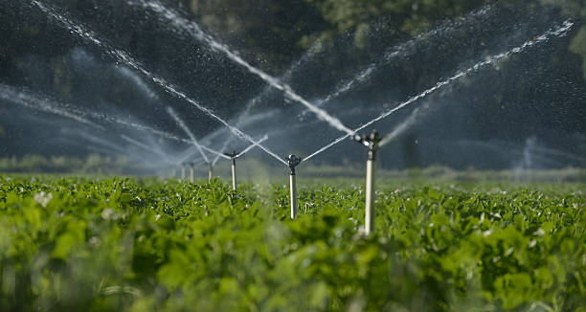
PROBLEM DEFINITION:
The Smart Water System Optimization and Management project aims to revolutionize the way water resources are managed and utilized in urban and rural areas.
This project focuses on implementing cutting-edge technologies and data-driven solutions to address water scarcity, improve distribution efficiency, and promote sustainable usage practices.

Slide 3
OBJECTIVES:
Real Time Monitoring
Data Analysis and Predictive Modeling
Leak Detection and Prevention
Smart Metering
Mobile App Development
Infrastructure Upgradation
Water Quality Management
Community Engagement
Regulatory compliance
Cost-Benefit Analaysis

Slide 4
EXISTING SYSTEM:
In rural areas we have seen that due to improper water utilization and due to erosion and cutting of canals, farmers suffer from irrigation problem and also when they go for the government offices then they have to wait for months for resolving the problem and hence it takes time, travel fatigue and also loss of money due improper convenience. And still there are many problems of water management related to irrigation.
We have also seen that on many public places mostly on railway stations there are wastage of water unusually like flowing of water form a pipeline that spends water in much amount and the railway official don't resolve the problem at the time so the precious water flows unusually. In the Urban areas some water tank is very old and near to collapse also there found to be many unusual leakage of water and there are many problems related to road and gutter.

Slide 5
PROPOSED SYSTEM:
Here we will bring an application by the help of which the user can find how many canals and government hand-pumps in the rural area(within 2 kilometers range),and can also complain to the government officials with the help of this application by sitting at home that can save time, travel fatigue and also can save money expenditure to travel . At the public place with the help of this application the user can also complain to the that officers to resolve a problem by typing that problem in the complaint box so that the unusual flow of water can be resolved quickly . The Complaint message is directly sent to the nodal officer so the management information can be transparent . In the Urban areas if the water tank is very old and near to collapse then by the use of this application public can send complain to the municipal corporation . Also if somewhere there found to be unusual leakage of water then after informing it through this application the municipal corporation can take action within hours, and the user can also send complain about any problem which are related to the municipal corporation.

Slide 6
IOT SENSOR DESIGN:
Water Quality Sensors:
These sensors measure parameters like pH levels, turbidity, dissolved oxygen, and chemical contaminants to ensure water quality meets regulatory standards.
Flow Sensors:
Flow sensors track the rate at which water is moving through pipes. This data helps in leak detection, usage monitoring, and optimizing water distribution.
Pressure Sensors:
Pressure sensors monitor water pressure in pipes and can help detect leaks or blockages in the system.
Ultrasonic Sensors:
Ultrasonic sensors can be used to measure water levels in open channels, such as rivers or streams, and are often employed in flood monitoring systems

Slide 7
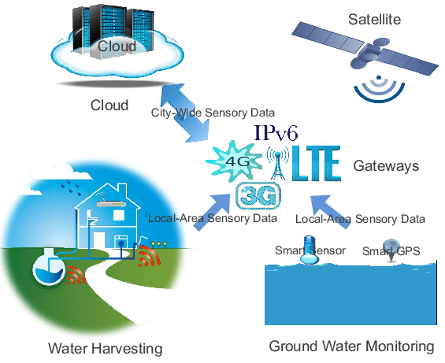

Slide 8
REAL-TIME TRANSIT INFORMATION FLATFORM:
With IoT, the whole water supply chain can become more transparent and easier to control With the help of sensors, a smart city water management system can enable you to collect real-time data—information that helps you visualize water distribution across the network.
Water Level Monitoring and Dam Management:
Water level monitoring and management of dams using IoT can improve this, using ultrasonic, vibration, and pressure sensors to help monitor dam function. With pressure sensors, in particular, you can detect leaks in pipes and receive instant alerts. Predictive technologies ensure dam operators get early warnings and are able to keep watch over water availability in each reservoir. This may be particularly helpful for irrigation.
Smart Irrigation Management:
Whenever the sensor detects a low quantity of moisture in the soil, the motor turns on automatically. Hence, will automatically irrigate the field. Once the soil becomes wet, the motor turns off.

Slide 9
INTEGRATION APPROACH:
SENSOR DEPLOYEMENT:
Install IoT sensors at key points in the water infrastructure to monitor parameters such as water quality, flow rates, pressure, and temperature.
DATA COMMUNICATION:
Establish reliable data communication channels, such as Wi-Fi, cellular networks, or LPWAN (Low-Power Wide-Area Network), to transmit sensor data to a central server or cloud platform.
USER INTERFACE:
Develop user-friendly interfaces, such as mobile apps or web dashboards, for stakeholders to monitor and control the smart water system.
DATA VISUALIZATION:
Use data visualization tools to provide real-time insights to water operators and decision-makers for informed actions.

Slide 10
INTEGRATION BENEFITS:
Real-time Monitoring:
IoT sensors placed throughout water infrastructure enable real-time monitoring of water quality, flow rates, pressure, and more. This data helps utilities detect leaks, assess water quality, and optimize distribution.
Leak Detection and Prevention:
IoT can quickly identify leaks in the water supply system, preventing water wastage and costly repairs. Automated alerts can notify.
Water Conservation:
Smart water meters and IoT-based analytics can provide consumers with real-time information about their water usage, encouraging water conservation efforts.
Improved Customer Service:
Utilities can use IoT to enhance customer service by providing better communication, faster response times to issues, and accurate billing based on actual consumption.

Slide 11
INNOVATION
PROBLEM SOLUTION
Our innovative water conservation system will utilize machine learning algorithms to analyze individual water consumption patterns, predict future usage, and provide actionable suggestions to optimize water consumption. The system will consist of the following components:
1. Data Collection and Integration:
Collect historical water consumption data from users, including usage patterns, seasonal variations, and demographic information . Integrate data from various sources, such as weather forecasts, local water supply, and household specifics, to create a comprehensive dataset.
2. Machine Learning Algorithms:
Utilize machine learning algorithms, such as clustering and regression, to analyze the integrated data and identify consumption patterns. Implement predictive models to forecast future water usage based on historical data and external factors.
3. User Interface and Recommendations:
Develop an intuitive user interface (UI) that allows users to input their information and view personalized insights. Provide conservation suggestions and tips based on the machine learning analysis, tailored to each user's consumption patterns and circumstances.
4. Real-time Monitoring and Alerts:
Implement real-time monitoring of water usage, enabling users to track their consumption and receive alerts for abnormal usage. Utilize anomaly detection algorithms to identify potential leaks or wasteful behaviors and notify users immediately.

Slide 12
BENEFITS
Personalized Conservation: By analyzing individual consumption patterns, our system can provide personalized conservation recommendations that are effective and actionable for each user.
Efficient Water Use: Through predictive analysis, users can anticipate their future water usage and adjust their behaviors to achieve more efficient water consumption.
Environmental Impact: By promoting water conservation and efficient usage, our system contributes to the preservation of natural resources and a reduction in the overall environmental impact.
Cost Savings: Users can potentially reduce their water bills by implementing the suggested conservation measures and optimizing their water usage.

Slide 13
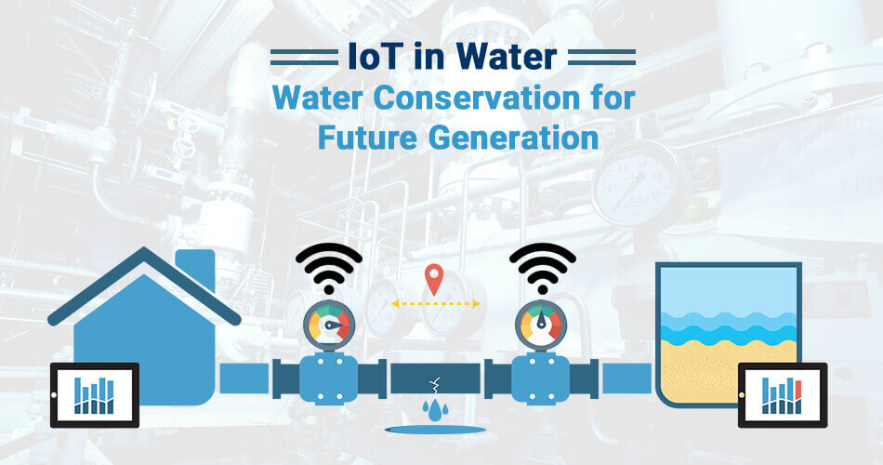
CONCLUSION
Our innovative water conservation system, incorporating machine learning algorithms for personalized analysis and recommendations, presents a promising solution to address water scarcity by promoting responsible and efficient water consumption. Through a user-friendly interface and real-time monitoring , we aim to empower individuals to make informed decisions and contribute to a more sustainable future.

Slide 14
THANK YOU!!

