Slide 1

DEPARTMENT OF COMPUTER SCIENCE AND ENGINEERING
Project name : Smart Water Management
Team name : Proj_224784_Team_5
Team members :
DHARSHINI.R(113321104017)
DHIVYA LAKSHMI.B(113321104018)
DONKALA KAMAKSHI HARSHITHA(113321104119)
DUVVURU BHAVANA REDDY(113321104022)

Slide 2
INNOVATION
IoT-enabled Water Sensors: Utilize IoT sensors for real-time monitoring of water usage, quality, and leak detection, providing actionable insights for efficient water management.
Data Analytics and AI: Apply AI and data analytics to process data from sensors, predicting water demand, optimizing distribution, and identifying leakages for proactive interventions.
Smart Metering and Billing: Implement smart water meters for real-time consumption data, enabling accurate billing, promoting water conservation, and detecting anomalies like leaks.
Water Recycling and Reuse Systems: Invest in advanced water treatment tech for efficient recycling and reuse of treated wastewater, minimizing strain on freshwater resources.
Mobile Applications for Water Management: Develop user-friendly mobile apps allowing consumers to monitor water usage, set conservation goals, and receive alerts, promoting awareness and responsible water usage.

Slide 3
PROJECT OBJECTIVES
Implement IoT-enabled Water Monitoring: Deploy IoT sensors and devices to monitor water usage, quality, and detect leaks, aiming to enhance real-time data collection and analysis for effective water management.
Integrate Data Analytics and AI Algorithms: Integrate data analytics and AI algorithms to process sensor data, predict water demand, optimize distribution, and proactively identify and address leakages and inefficiencies in the water system.
Upgrade to Smart Metering and Billing System: Upgrade the existing water metering system to smart meters, enabling real-time consumption tracking, accurate billing, leak detection, and encouraging water conservation among consumers.
Implement Water Recycling and Reuse Technologies: Implement advanced water treatment technologies to efficiently recycle and reuse treated wastewater, promoting sustainable water usage and reducing strain on freshwater resources.
Develop User-Friendly Water Management App: Develop an intuitive mobile application to empower consumers to monitor their water usage, set conservation goals, receive alerts for anomalies, and promote awareness and responsible water consumption.

Slide 4
Project Requirements
Data Collection and Monitoring: Deploy sensors for real-time data on water quality, usage, and distribution.
Data Analytics and Insights: Develop algorithms to predict demand, detect leaks, and optimize distribution.
Automation: Implement remote control systems for valves, pumps, and infrastructure components.
GIS Integration: Combine data with GIS for spatial analysis and decision support.
User Engagement: Create user-friendly apps for real-time feedback and water conservation education.

Slide 5
Leak Detection: Use sensors and algorithms to promptly identify and respond to leaks. Agricultural Optimization: Promote smart irrigation systems for efficient water use in agriculture. Infrastructure Improvement: Prioritize repairs and upgrades to reduce water loss. Energy Efficiency: Integrate energy-efficient technologies in water facilities. Community Involvement: Engage the community through awareness campaigns, workshops, and incentive programs. Regulatory Compliance: Ensure adherence to local water quality and environmental regulations. Emergency Response Planning: Develop contingency plans for managing water resources during crises like droughts, floods, or contamination events. Sustainability Evaluation: Assess the environmental impact and sustainability of the smart water management system, promoting eco-friendly practices.

Slide 6
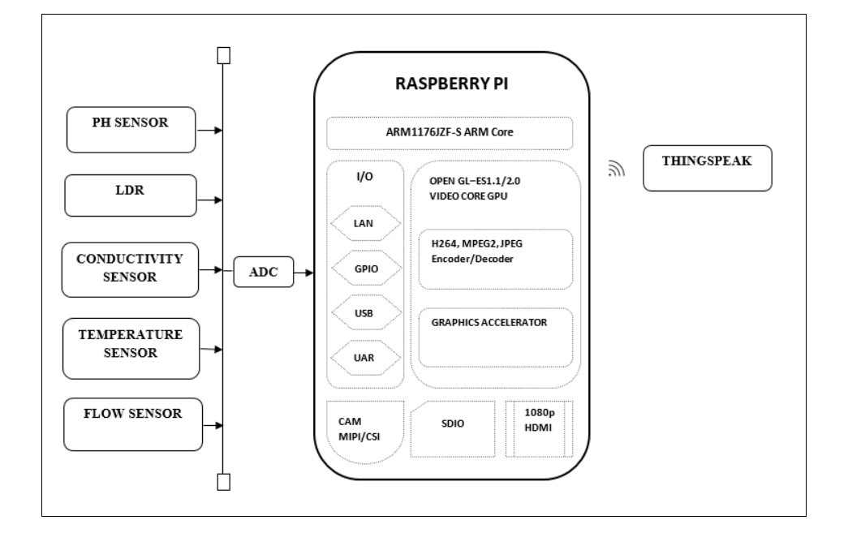
INTEGRATION

Slide 7
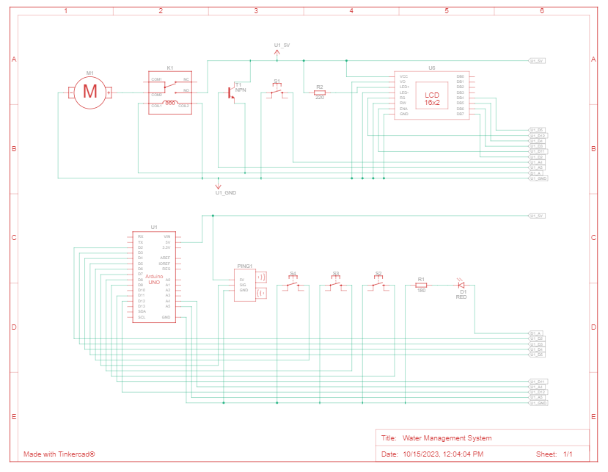
Arduino Integration

Slide 8
CODE IMPLEMENTATION
Python Script Development (On IoT Devices)
Python Script Development (On Central Server)
Hardware Components:
Raspberry Pi (or similar single-board computer)
Water Flow Sensor
Solenoid Valve (for controlling water flow)
Wi-Fi Module (for internet connectivity)
Power Supply
Software Components:
Python (for programming)
MQTT (for communication)
Cloud server (for data storage and remote control)
1. Set Up the Development Environment
2. Import Required Libraries
3. Initialize Device and Sensors
4. Data Collection
5. Data Processing
6. Data Transmission
7. Error Handling
8. Control Logic (If applicable)
9. Logging and Debugging
10. Power Management (If applicable)
11. Testing
12. Documentation
13. Integration with the Central Server
14. Deployment
1. Setting Up the Central Server Environment
2. Importing Required Libraries
3. Data Reception and Storage
4. Data Processing and Analysis
5. Data Visualization
6. User Authentication and Access Control
7. Error Handling and Logging
8. Remote Device Control Logic
9. Security Measures
10. Automation and Script Execution
11. Testing and Debugging
12. Documentation
13. Integration with IoT Devices
14. Deployment and Scaling

Slide 9
Mobile App Development
Objectives
Market Research
Technology Stack
Data Sources and Sensors
UI/UX Design
Feature Set
Backend Development
Mobile App Development
Data Analytics and Visualization
IoT Integration
Security and Privacy
Testing
User Testing
Launch and Marketing
Maintenance and Updates
Data Analysis and Feedback

Slide 10
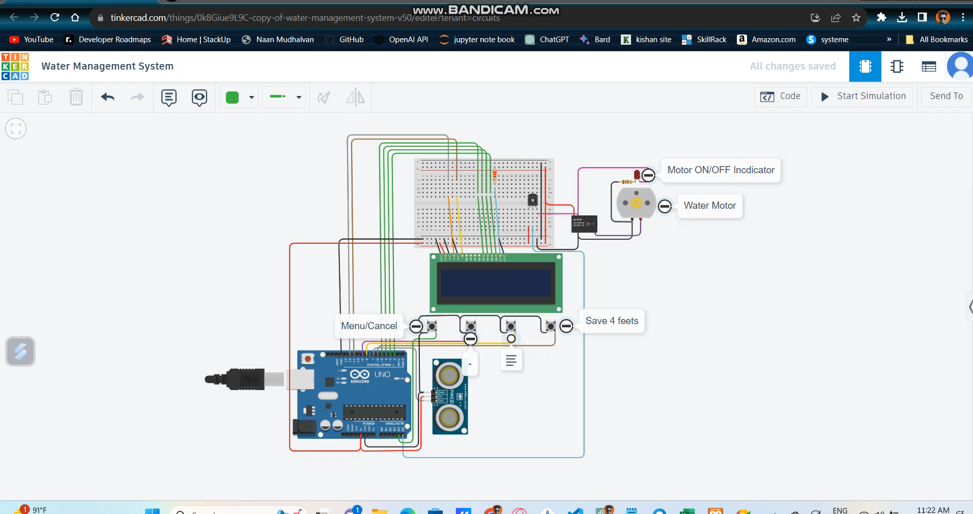
Implementation and Simulation (Watch the simulation video below)

Slide 11
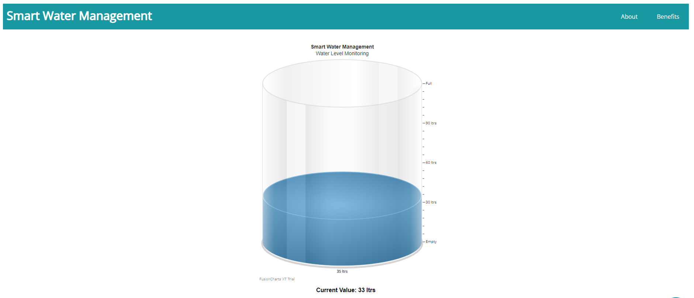
Real-Time Website
Click here to view code on GitHub
Click here to check my website

Slide 12
THANK YOU

