Slide 1

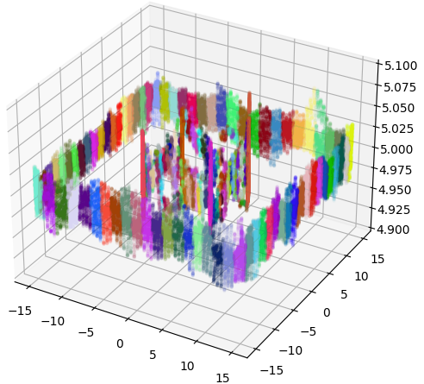
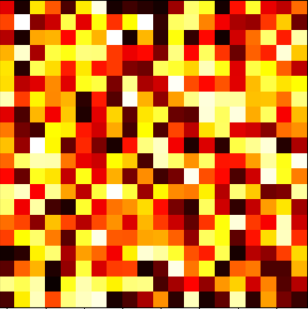
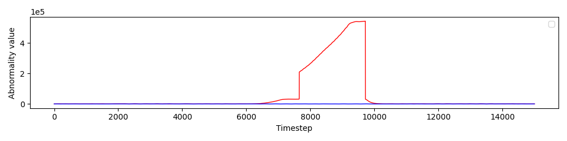
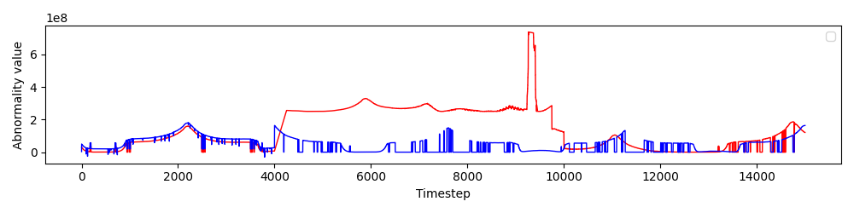
Towards Self-Awareness in Multi-Robot Systems
1
Framework
Clustering abstraction
2
Offline
learning
Exteroceptive
and
proprioceptive
data
Preprocessing
Proprioceptive DBN
Exteroceptive DBN
Create/update models
Simulation
3
Abnormality
detection
Cluster
transition
matrix
1
Online
inference
robot 2
GPS abnormality values for reference (blue) and test (red) scenarios
3
2
LIDAR abnormality values for reference (blue) and test (red) scenarios
robot 1
Test scenario
Coupled DBN

