Slide 1
Anomaly Detection in Multi-Robot Systems
Exploiting Self-Awareness
(FAIEMA 2023)
Mohammad Rahmani ¹ and Bernhard Rinner ²
¹ Doctoral School in Decision Making in a Digital Environment
² Institute of Networked and Embedded Systems

Slide 2

Introduction
Self-awareness (SA) is robots’ ability to model knowledge about “themselves,” in relation to the world
Robots use data from proprioceptive and exteroceptive sensors to build spatiotemporal models
In Multi-robot systems (MRS) such models could be also build about relations such as following
each other whenever there is a narrow corridor
To update or create models they need to detect abnormal experiences
Current
sensory observation
Most expected observation in
next timestep
GPS
model
Z_{t-1}
Z_{t}
This distance is a sample
abnormality
2
Z_{t}
LIDAR
observation
Exteroceptive sensors
Proprioceptive sensors

Slide 3
Motivation
Anomaly detection to make multiple robots able to detect new spatiotemporal relations
model
for 1
2
Create
a new model
for 2
Are we
experiencing
a new relation?
(high anomaly?)
yes
1
Training scenario
New scenario
3

Slide 4

Motivation | A self-aware framework for MRS
abstracting
state space
Offline
learning
Exteroceptive
and
proprioceptive
sensory data
Preprocessing
Create/update models
proprioceptive models
exteroceptive models
Anomaly
detection
Online
testing
anomaly
4

Slide 5
Related work
Markov Jump Particle Filter (MJPF) as spatiotemporal model
M. Baydoun et al “Learning switching models for abnormality detection for autonomous driving,”Conference on Information Fusion, 2018.
A hierarchical model applying Particle and Kalman filters based on dynamic Bayesian networks (DBN)
An SA framework based on MJPF in a single-robot system Regazzoni, B. Rinner et al, “Multisensorial generative and descriptive self-awareness models for autonomous systems,” Proc. of the IEEE 2020
Suggesting Coupled MJPFs as a spatiotemporal model in MRS M. Rahmani and B. Rinner, “Towards self-awareness in multi-robot systems,” in Proc. Austrian Robotics Workshop, 2022, pp. 1–2.
Uses Coupled MJPFs as spatiotemporal models in several scenarios for anomaly detection in MRS
Compares the results with single MJPF
Studies sensors’ noise impact anomaly detection ability
Studies impact of clusters number in state space on anomaly detection
This paper:
5

Slide 6
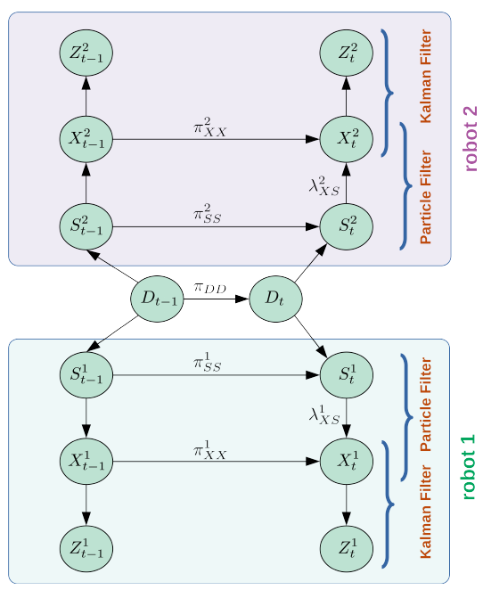
Methodology | Proposed spatiotemporal model
3-layer hierarchical model based on Coupled Dynamic
Bayesian Networks (CDBN)
Abstract layer (S) in which Particle filter is used for determining
the most probable abstract state
Continuous states (X) that uses a Kalman filter with a constant velocity vector for state estimation inside the abstract state
The interaction layer (D) couples robots for joint predictions
Joint
predictions
6

Slide 7
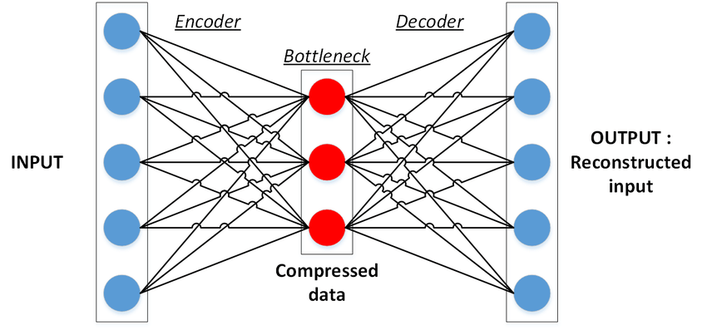
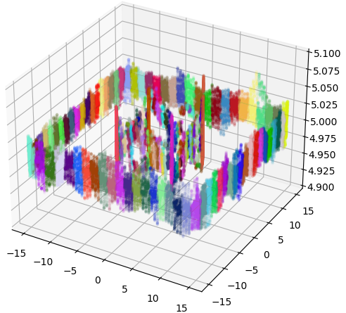
Methodology | Offline training
2
Reduce high dimensional LIDAR
data with neural auto-encoders
1
3
4
D
Cluster
sensor data
Cluster
sensor data
counting
Transition Matrix
for D Layer is learned
Simulate GPS and LIDAR data from a training scenario
Cluster sensory data to quasi-stationary segments
7

Slide 8
Methodology | Online inference
Robot 2
DBN
1. Transition matrix D 2. Live sensor data
High diffrence
btw observation
and prediction
Joint
prediction
High diffrence
btw observation
and prediction
Robot 1 DBN
New scenario
8

Slide 9
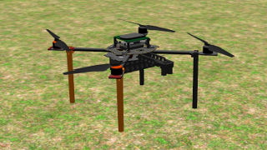
Experimental setup
Using Robot Operating System (ROS), Gazebo
and CTUMRS framework to simulate two Tarot t650 drones
GPS as proprioceptive sensor
281k sensory reading
AP2 LIDAR as exteroceptive sensor
720 dimensional sensory readings reduced to 3 using neural auto encoders.
120k sensory readings
Anomaly metric: Kullback–Leibler (KL) divergence between CDBN predictions and sensory observations
Tolerance: μ + 3σ of anomaly values in training scenario
9

Slide 10
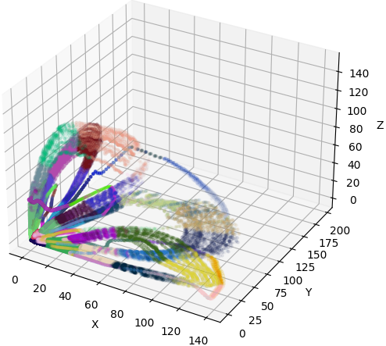
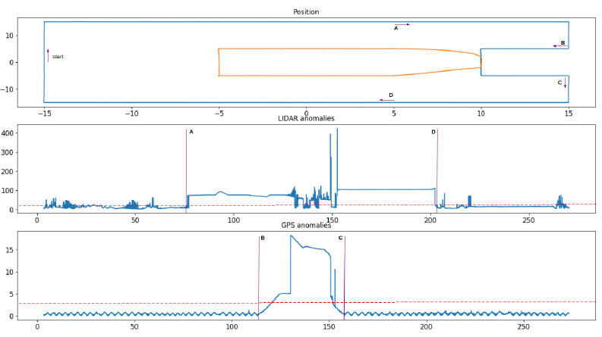
Results | CDBN
32 clusters, Gaussian noise 0.0002
LIDAR high anomalies happen before GPS high anomalies
Lidar clusters – reduced 3 dim
GPS clusters
10

Slide 11
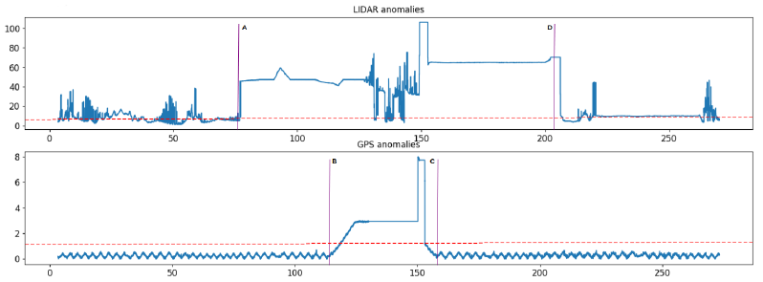
Aggregated DBN vs Coupled DBN
Robot 1 observation
Robot 2 observation
Aggregated Robot 1 & 2 observations
Aggregation suffers from curse of dimensionality and is not scalable
The anomaly values for GPS and LIDAR are 42% and 38% smaller respectively in aggregated approach vs CDBN
This could be interpreted as MRS’s less awareness of new experiences in aggregated approach vs CDBN
11

Slide 12
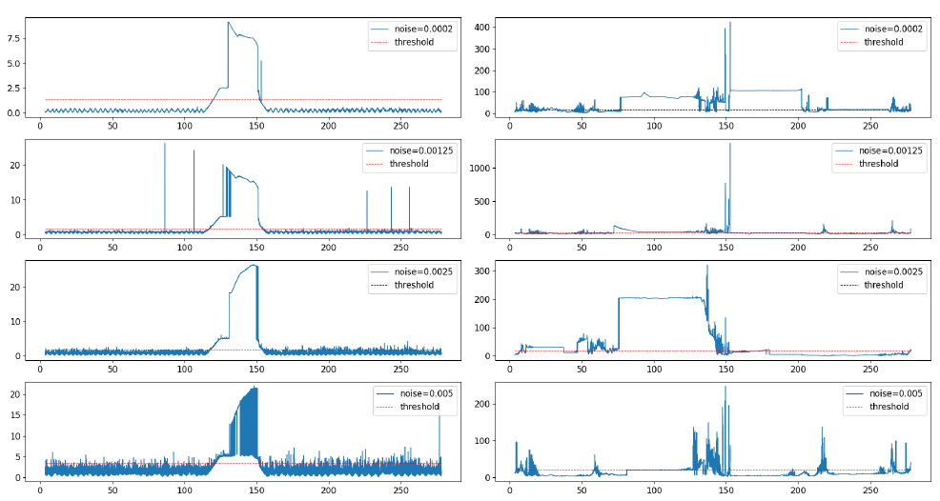
Noise impact on anomaly detection
CDBN learning rate reduces when using noisier sensors
12

Slide 13
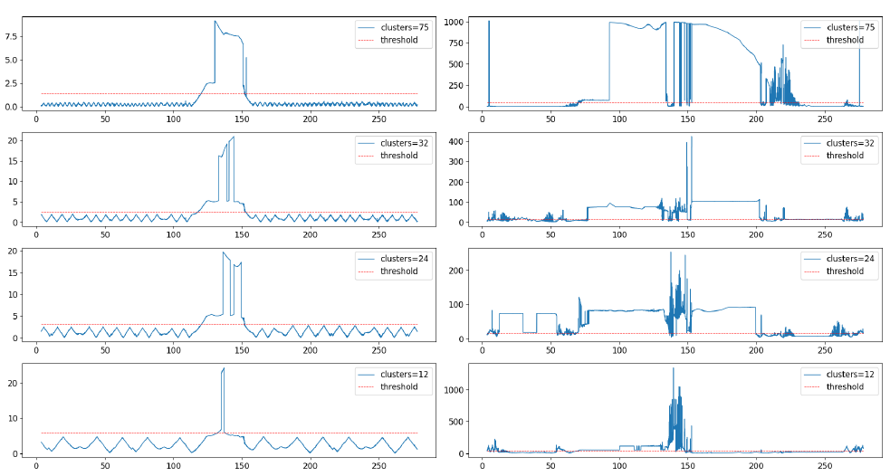
Number of clusters impact on anomaly detection
Higher clusters number improves anomaly detection performance
13

Slide 14
Conclusion
CDBNs performed as reliable spatiotemporal models in our simulations
They perform better than aggregated DBNs in anomaly detection
Higher sensor noise reduces their anomaly detection performance
Higher number of clusters increases their anomaly detection performance
Future work
Proposing an SA framework in MRS which includes
Pairing relevant exteroceptive and proprioceptive CDBNs
Creating and updating CDBNs in an MRS
Choosing the best predicting CDBN according to the most recent sensory observations in MRS
14

