Slide 1

Peter Donker
Create your own analytics engine
DNN Summit 2023

Slide 2
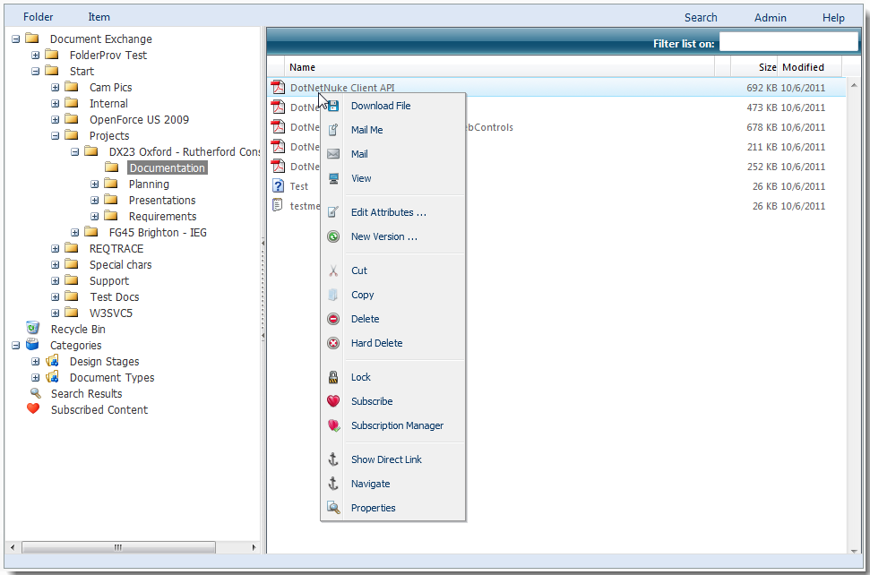
Bring2mind – Document Exchange

Slide 3
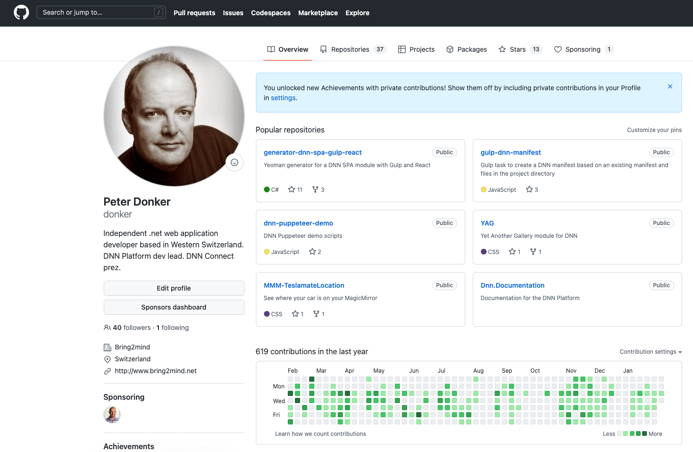
DNN – Dev Lead

Slide 4

DNN Connect

Slide 5
Monitoring your DNN installation
We can use Google, or we can “keep it in house”
Flexibility, data ownership, privacy concerns etc.
UsersOnline
Offload from DNN

Slide 6
What are the ingredients of this meal?
DNN events
MQTT
Node-Red
InfluxDb

Slide 7
MQTT
Messaging protocol from the 70s by IBM for monitoring industrial processes
TCP/IP port 1883
Just 3 elements to a message:
Topic
Message
QoS
Broker/clients
Pub/Sub

Slide 8
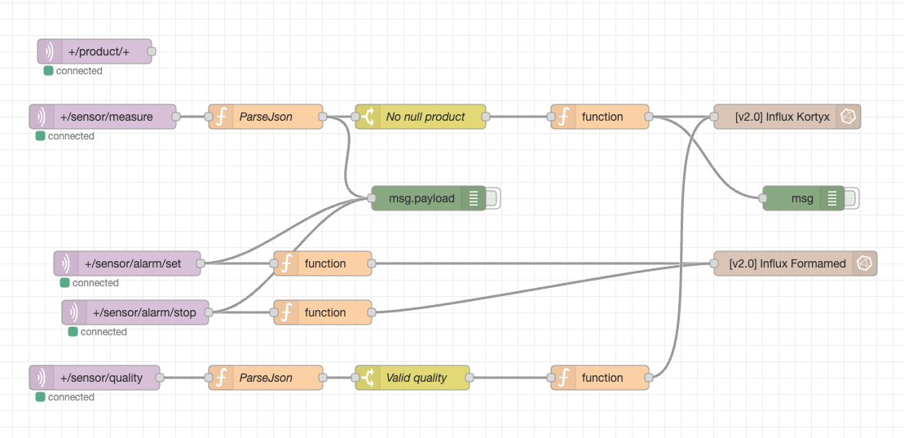
Node-Red
Wire stuff together graphically

Slide 9
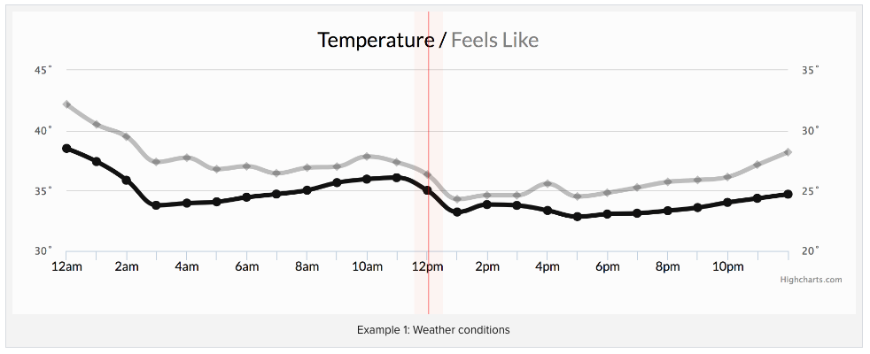
InfluxDb
Database technology optimized for time series data

Slide 10
Node-Red
InfluxDb
MQTT
DNN
MQTT
MQTT Broker
Grafana

Slide 11
Let’s dive in
http://demo.bring2mind.ch/

Slide 12
Useful links
https://github.com/SensorsIot/IOTstack
https://nodered.org/
https://www.influxdata.com/
https://mosquitto.org/

Slide 13
Questions?

