Slide 1
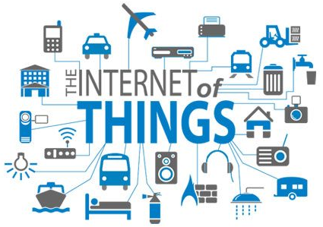
Unit – 1 Fundamentals of IoT
Lecture 1
Dr.R.Saranya/CUTN

Slide 2
Plan of Lecture 1
What is IoT?
How and Why IoT?
How IoT works?
Electronics for the Internet of Things
IoT Market – Future prospect of IoT
Threat vs. Opportunity
IoT tools

Slide 3
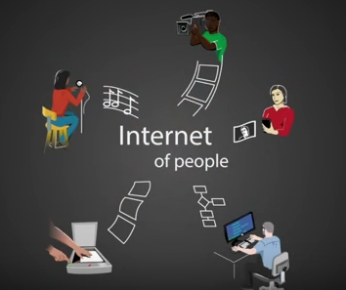
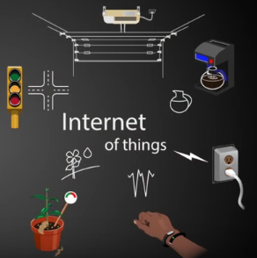
What is it that makes something 'Internet of Things‘ and Why does it matter?

Slide 4
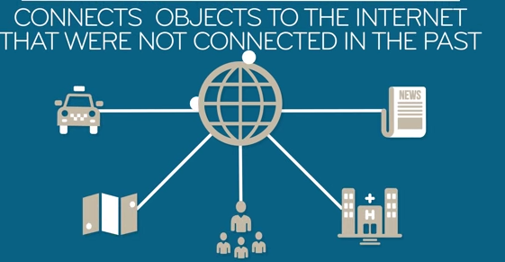
What is IoT ?
IoT - about connecting devices over the internet, letting them talk to us, and each other.
It is also refers to the Internet of Objects – Wireless networks between these objects.
CISCO - The NEXT REVOLUTION OF INTERNET - Internet of everything

Slide 5
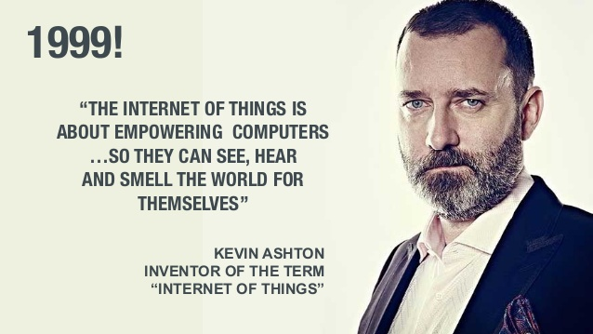
How and Why IoT?
We want to receive more data.
We want to control stuff.
We want to automate.
We want to make things faster.
Anything, Anywhere, Anytime, Anyway, Anyhow (5 A’s)

Slide 6
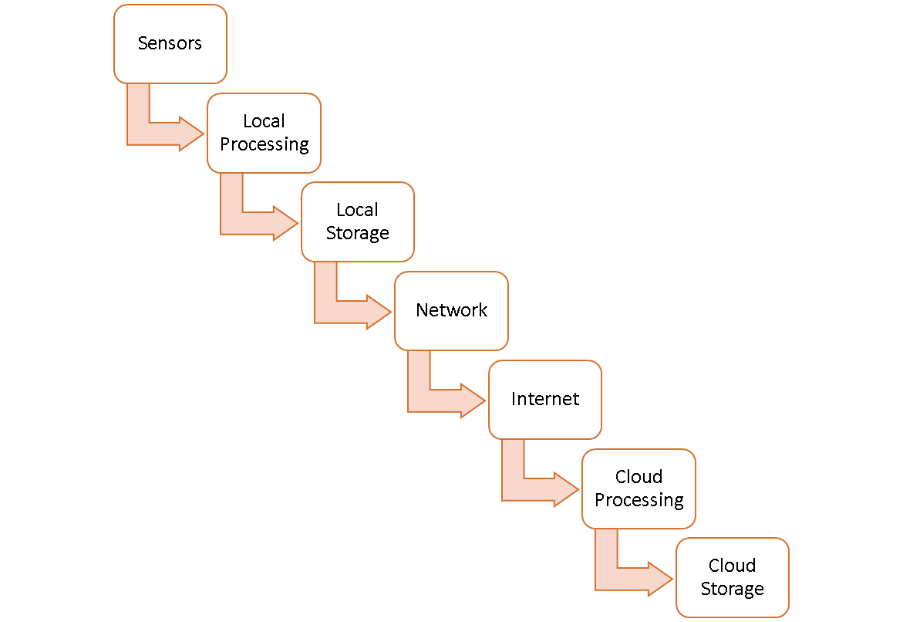
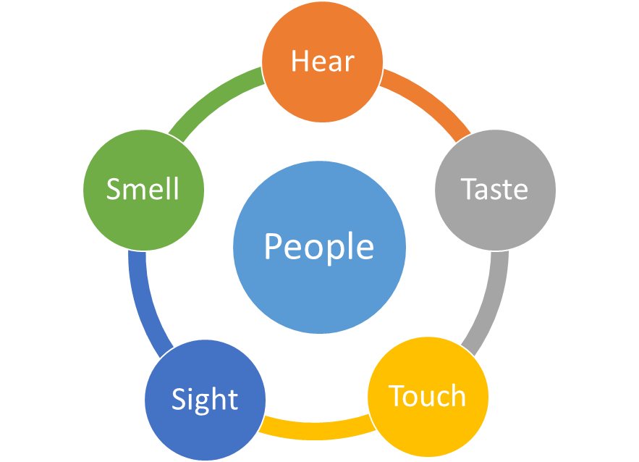
How IoT Works ?
Things
+
Sense & Communicate

Slide 7
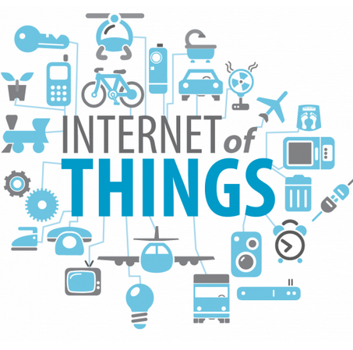
Electronics for the Internet of Things
Sensors
Local Processing and Local Storage
Network and Internet
Cloud Processing and Storage

Slide 8
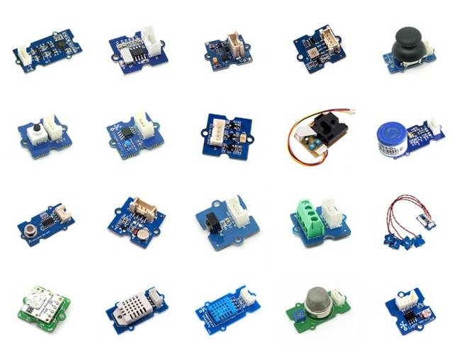
Sensors
Small device , used to measure the data.
An electronic device that produces electrical, optical, or digital data derived from a physical condition or event.
Sense the physical environment.
Do little or no processing.
Consume Low power.

Slide 9
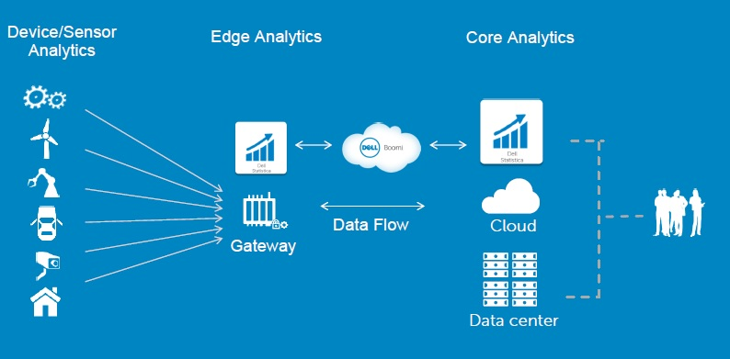
Local Processing and Local Storage
Get data from Sensors
Process
Upload available data to the cloud
Edge Computing

Slide 10
Network and Internet
IoT Gateway.
Gathers data from sensors routers, bridges in different topologies, including LAN, MAN and WAN.
Connecting the different parts of networks to the sensors can be done by different technologies including Wi-Fi, Bluetooth, Low Power Wi-Fi , Wi-Max, regular Ethernet , Long Term Evolution (LTE) and the recent promising technology of Li-Fi.
Protocols
CoAP, MQTT ,HTTP and XMPP.

Slide 11
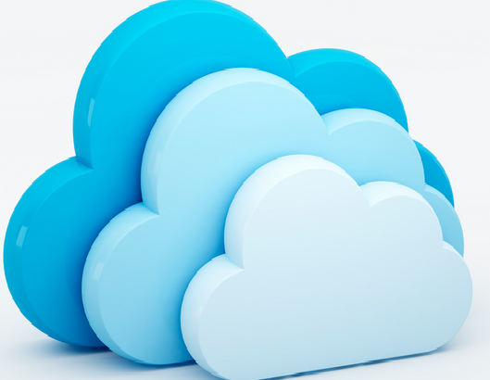
Cloud Processing and Storage
Aggregate the data
Storage
Inferences

Slide 12
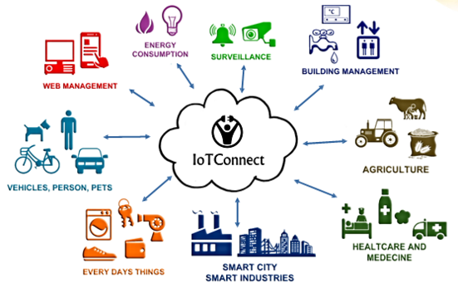
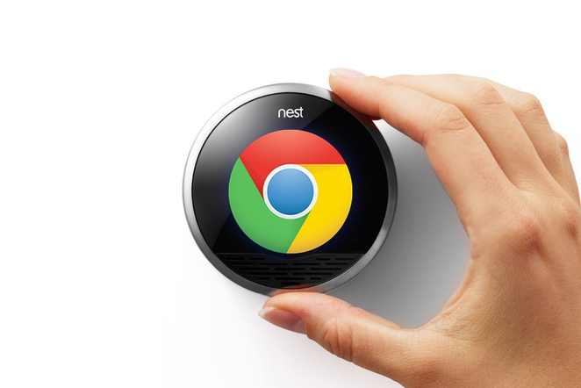
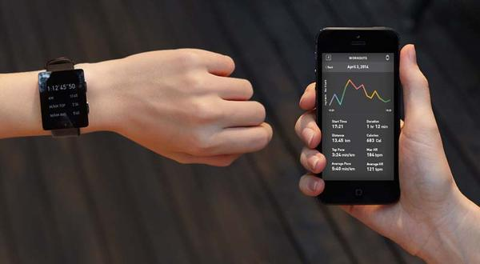
IoT Applications
IoT is about finding new ways to benefit from Technology around us
https://www.youtube.com/watch?v=OzZBVOF8u-0

Slide 13
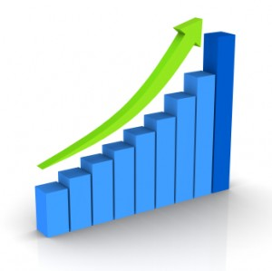
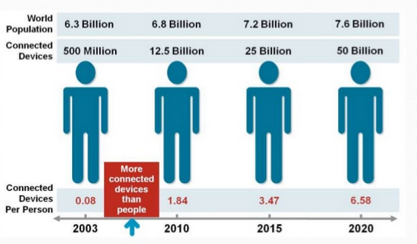
IoT Market – Future Prospect of IoT
As of 2015, 25 billion IoT units.
Expected to grow to 50 billion IoT devices by 2020
Revenue growth from $3.9 trillion in 2015 to $10.1 trillion in 2020

Slide 14






Threat vs. Opportunity
If misunderstood and misconfigured – Threat
If understood and secured –Opportunity
https://www.youtube.com/watch?v=UMTTaMPJ8fc
  Sensing a complex environment
  Connectivity
  Security is vital
  IoT is complex
  Cloud is important

Slide 15
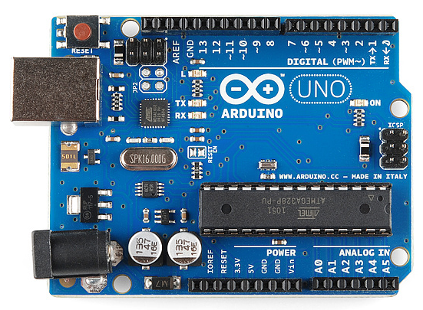
IoT development tools
IoT – open source hardware
Arduino
Open source , small programmable device.
Easily connectable
Simple to use as software

Slide 16
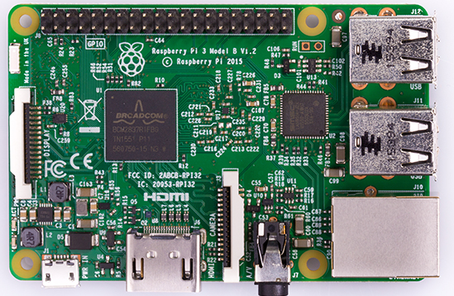
IoT – open source hardware
Raspberry Pi
General purpose computer
Runs Linux – Raspbian OS ( Linux OS)
More software oriented programming
Full Networking system
https://www.raspberrypi.org/

Slide 17
IoT Simulation boards ( Virtual Lab)
https://www.youtube.com/watch?v=spExcgLAjFg
TinkerCad , NetSim (Open Source)
https://www.youtube.com/watch?v=spExcgLAjFg
Listen to the following video ( Arduino vs. Raspberry pi)
https://www.youtube.com/watch?v=p40OetppIDg

Slide 18
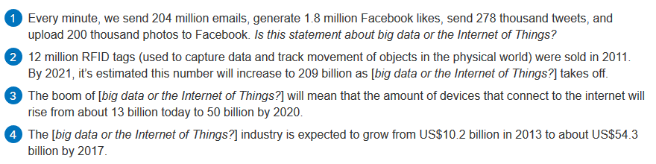
IoT – Research Directions
Big data and IoT

Slide 19
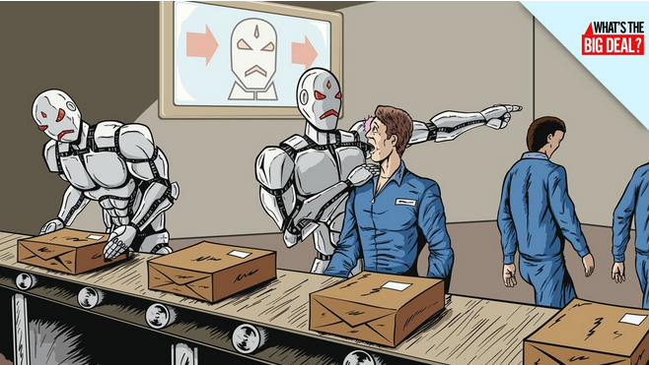
Impact on Jobs
Will Human lose their jobs to robots !!!

Slide 20
References
Distributed and Cloud Computing, From Parallel Processing to the Internet of Things Kai Hwang, Geoffrey C Fox, Jack G Dongarra, Morgan Kaufmann Publishers, 2012.
Arshdeep Bahga, Vijay Madisetti, “Internet of Things – A hands-on approach”, Universities Press, 2015.
Marco Schwartz, “Internet of Things with the Arduino Yun”, Packt Publishing, 2014
"Internet of Things: Science Fiction or Business Fact?" Harvard Business Review. November 2014. Retrieved 23 October 2016.

Slide 21
References
https://www.varonis.com/blog/the-mirai-botnet-attack-and-revenge-of-the-internet-of-things/
https://www.youtube.com/watch?v=OzZBVOF8u-0
https://www.automationworld.com/
https://www.networkworld.com/
https://www.wearable-technologies.com/2018/11/this-wearable-patch-detects-stress-hormone-in-sweat/

Slide 22
“If you think that the internet has changed your life, think again. The IoT is about to change it all over again!”
Thank you

