Slide 1
Societal Benefits of IoT
Dr.R.Saranya
AP/CS/CUTN

Slide 2
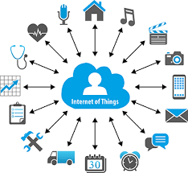
Top applications
Traffic Monitoring
Smart Home
Health care
Disaster Management
“ The Ultimate Goal of IoT is to Automate the Human life”

Slide 3
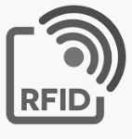
Traffic Monitoring
SMART TRAFFIC MANAGEMENT SYSTEM
Sophisticated Sensors and Chips embedded in road.
RFID tags -
RFID tag based Zone (Object) Detection System (UK) – Anti-collision system
INTELLIGENT TRANSPORTATION SYSTEMS (ITS) - China
  It’s an integrated technology (Sensor and AI) used to manage mixed traffic and guarantee traffic safety.
  3D - GIS technology and Dynamic forecasting technology (Intelligent Information boards (IIBoard)
  IIBoards are used to release nearly two million real-time traffic information every day to the public via text, graphics, and video and also broadcast TV stations.

Slide 4
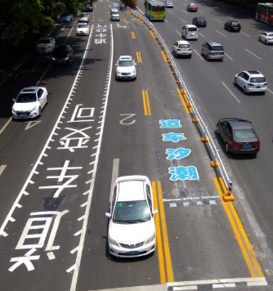
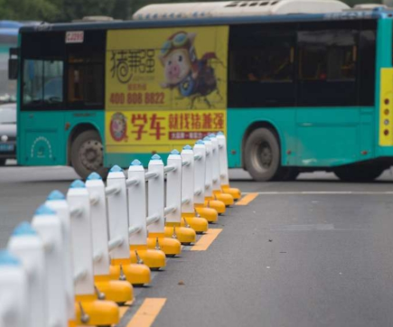
Traffic Monitoring
SMART TRAFFIC MANAGEMENT SYSTEM
LANE ROBOT SYSTEM - Shenzhen
  In Shenzhen - mobile robots to reduce road congestion - Machine – controlled Guard rail
https://www.youtube.com/watch?v=mCAPKvZ_5m4

Slide 5
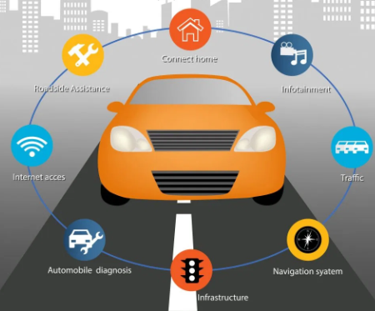
Traffic Monitoring
SMART TRAFFIC MANAGEMENT SYSTEM
CONNECTED CARS (V2V – VEHICLE TO VEHICLE)
  It uses embedded sensors and Wireless sensor networks and WiMAX accessing system, In – Car connectivity using RFID, BLE, Zigbee , GPS,Cloud based storage and processing
  Purpose
  Road Side Assistance
  Can connect with other cars for notifying collision warning)
  Monitors the car for fuel and oil levels, and tracks it in the event of a theft.

Slide 6
Traffic Monitoring
SMART TRAFFIC MANAGEMENT SYSTEM
ROAD SIDE DETECTION USING LOW COST EMBEDDED PC (RASPBERRY PI 3)
  Algorithm for a roadside detection and tracking - changing texture of a road from the centre to the road side.
  Methodology - Logitech C920 USB based 3D Projection cameras are mounted on the dashboard and from its intrinsic parameters Region Of Interest (ROI) of the road appearance.
  Hough transform Opencv and Raspberry pi - fixed at the centre of dashboard to detect road ahead
  Purpose
  Used in road side detection and real time tracking of Autonomous car.
  Used both as road map modelling.

Slide 7
Traffic Monitoring
SMART TRAFFIC MANAGEMENT SYSTEM
VANET BASED SAFETY AND ROUTE PLANNING METHOD
VANET (Vehicular Ad hoc Networks) used such as route discovery , emergency
i) Improved Road Safety
(ii) Complete driver support system (Co-operative driving) by auto - interpretation of real time information.
(iii) Enhanced and optimized route guidance
(iv) Alert the vehicles with best QoS with collision warning (post – crash), traffic warning lane change assistance
(v) Reliable emergency service

Slide 8
Traffic Monitoring
SMART TRAFFIC MANAGEMENT SYSTEM
COMPUTER VISION BASED VEHICLE DETECTION AND COUNTING SYSTEM
Traffic management system by using video based method for analysis and interpretation of images on the videos captured by a digital camera.
Predict dangerous situations (accidents, vehicles that go off the road and so on) that trigger an automatic warning to the vehicles

Slide 9
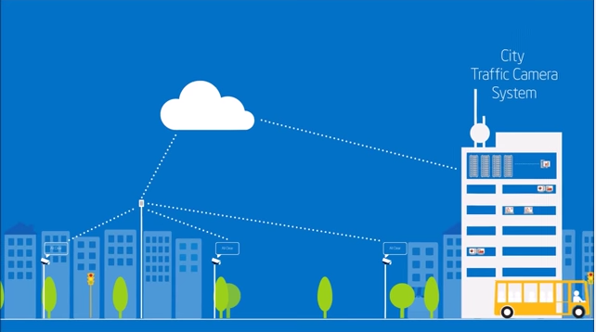
Traffic Monitoring
SMART TRAFFIC MANAGEMENT SYSTEM
Intelligent Smart Traffic Camera – Congestion ,Accidents, Weather.
Refer the report given by me for more understanding on applications side

Slide 10
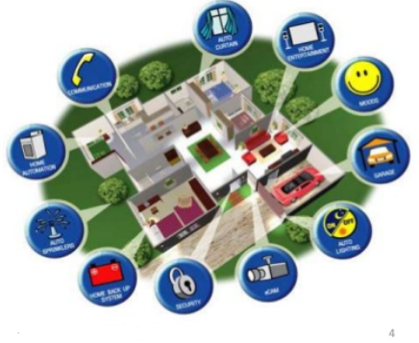
Smart Home
Smart Home has become the revolutionary ladder of success in the residential spaces and it is predicted Smart homes will become as common as smartphones.
Smart Home products are promised to save time, energy and money.
Network Interconnected
Internet with high speed broadband
Highly automated
Light control
Climate Control
Improve Comfort
Ensure Security

Slide 11
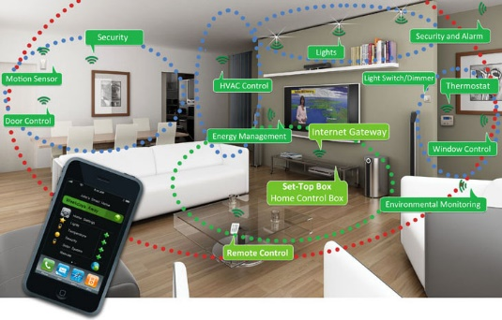
Life gets Simplified with connected Devices

Slide 12
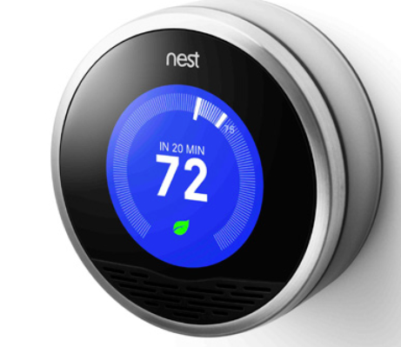
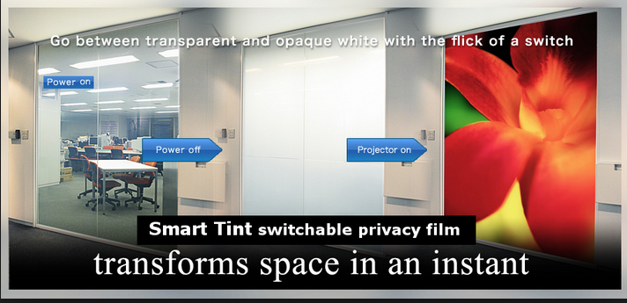
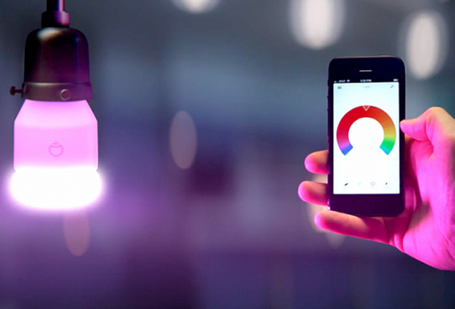
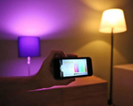
Smart Window , Smart light bulbs and Nest

Slide 13
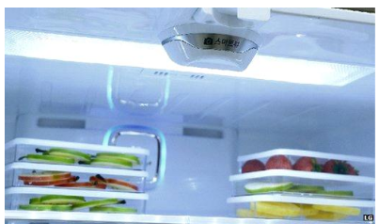
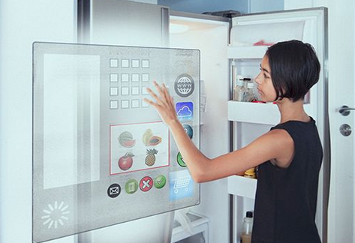
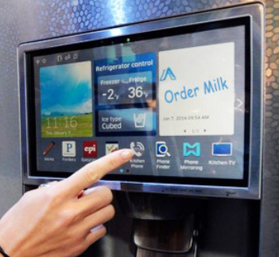
Internet Refrigerator – A typical IoT
Internet refrigerator with built in camera and RFID tag

Slide 14
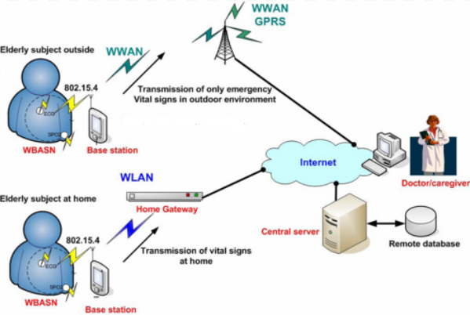
Health Care (IoHT – Internet of Health care Things)
Transform medical data into insights for smarter patient care.
Mobile medical applications or wearable devices that allow patients to capture their health data.
Measuring the heartbeat, body temperature or recording a prolonged electrocardiogram (ECG).
Body area network ( BAN) / BSN ( Body Sensor Network)

Slide 15
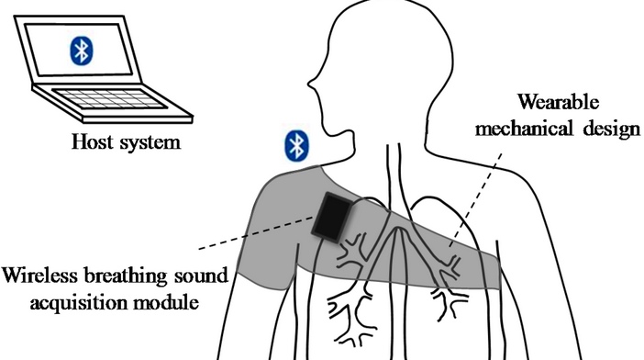
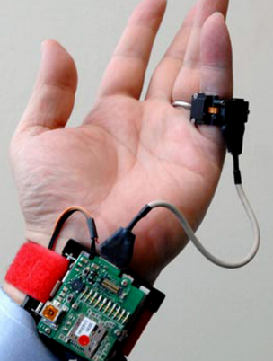
IoT in Healthcare industries
Remote patient monitoring
Personalizing treatment – ambient assisted living
Improving outcomes, and lowering healthcare costs
Chronic disease Management.

Slide 16
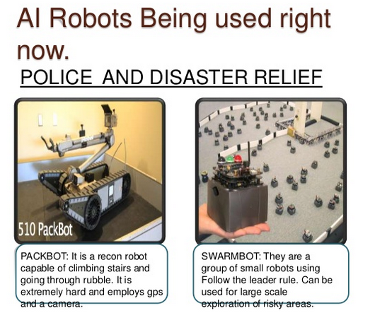
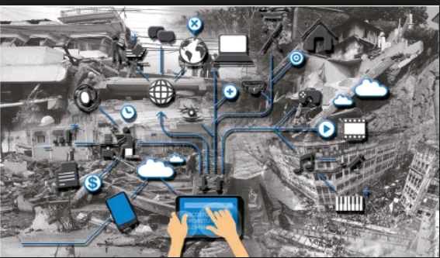
IoT in Disaster Management
Natural
Environmental
Complex

Slide 17
References
https://users.cs.fiu.edu/~carbunar/detection.pdf
https://www.researchgate.net/publication/315808980_RFID-based_Object_Detection_System_in_IoT
https://ieeexplore.ieee.org/document/7263640
Distributed and Cloud Computing, From Parallel Processing to the Internet of Things Kai Hwang, Geoffrey C Fox, Jack G Dongarra, Morgan Kaufmann Publishers, 2012.
Arshdeep Bahga, Vijay Madisetti, “Internet of Things – A hands-on approach”, Universities Press, 2015.
Marco Schwartz, “Internet of Things with the Arduino Yun”, Packt Publishing, 2014
"Internet of Things: Science Fiction or Business Fact?" Harvard Business Review. November 2014. Retrieved 23 October 2016.

