Slide 1
Physical Design of IoT
IoT Protocols
BY Dr.R.Saranya

Slide 2
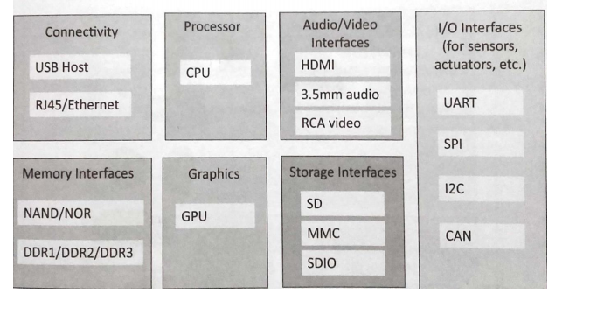
Physical Design of IoT

Slide 3
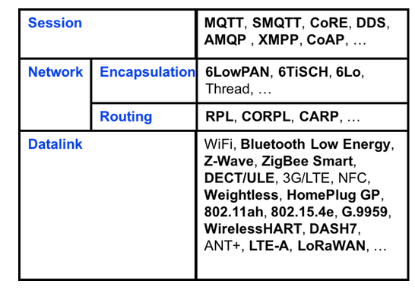
IoT Standard Protocols
Protocol Stack

Slide 4
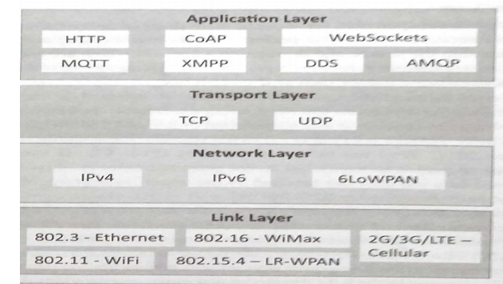
IoT Protocols

Slide 5
Physical and Data link Protocols ( Link layer Protocols)
Bluetooth Low Energy (LE) ( Bluetooth Smart) – IEEE 802.15.1
  Short range communication protocol with PHY and MAC layer.
  Its low energy can reach ten times less than the classic one.
  It follows master/slave architecture.
    Offers two types of frames: Advertising and Data frames.
    The Advertising frame is used for discovery and is sent by slaves .
    Master nodes sense advertisement channels to find slaves and connect them.
Frequency: 2.4GHz (ISM) ,Range: 50-150m (Smart/BLE) ,Data Rates: 1Mbps (Smart/BLE)

Slide 6
Link layer Protocols
ZIgBee - IEEE 802.15.4
Used for large range of IoT applications including smart homes, remote controls and healthcare systems – low rate wireless PAN - 65,000 devices
It supports a wide range of network topologies including star, peer-to-peer, or cluster-tree.
Multi hop routing
ZigBee standard defines two stack profiles: ZigBee and ZigBee Pro. These stack profiles support full mesh networking and work with different applications allowing implementations with low memory and processing power.
Frequency: 2.4GHz
Range: 10-100m
Data Rates: 250kbps

Slide 7
Link layer Protocols
Z-Wave
Z-Wave is a low-power MAC protocol designed for home automation and has been used for IoT communication, for smart home and small commercial domains. - 232 smart devices on its mesh network
It covers about 30-meter point-to-point communication and is suitable for small messages in IoT applications, like light control, energy control, wearable healthcare control and others.
Master/ Slave - scheduling of the whole network.
Frequency: 900MHz (ISM) ,Range: 30m ,Data Rates: 9.6/40/100kbit/s

Slide 8
Link layer Protocols
WiFi – 802.11
  Wireless communication standard for link layer.
  802.11a – 5GHz band 802.11b and 802.11g – 2.4 GHz
  802.11n – 2.4/5GHZ
  Data rate – 1mbps to 6.75Gb/s
Others : 802.16,802.3,2G/3G/4G/5G – mobile communication - 2G – GSM and CDMA, 3G- UMTS and CDMA2000,4G LTE,5G

Slide 9
Network / Internet Layer and Transport Layer
IPv4 – 32 bit addressing scheme with 2^{^32} addresses
IPv6 – 128 bit addressing scheme with 2^{^128} addresses
6LoWPAN - IPv6 over Low power Wireless Personal Area Networks. It is an adaption layer for IPv6 over IEEE 802.15.4 links.
  This protocol operates only in the 2.4 GHz frequency range with 250 kbps transfer rate.
TCP and UDP

Slide 10
Session & Application Layer
HTTP
Foundation of WWW.
Commands like GET,PUT,POST,DELETE,etc.
Request – Response Model
Stateless
Uses URI

Slide 11
IoT Protocol Taxonomy
D2D - Devices must communicate with each other e.g. DDS
D2S- Device data then must be collected and sent to the server infrastructure (D2S) , Eg.MQTT and CoAP ,XMPP
S2S-Server infrastructure has to share device data (S2S), possibly providing it back to devices, to analysis programs, or to people. E.g., AMQP

Slide 12
Application Layer
MQTT - Message Queue Telemetry Transport
1999 by IBM
Publish/Subscribe messaging protocol - lightweight M2M communications(A hub-and-spoke architecture)
Purpose :
  Simple messaging protocol for Constrained devices , Low bandwidth .
Large networks of small devices that need to be monitored or controlled from the cloud.
Remote device data collection and transport to IT structure .(Collect device Data) - Telemetry, or remote monitoring.
D2S – Device to Server Infrastructure

Slide 13
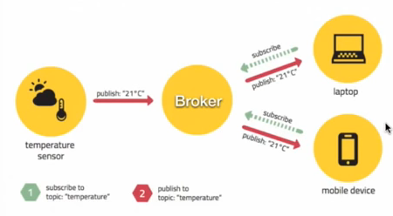
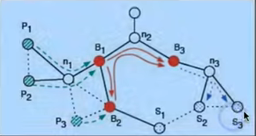
MQTT - PUBLISH SUBSCRIBE MODEL
Three main components:
Publishers – senders of the message
Message brokers – Middleman ( filters all messages and distribute accordingly)
Subscribers – Specific receivers
E.G : WSN P nodes – sensor nodes
B nodes – broker nodes
N nodes – collection nodes

Slide 14
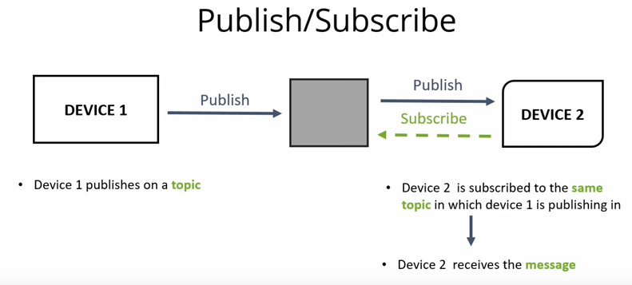
MQTT - PUBLISH SUBSCRIBE MODEL

Slide 15
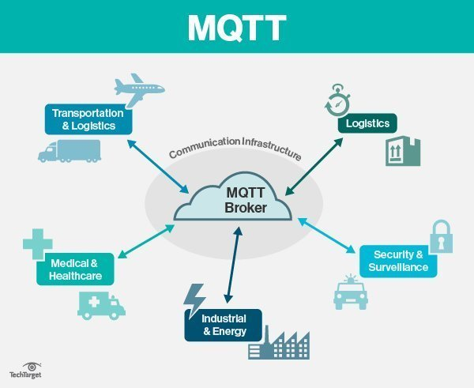
MQTT
Applications :
Facebook
Most major cloud services providers, including AWS, Google Cloud, IBM Bluemix , Amazon.

Slide 16
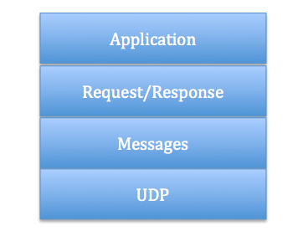
CoAP
CoAP - Constrained Application Protocol
Used for low-power compute-constrained devices can operate in the internet of things .
CoAP is specified in IETF RFC 7252.
Smart energy and building automation.
D2S

Slide 17
CoAP -Message Layer model
Supports 4 types message:
CON (confirmable)
NON (non-confirmable)
ACK (Acknowledgement)
RST (Reset)

Slide 18
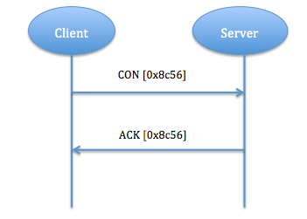
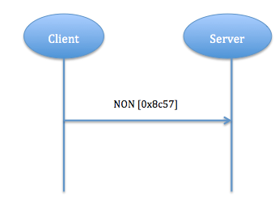
CoAP -Message Layer model
Reliable message transport Unreliable message transport

Slide 19
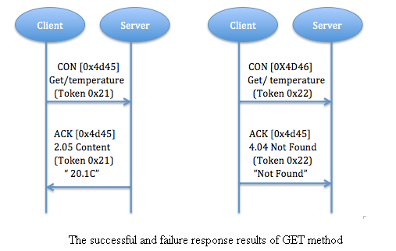
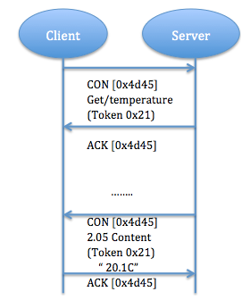
CoAP - Request/Response Layer model
Piggy-backed Separate response

Slide 20
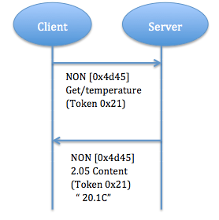
CoAP - Request/Response Layer model
Non confirmable request and response

Slide 21
XMPP – Access Device Data
Stands for Extensible Messaging and Presence Protocol
Jabber Protocol - was developed for instant messaging (IM) to connect people to other people via text messages .
Targeted use: presence, meaning people are intimately involved.
Uses the XML text format.
In the IoT context, XMPP offers an easy way to address a device
D2S
Applications : To connect your home thermostat to a Web server so you can access it from your phone.
Whatsapp (Ejabberd), Google Talk, FB Messenger and other instant messaging, multi-party chat.

Slide 22
AMQP- S2S
Stands for Advanced Message Queuing Protocol (AMQP)
It sends transactional messages between servers.
As a message-centric middleware that arose from the banking industry, it can process thousands of reliable queued transactions.
Communications from the publishers to exchanges and from queues to subscribers use TCP, which provides strictly reliable point-to-point connection.
Endpoints must acknowledge acceptance of each message.
AMQP is mostly used in business messaging.

Slide 23
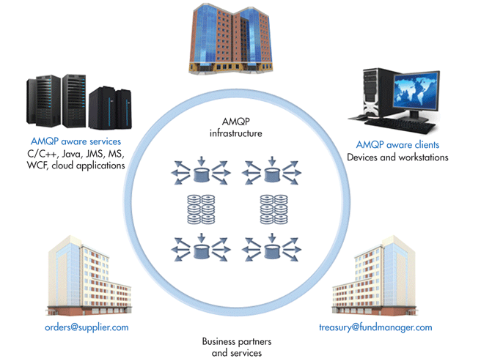
AMQP- S2S

Slide 24
References
Distributed and Cloud Computing, From Parallel Processing to the Internet of Things Kai Hwang, Geoffrey C Fox, Jack G Dongarra, Morgan Kaufmann Publishers, 2012.
Arshdeep Bahga, Vijay Madisetti, “Internet of Things – A hands-on approach”, Universities Press, 2015.
Marco Schwartz, “Internet of Things with the Arduino Yun”, Packt Publishing, 2014
"Internet of Things: Science Fiction or Business Fact?" Harvard Business Review. November 2014. Retrieved 23 October 2016.
https://www.automationworld.com/
https://www.networkworld.com/

