Slide 1
Logical design
Dr.R.Saranya

Slide 2
Logical Design of IoT
Refers to an abstract representation of the entities and the processes
Topics
IoT Functional blocks
IoT Communication Models
IoT Communication APIs

Slide 3
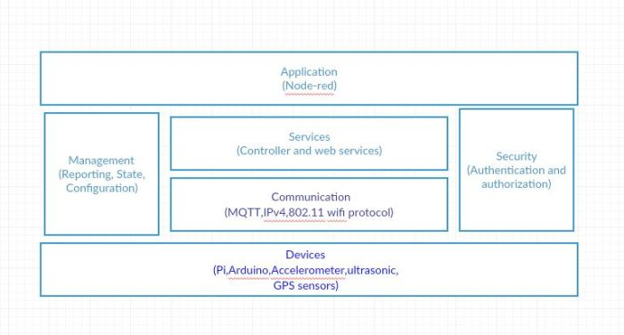
Logical Design of IoT
IoT Functional blocks

Slide 4
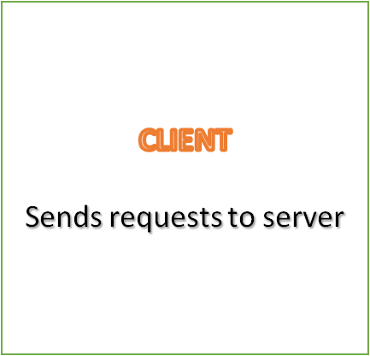
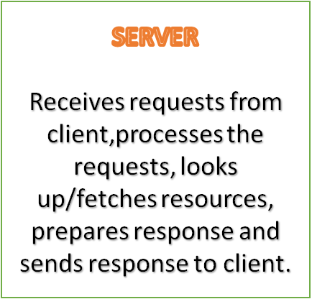

Logical Design of IoT
Iot Communications Models
Request – Response Model – It is a stateless communication model and each request – response pair is independent of each other.
Request
Response

Slide 5
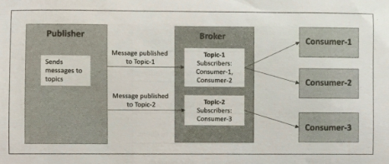
Iot Communications Models
Publisher _ Subscribe interaction model– involves publishers, brokers and consumers.
Publisher – Send data to the topics managed by broker.
Consumer – subscribe to the topics which are managed by broker.

Slide 6
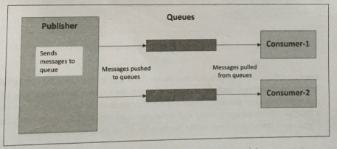
Iot Communications Models
Push – Pull model
Data producers – push the data to queues
Consumers – pull the data from queues
Purpose of queue
Used as a buffer to avoid mismatch between the pushing and pulling data.

Slide 7
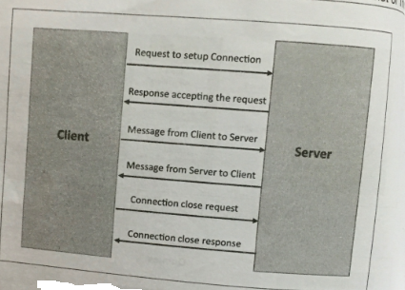
Iot Communications Models
Exclusive pair
It is a stateful ,bi-directional,fully duplex communication model.
Uses the persistent connection between client and server ( server is aware of all the open connections.

Slide 8
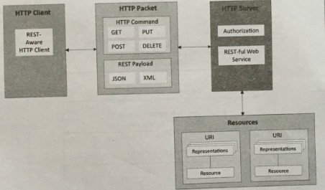
IoT Communication APIs
Representational State Transfer(REST) – based Communication API

Slide 9
IoT Communication APIs
REST – based Communication API
It is a set of architectural principles to design web services and APIs that focus on system resources and how resource sates are addressed and transferred.
REST architectural constraints are :
Client – Server :
The principle behind the client server constraint is the separation of concerns.
Separation allows client and server to be independently developed and updated.

Slide 10
REST – based Communication API
b) Stateless
Each request from client to server must contain all the information used to understand the request.
c) Cache – able
Cache constraints requires that the data within a response to a request be implicitly or explicitly labeled as cache able or non – cache – able.
d)Layered System
It constrains the behaviour of components.

Slide 11
REST – based Communication API
Uniform Identifier
This constraint requires that the method of communication between a client and a server must be uniform.
Code on demand ( optional)
  Servers provide executable code or scripts for clients to execute in their context.

Slide 12
RESTful web service
RESTful web service is a “web API” implemented using HTTP and REST principles
RESTful web service – collection of resources represented by URIs
Client send request using methods of HTTP ( GET,PUT,POST)
It supports various internet media types.

Slide 13
Web Socket based Communication APIs
It allows bidirectional, full duplex communication between clients and servers.
Web Socket communication – WebSocket handshake ( request sent over HTTP and the server interprets it as an upgrade request)
WebSocket API reduces network traffic and latency.
Best suited for IoT applications which have low latency / high throughput requirements.

Slide 14
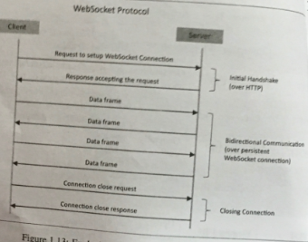
Exclusive pair model for WebSocketAPI

Slide 15
References (Acknowledments)
Arshdeep Bahga, Vijay Madisetti, “Internet of Things – A hands-on approach”, Universities Press, 2015.
"Internet of Things: Science Fiction or Business Fact?" Harvard Business Review. November 2014. Retrieved 23 October 2016.
https://www.automationworld.com/
https://www.networkworld.com/

