Slide 1
IoT Levels
Dr.R.Saranya

Slide 2
IoT Components
Device – Remote sensing and monitoring
Resource – accessing, processing and storing sensor information
Controller service – native service that runs on device and interacts with web services.
Database – storing the data generated by IoT device
Analysis component – done either locally or cloud
Application – provide an interface for the users to control and monitor various aspects of IoT system.

Slide 3
IoT Components
Web Service – can be implemented using REST service or WebSocket service.
REST | WebSocket
a)Stateless b) Unidirectional c) Request Response d) TCP Connection – each HTTP request involved for a new tcp connection | Stateful Bidirectional Full Duplex Single tcp

Slide 4
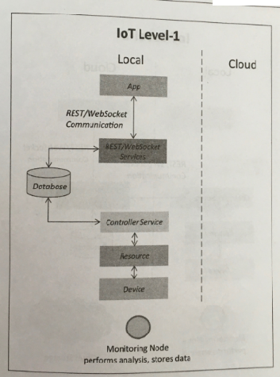
IoT Levels
IoT Level – 1
  This IoT system has sinlge node / device – sensing, actuation, stores data, perform analysis and host the application .
  For modelling low cost and low complexity solutions
  Example – IoT for home automation

Slide 5
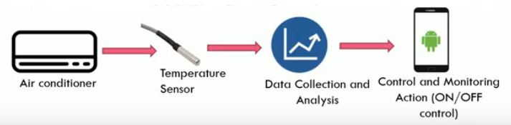
IoT Level – 1 Example
One Sensor / Device to sense
Data stored & analyzed locally

Slide 6
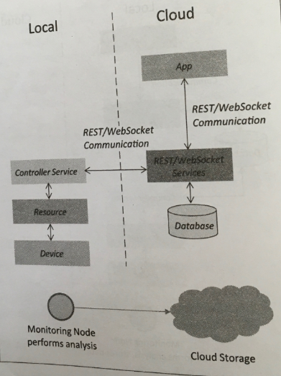
IoT Levels
IoT Level – 2
  This IoT system has single node / device – sensing, actuation and local analysis.
  Data is stored in cloud and application is cloud based.
  For modelling big data and low complexity solutions (done locally)
  E.g. IoT for smart irrigation

Slide 7
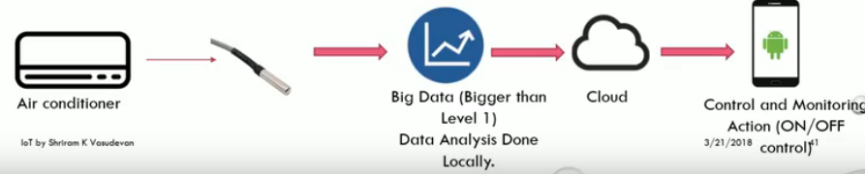
IoT Level – 2 Example
Sensing the data is faster
Analysis is done locally
Cloud storage is the preferred choice

Slide 8
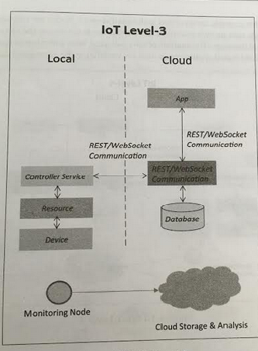
IoT Levels
IoT Level – 3
  This IoT system has single node.
  Data is stored and analysed in cloud and application is cloud based.
  For modelling big data and analysis requirement are computationally intensive.
  E.g. IoT for tracking package handling.

Slide 9
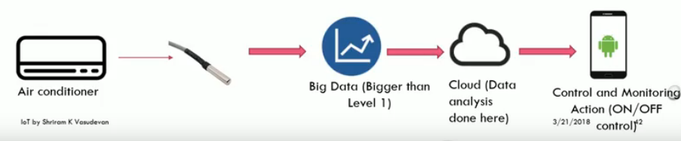
IoT Level – 3 Example
Sensing the data is faster
Analysis and Storage – Cloud

Slide 10
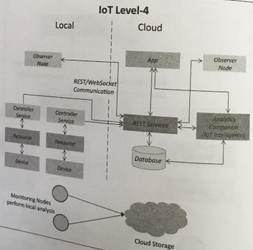
IoT Levels
IoT Level – 4
  This IoT system has multiple nodes perform local analysis.
  Data is stored in cloud and application is cloud based.
  Has local and cloud based observer nodes.
  Observer node – process information ,do not perform any control functions
  For modelling big data and analysis requirement are computationally intensive.
  E.g. IoT for noise monitoring

Slide 11
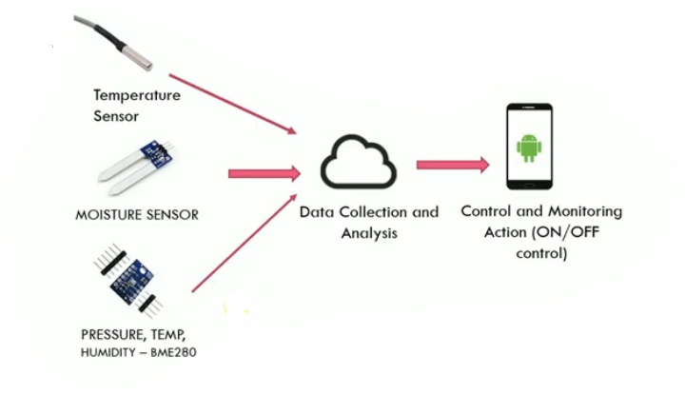
IoT Level – 4 Example

Slide 12
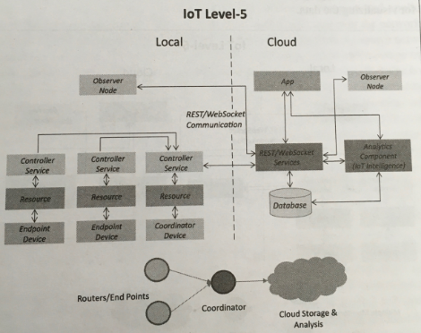
IoT Levels
IoT Level – 5
  This IoT system has multiple end nodes and one coordinator node.
  End node – sensing and actuation
  Coordinator node- collects data from end node and sends to cloud.
  Data is stored in cloud and application is cloud based.
  For Wireless sensor network with modelling big data and analysis requirement are computationally intensive.
  E.g. IoT for Forest Fire detection

Slide 13
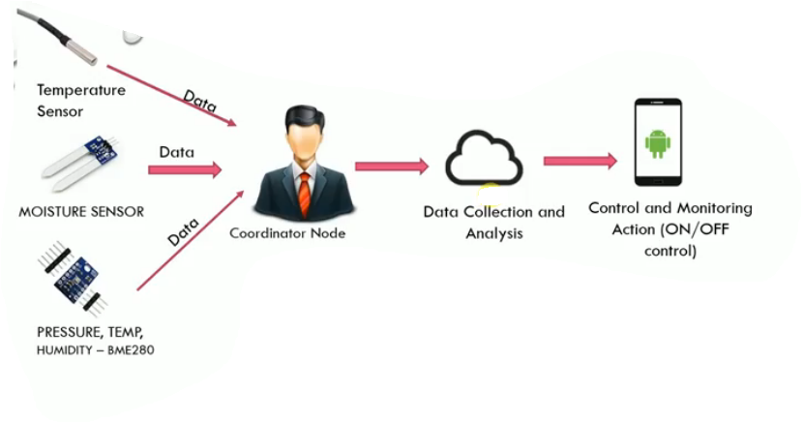
IoT Level – 5 Example

Slide 14
IoT levels
IoT Level 6
Multiple Independent end nodes that perform sensing and/or actuation.
Application is cloud based
Centralized controller is aware of the status of all the end nodes and send control commands to the nodes.

Slide 15
IoT Enabling Technologies – IoT Networking ( Swayam prabha and class discussion)
Wireless Sensor Networks( WSN)
Cloud computing
Big Data Analytics
Communication Protocols
Embedded Systems

Slide 16
References
Arshdeep Bahga, Vijay Madisetti, “Internet of Things – A hands-on approach”, Universities Press, 2015.
https://www.smartcitiesworld.net/resources/resources/mastering-the-6-levels-of-iot-success
Swayam Prabha

