Slide 1
Enabling Technologies of IoT
Dr.R.Saranya

Slide 2
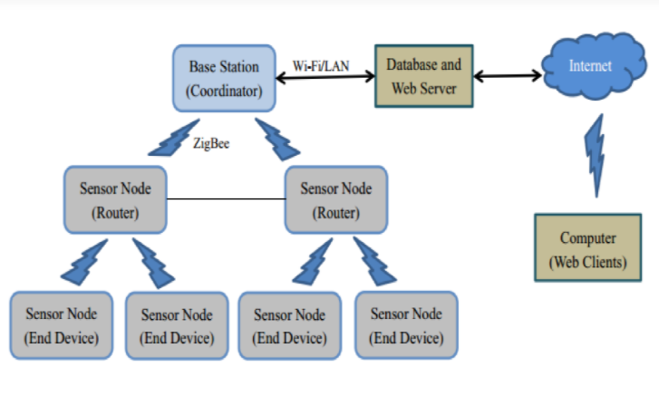
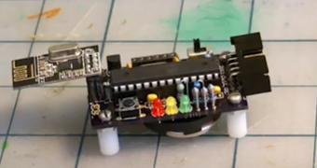
Wireless Sensor Networks(WSN)
WSNs are an effective distributed ( device) data collection technology ( Deployment of large number of Sensor nodes to monitor the environment or system).
A WSN consist of end-nodes, routers and a coordinator (gateway that connects WSN to Internet).

Slide 3
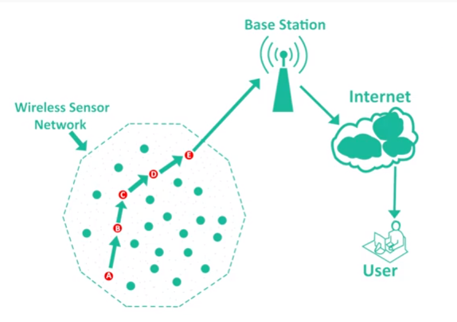
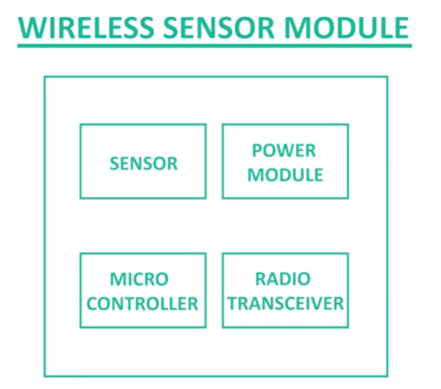
Wireless Sensor Networks(WSN)
Less cost than wired sensor networks.
Flexible configurations

Slide 4
Wireless Sensor Networks(WSN)
Some Examples of WSNs in IOT
Weather monitoring systems -> collect temperature, humidity and other data, for aggregation and analysis
Soil Moisture system ( at various locations)
Surveillance systems ( motion detection)
Wireless communication protocol is IEEE 802.15.4 ( ZigBee) – 2.4GHZ,250KB/s, 10 – 100 meters

Slide 5
Wireless Sensor Networks(WSN)
WSN -> Deploy large number of low cost and low power sensor nodes for continuous monitoring of environment and physical conditions.
WSNs are robust as self organizing networks ( Failure – reconfigure itself)

Slide 6
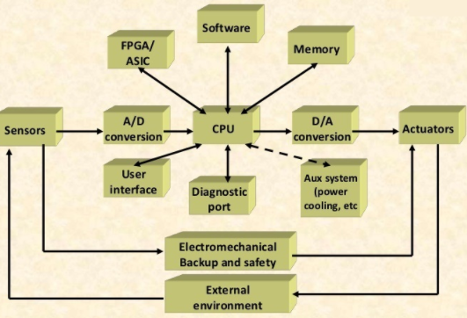
Embedded Systems
Hardware and Software embedded -> Specific tasks
Components like microprocessor or microcontroller, memory, networking units, I/O, digital signal processing, graphics processor, etc.
It ranges from lost miniaturized devices like digital watches to digital cameras, home appliances like (washing machines), etc.,

Slide 7
Communication Protocols
Form backbone of IoT system which enables the network connectivity and coupling to applications;
Protocols define the data exchange formats, addressing schemes, and routing of packets from source to destination.
Already Discussed as separate lecture.

Slide 8
Cloud Computing
Paradigm for deploying or delivering applications and services over the internet. (Microsoft Azure , Amazon Web Services, Google Cloud , Oracle Cloud , etc.,)
Pay-as-you-go model – Provisioning of the cloud computing resources ( like storage , networking ) on demand for the users.
The computing and storage resources provided by cloud service providers are served for multiple users using multi-tenancy.
Users are assigned virtual resources that run on the top of physical resources.

Slide 9
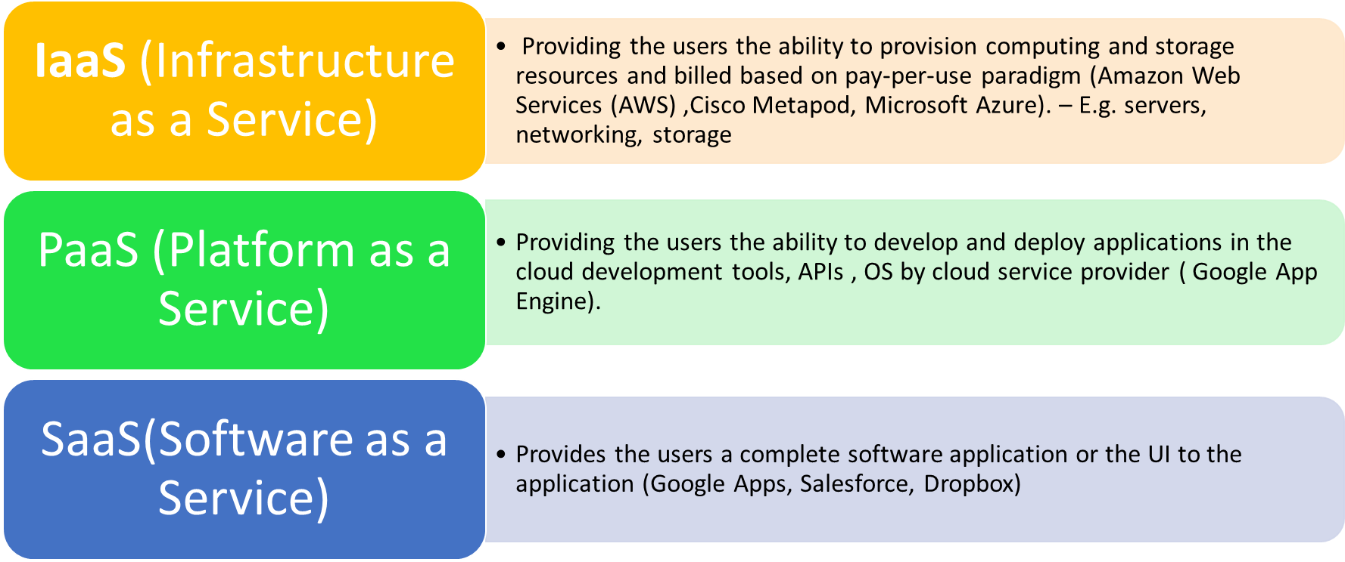
Cloud Computing
Different forms of services

Slide 10
Big Data Analytics
Examples of Big data generated by IoT systems
Weather Monitoring Stations ( Sensor data)
Data collected from sensors embedded in industrial systems for monitoring and detecting failures
Health data-> Wearable fitness bands
Location and Tracking of vehicles.
Characteristics :
Volume : Massive scale of data
Velocity : Frequent and fast generation of data
Variety : Different forms of data ( text, image, audio/video)

Slide 11
References
Arshdeep Bahga, Vijay Madisetti, “Internet of Things – A hands-on
approach”, Universities Press, 2015.

