Slide 1
M2M vs. IoT

Slide 2
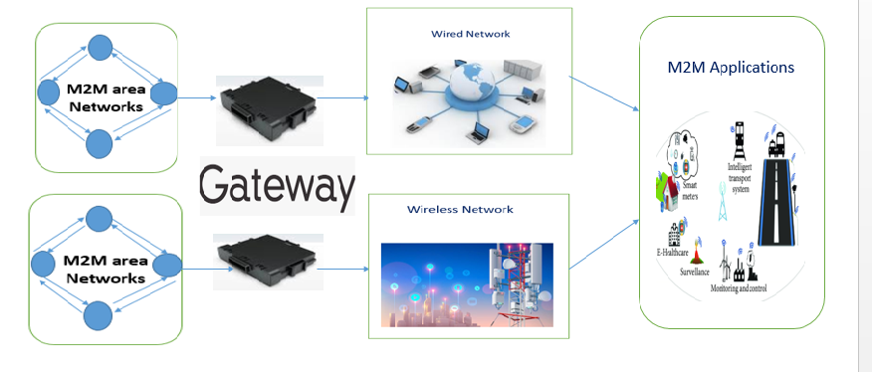
Machine-to-Machine(M2M)
Architecture
IoT and M2M are often used interchangeably , but these terms are evolved from different backgrounds.
It refers to networking of machines (or devices) for the purpose of remote monitoring , control and data exchange.

Slide 3
M2M Architecture
M2M systems consists of M2M area networks ( comprises of machines or nodes), communication network and application domain.
ZigBee, Bluetooth, ModBus, Wireless M-Bus , 6LowPan,etc.,
M2M area networks use either proprietary or non-IP based communication protocols, and IP based ( wired or wireless) communication protocols are used to connect remote M2M area networks using gateways.

Slide 4
M2M vs. IoT
Domain | M2M | IoT
Protocols | Uses proprietary or non IP based communication protocols ( within M2M area network). Eg. ZigBee, Bluetooth, ModBus, 6LoWPAN, Z- Wave, etc., | Communication in IoT above the network layers HTTP, CoAP, WebSockets, MQTT, etc.,
Machines | Homogenous machine types within an M2M area network. | IoT systems can have heterogeneous things ( Eg.IoT enabled Home automation include various type of devices such as fire alarms, etc.,)
Hardware Vs. Software Emphasis | More emphasis on more embedded hardware modules | Emphasis of IoT more on software
Applications , Data collection and analysis | M2M data – on-premises storage infrastructure an accessed by on – premises applications such as diagnosis applications, service management . | IoT data is collected in cloud ( public, private or hybrid) and accessed by cloud applications such as analytics, enterprises applications, remote diagnosis.

Slide 5
References
Arshdeep Bahga, Vijay Madisetti, “Internet of Things – A hands-on
approach”, Universities Press, 2015.

