Slide 1
UNIT - 2
IoT System Management

Slide 2
Need for IoT System Management
Gartner Research - Roughly 43 percent of businesses currently use some form of IoT
Automatic Configuration
Monitoring Operational and Statistical data
Improved Reliability
System Wide Configuration – All or None approach
Retrieving and Reusing Configuration

Slide 3
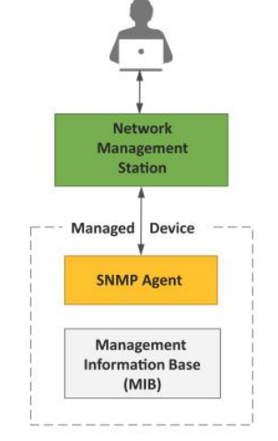
Simple Network Management Protocol (SNMP)
Network Management Station(NMS) – Execute SNMP commands
Managed device has MIB and SNMP agent

Slide 4
Limitations of SNMP
Stateless in nature
Connectionless
Does not support easy retrieval of configuration
Lack of security concerns

Slide 5
Network Operator Requirements
Internet Architecture Board (IAB) held a workshop on Network Management in 2002.
The following are the brief overview of the operator requirements:
  Ease of Use
  Distinction between configuration and state data
  Fetch configuration and state data separately
  Configuration of the network as a whole
  Configurations transaction across devices
  Configuration deltas
  Dump and Restore configuration ,Configuration validation and database schemas, Comparing configurations etc…

Slide 6
NETCONF
Network Configuration (NETCONF) protocol is a session based network management protocol
Content
(Conf.data)
Client
Server
Operations
(<get-config>,<edit-config>)
RPC or notification
(<rpc>,<rpc-reply>)
NETCONF
Configuration Datastore
Transport
(SSH,TLS,Console)
NETCONF Protocol layers

Slide 7
NETCONF
Information model – UML
Data model language - YANG
Encoding – XML,JSON
Protocol – NETCONFIG,SNMP
Programming Language – C,C++,python,Java,etc…
NETCONF Server – reside on network device
Management application - client

Slide 8
NETCONF – Management of network device
Client – NETCONF session with server
Exchange “hello”messages
Client can send multiple requests to the server for retrieving conf. data
NETCONF also define one or more configuration datastore.
NETCONF is connection oriented protocol

Slide 9
YANG
DML - used to model configuration and state data
YANG modules components :
  Configuration data
  State data
  RPC calls
  Data exchange between NETCONF client and server

Slide 10
YANG – Node Types
Leaf Nodes – contains simple data structure like integer and string
Leaf – List nodes – sequence of leaf nodes
Container nodes – used to group related nodes in a subtree
List nodes – defines the sequence of list entries

Slide 11
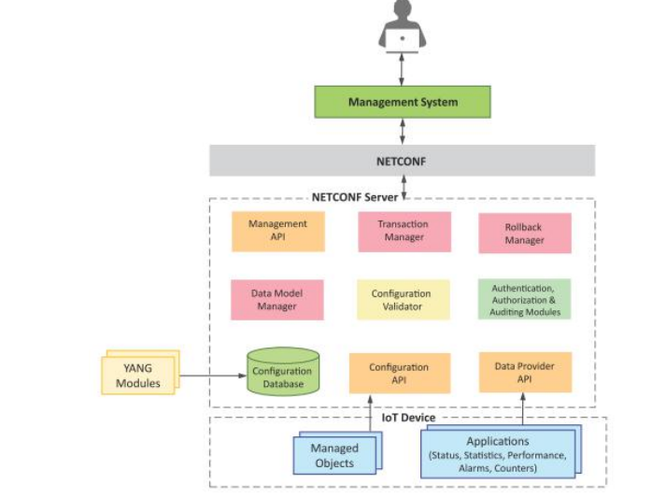
IoT System Management with NETCONF-YANG

Slide 12
IoT System Management with NETCONF-YANG
Various Components :
Management System – To Configure IoT device and receive notifications from the device as NETCONF messages.
Management API – Allows the management applications to start NETCONF sessions, read, write configuration and state data
Transaction Manager – Executes and Ensures the NETCONF transactions w.r.t ACID properties .
Roll back Manager - Responsible for generating all the transactions necessary to rollback a current configuration to its original state.

Slide 13
IoT System Management with NETCONF-YANG
Data Model Manager – keeps track of all YANG data models and corresponding managed objects.
Configuration Validator – checks if the resulting configuration after applying a transaction would be a valid configuration
Configuration Database – Contains both configuration and operational data
Configuration API – using this an IOT device can read and write configuration data store
Data provider API – Applications on the IoT device can register for call-backs for various events using data provider API

Slide 14
IoT Platforms - Design Methodology
The Proposed design methodology of IoT system has
  reduced design,testing and maintenance time
  better interoperability
  reduced complexity.

Slide 15
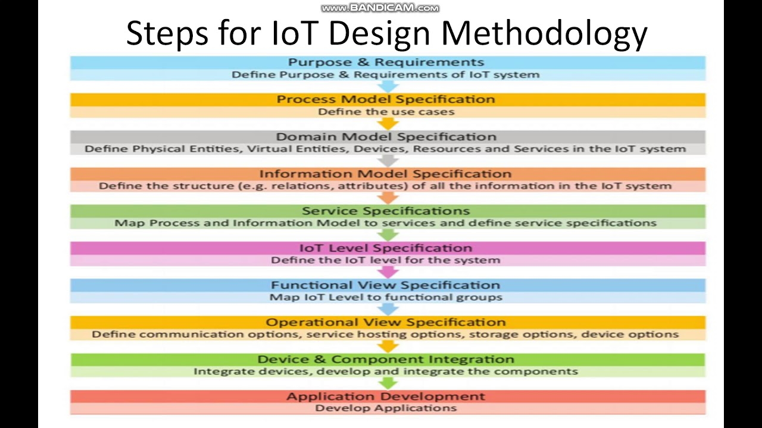
IoT Platforms - Design Methodology

Slide 16
Steps
Step 1 : Purpose and Requirement Specification
Purpose ?
Example : Controlling light /fan in home remotedly
Behaviour – Auto and manual modes
System Management Requirement – provide remote monitoring and control functions
Data Analysis Requirement – local
Application Development Requirement
Security Requirement – user authentication capability

Slide 17
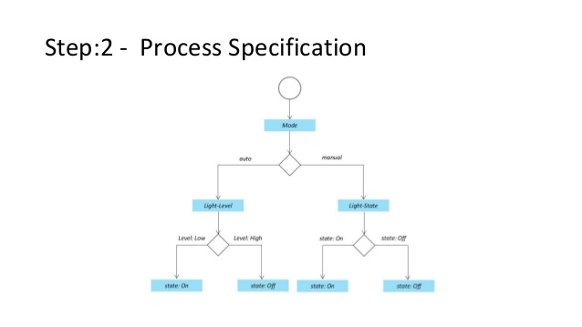
Steps
Step 2: Process Specification
Use cases are described from the inputs of first step.

Slide 18
Steps
Step 3: Domain Model Specification
Defines the attributes of the objects and relationship between objects.
Gives the abstract representation of the concepts, objects and entities in the IoT domain independent of any specific technology or platform
The entities ,objects and concepts defined in the domain model include:
      Physical entity : It is a discrete and identifiable entity in the physical environment
      Virtual Entity : It is a representation of the physical entity in the digital world.
      Device: It provides a medium for interaction between physical entities and virtual entities.
      Resources : Software components
      Services : It provides an interface for interacting with the physical entity.

Slide 19
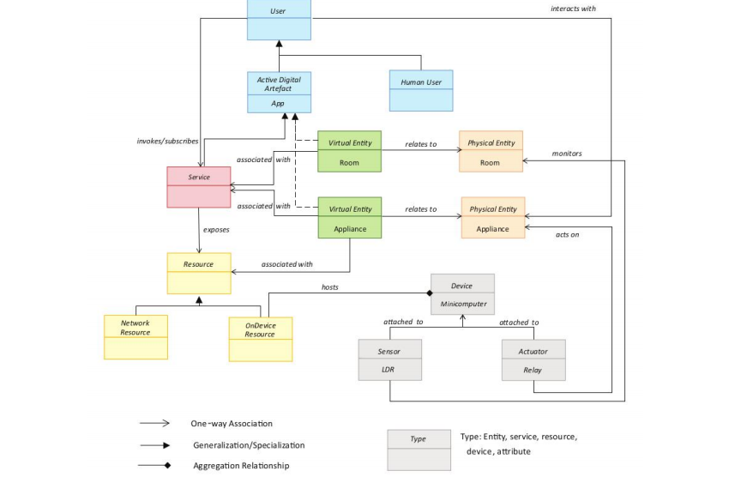
Domain Model Specification

Slide 20
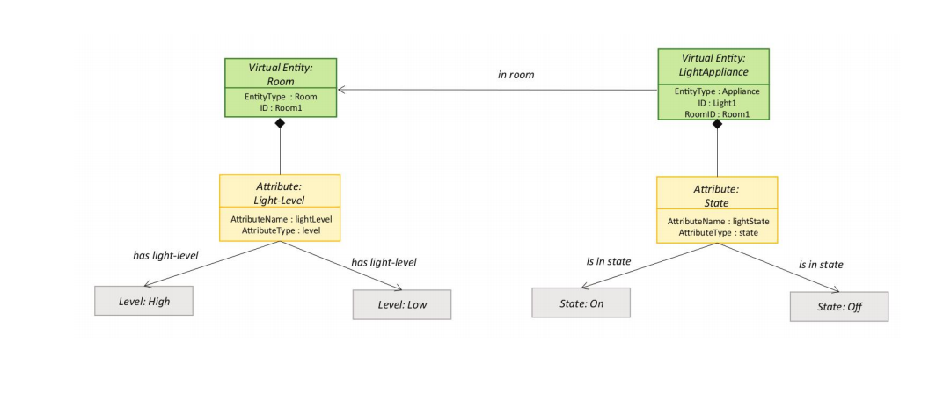
Steps
Step 4: Information Model Specification

Slide 21
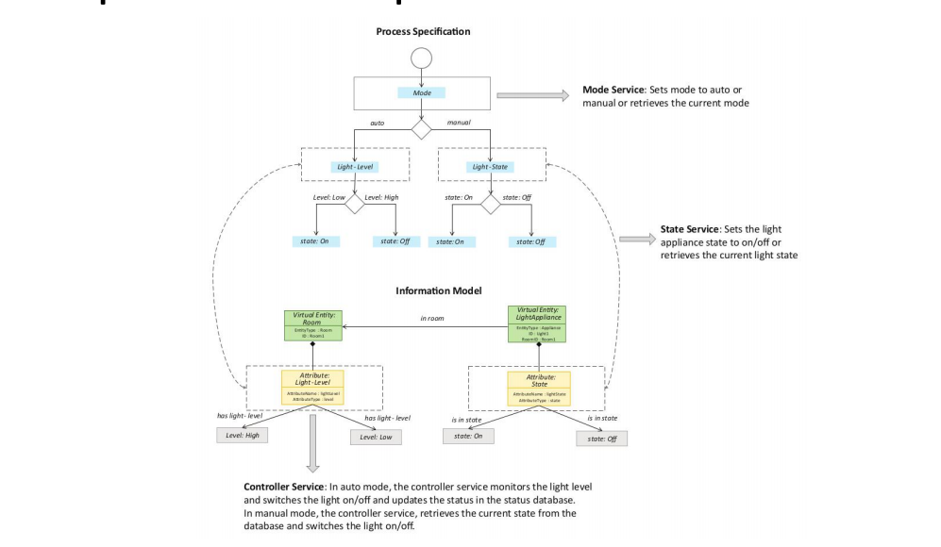
Steps
Step 5: Service Specifications
It defines the services of IoT system like service Types,service inputs/output,service endpoints,service schedules,service preconditions and service states.

Slide 22
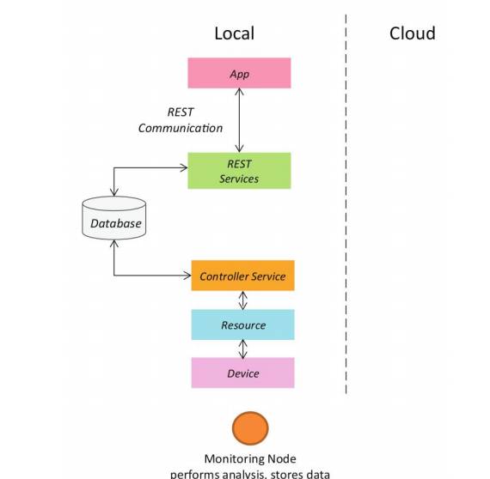
Steps
Step 6: IoT Level specification

Slide 23
Steps
Step 7 : Functional View (FV) Specification
It defines the functional view (fv) of the IoT system grouped into various Functional Groups(FGs)
FGs include:
Device FG
Communication
Services
Security FG

Slide 24
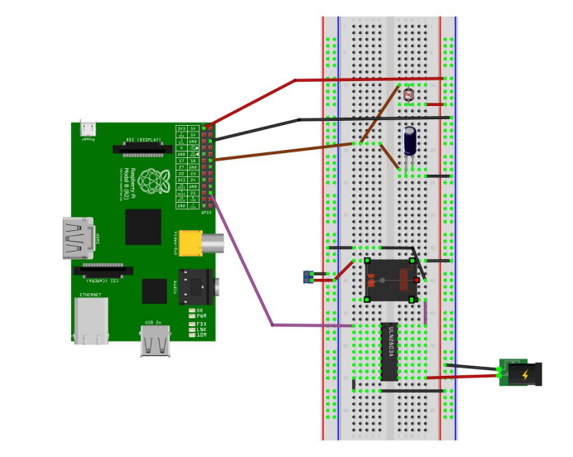
Steps
Step 8: Operational view Specification
Step 9: Device and component Integration

Slide 25
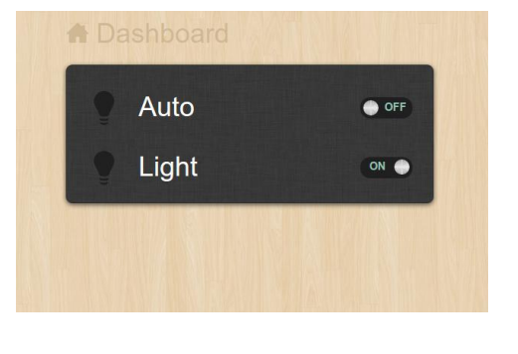
Steps
Step 10:Application development

Slide 26
References
Arshdeep Bahga, Vijay Madisetti, “Internet of Things – A hands-on approach”, Universities Press, 2015.

