Slide 1
Unit – 4
Arduino

Slide 2

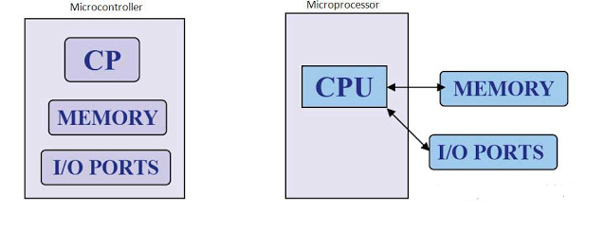
µP | µC
Applications which demand intense processing tasks | Applications which demands specific tasks.
Internal Structure – ONLY CPU ( other peripherals are added externally) | Internal Structure – All in one chip
Processing power ( Clock speed in GHz) and Memory ( GB and TB) -> high. | Processing power ( Clock speed in MHz) and Memory ( KB and MB) -> relatively low.

Slide 3
Arduino – An Introduction
Sparkfun Electronics :
Arduino is an open-source platform used for building electronics projects.
Design files including board schematics ,codes – Freely available
Arduino consists of both a physical programmable circuit board (often referred to as a microcontroller) and a piece of software, or IDE (Integrated Development Environment) that runs on your computer, used to write and upload computer code to the physical board.
Flexibility to modify the design
https://www.arduino.cc/

Slide 4
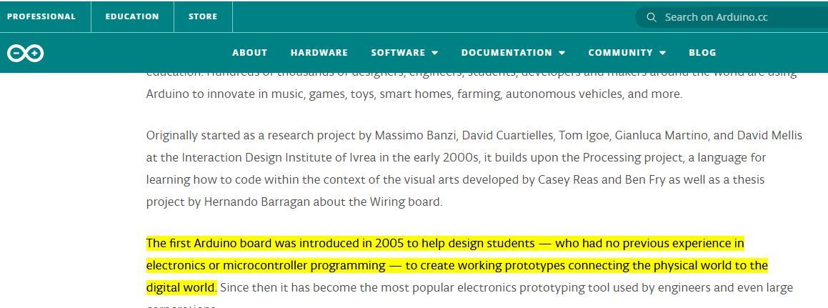
https://www.arduino.cc/

Slide 5
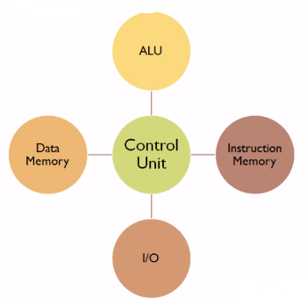
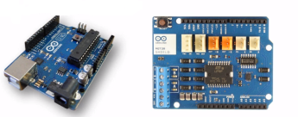
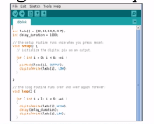
Microcontroller
Hardware – Arduino Boards
Software – Arduino IDE

Slide 6
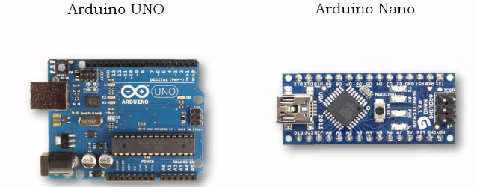

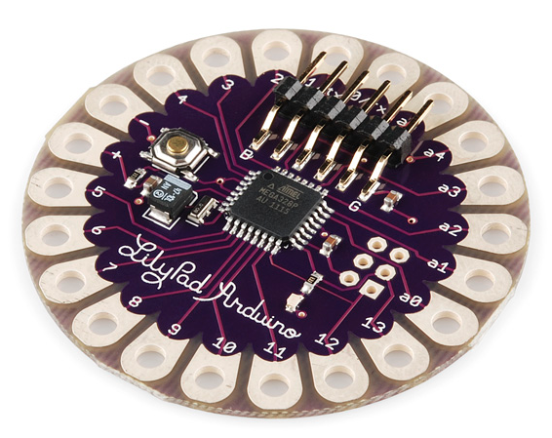

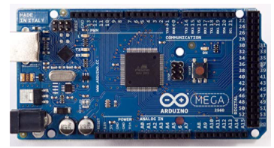
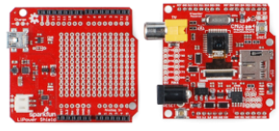
Arduino Family – Types of Boards

Slide 7
Arduino – An Introduction
Advantages
Inexpensive
Cross – Platform
Simple & Clear Programming environment
Open source and Extensible software
Open source and Extensible hardware

Slide 8
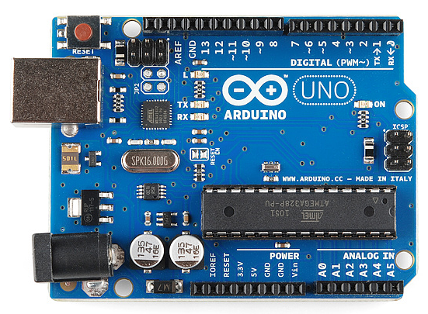
Arduino Uno
Digital pins
Reset button
USB to UART port
In – System Programming (ISP) pins
Crystal Oscillator
Atmega 328 microcontroller
Power Supply Jack
Analog pins
Power supply pins

Slide 9
IoT Simulation tools
Tinkercad (https://www.tinkercad.com/dashboard) – Open source
ArduinoSim
Node-Red
http://www.cupcarbon.com/
NS3
Proteus Simulator
Simulator for Arduino – paid
http://iot.appinventor.mit.edu/#/ - Open source ( Home automation)
https://tutorial45.com/arduino-simulator-emulator/ - gives you the list of simulator
Simple and intuitive tutorials available here - https://www.javatpoint.com/arduino-blinking-two-led

Slide 10

Sample – Tinkercad.com

Slide 11
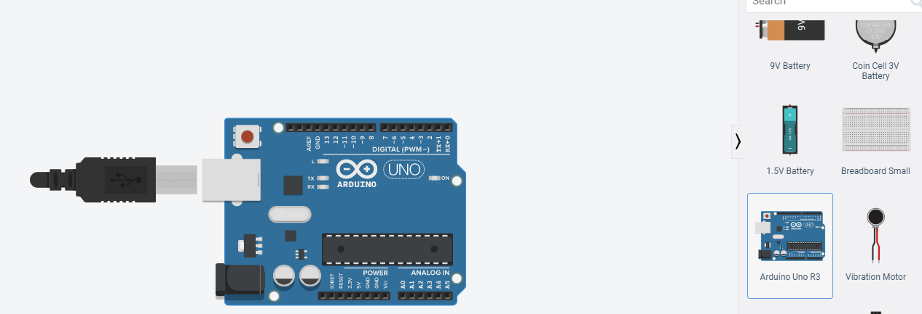
Sample – Tinkercad.com

Slide 12
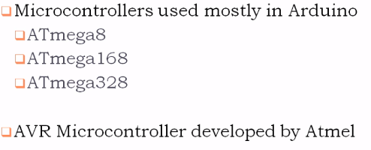
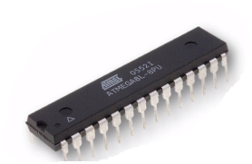
Arduino Architecture – Structure & Features
Microcontroller in Arduino

Slide 13
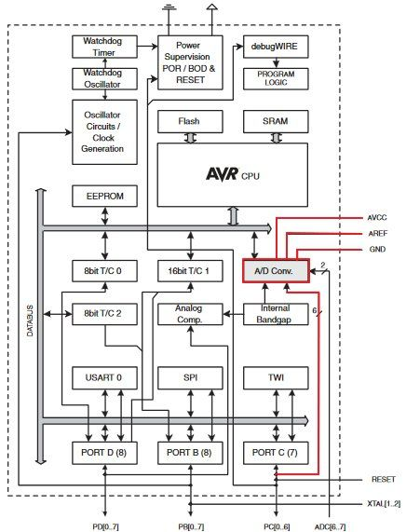
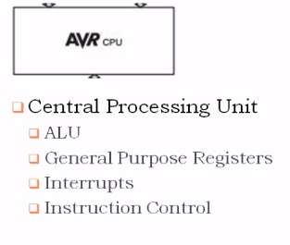
AVR Architecture - CPU

Slide 14
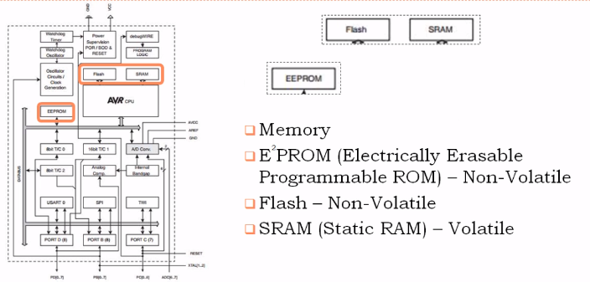
AVR Architecture - Memory

Slide 15
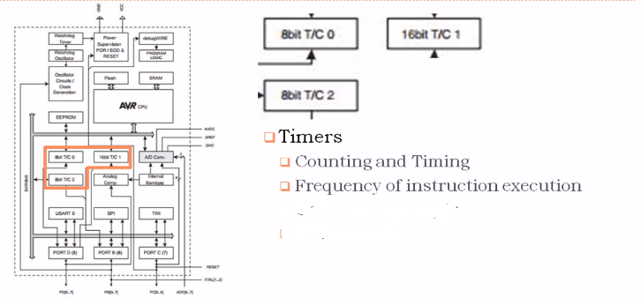
AVR Architecture - Timers

Slide 16
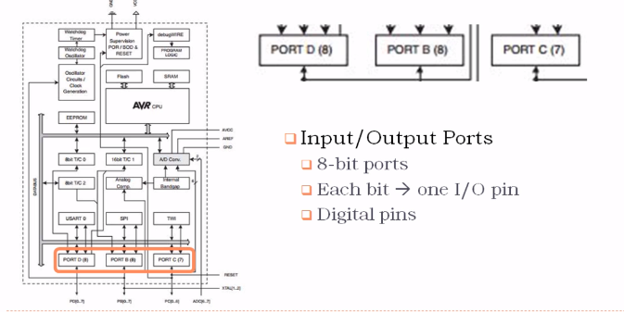
AVR Architecture – I/O

Slide 17
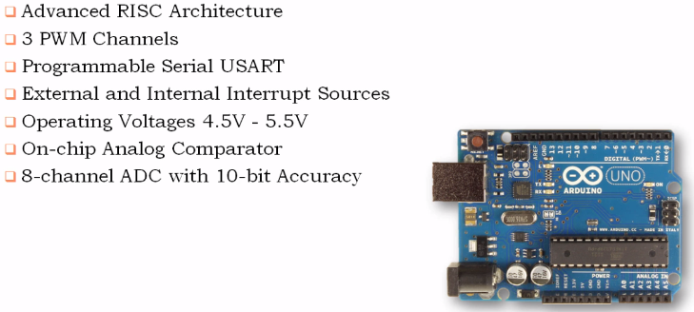
Summary of Arduino Uno

Slide 18
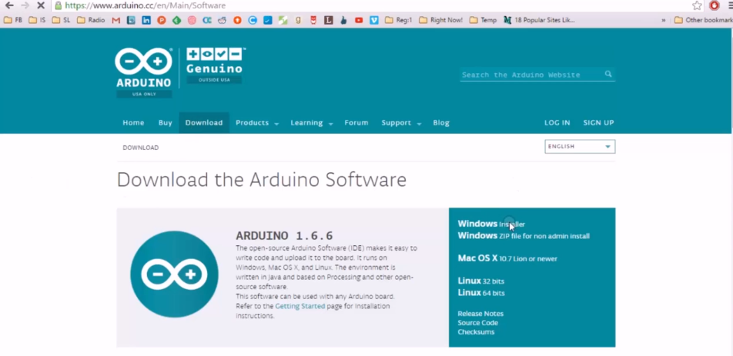
Interfacing Arduino
Connect and Detect Arduino Uno
Software Requirements
Arduino IDE - https://www.arduino.cc/en/Main/Software

Slide 19


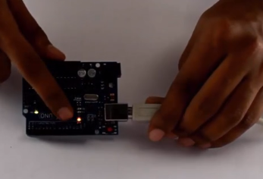
Interfacing Arduino
Connect and Detect Arduino Uno

Slide 20
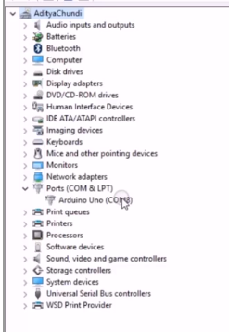
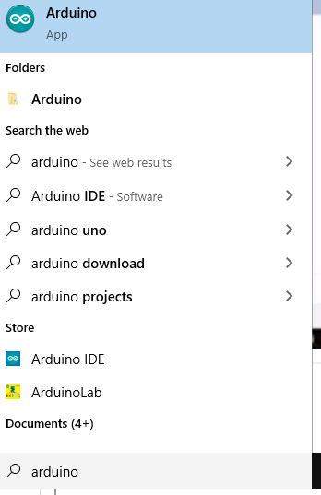
Interfacing Arduino
Connect and Detect Arduino Uno

Slide 21
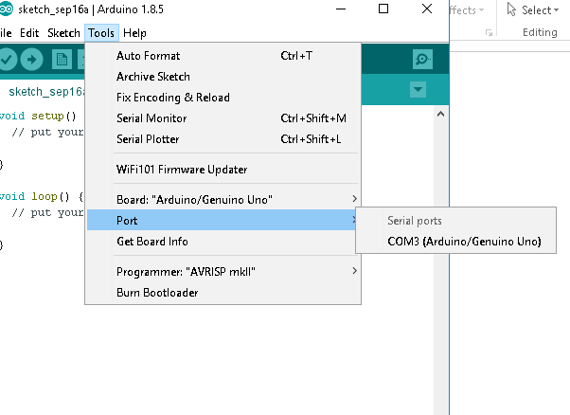
Interfacing Arduino
Connect and Detect Arduino Uno

Slide 22
References
Skifi labs
Sparkfun Learn
https://www.incognito.com/blog/

