Slide 1
XML
(Fundamentals)
Dr.R.Saranya

Slide 2
What is XML
XML stands for eXtensible Markup Language.
A markup language is used to provide information about a document.
Tags are added to the document to provide the extra information.
HTML tags tell a browser how to display the document.(Data interchange not possible) – Fixed tags
XML tags give a reader some idea what some of the data means.- Flexible tags ( User defined their own tags) – Meta language

Slide 3
Example of an HTML Document
<html>
<head><title>Example</title></head.
<body>
<h1>This is an example of a page.</h1>
<h2>Some information goes here.</h2>
</body>
</html>

Slide 4
Example of an XML Document
<?xml version=“1.0” encoding= “UTF-8”?> // declaration (optional)
<address> // root node
<name>R.Saranya</name> // child node
<email>saranya@cutn.ac.in</email>
<phone> 8870234599 </phone>
<birthday>1989- 10-11</birthday>
</address>

Slide 5
Difference Between HTML and XML
HTML tags have a fixed meaning and browsers know what it is.
XML tags are different for different applications, and users know what they mean.
HTML tags are used for display.
XML tags are used to describe documents and data.

Slide 6
XML Rules
Tags are enclosed in angle brackets.
Tags come in pairs with start-tags and end-tags.
Tags must be properly nested.
  <name><email>…</name></email> is not allowed.
  <name><email>…</email><name> is.
Tags that do not have end-tags must be terminated by a ‘/’.
  <br /> is an html example.

Slide 7
More XML Rules
Tags are case sensitive.
  <address> is not the same as <Address>
XML in any combination of cases is not allowed as part of a tag.
Tags may not contain ‘<‘ or ‘&’.
They must begin with a letter and may not contain white space.
Documents must have a single root tag that begins the document.

Slide 8
XML is not
A replacement for HTML
A presentation format
A programming language
A network transfer protocol
A database

Slide 9
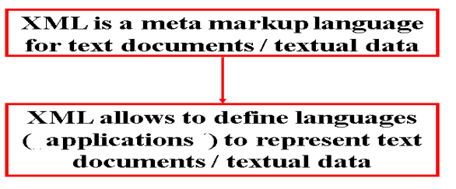
But then – what is it?

Slide 10
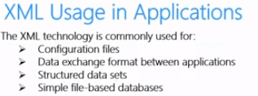
More on XML
XML Separates Data from Presentation.
XML is Often a Complement to HTML
XML Separates Data from HTML

Slide 11
XML document
Elements
Attributes

Slide 12
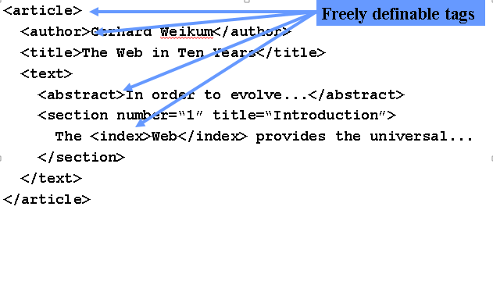
Simple XML document

Slide 13
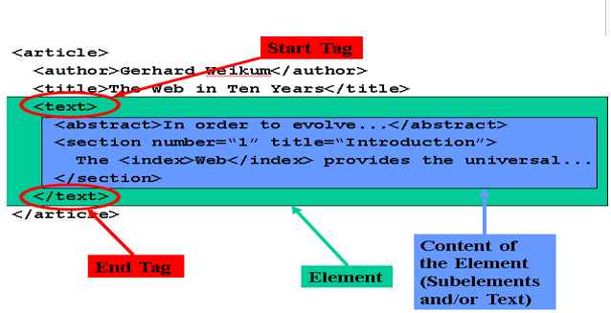
Simple XML document

Slide 14
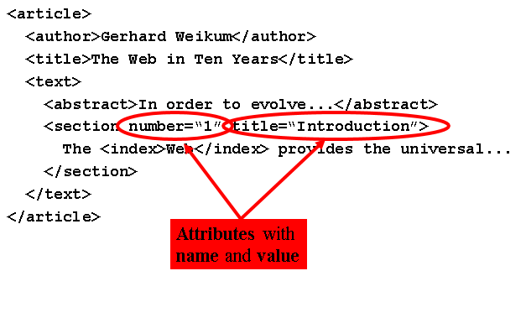
Simple XML document

Slide 15
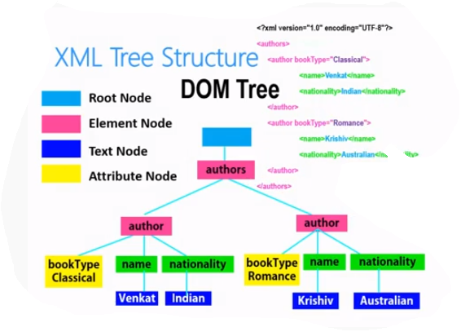

Slide 16
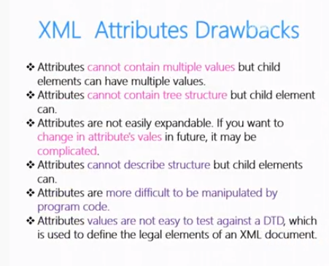

Slide 17
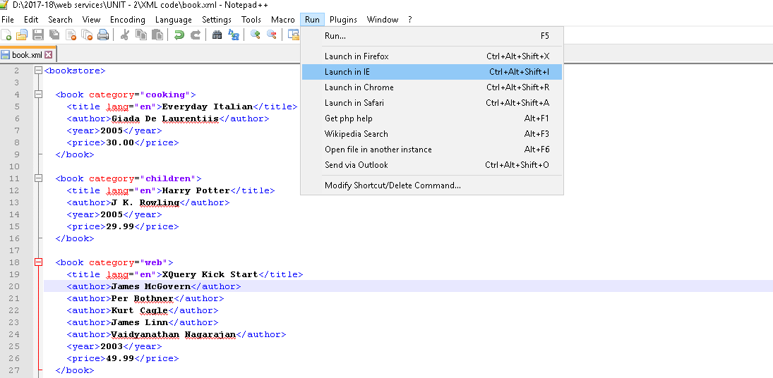
Example XML in Notepad++

Slide 18
XML Namespace
XML Namespaces provide a method to avoid element name conflicts.
E.G. This XML carries HTML infor.
<table>
<tr>
<td>Apples</td>
<td>Bananas</td>
</tr>
</table>

Slide 19
XML Namespace
E.g.2 This xml contain table info ( furniture)
<table>
<name>African CoffeeTable</name>
<width>80</width>
<length>120</length>
</table>

Slide 20
Solving the Name Conflict Using a Prefix
<h:table>
<h:tr>
<h:td>Apples</h:td>
<h:td>Bananas</h:td>
</h:tr>
</h:table>
<f:table>
<f:name>African Coffee Table</f:name>
<f:width>80</f:width>
<f:length>120</f:length>
</f:table>

Slide 21
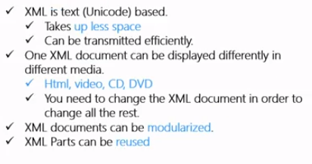
Advantages

Slide 22
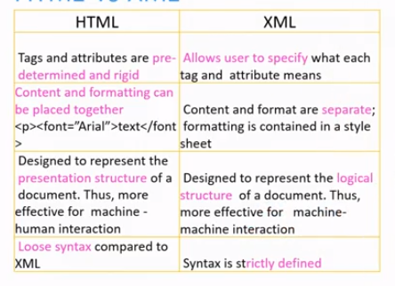

Slide 23
References
Elliotte Rusty Harold, Processing XML with Java, Addison Wesley, 2002.
Elliotte Rusty Harold and Scott Means, XML Programming, O’Reilly & Associates, Inc., 2002.
W3Schools Online Web Tutorials, http://www.w3schools.com.

