Slide 1
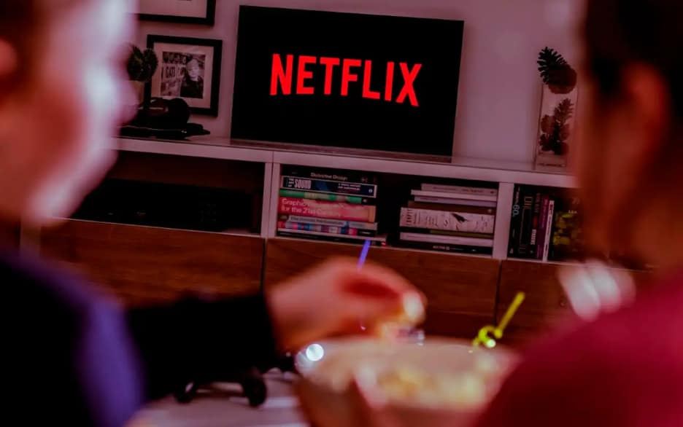


Reimagining Streaming: Netflix’s Next Leap
By: Think&Sell Consulting
Think&Sell Consulting

Slide 2












Overview
World’s leading streaming entertainment innovator
Global Binge: Rise of Netflix’s Subscribers from 2015 to 2024
US$39B
2024 Revenue
Trendsetter in streaming tech and content pearsonalization, holding ~21–23% share of the global streaming market.
190+
Countries
Subscription-based streaming platform
13K+
Employees
Delivers films, TV series, documentaries, and increasingly live events and sports.
Produces local content globally and localizes for different markets.
Founded: 1997
Netflix maintained its paid subscriber growth through global expansion and utilizing the pandemic, gaining viewers from 70 millions to 270.7 millions from 2015 to 2024.
301.6M
Paid Memberships
Video Streamer | Positioning VS Netflix
 | Backed by Amazon’s ecosystem and bundled with Prime, giving wide reach but lower engagement per user. Netflix counters with a pure-play entertainment focus and higher daily watch time.
 | Leverages strong franchise IPs (Marvel, Star Wars, Pixar). Netflix competes by offering greater content breadth and consistent release cadence across genres and geographies.
 | Premium storytelling niche with strong critical acclaim but limited output. Netflix balances both scale and prestige while investing heavily in international hits.
 | Competitive pricing and local language content drive regional stickiness. Netflix responds through localized originals and strategic partnerships in Asia, LATAM, and Europe.
Market Context
Global video-streaming market projected to reach US $416.8 B by 2030
Live-streaming sub-segment growing fastest: US $104.9 B → US $712.9 B by 2033
Ad-supported (AVOD) formats rising > 2× faster than paid subscriptions (SVOD).
North America is mature; Asia-Pacific expected > 25% CAGR through 2030.
Smart TVs & mobile drive > 70% of total viewing hours worldwide.
Online streaming now accounts for 44.8% of total TV viewing.
Industry shifting toward hybrid monetization (ad-tiers + bundling + commerce).

Slide 3




Executive Summary
To grow Netflix’s user base by attracting new audiences, increase viewer engagement through interactive features, and create additional revenue streams beyond subscriptions
VISION
How can Netflix expand complementary revenue streams to enhance long-term growth while staying true to its entertainment ecosystem?
How can Netflix deepen engagement into an immersive, interactive, and emotionally resonant journey?
How can cinematic sensory experiences help Netflix stand out in a saturated market and retain more users?
Netflix
QUESTION
 | The "SIS" Strategy
Shoppable Seamless in-app purchasing of featured products | Integration Connecting services for enhanced user experience | Smart Intelligent tech powering personalized interactions
SOLUTION
10% - 15%
increase in total annual revenue
20% - 25%
increase in average user engagement
12%
decrease in Churn Rates
IMPACT

Slide 4






Prioritizing Core Strengths: Entertainment Innovation Over Sports Expansion
Not Every Game Is Worth Playing
Strategic Misalignment with Core Identity
While Netflix Can Win Big with the Right Framework
Sports broadcasting conflicts with Netflix’s on-demand, storytelling-driven model.
Shifts focus away from original, owned IP toward expensive, time-limited rights.
Netflix Originals make up 55% of its content library, reinforcing its brand as a creative entertainment innovator rather than a live broadcaster.
Leveraging Storytelling Dominance
Sports games are single-occurrence events, whereas storytelling allows content to be rewatched, shared, and merchandised, maximizing lifetime value per viewer
Use existing production pipelines and technical capabilities for consistent high-quality content
Netflix originals create emotional attachment to characters and stories, fostering global fandoms
High Financial Risk and Low Profitability
Sports rights are extremely costly and must be renewed frequently.
Profit margins are thin due to unpredictable viewership and high licensing fees.
Investing in sports diverts resources from higher-ROI opportunities like global content creation and AI innovation.
Creating Long-Term, Low-Risk Monetization
To avoid volatile ad-driven sports economics
Launch shoppable ecosystems tied to shows
Strengthen brand partnerships for co-created campaigns
Operational and Market Challenges
Immersive Storytelling Beyond the Screen
Integrate Netflix with smart home devices for personalized, seamless cinematic experiences
Offer AR experiences that make viewers feel the characters’ journey firsthand
Requires new live-streaming infrastructure and real-time production capabilities.
Faces strong competition from established players like ESPN, Amazon, and Apple.
Limited global scalability due to most sports rights being region-specific, reducing Netflix’s global advantage.
Sports dilutes Netflix’s creative brand built around storytelling, originality, and cinematic quality.
Our “SIS” strategy will preserve the Netflix creative brand.
Source: Fortune

Slide 5







Insights to Entertainment Trends
Own a Piece of the Show
Connectivity in Interactive Entertainment
Around 7 in 10 Respondents Looked Online to Purchase Products Seen on TV in US
More than half of teens (53%)
discuss shows with friends
Nearly 9 in 10 youths
found community through gaming
Searched online to consider purchasing what you saw on TV
The average consumer is already spending $290 a year, totaling an estimated $144.9 billion in US retail sales, on products they see while consuming TV content. 108.7 million shoppable media buyers to be projected in US by 2027.
38.7%
Made an online purchase on what you saw on TV
TV, movies, and games strengthen peer connections.
17.9%
All of the above
15.0%
None of the above
Netflix Demonstrates Leading Content Quality
with Moderate Levels of Audience Engagement Relative to Competitors
28.5%
Rising consumer demand for items featured on shows underscores the value of integrating shoppable experiences into content.
High Community
Engagement
Immersive Cinematic Experience At Home
Home Theatre System Market Size (in USD Billion)
Low Production
Excellence
High Production
Excellence
1.57x
CAGR: 9.44%
2030: USD 16.40B
Smart home technology is gaining strong adoption in US, with 70% of households owning at least one smart device. Among home theatre users, 68% express interest in smart lighting.
Low Community
Engagement
2025: USD 10.45B
Growing interest in connected home devices and smart lighting to transform passive viewing into immersive experience.
Strong entertainment market influence but a higher community engagement is needed for longer retention.
Source: UCLA study, Mordor Intelligence, EMARKETER

Slide 6

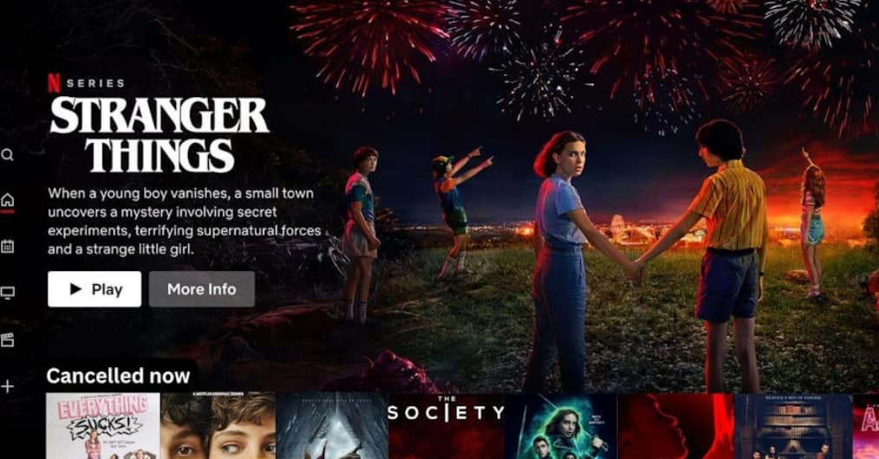






1 Journey 2 Breakpoints : From Curiosity to Craving
Customer Journey Map of Jerald – Gen Z Movie Enthusiast
Name: Jerald (Gen Z, Movie Enthusiast) Age: 20 Devices: iPhone (primary), Shared TV & Smart Lights in Living Room
1. Discovery
Needs: Unique & creator-led snippets
Impacts: Boosts awareness and recall
Emotions: Curious → Excited
2. Joining & Set-up
Needs: Instant Signups & One-Tap Payment
Impacts: ↑ Conversion & Activations
Emotions: Reassured → Confident
3. Ready to Watch
Needs: Smart Recs, Quick Previews & Seamless Searches
Impacts: Faster Selection, ↑ Trailer to play rates
Emotions: Decisive → Satisfied
5. Retain
Needs: New Content and Quick Access to Merch or Games
Pain points: Content Fatigue, Missed Post Hype Engagement
Impacts: ↑ Churn & Weak Lifetime Value
Emotions: Hyped → Disappointed
4. Watch
Needs: Uninterrupted & Immersive Experience
Pain points: App Hopping, Second-Screen Switch During Key Moments
Impacts: ↓ Completion rate, Mid-Stream exits ↑
Emotions: Absorbed → Frustrated
What starts with excitement for Jerald ends in disappointment which highlights Netflix’s need to deliver consistency and build lasting trust across every touchpoint.

Slide 7

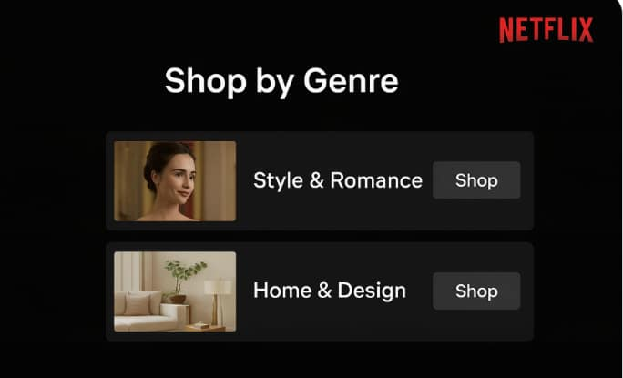
Shoppable Ecosystem at Your Fingertips: Stream&Shop
A shoppable ecosystem allows viewers to directly browse and purchase products featured within a show without disrupting the viewing experience.
It connects content, commerce, and technology into one seamless experience.
You see an item you like on screen → click/tap it → learn more → buy it instantly — all inside Netflix
Key Features​
Format
Interactive Product Tagging​
Viewers can click or tap on items (clothing, gadgets, décor, etc.) featured in a scene
Product Name: “Button up top and skirt” Brand: Zara Price: $199 ⭐ Rating: ★★★★☆ (4.6/5) Available Sizes: S, M, L, XL 🔘 Add to Cart 🔘 View Details 🔘 Save for Later
Integrated E-Commerce Partnerships​​
Collaboration with major retailers (e.g., Zara, Ikea, H&M)​
Enables direct purchasing or wish-listing from within Netflix​
Wishlist & Checkout Integration
Add items to a Netflix “Wishlist” for later
Unified checkout through Netflix
"Behind-the-Scenes Shop"
Add a short behind-the-scenes video after an episode, showing featured fashion or equipment with each item linked to stores
"Mini Shopping Tab" in Profiles
A static tab next to "My List" where users can see products from shows they recently watched
Non-Intrusive Design​
Shopping features appear only when users engage, keeping the core viewing experience immersive and distraction-free​
Example: A scene from Emily in Paris
Why it matters now?
70% of viewers say they’ve searched online for a product after seeing it in a show or movie
Consumers are 60% more likely to buy when emotionally engaged with storytelling
76% of Gen Z say they want to “own something from their favorite shows.”
Netflix viewers already exhibit strong parasocial attachment and emotional engagement — integrating clickable merch links would capture existing purchase intent rather than create new behavior
The Shoppable Ecosystem blurs the line between content and commerce — evolving Netflix from a streaming service into a lifestyle platform that entertains, engages, and sells.​

Slide 8
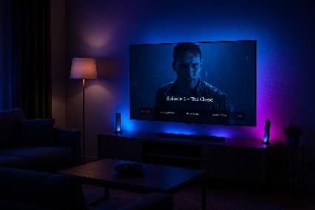




SceneSync : Cinema at Home
Immersion for All : Connecting Smart Streaming, Smart Homes and Smartphones
1. Partnership with Philips & Sony – A/V Enthusiasts
· Movie Night” with cinema-like experience
2. Pocket Theatre Mode – Everyday Streamers
· Instant “Movie Night” without new gear
Implementation:
Partner with Philips & Sony to launch a Netflix Mode
Auto Sync Lights + Audio based on scene
Control : Netflix app or voice commands
Implementation:
Subtle on-screen ambience (no smart lights needed)
Optional : Auto-detect devices (earbuds)
Partnership : 1st Sony (WF Series) then Expand to Apple/Google/JBL
An example of Netflix Mode
Why Partnerships & Why It Matters
Partnership Business Model
Model : Certification + Co-marketing (Netflix Mode Ready) Sony soundbars and Philips Hue lights works with Netflix to create a theatre-like “Movie Night”
Exchange : Netflix (toggle + timed cues) & Sony/Hue (firmware/app + retail demo) Netflix to add presets & Sony to develop app & provide retail support
No Revenue Share on viewing Netflix Returns : More Premium Upgrades, Higher Viewing & Retention Sony/Phillips Returns : Device Differentiation, Retail Lift
Record of Successful Partnerships with Philips & Sony (Netflix Calibrated & Hue Sync TV App)
Leverage Sony & Philips Expertise & Accelerate Entry into Smart-Sensing Tech
Lower Capital Needs → Greater Scalability
Develop Netflix’s Timed-Cue Capability to Enable Future Market Entry Opportunities
$537B (2030)
$563.2B
Projected Smart Home Market Value by 2030
Projected Wireless Earbuds Market Value by 2030
The Smart Home Integration : SceneSync turns every screen into a cinema, delivering gear-optional immersion that lifts completion, upgrades, and loyalty.
Notes:
https://www.grandviewresearch.com/industry-analysis/true-wireless-stereo-earbuds-market-repo

Slide 9
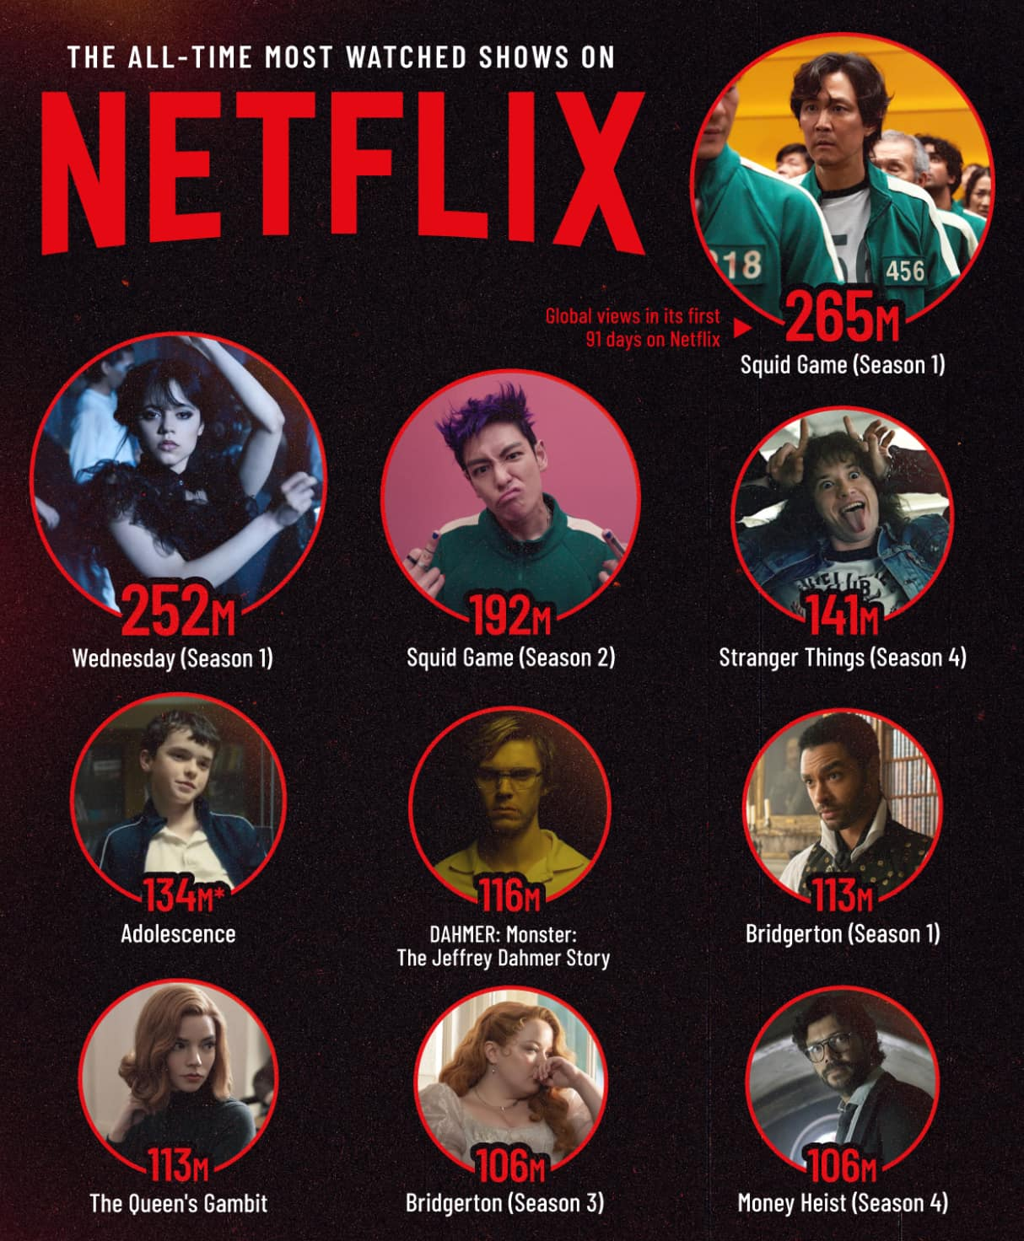





Transforming Viewing into Adventure: Netflix Quest Bridges Screens and Streets
From Passive Watching to Real-World Storytelling.
Netflix Quest redefines audience engagement by turning hit shows into real-world AR missions by powering Netflix’s existing gaming infrastructure and strategic AR partners.
Fans explore iconic locations from Stranger Things, Squid Game, and One Piece to unlock story-driven quests, collect exclusive rewards, and interact with immersive digital layers.
By merging streaming, gaming, and community into one ecosystem, Netflix strengthens brand loyalty through participation not just viewership.
1.7B+ active mobile AR devices
worldwide lower adoption barriers​
Younger Audiences
crave shareable, movement-based content that connects digital identity with real-world action.
Leverage Netflix Gaming’s current ecosystem and cloud servers instead of building new ones.​
Collaborate with Niantic, Meta, or Snap Lens Studio for mapping tech and scalability.​
Transition to recurring seasonal events tied to new releases (e.g. Squid Game S2 AR Trials), creating sustained engagement loops.

Slide 10
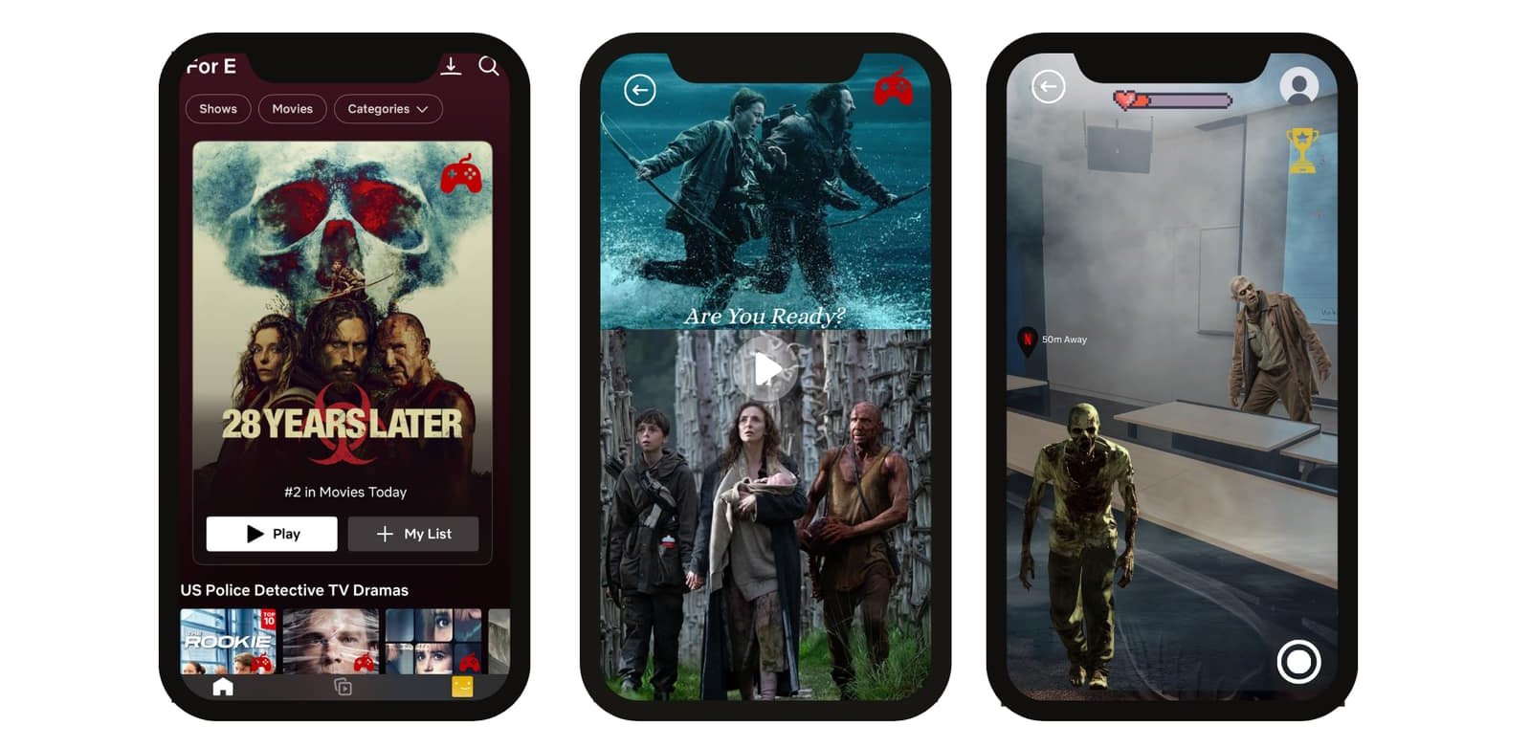
From Screen to Streets: Interactive AR Journeys for Every Netflix Universe
DISCOVER​
ENGAGE
​
CONQUER
​
Single-Story Game Mode: Users select an AR mission tied to a specific title (e.g., 28 Years Later Quest).
Pre-hype Integration:
Trailers link directly into “Play Quest” mode before official release.
Location-Based Start:
GPS detects user proximity to story landmarks.
AR Story Teaser:
Short cinematic intro uses Netflix Gaming’s engine to set mission tone.
Interactive NPCs / Enemies: Real-time AR characters appear in physical space.
Unlockables & Rewards: Completing missions grants exclusive Netflix merch, collectibles, or preview access.

Slide 11


Projecting Growth: Turning Netflix’s Ecosystem into a Revenue Engine
From Viewing to Living - Converting Netflix IP into Everyday Revenue Streams.
The next phase of Netflix’s growth is not in adding subscribers but it’s in monetizing attention through immersion. By integrating AR experiences, smart home partnerships, and in-content commerce, Netflix can transform passive engagement into an interactive, revenue-rich ecosystem spanning content, devices, and lifestyle products.
KPI FRAMEWORK
SOLUTION | REVENUE IMPACT | ENGAGEMENT IMPACT
Shoppable Ecosystem At Your Fingertips: Stream&Shop | Est. $300–$500M Incremental Revenue (Affiliate partnerships, in-app purchases, branded content tie-ins) | +10–15 % Engagement Lift through interactive, purchase-enabled experiences
SceneSync : Cinema at Home | Est. $225M Incremental Revenue (Tier Uplifts, Partnership ARPU, Churn Savings & OEM Monetization) | +12.5% Engagement Lift through cinematic and immersive experiences
From Screen to Streets: Interactive AR Journeys for Every Netflix Universe | New revenue vertical (AR campaigns, brand events) worth est. $80–120M annually | +20% monthly active user (MAU) growth through gamified engagement
Key Performance Indicators:
Subscriber/User Growth: +10–15% lift in active engagement per month
Average Revenue Per User (ARPU): +5–8% from commerce & partnerships
Retention Rate: +4–6% from integrated smart home & AR loyalty features
New Revenue Streams: 3 new monetizable IP channels by Year 3

Slide 12

Risk & Mitigation
Risks
Mitigation Plans
Risk Map
Start with smaller, tech-forward markets
Can help Netflix identify what works before committing globally, minimizing financial risk
1
3
1
High Development costs leading to delayed ROI​
2
Probability
Limit shoppable overlays to organic fits
Only use shopping features where it naturally enhances the story, not distracts
Keep content immersive and emotionally engaging, which protects brand trust
2
Brand fatigue due to over commercialized risk​
Transparent opt-in and localized data policies
Clearly explain what data is collected and why, letting users choose
Adjust policies to fit each country's privacy laws, reducing legal risk
Impact
3
Privacy concerns leading to user data usage for personalization​
All these strategies show Netflix balancing innovation with control — trying new tech and experiences, but in a measured, risk-aware way that protects ROI, user trust, and brand identity.

Slide 13
Implementation Roadmap
Shoppable Ecosystem
Smart Home Integration
AR Netflix Quest
2026
2027
Tasks
Q1
Q2
Q3
Q4
Q1
Q2
Q3
Q4
Research
Conduct market research on competitors who offer shoppable entertainment
and Development
Identify compatible devices and testing of sound and lighting
Source AR content partnerships and assess show popularity to select content
Pilot Entry
Integrate clickable product links in select shows and outreach to device partnerships (Phillips & Sony)
Test smart home-enabled viewing with targeted users to test reaction to multi-sensory effects
Conduct small-scale AR pilot, analyze user’s interactions and usage pattern
Evaluation
Analyze metrics: click-through rate, purchase conversion, engagement per show
and Scale
Analyze metrics: usage frequency, immersion rating per user
Further
Analyze metrics: AR session duration, repeat engagement per user
Full Integration
Integrate in-app purchase & delivery
Full immersive suite (sound, lighting, scent) for majority of content
Introduce gamification tied to Netflix originals

Slide 14
Appendix
Shoppable Ecosystem
Phase 1: Research, Design & Brand Partnership Setup (8–12 weeks) Cost: US$30,000 – $75,000 • Discovery & Market Research • UI/UX Design for shopping features • Identify and onboard brand partners for product placements • Negotiate collaboration agreements and integration strategies
Phase 2: Backend, AI & Brand Collaboration Integration (14–22 weeks) Cost: US$50,000 – $140,000 • Develop AI-powered product recognition & tagging system • Build e-commerce backend & APIs • Integrate brand collaboration features (exclusive branded content, offers)
Phase 3: Frontend & Cross-Platform App with Brand Features (14–26 weeks) Cost: US$60,000 – $170,000 • Frontend development for mobile, web, and smart TVs • Implement interactive hotspots, product pop-ups, “Buy Now” buttons • Sync “save for later” & wishlist features across devices
Phase 4: Testing, Deployment, Marketing & Brand Campaigns (12–20 weeks) Cost: US$55,000 – $180,000 • Comprehensive testing & QA • Launch brand-integrated marketing campaigns • Co-branded partner campaigns (teasers, special drops) • Year 1 maintenance & support
Total 7–14 months Investment: US$195,000 – $565,000
Smart Home Integration
Phase 1: Strategy, Partners & Design (6–10 weeks) Cost: US$0.25M – 0.6M • Align with Philips/Sony for Matter / HDMI-CEC / eARC integration
Phase 2: Cue Pipeline & Safety (8–14 weeks) Cost: US$0.5M – 1.2M • Build scene-cue sidecar (light/sound intensity, hue, motion, safety flags) • Automate cueing for new releases with photosensitivity guardrails
Phase 3: Client Engineering (TV, iOS, Android) (12–20 weeks) Cost: US$1.2M – 2.8M • Develop on-screen ambience experience • Build TV overlay renderer & mobile control platforms
Phase 4: OEM Integrations & Pilot Cert (10–16 weeks) Cost: US$1.0M – 2.2M • Implement Netflix Mode with Philips (Hue) & Sony (TVs/soundbars) • Conduct QA, latency testing, certify 1–2 TV lines + soundbar family
Phase 5: Launch, Marketing & Global Scale (12–24 weeks) Cost: US$3.0M – 8.0M • Run education & demo reels • Expand to LG/Samsung/Google /Apple/JBL
Total 18–24 months Investment: US$5.95M – 14.8M (~0.015–0.038% of Netflix 2024 revenue, financially feasible)
AR & VR
Phase 1: R&D & Prototype (6–9 months) Cost: US$8–12M • Develop AR engine, integrate with Netflix app, test content • Basis: Comparable to Niantic’s early AR development costs
Phase 2: Pilot Launch (Year 1) Cost: US$20–25M • Test in select cities (Singapore, LA, Seoul), early marketing, server scaling • Basis: Pokémon Go pilot benchmarks
Phase 3: Global Roll-Out & Scaling (Year 2) Cost: US$40–60M • Expand to 190+ countries, localize, scale via AWS/GCP • Basis: Multi-region platform norms
Phase 4: Marketing & Partnerships (Years 2–3) Cost: US$30–40M • Tie-ins with LG/Samsung, influencer campaigns, AR merch events • Basis: 8–10% of campaign revenue
Phase 5: Maintenance & Content Updates (Annual) Cost: US$10–15M/year • Ongoing content drops, QA, security, server ops • Basis: Live-ops AR platform norms
Total 3-Year Investment: ≈ US$100–150M (~0.4% of Netflix 2024 revenue) • Costs front-loaded in R&D & scaling, then recurring maintenance • Strong ROI potential via synergy with Netflix IP, app, and global user base

