Slide 1
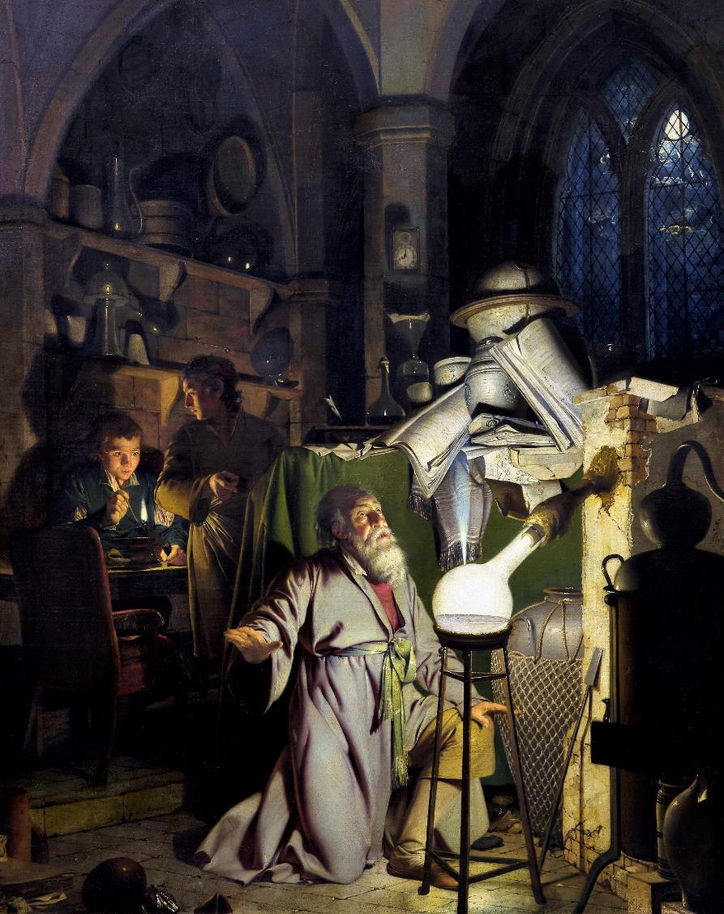

Dissemination 1: How to write everything
IL "Scientific Method and Analysis" WS 24-25
Kami Höferl
(Wright of Derby, Wikimedia, PD)
Notes:
"The Alchemist in Search of the Philosopher's Stone" by Joseph Wright of Derby (1771)
substance capable of turning base metals such as mercury into gold or silver[
In this work, Wright captures an alchemist conducting an experiment with a crucible in search of the philosopher's stone. The painting portrays a moment of discovery and highlights the experimental process central to early chemistry, before the formalisation of modern science.

Slide 2
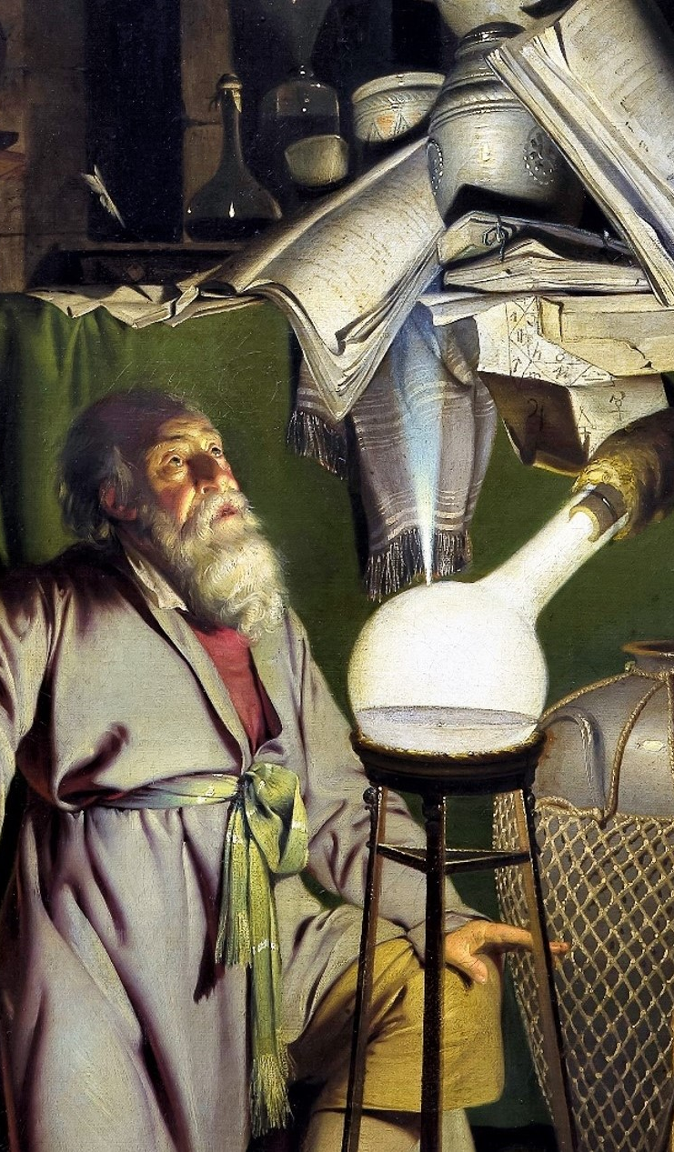
Overview
Why Writing still Matters
Writing a Draft
Reviewing a Draft
Neutral Language
… and Citations?
(Wright of Derby, Wikimedia, PD)

Slide 3
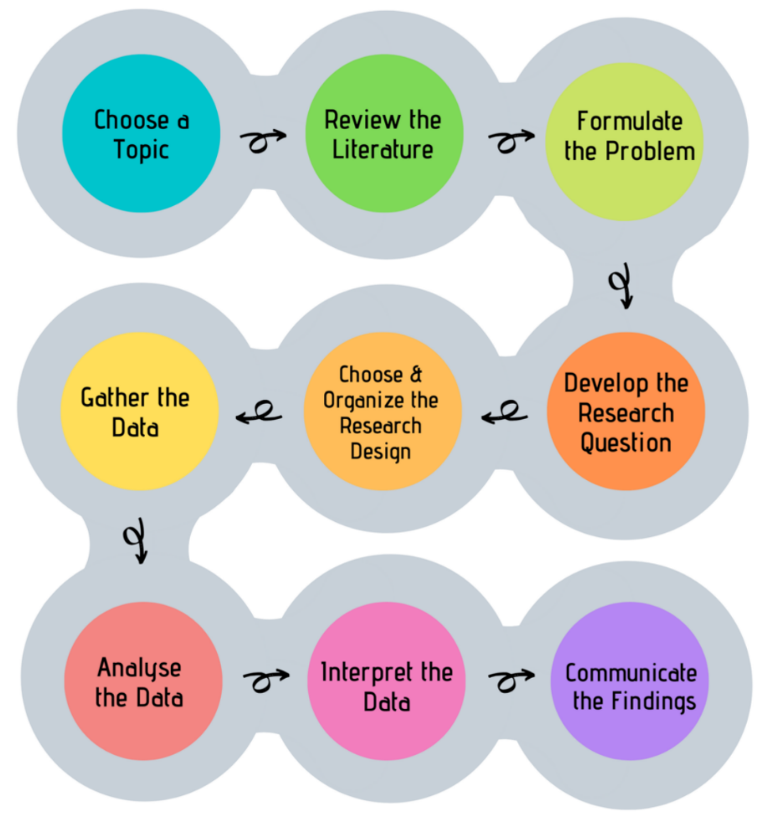
Look, Think, Test, Tell
(Sheppard, 2020:5)

Slide 4
How to communicate your Findings?
🤔

Slide 5
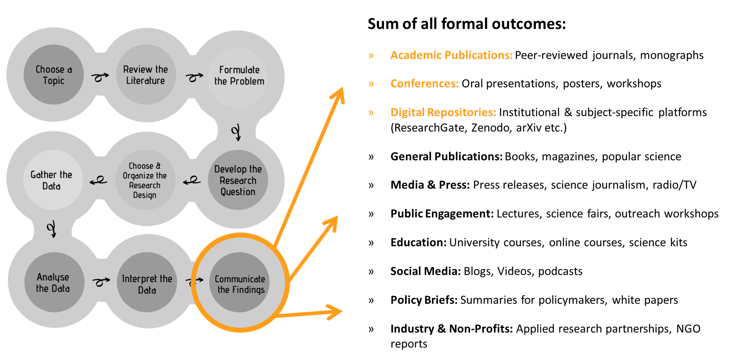
Here:

Slide 6
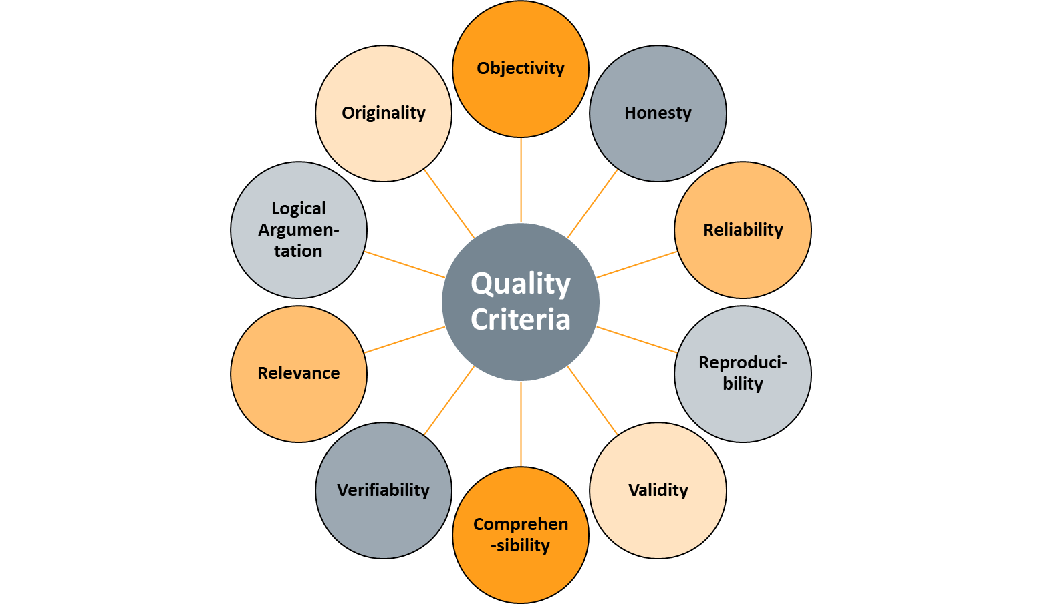
Quality Criteria in Science
( cf. Balzert et al. 2008:8ff.)

Slide 7


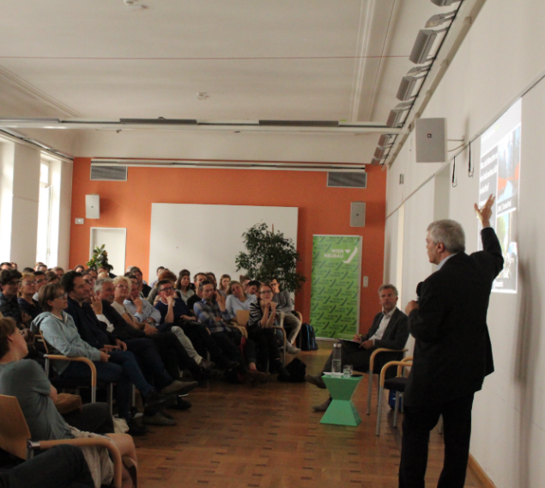
... Presentation of Findings I

Slide 8

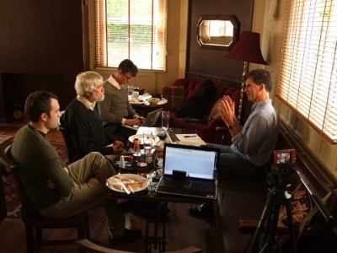
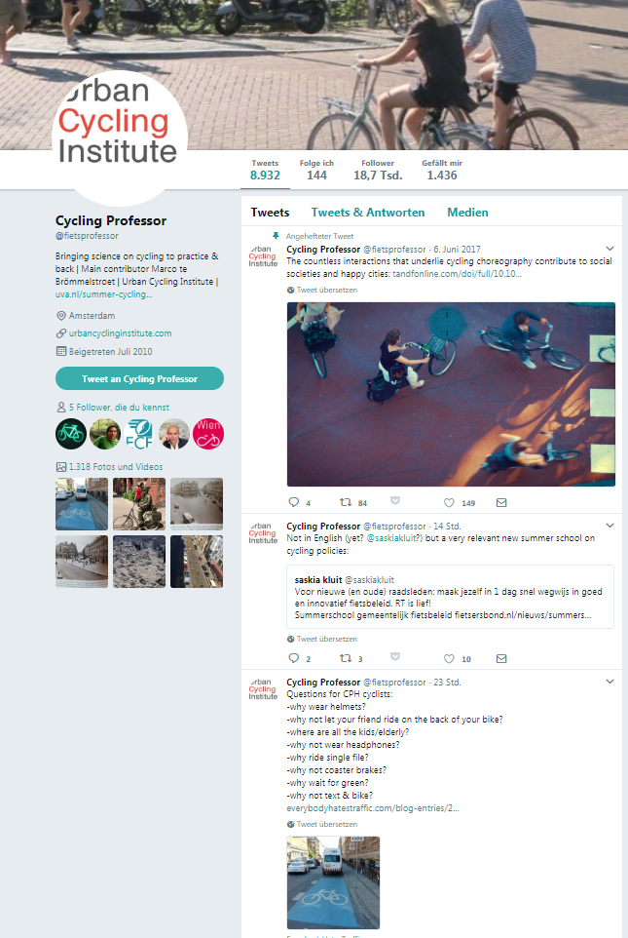
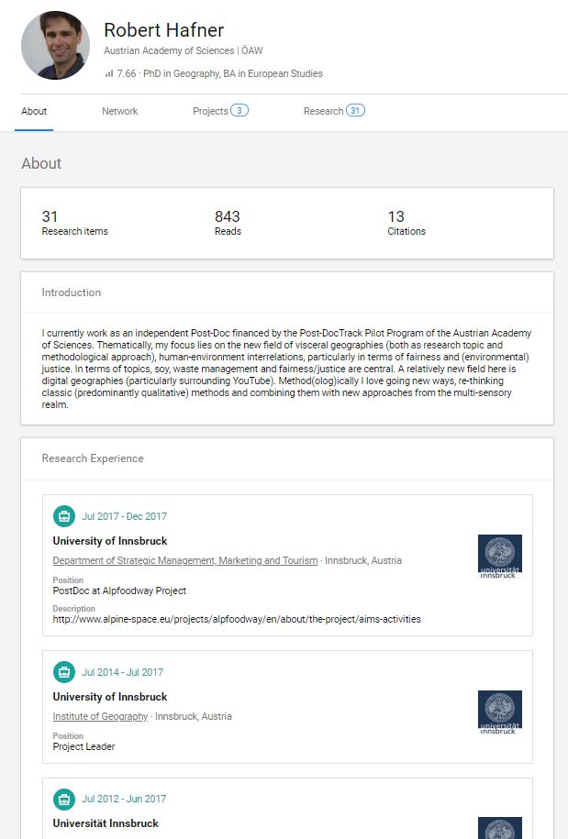

... Presentation of Findings II

Slide 9
Writing a Draft

Slide 10
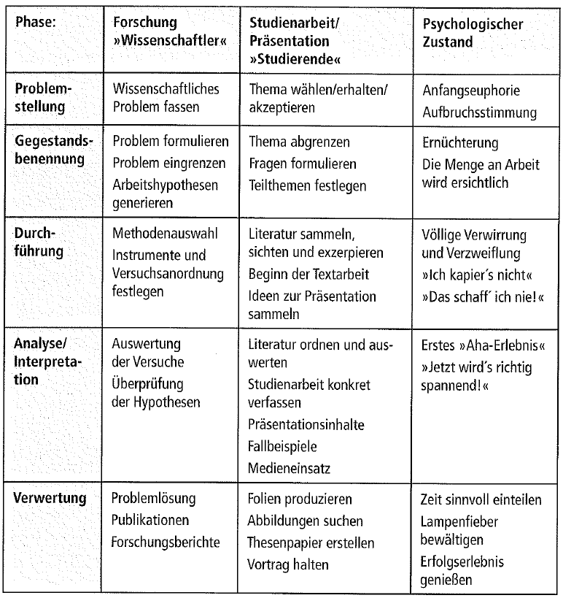
Where we are right Now
(Baade, Gertel & Schlottmann 2005:53)

Slide 11
Turning the Topic into a Scientific Paper
Topic
Research
Read
Evaluate
Core terms & concepts
Relevance & Context
Research objective & questions
Content organisation
Time course
Formulating the paper:
- Introduction
- Main part
- Conclusion
Corrections - final editing
Notes:
Formulating → Dealing with third-party intellectual property

Slide 12
A Quick Overview of the Writing Stages
WRITING PHASES
Topic
Core terms & concepts
Relevance & Context
Research objective & questions
PLANNING
Contant organisation
Formulating the work:
- Introduction
- Main part
- Conclusion
FORMULATING
Corrections - final editing
REVISION

Slide 13
A Quick Overview of the Writing Stages
WRITING PHASES
Topic
Concept “Expose” etc.
Core terms & concepts
Relevance & Context
Research objective & questions
PLANNING
Contant organisation
Formulating the work:
- Introduction
- Main part
- Conclusion
FORMULATING
Corrections - final editing
REVISION

Slide 14
The Starting Point: Goal(s), Question(s) & Structure
What? | Scope
Title page (→ do not forget the group number) | 1 page
Specification of a work title with clear reference to the chosen topic, research objective & questions | ─
Introduction to the topic (→ key authors & terms) & present the relevance of the topic | ~ 0.5 pages
Aim of the work | ─
Clearly state the questions investigated (~2-4) | ~ 0.25 pages
Presentation of the procedure for answering these questions | ~ 0.25 pages
Mind map on the topic of the work | ~ 1 page
Present the structure of the paper (= preliminary outline) & one sentence on the content of each outline level | ~ 0.75 pages
10 key references (selected after careful consideration) | ~ 0.75 pages
∑ ~ 4.5 pages

Slide 15
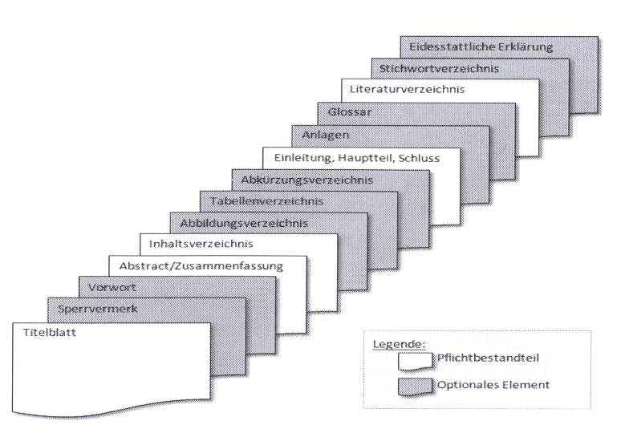
The Aim: A Scientific Text & its Components
(Heesen 2010: 30)

Slide 16
A Quick Overview of the Writing Stages
WRITING PHASES
Topic
Core terms & concepts
Relevance & Context
Concept
Research objective & questions
PLANNING
Contant organisation
Formulating the work:
- Introduction
- Main part
- Conclusion
FORMULATING
Corrections - final editing
REVISION

Slide 17
Scientific Writing = Permanent Reasoning
Do not postulate knowledge → argue
Language = logical reasoning
Relate knowledge components logically to each other
Traceability
Critically evaluate knowledge requirements, arguments & evidence
Clarify context
be clear on alternative ways of thinking & rival bodies of knowledge
Other positions ↔ own opinion
Notes:
@Conclusion & argumentation: basic function & overview of topoi

Slide 18
Scientific Use of Language
"Every author creates their own reality with their text, but the selections and reductions they make in their choice of words and grammar are rarely transparent. It is therefore important to minimise linguistic obfuscation in accordance with the requirements of scientific rigour - good structuring, simple language and the avoidance of convoluted sentences [...] are just as important as grammatical and orthographic correctness" (Baade et al. 2005:115)

Slide 19
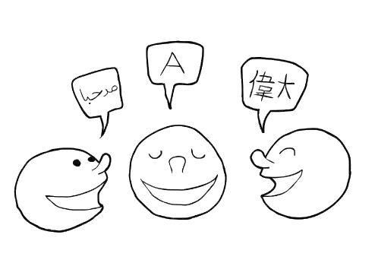
Scientific Language?
simple, fluent language
Foreign words 👉 do without or use sparingly
Use terms and technical expressions precisely
Consistent choice of words
Be careful with: "quite a lot, certain approaches, somehow, almost, in a way, ..."
→ Clearly indicate “educated guesses” etc.
factual presentation 👉 no poetic expressions (, humour or irony)

Slide 20
Scientific Language?
Conscious use of metaphors
Complete sentences 👉 no elliptical abbreviations
BSP: "The main thing [is] that you are healthy!
No colloquial formulations
BSP: As is generally known ..., it is quite obvious that ...
Present tense as the dominant tempo
BSP: Aristotle says ..., Harvey assumes...
Formulate actively 👉 reduce/omit passive voice

Slide 21
The Ego in Scientific Writing
Is it allowed to write scientific texts in the "first person"?
"Ego avoidance" 👉 not absolutely necessary
especially in the introduction, methods section and conclusion
But: No narrative first person throughout the text
No first-person statements on subjectively coloured opinions & evaluations of facts
👉 own positioning based on the argumentation of the work
Notes:
Connection to dealing with values in science:
# Values of others
# self-made valuations

Slide 22

First Text, then Layout
Work layout: clear, factually reduced
Simple fonts (Times New Roman, Arial etc.)
Side margins not too small (2 cm all round, 2.5-4 cm on the left)
Line spacing between 1.2 and 1.5 (depending on font)
Font size depends on font type (10-12 pt.)
Ensure correct use of punctuation and spaces
(possibly) justified text
(ev.) Hyphenation
Not sure? 👇

Slide 23
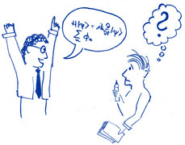
Notes on Text Comprehensibility
Pre-structuring helps 👉 Concept!
Let headlines "speak"
Meaningful summary
Set references
Facilitate orientation in the text & cross-references
Use footnotes
Interim summaries
Review of the contents of a (main) chapter
Set meta-statements (= abstraction)
Notes:
@meta statements: BSP "this only applies in relation to..." → Classification of a part in a larger whole

Slide 24
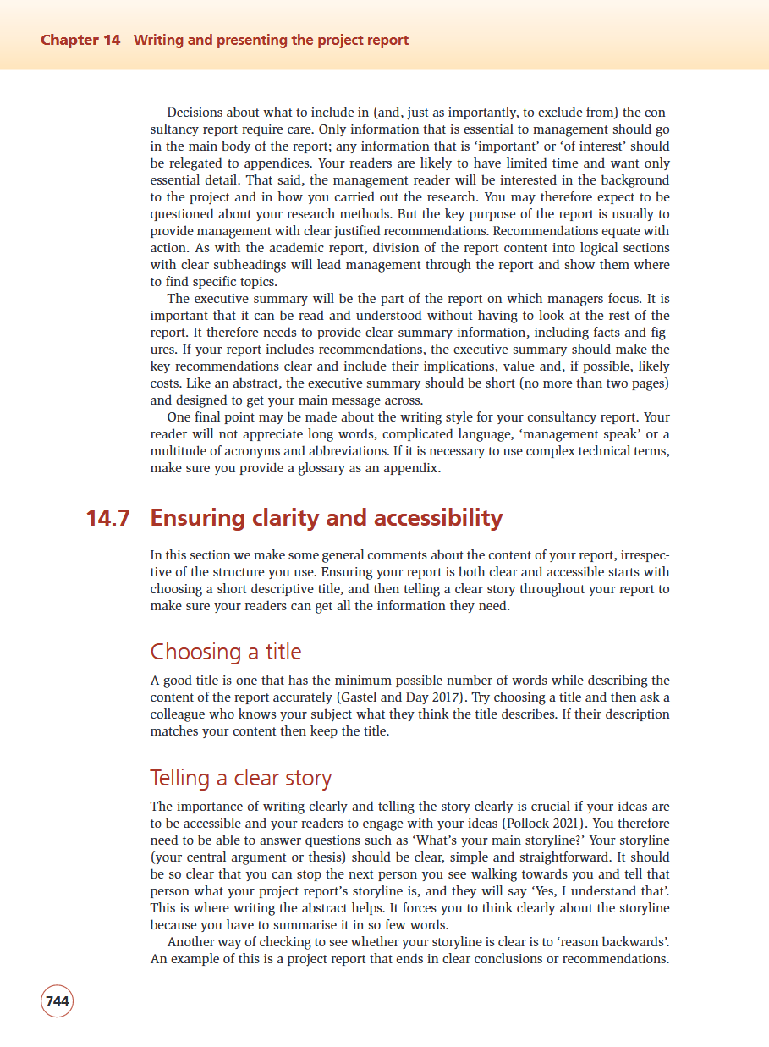
For @ Home:
👉 Read chapters 14.7 & 14.8 from Saunders et al. (2023)

Slide 25
Reviewing your Draft

Slide 26
A Quick Overview of the Writing Stages
WRITING PHASES
Topic
Core terms & concepts
Relevance & Context
Concept
Research objective & questions
PLANNING
Contant organisation
Formulating the work:
- Introduction
- Main part
- Conclusion
FORMULATING
Corrections - final editing
REVISION

Slide 27

Fine-Tuning your Text I
Fine tune via printout, not just on the screen
Focus on the text as a whole: order & message of the headings
Linguistic brevity 👉 Delete filler words
Verbs: strong contour, statement, coordinated with nouns
Syntactic balance: 1 verb → 6 nouns
Delete superfluous adjectives
(Nicolini 2001:131ff.)

Slide 28
Comprehensibility - a Question of Wording
indecisive language 👉 filler words
everywhere
known
respectively
notwithstanding
in this regard
If necessary
possibly
if necessary
in particular
ultimately
in principle
But worse
finally
so to speak
undoubtedly
(Nicolini 2001:89)

Slide 29
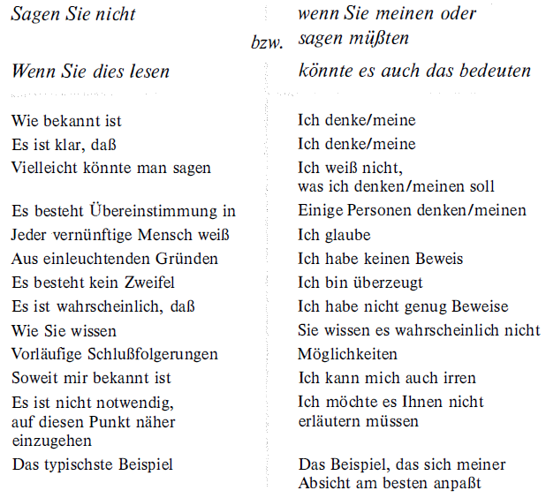
Comprehensibility - a Question of Wording
(Barrass 1983:30)

Slide 30
Pay Attention to the Positioning of Subordinate Clauses
From:
"In order to ensure that the text is tailored to the reader and easy to read, and thus immediately increases the recipient's comprehension, it is best to avoid inserting subordinate clauses."
To:
"If possible, one should refrain from inserting subordinate clauses. This keeps the text easy to read, fostering the recipient’s comprehension."
(Kruck 2010:117f.)

Slide 31
Do not Disempower the Main Clause I
From:
"The fact that he had to subject his text to another intensive content, formal and semantic check and therefore had a considerable additional workload made him angry."
To:
"He had to subject his text to another intensive check in terms of content, form and semantics, and that made him furious - especially because of the considerable amount of extra work involved."
(Kruck 2010:119f.)

Slide 32
Do not Disempower the Main Clause II
Avoid superfluous clauses, which shift the core statements to the subordinate clause:
The fact that ... cannot be dismissed out of hand.
Against the background that ... , it must be taken into account that ...
In view of the fact that ...
This chapter is about ...
What this example shows is that ...
(Kruck 2010:122)

Slide 33
One Change of Direction per Sentence
Sentences should not constantly jump back and forth in their statement
👉 Limitation to one change of direction
"She had major problems with the conception of her thesis because she couldn't manage the outline, even though she had attended a seminar to prepare for it, despite her busy schedule, because she still had to work!"
(Kruck 2010:125)

Slide 34
Fine-Tuning your Text II
Search & replace stereotypes
Search & replace nominalisations
Search & replace undecided language
Compact, not too short paragraphs
1 thought = 1 paragraph
Check text-image links
Transitions between paragraphs
Headings should “illuminate” the following text
(Nicolini 2001:131ff.)
Notes:
@Nominalisation: ...ung verb that wants out

Slide 35



Some Materials in German

Slide 36
Neutral Language

Slide 37
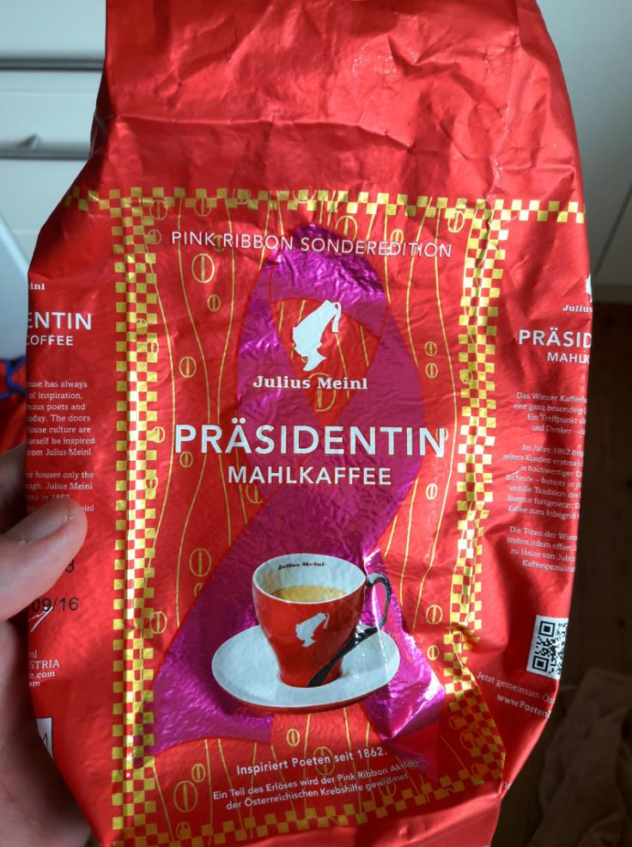

Slide 38

Gender-appropriate Formulation
Starting point: The "generic masculine"
Expression of established norms & power relations
👉 The "masculine" = linguistically overrepresented
"As early as 1840, mathematicians wrote the first the first 'computer programmes'" (BMUKK 2002:n.p.)
👉 Equal rights for women & men not depicted
Consequence:
Visualisation: Women must be made visible in language
Symmetry: Naming women & men equally & symmetrically
Notes:
Charles Babbage 1838 Difference engine → Lady Ada Lovelace Programmes with branches "first programmer"
# Lovelace Medal: British Computer Society since 1998

Slide 39


Gender-appropriate Formulation
Possibilities of visualisation:
Die Paarform: BSP: Viele Studentinnen und Studenten wählen …
Das Binnen-I: BSP: Die Pflichten der StudentInnen sind …
Der Schrägstrich, Gender-Gap & Gender-Stern BSP: Der/Die Schüler/in entscheidet sich für … BSP: Jede_r Teilnehmer_in wird … BSP: Jede*r Teilnehmer*in wird …
Strategie der Abwechslung: BSP: Die Autorin beschreibt Schüler bei …
Notes:
http://www.uni-graz.at/uedo1www_files_geschlechtergerechtes_formulieren-4.pdf

Slide 40
Gender-appropriate Wording ... Stay Relaxed 😉
"In this book, the masculine and feminine forms are used interchangeably when the gender of persons (groups) is unknown. This avoids cumbersome constructions as well as the generic masculine and still includes all genders." (Verheyen 2018:18)

Slide 41
Gender-appropriate Formulation - Symmetry
asymmetrical | symmetrical
The new Federal Chancellor Werner Faymann was accompanied by his wife Martina. | The new Federal Chancellor Werner Faymann was accompanied by his wife Martina Faymann-Ludwig.
A supporting programme is offered for women and children. | A supporting programme is offered for accompanying persons.
The University Council elected three new Vice Presidents at its meeting today. It followed the current President's list of nominations by a large majority and appointed Professor Maria Fischer, Professor Ernst Bäumel and Professor Günther Schneider to the Executive Board of the University. | At its meeting today, the University Council elected a new Vice President and two new Vice Presidents. By a large majority, it followed the list of proposals put forward by the incumbent President and appointed Professor Maria Fischer, Professor Ernst Bäumel and Professor Günther Schneider to the Executive Board of the University.
(Own compilation from: Fischer & Wolf 2009; LMU 2017)

Slide 42
Gender-appropriate Formulation - Symmetry
asymmetrical or sexist | symmetrical
Familie Hans Huber | Familie Huber
Mütterberatung | Elternberatung
Mannschaft | Team, Gruppe
Das schwache Geschlecht | Genereller Verzicht auf solche Formulierungen
Milchmädchenrechnung
Heulsuse
Ottonormalverbraucher
Seinen Mann stehen
(Own compilation from: Fischer & Wolf 2009; LMU 2017)

Slide 43
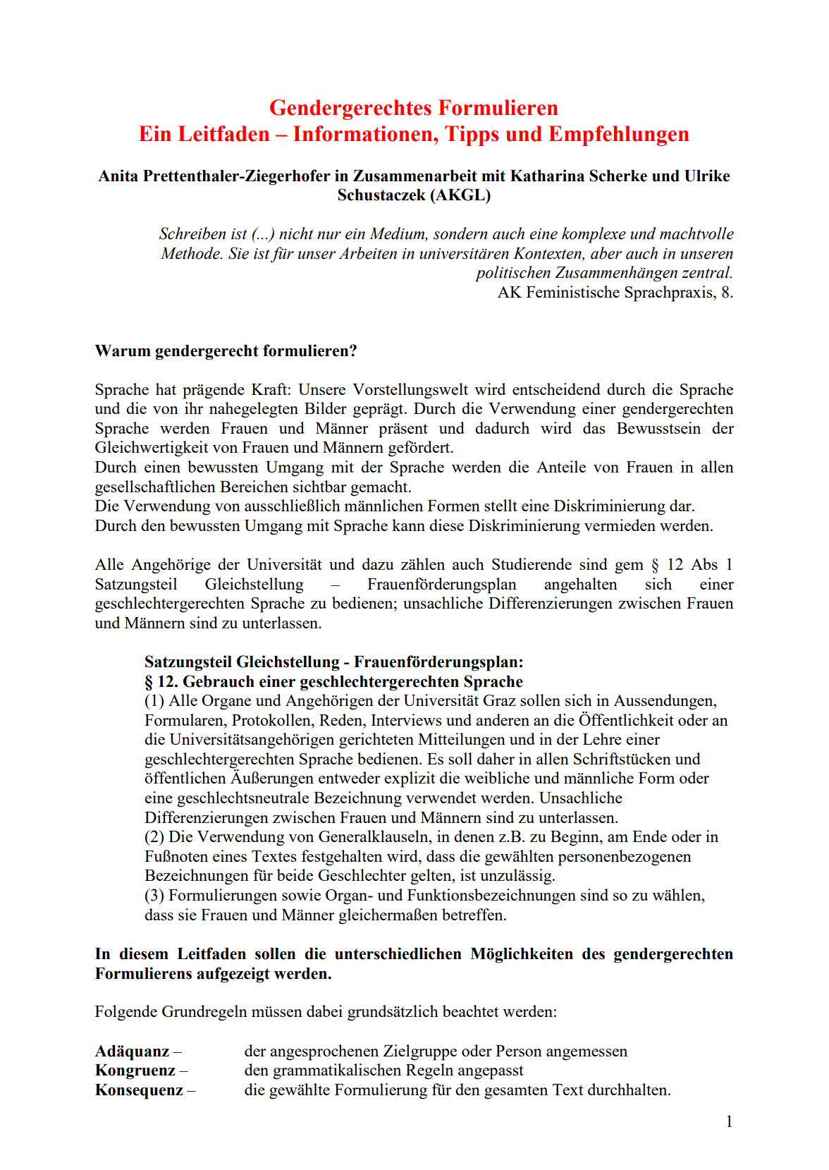


Some Materials
(Universität Graz, 2012; Stadt Wien, 2022; EU, 2018)

Slide 44
… and Citations?

Slide 45
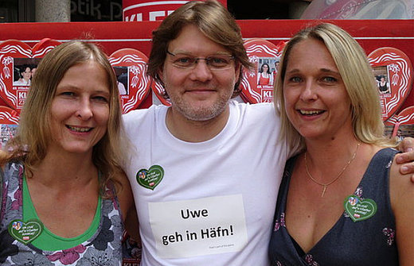
The literal (= direct) quotation
Let the author speak in the original → Avoid unwanted interpretations of the text
BSP: Introduction of a technical term, a definition, a central statement etc.
Problems:
Stylistic adaptation to your own text
Detached from the overall context
→ Rare, sparing use
→ No substitute for your own formulations!
(Der Standard, 2012)
Notes:
@ Overall context: ... go to Häfn

Slide 46
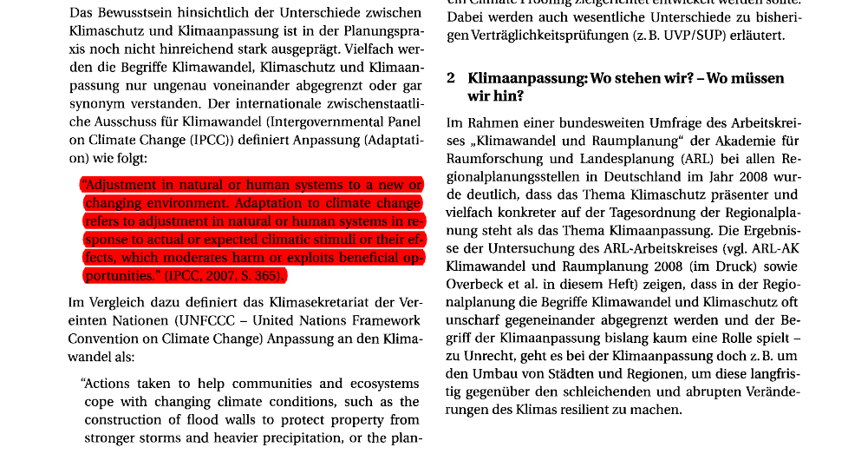
Example of a Direct Quote
(Birkmann & Fleischhauer 2009:115)

Slide 47
The Omission
The original (Ziai 2007: 16):
Poststructuralism, which can be described less as a theoretical school than as a loosely connected philosophical movement, emerged from the criticism of structuralism, in part by the structuralists themselves.
The quote:
"Poststructuralism [...] emerged from the critique of structuralism, in part already by the structuralists themselves" (Ziai 2007: 16).
ALWAYS indicate omissions with "[...]".
Notes:
Mark omission

Slide 48
The Indirect (= substantial, paraphrased) Quotation
Function: "Reproduction of content that is linguistically adapted to the context by the quoting author" (Jele 2006:47)
Or to put it another way: Adopting other people's statements in their own words
Attention: Reformulation ≠ Change/falsification
→ Standard form for citations

Slide 49
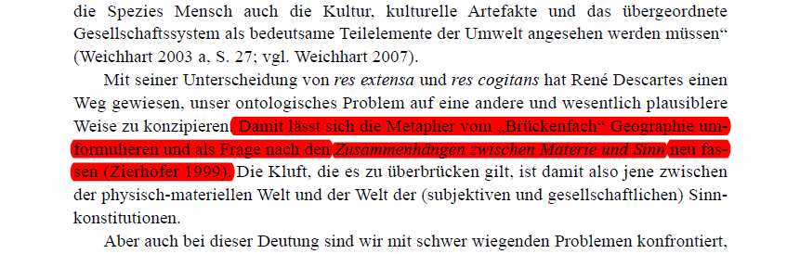
Example of an Indirect Quotation
(Weichhart 2008:61)

Slide 50
Citing, but How?
Two elements of a quotation:
Short reference in continuous text
Direct quote (Musterfrau 2000: 11).
Indirect quotation (Mustermann 2000: 12).
Long citation ("Bibliographic reference") in the list of sources:
Musterfrau, M. (2000): Title. Place, Publisher.
Notes:
* ... IBK-style → Ask lecturer

Slide 51
Citing, but How?
How to provide page numbers:
For a single page, use the abbreviation “p.”
e.g., p. 25, p. S41, p. e221
For multiple pages, use the abbreviation “pp.” and separate the page range with a dash
e.g., pp. 34–36
If pages are discontinuous, use a comma between the page numbers
e.g., pp. 67, 72
Notes:
* ... IBK-style → Ask lecturer

Slide 52
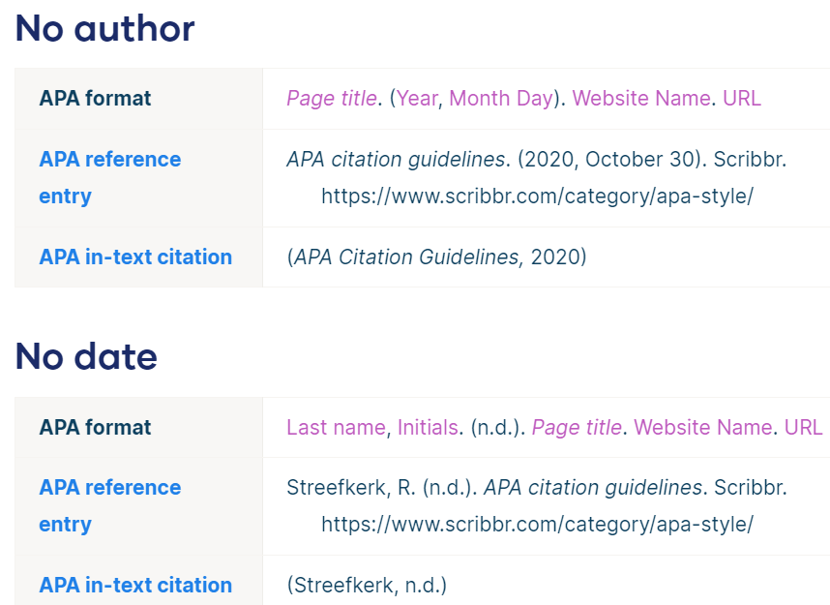
Citing, but How?
Missing bibliographic information:
No author | Use title in place of author.
No date | Use “n.d.” (“no date”) in place of date.
Notes:
* ... IBK-style → Ask lecturer

Slide 53
Location of Citations in a Scientific Paper
Long citation
Short references
(Heesen 2010: 30)

Slide 54
Where are the Short References placed in the Text?
Following the (partial) sentence to which the source reference refers
For numbers (→ secondary data): immediately afterwards
Reference to a longer paragraph whose content is taken from a work: End or beginning of the paragraph
In the following, I draw on Otto Kleiner's account, who points out that ... (Kleiner 1939:23-77).
As Kleiner (1939:23-77) on the concept of ...

Slide 55
Citing, but how?
Style: APA → No references in footnotes
Two elements of a document:
Short references in continuous text
Direct quote (Musterfrau 2000: 11).
Indirect quotation (Mustermann 2000: 12).
Long citation ("Bibliographic reference") in the list of sources:
Musterfrau, M. (2000): Title. Place, Publisher.
Notes:
* ... IBK-style → Ask lecturer

Slide 56
Components of a scient. thesis
Long quotes
Short references
(Heesen 2010: 30)

Slide 57
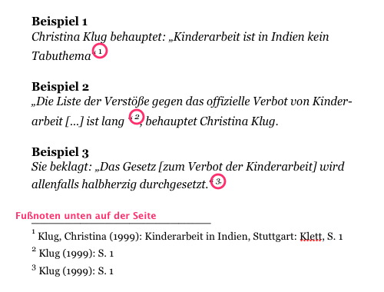
And Footnotes?
X
→ Footnotes = supplement to the argumentation
http://www.kreisgymnasium-neuenburg.de/images/665.png

Slide 58
Why footnotes?
"Footnotes [... can be used] to correct statements in the text. You are sure of your case, but you also realise that others disagree, or you believe that objections to your findings could be raised from a certain point of view. In this case, it is not only a matter of scientific fairness, but also a sign of a critical attitude to point out such limitations in a comment." (Eco 1993:212, quoted in Jele 2006:51, emphasis KMH)
👉 Footnotes = additions, explanations & digressions

Slide 59
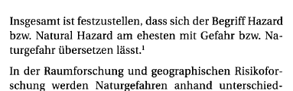
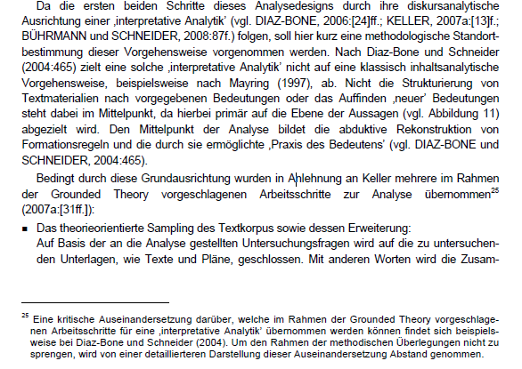
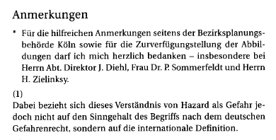
How to Footnote
Endnote
Page footer
(Birkmann 2008:7; Höferl 2010:51)

Slide 60
Wrap it Up

Slide 61
Wrap it Up!
Be clear, precise and logical in your wording
Use simple, fluent language and avoid complexity for its own sake
Apply technical terms accurately and consistently
Maintain a neutral, objective and factual tone
Prefer active voice and present tense for established knowledge
Avoid filler words, vague expressions and colloquial language
Structure your text: one idea per sentence, one focus per paragraph
Guide readers with meaningful headings and transitions
Revise for brevity and readability during editing
Use inclusive and gender-appropriate language throughout

Slide 62
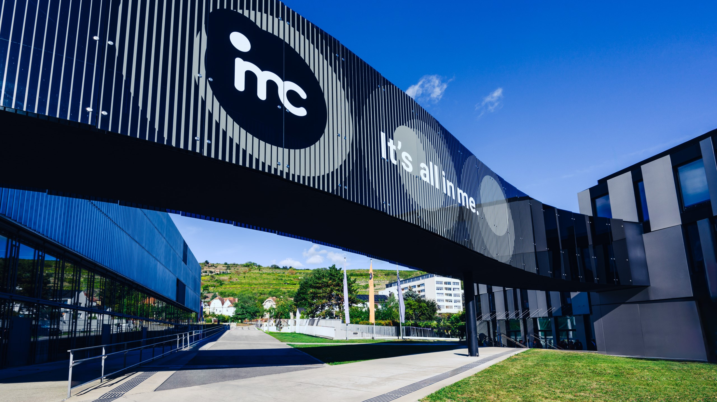
So long & cheerio!

