Slide 1
MACAU BUS ROUTE Data Science Project
Group H
SI Pui Lam, Bryce, M-B9-5549-1
KU Chon Tong, Don, M-B9-5512-3
NG CEN Andre, M-B9-5532-2

Slide 2
Presentation
Problem Statement
Data Collection and Cleaning
Visualization with Findings
Notes:
30 sec

Slide 3




Problem Statement
Macau Bus lines and bus stations changes over the years
Investigate the changes in the bus routes before and after
What are the standards and outputs of government strategies
Notes:
The bus transportation system in Macau has been developing frequently over the recent years, so its bus lines and bus stations also have been changing. Our objective is to investigate whether the changes in the bus routes before and after are really shown in our data.
15sec / already: 45sec

Slide 4


DATA COLLECTION AND CLEANING

Slide 5

Data Collection
Source: Macau Transport Bureau (DSAT)
Already Web-crawled at Github repository: macau-bus-data
the routes and stops information, schedule and geographical data.
Create Database
From multiples .json files convert to table structure
make it easier to be process by Pandas
create a sqlite database
Pick data from 2016 till 2019
filter out weekends
Notes:
So, first, our data is sourced from Macau Transport Bureau (DSAT),
and luckily we found a github repository with the historical data of the routes and stops information, schedule and geographical data we want.
yes, so we create our database
with the weekdays data from 2016 till 2019
20 secs/ 1 min 05 secs

Slide 6
Data Cleaning
Inconsistency in some bus stops
Inconsistency in some bus lines
Redundant Chinese characters used for explaining announcements
Notes:
We began the data cleaning by checking if our datasets have any inconsistency or redundant information, and we found the following main issues:
20 sec/ already: 1 mins 25 sec

Slide 7
Data Collection
Python Libraries used
shapely
Manipulation and analysis of geographical objects.
No burden with 100+ Geographic Information Systems(GIS) readers and writers
PostGIS geometry operations
peewee
Database mapping and operations
Designed to easy use, data can be get in clear coding
Notes:
What we have in our data was the coordinates of the bus stops, and bus moving gps location. So, in order to process this data, we use the “shapely” library, which help us to read and analyse geographic data, we choose it because it support many readers and can also do operations;
Then when dealing with our database, we use the “peewee” library, because it is very user friendly and we can get our data with a clear coding.
35 secs/ 2 mins 00 sec

Slide 8



VISUALIZATION WITH FINDINGS

Slide 9
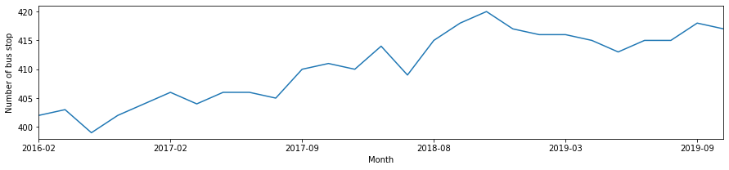

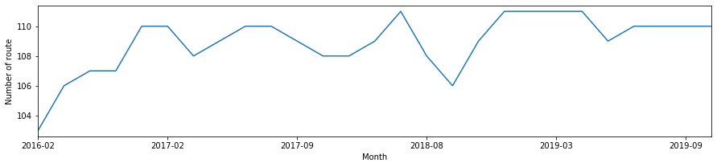
Visualization with Findings
Number of bus stops and bus routes
2016 FEB 2019 SEP
Notes:
We did simple statistics and found out that the number of bus stops and bus routes increased since 2016

Slide 10
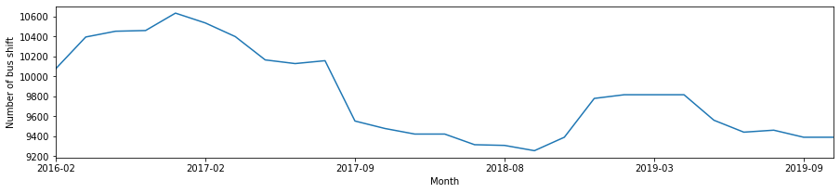
Visualization with Findings
Number of bus shifts
2016 FEB 2019 SEP
Notes:
However, the number of bus shifts declined!
So, in order to find how to interpret this, Bryce will show you more in our visualization.
20 secs/ 2 min 20 secs,

Slide 11
Visualization with Findings
Notes:
Bryce github link,
縮左前面啲對白, 而家剩2分鐘55秒你用.../ 5 mins

Slide 12
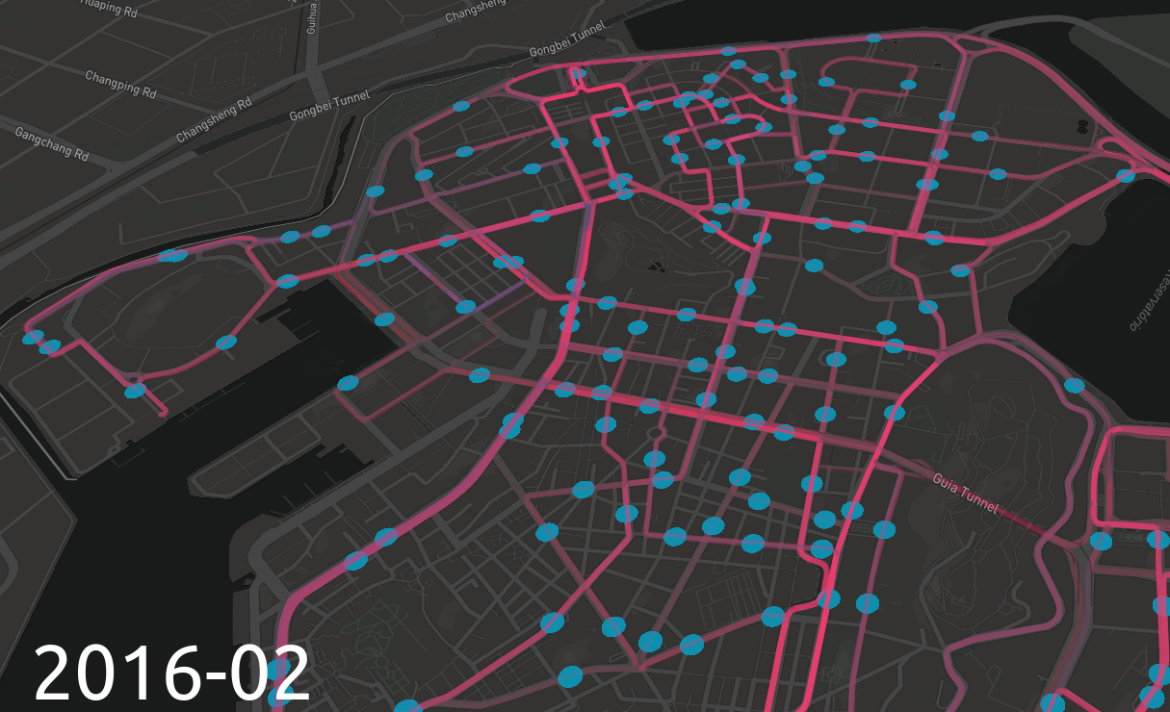
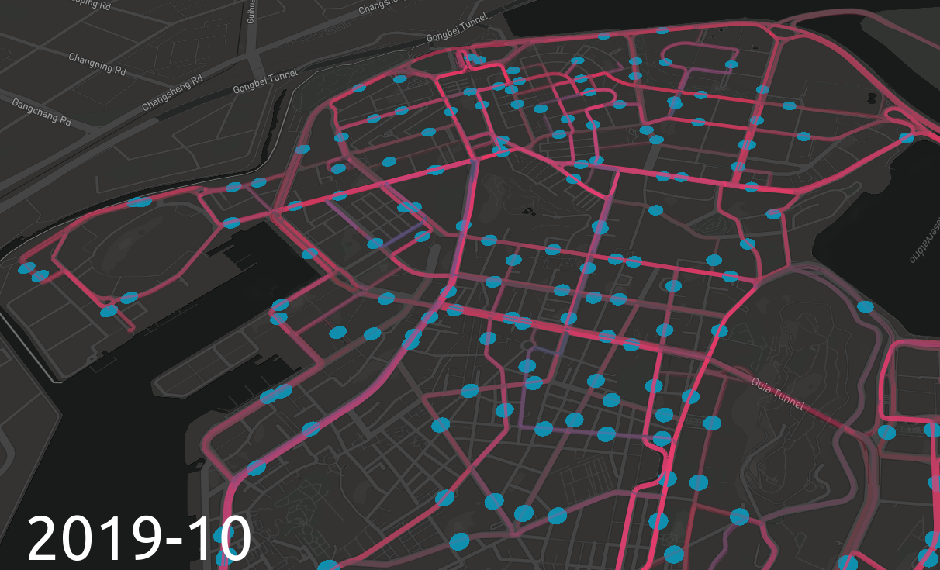

Slide 13
Notes:
找不同, 哈
係XD

Slide 14
Q & A

