Slide 1
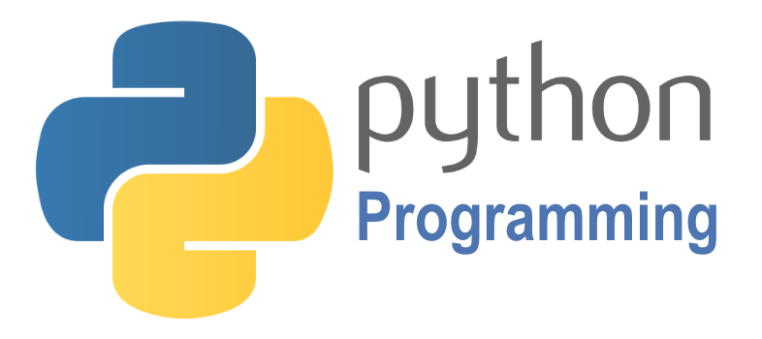

SCRIPTING
Course BIT07
Paco Hulpiau

Slide 2
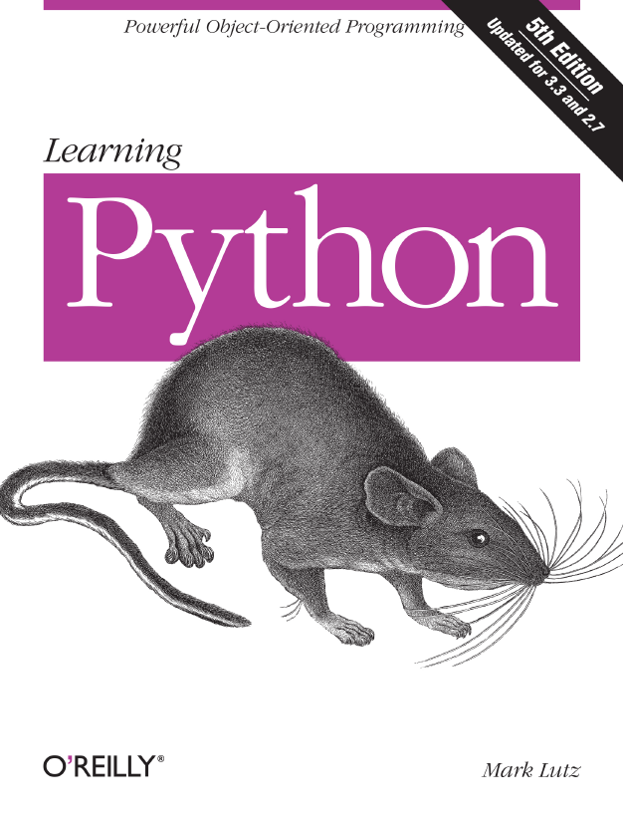
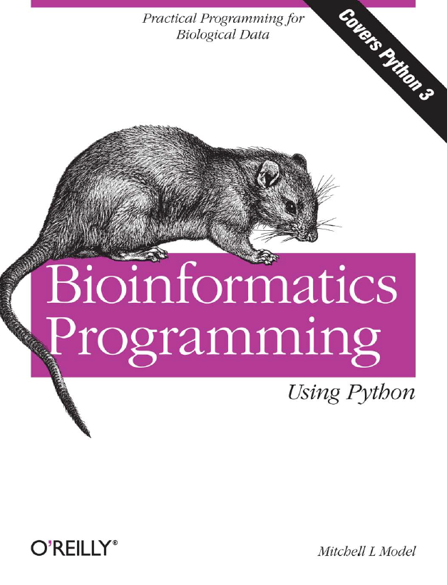
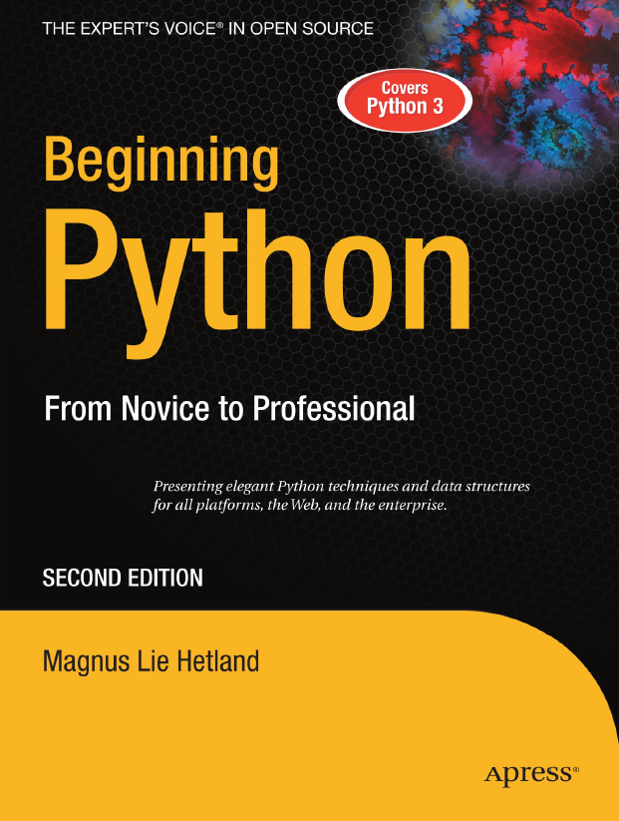
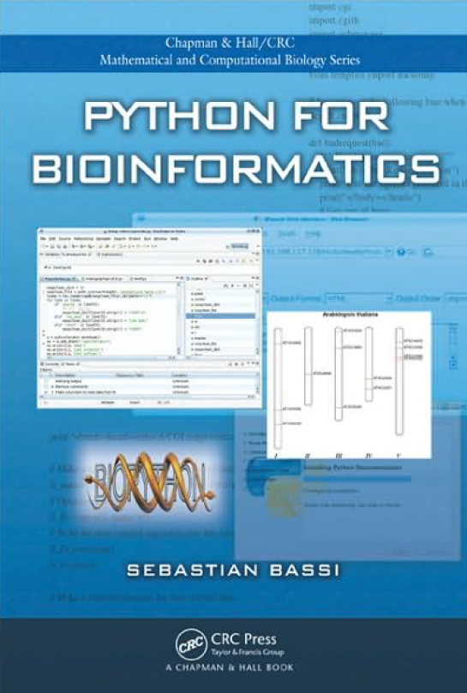
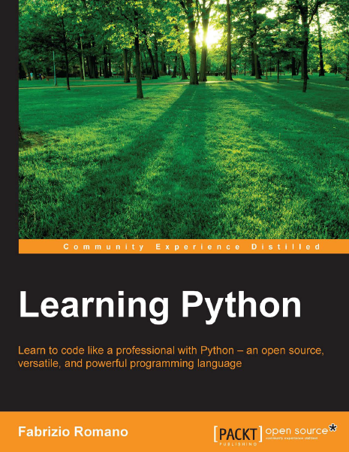
This course is inspired by these books
and by online resources

Slide 3
Overview course
Introduction
Data types and operations
Control statements
Functions and modules
Reading and writing files
Databases
Interactions with the web
Data science
Data visualization
Data analysis
Image processing

Slide 4
Introduction

Slide 5
Introduction
Python = general purpose programming language for small projects, also for larger applications
Great for simple scripting, data analysis, web scraping, machine learning
Lots of interesting packages (for bioinformatics)
Package managers: pip and anaconda

Slide 6
Introduction: Python 2 or Python 3
Python 2.x is legacy, Python 3.x is the present and future of the language
The final 2.x version 2.7 release came out in mid-2010 → The 2.x branch will see no new major releases
Python 3.0 was released in 2008 → 3.x is under active development → stable releases 3.6 from 2016, 3.7 from 2018, 3.8 from 2019 → in 2021 on June 28 version 3.9.6 was released

Slide 7
Introduction: Python 2 or Python 3
All recent standard library improvements → only available by default in Python 3.x.
Guido van Rossum (original creator of the Python language) decided to clean up Python 2.x properly → most drastic improvement better Unicode support
Introducing Python to new programmers → teaching Python 3 first → introducing the differences in Python 2 afterwards (if necessary)
Some current Linux distributions and Macs still use 2.x as default

Slide 8
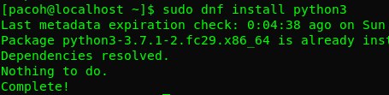
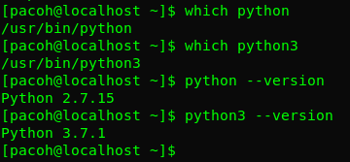
Introduction: installation
If not installed:
sudo dnf install python
sudo dnf install python3
Know where on your system:
which python
which python3
Check version:
python --version
python3 --version

Slide 9
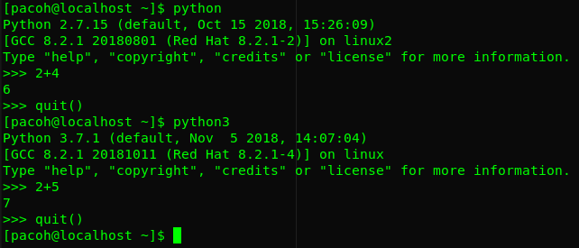
Introduction: installation
Try it!

Slide 10
Introduction: installation
You must have a code editor to create and edit your python scripts
The course will start with Visual Studio Code: https://code.visualstudio.com/download but you can also use your own favorite editor
Later we will also use the IPython Notebook known as Jupyter Notebook
Jupyter Notebook is an interactive computational environment in which you can combine code execution, rich text, mathematics, plots and rich media.

Slide 11
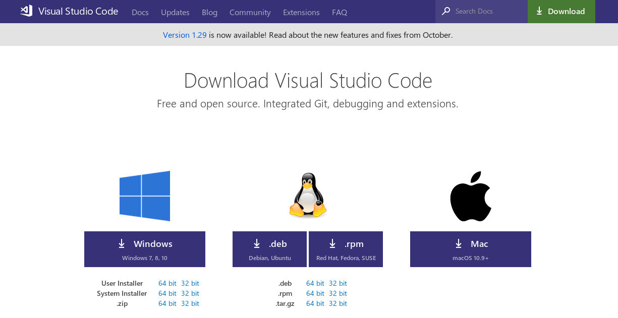
Introduction: installation

Slide 12
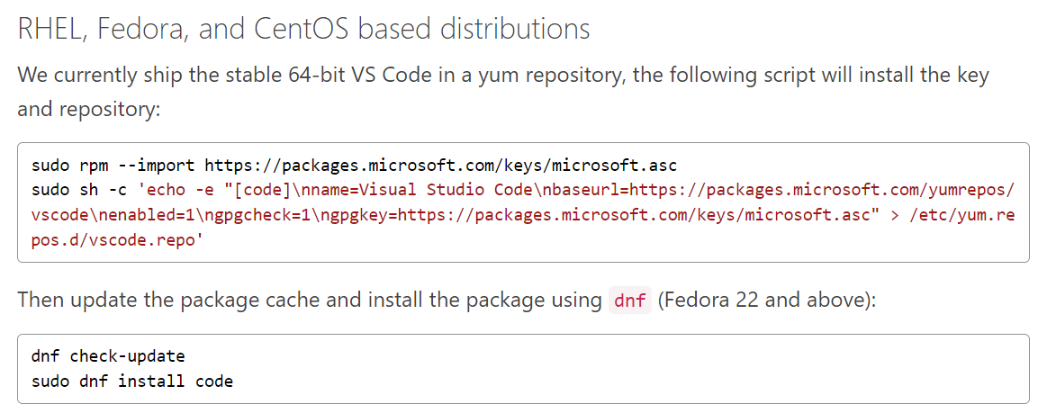
Introduction: installation
https://code.visualstudio.com/docs/setup/linux

Slide 13
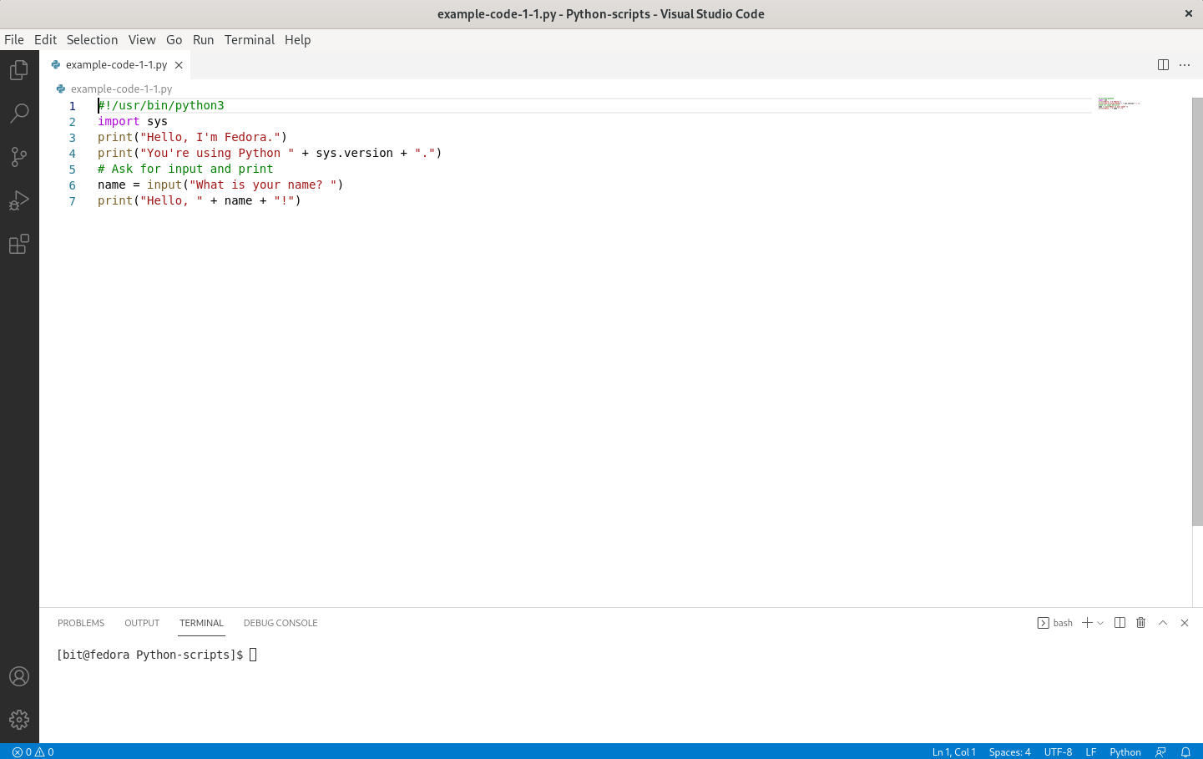
Introduction: installation

Slide 14
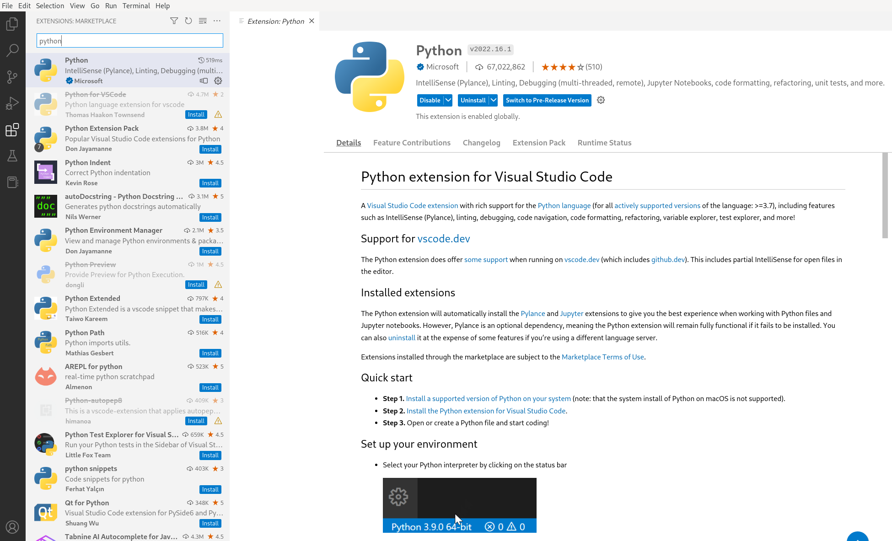
Introduction
Extensions

Slide 15

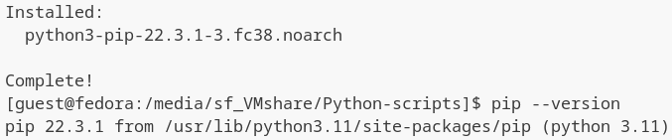
Introduction
PIP is a package manager for Python packages
A package contains all the files you need for a module
Modules are Python code libraries you can include in your project
If pip is not installed: sudo dnf install python3-pip

Slide 16
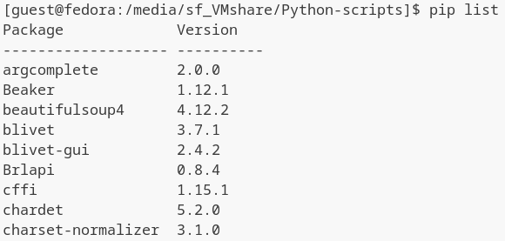
Introduction
Check PIP version: pip --version
List packages: pip list
Download a package: pip install packagename
Uninstall package: pip uninstall packagename

Slide 17
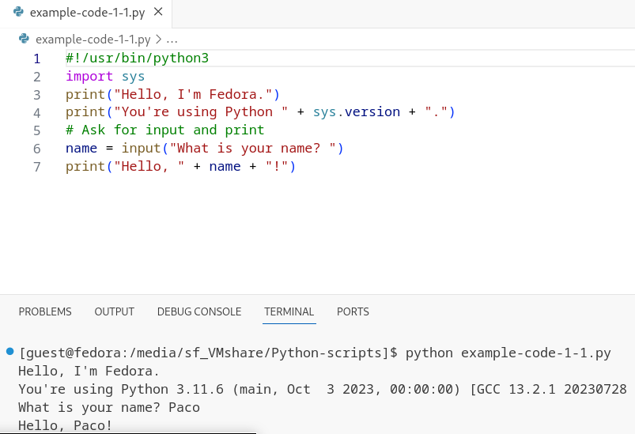
Introduction
Find more packages at https://pypi.org/
To use a package: import packagename e.g. import sys

Slide 18
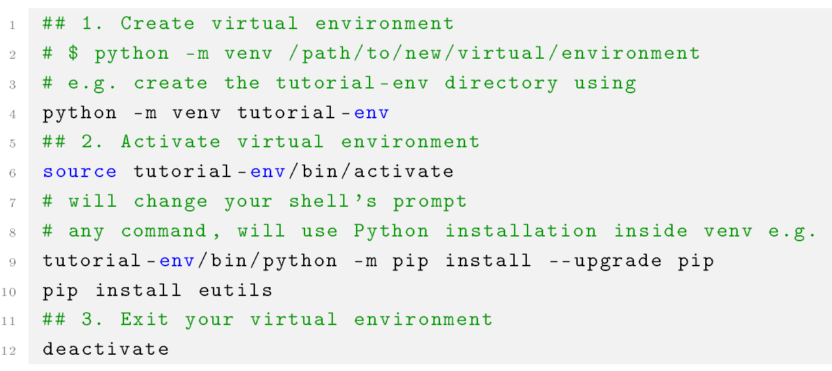
Introduction
Need different versions of the same package? → using a virtual environment (venv package standard as of Python 3.3) → will allow isolated package installation, can coexist on same system

Slide 19

Introduction: conda
Anaconda is a python distribution that comes preinstalled with lots of useful python libraries for data science
Popular because it brings many of the tools used in data science and machine learning with just one install → simple setup
https://www.anaconda.com/distribution/

Slide 20
Introduction: conda
Anaconda uses concept of creating environments → isolate different libraries and versions → own package manager called conda from where you can install libraries
Anaconda still has useful interaction with pip → allows you to install any additional libraries not available in Anaconda package manager

Slide 21
Introduction: conda
Conda package and environment manager is included in all versions of Anaconda, Miniconda and Anaconda repository
Anaconda Repository → enterprise server on your network or your private cloud where open source and proprietary packages may be stored, retrieved and shared
Anaconda Repository has a self-contained internal mirror of packages → can install securely behind an enterprise firewall

Slide 22
Introduction: conda
Choose Anaconda if you:
Like to have Python and 150 scientific packages automatically installed at once
Have time and disk space (minutes and 3 GB)
Don’t want to install each of packages you want to use individually
You will need to refresh packages you don’t need

Slide 23
Introduction: conda
Choose Miniconda if you:
Do not mind installing each of packages you want to use individually
Do not have time or disk space to install > packages at once
Just want fast access to Python and conda commands and sort out other packages later
Many packages are never used → could still be easily installed when needed
In Fedora: sudo dnf install conda

Slide 24
Introduction: conda
Installing e.g. bowtie2 for mapping .fastq read files using bioconda channel → might update and downgrade some packages!
To add bioconda channel as well as other channels bioconda depends on → add them in this order:
conda install -c bioconda bowtie2
conda config --add channels defaults
conda config --add channels bioconda
conda config --add channels conda-forge

Slide 25
Introduction
When program (Python script) is executed from text file rather than line by line (as interactive session) is called batch mode → extension .py → standard Python file
First line → path to python interpreter typically #!/usr/bin/python → is called shebang → unix convention so OS knows how to execute → without this line OS will try to execute as shell script

Slide 26
Introduction
.pyc file → “compiled” Python file → load faster but do not run faster → when importing Python module for first time it gets compile
.pyo file → “optimized” code → generated by running Python interpreter with -o flag → most code will run at same speed!
.pyw file → standard Python file makes Windows execute with python.exe → doesn’t launch DOS console → preferred for graphical programs in Windows

Slide 27
Introduction
The # character is used to identify lines that are not executed by interpreter → lines that begin with # symbol are “comments” → don’t add functionality → help programmer or other readers of code → can also be used to disable part of code → “comment-out”
The code indentation system in Python stands out → Python forces you to use indentation that you would/should have used anyway → feature of Python’s design philosophy: readability counts!

Slide 28
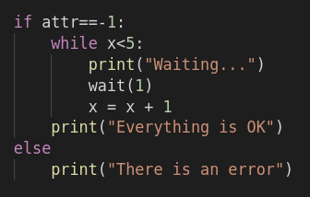
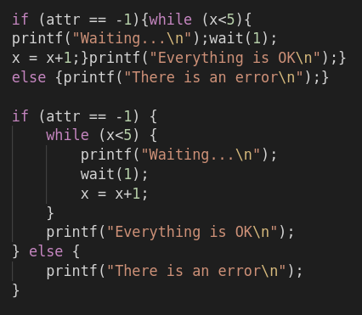
Introduction
No braces but code blocks defined by indentation!

Slide 29




Introduction
Without encoding comment Python’s parser will assume ASCII text
An encoding comment line defines character encoding for rest of document

Slide 30
Exercise 1.1
Matplotlib strives to produce publication quality graphics for interactive graphing, scientific publishing, user interface development → used in Python scripts, MATLAB and graphical user interface toolkits
Install matplotlib using dnf, pip OR conda:
dnf install python3-matplotlib
pip install --user matplotlib
conda install -c conda-forge matplotlib

