Slide 1
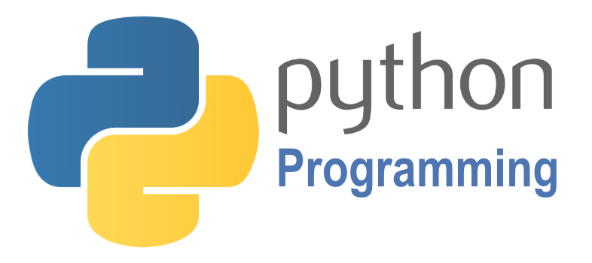

SCRIPTING
Course BIT07
Paco Hulpiau

Slide 2
Data types and operations

Slide 3
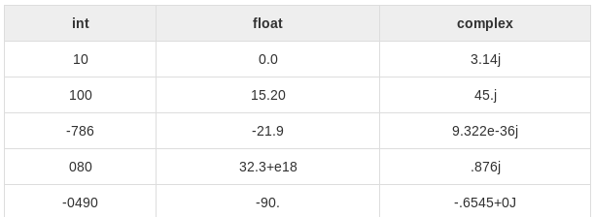
Data types and operations
Python has five standard data types for variables
Number → three different types: int (signed & long), float, complex
String
List
Tuple
Dictionary
Sets

Slide 4
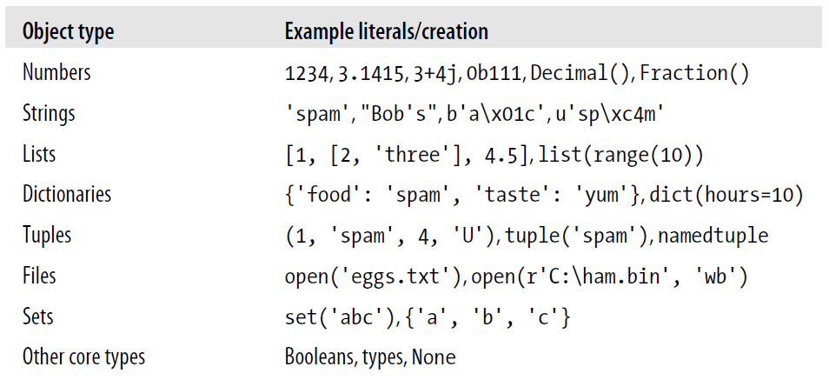
Data types and operations
Number
String
List
Tuple
Dictionary
Sets

Slide 5
Data types and operations
Variables → reserved memory locations to store values → upon creating a variable → reserve space in memory → based on data type of variable → interpreter allocates memory
Everything in Python is an object → if value can change object is called mutable: lists, dictionaries, sets → if value cannot change object is called immutable: numbers, strings, tuples

Slide 6
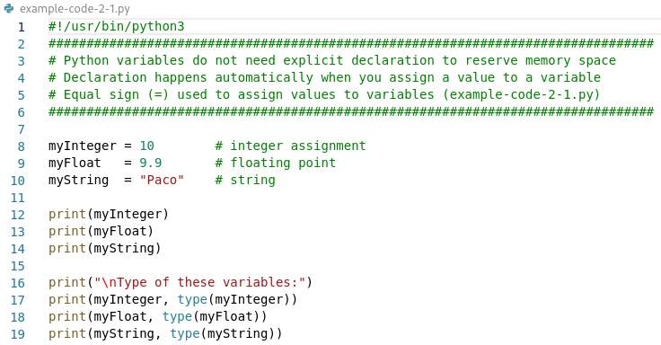
Data types and operations

Slide 7
Numbers
Signed integers → integers or ints are positive or negative whole numbers with no decimal point
Long integers → also called longs, are integers of unlimited size → written like integers and followed by an uppercase or lowercase L → no long integer in Python 3 anymore!

Slide 8
Numbers
Floating point real values or floats → real numbers written with decimal point dividing integer and fractional parts → may also be in scientific notation (with E or e indicating power of 10)
Complex numbers → form a + bJ where a and b are floats → J of j represents square root of -1 (imaginary number) → a is real part of number, b is imaginary part → not much used

Slide 9
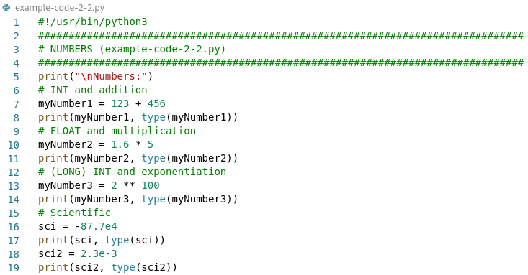
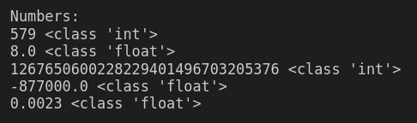
Numbers

Slide 10
Numbers
Number may need to be an explicit type e.g. as function parameter: int(x) → convert x to a plain integer float(x) → convert x to a floating-point number
Mathematical functions from math module always available → https://docs.python.org/3/library/math.html
Generate pseudo-random numbers with the random module → https://docs.python.org/3/library/random.html

Slide 11
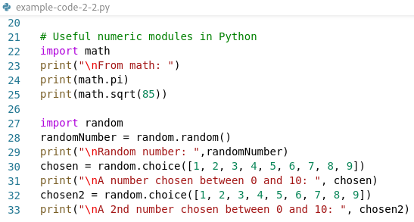
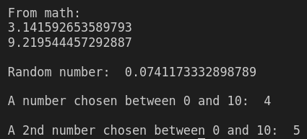
Numbers

Slide 12
Numbers: boolean
Python has explicit boolean data type called bool → values True and False available as preassigned built-in names → internally names are instances of bool → just a subclass of built-in integer type int → True and False behave like integers 1 and 0 → customized printing logic → print themselves as words True and False
>>> type(True)
<class 'bool'>

Slide 13
Sequences (in Python)
Sequence → fundamental data structure → data type having a sequential order → share common properties → have an order, can be indexed, can be sliced, can be iterated
String → ordered sequence of characters
Other sequences are lists and tuples

Slide 14
Strings
In a sequence indexes are coded as offsets from front and start from 0
Also index backward is possible → negative index count back from the right
Slicing (using :) is a way of extracting a section (slice) in one step → general form X[I:J] → give me everything in “X” from offset “I” up to but not including offset “J”
String methods available as built-in functions

Slide 15
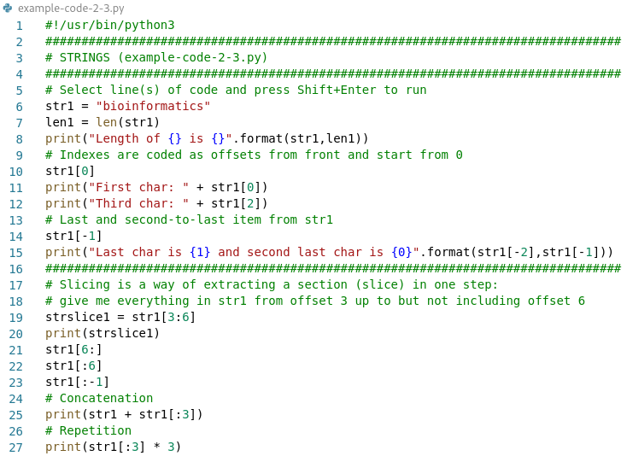
Strings

Slide 16
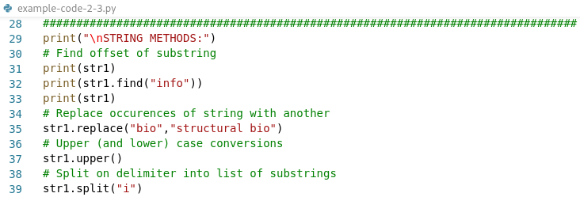
Strings

Slide 17
Strings
Method | Description
capitalize() | Converts first character to Capital Letter
count() | Returns occurrences of substring in string
isalnum() | Checks Alphanumeric Character
isalpha() | Checks if All Characters are Alphabets
lstrip() | Removes Leading Characters
rstrip() | Removes Trailing Characters
strip() | Removes Both Leading and Trailing Characters
rfind() | Returns the Highest Index of Substring
index() | Returns Index of Substring
rindex() | Returns Highest Index of Substring
rsplit() | Splits String From Right
splitlines() | Splits String at Line Boundaries
zfill() | Adds zeros (0) at beginning of string until it reaches the specified length
rjust() | Returns right-justified string of given width (adds whitespace)
More string methods:

Slide 18
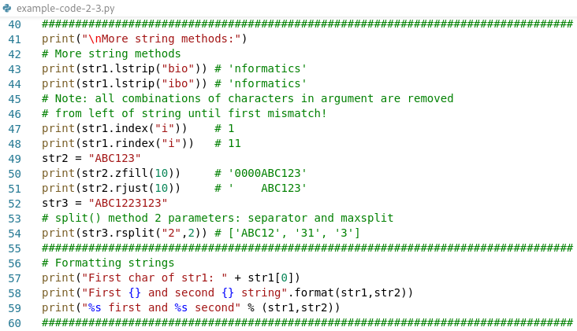
Strings

Slide 19
Formatting
String formatting with the % operator → advanced substitution operation → “old style” string formatting (% operator)
“New style” string formatting by calling .format()
>>> '%s, eggs, and %s' % ('spam', 'SPAM!') # Formatting expression (all, old style)
'spam, eggs, and SPAM!’
>>> '{0}, eggs, and {1}'.format('spam', 'SPAM!') # Formatting method (2.6+, 3.0+)
'spam, eggs, and SPAM!'
>>> '{}, eggs, and {}'.format('spam', 'SPAM!') # Numbers optional (2.7+, 3.1+)
'spam, eggs, and SPAM!’

Slide 20
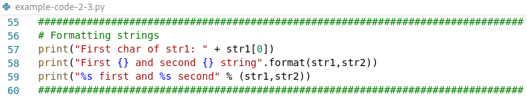

Strings

Slide 21
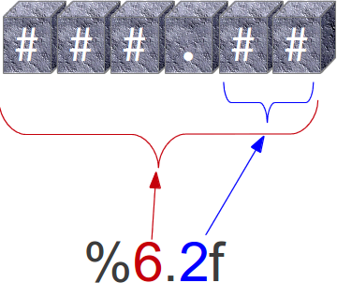
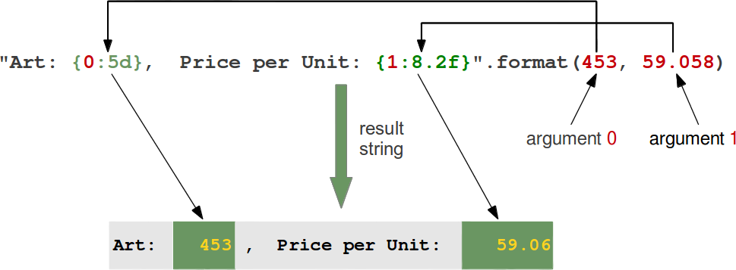
Formatting
Positional parameter of format method → place index of parameter after open brace e.g. {0} for first, {1} second, ...
“d” for int
“f” for float

Slide 22
Formatting
Index inside curly braces can be followed by a colon and a format string → e.g. {0:5d}
“d” for int
“f” for float

Slide 23
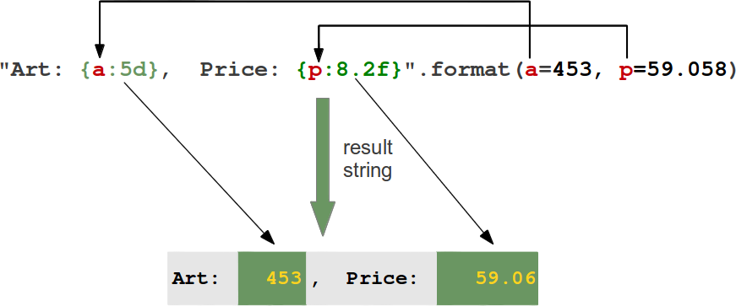
Formatting
Keyword parameters can also be used with the format method
“d” for int
“f” for float

Slide 24
Lists
List is the workhorse datatype in Python → one of most versatile object types in Python → ordered collection of objects → elements separated by commas and enclosed between square brackets → have no fixed size → are mutable → unlike strings, lists can be modified in place by assignment → flexible data type for representing arbitrary collections

Slide 25
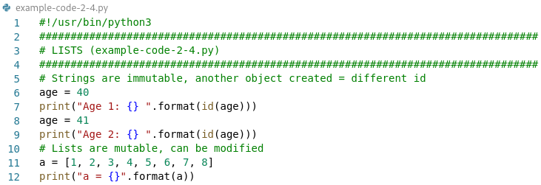
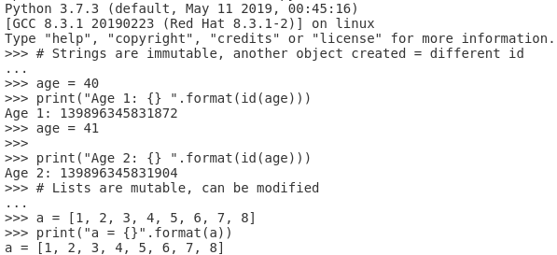
Lists

Slide 26
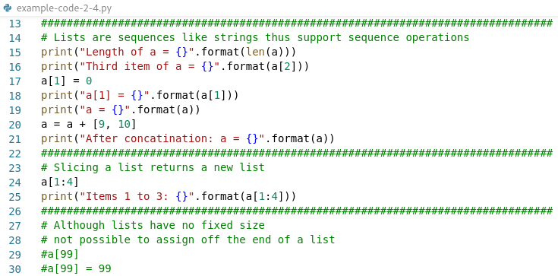
Lists

Slide 27
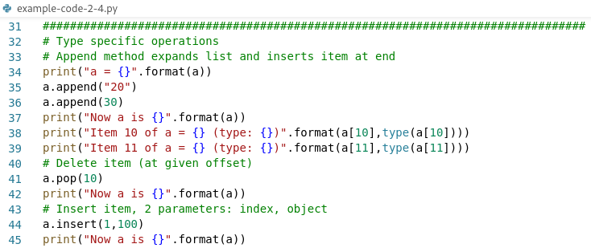
Lists

Slide 28
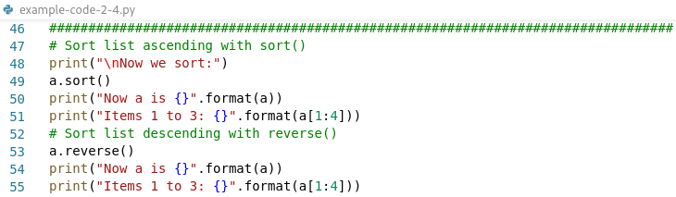
Lists

Slide 29
Lists
Nice feature of Python is support for arbitrary nesting of its core data types → in any combination and as deeply as we like → e.g. can be list containing a dictionary which contains another list and so on
One possible application is representing matrices or multidimensional arrays

Slide 30
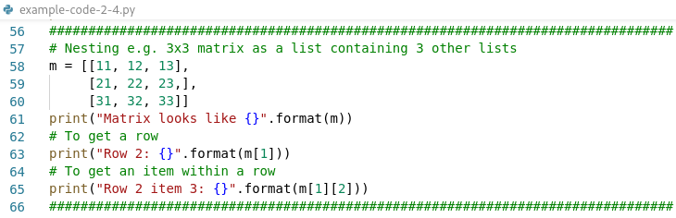
Lists

Slide 31
Tuples
Similar to lists but cannot be modified once created → immutable sequence that can contain any type of element → common use of tuples is simple representation of pairs e.g. x, y coordinates → also natural form for record-oriented data obtained from external source → written as comma-separated series of items surrounded by parentheses → one-element tuples must be written with comma after single element because parentheses used to group expressions

Slide 32
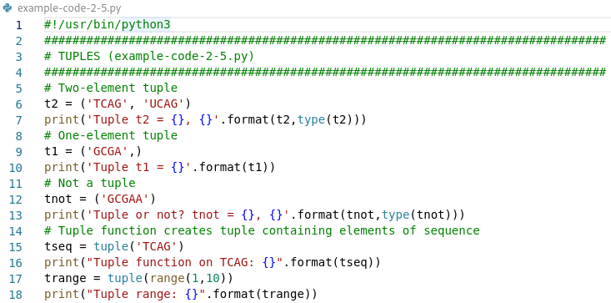
Tuples

Slide 33
Data types and operations
Unordered data types: dictionaries and sets
Dictionary → stores relationships between key and value
Set → just unordered collection of values

Slide 34
Dictionaries
Are not sequences but known as mappings → collections of other objects → store objects by key instead of by relative position → no order, simply map keys to associated values → are mutable → may be changed and can grow/shrink
example-code-04.py
D = {'A':'adenine', 'C':'cytosine', 'G':'guanine', 'T':'thymine'}

Slide 35
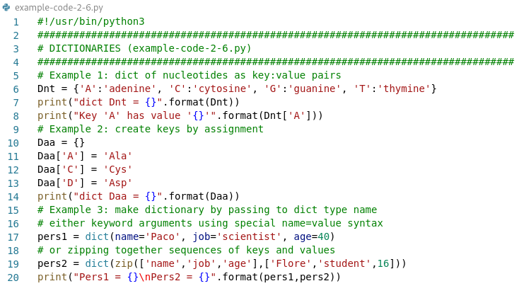
Dictionaries

Slide 36
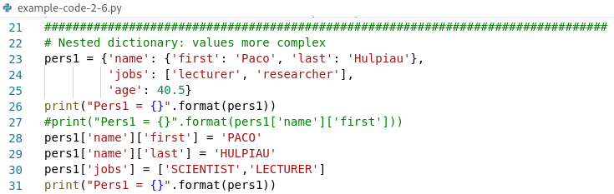
Dictionaries

Slide 37
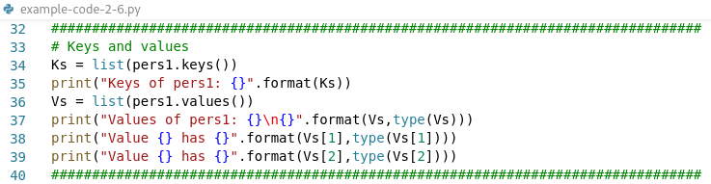
Dictionaries

Slide 38
Sets
A set is an unordered collection of unique items, that contains no duplicates cf. sequences which are ordered collections containing duplicate elements → recent addition to language, core type or not depends on definition → neither mappings nor sequences → immutable objects but set itself is mutable (can add or remove items)
Create set by calling built-in set() function or using new set literals and expressions in 3.X (and 2.7)

Slide 39
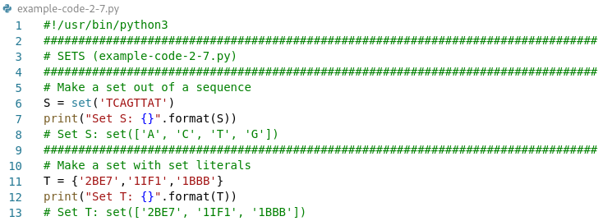
Sets

Slide 40
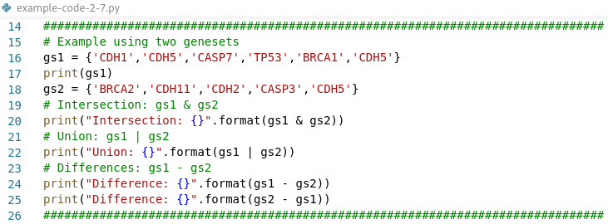
Sets

Slide 41
Summary data types/objects
Object type | Example
Numbers | 10 (int) 9,9 (float) | immutable
Strings | "MNKMDLVADVAE“ 'Paco' | immutable, sequence
Lists | [1, 2, 3, 4, 5] | mutable values, sequence
Tuples | ('TCAG', 'UCAG’) | immutable values, sequence
Dictionaries | {'A':'adenine', 'C':'cytosine’} Daa['A'] = 'Ala' dict(name='Paco', job='scientist', age=40) | mutable objects, collection, key:value pair
Sets | {'CDH1','CDH5’} set('TCAGTTAT') | immutable objects, collection, can add/remove items

Slide 42
Operators
Operators are special symbols in Python that carry out e.g. arithmetic or logical computation
The value that the operator operates on is called the operand
Example: >>> 2+3 → + is the addition operator → 2 and 3 are the operands → 5 is the output of the operation
Notes:
https://www.tutorialspoint.com/python/python_basic_operators.htm
https://www.programiz.com/python-programming/operators

Slide 43
Operators
Types of operators in Python:
Arithmetic Operators
Comparison (Relational) Operators
Assignment Operators
Logical Operators
Bitwise Operators
Membership Operators
Identity Operators
Notes:
https://www.tutorialspoint.com/python/python_basic_operators.htm
https://www.programiz.com/python-programming/operators

Slide 44
Operators
Arithmetic operators are used to perform mathematical operations like addition, substraction, multiplication, ...
Operator | Meaning | Example
+ | Add two operands or unary plus | x + y ; +2
- | Substract right operand from left or unary minus | x – y ; -2
* | Multiply two operands | x * y
/ | Divide left operand by right one | x / y (float)
% | Modulus, remainder of division | x % y
// | Floor division, division resulting in whole number | x // y
** | Exponent, left operand raised to power of right | x ** y

Slide 45
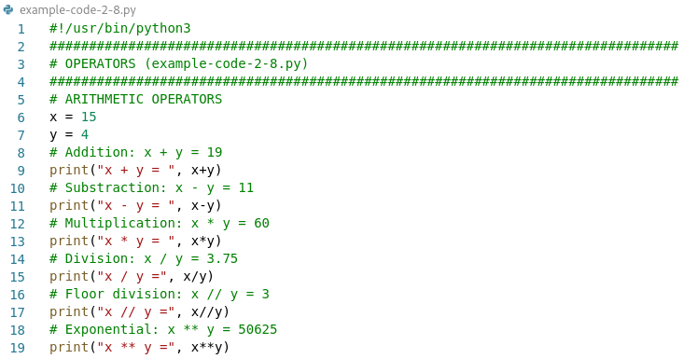
Operators

Slide 46
Operators
Comparison operators are used to compare values → either returns True or False according to condition
Operator | Meaning | Example
> | Greater than | x > y
< | Less than | x < y
== | Equal to | x == y
!= | Not equal to | x != y
>= | Greater than or equal to | x >= y
<= | Less than or equal to | x <= y

Slide 47
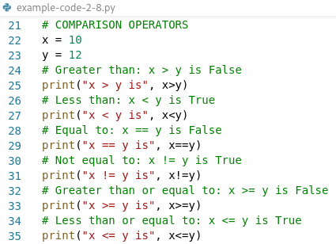
Operators

Slide 48
Operators
Assignment operators are used in Python to assign values to variables
Operator | Example | Meaning
= | x = 5 | x = 5
+= | x += 5 | x = x + 5
-= | x -= 5 | x = x - 5
*= | x *= 5 | x = x * 5
/= | x /= 5 | x = x / 5
%= | x %= 5 | x = x % 5
//= | x //= 5 | x = x // 5
**= | x **= 5 | x = x ** 5

Slide 49
Operators
Logical operators are the and, or, not operators
Operator | Meaning | Example
and | True if both operands are true | x and y
or | True if either of operands is true | x or y
not | True if operand is false (complements operand) | not x

Slide 50
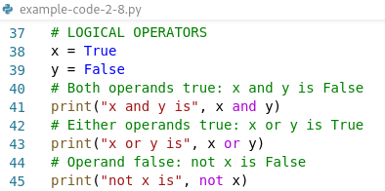
Operators

Slide 51
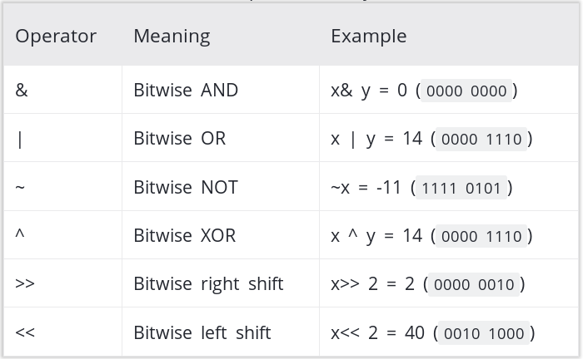
Operators
Bitwise operators act on operands as if they were string of binary digits → operates bit by bit

Slide 52
Operators
Python has special types of operators:
Identity operators: _is_ and _is not_ → are used to check if two values (or variables) are located on same part of memory; two variables that are equal does not imply that they are identical
Membership operators: _in_ and _not in_ → are used to test whether a value or variable is found in a sequence in Python
Notes:
“in” tests if two variables point the same object, not if two variables have the same value (“==“)

Slide 53
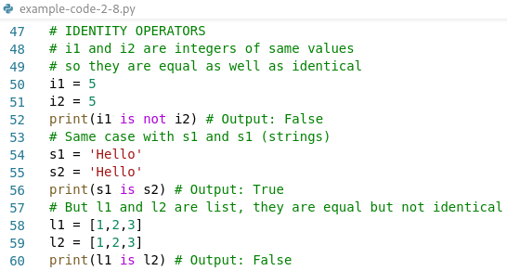
Operators

Slide 54
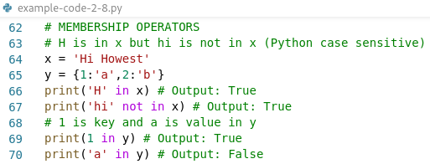
Operators

Slide 55
Exercise 2.1 : String methods
Write a Python script that takes input from the user and displays that input back in upper and lower cases
Write a Python script that takes a sequence and a motif, searches the motif and shows the position (not index) of the motif in the sequence
Write a Python script that takes a sequence and a cleavage site (split) and displays the sequence fragments after cleavage (split)

Slide 56
Exercise 2.2 : String slicing
A slice operation can specify a third number also following a colon. In the sequence string: MNKMDLVADVAEKTDLSKAKATEVIDAVFA
Take the slice [0:9:3]. What does the third number indicate?
What will be the output when you obtain the slice [16:0:-4]?
Explain what happens using the slice [:25:-1].

Slide 57
Exercise 2.3 : Lists
With list.append() and list.insert() we can add an element at the end or somewhere inside a list. Another method extend() appends the contents of a second list of elements to a first list.
Create a first list named “charged” with elements “Arg” and “Lys”.
Add a second list of elements “Asp” and “Glu” using list.extend().

Slide 58
Exercise 2.4 : Sets
What is the result of the following line of code? Explain. mySet = {1, 2, [3, 4]}
Make an empty set called Sprot. Add the following RefSeq identifiers one by one in Sprot: NP_001304113 and NP_001304114 Print the protein set.

Slide 59
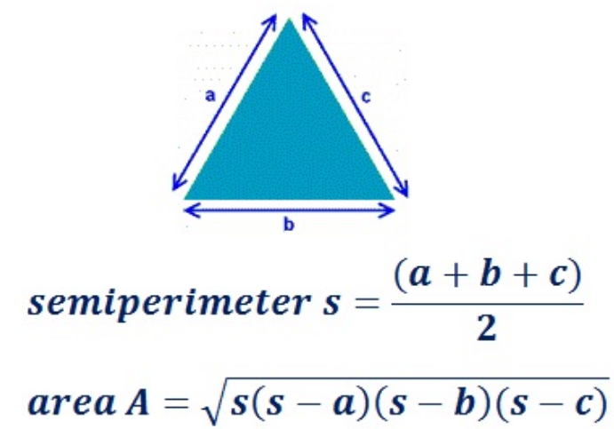
Exercise 2.5 : Operators
Write a Python script to calculate the area of a triangle using Heron’s formula:
E.g. a triangle having side lengths a = 18 cm, b = 12cm and c = 10 cm will have s = 20 cm and an area of 56,56 cm

