Slide 1
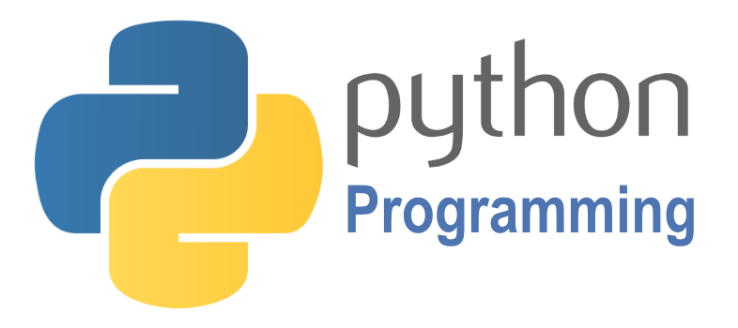

SCRIPTING
Course BIT07
Paco Hulpiau

Slide 2
Comprehensions & control statements
A comprehension creates a set, list or dictionary from the results of evaluating an expression for each element of another collection → core of comprehension: expression evaluated for each element of collection → expression! → statements are not permitted → different forms: list, set and dictionary comprehensions
comprehension
# ROLE: get results of evaluating expression
[expression for item in collection]

Slide 3
Comprehensions & control statements
Assignments (e.g. x = 1) and expressions (e.g. 2 + 2 combines values and operators) are simple statements and are comprised within a single line
Compound statements require at least one indented statement after first line and first line ends with a colon → e.g. control statements if, while and for → e.g. def for defining functions, with to use with files (next chapters)

Slide 4
Comprehensions & control statements
Control statements determine the order in which other statements are executed → order traditionally called control flow or flow of control
if/elif/else statement
while/else statement
for/else statement
# ROLE: selecting / conditionals
if "python" in text:
print(text)
# ROLE: general loops
while X > Y:
print('hello')
# ROLE: iteration
for x in mylist:
print(x)

Slide 5
Comprehensions

Slide 6
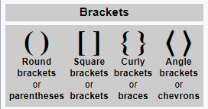
Comprehensions
A comprehension creates a set, list or dictionary from the results of evaluating an expression for each element of another collection
A comprehension is written surrounded by characters used to surround the corresponding type of collection value: square brackets [] for lists, curly brackets or braces {} for sets and dictionaries

Slide 7
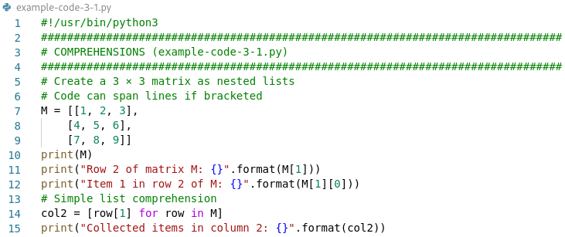
Comprehensions
Simplest form of comprehension for a list: [expression for item in collection]

Slide 8
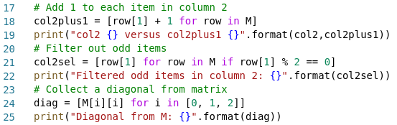
Comprehensions
One or more tests can be added → filtering using if condition → conditional comprehension: [expression for item in collection if test]

Slide 9

Comprehensions
Combination of collecting multiple values and using conditional statement in list comprehension

Slide 10
Comprehensions
Dictionaries are not sequences but mappings → collections of other objects → store objects by key
Object type | Example
Lists | [1, 2, 3, 4, 5] | mutable values, sequence
Dictionaries | {'A':'adenine', 'C':'cytosine’} Daa['A'] = 'Ala' dict(name='Paco', job='scientist', age=40) | mutable objects, collection, key:value pair
Sets | {'CDH1','CDH5’} set('TCAGTTAT') | immutable objects, collection, can add/remove items

Slide 11
Comprehensions
Set comprehensions work like list comprehensions enclosed in braces and produce a set: {expression for item in collection}
Dictionary comprehensions are also enclosed in braces, but they are a bit more complicated because they require key/value pairs: {key-expression: value-expression for key, value in collection}

Slide 12
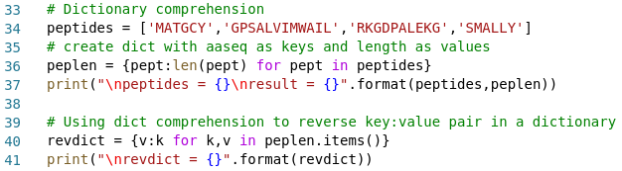
Comprehensions
Examples of dictionary comprehension:

Slide 13
Control statements

Slide 14
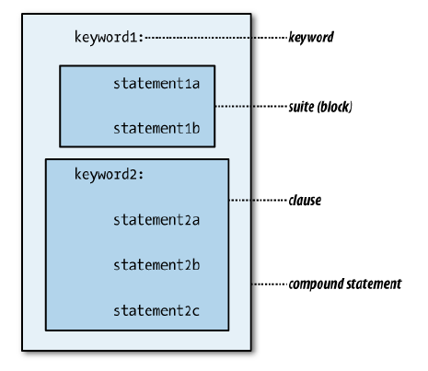
if/elif/else statement
# ROLE: selecting actions, conditionals
if "python" in text:
print(text)
multi-clause compound statement
while/else statement
# ROLE: general loops
while X > Y:
print('hello')
for/else statement
# ROLE: iterations
for x in mylist:
print(x)

Slide 15
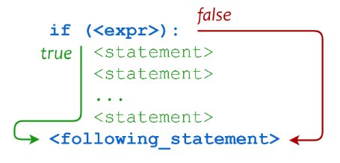
Conditionals: if statement
Most direct way to affect flow of control is with conditional statement → conditionals in Python are compound statements beginning with if
If expression is true statements are executed, otherwise skipped
Like if inside conditional comprehension but more powerful → followed by statements (comprehension limited to expressions)

Slide 16
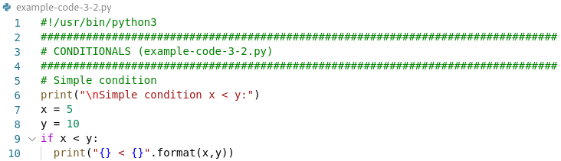
Conditionals: if statement
Example of simple conditional statement:

Slide 17
Conditionals: if statement
Several forms of conditional statements exist → choice between two groups of statements → two clauses: an if and an else
# Simple conditional
if expression:
statements
# One-alternative conditional
if expression:
statements1
else:
statements2

Slide 18
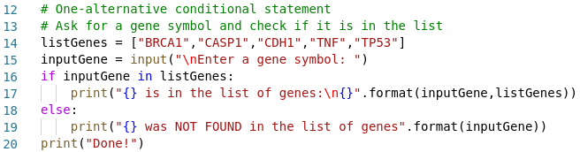
Conditionals: if statement
Example of one-alternative conditional statement:

Slide 19
Conditionals: if statement
Third form of conditional statement contains more than one test → if clause at beginning → all following test clauses start with keyword elif → may end with an else clause but not necessary
# Multi-test conditional
if expression1:
statements1
elif expression2:
statements2
# additional elif clauses
else:
statements

Slide 20
Conditionals: if statement
Expressions are evaluated in order until one is true → that clause’s statements are executed and rest of conditional is skipped
If none of expressions is true and there is an else clause its statements get executed
# Multi-test conditional
if expression1:
statements1
elif expression2:
statements2
# additional elif clauses
else:
statements

Slide 21
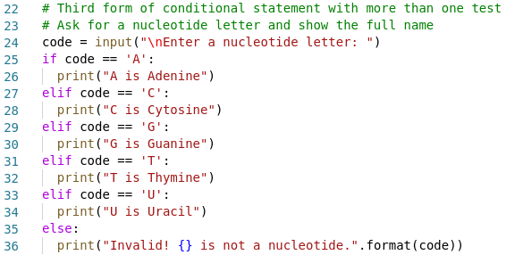
Conditionals: if statement
Example of a conditional statement with multiple tests:

Slide 22
Loops: while statement
A loop is a block of statements that gets executed repeatedly as long as some condition is true → using while statements
Once expression is false statements are skipped
# Loop
while expression:
statements

Slide 23
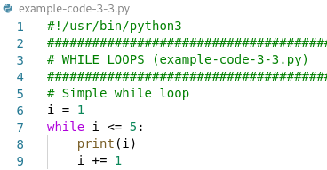
Loops: while statement
Example of simple while loop:
Adding one to itself → kind of step crucial in while loop → or it will be endless!

Slide 24
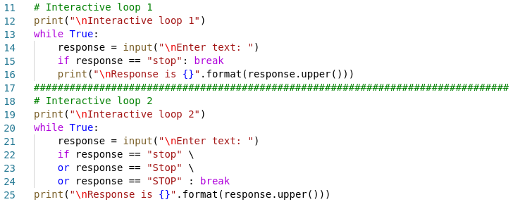
Loops: while statement

Slide 25
Loops: while statement
Test may be false first time it is evaluated → statements not executed
To execute some code once test is false include an else clause in loop
# Loop with final clause
while expression:
statements1
else:
statements2

Slide 26
Loops: while statement
Two simple statements associated with both loops and iterations (next section) → continue and break
Occasionally useful to interrupt execution of a loop’s statements
continue statement causes execution of loop to return to the test
break statement interrupts entire loop’s execution → causes script to continue with code following the while

Slide 27
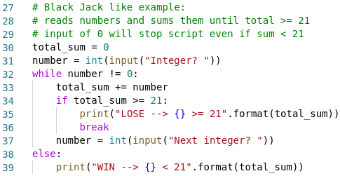
Loops: while statement
Example of while loop with else clause:

Slide 28
Loops: while statement
Version 1 → total sum < 21 → loop is exited normally after checking condition
Version 2 → total sum >= 21 → loop aborted by break, else is skipped

Slide 29
Iterations: for statement
Doing something to each element of a collection is called iteration → comprehensions are also a form of iteration → do something to every element → collect results into set, list or dictionary
Object type | Example
Lists | [1, 2, 3, 4, 5] | mutable values, sequence
Dictionaries | {'A':'adenine', 'C':'cytosine’} Daa['A'] = 'Ala' dict(name='Paco', job='scientist', age=40) | mutable objects, collection, key:value pair
Sets | {'CDH1','CDH5’} set('TCAGTTAT') | immutable objects, collection, can add/remove items

Slide 30
Iterations: for statement
Collections contain objects → some built-in functions e.g. min, max, any, all work for any type of collection
Object type | Example
Lists | [1, 2, 3, 4, 5] | mutable values, sequence
Dictionaries | {'A':'adenine', 'C':'cytosine’} Daa['A'] = 'Ala' dict(name='Paco', job='scientist', age=40) | mutable objects, collection, key:value pair
Sets | {'CDH1','CDH5’} set('TCAGTTAT') | immutable objects, collection, can add/remove items

Slide 31
Iterations: for statement
Operators in and not in accept any type of collection as their second operand
Iteration statements all begin with keyword for
Comprehensions allow only expressions → no action/statement on each element
Comprehensions cannot stop before end of collection is reached
# Iteration
for item in collection:
do something with item

Slide 32
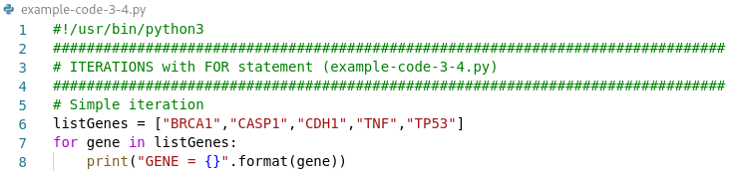
Iterations: for statement
Examples of iteration:

Slide 33
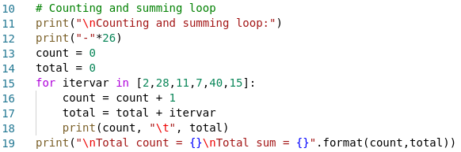
Iterations: for statement

Slide 34
Iterations: for statement
By default dictionary iteration uses the dictionary’s keys → but iteration can be performed with keys, values or key/value pairs → to iterate and use its keys or values → call keys or values method explicitly → to iterate with both keys and values at same time → call items method
# Dictionary iteration keys
for key in dictionary.keys():
do something with key
# Dictionary iteration values
for value in dictionary.values():
do something with value
# Dictionary iteration key/value pairs
for key, value in dictionary.items():
do something with key and value

Slide 35
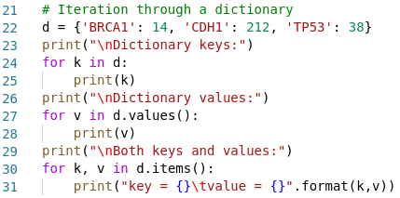
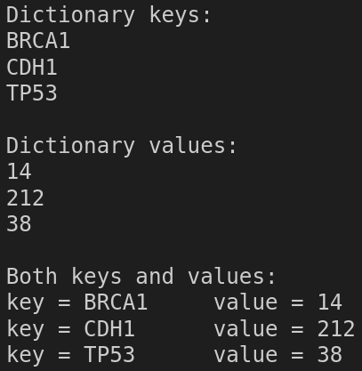
Iterations: for statement
output

Slide 36
Iterations: for statement
Sometimes useful to generate sequence of integers along with values → function enumerate(iterable) generates tuples of form (n, value) → n starting at 0 and incremented with each value taken from iterable
Common use for enumerate → print elements of collection along with numbers
# Numbering iteration
for n, value in enumerate(iterable):
do something with n and value
print(n, value, sep='\t')

Slide 37

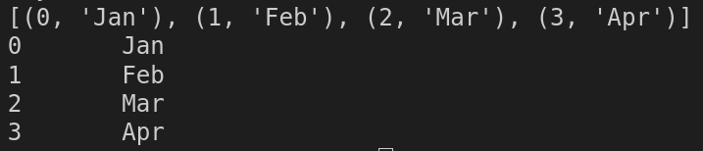
Iterations: for statement

Slide 38
Iterations: for statement
To iterate through a range of values e.g. from 0 to 4
For larger range better option is using the built-in range() function → returns an iterable containing a sequence of integers starting with 0
for n in (0, 1, 2, 3, 4):
do something with n
x = range(20)
for n in x:
do something with n

Slide 39
Iterations: for statement
range() returns an iterable object of class range (not a list or tuple of values) → range object is iterable → get all values from range at once with list() or tuple()
Adding extra parameters can return an iterable with integers → starting with <begin> up to but not including <end> → <stride> indicates amount to skip between values (default 1 when omitted)
range(<begin>, <end>, <stride>)

Slide 40
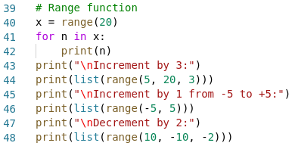
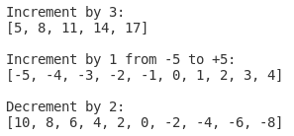
Iterations: for statement
output

Slide 41
Iterations: for statement
for statements often used → programming using collections → easy to read and write → works for collections that aren’t sequences → sets and dictionaries → also works with objects of broader range of types categorized as iterables e.g. file objects
# File iteration
for line in file:
do something with line

Slide 42
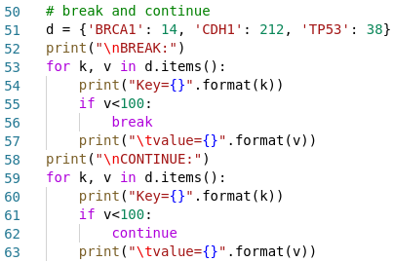
Iterations: for statement
break and continue statements work same way with for loops as with while loops
break terminates loop completely and proceeds to first statement after loop
continue terminates current iteration and proceeds to next iteration

Slide 43


Exercises 3.1 : Comprehensions
Write a script that makes a new list with only the even elements of a given list
Write a script that returns ages for a given list of years of birth

Slide 44
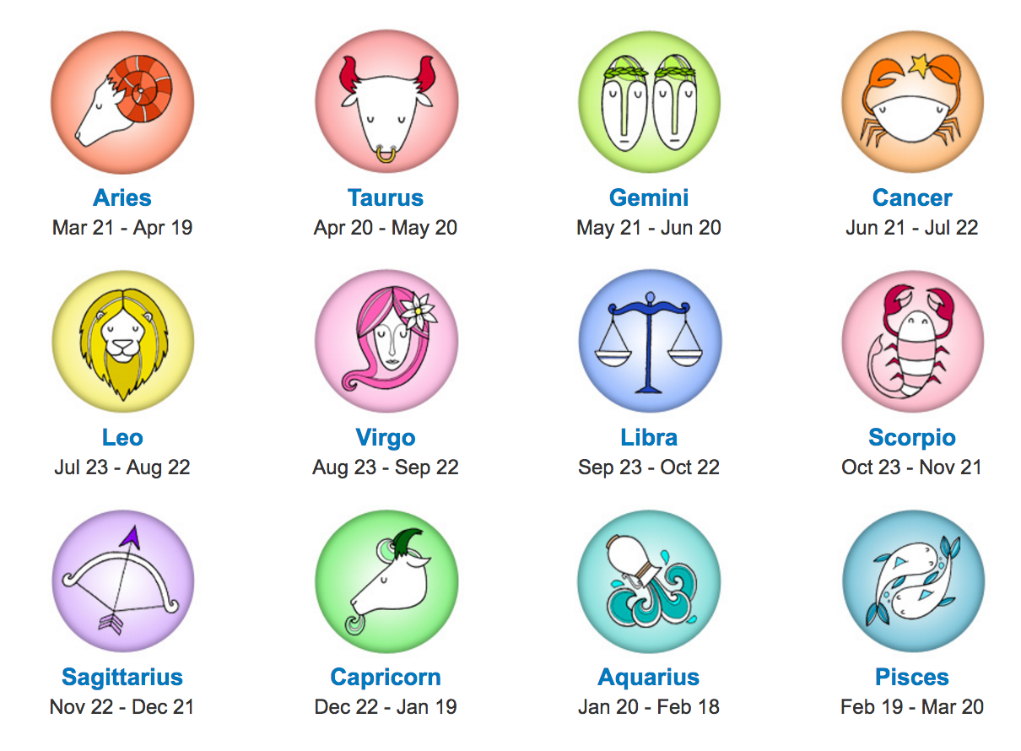
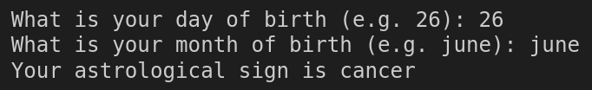
Exercises 3.2 : if conditional
Write a Python script that prints the astrological sign for a given date of birth
e.g.

Slide 45
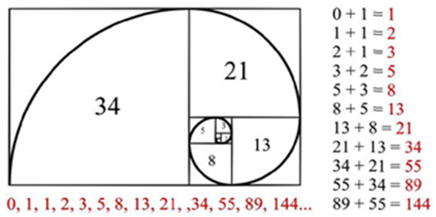
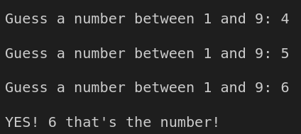
Exercises 3.3 : while loop
Write a Python script to get the Fibonacci series between 0 to 50 Fibonacci sequence of numbers : 0, 1, 1, 2, 3, 5, 8, 13, 21, .... (starts with 0 and 1, next element of series sum of two previous elements)
Write a script to guess a number between 1 to 9

Slide 46
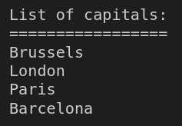
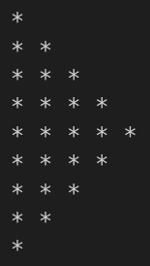
Exercises 3.4 : for iteration
Create a dictionary of countries (keys) and capitals (values) and write an iteration that prints a list of the capitals (values)
Write a script to construct the following pattern using a nested loop (n=5)

Slide 47
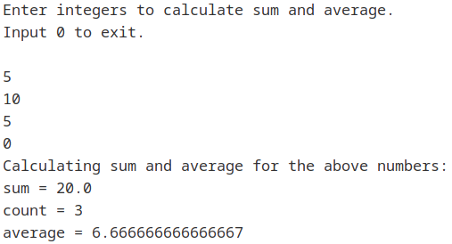
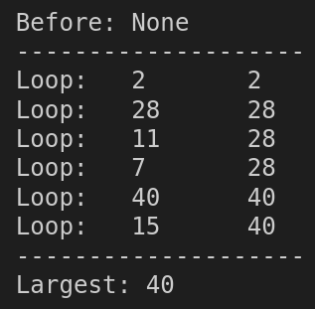
Exercises 3.5 : combined control statements
Write a script to get the largest number from a list
Write a script to calculate the sum and average of n integer numbers given by the user (input 0 to finish)

Slide 48
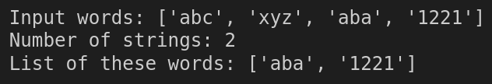
Exercises 3.5 : combined control statements
Write a script to count number of strings where length is 2 or more and first and last character are same from a given list of strings

