Slide 1


SCRIPTING
Course BIT07
Paco Hulpiau

Slide 2
The filesystem

Slide 3
The filesystem
The os module contains environmental values and operations similar to those in the sys module
Mostly it provides operations for manipulating files and directories
Functions in os raise an OSError when → given arguments are of wrong type → paths are invalid (e.g. file does not exist) → no permissions to paths to files or directories

Slide 4
The filesystem
Two variables provided by os module:
os.sep : string used to separate path components → "/" on Unix-based system and "\\" on Windows
os.environ : dictionary containing names and values of environment variables from operating system → assigning os.environ[varname] will change environment variable inside and outside Python!

Slide 5
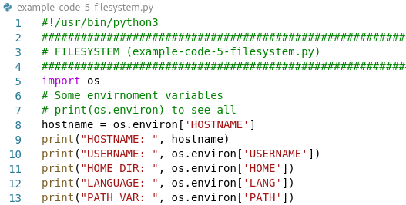

The filesystem
output

Slide 6
The filesystem
Common directory-related functions:
Function | Purpose
os.getcwd() | Returns current working directory
os.chdir(path) | Makes path the working directory
os.mkdir(path) | Creates directory at path
os.rmdir(path) | Removes directory at path

Slide 7
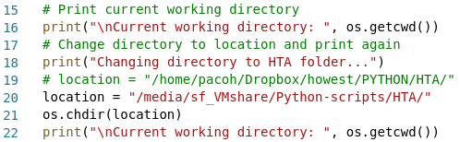

The filesystem
output

Slide 8
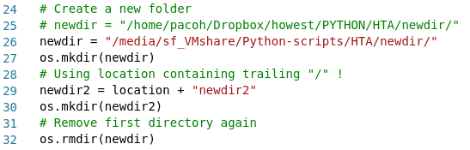
The filesystem

Slide 9
The filesystem
Common file-related functions:
Function | Purpose
os.remove(path) | Removes the file specified by the path
os.rename(sourcepath, destpath) | Renames the file at sourcepath to destpath
os.startfile(path) | Opens the file at path using its associated application

Slide 10
The filesystem
Two useful functions in os to deal with directory contents:
Function | Purpose
os.listdir(path) | Returns a list of names of files and directories at path
os.walk(path) | Produces the names of all files and directories at path and below; for each directory encountered it produces a tuple: (directory-path, subdirectory-names, filenames); returned value by os.walk is iterable

Slide 11
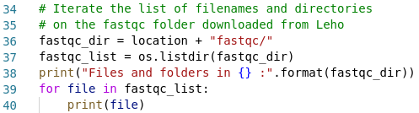
The filesystem

Slide 12
The filesystem
For creating new output file with name that doesn’t conflict with existing files → module tempfile can take care of this using following functions:
Function | Purpose
tempfile.makestemp( [suffix, [prefix, [dir, [text]]]]) | Create and return absolute path of temporary file with name including suffix at end and prefix at beginning
tempfile.makedtemp( [suffix, [prefix, [dir]]]) | Create and return absolute path of temporary directory
tempfile.gettempdir() | Returns path of current default directory for creating temporary files and directories

Slide 13
The filesystem
The submodule os.path contains functions for manipulating paths → e.g. breaking path apart into components in various ways
Function | Purpose
os.path.split(path) | Returns a pair (head, tail) where tail is file part of path (if any) and head is directory part (if any)
os.path.dirname(path) | Returns file part of path (first element split pair)
os.path.basename(path) | Returns directory part of path (second element of split pair)
os.path.splitdrive(path) | Returns a pair (drive, tail) where drive is drive specification (if any) and tail is remainder of path

Slide 14
The filesystem
If you only need to test something about a path and get information:
Function | Purpose
os.path.exists(path) | Returns True if there is a file or directory at path
os.path.isfile(path) | Returns True if there is a file at path
os.path.isdir(path) | Returns True if there is a directory at path
os.path.getsize(path) | Returns the size in bytes of the file at path

Slide 15
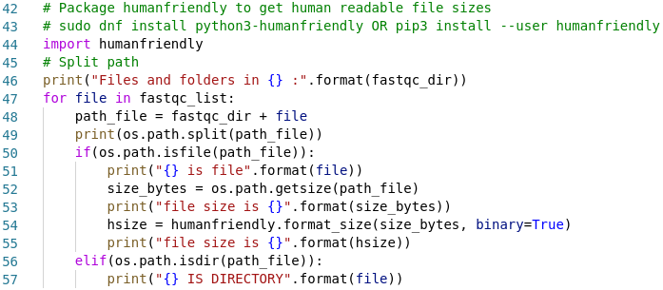
The filesystem

Slide 16
The filesystem
fnmatch and glob modules reproduce wildcard expansion operations of command-line shells
Pattern | Meaning
* | Match 0 or more characters
? | Match single character
[characters] | Match any of characters inside brackets (char not separated)
[!characters] | Match any of characters except those inside brackets

Slide 17
The filesystem
fnmatch works directly on strings
glob goes out of indicated path to expand wildcards relative to filesystem content → ignores files beginning with period → treats slashes as separating path component

Slide 18
The filesystem
fnmatch.fnmatch(filename, pattern) → return True if string filename matches pattern
fnmatch.filter(filenames, pattern) → return list of strings in filenames that match string pattern

Slide 19
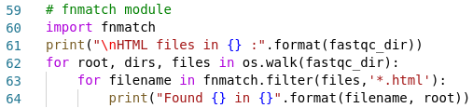
The filesystem
example-code-5-filesystem.py

Slide 20
The filesystem
glob.glob(pattern) → returns list of paths (string) that match pattern
glob.iglob(pattern) → same as glob.glob but returns iterator instead of list → for filename in glob.iglob('*.py'):

Slide 21
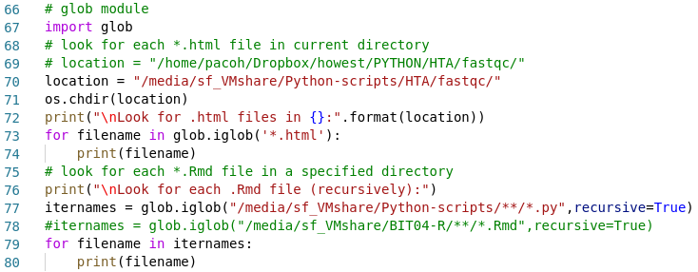
The filesystem
example-code-5-filesystem.py
Notes:
The separator is always the / character. A segment is everything that comes between the two separators.
Double Asterisk (**) matches zero or more characters across multiple segments. It is used for globbing files that are in nested directories.
By using the double asterisk (**), you are using a glob to list files on a filesystem. A glob is a string of literal or wildcard characters used for matching the file paths.
Using one or more globs for locating files on a filesystem is called globbing.

Slide 22
The filesystem
The shutil module provides functions for performing common file operations at higher level than os module → copying and deleting
Function | Meaning
copy(source, destination) | Copies file specified by source to file or directory specified by destination
copytree(source, destination) | Recursively copies directory source to destination, directories created as necessary, OSError raised if already exists
move(source, destination) | Moves file or directory source to destination
rmtree(path) | Deletes directory path and everything under it

Slide 23
The filesystem
Comparing contents of two files or two directories → many practical uses → filecmp module
filecmp(filepath1, filepath2) → compares files and returns True if their contents are equal

Slide 24
The filesystem
filecmp.cmpfiles(directorypath1, directorypath2, filepaths) → compares files in list filepaths in directory at directorypath1 with corresponding files in directory at directorypath2 → returns three lists of file paths
matches → contents same in both directories
mismatches→ were in both directory but had different content
errors → not found in both directories

Slide 25
The filesystem
filecmp.dircmp(directorypath1, directorypath2, hidenames) → creates instance of class filecmp.dircmp to compare directories at directorypath1 and directorypath2 → hidenames is list of names to ignore
Methods for instances of filecmp.dircmp:
Method | Purpose
report() | prints comparison between two directories
report_partial_closure() | prints comparison of two directories as well as immediate subdirectories
report_full_closure() | prints comparison of two directories, all their subdirectories and so on recursively

Slide 26
The filesystem
Details of comparisons that reporting methods print out may be accessed directly as attributes → left found in directorypath1 and right in directorypath2
Attribute | Meaning
left_list | names of files and subdirectories found in dirpath1
right_list | names of files and subdirectories found in dirpath2
common | names of files and subdirectories are in both dirpath1 and dirpath2
left_only | names of files and subdirectories are in dirpath1 only
right_only | names of files and subdirectories are in dirpath2 only
common_dirs | names of subdirectories are in both dirpath1 and dirpath2
common_files | names of files are in both dirpath1 and dirpath2
common_funny | names common in dirpath1 and dirpath2 but file in one and dir in other
same_files | paths to files whose contents are identical in both dirpath1 and dirpath2
diff_files | paths to files are in both dirpath1 and dirpath2 but their contents differ
funny_files | paths to files are in both dirpath1 and dirpath2 but could not be compared

Slide 27
The filesystem
Example: two large files differ only slightly → Unix diff command → getting differences is part of series of steps → Python difflib module → to show difference between two files
Function | Purpose
difflib.SequenceMatcher | Finds diffferences between two hashable sequences (strings, tuples, ...)
difflib.Differ | Compares two sequences of lines of text finding different lines
difflib.HtmlDiff | Like difflib.differ but for HTML formatted output

Slide 28
The filesystem
More what you can do with os module on https://docs.python.org/3/library/os.html
# os.stat(path) to get status of file
statinfo = os.stat('somefile.txt')
# size of file in bytes
statinfo.st_size
# file type and file mode (permissions)
statinfo.st_mode
# time most recent content modification in seconds
statinfo.st_mtime

Slide 29
CSV files

Slide 30
Comma- and tab-separated files
Comma-separated values (CSV) files are widely used as interchange format → spreadsheet and data-collection applications → variety of text field/separator files incl. tab-separated
Python’s csv module deals with variability of fields and separators → csv.reader and csv.writer functions

Slide 31
Comma- and tab-separated files
csv.reader(source) → returns iterator for lines in source file (open file!)
Additional parameters:
delimiter specifies character to separate each field (default comma)
quotechar specifies character that surrounds field (default double quote)
escapechar specifies character used to escape delimiter character in case quotes aren’t used (default no escape character)
dialect e.g. excel-tab: read file as tab-separated (else: comma-separated)

Slide 32
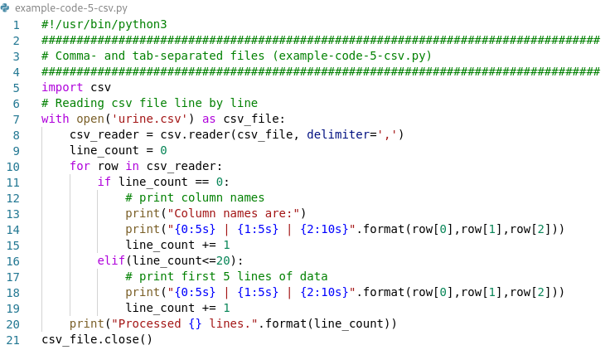
Comma- and tab-separated files

Slide 33
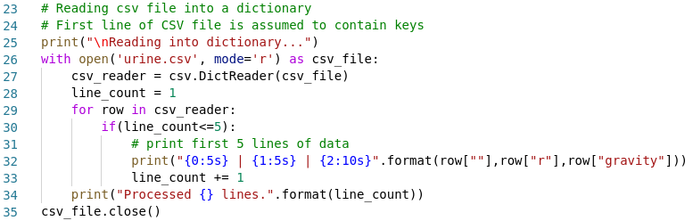
Comma- and tab-separated files
example-code-5-csv.py

Slide 34
Comma- and tab-separated files
csv.writer(destination) → returns an instance of a csvwriter for a file or anything else with a write method that is open for writing → dialect parameter excel-tab: writes tab-separated values
Writer has following methods:
writerow(fieldlist) → writes fields of fieldlist to destination (followed by \n)
writerows(rowlist) → csvwriter.writerow for each row in rowlist

Slide 35
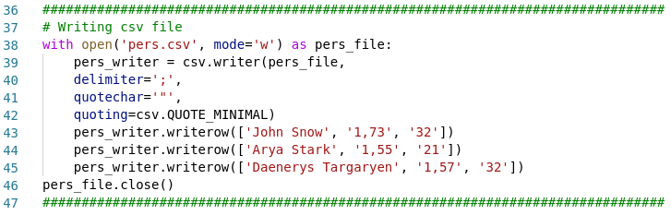
Comma- and tab-separated files
example-code-5-csv.py

Slide 36
Comma- and tab-separated files
quotechar optional parameter tells writer which character to use to quote fields → whether quoting is when writing determined by optional parameter
csv.QUOTE_MINIMAL → .writerow() will quote fields only if they contain delimiter or quotechar (default)
csv.QUOTE_ALL → .writerow() will quote all fields
csv.QUOTE_NONNUMERIC → then .writerow() will quote all fields containing text data and convert all numeric fields to the float data type
csv.QUOTE_NONE → .writerow() will escape delimiters instead of quoting them → in this case you also must provide value for escapechar

Slide 37
Comma- and tab-separated files
csv.register_dialect() → to use custom delimiter and quoting
# csv.reader(file, dialect='myDialect')
csv.register_dialect('myDialect',
delimiter = '|',
quoting = csv.QUOTE_ALL,
skipinitialspace = True)

Slide 38
Excel files (.xlsx)

Slide 39
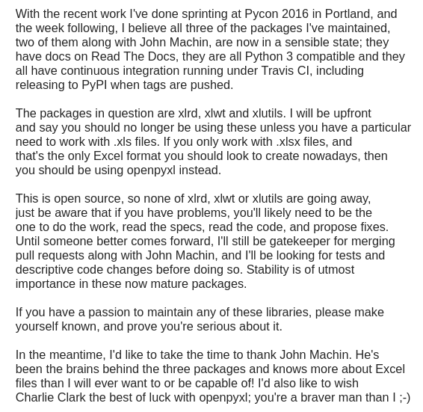
Excel files
xlrd, xlwt or xlutils packages → no longer use in future → unless specifically need .xls files
openpyxl recommended package → for reading and writing Excel 2010 files i.e. .xlsx → initially based on PHPExcel
xlsxwriter alternative package
Chris Withers
https://groups.google.com/forum/#!msg/python-excel/P6TjJgFVjMI/g8d0eWxTBQAJ

Slide 40
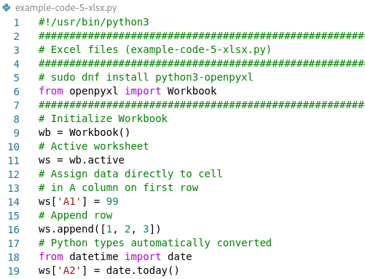
Excel files
# Installation on Fedora
sudo dnf install python3-openpyxl
# or using pip
pip3 install –-user openpyxl
Writing to .xlsx workbooks → in a cell → by row

Slide 41
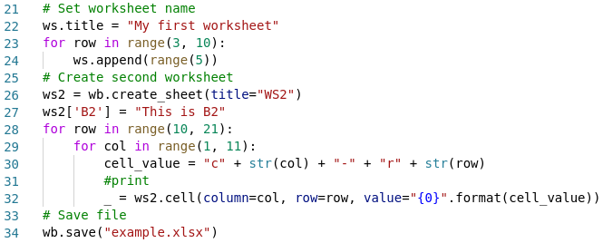
Excel files
example-code-5-xlsx.py
Notes:
Python automatically stores the value of the last expression in the interpreter to a particular variable called "_"

Slide 42
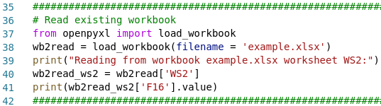
Excel files
Reading from .xlsx workbooks with load_workbook
example-code-5-xlsx.py

Slide 43
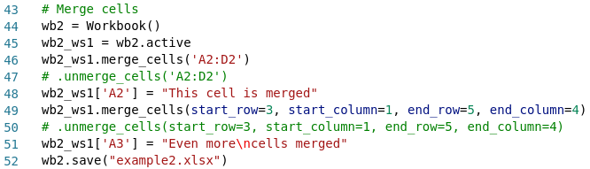
Excel files
Merging cells
example-code-5-xlsx.py

Slide 44
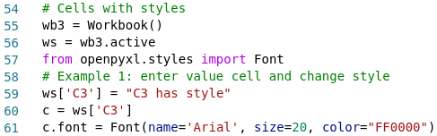
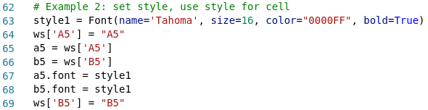
Excel files
Using styles:

Slide 45
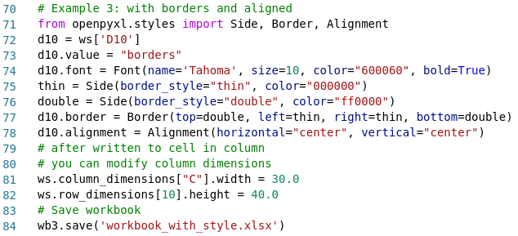
Excel files
example-code-5-xlsx.py

Slide 46
Word files (.docx)

Slide 47
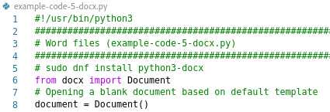
Word files
# Installation on Fedora
sudo dnf install python3-docx
# or using pip
pip3 install –-user python-docx
python-docx is a Python library for creating and updating MS Word .docx files
example-code-5-docx.py

Slide 48
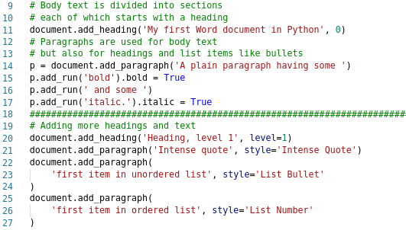
Word files

Slide 49
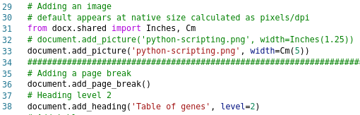
Word files

Slide 50
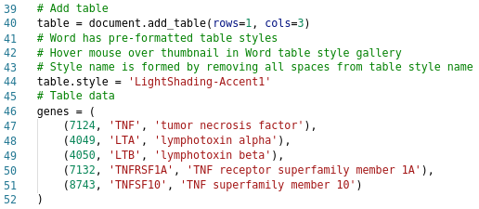
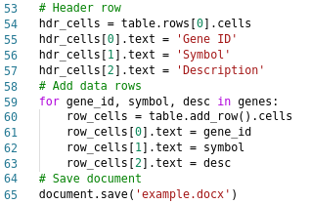
Word files

Slide 51
PDF files

Slide 52
PDF files
Popular Python PDF libraries are:
PyPDF2-PyPDF4: many features e.g. read metadata and encryption information, split, merge together, crop, and transform pages inside pdf files,…
pdfrw: fast pure Python pdf parser, read and write pdf documents
PDFMiner: text extraction, convert pdf into other formats
PyFPDF: library for PDF document generation under Python, ported from PHP
ReportLab (commercial) → PDF Toolkit (open source)

Slide 53
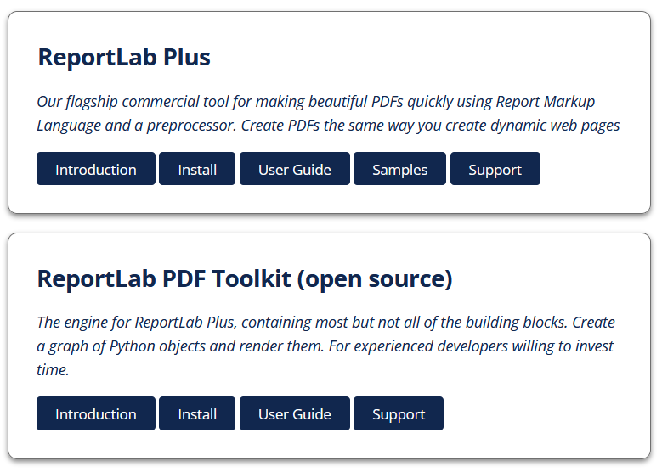
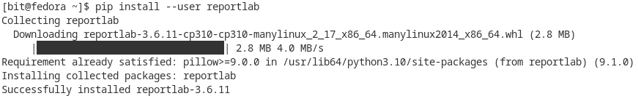
PDF files
# Install ReportLab Open Source on Fedora
pip install –-user reportlab

Slide 54
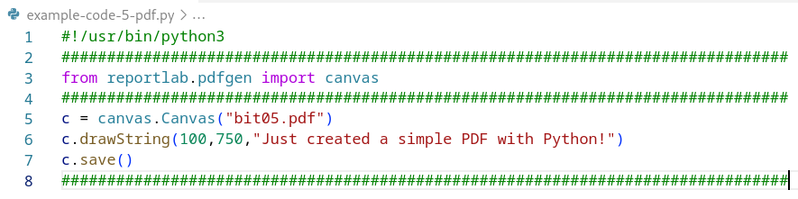
PDF files
Creating a Simple PDF: lowest-level component used regularly = canvas object → functions allow to "paint" document with text, images, lines

Slide 55
PDF files
Canvas ~ sheet of white paper → default A4 with points on sheet identified using Cartesian (X,Y) coordinates → default (0,0) origin point at lower left corner of page → coordinate x goes to the right, coordinate y goes up

Slide 56
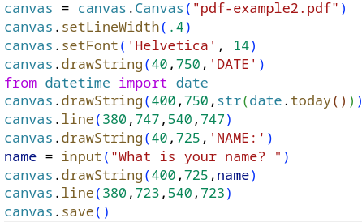
PDF files
canvas.setLineWidth(.4) sets how thick line should be
canvas.setFont('Helvetica', 12) will specify a specific font and point size → standard fonts: Helvetica, Courier, Times-Roman
canvas.line can be used to draw a line by passing two x/y pairs

Slide 57
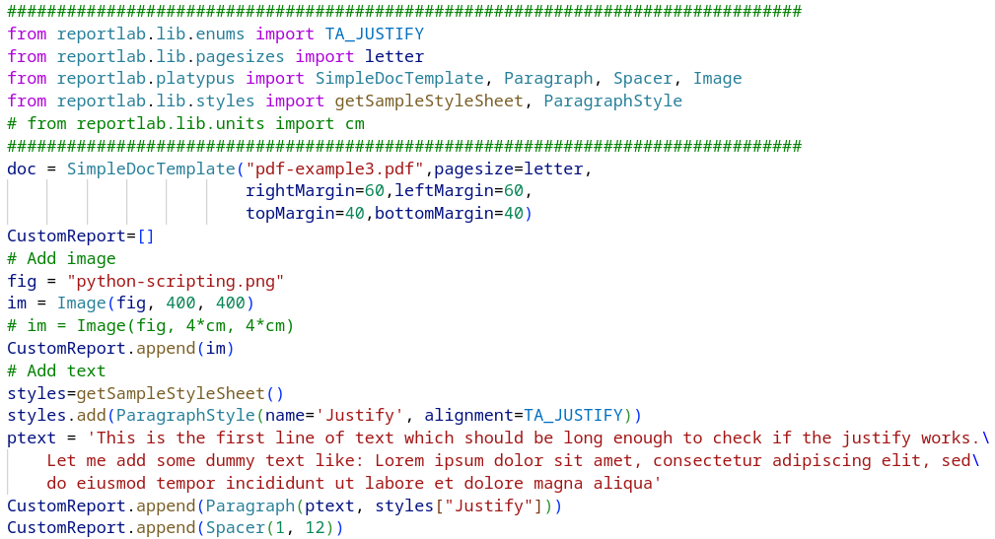
PDF files
Create a document template using the SimpleDocTemplate class
Add an image and text/paragraph

Slide 58
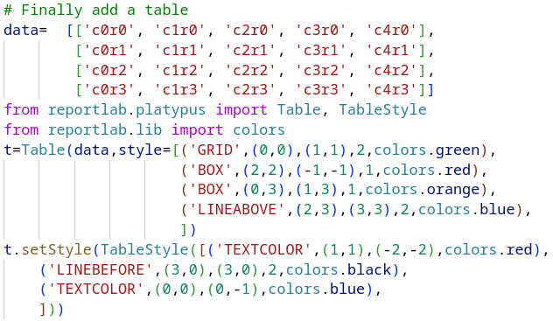
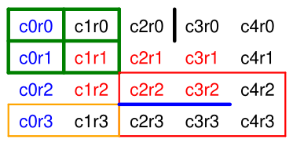

PDF files
TableStyle three main groups → affect table background, draw lines or set cell style
1st element = identifier
2nd + 3rd arguments determine cell coordinates of box of cells → coordinates are given as (column, row) → top left cell is (0, 0) the bottom right is (-1, -1)

Slide 59

Exercise 5.1
Write a Python script that parses a .vcf file and saves all indels causing “stop_gained” and “frameshift” to be saved in a .csv file
Download a strain specific indels .vcf file from
ftp://ftp-mouse.sanger.ac.uk/REL-1505-SNPs_Indels/strain_specific_vcfs/
More info over the mouse genomes project on:
https://www.sanger.ac.uk/science/data/mouse-genomes-project

Slide 60
Exercise 5.1
Downloading files from FTP site (no longer possible in Chrome) → using Linux wget command wget ftp://ftp-mouse.sanger.ac.uk/REL-1505-SNPs_Indels/strain_specific_vcfs/129P2_OlaHsd.mgp.v5.indels.dbSNP142.normed.vcf.gz → or using FileZilla

Slide 61
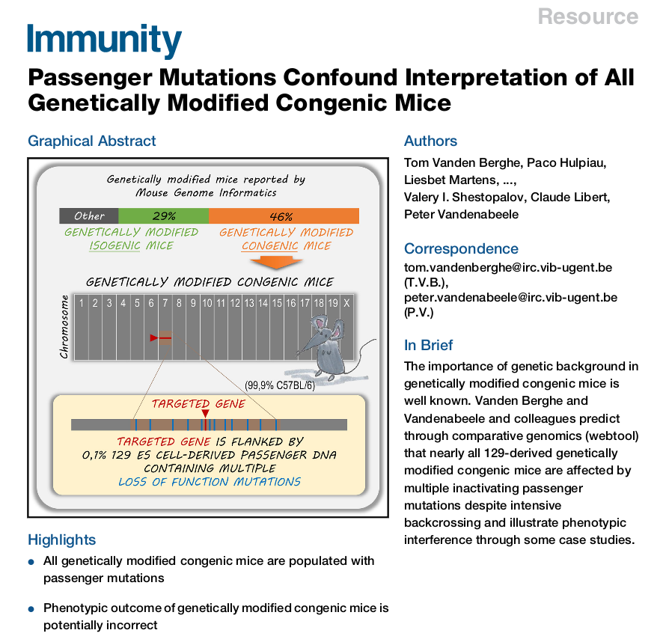
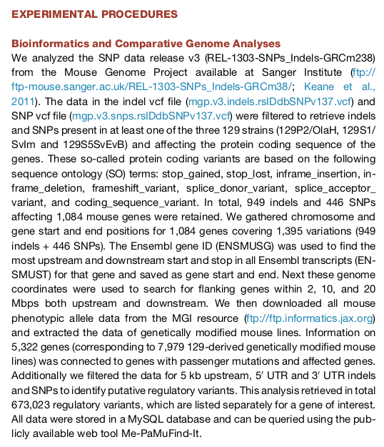
https://www.cell.com/immunity/pdf/S1074-7613(15)00254-X.pdf

Slide 62
Exercise 5.1
To be able to have a look at the content of the file before parsing use e.g. head -100 129P2_OlaHsd.mgp.v5.indels.dbSNP142.normed.vcf >indels_vcf_head100.txt
First try to only print the comment lines (start with #)
Next try to parse the lines with indel data which are tab-delimited but you can read the file line by line
You might want to use linecounter<100 before parsing all lines!
fileObj = open("indels.vcf", "r")
for line in fileObj.readlines():
# parse line

Slide 63
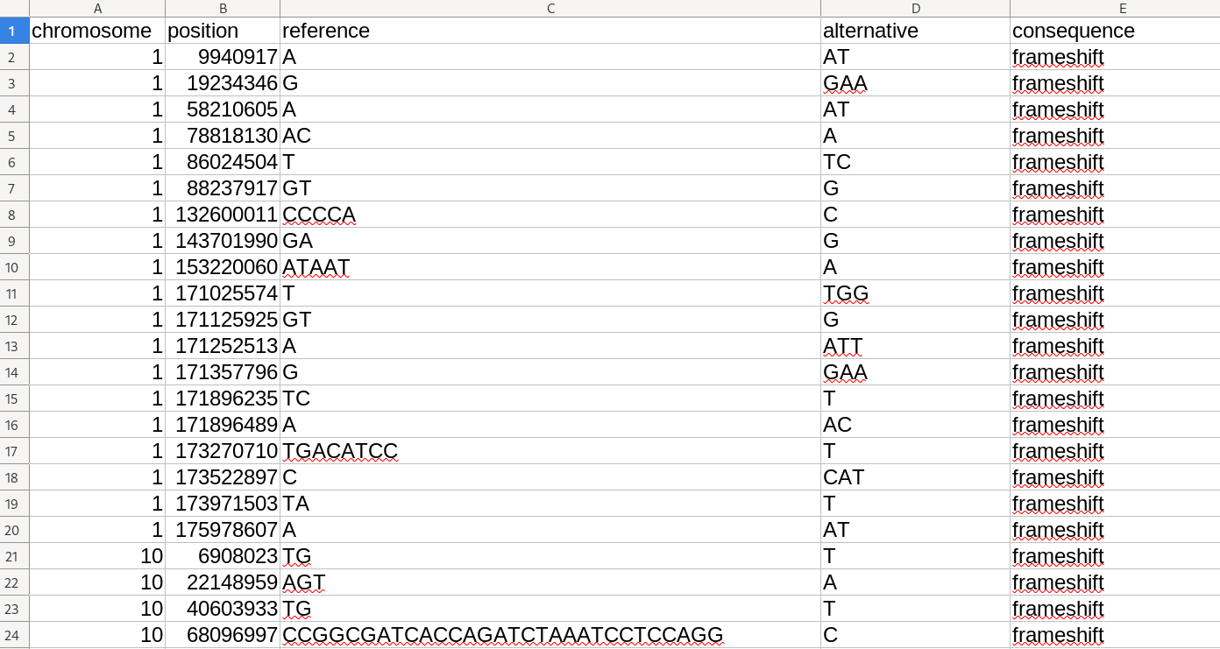
Exercise 5.1

Slide 64
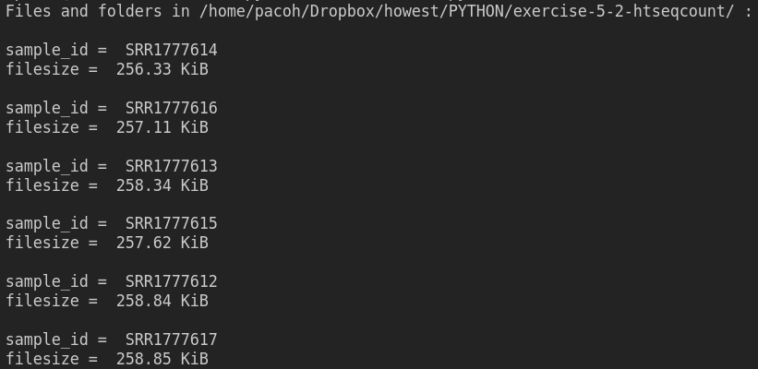
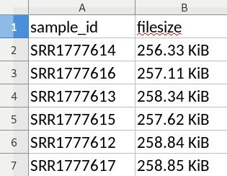
Exercise 5.2
Scan the directory exercise-5-2-htseqcount with count files.
Get the sample IDs from the filenames and save in an Excel file including file sizes.

Slide 65
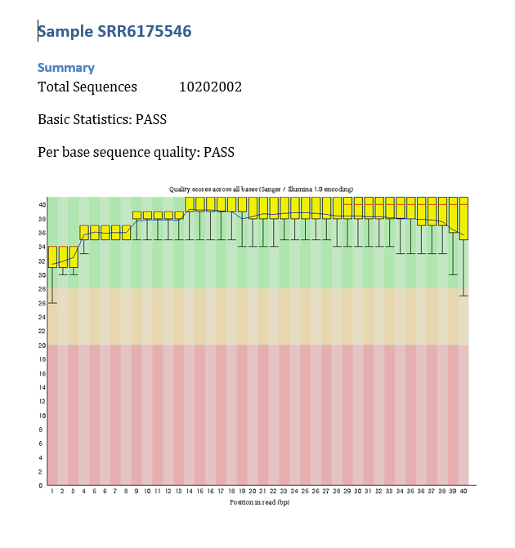
Exercise 5.3
Parse FastQC results to get a summary file → scan fastqc folder: scan folders sample_fastqc → extract data from fastqc_data.txt (total sequences) and from summary.txt (basic statistics, per base quality) → create a summary report as fastqc_summary.docx with each sample result on separate page → include per_base_quality.png image (Image subfolder)

