Slide 1


SCRIPTING
Course BIT07
Paco Hulpiau

Slide 2
Databases

Slide 3
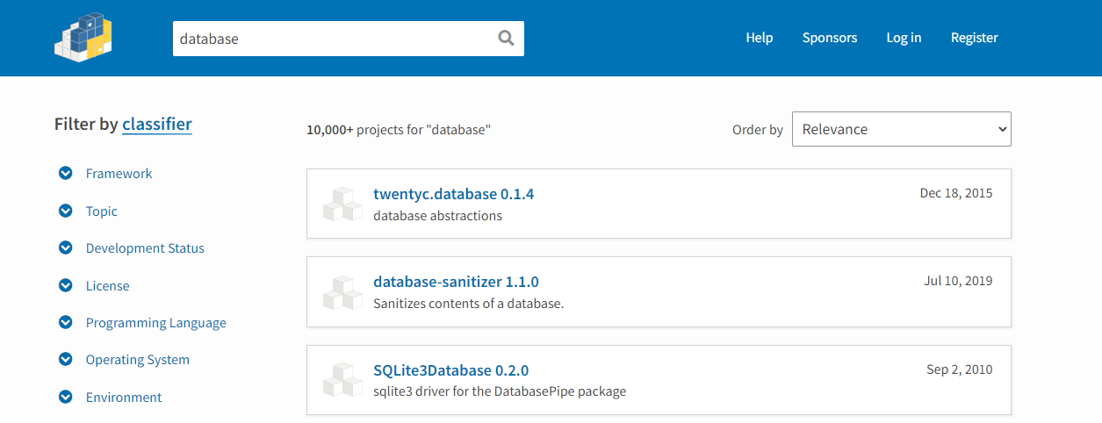
Introduction
Accessing specific database system → requires module that implements interface for that kind of database → implementations of interface for many server-based systems can be found through the Python Package Index or PyPI (https://pypi.org/)

Slide 4
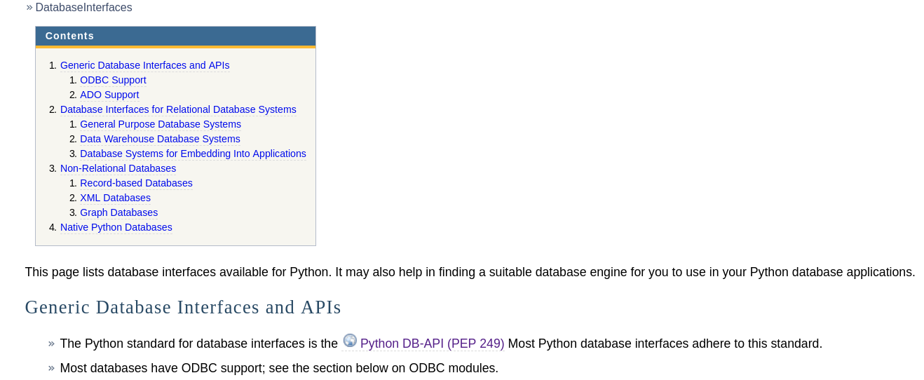
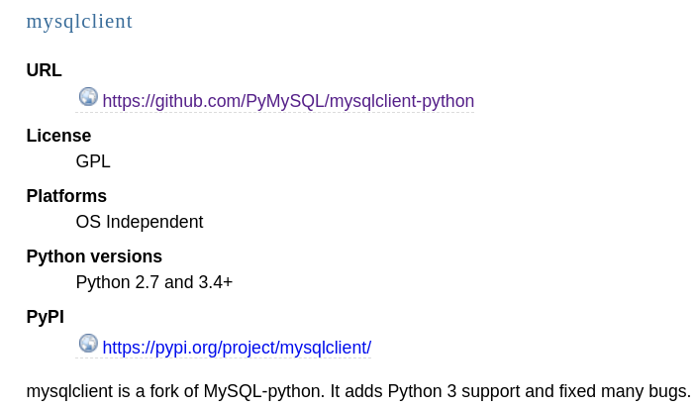
Introduction
List of available Python database interfaces: https://wiki.python.org/moin/DatabaseInterfaces

Slide 5
Introduction
Module | Description and link to documentation
sqlite3 | Very fast and easy, lightweight database engine included in Python standard library https://docs.python.org/3/library/sqlite3.html
mysqlclient | Fork of MySQL-python; adds Python 3 support and fixed many bugs https://mysqlclient.readthedocs.io/
pyodbc | Actively maintained open source Python module that makes accessing ODBC databases simple; precompiled binaries available for Windows, Linux (Centos and Fedora) https://github.com/mkleehammer/pyodbc
db.py | Easy way to interact with your databases; db.py uses pandas to manage data; supports MySQL, PostgreSQL, SQLite, MS SQL Server, ... https://github.com/yhat/db.py
pymongo | Official driver published by the Mongo developers https://docs.mongodb.com/drivers/python/
Notes:
Microsoft Open Database Connectivity (ODBC)

Slide 6
sqlite3
The SQLite3 database and Python’s sqlite3 module → easy to use, does not require separate server, included in Python installation → C library that provides a lightweight disk-based database https://docs.python.org/3/library/sqlite3.html

Slide 7
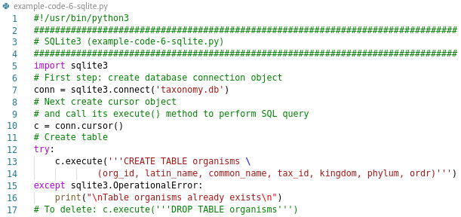
sqlite3
Example: create taxonomy database with table organisms (data can be found on: https://www.ncbi.nlm.nih.gov/taxonomy)

Slide 8
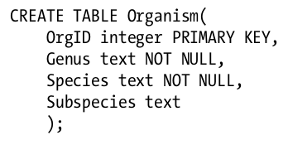
sqlite3
SQL keywords usually shown in uppercase → follow convention
For each table columns → statement lists name, type (and optionally constraints)
Constraints on table itself follow list of columns

Slide 9
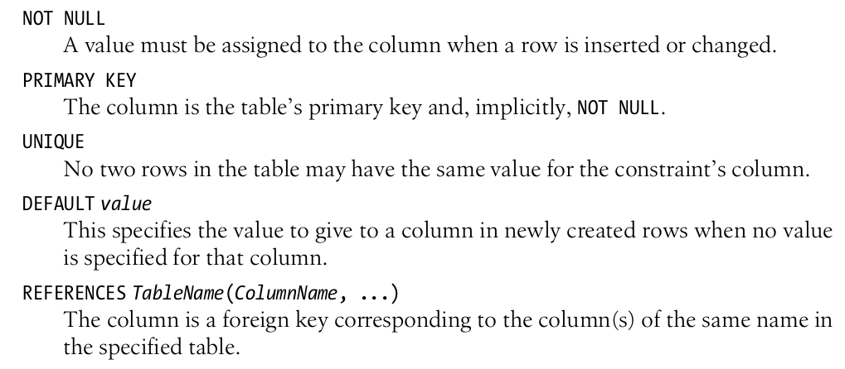
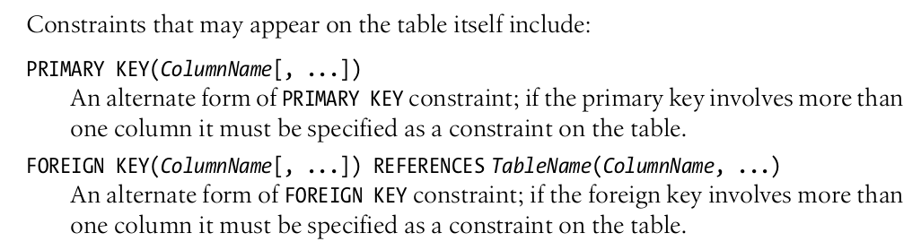

Slide 10
Test a block of code for errors with Try Except
Error or exception occurs → will stop and generate error
Exception handling! → try block: to test a block of code → except block: to handle the error
try:
print(x)
except:
print("An error occurred")

Slide 11
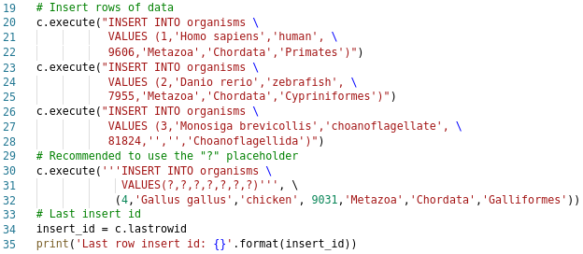
sqlite3
example-code-6-sqlite.py

Slide 12
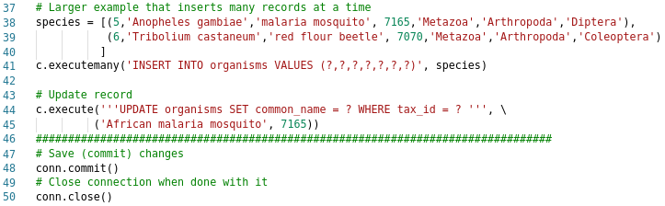
sqlite3
example-code-6-sqlite.py

Slide 13
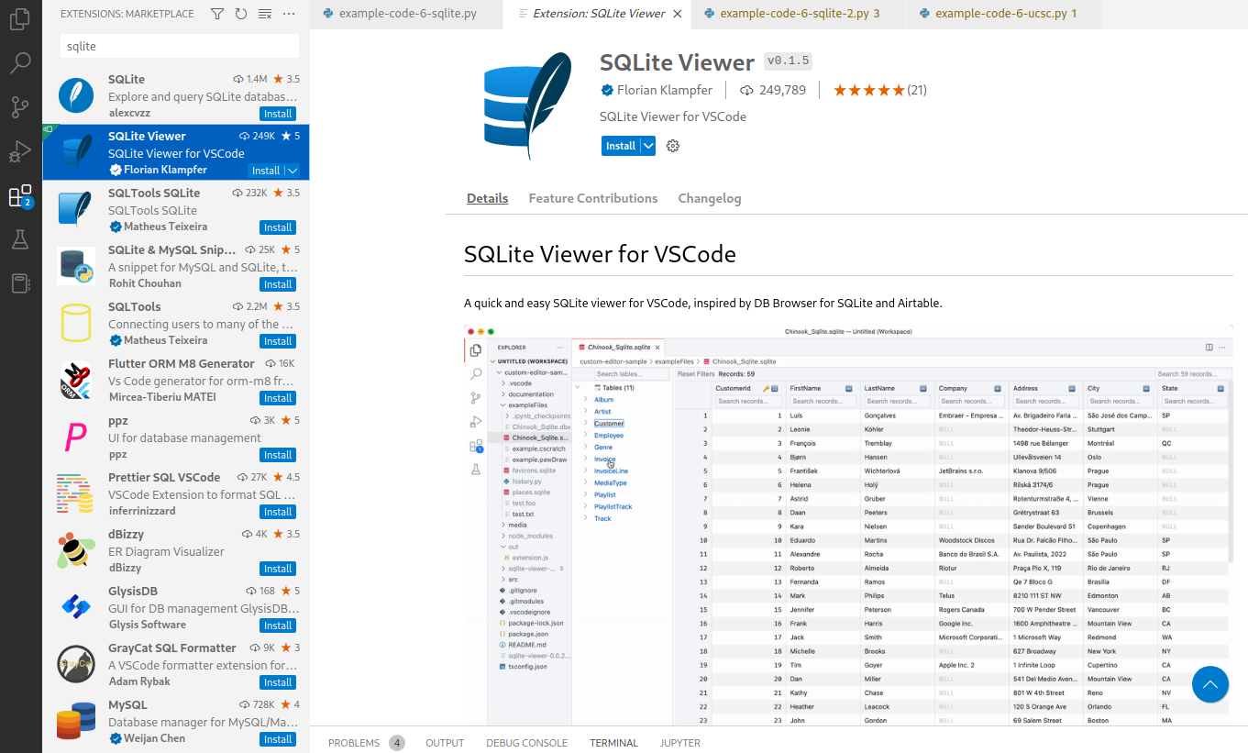
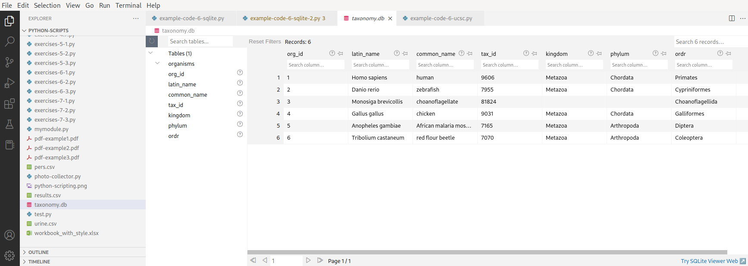
sqlite3

Slide 14
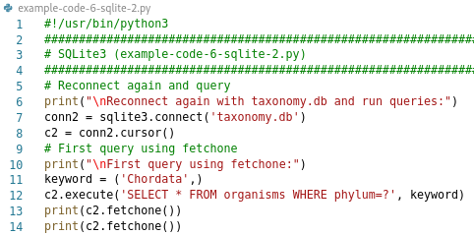
sqlite3
example-code-6-sqlite-2.py

Slide 15
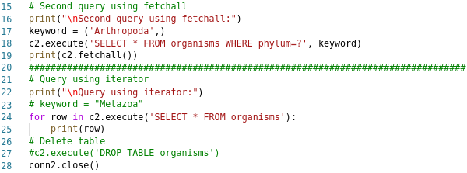
sqlite3
example-code-6-sqlite-2.py

Slide 16
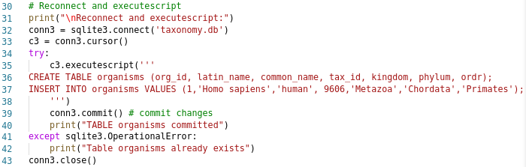
sqlite3
Nonstandard convenience method executescript() for executing multiple SQL statements at once
example-code-6-sqlite-2.py

Slide 17

MySQL
MySQL provides their own version of MySQL adapter → mysql_connector → all-in python module that uses MySQL API with no C modules dependencies and only standard python modules used
mysqlclient → fastest MySQL connector for CPython → requires mysql-connector-c C library to work
# sudo dnf install python3-mysqlclient
# pip install --user mysqlclient
import MySQLdb as mydb
db = mydb.connect(host="",user="",passwd="",db="")
Notes:
CentOS 8:
sudo dnf install python3-devel mysql-devel
pip3 install --user mysqlclient

Slide 18
MySQL
MySQLdb is a thread-compatible interface to popular MySQL database server
To write applications which are portable across databases → use MySQLdb and avoid using _mysql module directly → _mysql provides interface which mostly implements MySQL C API → MySQLdb is thin Python wrapper around _mysql which makes it compatible with Python DB API interface (version 2)
import _mysql
db=_mysql.connect(host="localhost",user="",passwd="",db="")
import MySQLdb
db=MySQLdb.connect(host="localhost",user="",passwd="",db="")

Slide 19
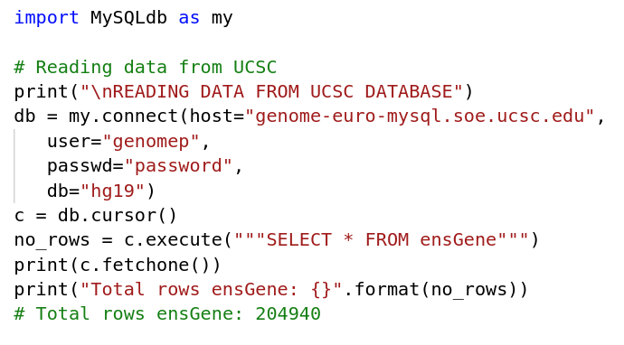
MySQL
Reading data from UCSC: https://genome.ucsc.edu/goldenPath/help/mysql.html
example-code-6-ucsc.py

Slide 20
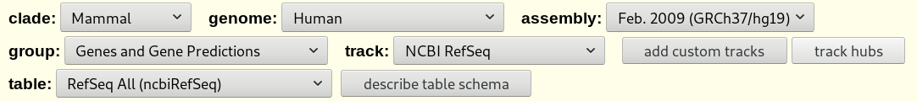
MySQL
To find the table and data you need → check the UCSC Genome Browser tracks → check the Table Browser: https://genome.ucsc.edu/cgi-bin/hgTables
e.g. Human genome assembly hg19 → RefSeq track in the group Genes and Gene Predictions → table: ncbiRefSeq → look at “describe table schema”

Slide 21
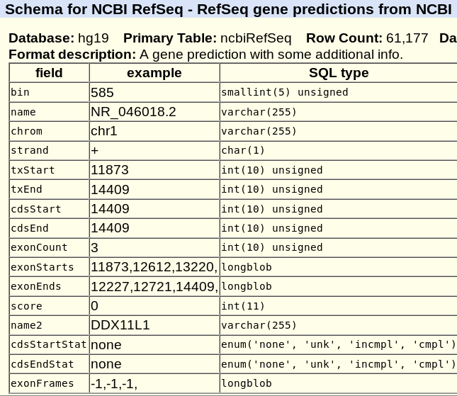
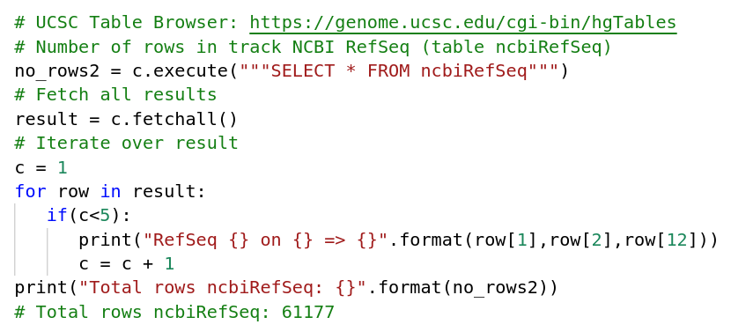
MySQL
Records in Human genome assembly hg19 table ncbiRefSeq

Slide 22
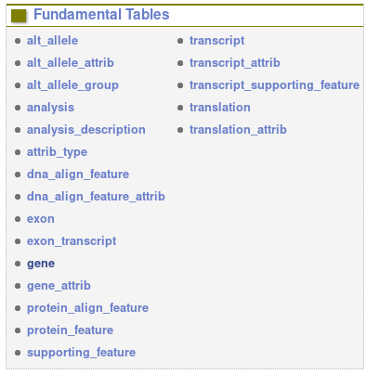
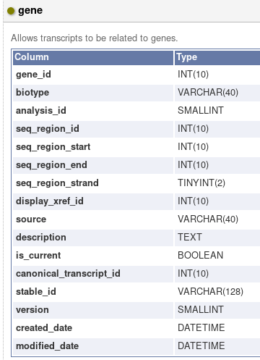
MySQL
Reading data from Ensembl: https://www.ensembl.org/info/data/mysql.html
Ensembl Core schema: https://www.ensembl.org/info/docs/api/core/core_schema.html
row[1]
row[9]
row[12]
Notes:
https://www.ensembl.org/info/data/mysql.html

Slide 23
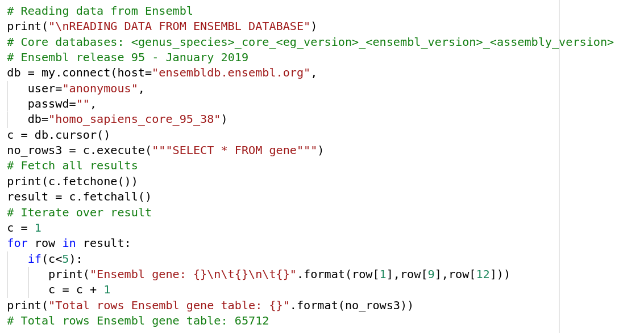
MySQL
example-code-6-ensembl.py

Slide 24
Overview
Module | Description and link to documentation
sqlite3 | Very fast and easy, lightweight database engine included in Python standard library https://docs.python.org/3/library/sqlite3.html
mysqlclient | Fork of MySQL-python; adds Python 3 support and fixed many bugs https://mysqlclient.readthedocs.io/
pyodbc | Actively maintained open source Python module that makes accessing ODBC databases simple; precompiled binaries available for Windows, Linux (Centos and Fedora) https://github.com/mkleehammer/pyodbc
db.py | Easy way to interact with your databases; db.py uses pandas to manage data; supports MySQL, PostgreSQL, SQLite, MS SQL Server, ... https://github.com/yhat/db.py
pymongo | Official driver published by the Mongo developers https://api.mongodb.com/python/current/

Slide 25
pyodbc
https://github.com/mkleehammer/pyodbc
# sudo dnf install redhat-rpm-config gcc-c++ python3-devel unixODBC-devel
# pip3 install --user pyodbc
import pyodbc
# Specifying the ODBC driver, server name, database, etc. directly
conn = pyodbc.connect('DRIVER={SQL Server};SERVER=localhost;DATABASE=testdb;UID=me;PWD=pass')
# Create a cursor from the connection
c = conn.cursor()
#[unixODBC][Driver Manager]Can't open lib '/usr/lib64/libmyodbc8.so'

Slide 26
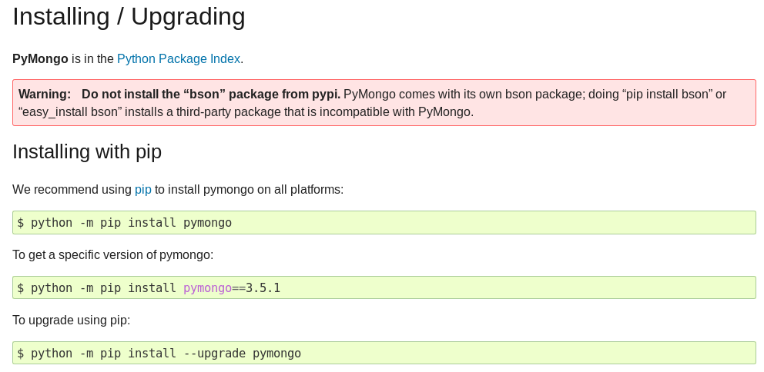
MongoDB
https://api.mongodb.com/python/current/
https://realpython.com/introduction-to-mongodb-and-python/

Slide 27
Exercise 6.1
The UCSC ncbiRefSeq table (hg19 assembly) has > 60000 records but include ncRNA (e.g. NR_046018.2)
How many mRNA transcripts (e.g. NM_001005484.1) can you find in: A) ncbiRefSeq for hg19
B) ncbiRefSeq for hg38
C) How many more mRNA transcripts in hg38 compared to hg19?

Slide 28
Exercise 6.2
Look for human (hg38) transcript information on Ensembl → ENST in transcript table → include corresponding gene information using gene_id → ENSG + description from gene table
First try on a few records (e.g. using LIMIT 100 in your query) Save all data (ENST, ENSG, description) in a sqlite database (ensembl.db)
(B) Once this works repeat for all transcripts (this might take a while)

Slide 29
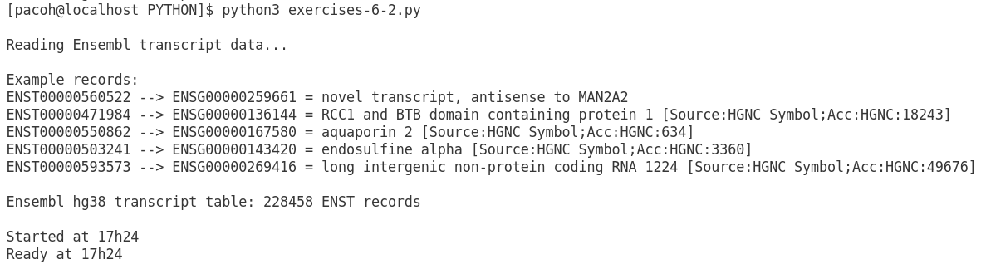
Exercise 6.2
Optional/extra: (1) Search in the enst table of your sqlite ensembl.db for a ENSG (ask as input)
(2) At the end of the script show start en end time
(3) Check total rows in enst table

Slide 30
Exercise 6.3
Combine RefSeq and Ensembl data in your own sqlite database (refgenes):
Look for genes (symbols/names) who have RefSeq and/or Ensembl transcripts (UCSC) and save in sqlite database
Using the genes (symbols/names) search for RefSeq and Ensembl transcripts and save for each gene the transcripts (comma-separated) in a RefSeq and in a Ensembl field in your sqlite database
Query your sqlite database to find genes having both RefSeq and Ensembl transcripts and also those who only have RefSeq or Ensembl genes.
Save the results in an Excel table (gene, location, RefSeq transcripts, Ensembl transcripts)

Slide 31
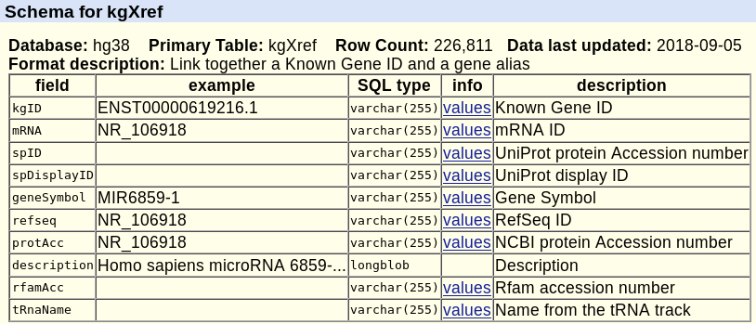
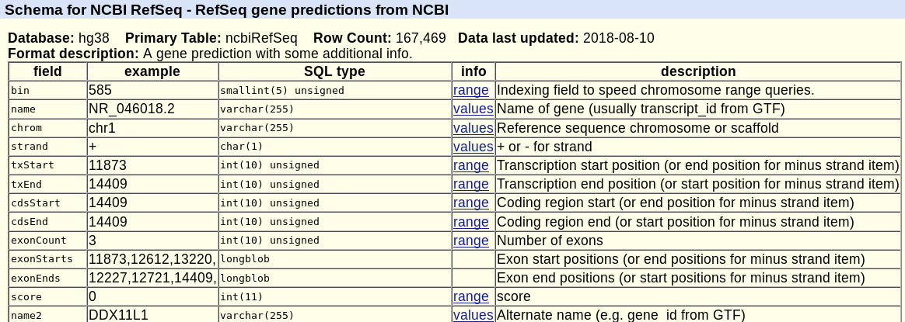
Exercise 6.3

Slide 32
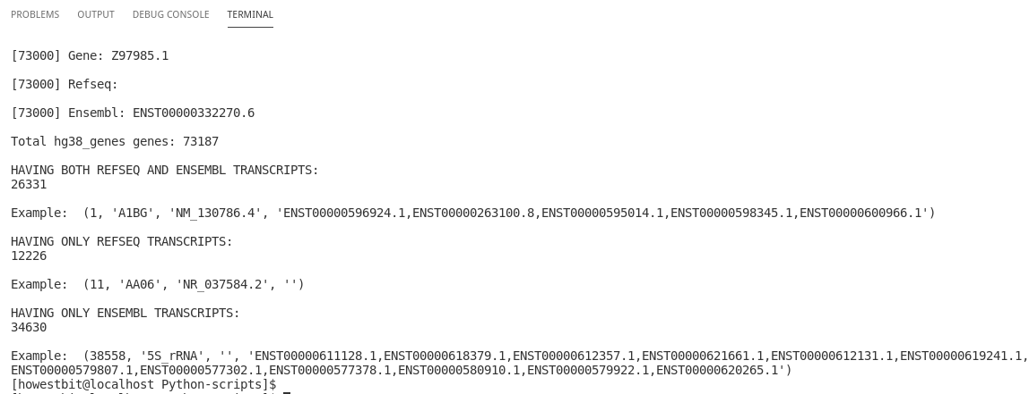
Exercise 6.3

