Slide 1


SCRIPTING
Course BIT07
Paco Hulpiau

Slide 2
Interactions with the web

Slide 3
Introduction
Web scraping → term for using a program to download and process content from the web → e.g. Google runs many web scraping programs to index web pages for its search engine
In this chapter → learn modules that make it easy to scrape web pages in Python

Slide 4
urllib
The urllib module in Python 3 allows you to access websites
urllib in Python 3 slightly different than urllib2 in Python 2 (mostly same)
Through urllib → access websites → download and parse data → modify your headers → do any GET and POST requests you might need to do

Slide 5
urllib
Some websites do not appreciate programs accessing data and placing weight on their servers → may sometimes choose to block you or serve different data
Can be overcome with some simple code → modify user-agent → a variable within your header that you send → identify application type, operating system, software of requesting user agent

Slide 6
urllib
Headers are bits of data that you share with servers to let them know you → Python by default tells website you are visiting with Python's urllib → we can however modify this → act as if we are Internet Explorer user, Chrome user, or anything else really!

Slide 7
urllib
Syntax:
Examples:
More on: https://developers.whatismybrowser.com/useragents/
User-Agent: <product> / <product-version> <comment>
Common format for web browsers:
User-Agent: Mozilla/<version> (<system-information>) <platform> (<platform-details>) <extensions>
Mozilla/5.0 (Windows NT 6.1; Win64; x64; rv:47.0) Gecko/20100101 Firefox/47.0
Mozilla/5.0 (Macintosh; Intel Mac OS X x.y; rv:42.0) Gecko/20100101 Firefox/42.0
Mozilla/5.0 (compatible; MSIE 9.0; Windows Phone OS 7.5; Trident/5.0; IEMobile/9.0)
Mozilla/5.0 (X11; Linux x86_64) AppleWebKit/537.36 (KHTML, like Gecko) Chrome/51.0.2704.103 Safari/537.36
Googlebot/2.1 (+http://www.google.com/bot.html)

Slide 8
urllib
urllib package collects several modules for working with URLs
urllib.request for opening and reading URLs
urllib.error containing exceptions raised by urllib.request
urllib.parse for parsing URLs
urllib.robotparser for parsing robots.txt files
Open an URL with urllib.request.urlopen() → can be string or Request object

Slide 9
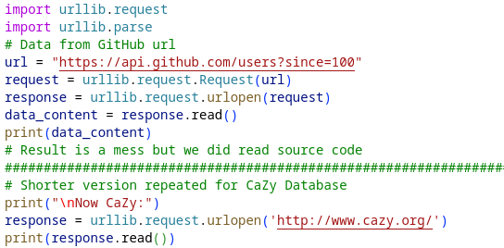
urllib
import urllib.request → assign opening of URL → read data
example-code-7-urllib.py

Slide 10

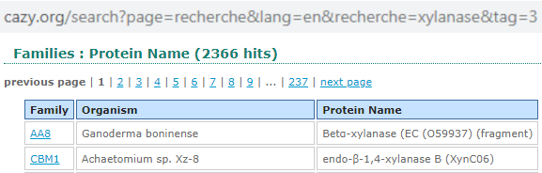
urllib
Reading all the source code = massive mess → web pages use HTML, CSS and javascript → we want text → clean up, get rid of all code e.g. using regular expressions
Sometimes use GET/POST values → Using GET with one or more variables (= sign) → first one after question mark, next after & sign

Slide 11
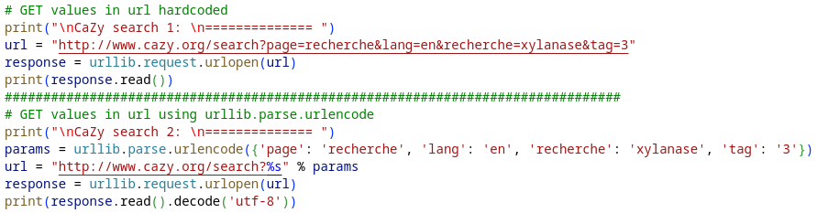
urllib
GET/POST variables → hard-code or using urllib
example-code-7-urllib.py

Slide 12
urllib
Some websites do not appreciate being visited by “robots” → whenever you visit a link you send in a header → basic information about “you” → this is how Google Analytics knows what browser you are using
Within header: value called user-agent → defines browser that is accessing the website's server → default Python user-agent → can block you → work around → identify yourself as “something” else

Slide 13
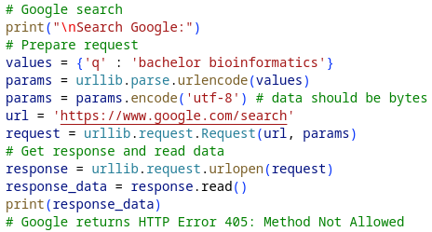
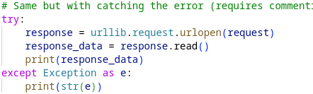
urllib
Example Google search:
example-code-7-urllib2.py

Slide 14
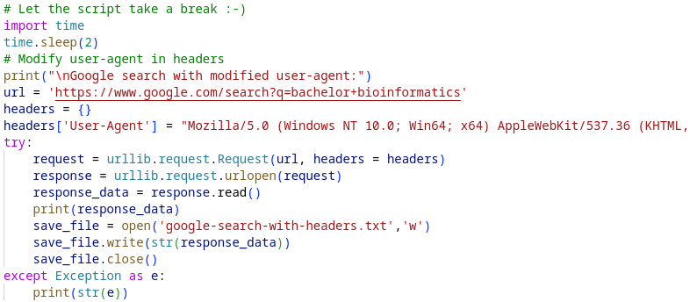
urllib
Example Google search with modified user-agent:
example-code-7-urllib2.py

Slide 15
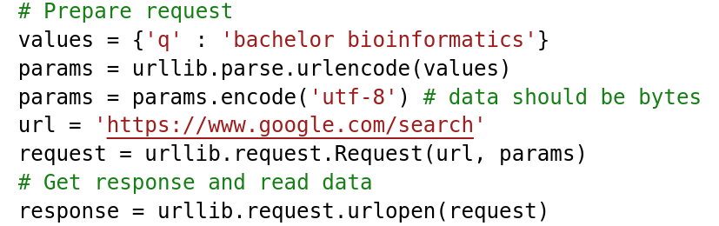
urllib
To POST data to a server → similarly how GET parameters are added → use dictionary with key-value pairs of POST parameters → formatted using urllib.parse.urlencode() → same steps of encoding formatted string into bytes and specify character encoding → open request as normal using urllib.request.urlopen() but add data as extra argument → this will add parameters to the request and change request type to POST

Slide 16
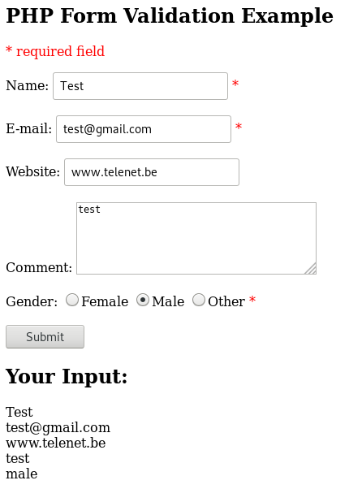
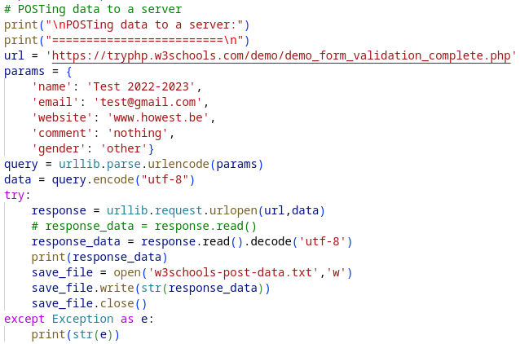
urllib
example-code-7-urllib3.py

Slide 17
Beautiful Soup
BeautifulSoup is a Python library for pulling data out of HTML and XML files
BeautifulSoup 3 has been replaced by BeautifulSoup 4 → BeautifulSoup 3 only works on Python 2.x → Beautiful Soup 4 also works on Python 3.x.
BeautifulSoup 4 is faster, has more features, and works with third-party parsers like lxml and html5lib → use BeautifulSoup 4 for all new projects
# pip3 install --user bs4
from bs4 import BeautifulSoup

Slide 18
Beautiful Soup
BeautifulSoup module’s name is bs4 for BeautifulSoup, version 4
Pass content data to BeautifulSoup to create a soup object → could be a document or an URL → BeautifulSoup does not fetch a web page → use in combination with urllib
Use BeautifulSoup methods on soup object → e.g. use prettify method to turn parse tree into nicely formatted string

Slide 19
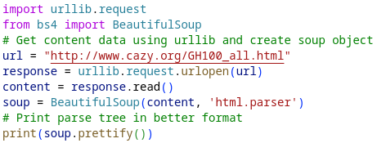
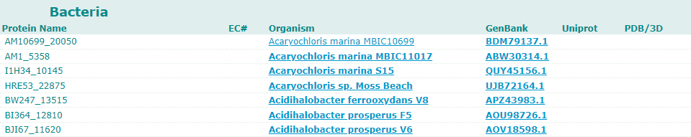
Beautiful Soup
example-code-7-bs4.py

Slide 20
Beautiful Soup
BeautifulSoup transforms complex HTML document into complex tree of Python objects → four kinds of objects:
BeautifulSoup: represents content/document as a whole
Tag: corresponds to XML or HTML tag in original content/document → lot of attributes and methods
NavigableString: corresponds to bit of text within tag
Comment: leftover not covered by previous e.g. <!-- Comments -->

Slide 21
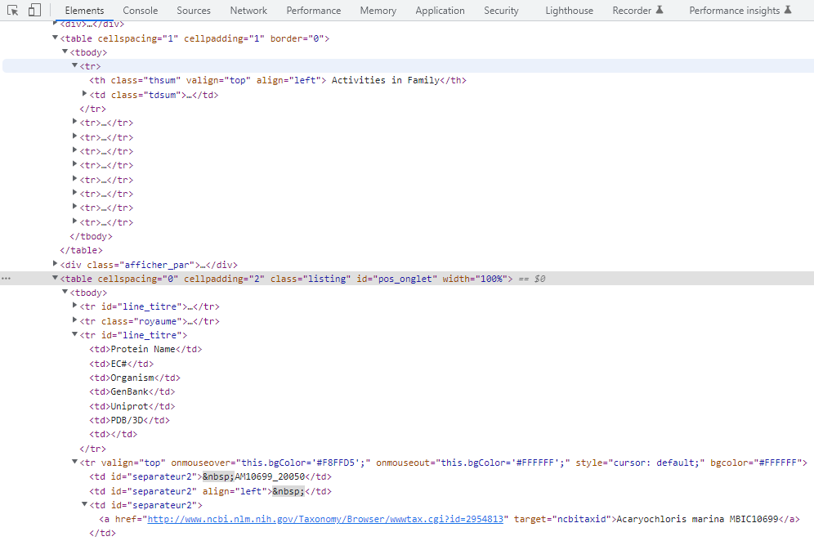
Beautiful Soup
In your browser: Ctrl + Shift + i to start developer tools

Slide 22
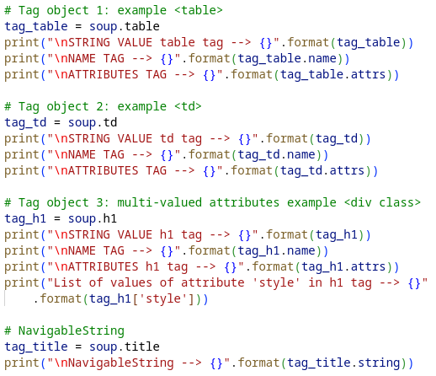
Beautiful Soup
example-code-7-bs4-2.py

Slide 23
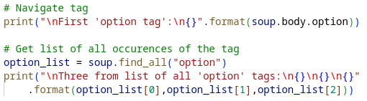
Beautiful Soup
Tags may contain strings and other tags → elements are tag’s “children” → attributes for navigating and iterating over a tag’s children
Navigate using tag names e.g. soup.body.option → zoom in on certain part of the parse tree → using tag name only gives you first tag → to get (a list of) all the tags use find_all() e.g. soup.find_all(“option")

Slide 24
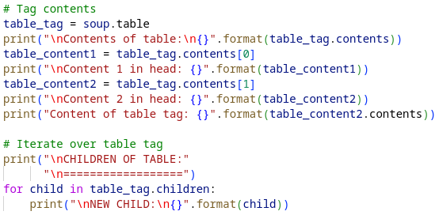
Beautiful Soup
A tag’s children are available in list tag.contents
Iterate over children using tag.children generator
example-code-7-bs4-3.py

Slide 25
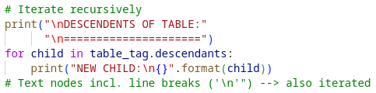
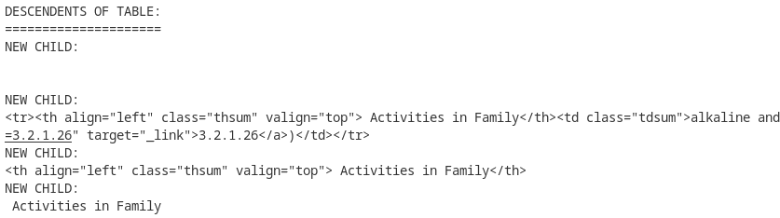
Beautiful Soup
tag.contents and tag.children attributes only consider the tag’s direct children
tag.descendents makes it possible to iterate over all tag’s children recursively

Slide 26
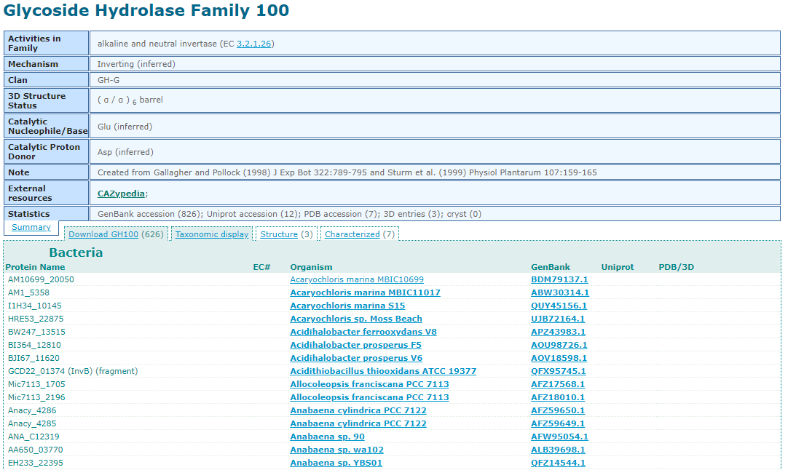
Beautiful Soup
To find a specific tag and attribute:
table1
table2
table1
table2

Slide 27
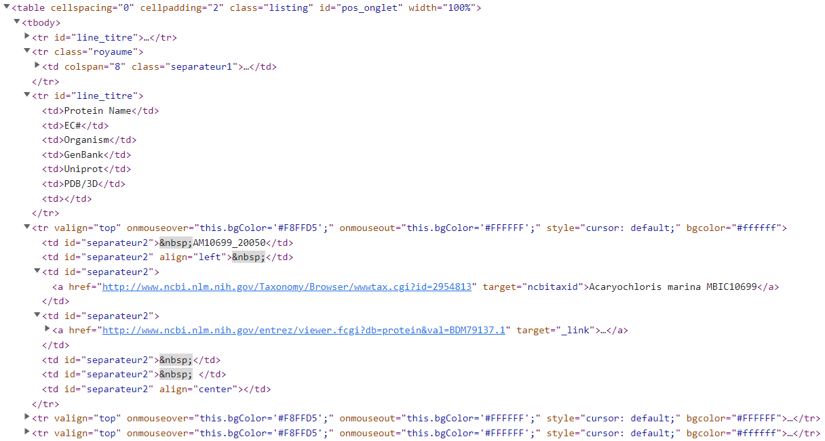

Slide 28
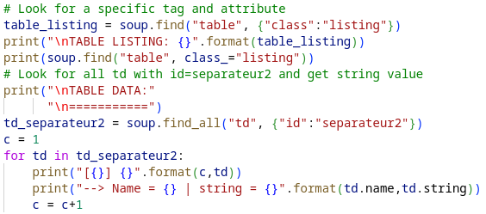
Beautiful Soup
To find a specific tag and attribute:
example-code-7-bs4-3.py

Slide 29
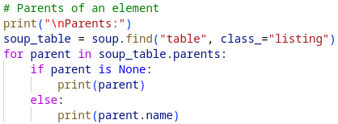

Beautiful Soup
To go up the “tree” every tag (and string) has a parent tag that contains it → .parent to access element’s parent → .parents to iterate over all parents of element
example-code-7-bs4-4.py

Slide 30
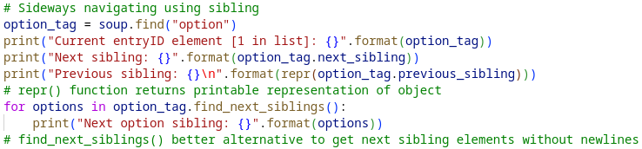
Beautiful Soup
To navigate between elements on same level of parse tree: → .next_sibling and .previous_sibling → .next_siblings and .previous_siblings
example-code-7-bs4-4.py

Slide 31
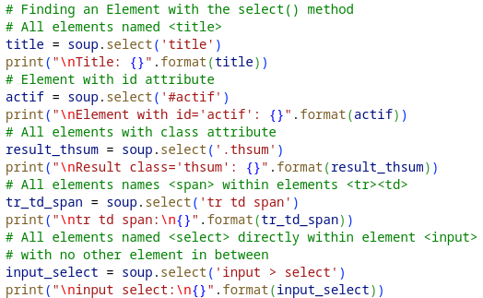
Beautiful Soup
Likewise to navigate to next and previous elements but not necessarily on same level: .next_element, .previous_element, .next_elements and .previous_elements
Finding element with select() method:
Notes:
More on bs4:
https://www.crummy.com/software/BeautifulSoup/bs4/doc/
https://automatetheboringstuff.com/chapter11/

Slide 32
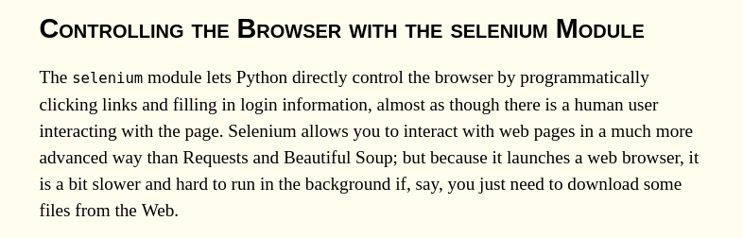
selenium
Selenium package is used to automate web browser interaction from Python
Read more on: https://automatetheboringstuff.com/chapter11/

Slide 33
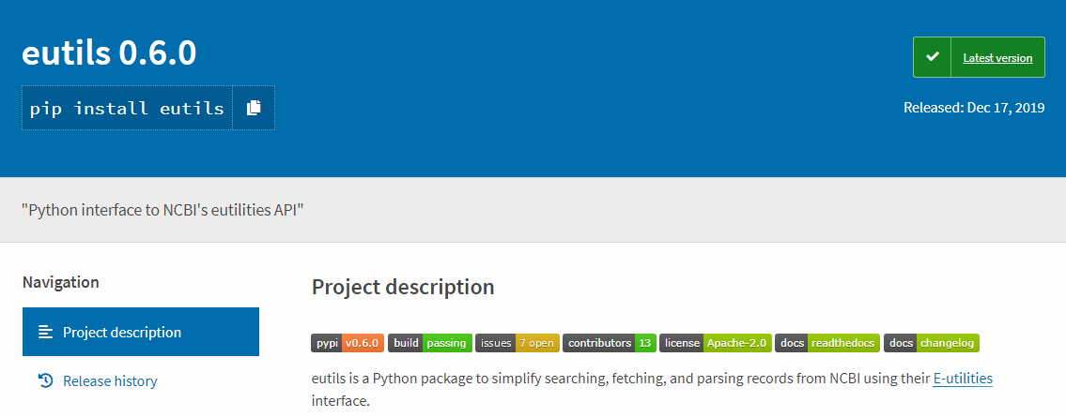
NCBI eutils
eutils exists as a Python package to simplify searching, fetching, and parsing records from NCBI using their E-utilities interface https://pypi.org/project/eutils/ https://github.com/biocommons/eutils

Slide 34
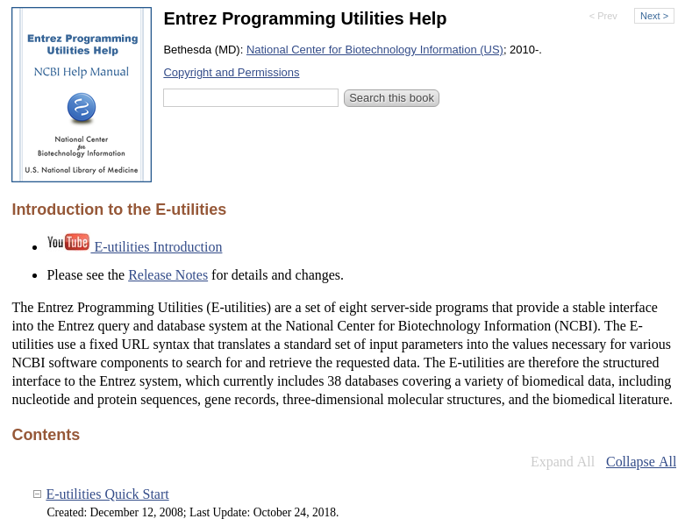
NCBI eutils
pip install --user eutils
https://eutils.ncbi.nlm.nih.gov

Slide 35
NCBI eutils
All E-utility requests should be made to URLs beginning with following string: https://eutils.ncbi.nlm.nih.gov/entrez/eutils/
URLs direct requests to servers used only by the E-utilities → optimized to give users best performance
Frequency, Timing and Registration of E-utility URL Requests! → do not overload E-utility servers → NCBI recommends no more than three URL requests per sec → limit large jobs to either weekends or between 9:00 PM and 5:00 AM Eastern time on weekdays → failure to comply with this policy may result in IP address blocking → service not restored unless developers register values of tool and email parameters with NCBI

Slide 36
NCBI eutils
From December 1, 2018 → use of API keys enforced → enhanced access to E-utilities → after that date any site (IP address) posting more than 3 requests per second to E-utilities without an API key receives an error message
By including API key → a site can post up to 10 requests per second by default → higher rates are available by request

Slide 37
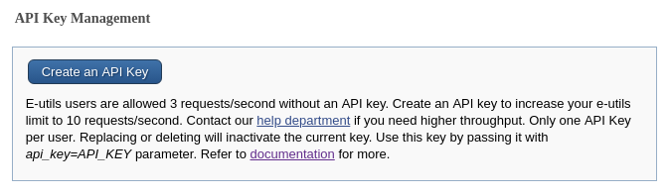
NCBI eutils
Obtain API key from settings page on NCBI account → https://www.ncbi.nlm.nih.gov/account/settings/ → include in each request
Example request including an API key: esummary.fcgi?db=pubmed&id=123456&api_key=ABCDE12345
Example error message if rates are exceeded: {"error":"API rate limit exceeded","count":"11"}

Slide 38
NCBI eutils
Handling (special) characters within URL → use lowercase characters for all parameters (except & WebEnv) → no required order for URL parameters → avoid placing spaces in URL queries → if required use plus (+) sign instead
Incorrect: &id=352, 25125, 234 Correct: &id=352,25125,234
Incorrect: &term=biomol mrna[properties] AND mouse[organism] Correct: &term=biomol+mrna[properties]+AND+mouse[organism]

Slide 39
NCBI eutils
Handling (special) characters within URL → other special characters, such as quotation marks (“) or the # symbol → represented by their URL encodings: %22 for “ and %23 for #
Incorrect: &term=#2+AND+"gene in genomic"[properties] Correct: &term=%232+AND+%22gene+in+genomic%22[properties]

Slide 40
NCBI eutils
einfo e.g. → provides list of names of all valid databases → provides statistics for single database incl. list of fields
Return list of all database names: e.g. https://eutils.ncbi.nlm.nih.gov/entrez/eutils/einfo.fcgi
Return for Protein database: e.g. https://eutils.ncbi.nlm.nih.gov/entrez/eutils/einfo.fcgi?db=protein

Slide 41
NCBI eutils
esearch → provides list of UIDs matching query
e.g. https://eutils.ncbi.nlm.nih.gov/eutils/esearch.fcgi?db=nucleotide&term=biomol+trna[prop]
efetch → returns formatted data records for list of UIDs
e.g. https://eutils.ncbi.nlm.nih.gov/eutils/efetch.fcgi?db=pubmed&id=17284678,9997&retmode=text&rettype=abstract

Slide 42
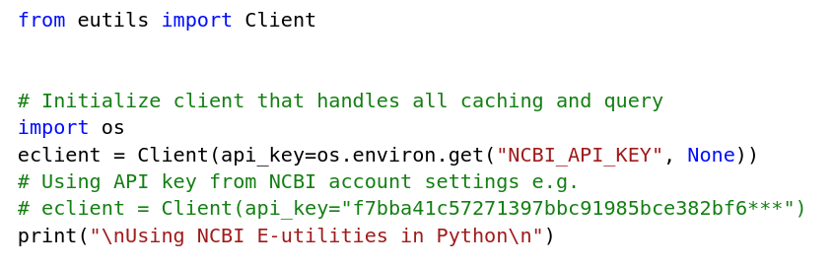
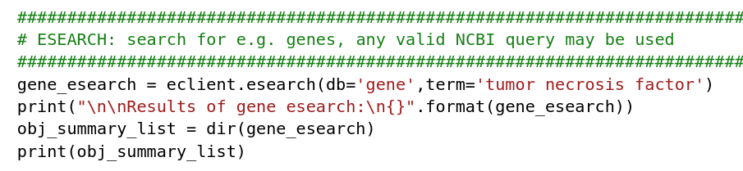
NCBI eutils
example-code-7-eutils.py

Slide 43
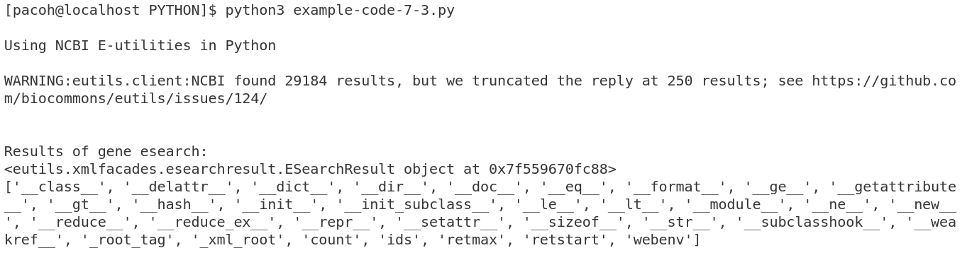
NCBI eutils
without API key
with API key
dir([object]) method → return list of valid attributes of object

Slide 44
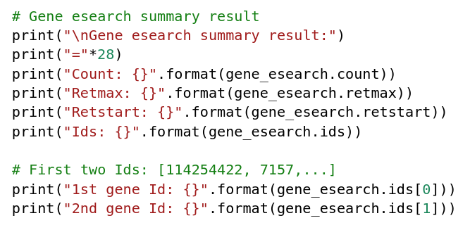
NCBI eutils
example-code-7-eutils.py

Slide 45
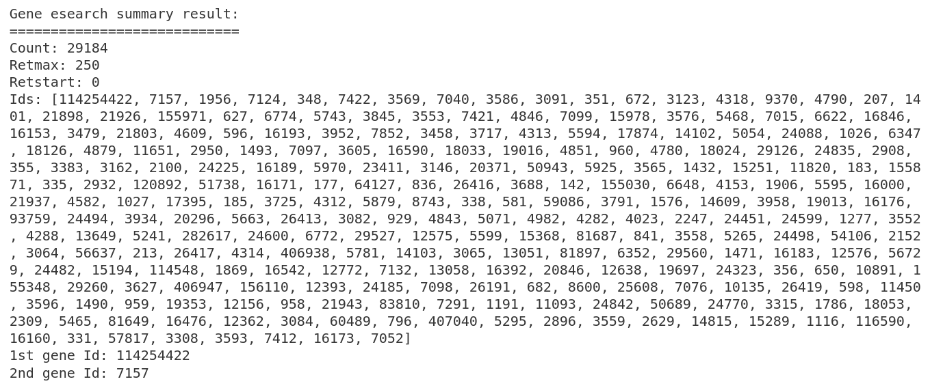
NCBI eutils

Slide 46
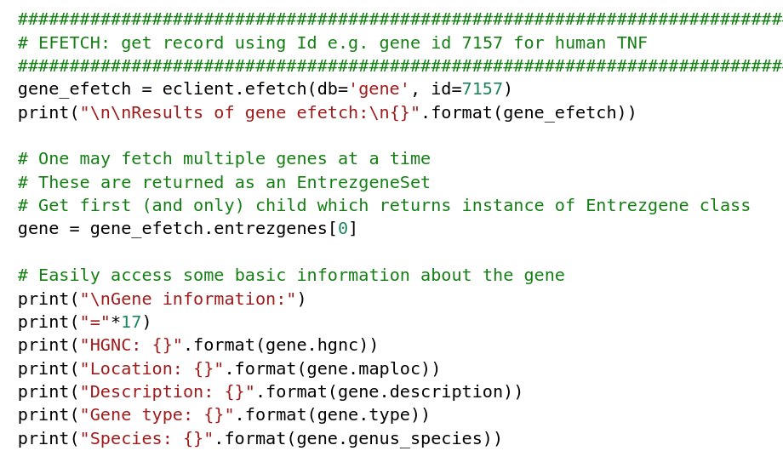
NCBI eutils
example-code-7-eutils.py

Slide 47
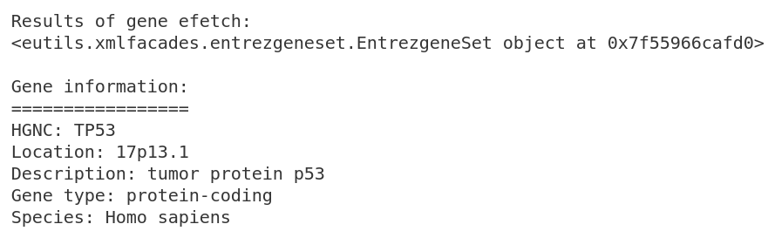
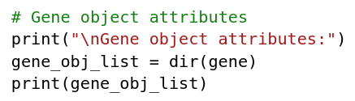
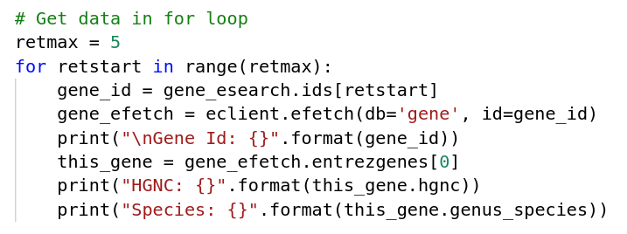
NCBI eutils

Slide 48
Exercise 7.1
Find a website with a search function and see if you can make use of it via Python to retrieve data
E.g.
https://service.azul.data.humancellatlas.org/ (catalog search → json output)
http://pfam.xfam.org/ (keyword search → html output)
https://www.ncbi.nlm.nih.gov/sra/SRX4179991[accn] → spots?
Extra/optional: parse strings out of the page with BeautifulSoup

Slide 49

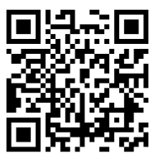
Exercise 7.2
Smartphone app ObsIdentify → take photo and identify >20000 wild animals and plants in northwestern Europe
Your observations and those of others are part of research into these species. Photos from the observations are available online on https://waarnemingen.be/
Write a photo-collector.py script that will collect photos and metadata from this online resource for a data science project.
Notes:
https://waarnemingen.be/apps/obsidentify/

Slide 50
Exercise 7.2
Your script should
A/ ask the user for different kinds of input,
B/ use that input to search and filter this online resource and
C/ save both photos and metadata locally on your computer.

Slide 51
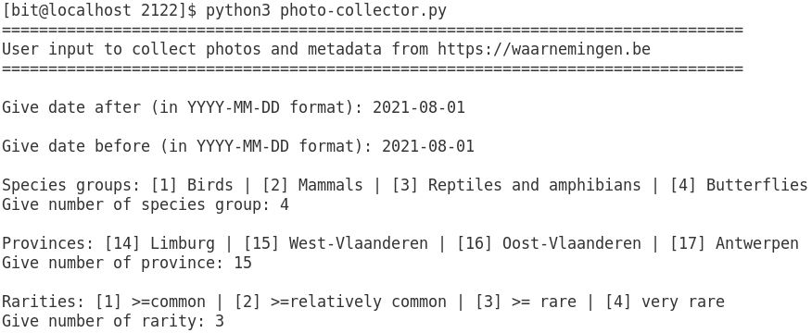
Exercise 7.2
A/ Ask the user for five input variables (date_after, date_before, species_group, province and rarity) using example in screenshot below.
Note that you do not need to perform any checks on the input format but suggest it in the text you print when you ask for input.
Print output in terminal when running the script.

Slide 52
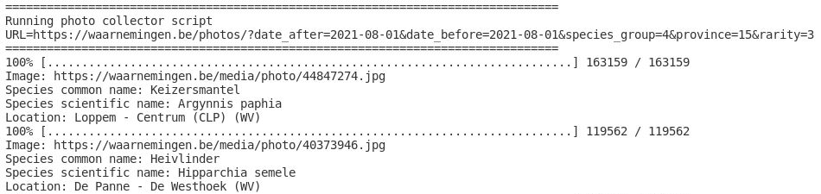
Exercise 7.2
B/ Use the input variables to perform an online query e.g. https://waarnemingen.be/photos/?date_after=2021-08-01&date_before=2021-08-01&species_group=4&province=15&rarity=3
Fetch the webpage and save it in a soup object for further processing.
The screenshot below shows an example of how the output in the terminal should look like. Note that metadata is processed in part C.

Slide 53
Exercise 7.2
C/ Parse the results found on the webpage to collect the photos and metadata.
Your script must save the photos in a folder named photos, created in the same folder where the script is located.
The image source to download the photo (e.g. with wget) is indicated by the first red arrow on the next slide. Note that you need to download the full image.
import wget # pip install --user wget

Slide 54
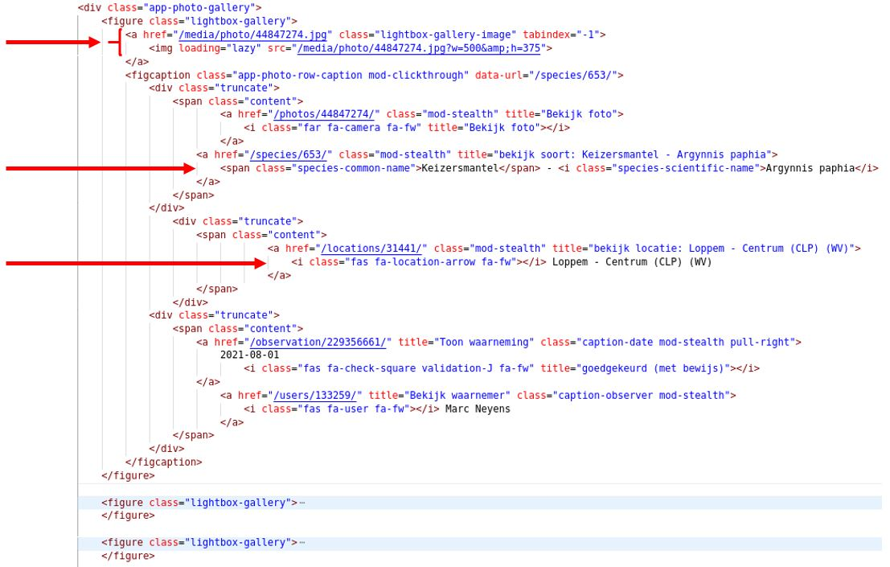
Exercise 7.2
C/

Slide 55
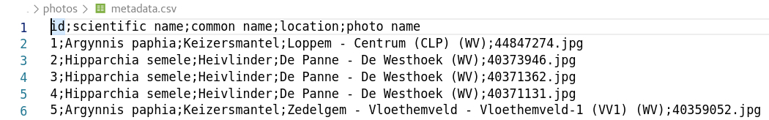
Exercise 7.2
C/ Additionally, use the soup object to collect the following metadata from the webpage and save it in a metadata.csv file:
own id (using a counter)
scientific name and common name (indicated by second red arrow)
location (indicated by the third red arrow in the screenshot above)
name of the image (downloaded and saved in the photos folder)

Slide 56
Exercise 7.3
Perform an esearch with NCBI eutils to find all mouse desmoglein RefSeq proteins
Print the Ids and perform an efetch for each protein
Print which properties are available using dir()
Print the protein sequences as fasta

Slide 57
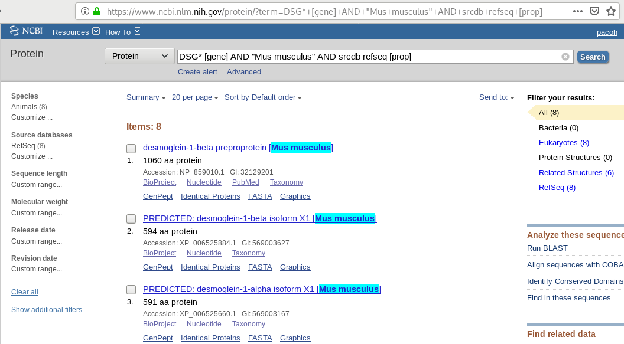
Exercise 7.3

Slide 58
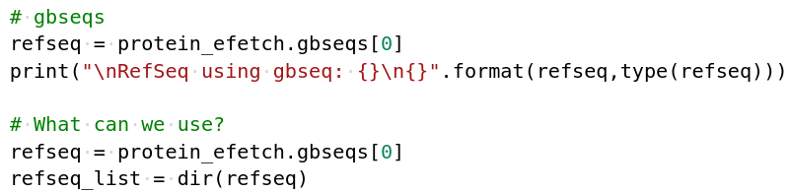
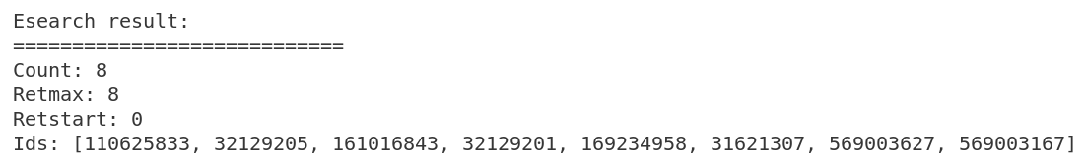
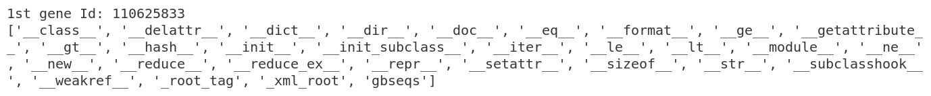
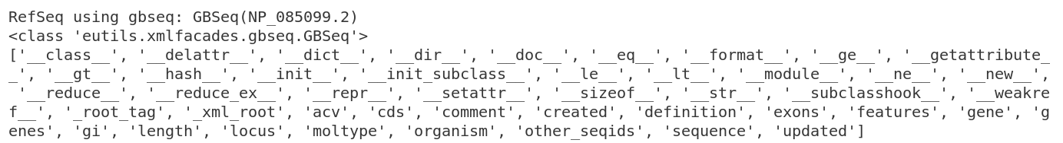
Exercise 7.3

Slide 59
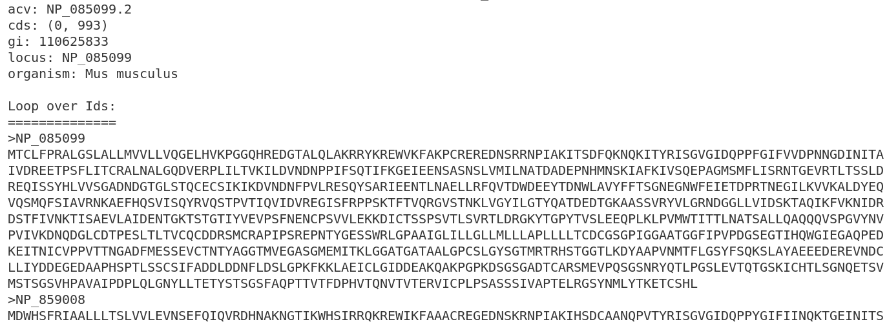
Exercise 7.3

