Slide 1
ngspice Basics
circuit to netlist to simulation

Slide 2
What is ngspice?
ngspice is a free, open-source circuit simulator. You describe a circuit as text (a netlist) and it calculates voltages and currents for you.
Draw circuit
Write netlist (.cir)
Run ngspice
Plot / read results
➜
➜
➜
Why simulate? Test a design safely, cheaply and quickly before building it on a breadboard.

Slide 3
Components & naming conventions
Component | Letter | Example line
Resistor | R | R1 1 2 1k
Capacitor | C | C1 2 0 1u
Inductor | L | L1 2 3 10m
Diode | D | D1 2 3 1N4148
BJT transistor | Q | Q1 3 2 0 2N2222
JFET | J | J1 1 2 0 JMOD
MOSFET | M | M1 d g s b NMOS1
DC / AC source | V | V1 1 0 DC 5
Current source | I | I1 1 0 DC 1m
IC (subcircuit) | X | X1 in out vcc 0 LM358
Rules
1st letter = type (R, C, D…)
Name = letter + label
: R1, Rload
Values: k, m, u, n, p, MEG

Slide 4
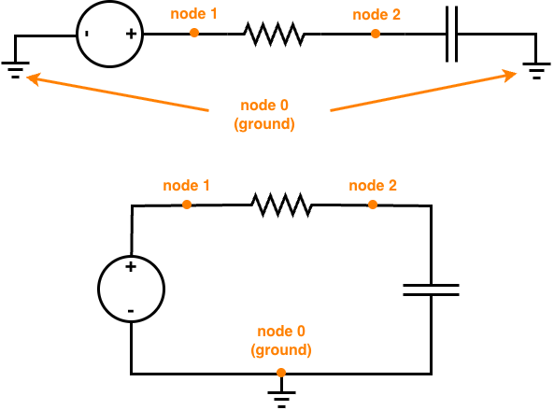
Nodes: the connection points
• A node is any point where components are connected by wire
• All points joined by plain wire are the SAME node
• Node 0 is always ground – the reference (0 V). Every circuit needs one
• Nodes can be numbers (1, 2, 3) or names (in, out, vcc)
node 1
+
–
node 0 (ground)

Slide 5
Circuit → netlist (step by step)
R1 1k
R1 1k
1
1
2
2
C1 1µF
C1 1µF
V1 5V
V1 5V
0
0

Slide 6
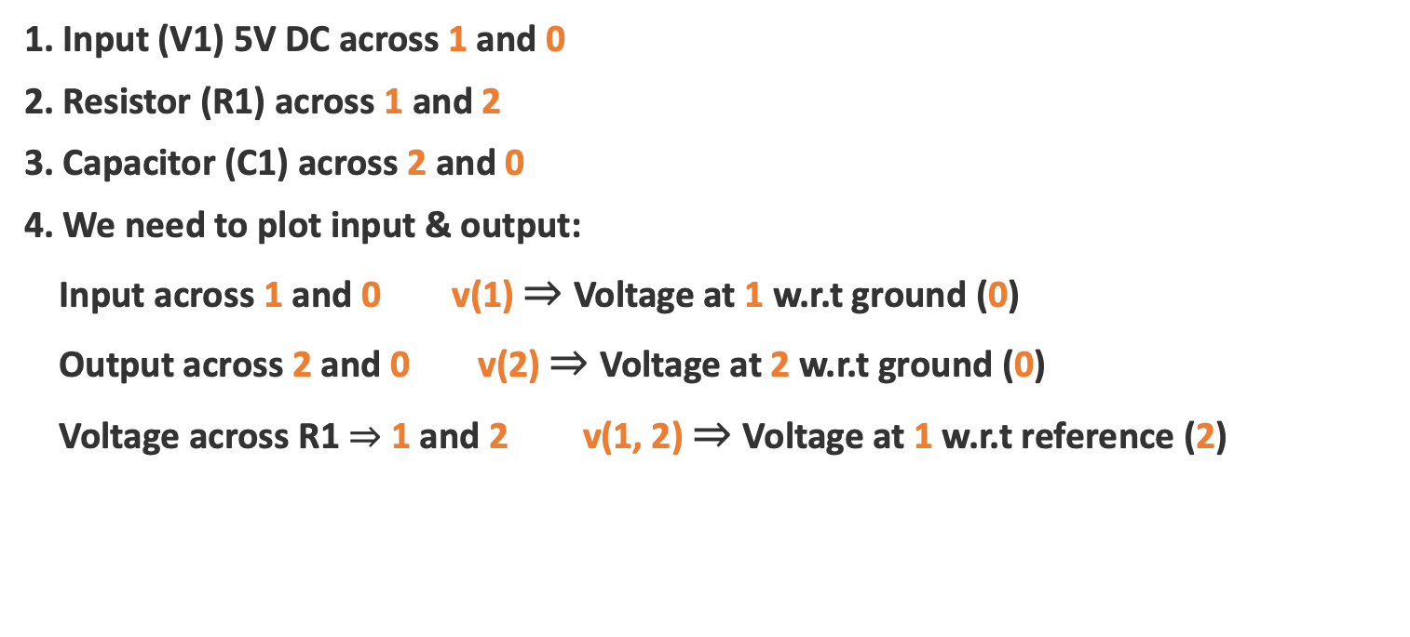
Circuit → netlist (step by step)
R1 1k
2
2
Steps
1
1
C1 1µF
1. Input (V1) 5V DC across 1 and 0
2. Resistor (R1) across 1 and 2
3. Capacitor (C1) across 2 and 0
4. We need to plot input & output:
Input across 1 and 0 v(1) $⇒$ Voltage at 1 w.r.t ground (0)
Output across 2 and 0 v(2) $⇒$ Voltage at 2 w.r.t ground (0)
Voltage across R1 $⇒$ 1 and 2 v(1, 2) $⇒$ Voltage at 1 w.r.t reference (2)
V1 5V
0
0

Slide 7
Circuit → netlist (step by step)
RC low-pass
V1 1 0 DC 5
R1 1 2 1k
C1 2 0 1u
.op
.end
R1 1k
2
2
1
1
C1 1µF
V1 5V
1. Number the nodes (ground = 0)
2. Name each component
3. One line per component:
name node node value
4. Add an analysis + .end
0
0

Slide 8
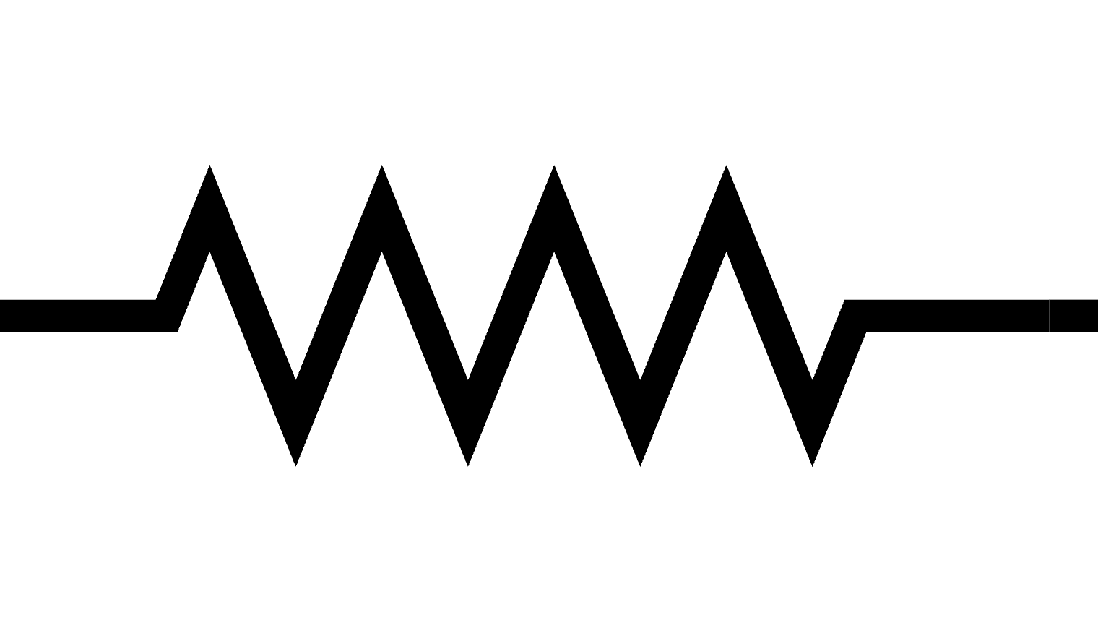
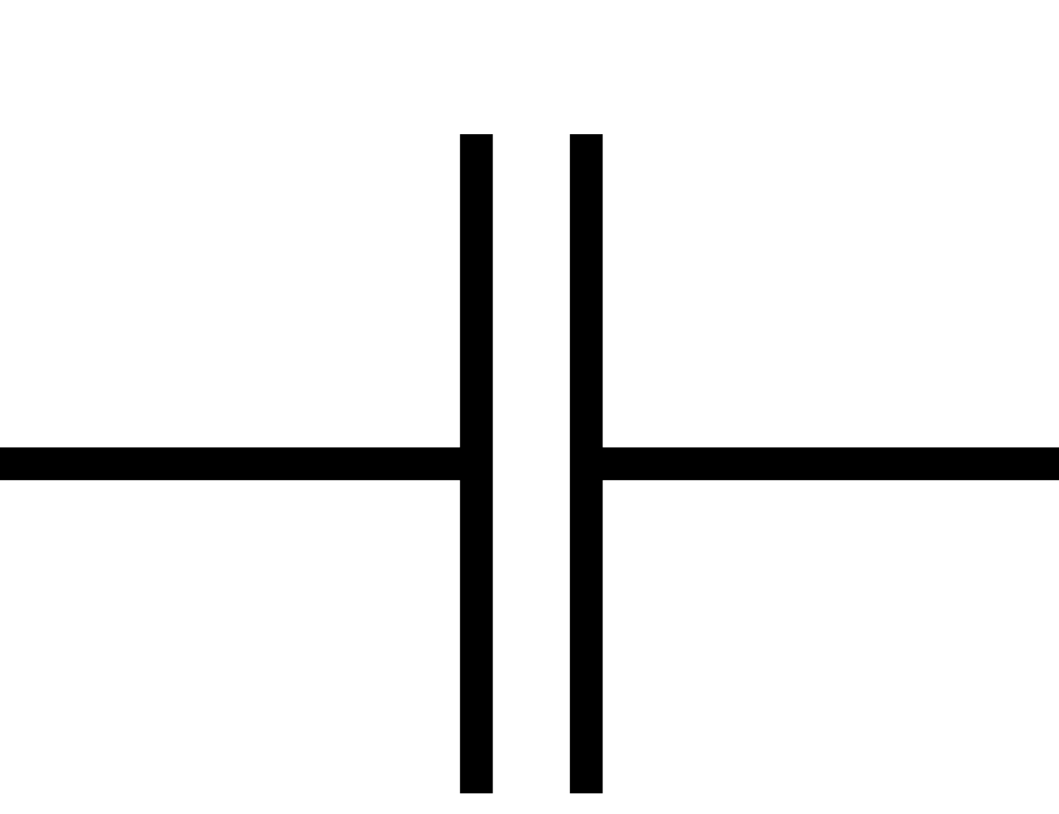
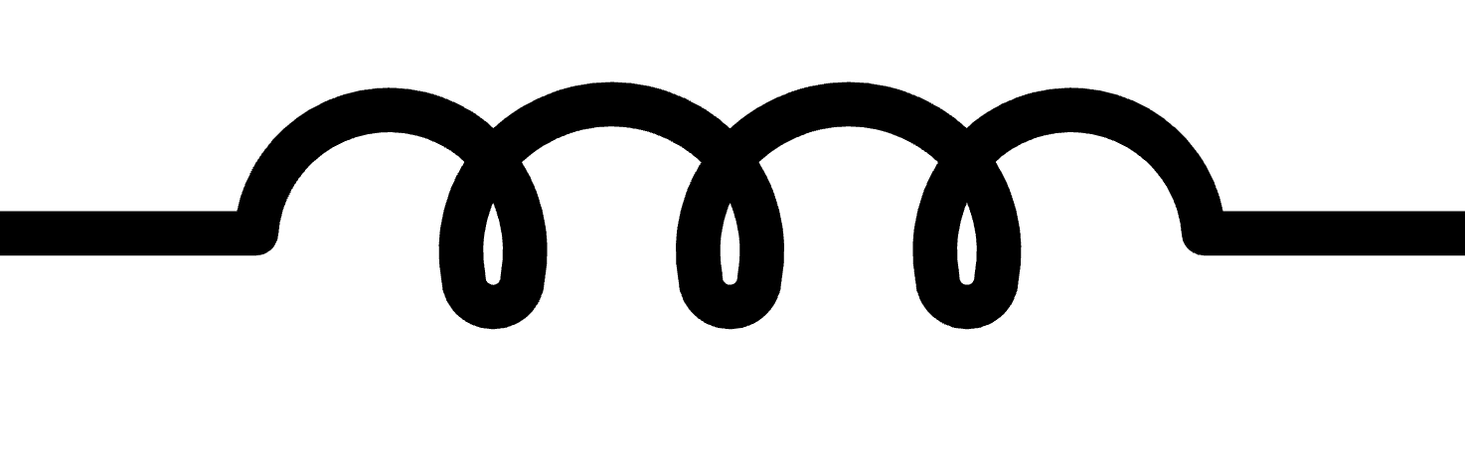
Passive components: R, C, L
Resistor
Capacitor
Inductor
node 1
node 2
node 2
node 0
node 2
node 3
R1 1 2 1k
C1 2 0 10u
L1 2 3 10m
2 nodes, value in ohms
2 nodes, value in farads
2 nodes, value in henries

Slide 9

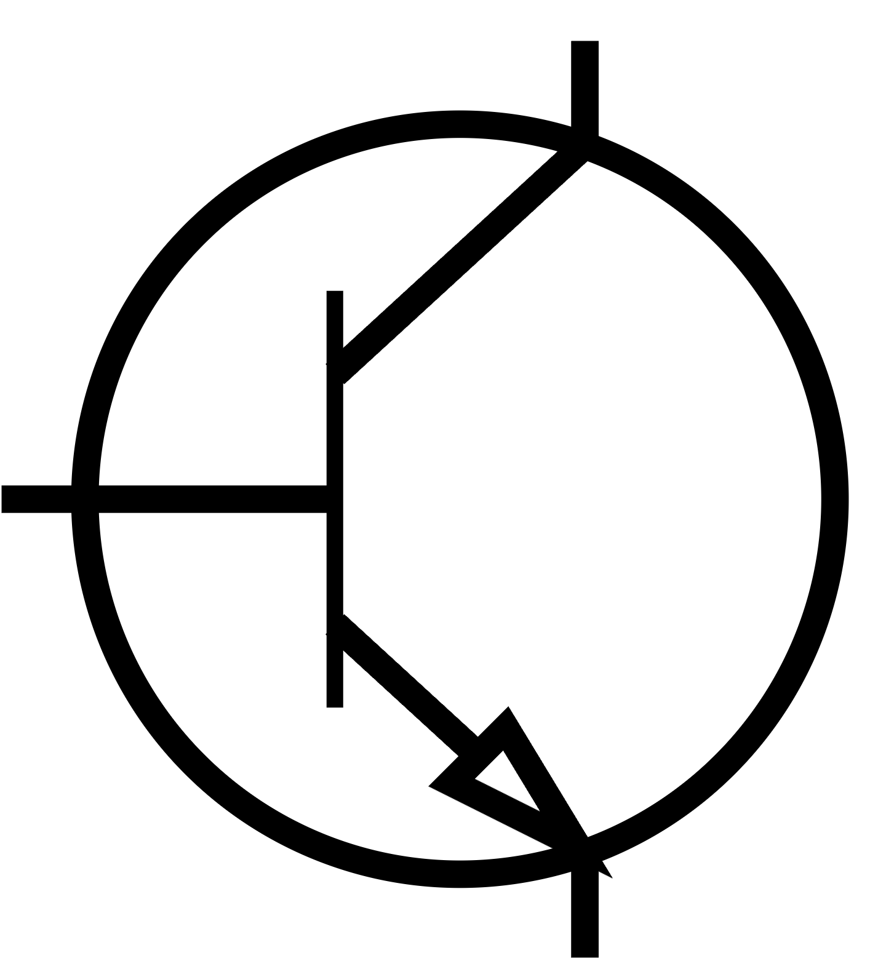
Diode and transistor
Diode
BJT (NPN)
Collector (3)
Base (2)
anode (1)
cathode (2)
Emitter (0)
D1 1 2 D1N4148
.model D1N4148 D(IS=1e-14)
Q1 3 2 0 2N2222
.model 2N2222 NPN(BF=200)
Order: anode, cathode, model name
Order: Collector, Base, Emitter, model

Slide 10
JFET (Junction Field-Effect Transistor)
D (node 1)
J1 1 2 0 JMOD
.model JMOD NJF(VTO=-2 BETA=1m)
G (node 2)
• Gate voltage controls the drain current
• N-channel JFET is ON at VGS = 0 and turns OFF
at a negative VGS (pinch-off, VTO)
• Gate draws almost no current
• Pin order: Drain, Gate, Source
• P-channel: use PJF
S (node 0)
N-channel JFET symbol

Slide 11
MOSFET
D (node 1)
M1 1 2 0 0 NMOD W=10u L=1u
.model NMOD NMOS(VTO=1 KP=100u)
G (node 2)
B (body)
• Insulated gate: ON when VGS is above the
threshold VTO
• Pin order: Drain, Gate, Source, Body
• Body is usually tied to the source
• W and L (width, length) set the size
• PMOS: use a PMOS model with VTO negative
S (node 0)
N-channel enhancement MOSFET

Slide 12
CMOS inverter (NOT gate)
Vdd
VDD vdd 0 DC 5
VIN in 0 DC 0
MP1 out in vdd vdd PMOD
MN1 out in 0 0 NMOD
.model NMOD NMOS(VTO=1 KP=100u)
.model PMOD PMOS(VTO=-1 KP=50u)
.dc VIN 0 5 0.1
PMOS
in
out
NMOS
• in = 0 V: PMOS ON, NMOS OFF, so out = 5 V
• in = 5 V: PMOS OFF, NMOS ON, so out = 0 V
• Almost no power is used when the input is steady

Slide 13
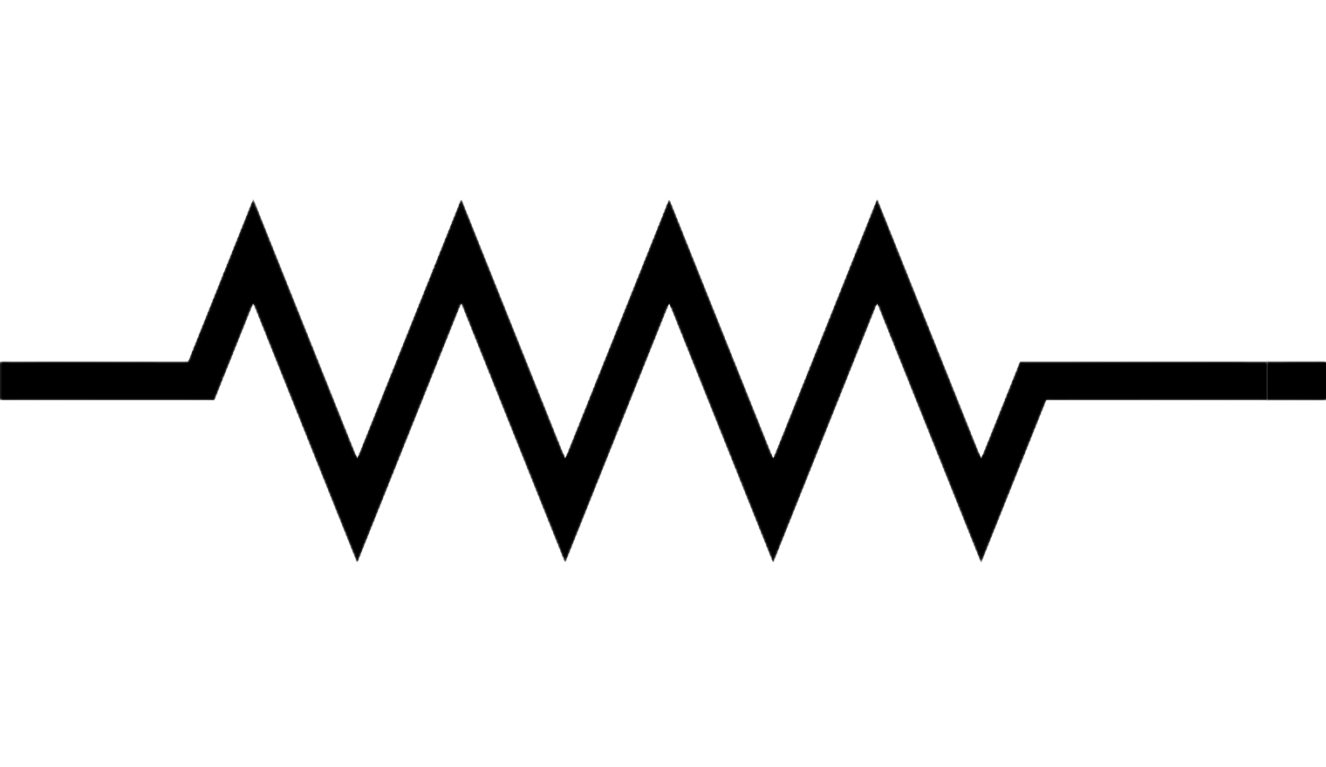

Op-amp: inverting amplifier
Rf = R2
Vin 1 0 DC 1
R1 1 2 1k
R2 2 3 10k
X1 0 2 3 OPAMP
.subckt OPAMP inp inn out
Rin inp inn 1MEG
E1 a 0 inp inn 1e5
Ro a out 50
.ends OPAMP
.op
.end
Rin = R1
–
node 1
(Vin)
node 2
+
node 3 (out)
Gain $=−\frac{R_{f}}{R_{1}}=−\frac{R_{2}}{R_{1}}= –10$
• E source = voltage-controlled voltage source (gain 1e5)
• Pin order: in+, in-, out. Output here: –10 V

Slide 14
ICs: subcircuits (X)
An IC (op-amp, gate, regulator…) is a small circuit packaged as a .subckt. You place it with the letter X and list its pins in order.
.include opamp.lib
X1 3 2 4 0 5 LM358
* pins: in+ in- out ... (check the
* model’s .subckt line for the order)
in+
+
out
in-
–
X1 (op-amp)

Slide 15
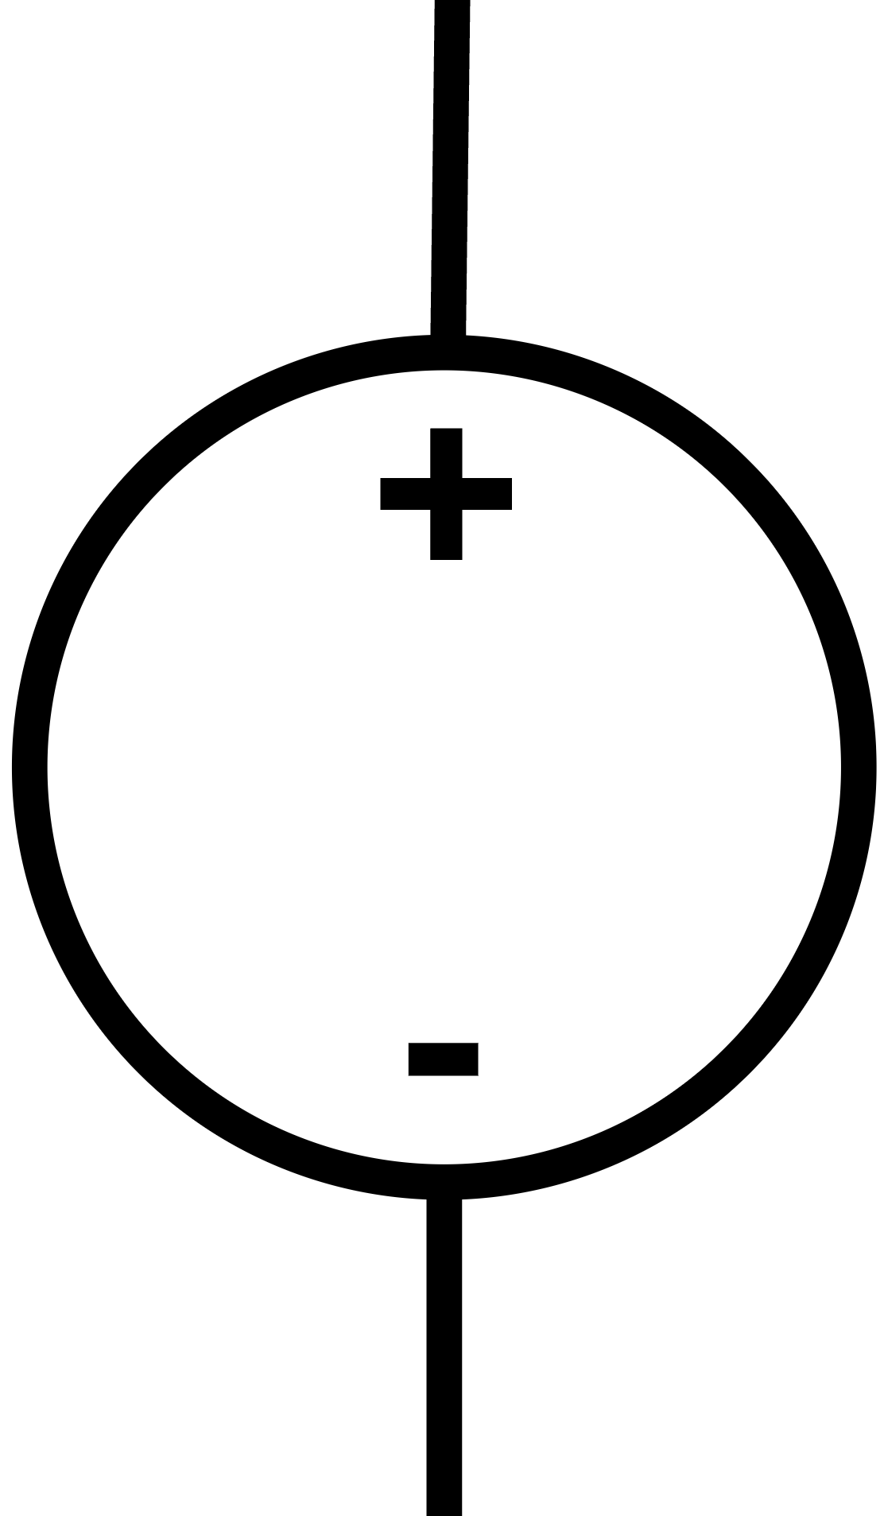

Power supplies: DC and AC
DC voltage source
AC (sine) source
node 1
node 1
V1 1 0 DC 5
V2 1 0 SIN(0 5 1k)
Constant 5 V between node 1 and node 0
Sine: offset 0 V, amplitude 5 V, 1 kHz
node 0
node 0
Other useful forms:
• I1 1 0 DC 1m (current source)
• V3 1 0 PULSE(0 5 0 1n 1n 1m 2m) (square wave)
• V4 1 0 AC 1 (for AC sweep)

Slide 16
Analysis commands
.op
.dc
DC operating point: all node voltages at one instant
Sweep a source, e.g. 0 to 5 V
.op
.dc V1 0 5 0.1
.ac
.tran
Frequency response (Bode plot)
Voltages vs time
.ac dec 10 1 100k
.tran 0.1m 10m

Slide 17
Running ngspice
$ ngspice rc.cir
ngspice 1 -> run
ngspice 2 -> print v(2)
ngspice 3 -> plot v(1) v(2)
ngspice 4 -> quit
Steps
1. Save your netlist as rc.cir
2. Open a terminal, run ngspice rc.cir
3. Type run to simulate
4. print v(node) shows values;
plot v(node) draws a graph
5. v(2) = voltage at node 2;
i(V1) = current through V1

Slide 18
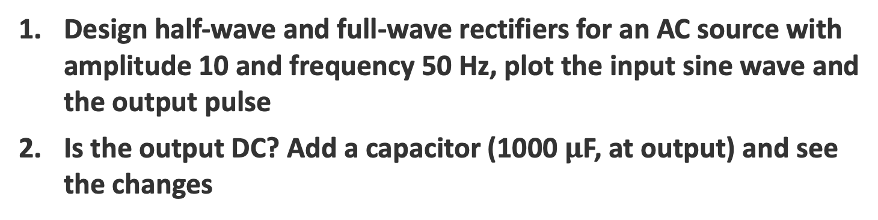
Question
Design half-wave and full-wave rectifiers for an AC source with amplitude 10 and frequency 50 Hz, plot the input sine wave and the output pulse
Is the output DC? Add a capacitor (1000 $μ$F, at output) and see the changes

Slide 19
Report Format
Title
Aim / Objective
Components Required
Circuit Diagram (with all nodes labeled)
Working Principle
ngspice Netlist
Simulated Waveforms / Bode Plots
Observation and Results

Slide 20
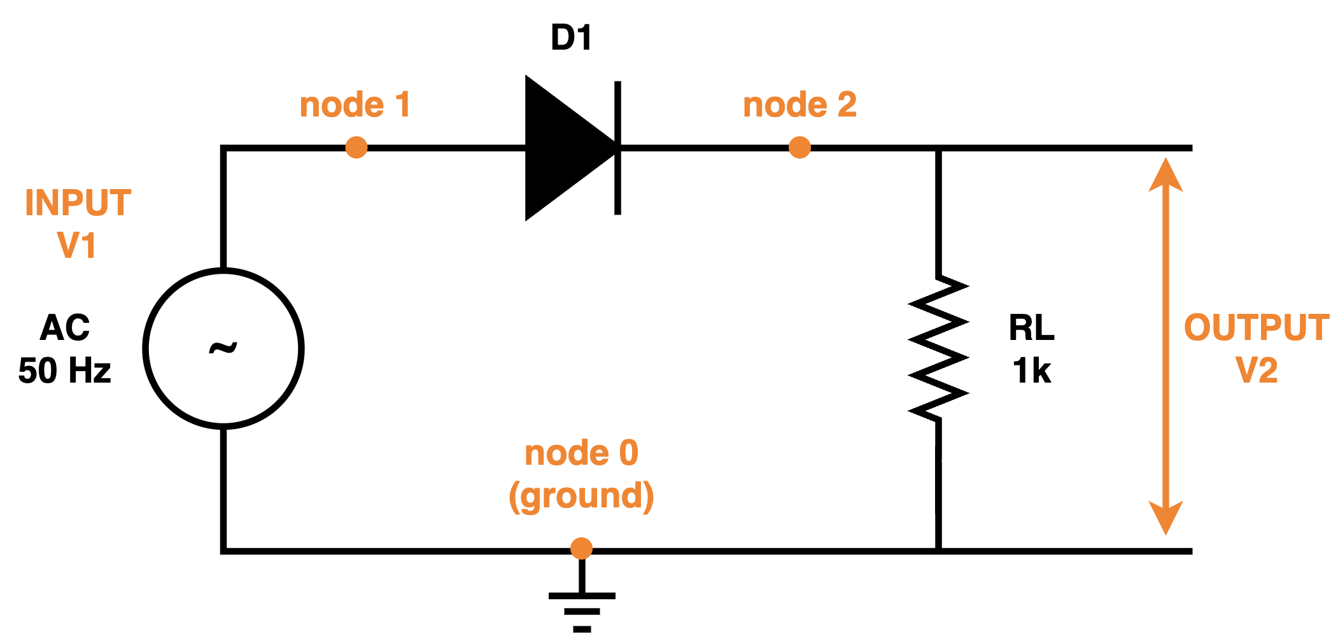
Half-wave Rectifier
Circuit

Slide 21
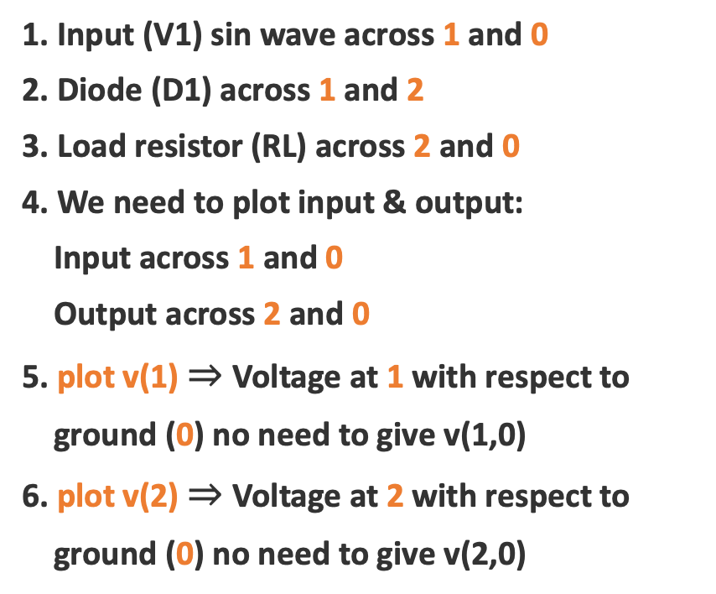
Half-wave Rectifier
1. Input (V1) sin wave across 1 and 0
2. Diode (D1) across 1 and 2
3. Load resistor (RL) across 2 and 0
4. We need to plot input & output:
Input across 1 and 0
Output across 2 and 0
5. plot v(1) $⇒$ Voltage at 1 with respect to
ground (0) no need to give v(1,0)
6. plot v(2) $⇒$ Voltage at 2 with respect to
ground (0) no need to give v(2,0)
Circuit

Slide 22
Half-wave Rectifier
Netlist
* Half-wave rectifier
V1 1 0 SIN(0 10 50)
D1 1 2 Dmod
RL 2 0 1k
.model Dmod D(Is=2.52n N=1.7)
.control
set noaskquit
tran 100u 100m
plot v(1) v(2) title "Half-Wave Rectifier"
.endc
.end

Slide 23
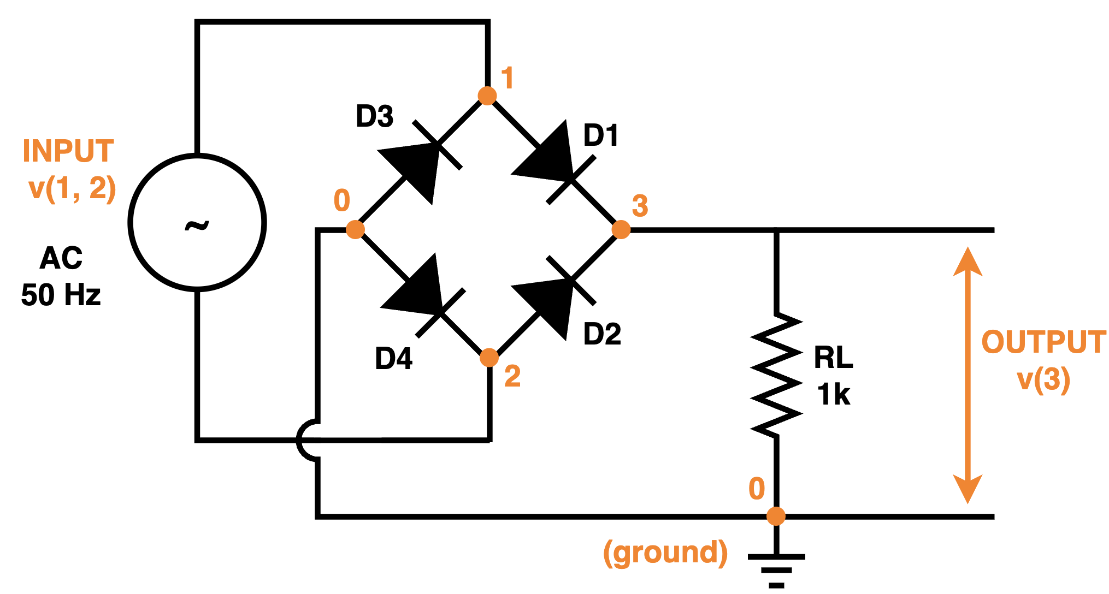
Full-wave Rectifier
Circuit

Slide 24
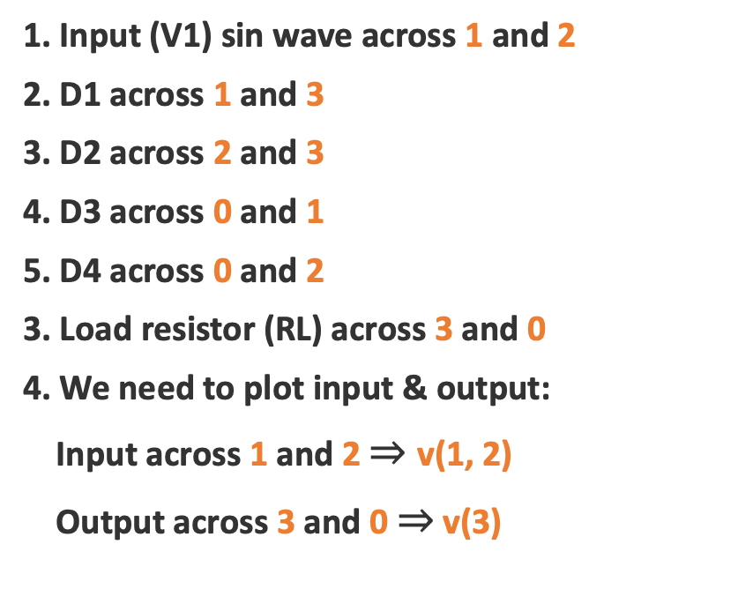
Half-wave Rectifier
Circuit
1. Input (V1) sin wave across 1 and 2
2. D1 across 1 and 3
3. D2 across 2 and 3
4. D3 across 0 and 1
5. D4 across 0 and 2
3. Load resistor (RL) across 3 and 0
4. We need to plot input & output:
Input across 1 and 2 $⇒$ v(1, 2)
Output across 3 and 0 $⇒$ v(3)

Slide 25
Half-wave Rectifier
* Full-wave bridge rectifier
V1 1 2 SIN(0 10 50)
D1 1 3 Dmod
D2 2 3 Dmod
D3 0 1 Dmod
D4 0 2 Dmod
RL 3 0 1k
.model Dmod D(Is=2.52n N=1.7)
.control
set noaskquit
tran 100u 100m
plot v(1,2) v(3) title "Full-Wave Bridge Rectifier"
.endc
.end
Netlist

Slide 26
Common mistakes & summary
Avoid these
Remember
No node 0 (no ground)
Floating node (only one connection)
Missing .end
Writing M for mega (use MEG)
Wrong pin order for D, Q, X
First line is the title – not a component!
Node 0 = ground
First letter = component type
One line per component
Netlist = name, nodes, value
Add an analysis (.op/.dc/.ac/.tran)
End with .end

