Slide 1
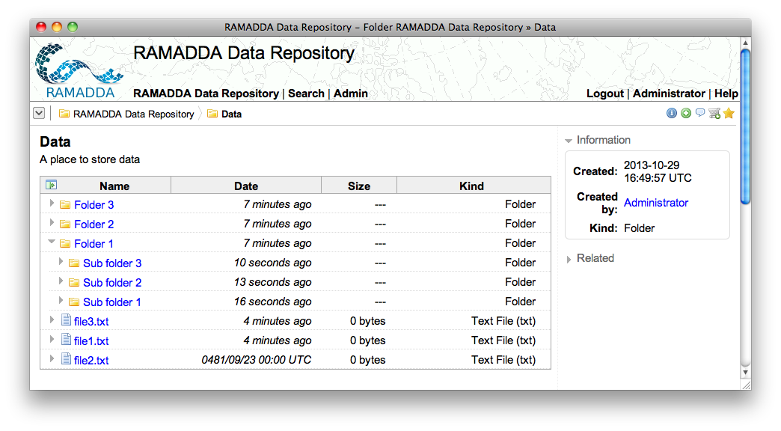
You are always viewing an entry.
Here it is a folder called “Data”
RAMADDA is organized like a file
system. There are folders, files
and other types of entries
Click on an arrow to open in place
Click on a link to go to that entry

Slide 2
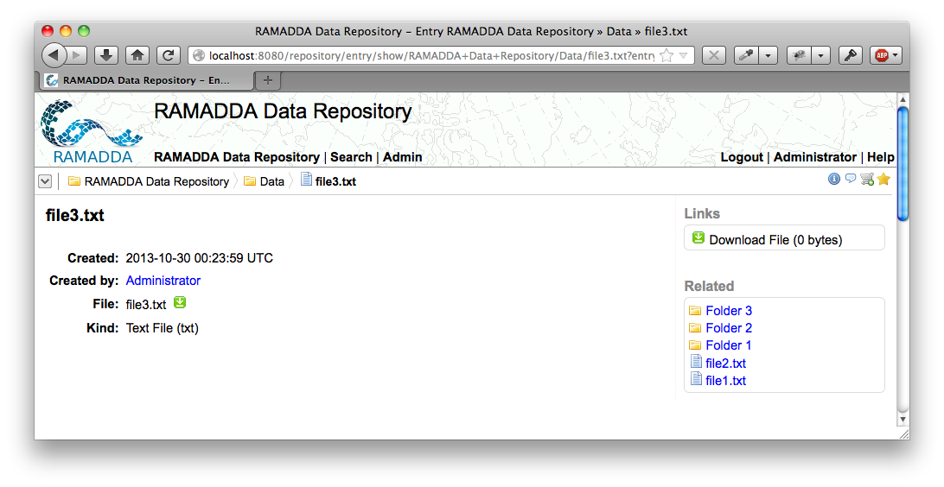
Breadcrumbs
Current entry is “file3.txt”

Slide 3
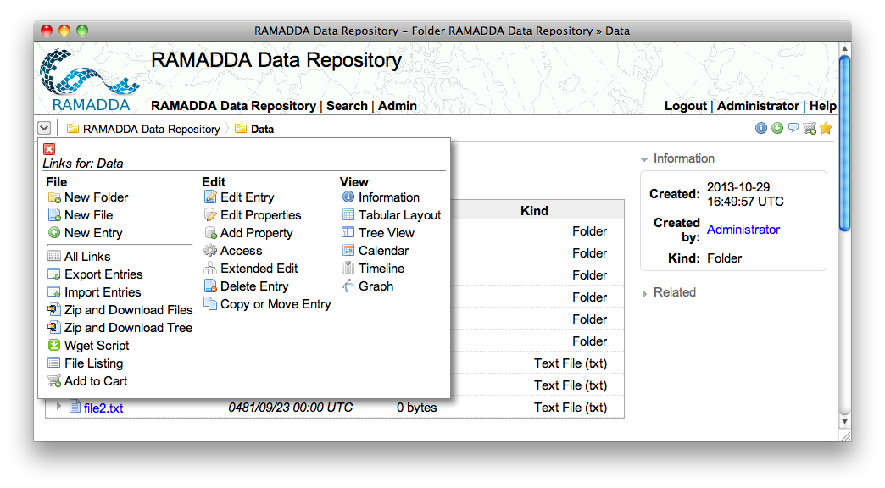
Popup menu

Slide 4
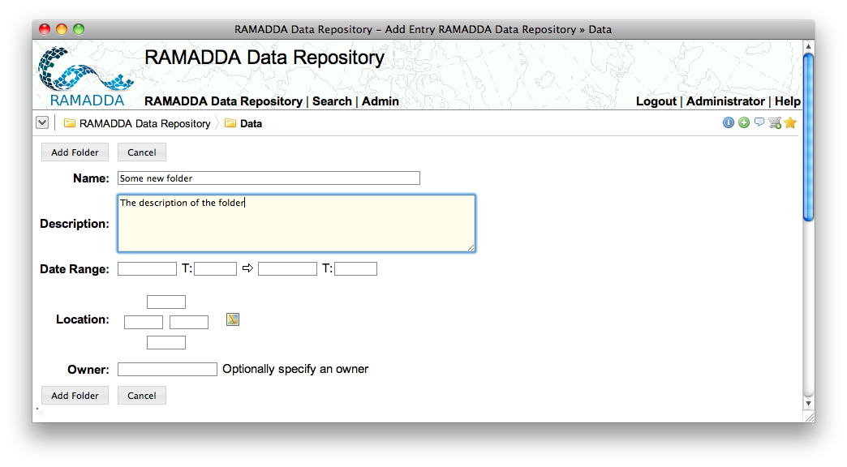

Slide 5
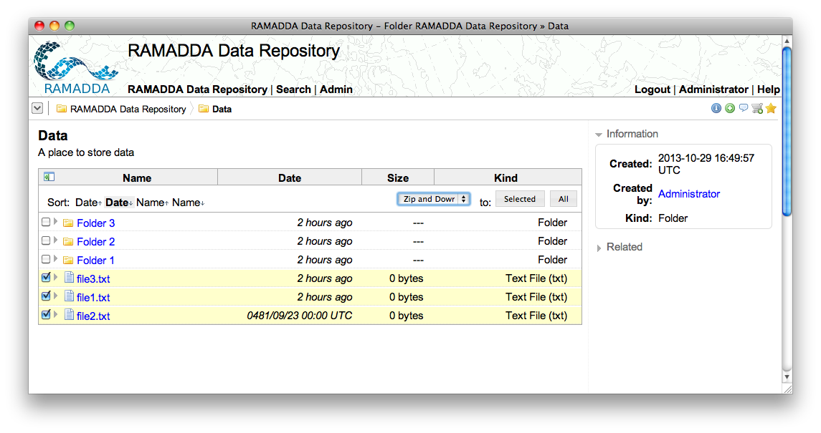
Show checkboxes
Select action

