Slide 1
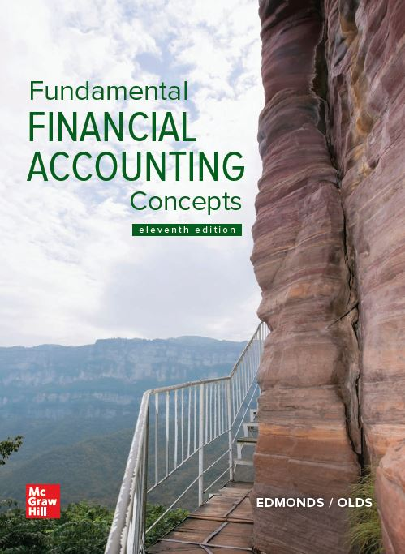
Chapter 1
An Introduction to
Accounting
Notes:
Why should you study accounting? You should study accounting because it can help you succeed in business. Businesses use accounting to keep score. Imagine trying to play football without knowing how many points a touchdown is worth. Like sports, business is competitive. If you do not know how to keep score, you likely will not succeed.
In this chapter, we provide a look at accounting as an information system that reports on the economic activities and financial condition of a business or other organization.

Slide 2
Section 1: Collecting and Organizing Information
Accounting is an information system that reports on the economic activities and financial condition of a business or other organization.
Notes:
Section 1: Collecting and Organizing Information
Accounting is an information system that reports on the economic activities and financial condition of a business or other organization.

Slide 3
LO 1-1:
Identify the ways accounting benefits society.
Notes:
LO 1-1: Identify the ways accounting benefits society.

Slide 4
Role of Accounting in Society
How should society allocate its resources? Should we spend more money to harvest food or cure disease?
Notes:
Accounting provides information that is useful in answering questions about resource allocation.

Slide 5
Role of Accounting in Society Continued
Should we build computers or cars? Should we invest money in IBM or General Motors?
Accounting provides information that helps answer such questions.
Notes:
Accounting provides information that is useful in answering questions about resource allocation. Do not underestimate the importance of reliable information used to answer these questions. The users of accounting information include a variety of people and organizations.

Slide 6
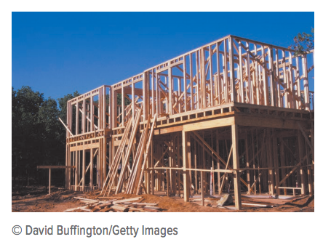
Market-Based Allocations
A market is a group of people or entities organized to exchange items of value.
Notes:
Suppose you want to start a business. You will likely need such resources as money, equipment, land, materials, employees, and so on. In the United States, you would compete for these resources in open markets. A market is a is a group of people or entities organized to exchange items of value.

Slide 7
Market-Based Allocations Continued
Common terms for the added value created in the transformation process:
Profit
Income
Earnings
Notes:
Common terms for the added value created in the transformation process include profit, income, or earnings. Accountants measure the added value as the difference between the cost of a product or service and the selling price of that product or service.

Slide 8
Financial Resources
Businesses need financial resources (money) to establish and operate their businesses.
Investors
Creditors
Notes:
Part I
Businesses need financial resources (money) to get started and to operate.
Part II
Investors provide resources in exchange for ownership interests in a business. Owners expect businesses to return to them a share of the business, including a portion of earned income.
Part III
Creditors lend financial resources to businesses. Instead of a share of the business, creditors expect the businesses to repay borrowed resources at a future date plus a specified fee called interest.

Slide 9
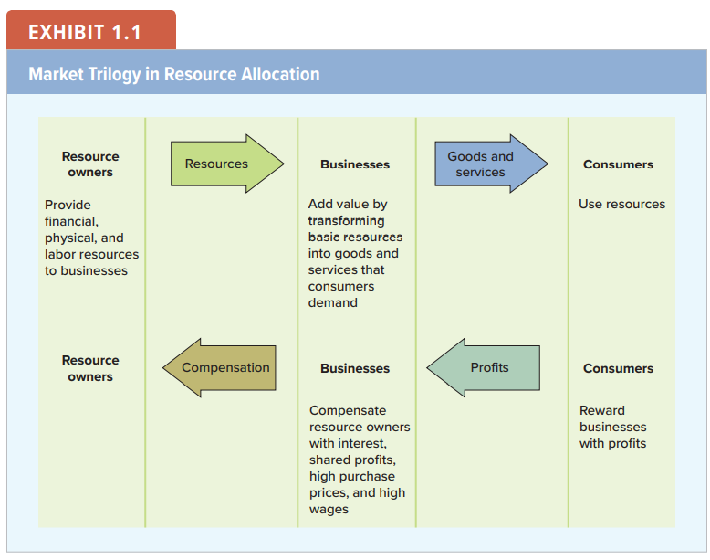
Market Trilogy in Resource Allocation
Notes:
Exhibit 1.1:
How can you get the resources you need to start a business? You must go to open markets and convince resource owners that you can produce profits.
Part I
The market for business resources involves three distinct participants: consumers, businesses, and resource owners.
Part II
Consumers use resources. Resources, however, are frequently not in a form that consumers want.
Part III
Businesses add value by transforming resources such as trees into desirable products such as furniture.
Part IV
Resource owners control the distribution of resources to businesses. Resource owners include investors and creditors.

Slide 10
Physical Resources
In their most primitive form, physical resources are natural resources.
Owners of physical resources seek to sell those resources to profitable businesses which are able to pay higher prices and make repeat purchases.
Notes:
In their most primitive form, physical resources are called natural resources. Physical resources often move through numerous stages of transformation. For example, standing timber may be successively transformed into harvested logs, raw lumber, and finished houses.
Owners of physical resources seek to sell those resources to businesses with high earnings potential because profitable businesses are able to pay higher prices and make repeat purchases.

Slide 11
Labor Resources
Labor resources include both intellectual and physical labor. Workers seek relationships with businesses that have high earnings potential because these businesses are better able to pay high wages.
Notes:
Labor resources include both intellectual and physical labor.
Like other resource providers, workers prefer businesses that have high income potential because these businesses are able to pay higher wages and offer continued employment.

Slide 12
Types of Accounting Information
Financial Accounting
Focused on the needs of external users
Managerial Accounting
Focused on the needs of internal users
Notes:
Part I
Accounting information focused on the needs of external users is called financial accounting. For example, investors are interested in whether a business produces more overall income relative to risk.
Part II
Accounting information focused on the needs of internal users is called managerial accounting. For example, a regional manager in the business is interested in the store-by-store earnings under her control.

Slide 13
Nonbusiness Resource Usage
Not all entities allocate resources based on profitability. Organizations that are not motivated by profit are called not-for-profit entities.
Governments allocate resources for national defense, to reallocate wealth, or to protect the environment.
Foundations, religious groups, and various benevolent organizations allocate resources based on humanitarian concerns.
Notes:
Part I
Not all entities allocate resources based on profitability. Organizations that are not motivated by profit are called not-for-profit entities.
Part II
Government, foundations, religious groups, the Peace Corps, and various benevolent organizations allocate resources based on humanitarian concerns. Some examples include the John D. and Catherine T. MacArthur Foundation, the American Red Cross, and The Salvation Army.

Slide 14
Careers in Accounting
Public Accounting
Private Accounting
Certified Public Accountant
Audit services
Tax services
Consulting services
Certified Management Accountant
Certified Internal Auditor
Notes:
You are probably familiar with the acronym CPA. CPA stands for certified public accountant. Public accountants provide services to various clients. They are usually paid a fee that varies depending on the service provided. Services typically offered by public accountants include audit services, tax services, and consulting services. Audit services involve examining a company’s accounting records in order to issue an opinion about whether the company’s financial statements conform to generally accepted accounting principles. Tax services include both determining the amount of tax due and tax planning to help companies minimize tax expense. Consulting services cover a wide range of activities that include everything from installing sophisticated computerized accounting systems to providing personal accounting advice.
Accountants employed in the private sector usually work for a specific company or nonprofit organization. Private sector accountants perform a wide variety of functions for their employers. Their duties include classifying and recording transactions, billing customers and collecting amounts due, ordering merchandise, paying suppliers, preparing and analyzing financial statements, developing budgets, measuring costs, assessing performance, and making decisions. Designations such as the CMA (Certified Management Accountant) and CIA (Certified Internal Auditor) are widely recognized professional certifications held by private accountants to indicate technical competence and integrity on the part of individuals who hold them.

Slide 15
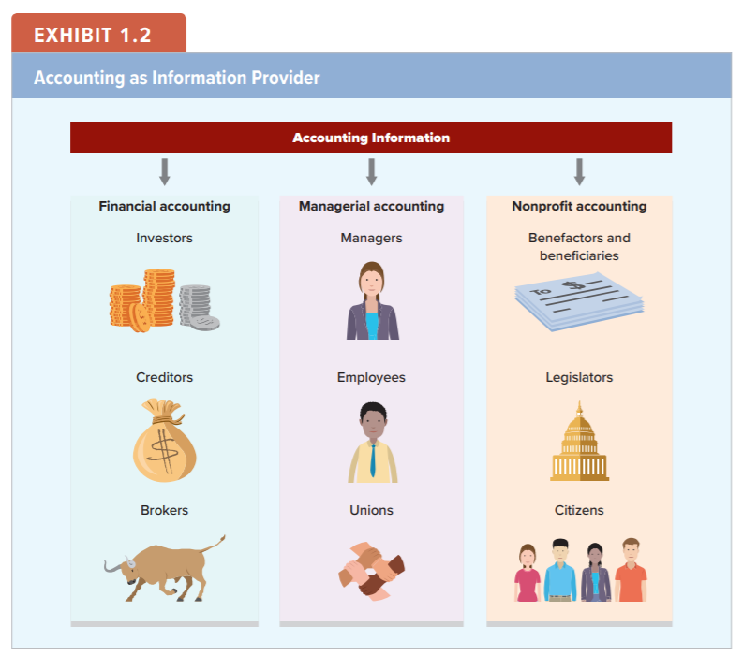
Accounting as Information Provider
Notes:
The focus of accounting is to provide information that is useful to a variety of business and nonbusiness user groups for decision making. The different types of accounting information and the stakeholders that commonly use the information are summarized in Exhibit 1.2.

Slide 16
Accounting Improves Communication
Accountants establish measurement and reporting rules that businesses use to facilitate communication.
FASB
Generally
Accepted
Accounting
Principles
Notes:
The Financial Accounting Standards Board (FASB) establishes measurement and reporting rules that businesses use to facilitate communication.
The FASB is a privately funded organization with the primary authority for establishing accounting standards in the United States. The measurement rules established by the FASB are called generally accepted accounting principles (GAAP). Financial reports issued to the public must follow GAAP. This textbook introduces these principles so you will be able to understand business activity presented in accounting reports issued in the United States.

Slide 17
Focus on International Issues
Until recently, each country developed its own unique GAAP. Global companies were required to prepare multiple sets of financial statements.
To address the need for a common set of financial standards, the International Accounting Standards Committee was formed in 1973.
The committee was reorganized as the International Accounting Standards Board (IASB) in 2001.
Notes:
The IASB issues International Financial Reporting Standards (IFRS), which are rapidly gaining support worldwide. As of 2020, most of the major economic countries have switched from their local GAAP to IFRS. One notable exception is the United States, but even here, there is an active process in place to reduce the differences between IFRS and U.S. GAAP. Throughout this text, where appropriate, we will note the differences between U.S. GAAP and IFRS. However, by the time you graduate, it is likely that among the major industrialized nations, there will be a global GAAP.

Slide 18
LO 1-2:
Identify reporting entities.
Notes:
LO 1-2: Identify reporting entities.

Slide 19
Reporting Entities
Financial accounting reports disclose the financial activities of particular individuals or organizations described as reporting entities. Each entity is treated as a separate reporting unit.
Businesses
Individuals
Organizations
Notes:
Part I
Financial accounting reports disclose the financial activities of particular individuals or organizations described as reporting entities. Each entity is treated as a separate reporting unit.
Part II
For example, a business, the person who owns the business, and a bank that loans money to the business are treated as three separate reporting entities. Accountants would prepare three separate sets of financial reports to describe the economic activities of each of the three entities.

Slide 20
LO 1-3:
Identify the components of the accounting equation.
Notes:
LO 1-3: Identify the components of the accounting equation.

Slide 21
Elements of Financial Statements
Assets
Liabilities
Stockholders’ Equity
Contributed Capital
Revenue
Expenses
Distributions
Net Income
Gains
Losses
The elements represent broad categories. We will discuss elements 1–8 in this chapter. We will save elements 9 and 10 for a later chapter.
Notes:
The information reported in financial statements is organized into categories known as elements. Eight of the ten financial elements the Financial Accounting Standards Board has defined are discussed in this chapter: assets, liabilities, stockholders’ equity, contributed capital, revenue, expenses, distributions, and net income. The other two elements (gains and losses) are discussed in a later chapter.

Slide 22
Using Accounts to Gather Information
Assets – cash, equipment, buildings
Liabilities
Stockholders’ Equity
Contributed Capital
Revenue
Expenses
Distributions
Net Income
Gains
Losses
Detailed information about elements is maintained in accounts.
Not all business entities use the same accounts or account names.
Notes:
The elements represent broad categories. Detailed information about the elements is maintained in records commonly called accounts. Accounts are reported in the financial statements.

Slide 23
The Accounting Equation
The Accounting Equation is composed of three elements: assets, liabilities and stockholders’ equity. Stockholders’ equity is subdivided into two additional elements called common stock and retained earnings.
Businesses use resources to conduct their operations. The resources a business uses to earn money are called assets.
Notes:
The elements represent broad categories. Accountants do not identify financial statement items like cash, equipment, buildings, and land as elements, but rather as subclassifications of the asset element known as accounts. The subclassifications of the elements are frequently called accounts. Accounts are reported in the financial statements.

Slide 24
Creating an Accounting Equation
Assets = Claims
Claims on the assets are from three sources:
Creditors (liabilities)
Investors (stockholders’ equity)
Operations (profits increase assets)
Assets = Liabilities + Stockholders’ equity
Notes:
Part I
The assets of a business belong to the resource providers. These resource providers have claims on the assets.
Part II
The resource providers who have claims on the assets are the creditors and investors.
Part III
This is known as the accounting equation. It recognizes the relationship among the assets, the creditors’ claims (called liabilities), and the investors’ claims (called stockholders’ equity).

Slide 25
Creating an Accounting Equation Continued
Commitments made to investors are described in certificates called common stock.
Assets = Liabilities + Stockholders’ equity
Common
Stock
Retained Earnings
Increases to stockholders’ equity from earnings are called retained earnings.
Notes:
Part I
Stockholders’ equity can also be viewed as two distinct parts. First, common stock represents assets received from investors (owners). The owners of such businesses are often called stockholders, and the ownership interest in the business is called stockholders’ equity.
Second, retained earnings represents assets obtained through the earnings activities. Assets a business has earned can either be distributed to the owners or kept in the business. Retained earnings is therefore a component of stockholders’ equity that represents the owners’ claims on the assets.
Part II
When a business has common stock and retained earnings, the accounting equation is slightly modified to specifically refer to stockholders’ equity.

Slide 26
LO 1-4:
Show how business events affect the accounting equation.
Notes:
LO 1-4: Show how business events affect the accounting equation.

Slide 27
Recording Business Events Under an Accounting Equation
An accounting event is an economic occurrence that changes an entity’s assets, liabilities, or stockholders’ equity.
A transaction is a particular kind of event that involves transferring something of value between two entities.
Notes:
An accounting event is an economic occurrence that changes an enterprise’s assets, liabilities, or stockholders’ equity. A transaction is a particular type of event that involves transferring something of value between two entities. These transactions include:
asset source transactions.
asset exchange transactions.
asset use transactions.

Slide 28
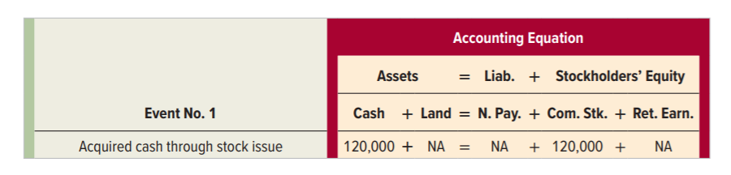
Asset Source Transactions
Event 1: Rustic Camp Sites (RCS) was formed on January 1, Year 1, when it acquired $120,000 cash from issuing common stock.
RCS increases assets (cash).
RCS increases stockholders’ equity (common stock).
Double-Entry Bookkeeping
Recorded Twice
Notes:
Part I
Event 1: Rustic Camp Sites was formed on January 1, Year 1, when it acquired $120,000 cash from issuing common stock.
Part II
To record this transaction, Rustic Camp Sites increases assets (cash) and increases stockholders’ equity (common stock). This is an asset source transaction.
Part III
Here is the impact of this transaction on the accounting equation.
Notice that the elements have been divided into accounts. For example, the element of assets is divided into a Cash account and a Land account.
Part IV
Every transaction affects the accounting equation in at least two places. It is from this practice that the double-entry bookkeeping system derives its name.

Slide 29
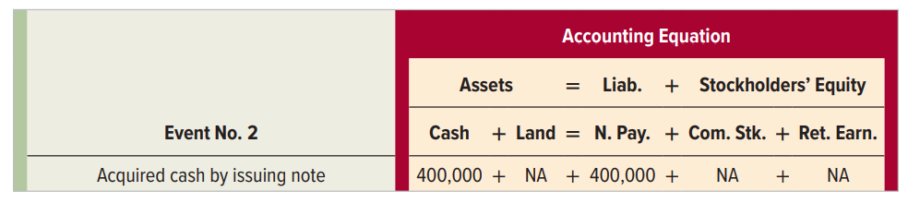
An Asset Source Transaction
Event 2: RCS acquired an additional $400,000 of cash by borrowing from a creditor.
RCS increases assets (cash).
RCS increases liabilities (notes payable).
Notes:
Part I
Event 2: Rustic Camp Sites acquired an additional $400,000 of cash by borrowing from a creditor.
Part II
To record this transaction, Rustic Camp Sites increases assets (cash) and increases liabilities (notes payable). This is an asset source transaction.

Slide 30
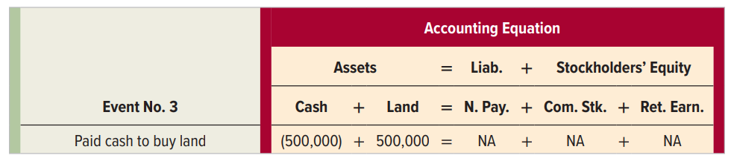
Asset Exchange Transaction
Event 3: RCS paid $500,000 cash to purchase land.
RCS decreases assets (cash).
RCS increases assets (land).
Notes:
Part I
Event 3: Rustic Camp Sites paid $500,000 cash to purchase land.
Part II
To record this transaction, Rustic Camp Sites decreases assets (cash) and increases assets (land). This is an asset exchange transaction.
Part III
Here is the impact of this transaction on the accounting equation.

Slide 31
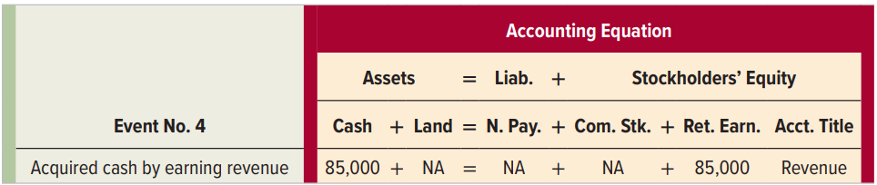
Another Asset Source Transaction
Event 4: RCS obtained $85,000 cash by leasing campsites to customers.
RCS increases assets (cash).
RCS increases stockholders’ equity (retained earnings).
revenues
Notes:
Part I
Event 4: Rustic Camp Sites obtained $85,000 cash by leasing campsites to customers.
Part II
To record this transaction, Rustic Camp Sites increases assets (cash) and increases stockholders’ equity (retained earnings). This is an asset source transaction. Revenue represents an economic benefit a company obtains by providing customers with goods and services.
Part III
Here is the impact of this transaction on the accounting equation.

Slide 32
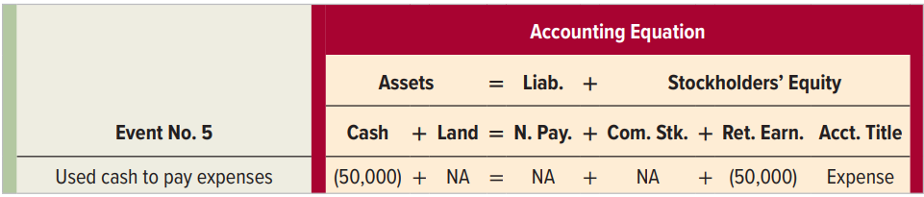
Asset Use Transaction
Event 5: RCS paid $50,000 cash for operating expenses such as salaries, rent, and interest.
RCS decreases assets (cash).
RCS decreases stockholders’ equity (retained earnings).
expenses
Notes:
Part I
Event 5: Rustic Camp Sites paid $50,000 cash for operating expenses such as salaries, rent, and interest. (RCS could establish a separate account for each type of expense. However, the management team does not currently desire this level of detail. The number of accounts a business uses depends on the level of information managers need to make decisions.)
Part II
To record this transaction, Rustic Camp Sites decreases assets (cash) and decreases stockholders’ equity (retained earnings). This is an asset use transaction. In the normal course of generating revenue, a business consumes various assets and services. The assets and services consumed to generate revenue are called expenses.
Part III
Here is the impact of this transaction on the accounting equation.

Slide 33
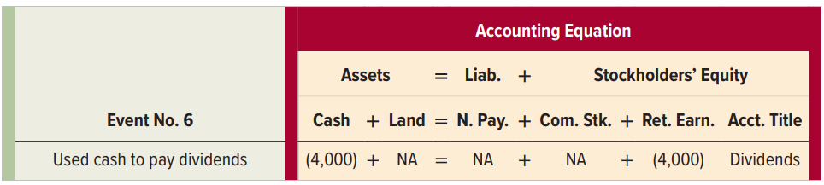
Another Asset Use Transaction
Event 6: RCS paid $4,000 in cash dividends to its owners.
RCS decreases assets (cash).
RCS decreases stockholders’ equity (retained earnings).
dividends
Notes:
Part I
Event 6: Rustic Camp Sites paid $4,000 in cash dividends to its owners.
Part II
To record this transaction, Rustic Camp Sites decreases assets (cash) and decreases stockholders’ equity (retained earnings). This is an asset use transaction. If a business transfers some or all of its earned assets to owners, the transfer is frequently called a dividend. Since assets distributed to stockholders are not used for the purpose of generating revenue, dividends are wealth transfers, not expenses.
Part III
Here is the impact of this transaction on the accounting equation.

Slide 34
Changes in Market Value
Event 7: The land that RCS paid $500,000 to purchase had an appraised market value of $525,000 on December 31, Year 1.
Historical Cost Concept
Requires that most assets be reported at the amount paid for them (their historical cost) regardless of increases in market value.
Notes:
Part I
Event 7: The land that Rustic Camp Sites paid $500,000 to purchase had an appraised market value of $525,000 on December 31, Year 1
Part II
The historical cost concept requires that most assets be reported at the amount paid for them (their historical cost) regardless of increases in market value. As a result of following the historical cost concept, event 7 does not result in a change in Rustic Camp Sites’ accounting records.

Slide 35
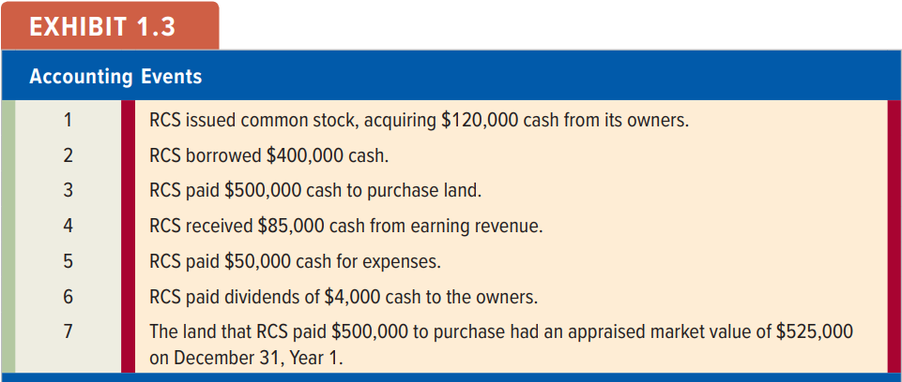
Summary of Accounting Events
Notes:
A summary of Rustic Camp Sites Year 1 accounting events is shown in Exhibit 1.3.

Slide 36
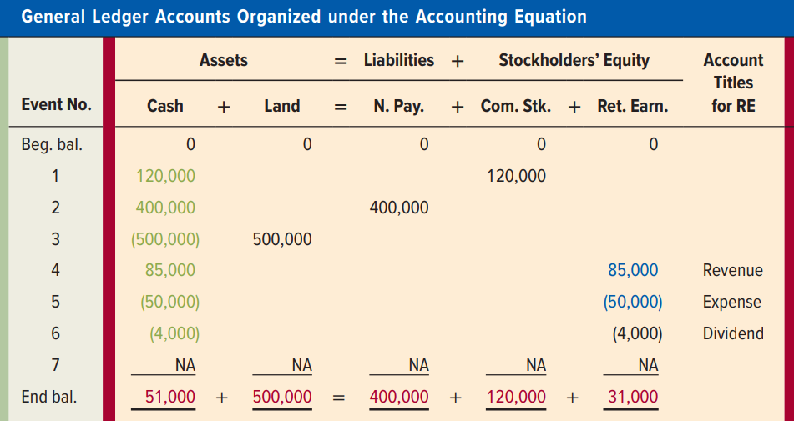
Summary of Accounting Events
Notes:
Exhibit 1.3 continued:
Here is a summary of the impact on the accounting equation of the transactions for Rustic Camp Sites we completed earlier. The data in the summary are coded as follows. The numbers in green are used in the statement of cash flows. The numbers in red are used to prepare the balance sheet. Finally, the numbers in blue are used to prepare the income statement. The numbers reported on the statement of changes in stockholders’ equity have not been color coded because they appear in more than one statement.
The complete collection of a company’s accounts is called the general ledger. A summary of the accounting events and the general ledger accounts is shown in Exhibit 1.3.

Slide 37
LO 1-5:
Interpret information shown in an accounting equation.
Notes:
LO 1-5: Interpret information shown in an accounting equation.

Slide 38
The Left versus the Right Side of the Accounting Equation
The right side of the equation
is not related to the amount of actual cash a company has on hand.
Assets are displayed on the left side of the accounting equation. Assets include cash, but are not always cash.
The right side of the accounting equation identifies the sources of the company’s assets, not their composition.
Notes:
Part I
Assets are displayed on the left side of the accounting equation. Assets include cash, but are not always cash.
Part II
The amounts in liabilities, common stock, and retained earnings do not represent cash. Instead, they represent the original sources of the company’s assets. The right side identifies the sources of assets, not their composition.

Slide 39
Cash and Retained Earnings
While Retained Earnings does not represent the amount of cash on hand, it does limit the amount of cash that can be used to pay dividends.
So, both Cash and Retained Earnings are needed to pay cash dividends.
Dividends are distributions of assets generated through earnings
Notes:
While the amount of retained earnings does not represent the amount of cash a company has on hand, it does limit the amount of cash that can be used to pay dividends. The payment of dividends is limited by both the amount of cash and the amount of retained earnings. In other words, to pay a cash dividend a company must have both cash and retained earnings.

Slide 40
Business Liquidations
Liquidations can result from net losses or mismanagement of assets.
Creditors have priority and investors receive any residual.
Going Concern
Assumes that a business is able to continue operations into the foreseeable future.
Notes:
Part I
If a business ceases to operate, its remaining assets are sold and the sale proceeds are returned to the creditors and investors through a process called business liquidation. Liquidations can result from net losses or mismanagement of assets.
Part II
Creditors have priority in business liquidations. This means the business uses its assets first to settle the obligations to the creditors. Any assets remaining after the creditors have been paid are then distributed to the investors.
Part III
The going concern doctrine assumes that a business is able to continue its operations into the foreseeable future. Many procedures and practices used by accountants are based on a going concern assumption. If a company’s going concern status becomes uncertain, accountants are required to notify creditors and investors.

Slide 41
Two Views of the Right Side of the Accounting Equation
Sources of the company’s assets.
View One
Obligations of the company to return creditor assets.
View Two
Stewardship
is the duty to
protect and
use assets for the benefit of the owners.
Commitments of the company to investor-provided assets.
Notes:
View One: Creditors are a source of assets or alternatively as obligations to the business.
View Two: Common stock and retained earnings can be viewed as sources of assets or, alternatively, as commitments to the investors.
The business has a stewardship function, which means that it has a duty to protect and use the assets for the benefit of the owners.

Slide 42
LO 1-6:
Classify business events as asset source, use, or exchange transactions.
Notes:
LO 1-6: Classify business events as asset source, use, or exchange transactions.

Slide 43
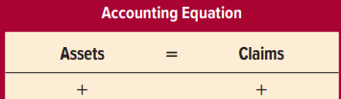
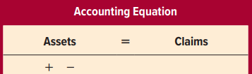
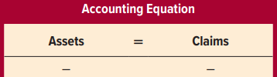
Recap: Types of Transactions
The described transactions have been classified into one of three categories:
Asset Source
Asset Exchange
Asset Use
Increase total assets, increase total claims
Increase one asset, decrease another asset
Decrease total assets, decrease total claims
Notes:
The transactions that have been described have been classified into one of three categories: asset source transactions, asset exchange transactions, and asset use transactions. It is far more effective to learn how to classify the transactions into meaningful categories than to attempt to memorize the effects of thousands of transactions.

Slide 44
Section 2: Reporting Information
Accounting information is normally presented to external users in four general-purpose financial statements.
The next section explains how the information in the accounts is presented in financial statements.
The information in the ledger accounts is used to prepare these financial statements.
Notes:
Section 2: Reporting Information
Accounting information is normally presented to external users in four general-purpose financial statements. The information in the ledger accounts is used to prepare these financial statements. The next section explains how the information in the accounts is presented in financial statements.

Slide 45
LO 1-7:
Prepare an income statement, a statement of changes in stockholders’ equity, and a balance sheet.
Notes:
LO 1-7: Prepare an income statement, a statement of changes in stockholders’ equity, and a balance sheet.

Slide 46
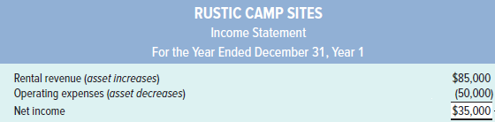
Income Statement and the Matching Concept
{
Matching Concept
Revenues exceeded expenses. If expenses exceed revenues, the entity will report a net loss.
Revenues (benefits) are matched to expenses (sacrifices).
Income is measured for a span of time called the accounting period.
Notes:
Exhibit 1-4 Financial Statements:
Part I
Here is the income statement. The information used to prepare this statement (and the others that will follow) was drawn from the ledger accounts.
Part II
Businesses consume assets and services in order to generate revenues, thereby creating greater quantities of other assets. The income statement follows the Matching Concept. The Matching Concept states that the income statement matches asset increases from operating a business (revenues) with asset decreases from operating the business (expenses).
Part III
Rustic Camp Sites has net income because its revenues are greater than its expenses. However, if expenses are greater than revenues, the difference is a net loss.
Part IV
Income is measured for a span of time called an accounting period. While accounting periods of one year are normal for external financial reporting, income can be measured weekly, monthly, quarterly, semi-annually, or over any appropriate time period.

Slide 47
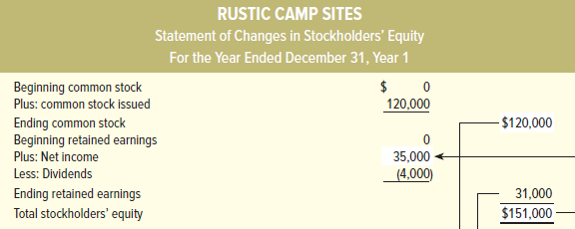


Statement of Changes in Stockholders’ Equity
Notes:
Exhibit 1-4 Financial Statements continued:
Here is the statement of changes in stockholders’ equity. This statement explains the effects of transactions on stockholders’ equity during the accounting period. It starts with the beginning balance in the Common Stock account and adds or subtracts any changes that occurred during the accounting period. The statement also describes the changes in retained earnings for the accounting period.

Slide 48
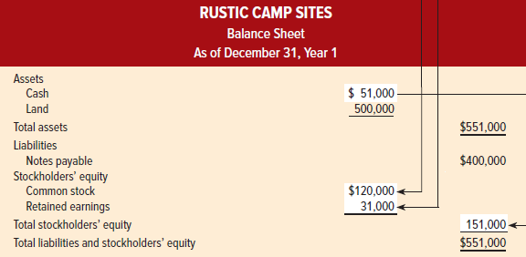



Balance Sheet
Notes:
Exhibit 1-4 Financial Statements continued:
Part I
Here is the balance sheet. Notice that total assets equals total liabilities plus equity—just like we discussed earlier with the accounting equation.
The balance sheet lists the assets and liabilities of the business and the owners’ claims.
Part II
Assets are listed in the order of liquidity. This means that assets are listed in order of how rapidly they will be converted to cash.

Slide 49
LO 1-8:
Prepare a statement of cash flows.
Notes:
LO 1-8: Prepare a statement of cash flows.

Slide 50
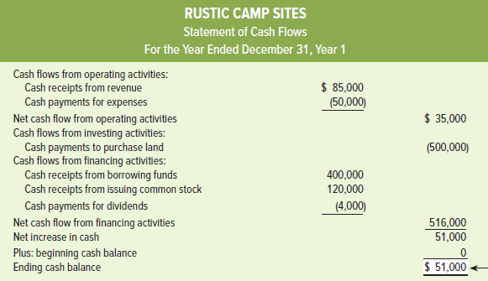

Statement of Cash Flows for Rustic Camp Sites
Notes:
Exhibit 1.4 Financial Statements continued:
Part I
Here is the statement of cash flows. It has three major sections: Operating, Investing, and Financing.
Part II
Operating activities involve receiving cash from revenue and paying cash for expenses.
Part III
Investing activities involve paying cash for productive assets or receiving cash from selling productive assets.
Part IV
Financing activities include obtaining cash from owners or from creditors and paying cash to owners (dividends) or creditors.

Slide 51
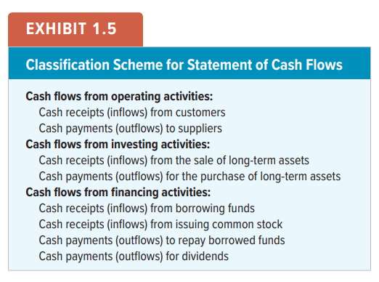
Statement of Cash Flows
Notes:
The primary cash inflows and outflows related to the types of business activity introduced in this chapter are summarized in Exhibit 1.5. The exhibit will be expanded as additional types of events are introduced in subsequent chapters.

Slide 52
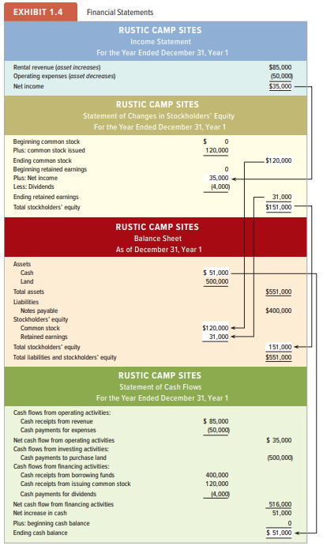
Financial Statements
Notes:
Part I
In summary, the balance sheet shows the amounts that exist in the accounts at the end of each accounting period, while the income statement, the statement of changes in stockholders’ equity, and the statement of cash flows explain what caused the account balances to change from one accounting period to the next. To reflect these differences, balance sheets are dated with a phrase that begins with “As of,” while the other statements are dated with a phrase that begins with “For the Period Ended.”
Part II
Take note that information in one statement may relate to information in another statement. For example, the amount of net income reported on the income statement also appears on the statement of changes in stockholders’ equity. Accountants use the term articulation to describe the interrelationships among the various elements of the financial statements. The key articulated relationships in RCS’ financial statements are highlighted with the arrows shown in Exhibit 1.4.

Slide 53
LO 1-9:
Close revenue, expense, and dividend accounts.
Notes:
LO 1-9: Close revenue, expense, and dividend accounts.

Slide 54
The Closing Process
The process of transferring information from the revenue, expense, and dividend (temporary) accounts to the Retained Earnings account is called closing.
Since the Retained Earnings account carries forward from one accounting period to the next, it is considered a permanent account.
Notes:
Part I
At the end of the year, closing entries are prepared. Closing entries serve two purposes. First, they transfer net income (or loss) and dividends to Retained Earnings. This process gets the Retained Earnings account balance up to date. Second, they establish zero balances in all income statement and dividend accounts so they are ready to start collecting amounts for the next accounting period.
Part II
Accounts that are closed (revenues, expenses, and dividends) are referred to as temporary accounts. Temporary accounts track financial results for a limited period of time.
Part III
Accounts that are not closed (assets, liabilities, and stockholders’ equity) are referred to a permanent accounts. Permanent accounts track financial results from year to year.

Slide 55
LO 1-10:
Record business events using a horizontal financial statements model.
Notes:
LO 1-10: Record business events using a horizontal financial statements model.

Slide 56
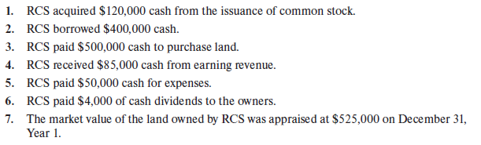
Accounting Events for RCS During Year 1
Notes:
A summary of Rustic Camp Sites Year 1 accounting events is shown above.

Slide 57
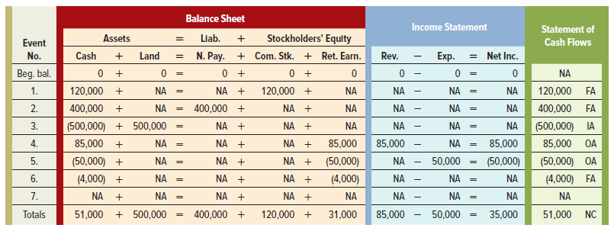
Horizontal Financial Statements Model
Notes:
This is called the horizontal statements model. We will use it throughout the text. This model helps you visualize several financial statements simultaneously to help you understand how business events affect financial statements. This is a learning tool—not a financial statement. The model frequently uses abbreviations such as OA for Operating Activities, IA for Investing Activities, FA for Financing Activities, NA for not affected, and NC for net change in cash. The background of the balance sheet is red, the income statement is blue, and the statement of cash flows is green.

Slide 58
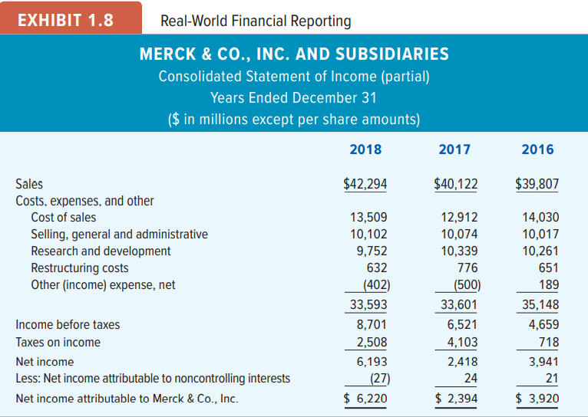
Real-World Financial Reporting
Notes:
Part I
Organizations exist in many different forms. Service businesses, which include doctors, attorneys, accountants, dry cleaners, and housekeepers, provide services to their customers.
Part II
Merchandising businesses, sometimes called retail or wholesale companies, sell goods to customers that other entities make.
Part III
Manufacturing businesses make the goods that they sell to their customers.
Part IV
The textbook will usually present income statements that end with “Net income.” Due to an accounting rule that became effective at the end of 2009, income statements of large, real-world companies often appear to have three lines for net income. The partial income statements for Merck & Company, a large pharmaceutical company, shown in Exhibit 1.8, illustrate this issue. Notice that the third line from the bottom of the statement is called “Net income.” However, “Net income attributable to noncontrolling interests” is subtracted from this first net income to arrive at “Net income attributable to Merck & Co., Inc.” The illustrations in the text always assume that there is no net income attributable to noncontrolling interests; therefore, our examples simply end with the term “Net income.”

Slide 59
Annual Report
The U.S. Securities and Exchange Commission (SEC) requires publicly traded corporations to file a 10-K report, which contains more detailed financial information, and frequently substitutes for the annual report.
Consists of:
Financial Statements
Notes
Auditors’ Report –Chapter 6
Management’s Discussion
and Analysis (MD&A)
Notes:
Part I
Annual reports consist of financial statements, notes to the financial statements, the auditor’s report, and management’s discussion and analysis.
Part II
Traditionally, large companies have distributed expensive annual reports with many color photographs. Increasingly, however, companies are issuing more modest annual reports or are simply distributing their 10-K reports.

Slide 60

Special Terms in Real-World Reports
The financial statements of real-world companies include numerous items relating to advanced topics that are not covered in introductory accounting textbooks.
However, we encourage you to look for annual reports in the library, from your employer, or on the Internet. Look for links labeled “about the company” or “investor relations.”
The best way to learn accounting is to use it!
Notes:
The financial statements of real-world companies include numerous items relating to advanced topics that are not covered in introductory accounting textbooks. However, we encourage you to look for annual reports in the library, from your employer, or on the Internet. The best way to learn accounting is to use it!

Slide 61
End of Chapter 1
Notes:
End of Chapter 1.

