Slide 1
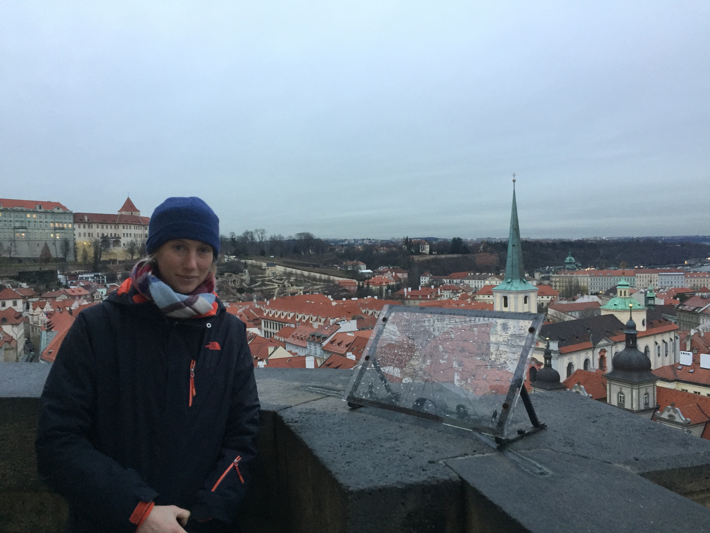
Hello!
I am currently a fourth-year PhD student in the Statistics Department at Stanford University, advised by Prof. Susan Holmes and Prof. Jure Leskovec.
My research focuses on the extension of machine learning and statistics to graph-structured data: my objective is to develop tools and methods for analyzing and comparing sets of graphs. I am especially interested in applications related to neuroscience and brain connectomics!

