Slide 1
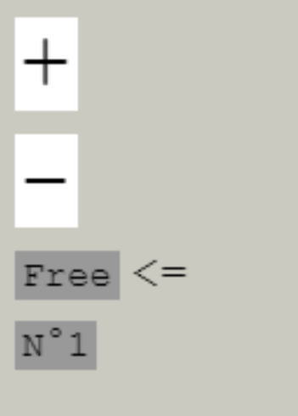
Zoom in
Zoom out
Free mode
Following mode

