Slide 1
Introduction to
Android Development

Slide 2

DONN FELKER twitter:@donnfelker
ANDROID SEEDING DEVELOPER AWARDEE
OVER 20 APPS DEVELOPMENT FOR VARIOUS CLIENTS
1.3M+ ACTIVE INSTALLS
ANDROID TEKPUB.COM VIDEO SERIES AUTHOR
OWNER OF AGILEVENT – CUSTOM DEV / MOBILE DEV
OTHER TECH
MICROSOFT ASP INSIDER
MCTS, MCP, ScrumMaster, ITIL
.NET DEVELOPMENT
PRES. of TWIN CITIES DEVELOPERS GUILD

Slide 3
WE’RE COVERING
TOOLS NEEDED (~5 MINS)
ANDROID FRAMEWORK INTRO (~5-8 MINS)
BUILDING A REAL APP (MAJORITY OF TIME)
PUBLISHING TO THE MARKET (3-5 MINS)
QUESTIONS
FYI: THIS IS A LOT OF INFO! WE’RE GOING TO MOVE VERY FAST! ☺

Slide 4
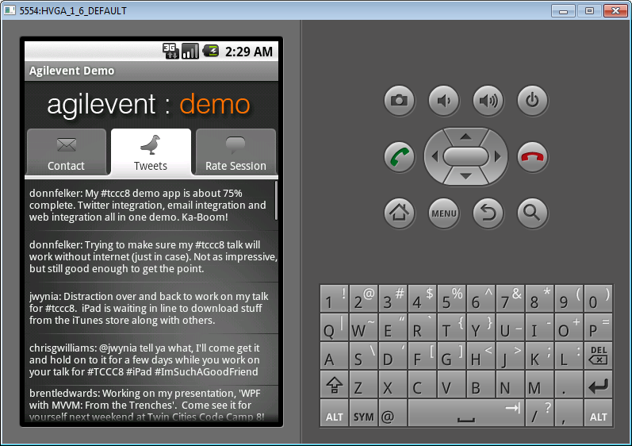
THE APP
Emulator!

Slide 5


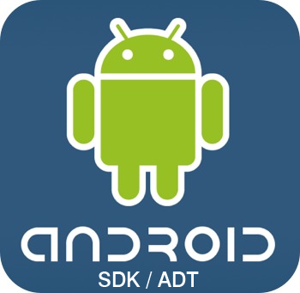
What You’ll Need

Slide 7
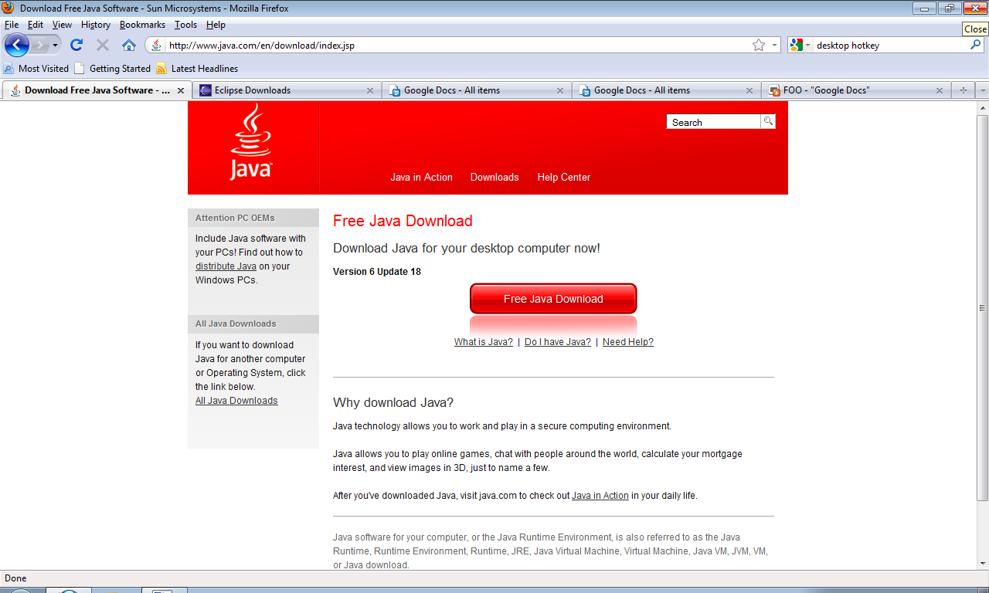

Slide 9
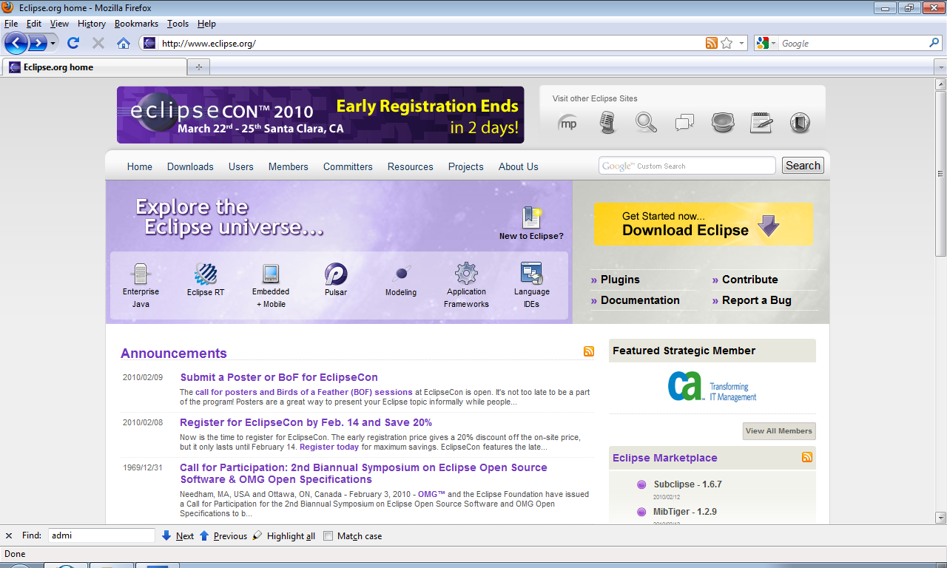

Slide 10
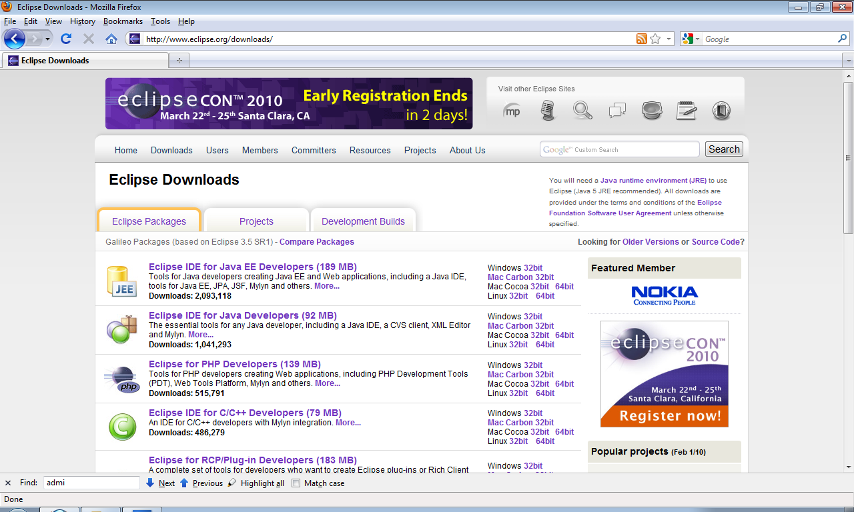

Slide 11
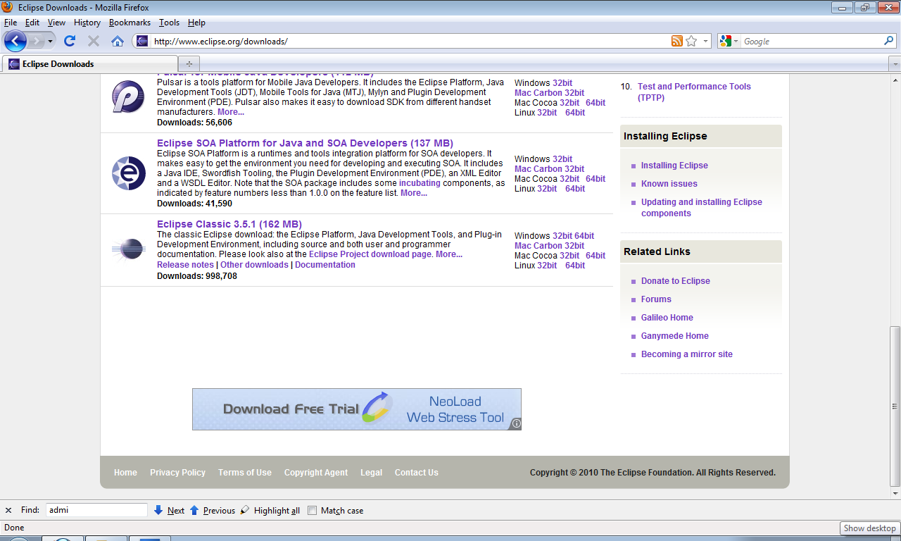

Slide 13
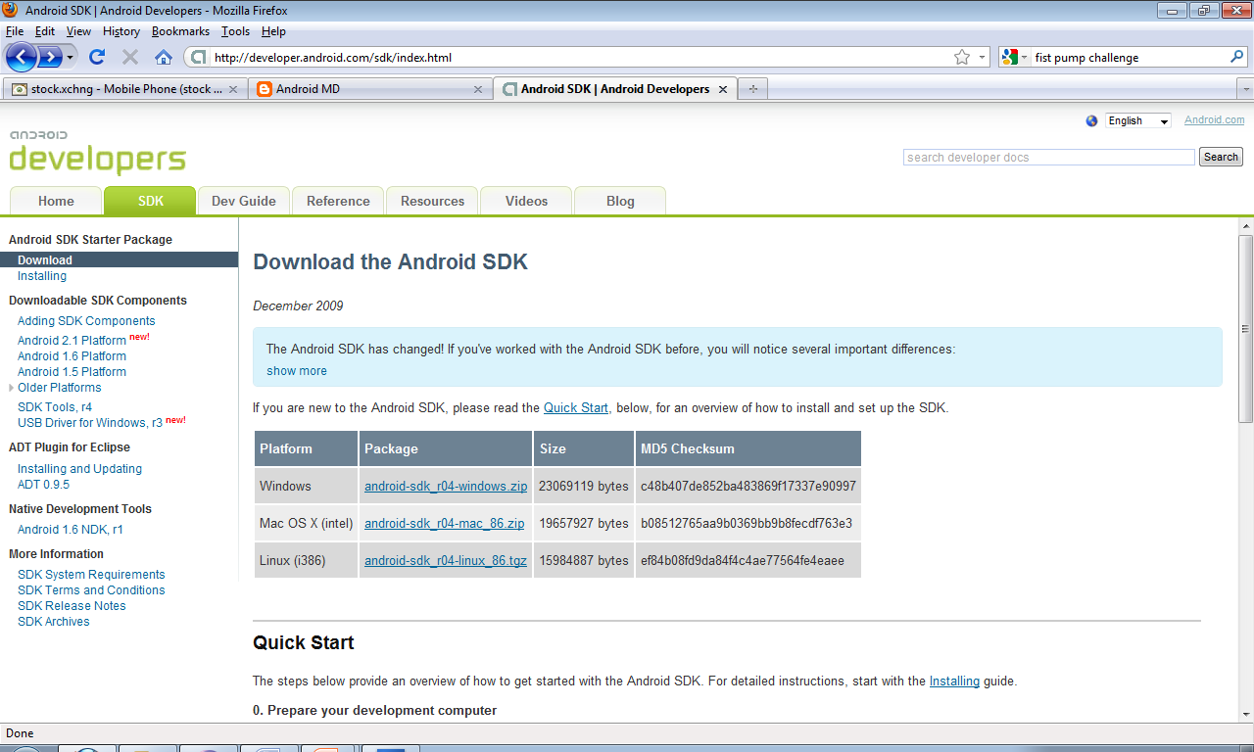

Slide 14
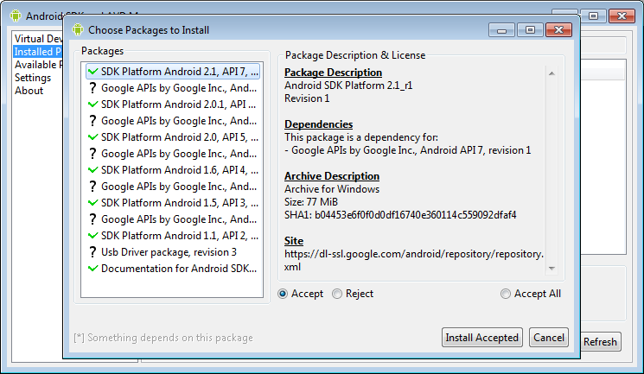

Slide 15
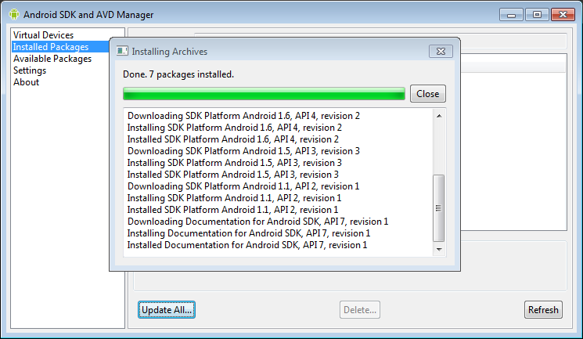

Slide 17
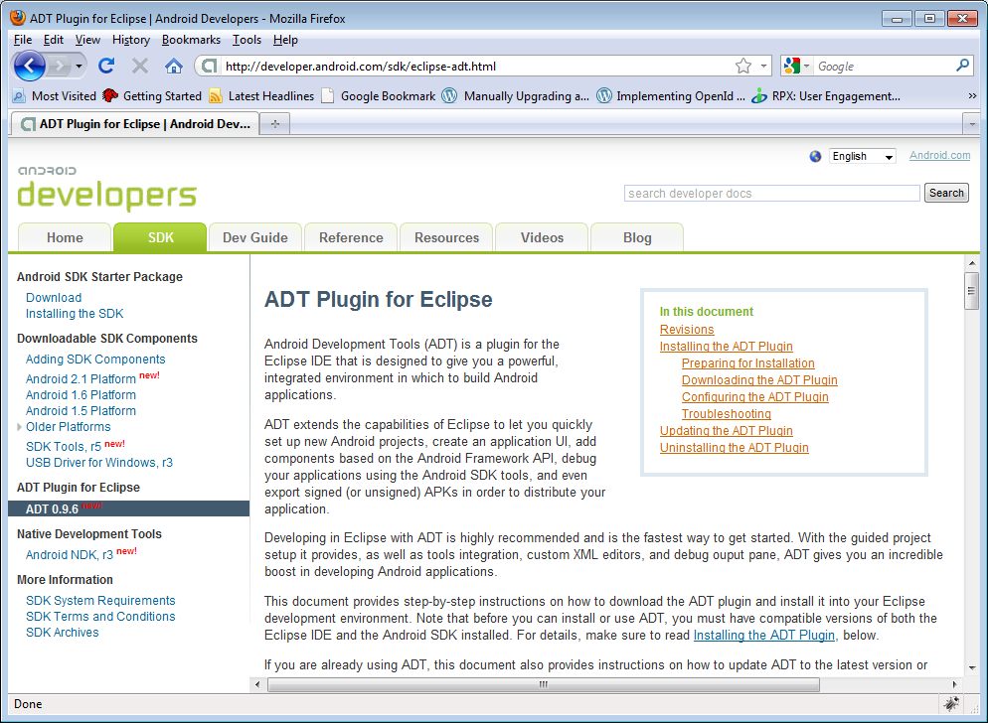

Slide 18

ARCHITECTURE

Slide 19

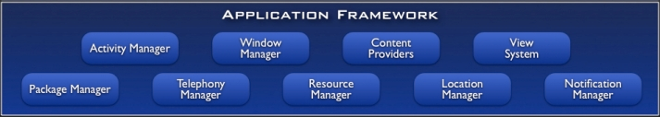
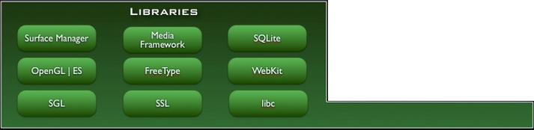
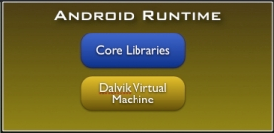
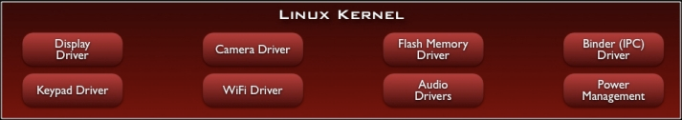
Notes:
Applications
Built in applications that come with android
.. As well as the applications that developer build for the platform.
Application Framework
Activity Manager:
Window Manager:
Package Manager:
Telephony Manager: Responsible for telephone based operations.
Resource Manager: All embedded bitmaps, audio, video, strings, and layouts are rendered to a class the name of “R”. The resource manager handles working with them.
Location manager: Responsible for handling GPS updates and location based information.
Notification Manager: Responsible for placing notifications into the status bar. Allows the developer to provide a rich interface for the users to view information about applications and/or background services.
View system: Handles the views in the system. Each item on the screen is a view. A button is a view, a textbox is a view, a list is a view. The view system manages the view components.
Content Providers: Allows access to various pieces of data across the android system.
Android Runtime
Core libraries such as file, network, drawing, etc.
DalVik virtual machine that runs compiled .dex files. The code is compled into .dex intermediate code files and DalVik runs this.
Libraries: All written in C, C++ and this is where the core power of android comes from.
- Surface Manager: Responsible for composing diff drawing surfaces onto the screen. From views, to maps, images, different applications, its responsibility is figuring out how to get the pixels to the screen.
OpenGL | ES & SGL: Core graphics libraries. OpenGL|ES is the 3d library and SGL is the 2D platform. The majority of drawing uses the SGL model.
Can combine 2d and 3d in the same application
SQL Lite for data storage (its also important to note that object databases such as db40 can also be used in android)
WebKit is the foundation of the browser, which is also what Safari runs on.
-----------------------
Linux Kernel as the HAL
Based on the linux 2.6 kernel
Reason: Proven Driver Model, Process mgmt, Mem mgmt, Networking, Security Model , and it is a proven robust OS that provides a vast array of core OS features.

Slide 20
APPLICATION BUILDING BLOCKS
Activity
UI Component Typically Corresponding to one screen.
IntentReceiver
Responds to notifications or status changes. Can wake up your process.
Faceless task that runs in the background.
Service
ContentProvider
Enable applications to share data.

Slide 21
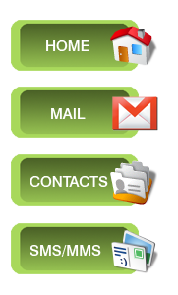


APPLICATION REPLACING & REUSING
Pick Photo
(intent)
Client component makes a request for a specific action.
System picks the best component for that action.
Components can be replaced at any time.

Slide 22
View Map
INTENTS: APPLICATION REPLACING & REUSING
Send Email
Call Mom
Edit Contact
Capture Photo
Send Tweet
Play Song
Get GPS Location
Edit Calendar
View Web Page
Pick Photo
View Video
Start App
Browse Market
Capture Video

Slide 23
WRITING THE APP

