Slide 1
SMARTER MONITORING
Building an AI-Enhanced
Event Pipeline
Correlating events from everywhere into the two that matter.
Donnie Taylor · The Cloud & AI Summit 2026
Notes:
Open cold. Do not introduce yourself yet - go straight to the firehose slide and let them try to find the cause. Come back to who you are after they have felt the problem.

Slide 2
BEFORE WE GO FURTHER
Donnie Taylor
1
Microsoft MVP, ninth consecutive year
Azure, PowerShell, and increasingly AI plumbing.
2
Woodworker, solar enthusiast, home automation
No good way to tie those together – or is there?
3
Everything here is on GitHub
github.com/donnietaylor - deploy it in your own tenant in about ten minutes.
draith.com · linkedin.com/in/donnietaylor · @donnietaylor.bsky.social
Notes:
Keep this to sixty seconds. They came for the pipeline, not the resume.

Slide 4
THREE MINUTES OF PRODUCTION
179 events. 12 tools. One cause.
16:54:31
critical
sql-watch sql-prod-03 Connection pool exhausted, 97 of 100 in use
16:54:30
error
storage-watch sql-prod-03 Disk read latency 480 ms, sustained
16:54:30
critical
apm app-web-01 Checkout failures 27 percent of requests
16:54:29
error
auth-svc app-api-03 Token validation failing, upstream returned 526
16:54:28
warning
net-monitor fw-edge-01 Packet loss 2 percent on WAN interface
16:54:28
critical
store-api sql-prod-03 Call to sql-prod-03 failed (500)
16:54:27
warning
backup-agent backup-01 Nightly backup of sql-prod-03 still running, 4 hours over window
16:54:27
error
sql-watch sql-prod-03 Lock wait time 4400 ms on OrderLines
16:54:26
critical
cert-watch lb-edge-02 TLS certificate for api.contoso.com expired
16:54:26
warning
vsphere esx-04 Datastore DS-VOL-02 at 82 percent capacity
16:54:25
critical
synthetic probe-dfw Login journey failing from 3 of 4 regions
16:54:25
error
apm app-web-01 Payments database connection timeout after 1500 ms
16:54:24
warning
patch-agent win-print-02 Reboot pending for 11 days
...and 166 more.
Which one caused the rest?
Notes:
This is the cold open. Read two or three lines out loud, then stop talking and let the room look. Ask it straight: which one caused the others? Take a couple of guesses from the audience - people usually pick a critical. Nobody picks the backup job. That is the whole talk in thirty seconds.

Slide 5

MEANWHILE, IN THE ON-CALL CHANNEL
Nobody finds it by reading faster.
Notes:
Land it and move. The room has just failed to find the cause, so this is a release valve, not a bit. If it gets a laugh, ride it straight into the introduction.

Slide 6
THE WORD THAT DOES A LOT OF WORK
Correlation - Three different things
1
2
3
Deduplication
Grouping
Causality
Is this the same thing I already saw?
Do these belong to the same incident?
Did this one cause that one?
Same failure, 300 times. One row, count 300.
Same host, same resource, same trace.
A backup job on one host starved a database on another.
Most tools do this.
Some tools do this.
Almost nothing does this.
Only the third one needs a model.
Notes:
This slide is what makes the rest of the session legible. Most monitoring tools do the first. Some do the second. Almost nothing does the third, and the third is what the on-call engineer actually needs at 3am.

Slide 7
EVERYTHING LANDS ON ONE HUB
Where the events come from
OpenTelemetry
Requests, dependencies and exceptions, one trace per checkout, exported through Application Insights.
1
A real Flask app on this laptop
Azure Monitor
Common alert schema, straight to the hub via an action group. No glue code.
2
A metric alert on failed requests
Third-party tools
sql-watch, storage-watch, backup-agent, cert-watch, net-monitor... a PowerShell script standing in for the estate.
3
Twelve of them, all fictional
Notes:
Three genuinely different shapes arriving on one hub. The point of the third is that it is fake infrastructure - I am not deploying a SQL box to prove a correlation engine works.

Slide 8
THREE TRIGGERS, ONE SET OF TABLES
OPTION B · HUB
How the pieces fit
TABLE STORAGE
reads
RawEvents
TIMER + HTTP
MODEL
every failure, as it arrived
Analyze
Azure OpenAI
verdict
every minute
gpt-4.1-mini
THREE SOURCES
HUB TRIGGER
writes
Event Hubs
IngestEvents
Events
monitoring-events
one row per symptom
reads
HTTP TRIGGER
DASHBOARD
GetIncidents
Workbook
Incidents
one row per group + verdict
read-only
Azure Monitor
The functions never call each other. The tables are the only thing they share.
Notes:
OPTION B - hub and spoke. Start in the middle: three tables in one storage account. Left side is the write path - the hub fires IngestEvents and it writes. Top right is the AI pass: reads the open incidents, asks the model, writes the verdict back onto the same rows. Bottom right is the dashboard, which only reads. Nothing talks to anything except through the middle.

Slide 9
SOURCES TO DASHBOARD
The whole event flow
SOURCES
EVENT HUB
INGESTEVENTS · EVENT HUBS TRIGGER
TABLE STORAGE
GETINCIDENTS · HTTP
OpenTelemetry
1
Normalise
RawEvents
Shapes the data
for the screen
store-api on this laptop
Everything flows here
three shapes, one object
every event,
as it arrived
via Application Insights
2
Drop successes
?view= raw | summary
sources | tree
Azure Monitor
a success is not an event
Events
metric alert on failures
monitoring-
events
3
Archive the raw event
one row per
symptom + count
via an action group
nothing merged yet
AZURE WORKBOOK
12 monitoring tools
4
Correlate
Incidents
The dashboard
Send-Event.ps1
which incident, which symptom
one row per
group + verdict
custom endpoint,
no Log Analytics
REST + SAS
SAME SYMPTOM?
SAME INCIDENT?
no model
reads
writes back
EVERY ARROW IN THIS DIAGRAM
ANALYZETIMER · EVERY MINUTE, ONLY WHEN SOMETHING CHANGED
ALSO READS THE TABLES
No keys anywhere
Azure OpenAI · gpt-4.1-mini
Show-Incidents.ps1
Reset-Pipeline.ps1
The Function App has a managed identity with three role assignments: read the hub, write the tables, call Azure OpenAI. Nothing in the pipeline holds a secret.
Which incidents are one problem. Which one is the cause. What to do first.
The verdict is written back onto the incident rows.
a short-lived SAS,
from your terminal
SAME PROBLEM?
the only question that needs English
179 events in. 13 incidents and 2 root causes out. About four seconds of model time.
Notes:
The architecture slide. Walk it left to right once, then point at the two things that are not obvious: the dashed loop is the AI pass reading and writing the same table the ingest path writes, and the three question chips - same symptom, same incident, same problem - are the spine of the session. Roughly ninety seconds; do not narrate every box.

Slide 10
INGESTEVENTS / RUN.PS1 · 34 LINES
The whole trigger
foreach ($message in @($eventHubMessages)) {
$payload = $message | ConvertFrom-Json -Depth 50
foreach ($event in ConvertTo-PipelineEvent -Payload $payload) {
if ($event.Success) { $dropped++; continue } # a success is not news
Write-RawEvent -Event $event # keep the firehose
Add-EventToIncident -Event $event # correlate it
}
}
Read the hub, normalise, throw away the successes, correlate. Everything else in this session is one of those three verbs, opened up.
Notes:
Show this before the first demo. The point is that the function that reads the hub is trivially small - all the interesting work is behind three verbs. Read the three lines in the inner loop out loud and move on; the next slides open each one up.

Slide 11
DEMO 1
Break everything
./Break-Everything.ps1 - one command, one outage
Live checkout traffic starts failing for real
Twelve tools begin reporting, 68 events over about forty seconds
Watch the raw stream arrive in the workbook
Notes:
Run it and talk over it. The checkouts going red in the terminal are real HTTP calls against the Flask app on this machine. Do not skip the raw view - that is the "can you find it" screen again, now live.

Slide 12
THREE TRIGGERS, ONE TABLE
Which function runs when
INGESTEVENTS
ConvertTo-PipelineEvent
Write-RawEvent
Add-EventToIncident
Event Hubs trigger
Three payload shapes become one event object. Successes are dropped here - a success is not an event.
Archived exactly as it arrived, before anything is merged away. This is the RawEvents firehose.
The correlator. Everything on the row below happens inside this one call, in this order.
runs per batch,
every step per event
inside Add-EventToIncident, for each event, left to right
Get-PrimaryKey
→ Get-IncidentId
Get-Fingerprint
New-Incident
Events(id, fp)
seen in the window?
Touch the incident
Normalize.psm1
Correlation.psm1
Which symptom. Digits → N, then source | kind | title | resource | host, hashed.
Create the incident row, or revive it if it went quiet longer than the window.
Yes: Count + 1, outcome deduped. No: POST a new symptom row, outcome new-symptom.
LastSeen and TouchedAt, unconditional. Nothing on the incident row is a counter, so nothing can race.
Which incident: host > resource > service > trace, then hashed.
SAME INCIDENT?
SAME SYMPTOM?
ANALYZETIMER · ANALYZE
Get-OpenIncident
Anything touched
since the last pass?
Get-IncidentBrief
Invoke-OpenAI
Write-IncidentVerdict
Every minute,
or on demand
Every open incident seen in the last 60 minutes.
A meta row remembers LastRun. A quiet minute costs nothing. -Force skips the check for the demo.
Top 6 symptoms per incident. Row keys and plumbing stripped - the model sees the outage, not the schema.
One call. gpt-4.1-mini, temp 0, JSON out, parsed by ConvertFrom-ModelJson.
Once per incident: cause, downstream, unrelated or forgotten. Clusters of one are demoted. Then LastRun moves.
one call to
Invoke-IncidentAnalysis
SAME PROBLEM?
Ai.psm1
GETINCIDENTS
Read
Shape
Answer
HTTP, when the
workbook refreshes
Incidents open in the last 2 hours, plus their Events rows. Imports Plumbing.psm1 and nothing else.
?view= raw · summary · sources · tree · incidents · symptoms - one per visual on the workbook.
JSON the workbook can colour. No correlation logic lives here; it is presentation only.
The first two questions are not two passes. They are the two halves of one row address - Events(PartitionKey = incident id, RowKey = fingerprint) - and the code works out the incident before the symptom.
Notes:
The execution slide. Three swim lanes, one per trigger. The top lane is the one to spend time on: point at the row inside Add-EventToIncident and say that the incident is decided before the symptom - question two before question one - because they are the two halves of one row address. The other two lanes are a sentence each.

Slide 13
NORMALIZE.PSM1 · 122 LINES
Three shapes, one object
function Get-PayloadShape {
Out the other side
if ($Payload.records) { 'appinsights' } # diagnostic setting
Source Kind Time
Severity Title Message
TraceId Host Resource
if ($Payload.data.essentials) { 'alert' } # common alert schema
if ($Payload.tool) { 'script' } # our own senders
}
Every source disagrees about field names. OperationId or operation_Id. TimeGenerated or time or timestamp. Nothing downstream can be written until one object comes out of here - and this is the part everyone underestimates when they plan a pipeline like this.
Notes:
Three sources, three completely different JSON shapes, and none of them agree on what a field is called. This is the unglamorous half of any pipeline like this and it is worth saying so - people underestimate it every time.

Slide 14
CORRELATION.PSM1 · IS THIS THE SAME SYMPTOM?
Deduplication is three lines
$title = $Event.Title -replace '\d+', 'N' # 480 ms and 8 ms are the same symptom
$seed = "$Source|$Kind|$title|$ResourceId|$Host".ToLowerInvariant()
$hash = [Security.Cryptography.SHA256]::HashData([Text.Encoding]::UTF8.GetBytes($seed))
What goes in
What comes out
Disk read latency 410 ms, sustained
Disk read latency 455 ms, sustained
Disk read latency 480 ms, sustained
Disk read latency 512 ms, sustained
Disk read latency 498 ms, sustained
Disk read latency 466 ms, sustained
Disk read latency N ms, sustained
>
one row · seen 6 times
Every run of digits collapses. Durations, counts, percentages and addresses are values, not identities - 300 identical checkout failures become one row with a count, not 300 rows. The honest cost: "Port 22 closed" and "Port 443 closed" collapse together too.
Notes:
Question one, in full. Three lines. Say plainly that this is the entire deduplication engine and that it involves no intelligence of any kind - it is a hash of a string with the numbers taken out. Then be honest about the cost: "Port 22 closed" and "Port 443 closed" collapse together too. Worth it.

Slide 15
CORRELATION.PSM1 · IS THIS THE SAME INCIDENT?
Follow one alert
1
An alert arrives
sql-watch · Lock wait 3100 ms · sql-prod-03
Tool, what went wrong, and which machine.
2
Pick the label to group on
host:sql-prod-03
The machine name if it has one. Otherwise the Azure resource, then the app name.
3
Turn the label into an id
inc-de92ae29a9bb
A hash of the label. Same label in, same id out - every time.
The next alert about sql-prod-03 - from any tool - computes inc-de92ae29a9bb too. Same incident, and nobody had to look anything up.
Notes:
OPTION B - follow one alert. Step one is a real alert from the demo. Step two: we pick the one label to group on - the machine name if the alert has one, otherwise the Azure resource, otherwise the app name. Step three: that label is hashed into the incident id. inc-de92ae29a9bb is the real id for sql-prod-03. The punchline is the callout: every other alert about that machine computes the same id, so it lands in the same incident without anyone searching for it.

Slide 16
CORRELATION.PSM1 · IS THIS THE SAME INCIDENT?
Identity is derived, not invented
function Get-PrimaryKey {
if ($Event.Host) { return "host:$($Event.Host)" } # a machine name
if ($Event.ResourceId) { return "resource:$($Event.ResourceId)" } # an Azure resource
if ($Event.Service) { return "service:$($Event.Service)" } # a role, when there is no host
if ($Event.TraceId) { return "trace:$($Event.TraceId)" } # last: one per request
}
$incidentId = 'inc-' + (Sha256 $primaryKey).Substring(0, 12)
First match wins, and the id is a hash of it. Four tools reporting sql-prod-03 all produce the same key, so they all produce the same incident id - nothing is looked up, nothing is generated, nothing can drift. The same host always lands in the same incident.
Notes:
Question two. Read the four lines top to bottom: host if there is one, otherwise the Azure resource, otherwise the service. Trace is last on purpose - every request has its own, so it is the worst thing to group on. Then the last line: the incident id is just a hash of that key. Same host, same id, every time. No lookup.

Slide 17
THE PART WORTH ARGUING ABOUT
Instrumentation earns the correlation
store_api.py
What that buys
with tracer.start_as_current_span(
"SELECT payments.pending",
App Insights exports the dependency with Target = sql-prod-03
The pipeline reads that as a host
The app's failure joins the database's incident
No model. No prompt. No tokens.
kind=trace.SpanKind.CLIENT,
attributes={
"db.system": "mssql",
"server.address": "sql-prod-03",
},
):
Instrument properly and you need less AI. Shared keys are earned by good telemetry. The model is for the link nothing emitted.
Notes:
This is the advocacy slide and probably the most useful thing anyone takes home. Five lines of span attributes did work that would otherwise need a model. Say it plainly: good telemetry is cheaper than inference.

Slide 18
DEMO 2
What arithmetic alone can do
179 events collapse to 26 distinct symptoms, then 13 incidents
Four tools reporting sql-prod-03 arrive as one incident
The laptop app sits inside it, because its span named the host
And the room still cannot see the cause
Notes:
Land the last bullet hard. Thirteen incidents is a real improvement and it is still thirteen things to look at. The backup job is sitting there as a warning nobody would open.

Slide 19
SAME PROBLEM? · WHERE THE MODEL EARNS IT
Some links only exist in the words
backup-01
sql-prod-03
"Nightly backup of sql-prod-03 still running,
4 hours over window"
"Disk read latency 480 ms, sustained"
"Lock wait 4400 ms - waiting on disk, not on a query"
No shared host. No shared resource. No shared trace. Nothing to match on.
The only thing connecting them is that one of them says the other one's name.
That is a reading comprehension problem, not a data problem. It is the one part of this pipeline that could not be written as a rule - and the cause is a warning, on a host nobody was paging about, underneath twelve criticals.
Notes:
Now the model earns its place. The link between backup-01 and sql-prod-03 exists only in English - no shared host, no shared resource, no trace. No amount of key matching finds it.

Slide 20
AI.PSM1 · THE MODEL CALL IS 29 LINES OF IT
Asking the model is the easy part
$body = @{
messages = @(
@{ role = 'system'; content = $SystemPrompt }
@{ role = 'user'; content = ($incidents | ConvertTo-Json -Depth 8) }
)
temperature = 0 # same events, same answer
response_format = @{ type = 'json_object' } # not prose, a contract
}
Invoke-RestMethod -Uri $uri -Method Post -Body ($body | ConvertTo-Json -Depth 10) `
-Headers @{ Authorization = "Bearer $(Get-ResourceToken ...)" } # managed identity
The prompt is 698 words. The code that sends it is 29 lines.
Notes:
Deflate the AI stage deliberately. It is one HTTP call with temperature zero and a JSON contract. The interesting engineering is everywhere except here - and that is the honest shape of most production AI features.

Slide 21
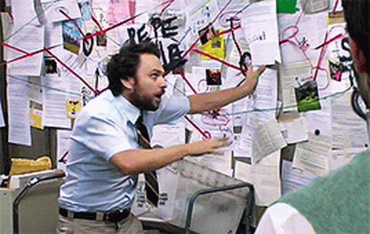
THE EASY WAY TO LOOK CLEVER
Connecting everything is not correlation.
It is the failure mode that looks most like success.
Notes:
This is the best-fitting joke in the deck because the picture IS the point. Set up the next demo with it: the interesting question is not what the model connects, it is what it refuses to connect. Then go run the analysis.

Slide 22
DEMO 3
Ask the model
One call, every open incident at once - grouping, cause, and the first action
Two root causes found across thirteen incidents
Five things it reviewed and deliberately left alone
Roughly 3,500 tokens and about four seconds
Notes:
Point at the red herrings as hard as at the root cause. A correlator that connects everything is as useless as one that connects nothing. The firewall packet loss during carrier maintenance is there to be left alone, and it was.
STAGING: the AnalyzeTimer must be OFF during the talk (app setting AzureWebJobs.AnalyzeTimer.Disabled = 1), or the dashboard shows root cause a minute after Demo 1 and this reveal is gone. This demo is the forced call: POST /api/analyze. Turn the timer back on afterwards.

Slide 23

THE CAUSE WAS A WARNING
The loudest thing is almost never the cause.
Twelve criticals. The answer was an amber warning nobody was paged for.
Notes:
Say the top line out loud - it is the single most portable idea in the session and the thing people will repeat to their team on Monday. Then go to the chain slide and walk it.

Slide 24
WHAT IT FOUND
The chain, in the order it happened
1
backup-01
Nightly backup overran its window and is still reading sql-prod-03 at 11 MB/s
warning
2
sql-prod-03
Disk saturated, lock waits climbing, connection pool exhausted at 100 of 100
critical
3
app-web-01
Checkout failing 27% of requests - timeouts, not application errors
critical
DO NOW Kill job SQL-NIGHTLY-FULL on backup-01 to relieve I/O pressure on sql-prod-03, then recycle the application pool.
Notes:
Flip back here if the room loses the thread during any demo. This is the scenario on one slide.

Slide 25
THE HONEST PART
Where this falls over
What it does not do
What it costs
No ticketing, no paging, no auto-remediation
One window at a time - no history, no trends
A model can be confidently wrong, and will be
Same events, same answer only because temperature is zero
Never creates or merges incidents - the model annotates. A model that can rewrite identity can lose your data
~3.5k
tokens per analysis pass, all thirteen incidents in one call
1/min
and it skips the call entirely when nothing changed
0
keys anywhere - managed identity end to end
Notes:
Do not skip this one. Saying where it breaks is what makes the rest credible, and this room can smell a sales pitch.

Slide 26
IF YOU REMEMBER THREE THINGS
Takeaways
Do the arithmetic first
1
Fingerprinting and key matching removed 92% of the volume before anything read a word. Cheap, instant, and it never hallucinates.
Instrumentation earns the correlation
2
One OpenTelemetry span attribute did work a model would otherwise have to do. Good telemetry is cheaper than inference.
Use the model for the reading problem
3
Ask it to connect what only prose connects, judge it on what it refuses to connect, and never let it own your data model.
Notes:
Three, not seven. If they remember one, make it the middle one.

Slide 27
EVERY FUNCTION, BY JOB
Which function answers which question
Normalise
ConvertTo-PipelineEvent the entry point: sniffs the payload shape and hands off
ConvertFrom-AppInsightsRecord · -AzureMonitorAlert · -ScriptEvent one per shape
Get-HostFromTarget a dependency’s Target becomes the host, so the app’s failed call joins the server’s incident
Get-Field · Get-ExceptionMessage · Format-Time · New-PipelineEvent helpers
Normalize.psm1 (10)
Same symptom?
Get-Fingerprint SHA256 of source | kind | title with digits → N | resource | host. Four lines. The whole answer.
QUESTION 1
Correlation.psm1
Same incident?
Get-PrimaryKey · Get-IncidentId the one key that decides the incident, and the id derived from it
Get-EventKey every key the event carries, for the “correlated on” line
Add-EventToIncident the orchestrator - the only thing IngestEvents calls after archiving
New-Incident · Write-RawEvent the writes; neither is conditional
QUESTION 2
Correlation.psm1
Plumbing
Invoke-Table · Get-TableRow · Get-OpenIncident · Measure-Incident Table Storage over REST, and the totals the incident row does not store
Get-ResourceToken · Get-StorageToken managed identity, one token per resource, cached
Get-HttpStatus · ConvertTo-TableLiteral · ConvertTo-Utc the small conversions everyone leans on
Plumbing.psm1 (9)
Same problem?
Invoke-IncidentAnalysis the pass: fetch, skip if quiet, brief, ask, write back
Get-IncidentBrief what the model is allowed to see
Invoke-OpenAI · ConvertFrom-ModelJson the one call, and the JSON it must return
Write-IncidentVerdict one incident’s verdict, a plain merge - it sends no counters
QUESTION 3
Ai.psm1 (5)
Presentation
six ?view= shapes raw · summary · sources · tree · incidents · symptoms
Format-Count · Format-Age · Write-Json · Get-TableRow local helpers - that last one is a filter query, not the module’s point read
GetIncidents/run.ps1
35 functions. Three of them decide what belongs together. One of them talks to a model.
Notes:
The catalogue. Do not read it aloud; let it sit while you say the one sentence at the bottom. The thing to point at is the same-symptom row: one function, four lines, and the middle row - the plumbing - which is its own module now and knows nothing about correlation.

Slide 28
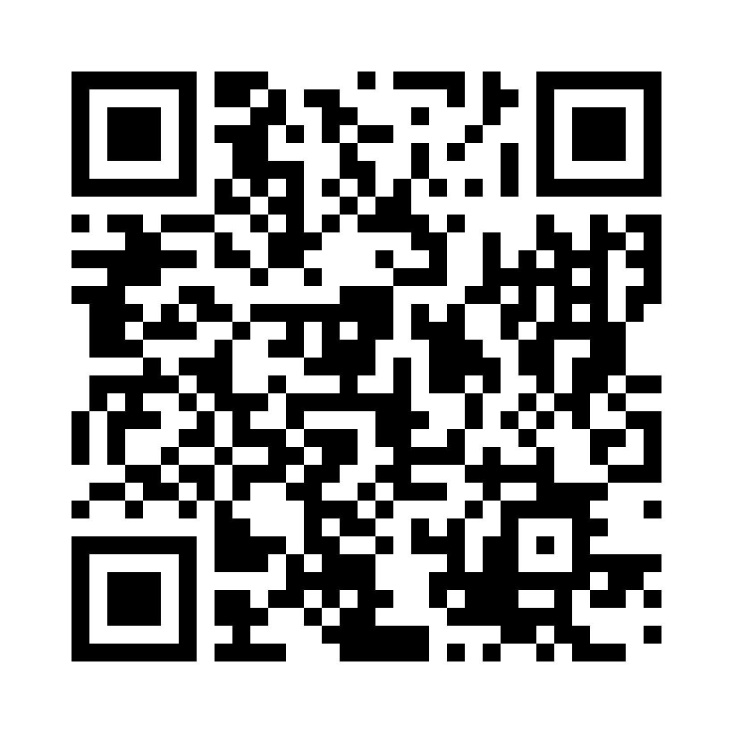
SMARTER MONITORING
Thank you
Donnie Taylor · The Cloud & AI Summit 2026
github.com/donnietaylor
The code from today - Deploy-Azure.ps1 builds it in your tenant
draith.com
Blog and write-ups
donnietaylor.bsky.social
Also on LinkedIn: linkedin.com/in/donnietaylor
Questions - now, or find me afterwards.
Notes:
Thank-you slide. Leave it up through the last questions so people can grab the links. The repo line is the one to point at: Deploy-Azure.ps1 builds the whole thing in their own subscription.

