Slide 1
Movie Ratings
By:
Ethan Donoho
Zach Rehfuss
DuVoe Moua
James Elander
Makenna Vick
Nick O'Donnell

Slide 2
In what situation is a movie most likely to have a higher rating?
Our goal was to see if we could find a correlation between a movies ratings from 2010-2019 through the lenses of:
-Targeted audience - Is there a correlation between a movies MPAA rating and imdb rating
-Box office - Is there a correlation between a movies box office success and imdb rating
-Run time - Is there a correlation between a movies run time and imdb rating
-Seasonal - Does the time of year of the movie’s release have an affect on a movies imdb rating

Slide 3
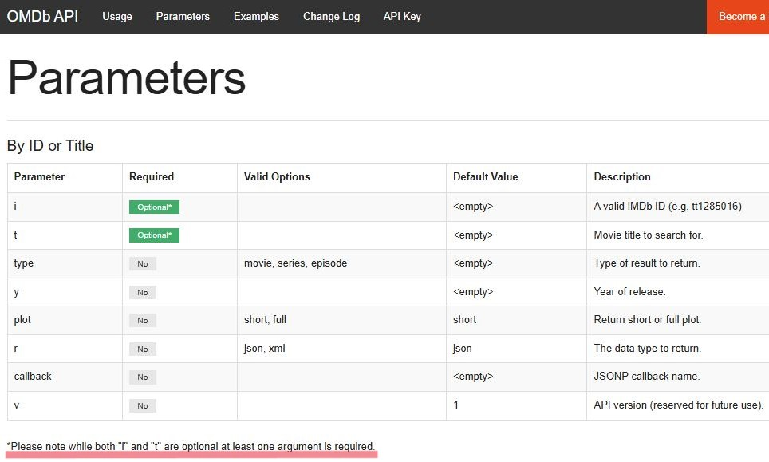
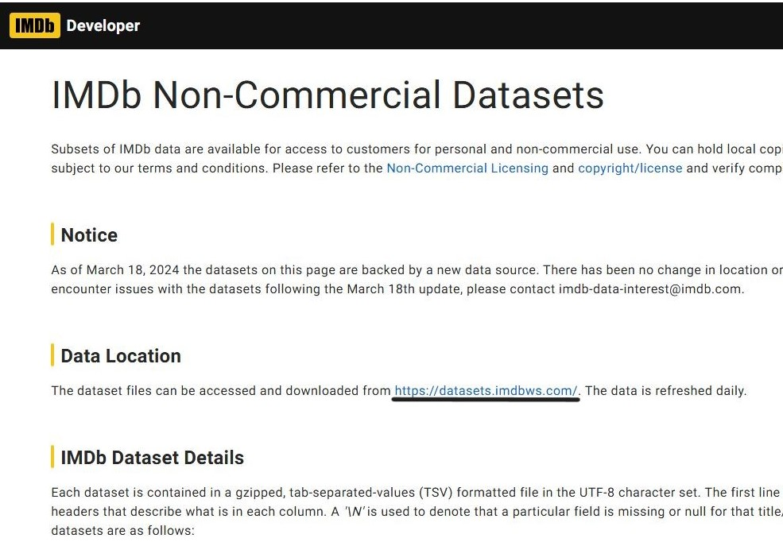
Data cleaning process
-The initial obstacle we faced after deciding to use the OMDB API was its specific formatting for pulling data. While i (imdb ID) and t (movie title) are both optional, at least 1 is required for the data pull. This meant that we would need to know which titles were needed before running our code through the API.
-We were able to work around that issue by using the IMDB website. IMDB’s website provided 2 tsv files, 1 with movie titles and the other with movie rating data, that we then loaded onto our code and filtered to get a list of movies to run through the OMDB API

Slide 4
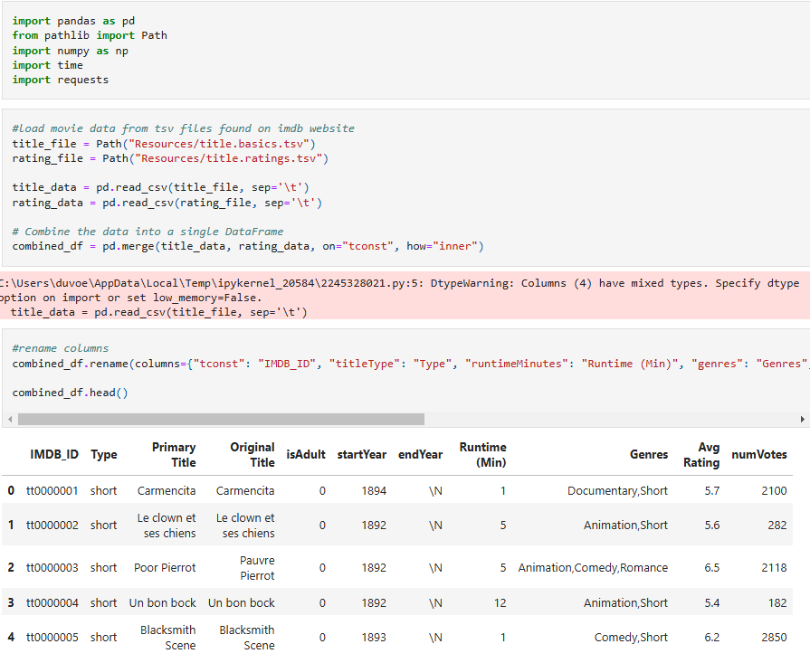
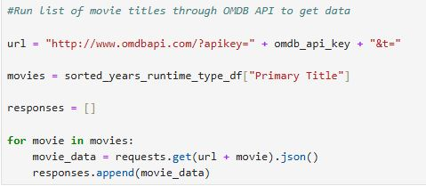
Loading the tsv files.
Running movie list through API
-Filtered titles to fit our timeframe 2010-2019
-Filtered by runtime to remove short films and tv shows.
-Filtered types to only show movies
-Filtered by number of votes to be a minimum of 1000
Our initial list went from 1,497,921 titles to run through OMDB’s api to 13892.

Slide 5
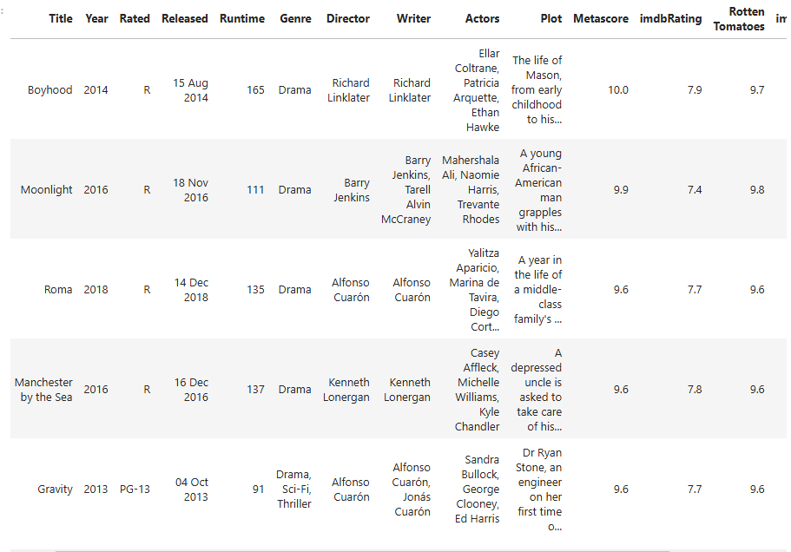

Slide 6
Code for MPAA rating analysis
# Drop rows with missing 'Rated' or 'imdbRating' or 'BoxOffice'
data_clean = data.dropna(subset=['Rated', 'imdbRating', 'BoxOffice']
# Focus on valid MPAA ratings (G, PG, PG-13, R, NC-17)
valid_ratings = ['G', 'PG', 'PG-13', 'R', 'NC-17']
data_clean = data_clean[data_clean['Rated'].isin(valid_ratings)]
# Plot IMDb Rating comparison across MPAA ratings
plt.figure(figsize=(12, 6))
sns.boxplot(x='Rated', y='imdbRating', data=data_clean)
plt.title('IMDb Rating Distribution by MPAA Rating')
plt.xlabel('MPAA Rating')
plt.ylabel('IMDb Rating')
plt.show()
# Plot Box Office comparison across MPAA ratings
plt.figure(figsize=(12, 6))
sns.boxplot(x='Rated', y='BoxOffice', data=data_clean)
plt.title('Box Office Distribution by MPAA Rating')
plt.xlabel('MPAA Rating')
plt.ylabel('Box Office ($)')
plt.show()

Slide 7
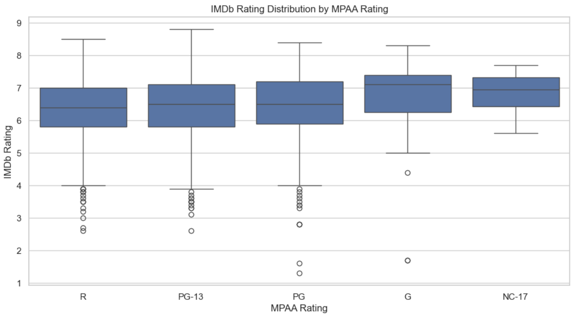
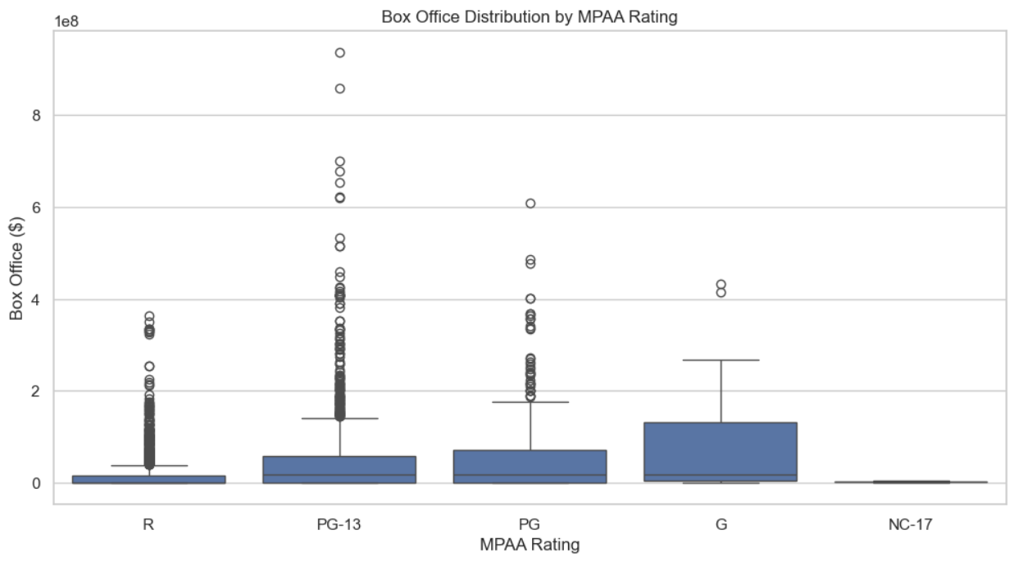
MPAA ratings Analysis
The correlation between MPAA rating and IMDB score is 0.211762.

Slide 8
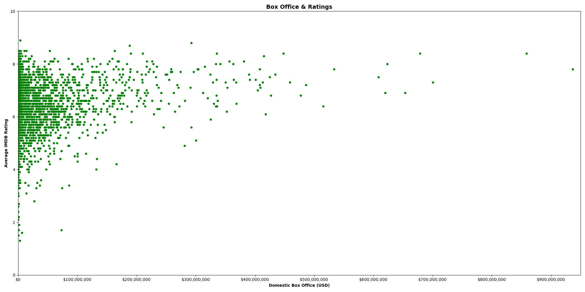
Box Office

Slide 9
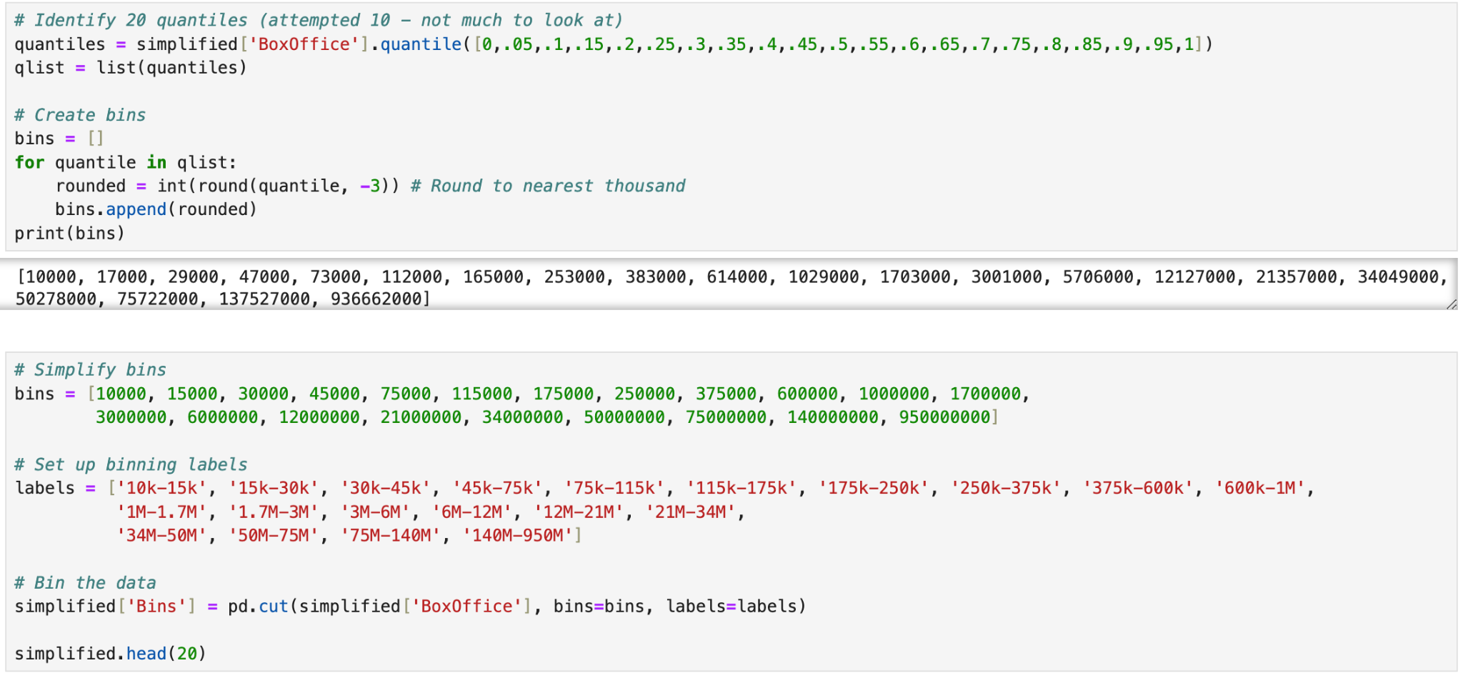
Box Office

Slide 10
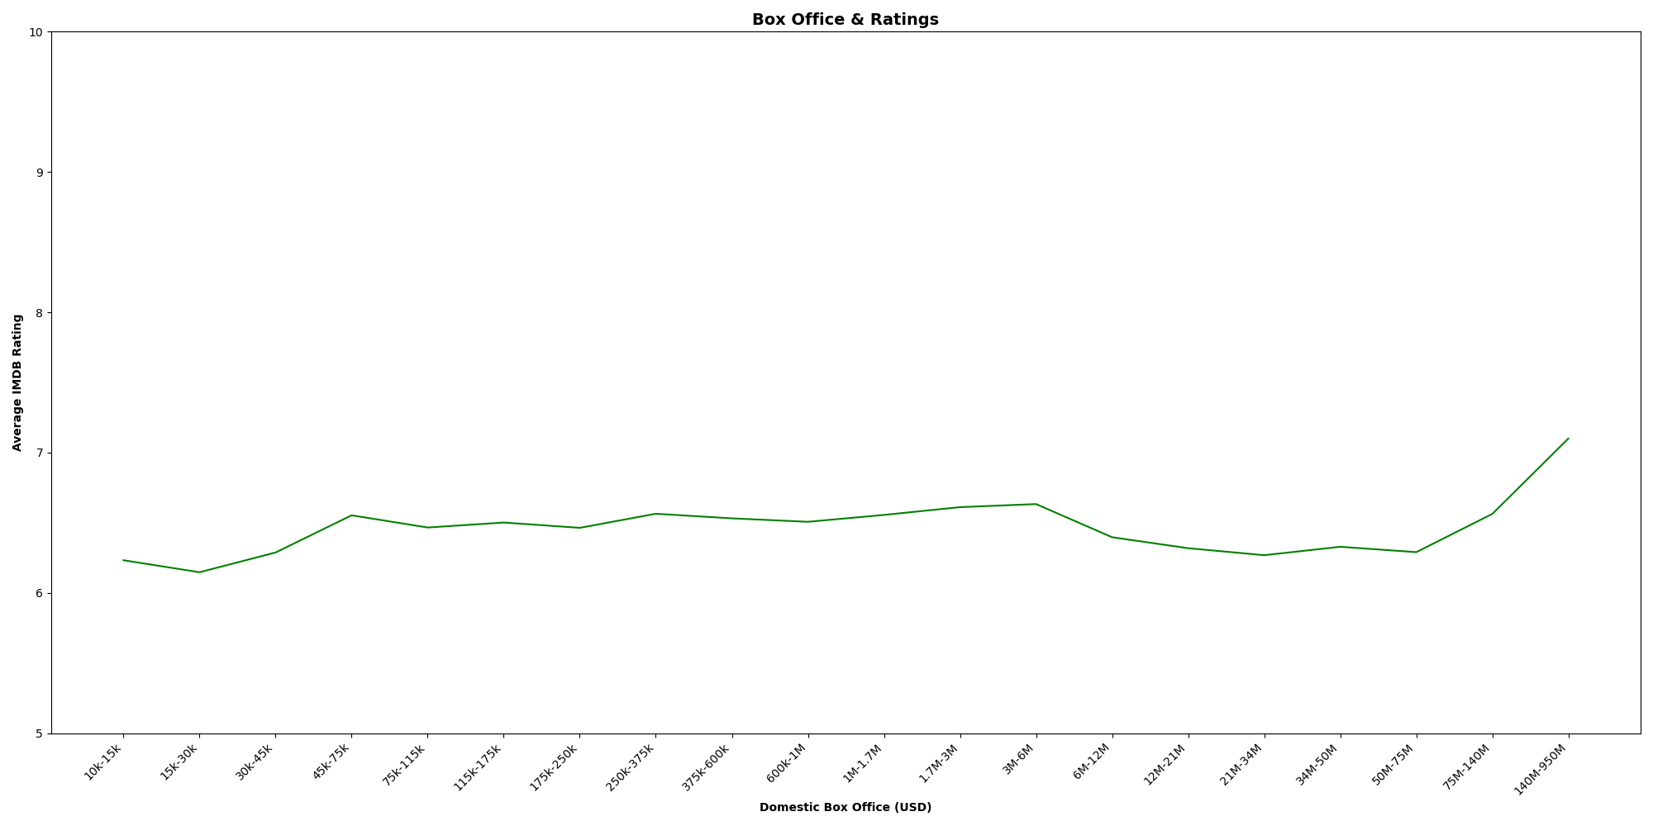
Box Office
P-Value: ~1.52e-28

Slide 11
Box Office
Domestic vs. international
Different quantiles/bins
Genre?

Slide 12
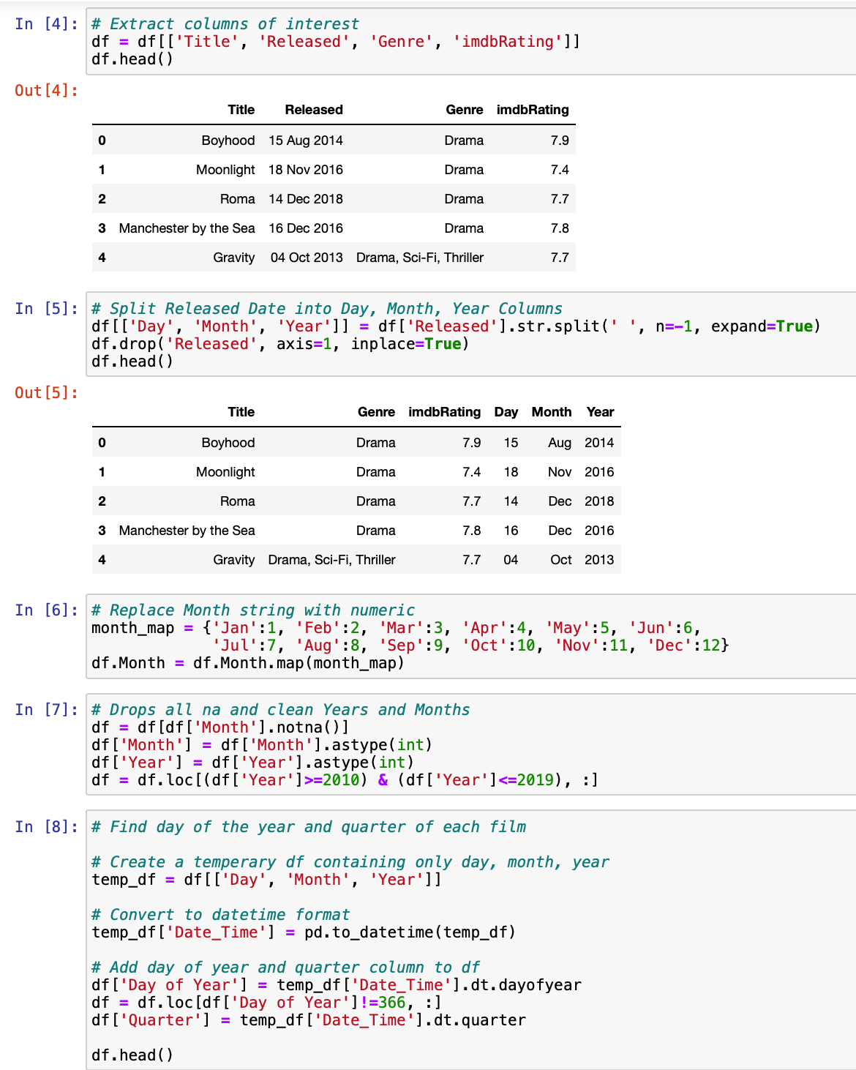
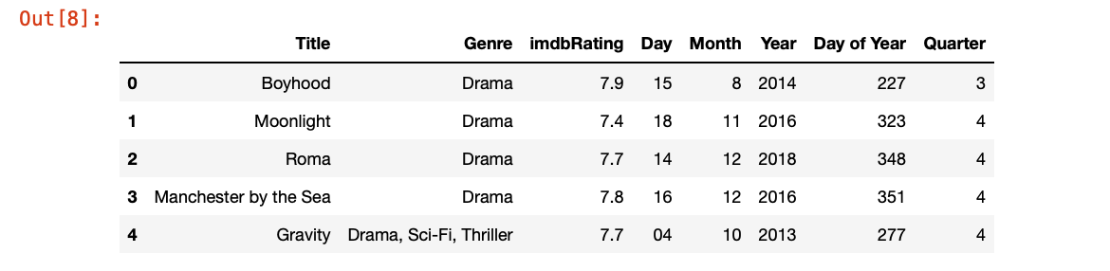
Seasonal trends

Slide 13
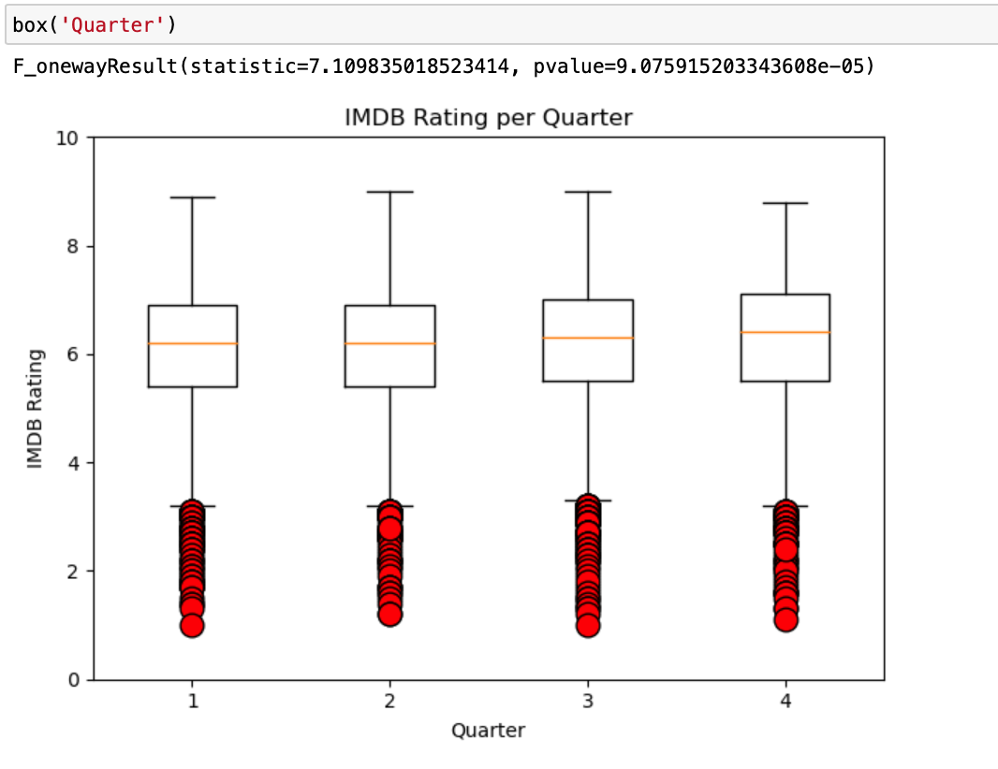
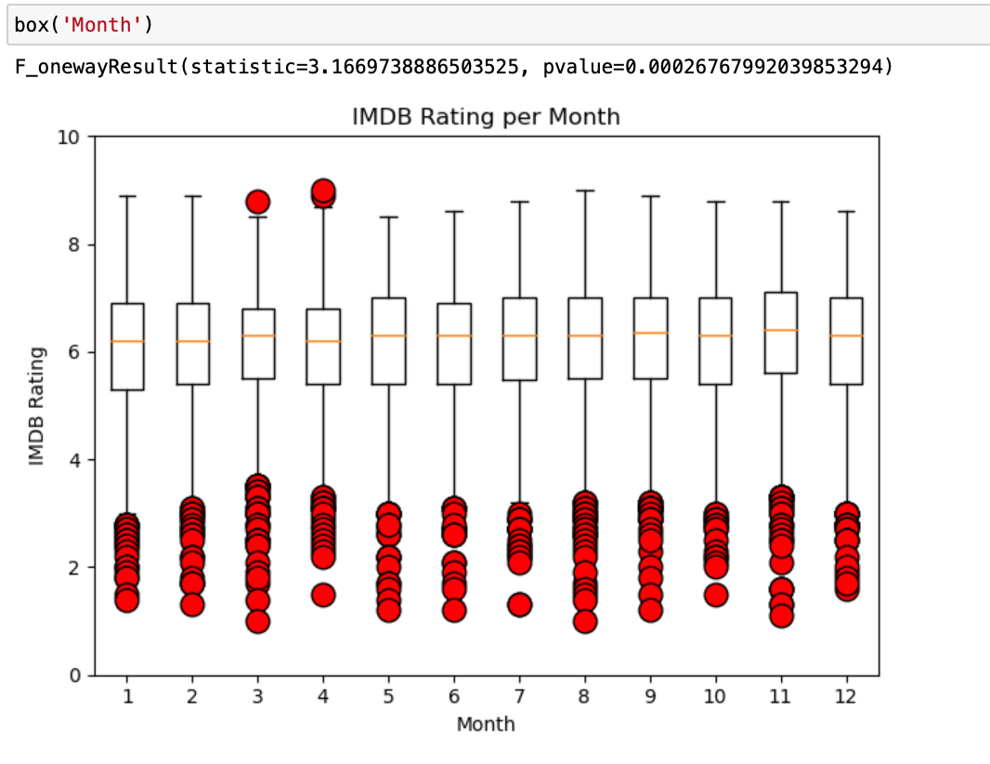
Seasonal trends

Slide 14
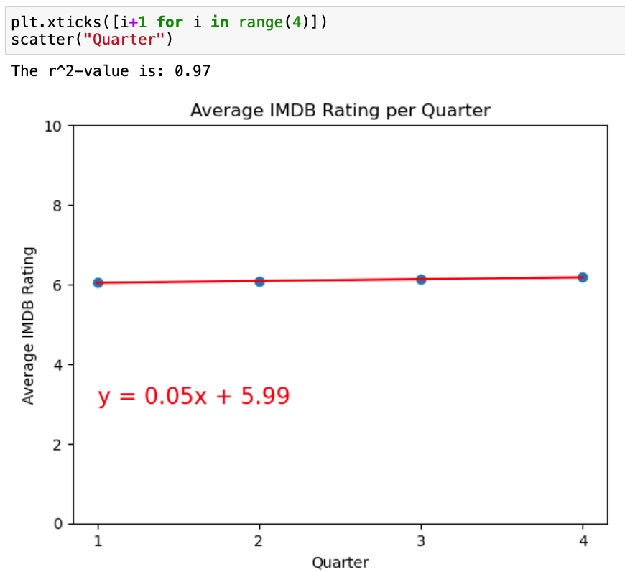
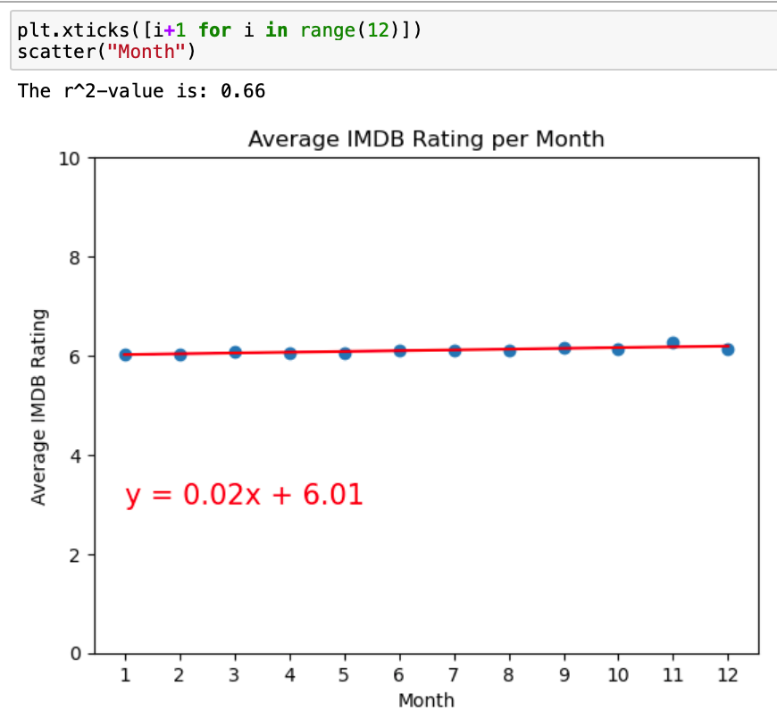
Seasonal trends

Slide 15
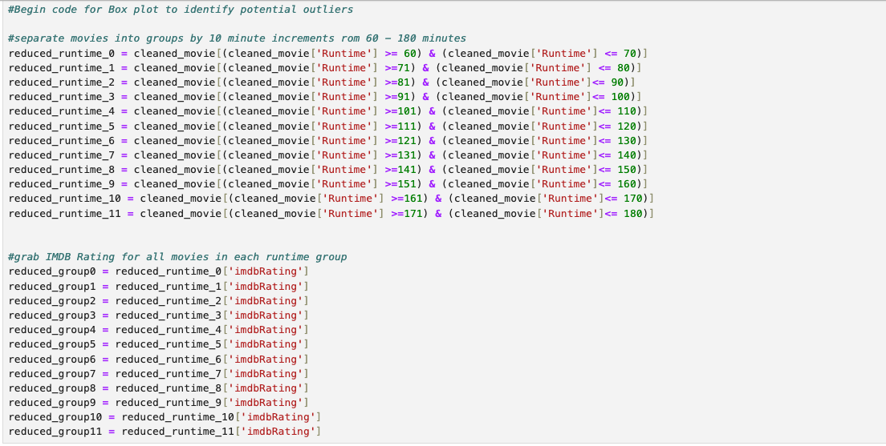
Runtime

Slide 16
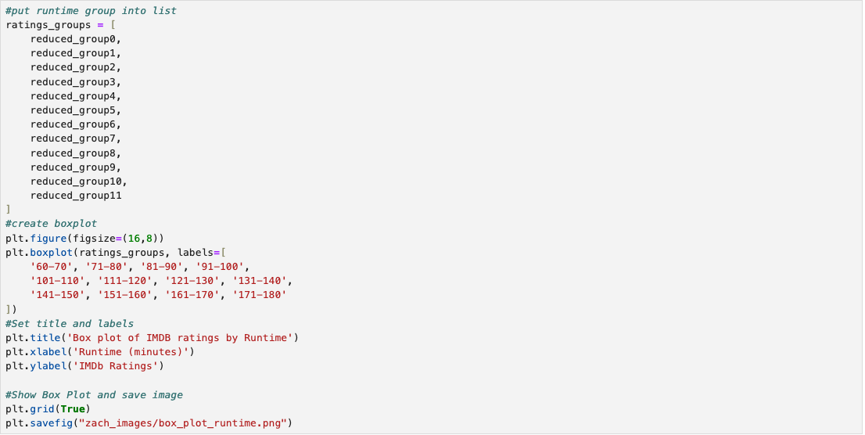
Runtime

Slide 17
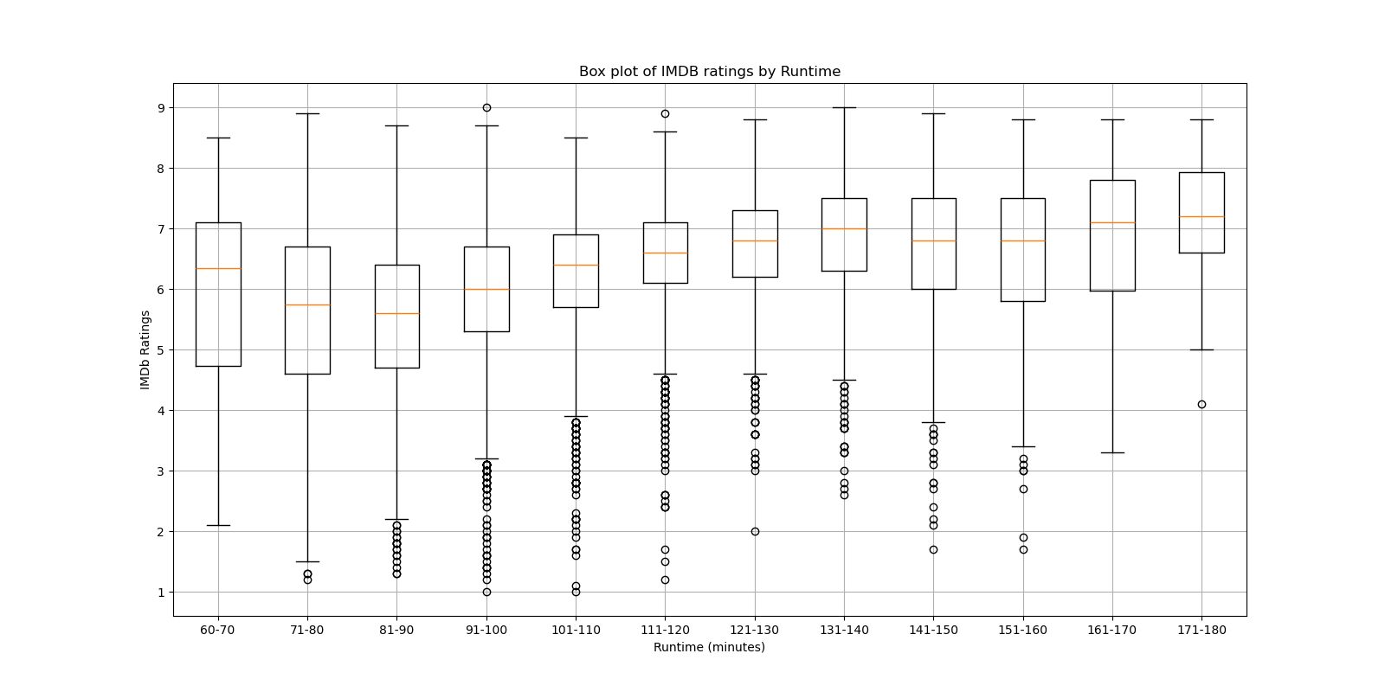
Ran ANOVA

Slide 18
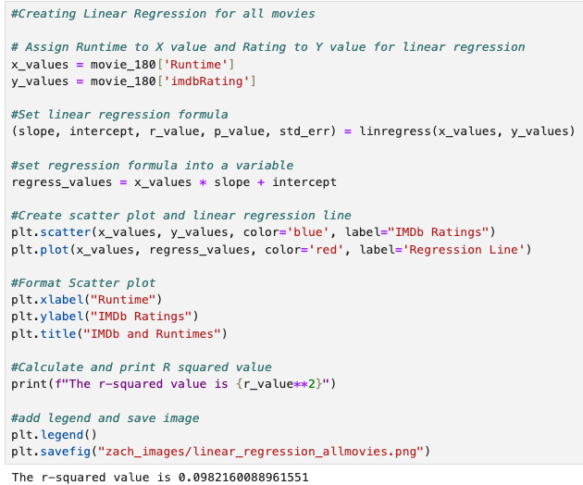
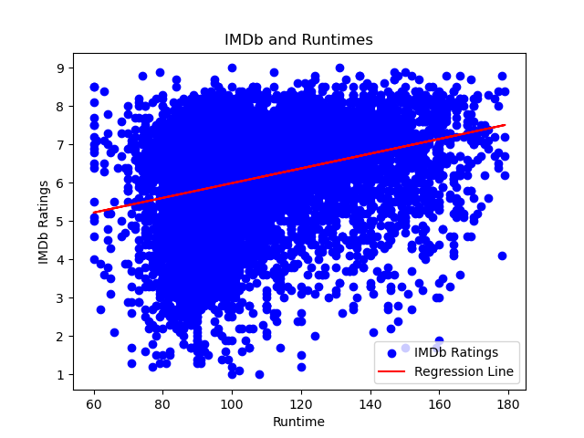

Slide 19
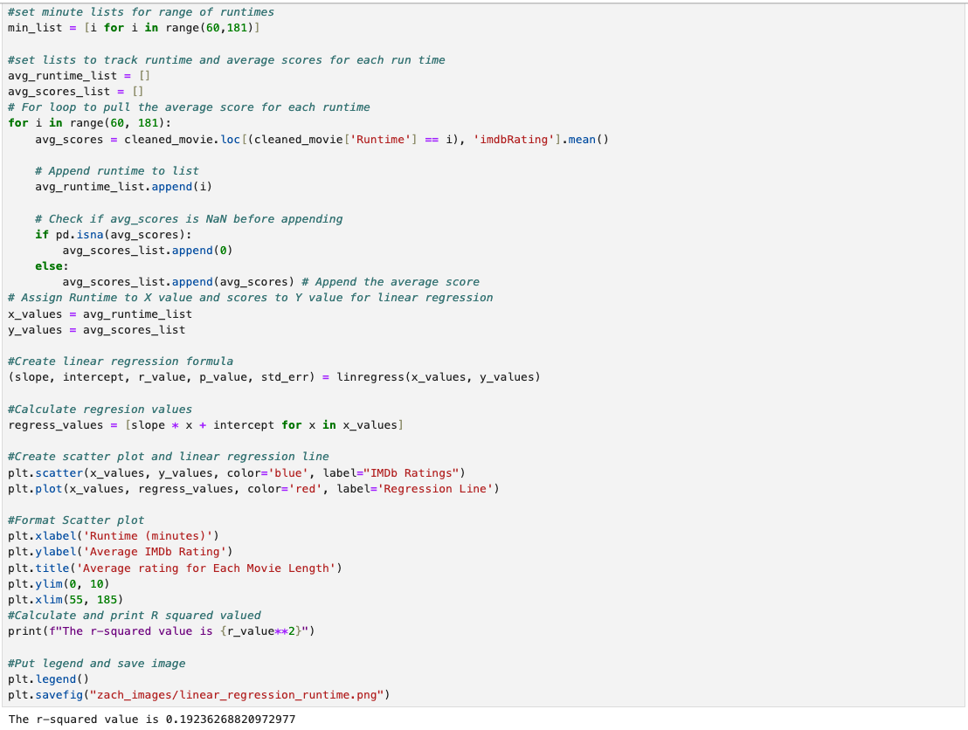

Slide 20
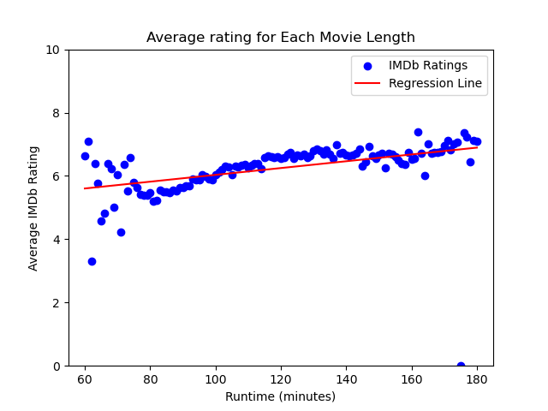

Slide 21
Conclusion
Box office and seasonal had the highest correlation to IMDB ratings. However, run-time & MPAA had some to very slight correlation to IMDB ratings.

Slide 22
Sources and API tools
Imdb Datasets
https://developer.imdb.com/non-commercial-datasets/
OMDB API
https://www.omdbapi.com/

