Slide 1
2
Number Systems,
Operations, and Codes

Slide 2
CHAPTER OUTLINE
2–1 Decimal Numbers（十进制）
2–2 Binary Numbers
2–3 Decimal-to-Binary Conversion
2–4 Binary Arithmetic（算术）
2–5 Complements of Binary Numbers（反码及补码）
2–6 Signed Numbers（带符号数）
2–7 Arithmetic Operations with Signed Numbers
2–8 Hexadecimal Numbers（十六进制数）
2–9 Octal Numbers（八进制数）
2–10 Binary Coded Decimal (BCD)（二-十进制编码）
2–11 Digital Codes（数字编码）
2–12 Error Codes （错误检测码）

Slide 3
Decimal Numbers，十进制数
The position of each digit in a weighted number system is assigned a weight based on the base or radix of the system. The radix of decimal numbers is ten, because only ten symbols (0 through 9) are used to represent any number.
The column weights of decimal numbers are powers of ten that increase from right to left beginning with 10⁰ =1:
基为10
权：位的大小
整数的权：10的正次幂
小数的权：10的负次幂
…10⁵ 10⁴ 10³ 10² 10¹ 10⁰.
For fractional decimal numbers, the column weights are negative powers of ten that decrease from left to right:
10² 10¹ 10⁰. 10⁻¹ 10⁻² 10⁻³ 10⁻⁴ …

Slide 4
Decimal Numbers
数字的值：
Decimal numbers can be expressed as the sum of the products of each digit times the column value for that digit. Thus, the number 9240 can be expressed as
(9 x 10³) + (2 x 10²) + (4 x 10¹) + (0 x 10⁰)
or
9 x 1,000 + 2 x 100 + 4 x 10 + 0 x 1
Example
Express the number 480.52 as the sum of values of each digit.
Solution
480.52 = (4 x 10²) + (8 x 10¹) + (0 x 10⁰) + (5 x 10⁻¹) +(2 x 10⁻²)

Slide 5
Binary Numbers，二进制数
For digital systems, the binary number system is used. Binary has a radix of two and uses the digits 0 and 1 to represent quantities.
The column weights of binary numbers are powers of two that increase from right to left beginning with 2⁰ =1:
…2⁵ 2⁴ 2³ 2² 2¹ 2⁰.
基为2
For fractional binary numbers, the column weights are negative powers of two that decrease from left to right:
2² 2¹ 2⁰. 2⁻¹ 2⁻² 2⁻³ 2⁻⁴ …
n位，最大计数为2^{n}-1

Slide 6
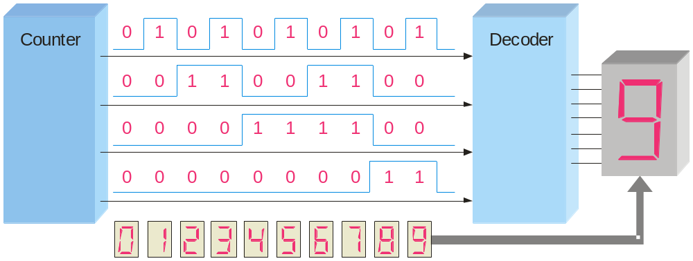
Decimal Number
Binary Number
Binary Numbers
0 0 0 0 0
1 0 0 0 1
2 0 0 1 0
3 0 0 1 1
4 0 1 0 0
5 0 1 0 1
6 0 1 1 0
7 0 1 1 1
8 1 0 0 0
9 1 0 0 1
10 1 0 1 0
11 1 0 1 1
12 1 1 0 0
13 1 1 0 1
14 1 1 1 0
15 1 1 1 1
0~15的二进制计数方法
n位，最大计数为2^{n}-1
Notice the pattern of zeros and ones in each column.
Digital counters frequently have this same pattern of digits:

Slide 7
Binary Conversions
二进制到十进制的转换
把二进制数中所有位为1的权相加，得到十进制数.
Example
Convert the binary number 100101.01 to decimal.
Solution
Start by writing the column weights; then add the weights that correspond to each 1 in the number.
2⁵ 2⁴ 2³ 2² 2¹ 2⁰. 2⁻¹ 2⁻²
32 16 8 4 2 1 . ½ ¼
1 0 0 1 0 1. 0 1
32 +4 +1 +¼ =
37¼

Slide 8
Binary Conversions
十进制到二进制的转换
权和法
求十进制数中包含的二进制的权，全部权相加→十进制数
Example
Convert the decimal number 49 to binary.
Solution
2⁶ 2⁵ 2⁴ 2³ 2² 2¹ 2⁰.
64 32 16 8 4 2 1.
0 1 1 0 0 0 1.

Slide 9
Binary Conversions
整数！
重复除2法
重复除2至商为0，每次得到的余数即构成二进制数
Convert the decimal number 49 to binary by repeatedly dividing by 2.
Example
Solution
Answer:
1
1
0
0
0
1
remainder
整数！
整数！
0
1
3
6
12
24
49 2
Continue until the last quotient is 0
Decimal number
base
Quotient

Slide 10
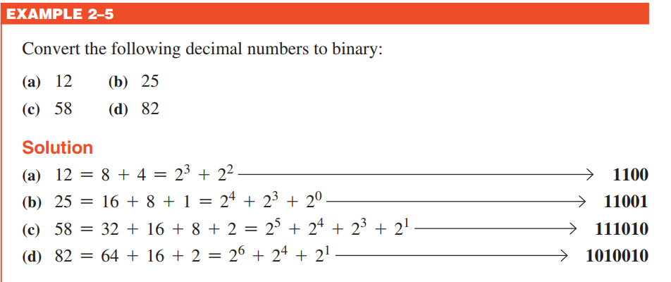

Slide 11
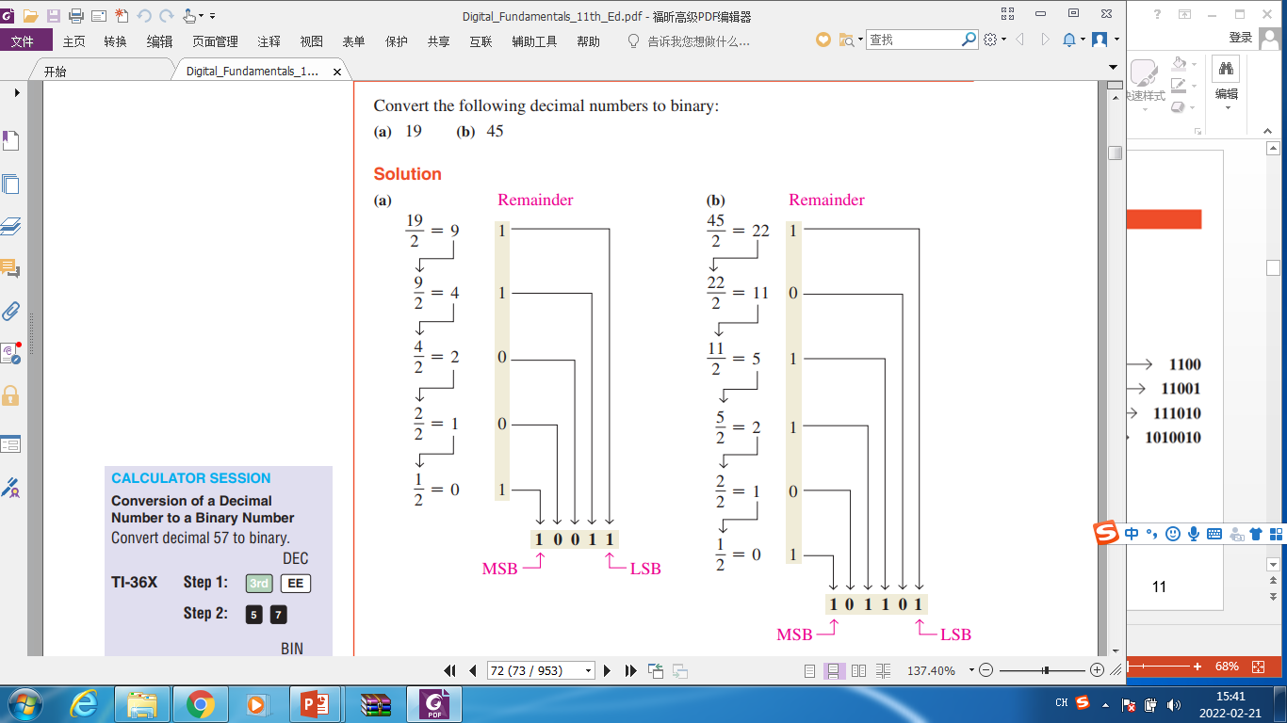

Slide 12
Binary Conversions
小数！
1、权和法
2、重复乘2法
2⁻¹ 2⁻² 2⁻³ 2⁻⁴ …
重复乘，进位即为所求数，直到满足精度
Convert the decimal fraction 0.188 to binary by repeatedly multiplying the fractional results by 2.
Example
0.188 x 2 = 0.376 carry = 0
MSB
Solution
0.376 x 2 = 0.752 carry = 0
0.752 x 2 = 1.504 carry = 1
0.504 x 2 = 1.008 carry = 1
0.008 x 2 = 0.016 carry = 0
Answer = .00110 (for five significant digits)

Slide 13
二进制算术
Binary Addition
The rules for binary addition are
0 + 0 = 0 Sum = 0, carry = 0
0 + 1 = 1 Sum = 1, carry = 0
1 + 0 = 1 Sum = 1, carry = 0
1 + 1 = 10 Sum = 0, carry = 1
When an input carry = 1 due to a previous result, the rules are
1 + 0 + 0 = 01 Sum = 1, carry = 0
1 + 0 + 1 = 10 Sum = 0, carry = 1
1 + 1 + 0 = 10 Sum = 0, carry = 1
1 + 1 + 1 = 11 Sum = 1, carry = 1

Slide 14
Binary Addition
Example
Add the binary numbers 00111 and 10101 and show the equivalent decimal addition.
Solution
0
1
1
1
00111 7
10101 21
1
1
1
0
0
=
28

Slide 15

Binary Subtraction
The rules for binary subtraction are
0 − 0 = 0
1 − 1 = 0
1 − 0 = 1
10 − 1 = 1 with a borrow of 1
Example
Subtract the binary number 00111 from 10101 and show the equivalent decimal subtraction.
Solution
/¹
/¹
/¹
10101 21
00111 7
0
不够减
1
1
1
0
=
14

Slide 16
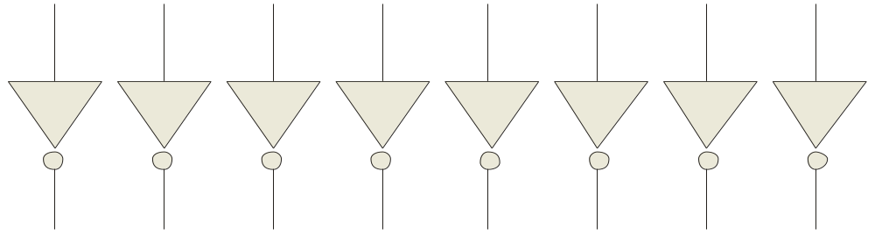
1’s Complement
反码：按位取反
The 1’s complement of a binary number is just the inverse of the digits. To form the 1’s complement, change all 0’s to 1’s and all 1’s to 0’s.
For example, the 1’s complement of 11001010 is
00110101
In digital circuits, the 1’s complement is formed by using inverters:
1 1 0 0 1 0 1 0
0 0 1 1 0 1 0 1

Slide 17

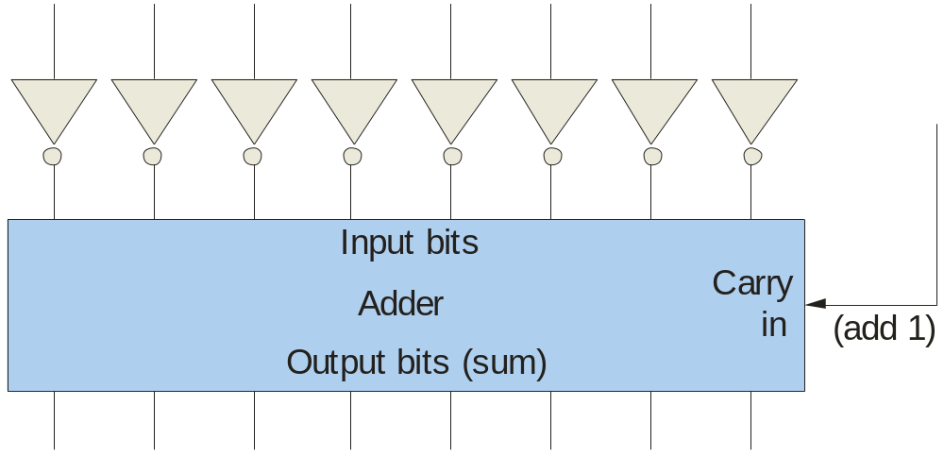
2’s Complement
The 2’s complement of a binary number is found by adding 1 to the LSB of the 1’s complement.
Recall that the 1’s complement of 11001010 is
00110101 (1’s complement)
+1
00110110 (2’s complement)
To form the 2’s complement, add 1:
1 1 0 0 1 0 1 0
1
求二进制负数的补码装置：反相器+加法器
0 0 1 1 0 1 0 1
0 0 1 1 0 1 1 0

Slide 18


2’s Complement
补码：替代法
1、从右边最低有效位开始，直到出现第一个1，写下这些实际数位
2、剩下的位求反码

Slide 19
Signed Binary Numbers
带符号数
There are several ways to represent signed binary numbers. In all cases, the MSB in a signed number is the sign bit, that tells you if the number is positive or negative. （最高位，最左端）
Computers use a modified 2’s complement for signed numbers. Positive numbers are stored in true form (with a 0 for the sign bit) and negative numbers are stored in complement form (with a 1 for the sign bit).
For example, the positive number 58 is written using 8-bits as
00111010 (true form).
正数：符号位0+真值
Sign bit
Magnitude bits

Slide 20
Signed Binary Numbers
Negative numbers are written as the 2’s complement of the corresponding positive number.
负数：符号位→1
补码
The negative number −58 is written as:
−58 = 11000110 (complement form)
Sign bit
Magnitude bits

Slide 21
Signed Binary Numbers
带符号数
正数：符号位0，数值位不变，反码、补码、原码一致
负数：反码——符号位1+数值按位取反
补码——符号位1+数值按位取反，末位+1
符号+数值绝对值（原码形式）
反码形式
补码形式
0？

Slide 22
Signed Binary Numbers
带符号数
（+0）_{补}=0 0000000
（-0）_{补} =1 1111111
+1
0 0000000
（+0）_{原}=0 0000000
（-0）_{原} =1 0000000
（+0）_{反}=0 0000000
（-0）_{反} =1 1111111
一致

Slide 23
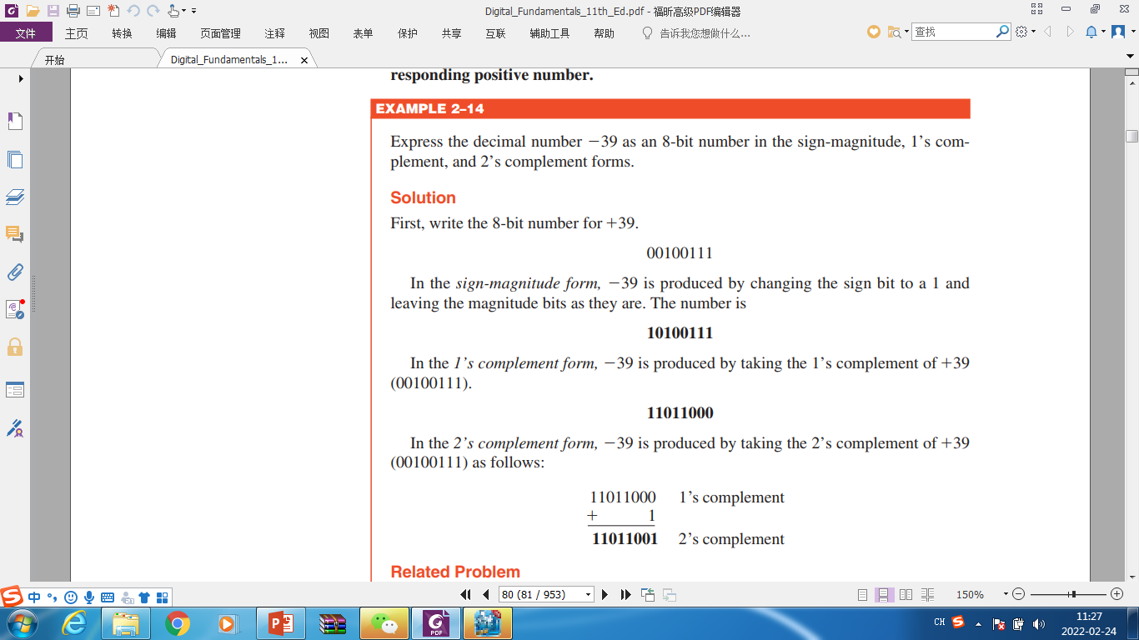
Signed Binary Numbers
带符号数

Slide 24
Signed Binary Numbers
带符号二进制数的十进制数
An easy way to read a signed number that uses this notation is to assign the sign bit a column weight of −128 (for an 8-bit number). Then add the column weights for the 1’s.
Example
Assuming that the sign bit = −128, show that 11000110 = −58 as a 2’s complement signed number:
Solution
Column weights: −128 64 32 16 8 4 2 1.
1 1 0 0 0 1 1 0
真值与补码关系：
按位取反，末位+1
符号！
−128 +64 +4 +2 = −58
负数：把所有位置为1的权加起来

Slide 25
Signed Binary Numbers
确定以符号数值（原码）形式表示的带符号二进制数的十进制数值
10010101
确定以反码形式表示的带符号二进制数的十进制数值
11101000
确定以补码形式表示的带符号二进制数的十进制数值
10101010

Slide 26
Signed Binary Numbers
确定以符号数值（原码）形式表示的带符号二进制数的十进制数值
10010101
确定以反码形式表示的带符号二进制数的十进制数值
11101000
确定以补码形式表示的带符号二进制数的十进制数值
10101010
-21
-23
负数：1、把所有位置为1的权加起来，结果加1
2、数值位按位取反→按权相加
-86
负数：1、把所有位置为1的权加起来
2、数值位按位取反，末位加1→按权相加

Slide 27
Signed Binary Numbers
带符号整数的表示范围
补码带符号数，n位的数值范围为：
- 2^{n-1} ~ +（2^{n-1}-1）
8位的数值范围为：
- 128 到 +127
0 | 1 | 1 | 1 | 1 | 1 | 1 | 1
+127
1 | 0 | 0 | 0 | 0 | 0 | 0 | 0
- 128

Slide 28

Floating Point Numbers，浮点数
Floating point notation is capable of representing very large or small numbers by using a form of scientific notation.
符号 指数 尾数
0.243789×10⁸

Slide 29
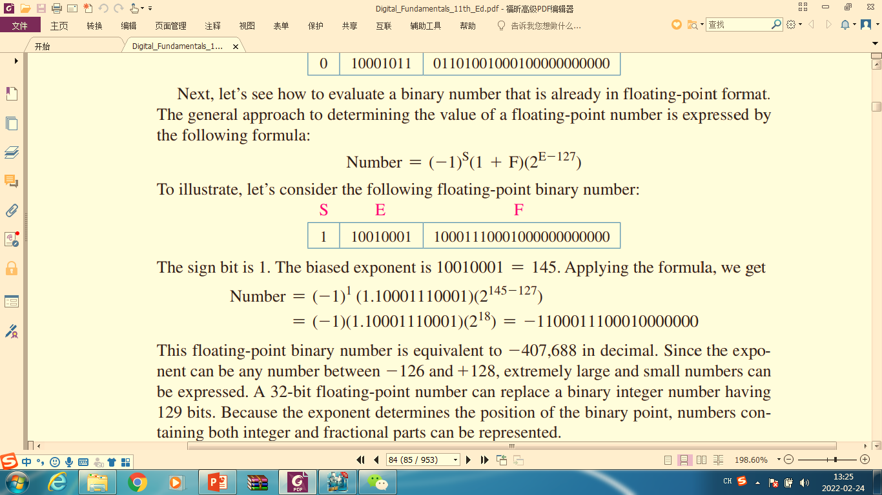
Floating Point Numbers
单精，双精，扩展精度
单精
S E (8 bits) F (23 bits)
Sign bit
Magnitude with MSB dropped
Biased exponent (+127)
Example
Express the speed of light, c, in single precision floating point notation. (c = 0.2998 x 10⁹)
Solution
In binary, c = 0001 0001 1101 1110 1001 0101 1100 0000₂.
In scientific notation, c = 1.001 1101 1110 1001 0101 1100 0000 x 2²⁸.
S = 0 because the number is positive. E = 28 + 127 = 155₁₀ = 1001 1011₂. F is the next 23 bits after the first 1 is dropped.
In floating point notation, c =
0 10011011 001 1101 1110 1001 0101 1100

Slide 30
Example
求十进制数 c = +3.248 x 10⁴的单精浮点二进制数
In binary, c = 32480=111111011100000=1.11111011100000 x 2¹⁴
Solution
S = 0 because the number is positive.
E = 14 + 127 = 141₁₀ = 10001101₂.
F is the next 23 bits after the first 1 is dropped.
In floating point notation, c =
0 10001101
真值指数：-126~128，阶码E：1~255
全0→数0.0
指数全1，尾数全0→∞

Slide 31
带符号数算数运算
Using the signed number notation with negative numbers in 2’s complement form simplifies addition and subtraction of signed numbers.
负数用补码形式
加法规则: 两个数相加，舍去最后进位
Examples:
00011110 = +30
00001111 = +15
00001110 = +14
11101111 = −17
11111111 = −1
11111000 = −8
00101101
= +45
11111101
= −3
1
11110111
= −9
Discard carry

Slide 32
带符号数算数运算
溢出
两数相加，表示和所需的位数超出数值能表示的位数，由一个错误符号位指明。
同号相加，可能溢出
Two examples are:
01111101 = +125
00111010 = +58
10000001 = −127
10000001 = −127
10110111
= -73（183）
Discard carry
100000010
= +2
Wrong!
符号错，大小错
2⁷-1=127，溢出

Slide 33
Arithmetic Operations with Signed Numbers
减法规则: 取减数的补码，加被减数，舍去最后进位
A – B = A + （- B）_{补}
例1, (+ 4)_{补码}=00000100， (- 4)_{补码}=11111100
-128 + 64 + 32 + 16 + 8 + 4 = -4
例2, (-19)_{补码}= 11101101， (+19)_{补码}=00010011
16 + 2 + 1 = 19

Slide 34
减法规则: 取减数的补码，加被减数，舍去最后进位
Repeat the examples done previously, but subtract:
00011110
00001111
(+30)
–(+15)
00001110
11101111
11111111
11111000
(+14)
–(−17)
(−1)
–(−8)
−
−
−
2’s complement subtrahend and add:
00011110 = +30
11110001 = −15
00001110 = +14
00010001 = +17
11111111 = −1
00001000 = +8
1
00001111
= +15
00011111
= +31
1
00000111
= +7
Discard carry
Discard carry

Slide 35

Hexadecimal Numbers十六进制数
Hexadecimal uses sixteen characters to represent numbers: the numbers 0 through 9 and the alphabetic characters A through F.
Decimal
Hexadecimal
Binary
0 1 2 3 4 5 6 7 8 9 10 11 12 13 1415
0 1 2 3 4 5 6 7 8 9 A B C D E F
0000 0001 0010 0011 0100 0101 0110 0111 1000 1001 1010 1011 1100 1101 1110 1111
Large binary number can easily be onverted to hexadecimal by grouping bits 4 at a time and writing the equivalent hexadecimal character.
Example
Express 1001 0110 0000 1110₂ in hexadecimal:
Solution
Group the binary number by 4-bits starting from the right. Thus, 960E
960EH，ox960E，960E₁₆

Slide 36
十六进制计数
{
16³ 16² 16¹ 16⁰.
Column weights
4096 256 16 1.
十六进制的权
00、01、02、┄、0F
10、11、12、┄、1F
20、21、22、┄、2F
┄
F0、F1、F2、┄、FF
F→15
FF→255
FFF→4095
FFFF→65535

Slide 37
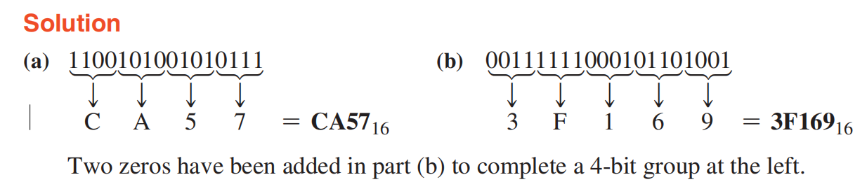
二进制数到十六进制数的转换
Simply break the binary number into 4-bit groups, starting at the right-most bit and replace each 4-bit group with the equivalent hexadecimal symbol.
EXAMPLE
Convert the following binary numbers to hexadecimal:
(a) 1100101001010111 (b) 111111000101101001

Slide 38
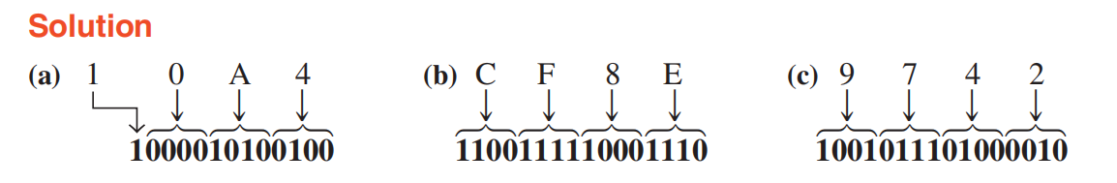
十六进制数到二进制数的转换
To convert from a hexadecimal number to a binary number, reverse the process and replace each hexadecimal symbol with the appropriate four bits.
Example
Determine the binary numbers for the following hexadecimal numbers:
(a) 10A4₁₆ (b) CF8E₁₆ (c) 9742₁₆

Slide 39
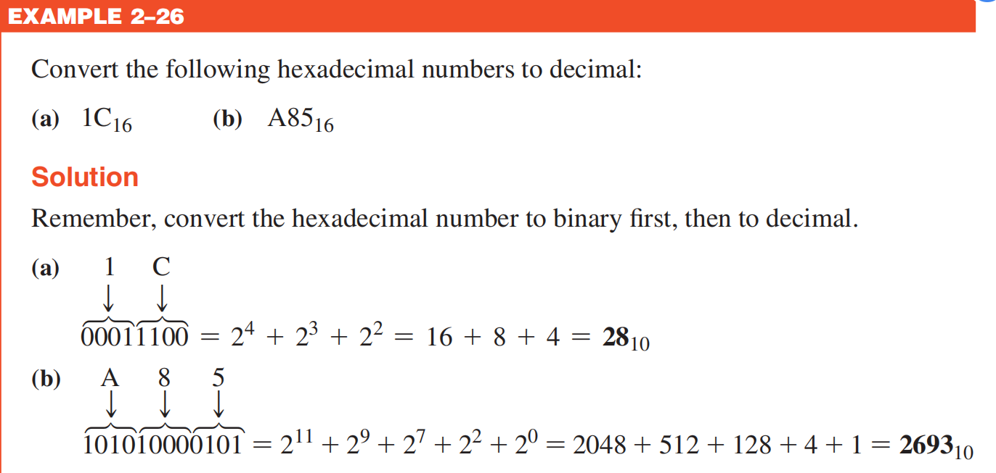
十六进制数到十进制数的转换
方法1、十六进制数→二进制数→十进制数

Slide 40
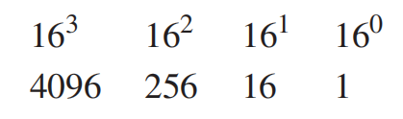
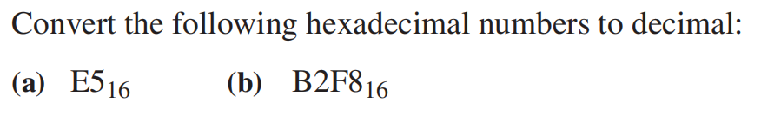
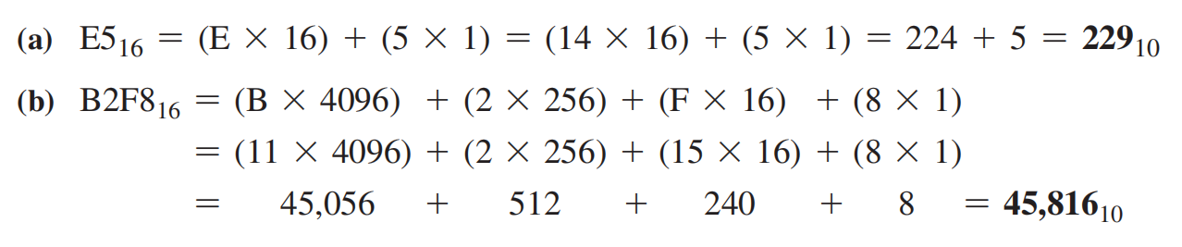
十六进制数到十进制数的转换
方法2、权和法
For a 4-digit hexadecimal number, the weights are
Example

Slide 41
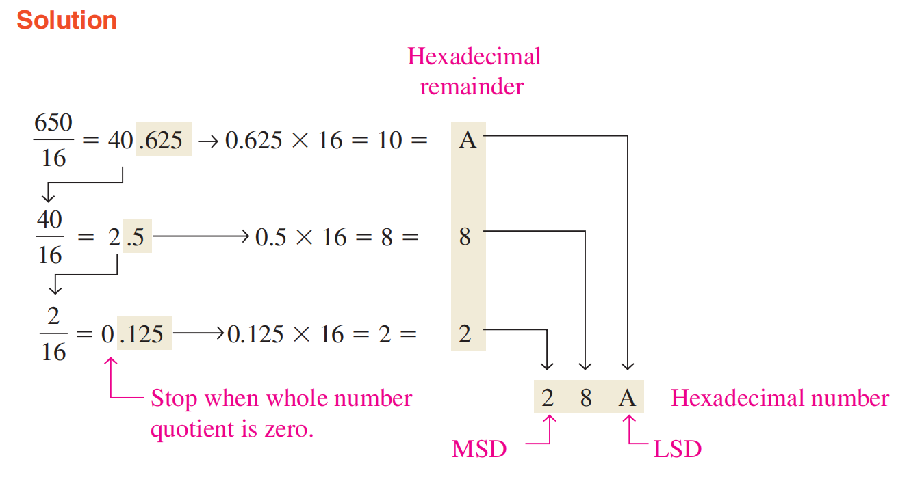
十进制数到十六进制数的转换
类似十进制数到二进制数的转换，注意余数的求法
或者十进制数→二进制数→十六进制数
Example
Convert the decimal number 650 to hexadecimal by repeated division by 16.

Slide 42
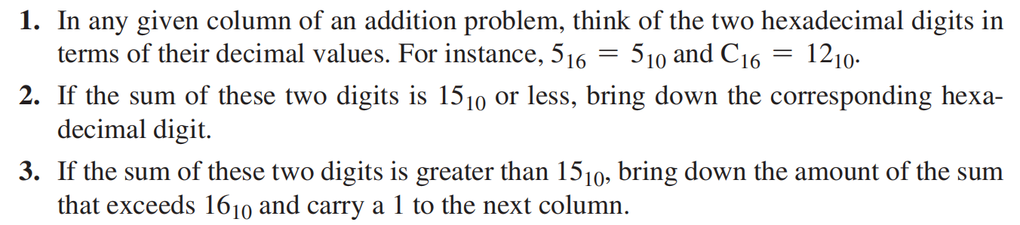
the hexadecimal digits 0 ~ 9 are equivalent to decimal digits 0 ~ 9 and that hexadecimal digits A ~ F are equivalent to decimal numbers 10 ~ 15.
十六进制加法
记下超出的数，在下一列加进位1
Example
Add the following hexadecimal numbers:
(a) 2316 + 1616 (b) 5816 + 2216 (c) 2B16 + 8416 (d) DF16 + AC16

Slide 43
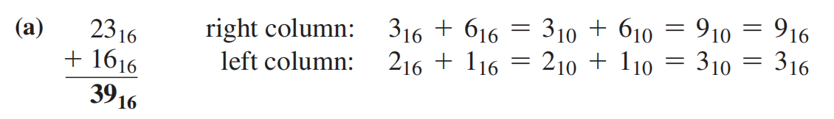
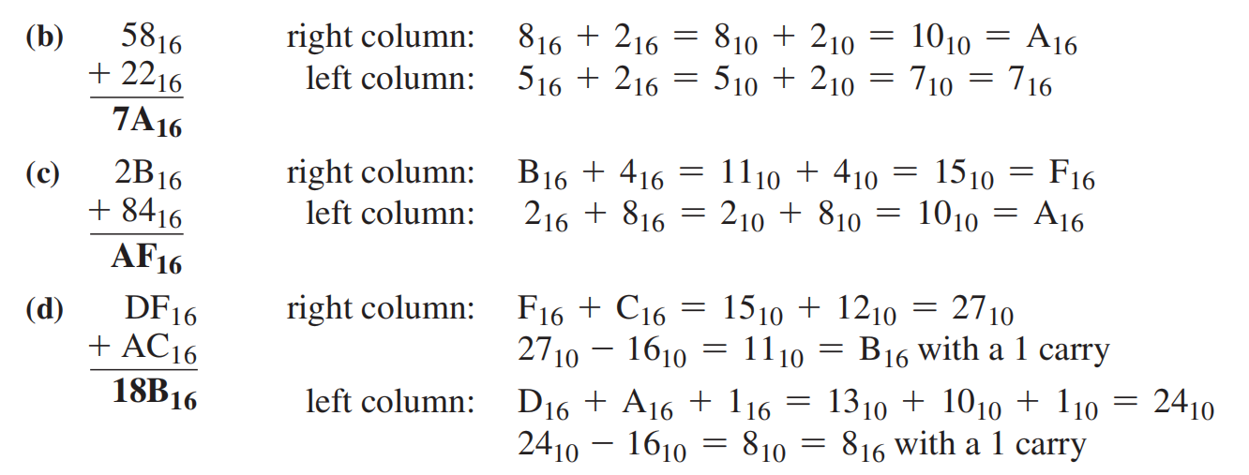
十六进制加法
Add the following hexadecimal numbers:
(a) 2316 + 1616 (b) 5816 + 2216 (c) 2B16 + 8416 (d) DF16 + AC16
Example

Slide 44
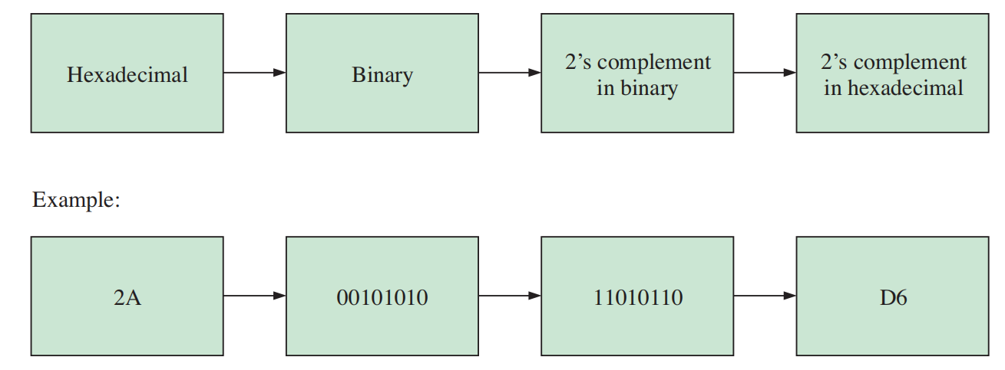
十六进制数减法
十六进制数的补码求法
方法1、十六进制数→二进制数→取二进制数补码→十六进制数补码

Slide 45
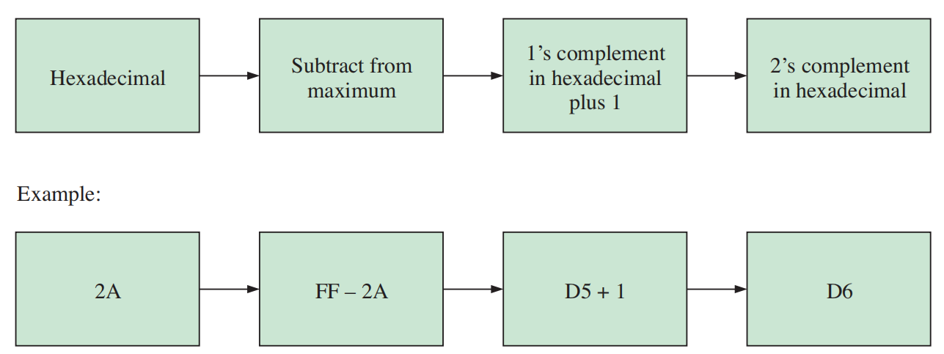
十六进制数减法
十六进制数的补码求法
方法2、从最大十六进制数减去当前十六进制数，并加1

Slide 46
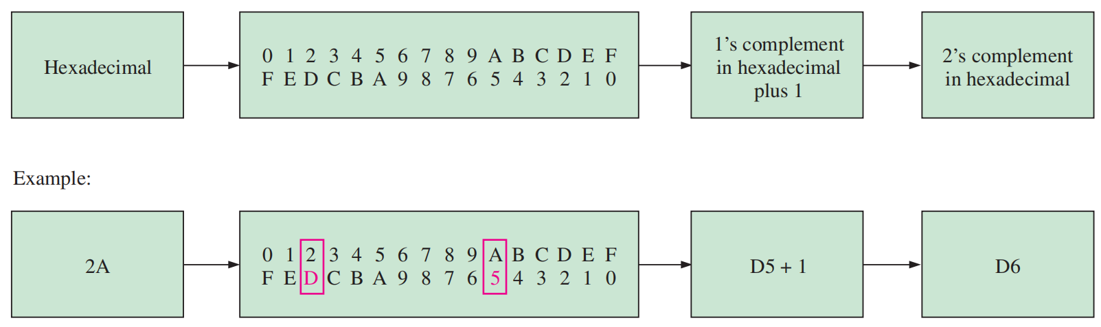
十六进制数减法
十六进制数的补码求法
方法3、反码加1

Slide 47
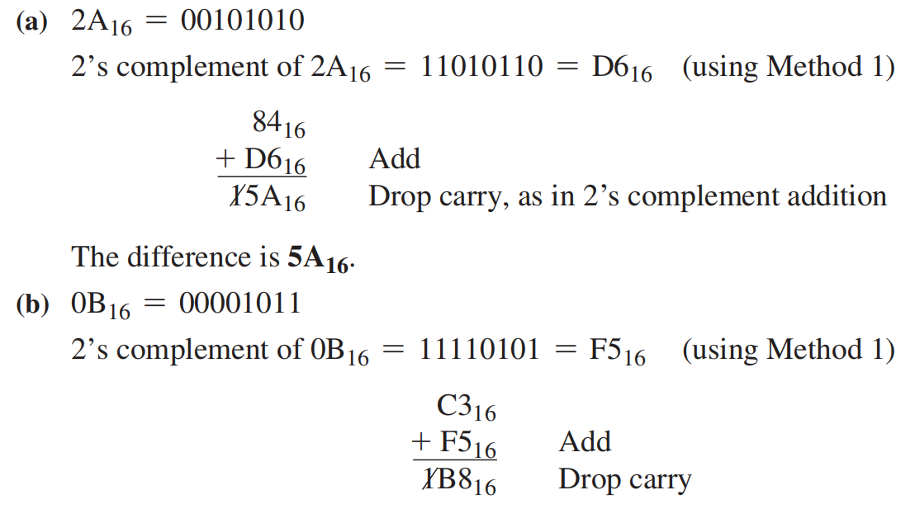
十六进制数减法
Subtract the following hexadecimal numbers:
(a) 8416 - 2A16 (b) C316 - 0B16
Example

Slide 48
Octal Numbers 八进制数
Decimal
Octal
Binary
0, 1, 2, 3, 4, 5, 6, 7 ，8个数位
0 1 2 3 4 5 6 7 8 9 10 11 12 13 1415
0 1 2 3 4 5 6 7 10 1112 13 14 15 16 17
0000 0001 0010 0011 0100 0101 0110 0111 1000 1001 1010 1011 1100 1101 1110 1111
15₈ =13₁₀ = D₁₆
Binary number can easily be converted to octal by grouping bits 3 at a time and writing the equivalent octal character for each group.
Example
Express 1 001 011 000 001 110₂ in octal:
Solution
Group the binary number by 3-bits starting from the right. Thus, 113016₈

Slide 49
八进制数到十进制数的转换
Octal is also a weighted number system. The column weights are powers of 8, which increase from right to left.
{
8³ 8² 8¹ 8⁰.
Column weights
512 64 8 1.
Example
Express 3702₈ in decimal.
Solution
Start by writing the column weights:
512 64 8 1
3 7 0 2₈
3(512) + 7(64) +0(8) +2(1) =
1986₁₀

Slide 50
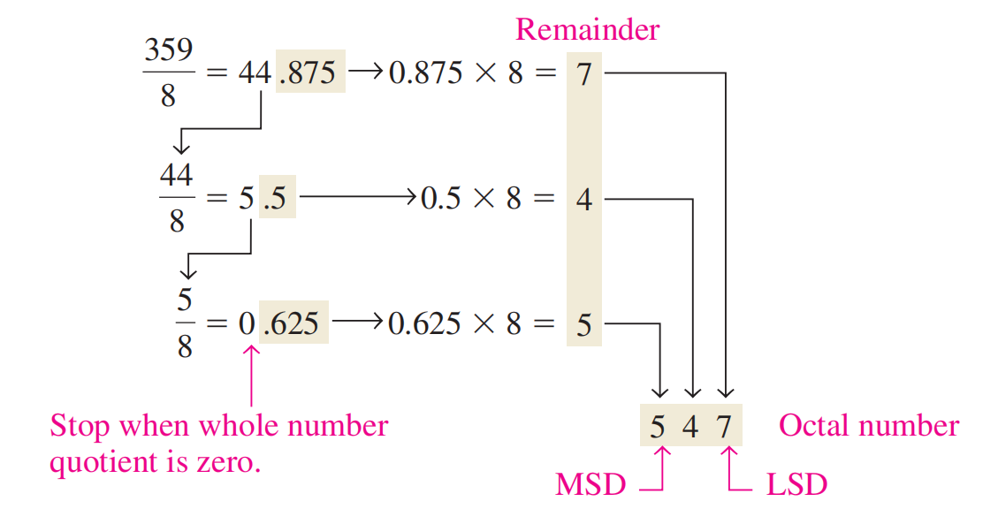
十进制数到八进制数的转换
重复除8，类似十六进制数
Example
convert the decimal number 359 to octal
Solution

Slide 51
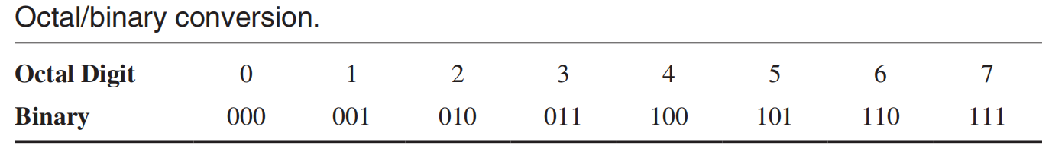
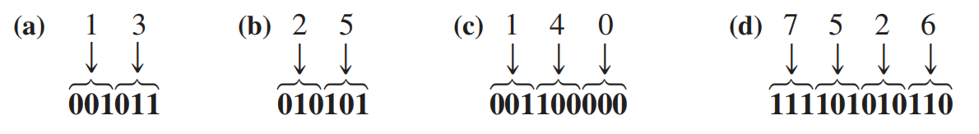
八进制数到二进制数的转换
一个八进制数由3位二进制数表示
Example
Convert each of the following octal numbers to binary:
(a) 13₈ (b) 25₈ (c) 140₈ (d) 7526₈
Solution

Slide 52
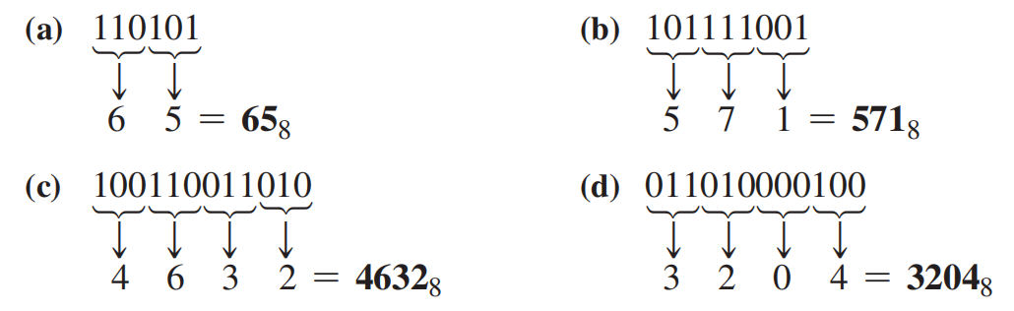
二进制数到八进制数的转换
是八进制数到二进制数转换的逆过程，3位一组
Example
Convert each of the following binary numbers to octal:
(a) 110101 (b) 101111001 (c) 100110011010 (d) 11010000100
Solution

Slide 53
8421BCD码
二—十进制编码
加权码
Decimal
Binary
BCD
0 1 2 3 4 5 6 7 8 9 10 11 12 13 1415
0000 0001 0010 0011 0100 0101 0110 0111 1000 1001 1010 1011 1100 1101 1110 1111
0000 0001 0010 0011 0100 0101 0110 0111 1000 1001
Binary coded decimal (BCD) is a weighted code that is commonly used in digital systems when it is necessary to show decimal numbers such as in clock displays.
The table illustrates the difference between straight binary and BCD.
BCD represents each decimal digit with a 4-bit code.
Notice that the codes 1010 through 1111 are not used in BCD.
无效码

Slide 54
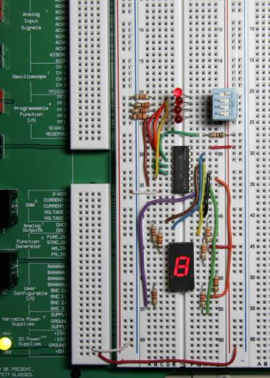
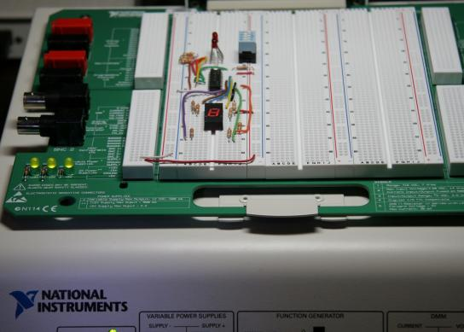
BCD
A lab experiment in which BCD is converted to decimal is shown.

Slide 55
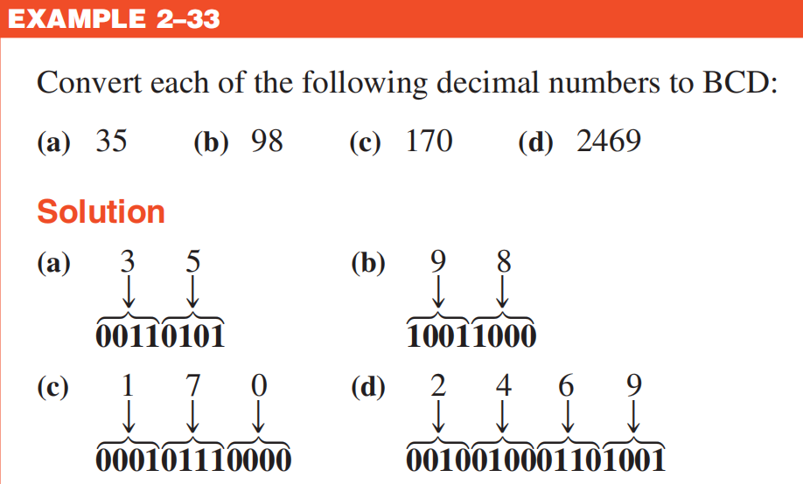
8421BCD码
十进制数→BCD码

Slide 56
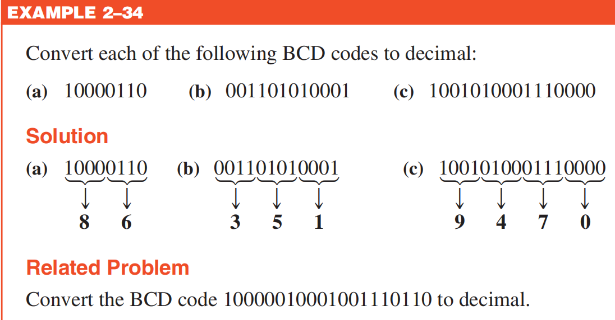
8421BCD码
BCD码→十进制数

Slide 57
BCD 码加法 （调整）
BCD加法运算，及调整
Example Add the BCD numbers 1001 + 0100
Solution: The decimal number addition is shown for comparison
1001 9
+ 0100 + 4
1101 13
+ 0110 (add 6 0110)
0001 0011 (BCD 13)
1、两个BCD码相加
2、和≤9，合法
3、>9/有进位，无效结果
+6调整；
+6产生进位，进位加到下一个4位中

Slide 58
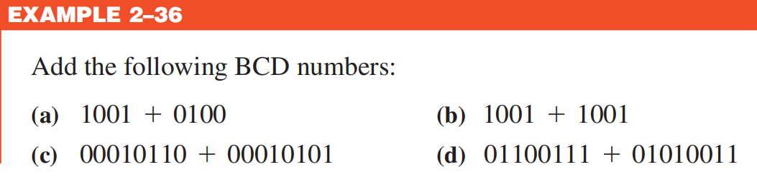
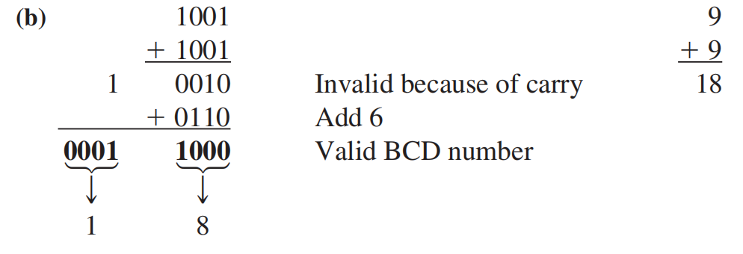

Slide 59
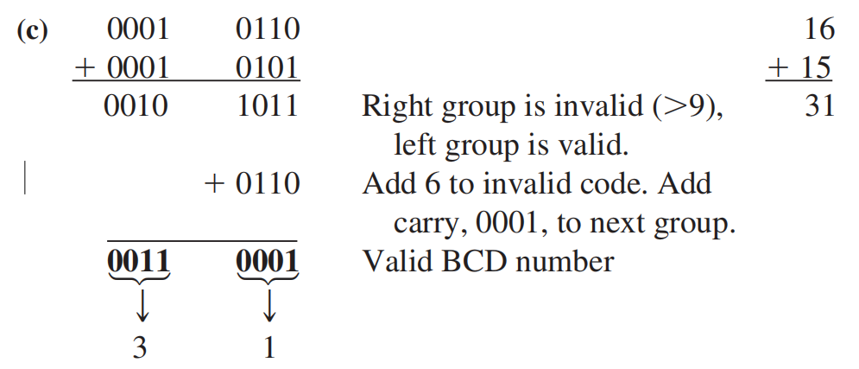

Slide 60
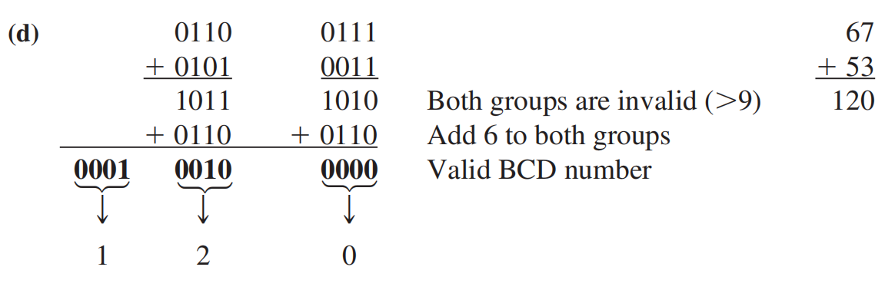

Slide 61
数字编码
Gray code 格雷码
Decimal
Binary
Gray code
0 1 2 3 4 5 6 7 8 9 10 11 12 13 1415
0000 0001 0010 0011 0100 0101 0110 0111 1000 1001 1010 1011 1100 1101 1110 1111
0000 0001 0011 0010 0110 0111 0101 0100 1100 1101 1111 1110 1010 1011 1001 1000
Gray code is an unweighted code（无权码） that has a single bit change between one code word and the next in a sequence.
Gray code is used to avoid problems in systems where an error can occur if more than one bit changes at a time.
特征：两个相邻码字之间只有一位不同
可以减少出错概率

Slide 62
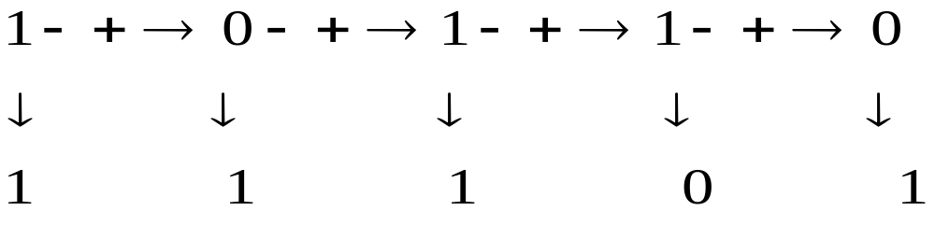
Binary-to-Gray Code Conversion
格雷码最高有效位与二进制最高有效位一致
从左到右，加上每一对相邻的二进制编码位，得到下一个格雷码，舍去进位
The binary number is 10110, the Gray code is 11101
CHAPTER 2

Slide 63
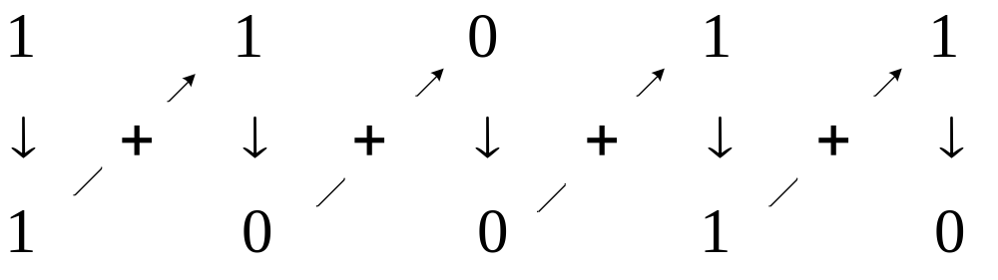
Gray Code-to-Binary Conversion
二进制最高有效位与格雷码最高有效位一致
将所产生的每一个二进制编码位加上下一个相邻位置的格雷码位，舍去进位
The Gray code is 11011, the binary number is 10010
CHAPTER 2

Slide 64
字符编码
信息编码
1、数值信息编码
2、非数值信息编码——字符编码
  文字、图表、声音、图像、视频……
计算机按照某种约定的规则进行编码和解释
Notes:
本节课我们来说说字符编码

Slide 65
字符编码
1.文字编码-西文
ASC II码：美国信息交换标准码
（American Standard Code For Information Interchange）
计算机内，每个字符的ASCII码用1字节( 8位 )来存放，字节的最高位用“0”填充，后7位 (b ₆ b ₅ b ₄ b ₃ b ₂ b ₁ b ₀) 为编码值，共有128种状态(2⁷= 128 )，可表示128个字符，即26个小写字母、26个大写字母、0~9共10个数字、32个符号、33个控制符号和一个空格。
7位编码的ASCII码是目前使用最为广泛的字符编码，称为标准的ASCII码字符集。

Slide 66
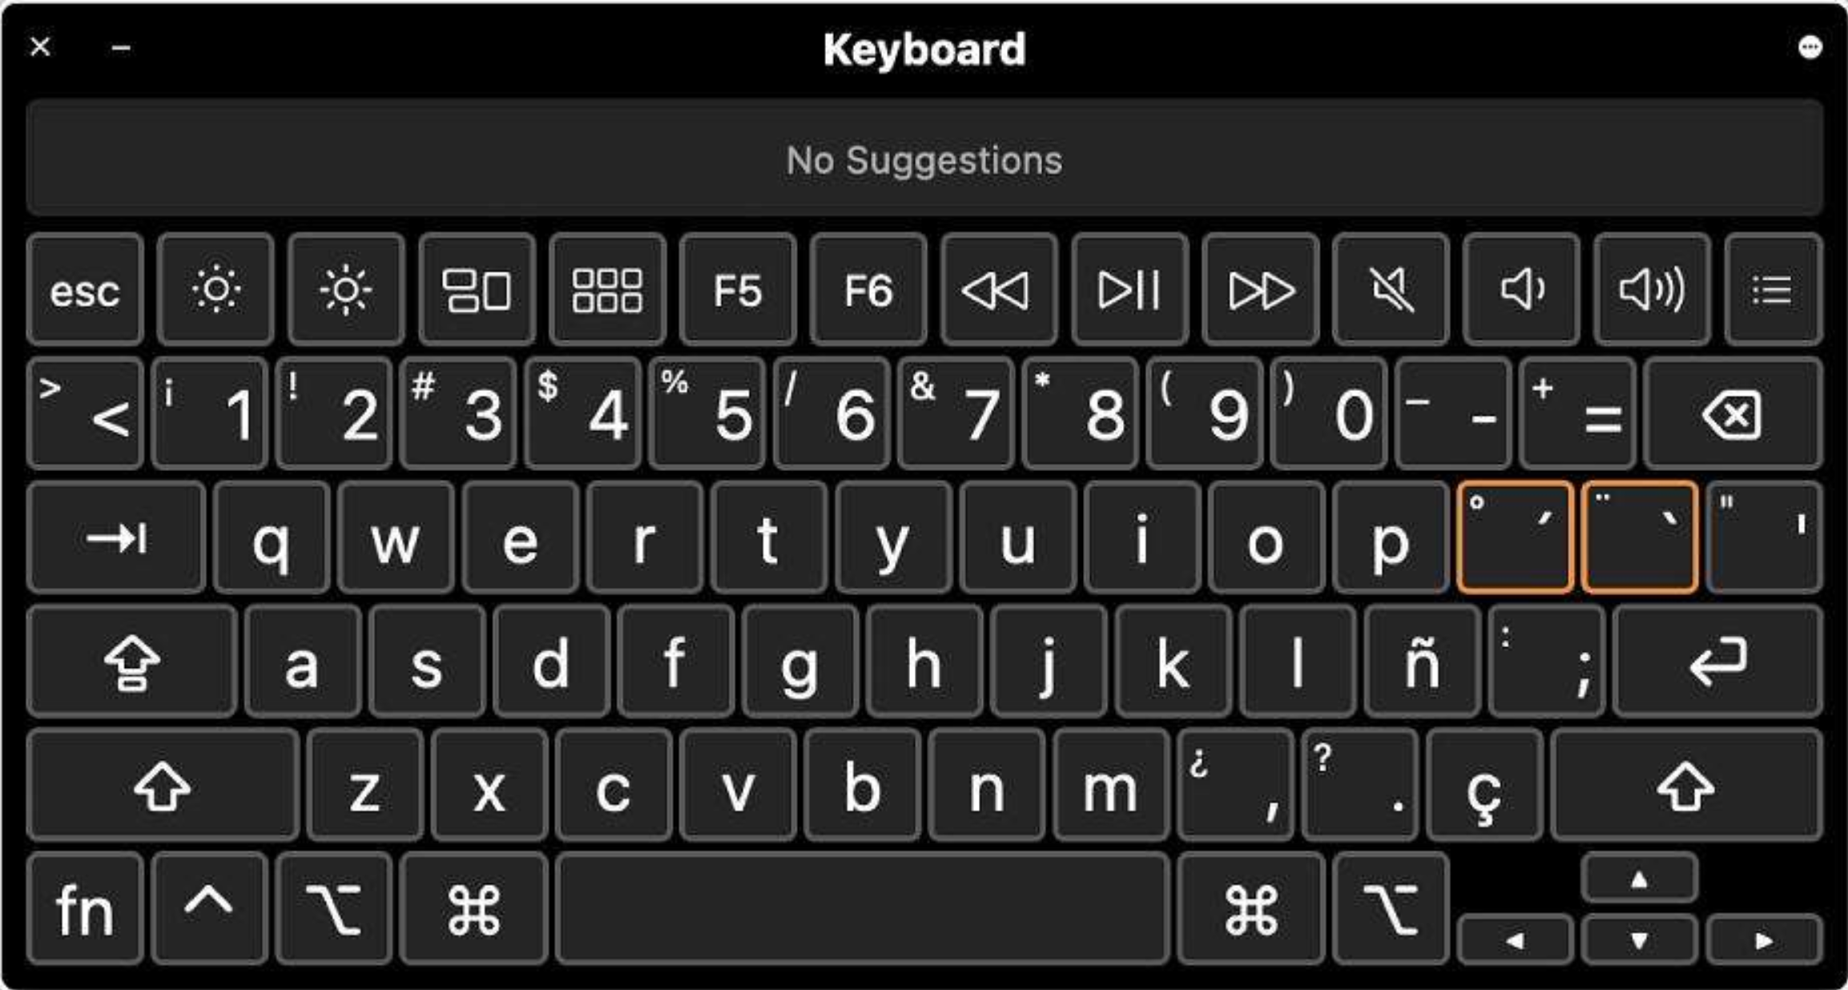
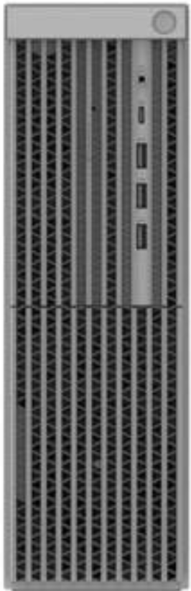


字符编码
西文字符编码最常用的是ASCII字符编码，7位二进制编码，表示128个字符。
 | 000 | 001 | 010 | 011 | 100 | 101 | 110 | 111
0000 | NUL | DLE | SP | 0 | @ | P | 、 | p
0001 | SOH | DC1 | ! | 1 | A | Q | a | q
0010 | STX | DC2 | ” | 2 | B | R | b | r
0011 | ETX | DC3 | # | 3 | C | S | c | s
0100 | EOT | DC4 | $ | 4 | D | T | d | t
0101 | ENQ | NAK | % | 5 | E | U | e | u
0110 | ACK | SYN | & | 6 | F | V | f | v
0111 | BEL | ETB | ’ | 7 | G | W | g | w
1000 | BS | CAN | ( | 8 | H | X | h | x
1001 | HT | EM | ) | 9 | I | Y | i | y
1010 | LF | SUB | * | : | J | Z | j | z
1011 | VT | ESC | + | ; | K | [ | k | {
1100 | FF | FS | , | < | L | \ | l | |
1101 | CR | GS | - | = | M | ] | m | }
1110 | SO | RS | . | > | N | ↑ | n | ~
1111 | SI | US | / | ? | O | ↓ | o | DEL
A
键盘输入 编码存储 显示输出
‘A’ 1000001

Slide 67
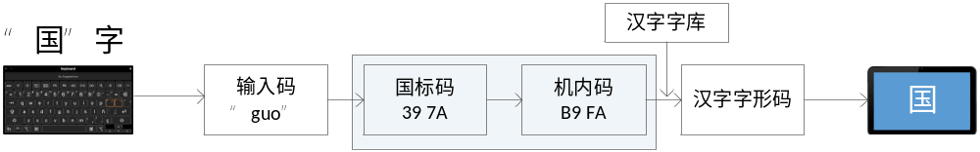




字符编码
2.文字编码-汉字
涉及几个阶段不同编码的转换。
如：汉字输入码、交换码、内码、字形码。
汉字输入码
键盘输入（输入码）
输入法：拼音、五笔、 区位
内部处理（机内码）
国标码：GB2312
输出（字形码）
字库
Unicode
显示输出
打印输出
信息交换（交换码）

Slide 68
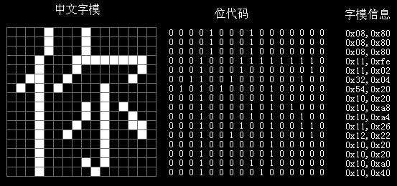
字符编码
汉字字形码

Slide 69
文字编码-Unicode，统一码
世界上所有语言的符号，组成通用字符集（Universal Character Set，UCS），统一且唯一。
支持跨语言、跨平台的文本转换和处理。
Unicode编码由4个字节组成
Unicode编码体系具有较复杂的“立体” 结构。
  128个组（group）
  每组256个平面（plane）
  每个平面有256行（row）
  每行包括256个单元格（cell）
2018/10/8

Slide 70
Error Detection Codes 错误检测码
We often add some redundant bits in the codes, then we can detect the error, or correct the error.
检错，纠错
CHAPTER 2

Slide 71
Parity Method for Error Detection 奇偶校验法
Even（偶） Parity |  | Odd Parity
P | BCD | P | BCD
0 | 0000 | 1 | 0000
1 | 0001 | 0 | 0001
1 | 0010 | 0 | 0010
0 | 0011 | 1 | 0011
1 | 0100 | 0 | 0100
0 | 0101 | 1 | 0101
0 | 0110 | 1 | 0110
1 | 0111 | 0 | 0111
1 | 1000 | 0 | 1000
0 | 1001 | 1 | 1001
Many systems use a parity bit as a means for bit error detection.
A parity tells if the number of 1s is odd or even.
A parity bit（校验位） is attached to a group of bits to make the total number of 1s in a group always even or always odd.
CHAPTER 2

Slide 72
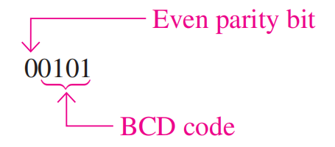
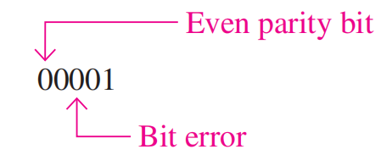
Parity Method for Error Detection 奇偶校验法
检测一个错误
码被接收时，指出了错误！
CHAPTER 2

Slide 73
Parity Method for Error Detection
Example Add odd parity system received the code group,
00110111, 11110000, which one is incorrect?
CHAPTER 2

Slide 74
Parity Method for Error Detection
Example Add odd parity system received the code group,
00110111, 11110000, which one is incorrect?
00110111, has 5 1s, it is odd, this code is OK.
11110000, has 4 1s, it is even, it is incorrect.
CHAPTER 2

Slide 75
Parity Method
Example
The ASCII character for “a” is 1100001 and for “A” is 1000001. What is the correct bit to append to make both of these have odd parity?
Solution
The ASCII “a” has an odd number of bits that are equal to 1; therefore the parity bit is 0. The ASCII “A” has an even number of bits that are equal to 1; therefore the parity bit is 1.

Slide 76
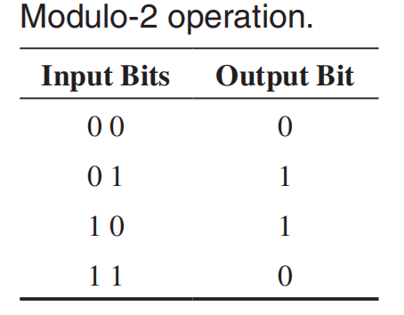
循环冗余校验码CRC
通信中的检测、纠错码
模2运算（异或运算）
生成多项式
Example
Determine the transmitted CRC for the following byte of data (D) and generator code (G). Verify that the remainder is 0.
D: 11010011 ， G: 1010

Slide 77
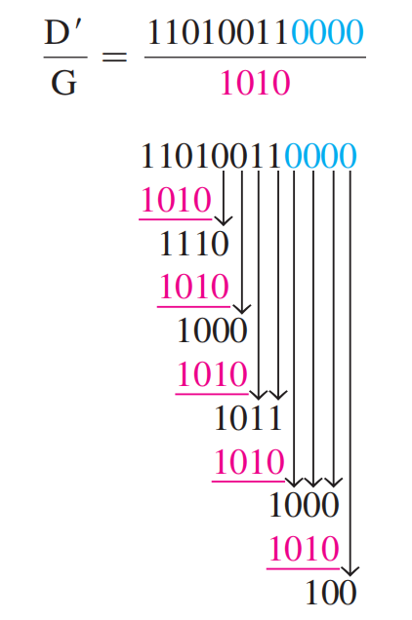
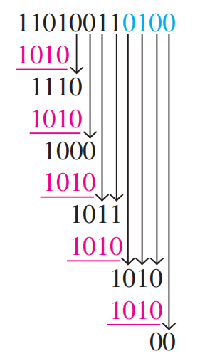
循环冗余校验码CRC
Example
Determine the transmitted CRC for the following byte of data (D) and generator code (G). Verify that the remainder is 0.
D: 11010011 ， G: 1010
Solution
D’ = 110100110000
CRC is 110100110100
Remainder = 0

Slide 78
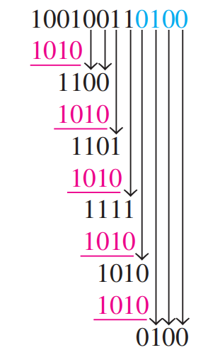
循环冗余校验码CRC
Example
CRC is 110100110100
传输错误，D’ = 100100110100
Remainder = 0100
出错

Slide 79
作业
56(b)
57(b)
中文版58
60
63
英文版
63
64
65
68
5(e)
6(e)
8(i)
14(c)
15(f)
16(e)
20
22(e)
23(d)
24(c)
25(b)
26(a)
28(c)
30(a)
34
52(g)(h)
54(h)

