Slide 1


并行程序设计
任课教师：
黄聃（Huang，Dan）

Slide 2
CUDA OPTIMIZATION, PART 1
NVIDIA Corporation

Slide 3







OUTLINE
Architecture:
  Kepler/Maxwell/Pascal/Volta
Kernel optimizations
  Launch configuration (use lots of threads)
Part 2 (next session):
  Global memory throughput (use memory efficiently)
  Shared memory access
Most concepts in this presentation apply to any language or API on NVIDIA GPUs

Slide 4
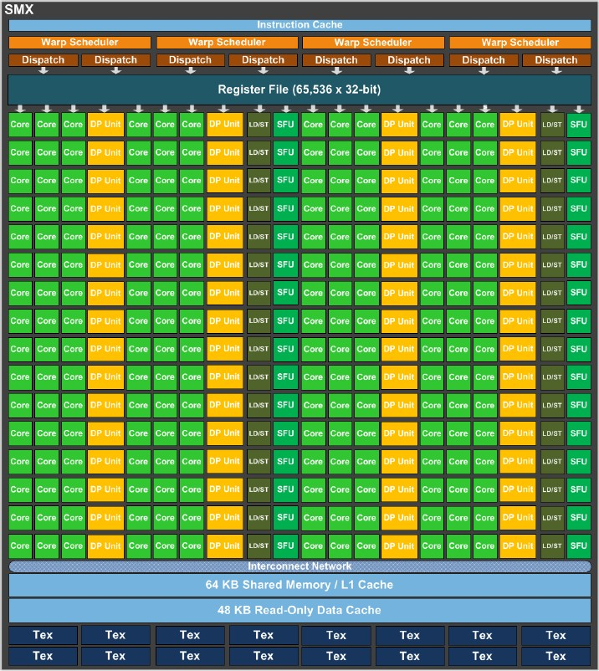
KEPLER CC 3.5 SM (GK110)
    “SMX” (enhanced SM) SIMD processor
    192 SP(single precision) units (“cores”)
    64 DP (double precision) units
    LD/ST units,
    64K registers
    4 warp scheduler
    Each warp scheduler is dual-issue capable
    K20: 13 SMX’s, 5GB
    K20X: 14 SMX’s, 6GB
    K40: 15 SMX’s, 12GB
    K80: 26 SMXs, 24 GB

Slide 5
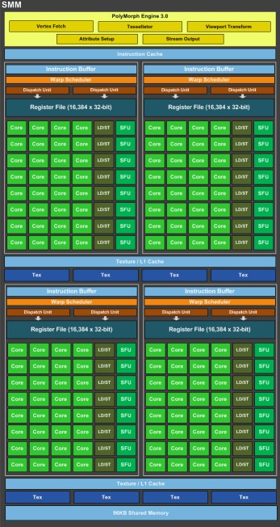
MAXWELL/PASCAL CC5.2, CC6.1 SM
    “SMM” (enhanced SM)
    128 SP units (“cores”)
    4 DP units
    LD/ST units
    cc 6.1: INT8
    4 warp schedulers
    Each warp scheduler is dual-issue capable
    M40: 24 SMM’s, 12/24GB
    P40: 30 SM’s, 24GB
    P4: 20 SM’s, 8GB

Slide 6
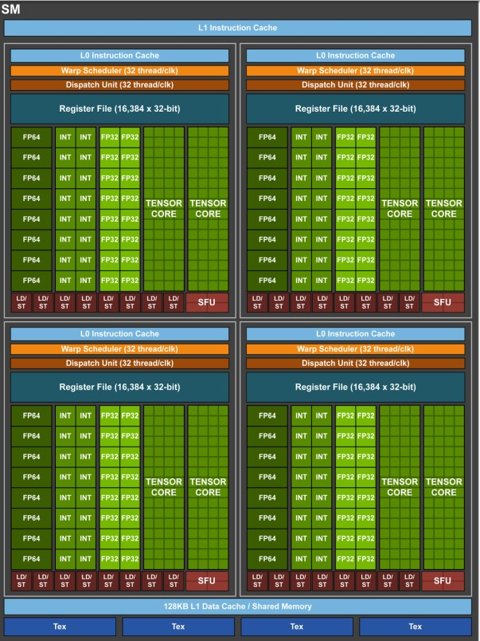
PASCAL/VOLTA CC6.0/7.0
    64 SP units (“cores”)
    32 DP units
    LD/ST units
    FP16 @ 2x SP rate
    cc7.0: TensorCore
    P100/V100 2/4 warp schedulers
    Volta adds separate int32 units
    P100: 56 SM’s, 16GB
    V100: 80 SM’s, 16/32GB

Slide 7






EXECUTION MODEL
Software
Hardware
    CUDA threads are executed by scalar processors (Lane of SIMD processor)
    Thread blocks are split to warps and executed on multiprocessors (SIMD processor) in SIMT.
    Several concurrent thread blocks can reside on one SIMD processor (when the number of thread blocks greater than multiprocessors) - limited by SIMD processor resources (shared memory and register file)
    A kernel is launched as a grid of thread blocks
Scalar Processor
CUDA Thread
Lane of SIMD processor
Thread Block
Streaming Multiprocessor
Warp
SIMD thread
SIMD processor
...
Grid
Device

Slide 8

WARPS 线程束
A thread block consists of thread warps
A warp is executed physically in parallel (SIMD) on a multiprocessor
32 CUDA Threads
...
=
32 CUDA Threads
Thread Block
32 CUDA Threads
Streaming Multiprocessor
SIMD Processor
Warps

Slide 9
LAUNCH CONFIGURATION

Slide 10
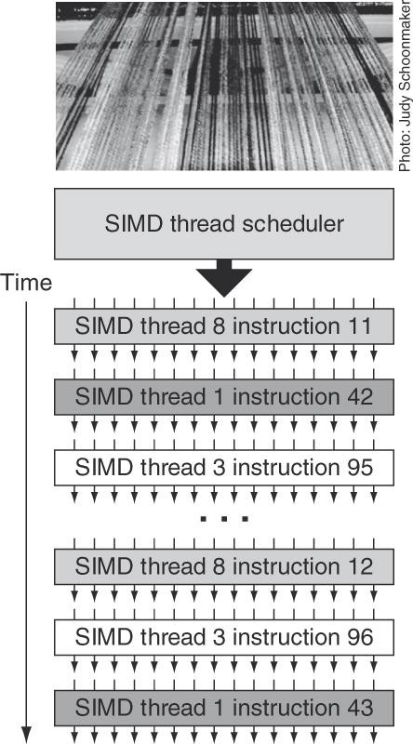
LAUNCH CONFIGURATION
Key to understanding:
  Instructions are issued in order
  A SIMD thread stalls when one of the operands isn’t ready:
    Memory read by itself doesn’t stall execution
  Latency is hidden by switching threads
    GPU MEM latency: >100 cycles e.g. 100 (varies by architecture/design)
    Arithmetic latency: <100 cycles e.g. 10 (varies by architecture/design)
How many threads/threadblocks to launch?
Conclusion:
  Need enough threads to hide latency

Slide 11
LATENCY: ANALYSIS
Suspect unhidden latency if:
  Neither memory nor instruction throughput is close to HW theoretical rates
  Poor overlap between memory access and compute instructions
Two possible causes:
  Insufficient concurrent warps per SIMD processor to hide latency
    Occupancy too low
    Too few threads in kernel launch to load the GPU
      elapsed time doesn’t change if problem size is increased (and with it the number of blocks/threads)
  Too few concurrent warps per SIMD processor when using __syncthreads()
    __syncthreads() can prevent overlap between compute and mem within the same threadblock

Slide 12


SIMPLIFIED VIEW OF LATENCY AND SYNCS
Kernel where most math cannot be executed until all data is loaded by the threadblock
Memory-only time Math-only time
Full-kernel time, one warp per SIMD processor
Full-kernel time, two warps per SIMD processor (each half the size of one large one)
time

Slide 13
GPU LATENCY HIDING
In CUDA C source code:
int idx = threadIdx.x+blockDim.x*blockIdx.x;
c[idx] = a[idx] * b[idx];
In machine code:
I0: LD R0, a[idx];
I1: LD R1, b[idx];
I2: MPY R2,R0,R1

Slide 14
GPU LATENCY HIDING – INSIDE THE SM
More warps sequentially access data elements without overlapping.
I0: LD R0, a[idx];
I1: LD R1, b[idx];
clock cycles:
C0 C1 C2 C3 C4 C5 C6 C7 C8 C9 C10 C11 C12 C13 C14 C15 C16 C17 C18 …
I2: MPY R2,R0,R1
warps
W0:
W1:
W2:
W3:
W4:
W5:
W6:
W7:
W8:
W9:
…

Slide 15
GPU LATENCY HIDING – INSIDE THE SM
I0: LD R0, a[idx];
I1: LD R1, b[idx];
clock cycles:
C0 C1 C2 C3 C4 C5 C6 C7 C8 C9 C10 C11 C12 C13 C14 C15 C16 C17 C18 …
I2: MPY R2,R0,R1
warps
W0:
W1:
W2:
W3:
W4:
W5:
W6:
W7:
W8:
W9:
…
I0 I1

Slide 16
GPU LATENCY HIDING – INSIDE THE SM
I0: LD R0, a[idx];
I1: LD R1, b[idx];
clock cycles:
C0 C1 C2 C3 C4 C5 C6 C7 C8 C9 C10 C11 C12 C13 C14 C15 C16 C17 C18 …
I2: MPY R2,R0,R1
warps
W0:
W1:
W2:
W3:
W4:
W5:
W6:
W7:
W8:
W9:
…
I0 I1

Slide 17
GPU LATENCY HIDING – INSIDE THE SM
I0: LD R0, a[idx];
I1: LD R1, b[idx];
clock cycles:
C0 C1 C2 C3 C4 C5 C6 C7 C8 C9 C10 C11 C12 C13 C14 C15 C16 C17 C18 …
I2: MPY R2,R0,R1
warps
W0:
W1:
W2:
W3:
W4:
W5:
W6:
W7:
W8:
W9:
…
I0 I1
I0

Slide 18
GPU LATENCY HIDING – INSIDE THE SM
I0: LD R0, a[idx];
I1: LD R1, b[idx];
clock cycles:
C0 C1 C2 C3 C4 C5 C6 C7 C8 C9 C10 C11 C12 C13 C14 C15 C16 C17 C18 …
I2: MPY R2,R0,R1
warps
W0:
W1:
W2:
W3:
W4:
W5:
W6:
W7:
W8:
W9:
…
I0 I1
I0
I1

Slide 19
GPU LATENCY HIDING – INSIDE THE SM
I0: LD R0, a[idx];
I1: LD R1, b[idx];
clock cycles:
C0 C1 C2 C3 C4 C5 C6 C7 C8 C9 C10 C11 C12 C13 C14 C15 C16 C17 C18 …
I2: MPY R2,R0,R1
warps
W0:
W1:
W2:
W3:
W4:
W5:
W6:
W7:
W8:
W9:
…
I0 I1
I0
I1
I0
I1

Slide 20
GPU LATENCY HIDING – INSIDE THE SM
I0: LD R0, a[idx];
I1: LD R1, b[idx];
clock cycles:
C0 C1 C2 C3 C4 C5 C6 C7 C8 C9 C10 C11 C12 C13 C14 C15 C16 C17 C18 …
I2: MPY R2,R0,R1
warps
W0:
W1:
W2:
W3:
W4:
W5:
W6:
W7:
W8:
W9:
…
I0 I1
I0
I1
I0
I1
I0
I1
I0
I1
I0
I1
I0
I1
I0
I1
I0
I1

Slide 21
GPU LATENCY HIDING – INSIDE THE SM
I0: LD R0, a[idx];
I1: LD R1, b[idx];
clock cycles:
C0 C1 C2 C3 C4 C5 C6 C7 C8 C9 C10 C11 C12 C13 C14 C15 C16 C17 C18 …
I2: MPY R2,R0,R1
warps
W0:
W1:
W2:
W3:
W4:
W5:
W6:
W7:
W8:
W9:
…
I0 I1
I0
I1
I0
I1
I0
I1
I0
I1
I0
I1
I0
I1
I0
I1
I0
I1
I0
I1

Slide 22
GPU LATENCY HIDING – INSIDE THE SM
I0: LD R0, a[idx];
I1: LD R1, b[idx];
clock cycles:
C0 C1 C2 C3 C4 C5 C6 C7 C8 C9 C10 C11 C12 C13 C14 C15 C16 C17 C18 …
I2: MPY R2,R0,R1
warps
W0:
W1:
W2:
W3:
W4:
W5:
W6:
W7:
W8:
W9:
…
I0 I1
I2
I0 I1
I0
I1
I0
I1
I0
I1
I0
I1
I0
I1
I0
I1
I0
I1
I0
I1

Slide 23
GPU LATENCY HIDING – INSIDE THE SM
I0: LD R0, a[idx];
I1: LD R1, b[idx];
clock cycles:
C0 C1 C2 C3 C4 C5 C6 C7 C8 C9 C10 C11 C12 C13 C14 C15 C16 C17 C18 …
I2: MPY R2,R0,R1
warps
W0:
W1:
W2:
W3:
W4:
W5:
W6:
W7:
W8:
W9:
…
I0 I1
I2
I0 I1
I0
I1
I2
I0
I1
I0
I1
I0
I1
I0
I1
I0
I1
I0
I1
I0
I1

Slide 24
LAUNCH CONFIGURATION
Hiding arithmetic latency:
  E.g. need ~10’s warps (~320 CUDA threads, or 10 SIMD threads) per SIMD processor
  Or, latency can also be hidden with independent instructions from the same warp
    ->if instructions never depends on the output of preceding instruction, then only 5 warps are needed, etc.
Maximizing global memory throughput:
  Depends on the access pattern, and word size
  Need enough memory transactions in flight to saturate the bus
    Independent loads and stores from the same warp
    Loads and stores from different warps
    Larger word sizes can also help (float2 is twice the transactions of float, for example)

Slide 25
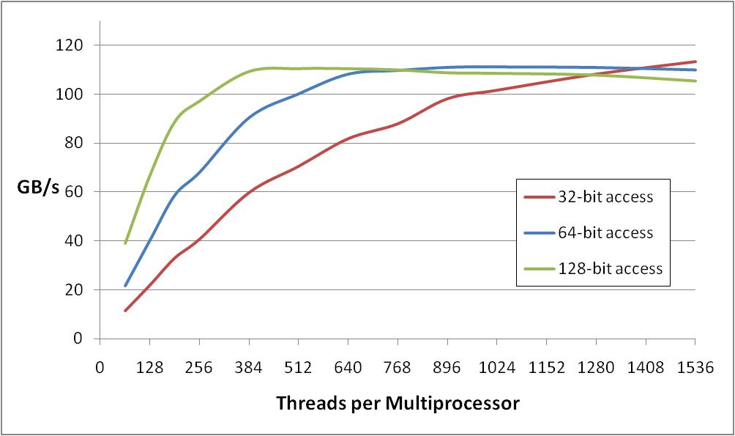
MAXIMIZING MEMORY THROUGHPUT
Increment of an array of 64M elements
Two accesses per thread (load then store) - dependent, so really 1 access per thread at a time
theoretical bandwidth: ~120 GB/s
Several independent smaller accesses have the same effect as one larger one.
For example:
Four 32-bit ~= one 128-bit

Slide 26
LAUNCH CONFIGURATION: SUMMARY
Need enough total threads to keep GPU busy
  Typically, you’d like 512+ CUDA threads per SIMD Processor
    More if processing one fp32 element per thread
  Of course, exceptions exist
Threadblock configuration
  Threads per block should be a multiple of warp size (32)
  SIMD Processor can concurrently execute at least 16 thread blocks (Maxwell/Pascal/Volta/Ampere: 32)
    Really small thread blocks prevent achieving good occupancy
    Really large thread blocks are less flexible
    Could generally use 320-512 threads/block, but use whatever is best for the application

Slide 27
ASIDE: WHAT IS OCCUPANCY?
A measure of the actual thread load in an SIMD Processor, vs. peak theoretical or peak achievable
CUDA includes an occupancy calculator spreadsheet
Achievable occupancy is affected by limiters to occupancy
Primary limiters:
  Registers per CUDA thread (can be reported by the profiler, or can get at compile time)
  CUDA Threads per threadblock
  Shared memory usage

Slide 28
SUMMARY
GPU is a massively thread-parallel, latency hiding machine
Kernel Launch Configuration:
  Launch enough threads per SM to hide latency
  Launch enough threadblocks to load the GPU
Use analysis/profiling when optimizing:
  “Analysis-driven Optimization” (future session)
  -> Nsight Compute can show you information about whether you’ve saturated the compute subsystem or the memory subsystem.

Slide 29
FUTURE SESSIONS
Fundamental Optimization, Part 2
Atomics, Reductions, Warp
Shuffle Using Managed Memory
Concurrency (streams, copy/compute overlap, multi-
GPU) Analysis Driven Optimization
Cooperative Groups

Slide 30
FURTHER STUDY
Optimization in-depth:
  http://on-demand.gputechconf.com/gtc/2013/presentations/S3466-Programming-Guidelines-GPU-Architecture.pdf
Analysis-Driven Optimization:
  http://on-demand.gputechconf.com/gtc/2012/presentations/S0514-GTC2012-GPU-Performance- Analysis.pdf
CUDA Best Practices Guide:
  https://docs.nvidia.com/cuda/cuda-c-best-practices-guide/index.html
CUDA Tuning Guides:
  https://docs.nvidia.com/cuda/index.html#programming-guides (Kepler/Maxwell/Pascal/Volta)

