Slide 1



并行程序设计
任课教师：
黄聃（Huang，Dan）

Slide 2
Roadmap
Why we need ever-increasing performance.
Why we’re building parallel systems.
Why we need to write parallel programs.
How do we write parallel programs?
What we will be doing.
Concurrent, parallel, distributed!
Notes:
Slide 2：本次汇报包括以下五方面内容，首先介绍的是研究背景

Slide 3

Changing times
From 1986 – 2002, microprocessors were speeding like a rocket, increasing in performance an average of 50% per year.
Since then, it’s dropped to about 20% increase per year.
Notes:
Slide 2：本次汇报包括以下五方面内容，首先介绍的是研究背景

Slide 4
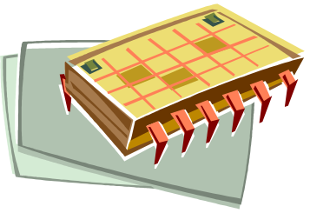
An intelligent solution
Instead of designing and building faster microprocessors, put multiple processors on a single integrated circuit.
Notes:
Slide 2：本次汇报包括以下五方面内容，首先介绍的是研究背景

Slide 5

Now it’s up to the programmers
Adding more processors doesn’t help much if programmers aren’t aware of them…
… or don’t know how to use them.
Serial programs don’t benefit from this approach (in most cases).
Notes:
Slide 2：本次汇报包括以下五方面内容，首先介绍的是研究背景

Slide 6
Why we need ever-increasing performance
Computational power is increasing, but so are our computation problems and needs.
Problems that we never dreamed of, have been solved because of past increases, such as decoding the human genome.
More complex problems are still waiting to be solved.
Notes:
Slide 2：本次汇报包括以下五方面内容，首先介绍的是研究背景

Slide 7

Climate modeling
Notes:
Slide 2：本次汇报包括以下五方面内容，首先介绍的是研究背景

Slide 8
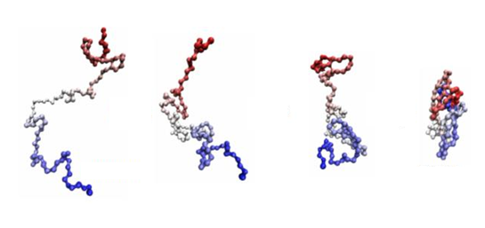
Protein folding
Notes:
Slide 2：本次汇报包括以下五方面内容，首先介绍的是研究背景

Slide 9


Drug discovery
Notes:
Slide 2：本次汇报包括以下五方面内容，首先介绍的是研究背景

Slide 10


Energy research
Notes:
Slide 2：本次汇报包括以下五方面内容，首先介绍的是研究背景

Slide 11

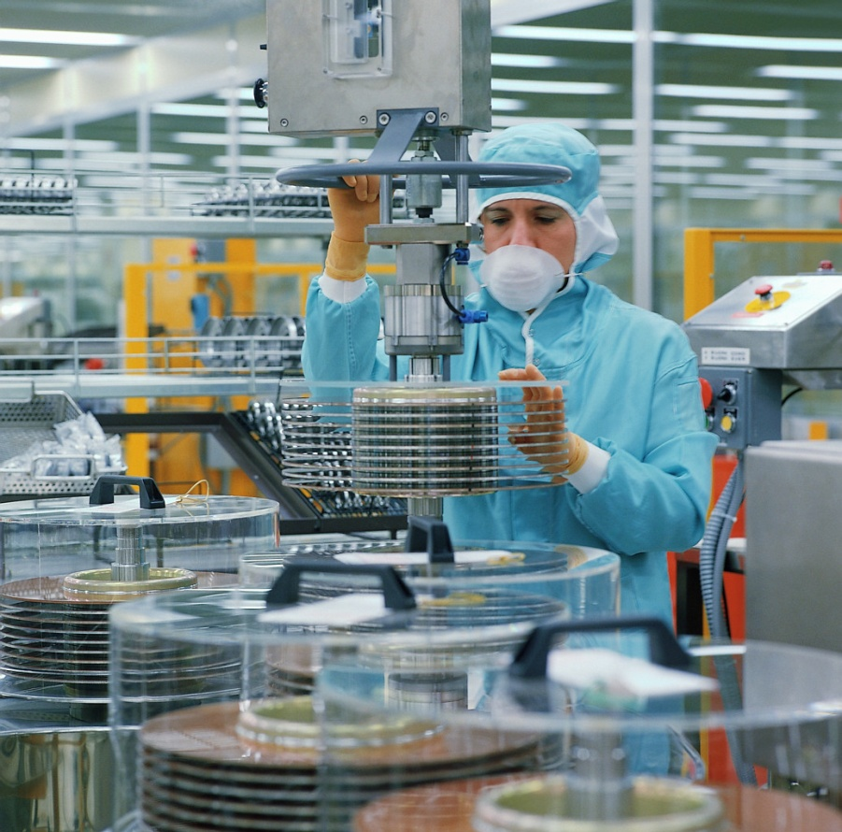

Data analysis
Notes:
Slide 2：本次汇报包括以下五方面内容，首先介绍的是研究背景

Slide 12
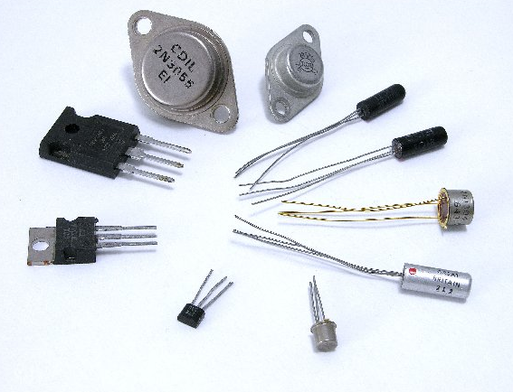
Why we’re building parallel systems
Up to now, performance increases have been attributable to increasing density of transistors.
But there are inherent problems.
Notes:
Slide 2：本次汇报包括以下五方面内容，首先介绍的是研究背景

Slide 13

A little physics lesson
Smaller transistors -> faster processors. (Dennard Scaling)
Faster processors -> increased power consumption.
Increased power consumption -> increased heat.
Increased heat -> unreliable processors.
Notes:
Slide 2：本次汇报包括以下五方面内容，首先介绍的是研究背景

Slide 14
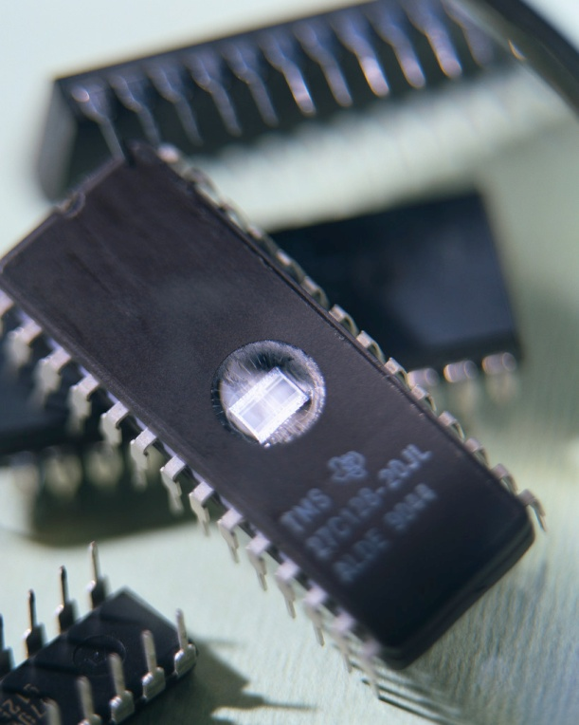
Solution
Move away from single-core systems to multicore processors.
“core” = central processing unit (CPU)
Introducing parallelism!!!
Notes:
Slide 2：本次汇报包括以下五方面内容，首先介绍的是研究背景

Slide 15

Why we need to write parallel programs
Running multiple instances of a serial program often isn’t very useful.
Think of running multiple instances of your favorite game.
What you really want is for it to run faster.
Notes:
Slide 2：本次汇报包括以下五方面内容，首先介绍的是研究背景

Slide 16
Approaches to the serial problem
Rewrite serial programs so that they’re parallel.
Write translation programs that automatically convert serial programs into parallel programs.
  This is very difficult to do.
  Success has been limited.
Notes:
Slide 2：本次汇报包括以下五方面内容，首先介绍的是研究背景

Slide 17
More problems
Some coding constructs can be recognized by an automatic program generator, and converted to a parallel construct.
However, it’s likely that the result will be a very inefficient program.
Sometimes the best parallel solution is to step back and devise an entirely new algorithm.
Notes:
Slide 2：本次汇报包括以下五方面内容，首先介绍的是研究背景

Slide 18
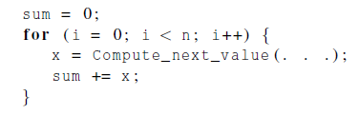
Example
Compute n values and add them together.
Serial solution:
Notes:
Slide 2：本次汇报包括以下五方面内容，首先介绍的是研究背景

Slide 19
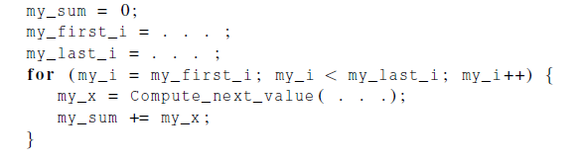
Example (cont.)
We have p cores, p much smaller than n.
Each core performs a partial sum of approximately n/p values.
Each core uses it’s own private variables
and executes this block of code
independently of the other cores.

Slide 20
Example (cont.)
After each core completes execution of the code, is a private variable my_sum contains the sum of the values computed by its calls to Compute_next_value.
Ex., 8 cores, n = 24, then the calls to Compute_next_value return:
1,4,3, 9,2,8, 5,1,1, 5,2,7, 2,5,0, 4,1,8, 6,5,1, 2,3,9
Notes:
Slide 2：本次汇报包括以下五方面内容，首先介绍的是研究背景

Slide 21
Example (cont.)
Once all the cores are done computing their private my_sum, they form a global sum by sending results to a designated “master” core which adds the final result.
Notes:
Slide 2：本次汇报包括以下五方面内容，首先介绍的是研究背景

Slide 22
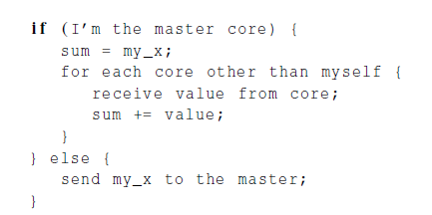
Example (cont.)
Notes:
Slide 2：本次汇报包括以下五方面内容，首先介绍的是研究背景

Slide 23
Example (cont.)
Core | 0 | 1 | 2 | 3 | 4 | 5 | 6 | 7
my_sum | 8 | 19 | 7 | 15 | 7 | 13 | 12 | 14
Global sum
8 + 19 + 7 + 15 + 7 + 13 + 12 + 14 = 95
Core | 0 | 1 | 2 | 3 | 4 | 5 | 6 | 7
my_sum | 95 | 19 | 7 | 15 | 7 | 13 | 12 | 14
Notes:
Slide 2：本次汇报包括以下五方面内容，首先介绍的是研究背景

Slide 24

Example (cont.)
But wait!
There’s a much better way
to compute the global sum.
Notes:
Slide 2：本次汇报包括以下五方面内容，首先介绍的是研究背景

Slide 25
Better parallel algorithm
Don’t make the master core do all the work.
Share it among the other cores.
Pair the cores so that core 0 adds its result with core 1’s result.
Core 2 adds its result with core 3’s result, etc.
Work with odd and even numbered pairs of cores.
Notes:
Slide 2：本次汇报包括以下五方面内容，首先介绍的是研究背景

Slide 26
Better parallel algorithm (cont.)
Repeat the process now with only the evenly ranked cores.
Core 0 adds result from core 2.
Core 4 adds the result from core 6, etc.
Now cores divisible by 4 repeat the process, and so forth, until core 0 has the final result.
Notes:
Slide 2：本次汇报包括以下五方面内容，首先介绍的是研究背景

Slide 27
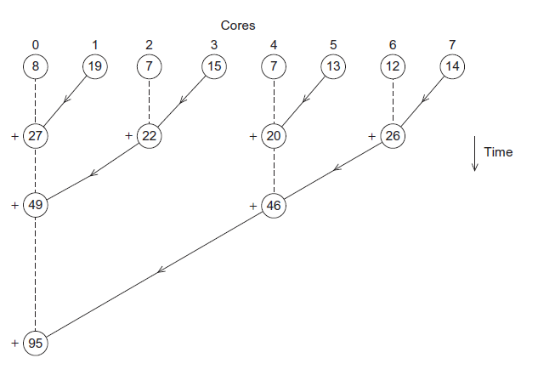
Multiple cores forming a global sum
Notes:
Slide 2：本次汇报包括以下五方面内容，首先介绍的是研究背景

Slide 28
Analysis
In the first example, the master core performs 7 receives and 7 additions.
In the second example, the master core performs 3 receives and 3 additions.
The improvement is more than a factor of 2!
Notes:
Slide 2：本次汇报包括以下五方面内容，首先介绍的是研究背景

Slide 29
Analysis (cont.)
The difference is more dramatic with a larger number of cores.
If we have 1000 cores:
  The first example would require the master to perform 999 receives and 999 additions.
  The second example would only require 10 receives and 10 additions.
That’s an improvement of almost a factor of 100!
Notes:
Slide 2：本次汇报包括以下五方面内容，首先介绍的是研究背景

Slide 30
How do we write parallel programs?
Task parallelism
  Partition various tasks carried out solving the problem among the cores.
Data parallelism
  Partition the data used in solving the problem among the cores.
  Each core carries out similar operations on it’s part of the data.
Notes:
Slide 2：本次汇报包括以下五方面内容，首先介绍的是研究背景

Slide 31


Professor P
15 questions
300 exams
Notes:
Slide 2：本次汇报包括以下五方面内容，首先介绍的是研究背景

Slide 32

Professor P’s grading assistants
Notes:
Slide 2：本次汇报包括以下五方面内容，首先介绍的是研究背景

Slide 33
Division of work – data parallelism
TA#1
TA#3
100 exams
100 exams
TA#2
100 exams
Notes:
Slide 2：本次汇报包括以下五方面内容，首先介绍的是研究背景

Slide 34

Division of work – task parallelism
TA#1
TA#3
Questions 11 - 15
Questions 1 - 5
Pipeline?
TA#2
Questions 6 - 10
Notes:
Slide 2：本次汇报包括以下五方面内容，首先介绍的是研究背景

Slide 35
Division of work – data parallelism
Notes:
Slide 2：本次汇报包括以下五方面内容，首先介绍的是研究背景

Slide 36
Division of work – task parallelism
Tasks
Receiving
Addition
Sending
Notes:
Slide 2：本次汇报包括以下五方面内容，首先介绍的是研究背景

Slide 37
Coordination and enhancement
Cores usually need to coordinate their work.
Communication – one or more cores send their current partial sums to another core.
Load balancing – share the work evenly among the cores so that one is not heavily loaded.
Synchronization – because each core works at its own pace, make sure cores do not get too far ahead of the rest.
Notes:
Slide 2：本次汇报包括以下五方面内容，首先介绍的是研究背景

Slide 38
What we will be doing
Learning to write programs that are explicitly parallel.
Using the C language.
Using three different extensions to C.
  Message-Passing Interface (MPI)
  Posix Threads (Pthreads)
  OpenMP
Notes:
Slide 2：本次汇报包括以下五方面内容，首先介绍的是研究背景

Slide 39
Type of parallel systems
Shared-memory
  The cores can share access to the computer’s memory.
  Coordinate the cores by having them examine and update shared memory locations.
Distributed-memory
  Each core has its own, private memory.
  The cores must communicate explicitly by sending messages across a network.
Notes:
Slide 2：本次汇报包括以下五方面内容，首先介绍的是研究背景

Slide 40
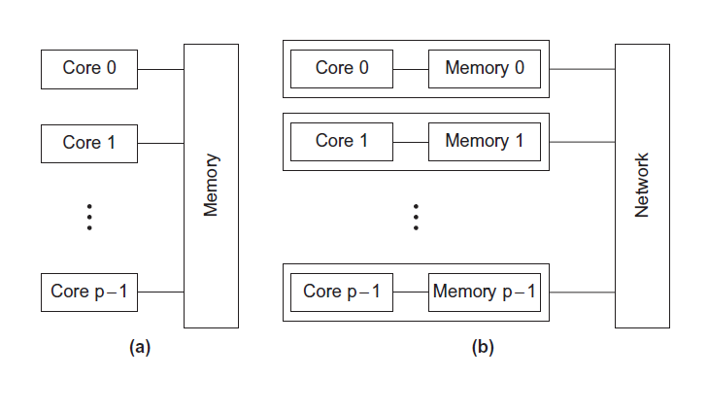
Type of parallel systems
Notes:
Slide 2：本次汇报包括以下五方面内容，首先介绍的是研究背景

Slide 41
Terminology
Concurrent computing – a program is one in which multiple tasks can be in progress at any instant.
  E.g. E-business website
Parallel computing – a program is one in which multiple tasks cooperate closely to solve a problem
  Parallel matrix multiplication solver
Distributed computing – a program may need to cooperate with other programs to solve a problem.
Notes:
Slide 2：本次汇报包括以下五方面内容，首先介绍的是研究背景

Slide 42
Concluding Remarks (1)
The laws of physics have brought us to the doorstep of multicore technology.
Serial programs typically don’t benefit from multiple cores.
Automatic parallel program generation from serial program code isn’t the most efficient approach to get high performance from multicore computers.
Notes:
Slide 2：本次汇报包括以下五方面内容，首先介绍的是研究背景

Slide 43
Concluding Remarks (2)
Learning to write parallel programs involves learning how to coordinate the cores.
Parallel programs are usually very complex and therefore, require sound program techniques and development.
Notes:
Slide 2：本次汇报包括以下五方面内容，首先介绍的是研究背景

