Slide 1



并行程序设计
任课教师：
黄聃（Huang，Dan）

Slide 2
并行硬件和软件

Slide 3
Roadmap
Some background
Modifications to the von Neumann model
Parallel hardware
Parallel software
Input and output
Performance
Parallel program design
Writing and running parallel programs
Assumptions

Slide 4

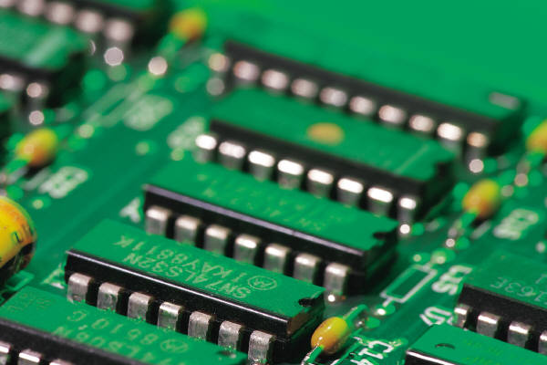

Some background

Slide 5



Serial hardware and software
programs
input
Computer runs one
program at a time.
output

Slide 6
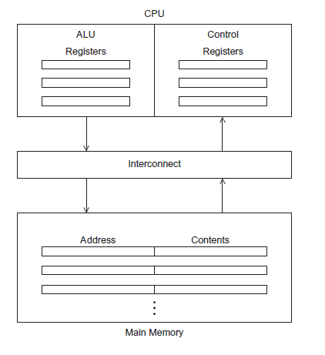
The von Neumann Architecture
冯诺依曼结构：主存、中央处理单元、以及主存和CPU之间的互连结构
冯诺依曼瓶颈：主存和CPU之间的分离带来的数据访问瓶颈
Figure 2.1

Slide 7
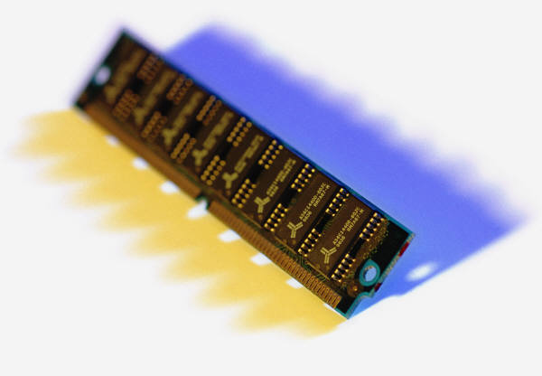
Main memory
This is a collection of locations, each of which is capable of storing both instructions and data.
Every location consists of an address, which is used to access the location, and the contents of the location.

Slide 8
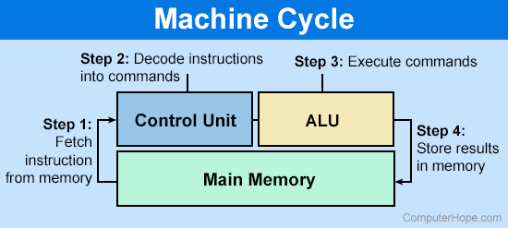
Central processing unit (CPU)
Divided into two parts.
Control unit（控制单元）-
  responsible for
  deciding which instruction in
  a program should be
  executed. (the boss)
Arithmetic and logic unit (ALU算术逻辑单元) –
  responsible for executing the actual instructions. (the worker)

Slide 9

Key terms
Register（寄存器） – very fast storage, part of the CPU.
Program counter（程序计数器） – stores address of the next instruction to be executed.
Bus （总线） – wires and hardware that connects the CPU and memory.

Slide 10
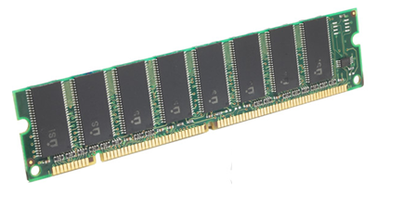

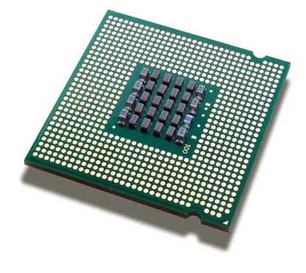
memory
fetch/read
CPU

Slide 11

memory
write/store
CPU

Slide 12




von Neumann bottleneck（冯诺依曼瓶颈）

Slide 13
An operating system “process” （进程）
An instance of a computer program that is being executed（进程是程序的一个运行着实例）.
Components of a process:
  The executable machine language program.
  A block of memory.
  Descriptors of resources the OS has allocated to the process.
  Security information.
  Information about the state of the process.

Slide 14
Multitasking （多任务）
Gives the illusion that a single processor system is running multiple programs simultaneously.
Each process takes turns running. (time slice)
After its time is up, it waits until it has a turn again. (blocks阻塞)

Slide 15
Threading（线程）
Threads are contained within processes.
They allow programmers to divide their programs into (more or less) independent tasks.
The expectation is that when one thread blocks because it is waiting on a resource, another will have work to do and can run.

Slide 16
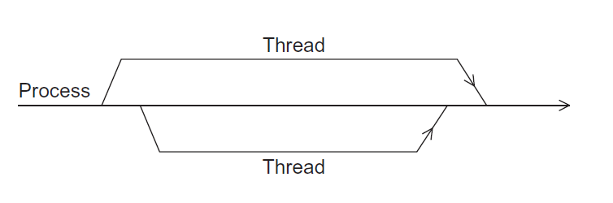
A process and two threads
the “master” thread
terminating a thread
Is called joining
starting a thread
Is called forking
Figure 2.2

Slide 17

Modifications to the von neumann model （对冯诺依曼模型的改进）

Slide 18
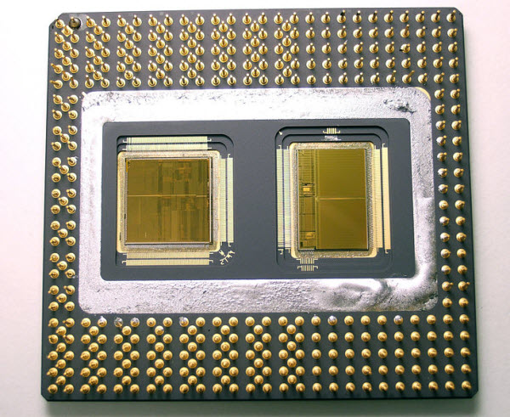
Basics of caching
A collection of memory locations that can be accessed in less time than some other memory locations.
A CPU cache is typically located on the chipset, or one that can be accessed much faster than ordinary memory.
The rectangle on the left is a CPU
The rectangle on the right is a (level 2) cache
A level 2 cache (L2 cache) is a CPU cache memory that is located outside and separate from the microprocessor chip core

Slide 19
Principle of locality（局部性）
Accessing one location is followed by an access of a nearby location.
Spatial locality 空间局部性 – accessing a nearby location.
Temporal locality 时间局部性 – accessing in the near future.

Slide 20
Principle of locality
float z[1000]; // how to store array in memory
…
sum = 0.0;
for (i = 0; i < 1000; i++)
sum += z[i];

Slide 21
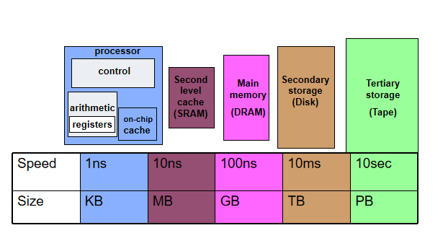
Levels of Cache

Slide 22
Cache Basics
Cache is fast (expensive) memory which keeps copy of data in main memory; hidden from software
  Simplest example: data at memory address xxxxx1101 is stored at cache address 1101
Cache hit: in-cache memory access—cheap
Cache miss: non-cached memory access—expensive
  Need to access next, slower level of cache
Cache line size: # of bytes loaded together
  E.g. cache line size is 2. If either xxxxx1100 or xxxxx1101 is loaded, both are in one cache line
Associativity
  direct-mapped: only 1 address (line) in a given range in cache
    Data from any address xxxxx1101 stored at cache block 1101
  n-way associate: n≥2 lines with different addresses can be stored
  fully associative: data to be stored in any cache address, instead of forcing each memory address, e.g. xxxxx1101, into one particular cache address.

Slide 23
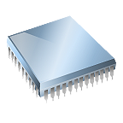
Cache hit
fetch x
L1
x sum
L2
y z total
L3
A[ ] radius r1 center

Slide 24
Cache miss
fetch x
x
main
memory
L1
y sum
L2
r1 z total
L3
A[ ] radius center

Slide 25
Issues with cache
When a CPU writes data to cache, the value in cache may be inconsistent with the value in main memory.
Write-through （写直达）caches handle this by updating the data in main memory at the time it is written to cache.
Write-back（写回） caches mark data in the cache as dirty. When the cache line is replaced by a new cache line from memory, the dirty line is written to memory.

Slide 26
Cache mappings
Full associative （全相联）– a new line can be placed at any location in the cache.
Direct mapped （直接映射）– each cache line has a unique location in the cache to which it will be assigned.
n-way set associative（n路组相联） – each cache line can be place in one of n different locations in the cache.

Slide 27

n-way set associative（n路组相联）
When more than one line in memory can be mapped to several different locations in cache we also need to be able to decide which line should be replaced or evicted（驱逐）.

Slide 28
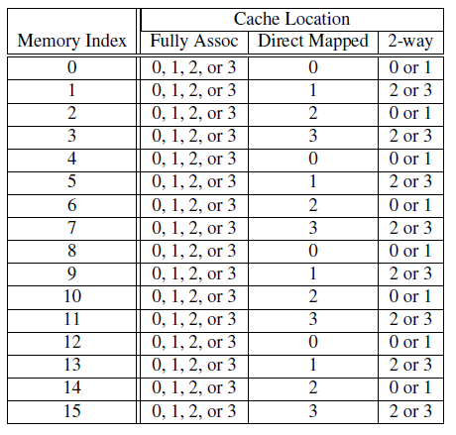
Example
Table 2.1: Assignments of a 16-line main memory to a 4-line cache

Slide 29
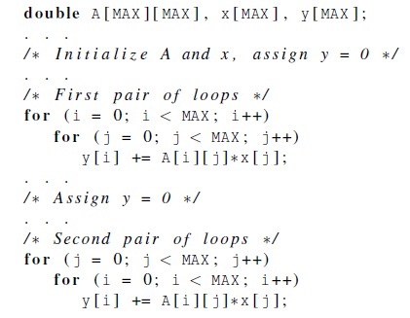
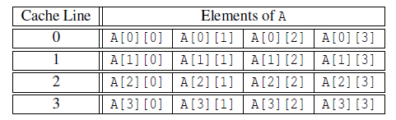
Caches and programs

Slide 30
Virtual memory 虚拟存储器 (1)
If we run a very large program or a program that accesses very large data sets, all of the instructions and data may not fit into main memory.
Virtual memory functions as a cache for secondary storage.

Slide 31
Virtual memory虚拟存储器(2)
It exploits the principle of spatial and temporal locality.
It only keeps the active parts of running programs in main memory.

Slide 32
Virtual memory (3)
Swap space 交换空间- those parts that are idle are kept in a block of secondary storage.
Pages – blocks of data and instructions.
  Usually these are relatively large.
  Most systems have a fixed page
  size that currently ranges from
  4 to 16 kilobytes.

Slide 33
Virtual memory (4)
program A
main memory
program B
program C

Slide 34
Virtual page numbers（虚拟页号）
When a program is compiled its pages are assigned virtual page numbers.
When the program is run, a table is created that maps the virtual page numbers to physical addresses.
A page table is used to translate the virtual address into a physical address.

Slide 35
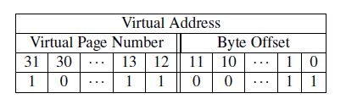
Page table
Table 2.2: Virtual Address Divided into Virtual Page Number and Byte Offset

Slide 36
Translation-lookaside buffer (TLB)
Using a page table has the potential to significantly increase each program’s overall run-time.
A special address translation cache in the processor.

Slide 37
Translation-lookaside buffer (2)
It caches a small number of entries (typically 16–512) from the page table in very fast memory.
Page fault 页面失效– attempting to access a valid physical address for a page in the page table but the page is only stored on disk.

Slide 38
Instruction Level Parallelism (ILP)
指令级并行

Slide 39
Instruction Level Parallelism (ILP)
Attempts to improve processor performance by having multiple processor components or functional units 功能单元 simultaneously executing instructions.

Slide 40
Instruction Level Parallelism (2)
Pipelining 流水线 - functional units are arranged in stages.
Multiple issue 多发射 - multiple instructions can be simultaneously initiated.

Slide 41
Pipelining
Instruction
Fetch
Instr. Decode
Reg. Fetch
Execute
Addr. Calc
Memory
Access
Write
Back
Next PC
IF/ID
ID/EX
EX/MEM
MUX
MEM/WB
Next SEQ PC
Next SEQ PC
Adder
4
Zero?
RS1
Reg File
Address
MUX
Memory
RS2
ALU
Data
Memory
MUX
MUX
Sign
Extend
Imm
WB Data
RD
RD
RD
Pipelining is also used within arithmetic units
  a fp multiply may have latency 10 cycles, but throughput of 1/cycle

Slide 42
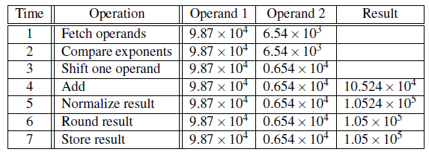
Pipelining example (1)
Add the floating point numbers 9.87×10⁴ and 6.54×10³

Slide 43

Pipelining example (2)
Assume each operation takes one nanosecond (10⁻⁹ seconds).
This for loop takes about 7000 nanoseconds.

Slide 44
Pipelining (3)
Divide the floating point adder into 7 separate pieces of hardware or functional units.
First unit fetches two operands, second unit compares exponents, etc.
Output of one functional unit is input to the next.

Slide 45
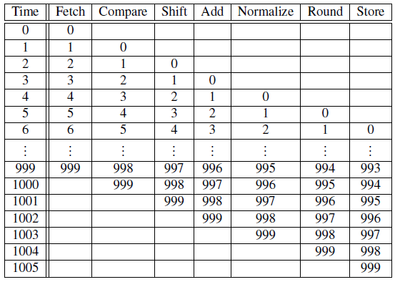
Pipelining (4)
Table 2.3: Pipelined Addition.
Numbers in the table are subscripts of operands/results.

Slide 46

Pipelining (5)
One floating point addition still takes
7 nanoseconds.
But 1000 floating point additions
now takes 1006 nanoseconds!

Slide 47
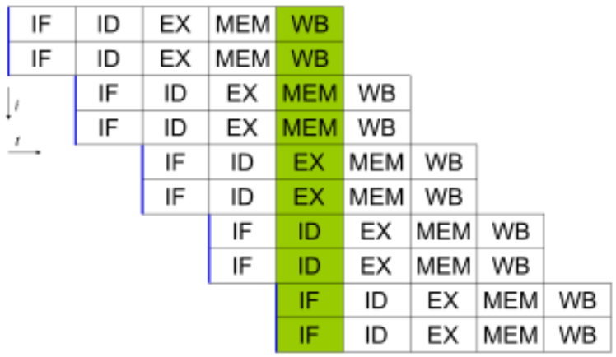
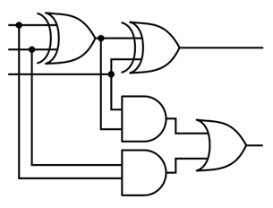
Multiple Issue (1)
Multiple issue processors replicate functional units and try to simultaneously execute different instructions in a program.
for (i = 0; i < 1000; i++)
z[i] = x[i] + y[i];
z[3]
z[4]
How to implement it?
By compiler?
Or by hardware?
z[1]
z[2]
adder #1
adder #2

Slide 48
Multiple Issue (2)
static multiple issue - functional units are scheduled at compile time.
dynamic multiple issue – functional units are scheduled at run-time.
Superscalar超标量

Slide 49

Speculation (1)
In order to make use of multiple issue, the system must find instructions that can be executed simultaneously.
In speculation, the compiler or the processor makes a guess about an instruction, and then executes the instruction on the basis of the guess.

Slide 50

Speculation (2)
z = x + y ;
if ( z > 0)
w = x ;
else
w = y ;
Z will be
positive
If the system speculates incorrectly,
it must go back and recalculate w = y.

Slide 51
Hardware multithreading 硬件多线程(1)
指令级并行很难利用，因为程序中有许多部分之间存在依赖关系 There aren’t always good opportunities for simultaneous execution of different threads
Hardware multithreading provides a means for systems to continue doing useful work when the task being currently executed has stalled.
  Ex., the current task has to wait for data to be loaded from memory.

Slide 52
Hardware multithreading (2)
Fine-grained 细粒度- the processor switches between threads after each instruction, skipping threads that are stalled.
  Pros: potential to avoid wasted machine time due to stalls.
  Cons: a thread that’s ready to execute a long sequence of instructions may have to wait to execute every instruction.

Slide 53
Hardware multithreading (3)
Coarse-grained 粗粒度 - only switches threads that are stalled waiting for a time-consuming operation to complete.
  Pros: switching threads doesn’t need to be nearly instantaneous.
  Cons: the processor can be idled on shorter stalls, and thread switching will also cause delays.

Slide 54
Hardware multithreading (3)
Simultaneous multithreading 同步多线程(SMT) - a variation on fine-grained multithreading.
Allows multiple threads to make use of the multiple functional units.
  More registers and functional units for thread states of multiple concurrent threads.
Issue multiple instructions from multiple threads in one cycle. The processor must be superscalar to do so.

Slide 55
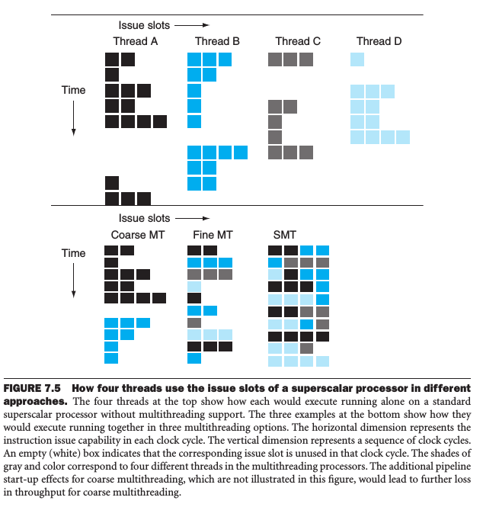

Slide 56
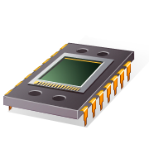
A programmer can write code to exploit.
Parallel hardware

Slide 57
Flynn’s Taxonomy
classic von Neumann
SISD
Single instruction stream
Single data stream
(SIMD)
Single instruction stream
Multiple data stream
MISD
Multiple instruction stream
Single data stream
(MIMD)
Multiple instruction stream
Multiple data stream
not covered

Slide 58
SIMD
Parallelism achieved by dividing data among the processors.
Applies the same instruction to multiple data items.
Called data parallelism.

Slide 59
SIMD example
n data items
n ALUs
control unit
…
x[1]
x[2]
x[n]
ALU₁
ALU₂
ALU_{n}
for (i = 0; i < n; i++)
x[i] += y[i];

Slide 60
SIMD
What if we don’t have as many ALUs as data items?
Divide the work and process iteratively.
Ex. m = 4 ALUs and n = 15 data items.
Round3 | ALU₁ | ALU₂ | ALU₃ | ALU₄
1 | X[0] | X[1] | X[2] | X[3]
2 | X[4] | X[5] | X[6] | X[7]
3 | X[8] | X[9] | X[10] | X[11]
4 | X[12] | X[13] | X[14]

Slide 61
SIMD drawbacks
All ALUs are required to execute the same instruction, or remain idle.
In classic design, they must also operate synchronously.
The ALUs have no instruction storage.
Efficient for large data parallel problems, but not other types of more complex parallel problems.

Slide 62
Vector processors 向量处理器 (1)
Operate on arrays or vectors of data while conventional CPU’s operate on individual data elements or scalars.
Vector registers 向量寄存器.
  Capable of storing a vector of operands and operating simultaneously on their contents.

Slide 63
Vector processors (2)
Vectorized and pipelined functional units.
  The same operation is applied to each element in the vector (or pairs of elements).
Vector instructions 向量指令.
  Operate on vectors rather than scalars.

Slide 64
Vector processors (3)
Interleaved memory 交叉存储器.
  Multiple “banks” of memory 内存体, which can be accessed more or less independently.
  Distribute elements of a vector across multiple banks, so reduce or eliminate delay in loading/storing successive elements.
Strided memory access and hardware scatter/gather.
  The program accesses elements of a vector located at fixed intervals.

Slide 65

Vector processors - Pros
Fast.
Easy to use.
Vectorizing compilers are good at identifying code to exploit.
Compilers also can provide information about code that cannot be vectorized.
  Helps the programmer re-evaluate code.
High memory bandwidth.
Uses every item in a cache line.

Slide 66

Vector processors - Cons
They don’t handle irregular
data structures as well as other
parallel architectures.
A very finite limit to their ability to handle ever larger problems. (scalability)

Slide 67

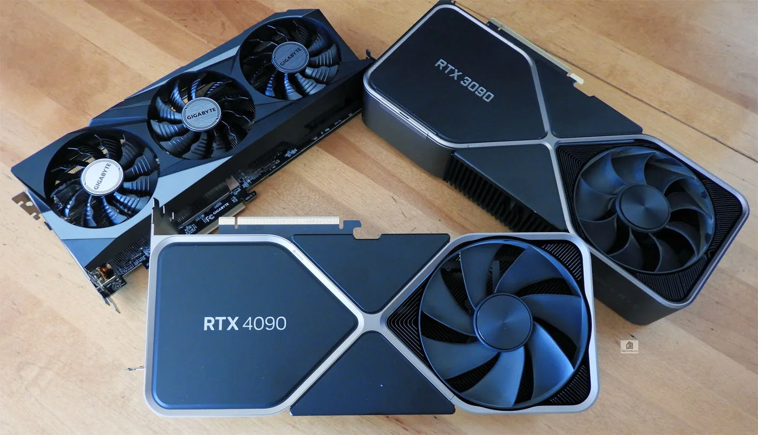
Graphics Processing Units (GPU)
Real time graphics application programming interfaces or API’s use points, lines, and triangles to internally represent the surface of an object.

Slide 68

GPUs
A graphics processing pipeline converts the internal representation into an array of pixels that can be sent to a computer screen.
Several stages of this pipeline
(called shader functions) are programmable.
  Typically just a few lines of C code.

Slide 69
GPUs
Functions are also implicitly parallel, since they can be applied to multiple elements in the graphics stream.
GPUs can often optimize performance by using SIMD parallelism.

Slide 70
Summary
Instruction
Fetch
Instr. Decode
Reg. Fetch
Execute
Addr. Calc
Memory
Access
Write
Back
Next PC
IF/ID
Next SEQ PC
ID/EX
Next SEQ PC
EX/MEM
MUX
MEM/WB
Adder
4
RS1
Zero?
Address
Memory
RS2
Reg File
MUX
Data
Memory
Speculation
ALU
MUX
Out of order
execution
MUX
Sign
Extend
Control
Unit
Instruction
Buffer
Imm
WB Data
Vector
instruction
RD
RD
RD
Reg File
Data
Memory
Reg File
Instruction
Fetch
Instr. Decode
Reg. Fetch
Execute
Addr. Calc
Memory
Access
Write
Back
Pipeline
Next PC
IF/ID
Next SEQ PC
ID/EX
Next SEQ PC
EX/MEM
MUX
MEM/WB
Multiple issue
Adder
ALU
Multithreading:
Coarse-grained,
Fine-grained,
SMT
4
RS1
Zero?
Address
Memory
RS2
Reg File
MUX
Data
Memory
MUX
ALU
MUX
Sign
Extend
Imm
WB Data
RD
RD
RD

Slide 71
MIMD
Supports multiple simultaneous instruction streams operating on multiple data streams.
Typically consist of a collection of fully independent processing units or cores, each of which has its own control unit and its own ALU.

Slide 72
Shared Memory System (1)
A collection of autonomous processors is connected to a memory system via an interconnection network.
Each processor can access each memory location.
The processors usually communicate implicitly by accessing shared data structures.

Slide 73
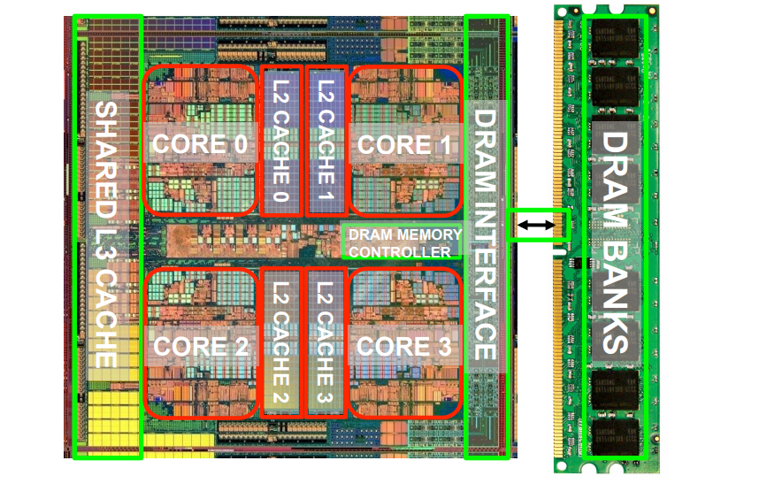
Shared Memory System (2)
Most widely available shared memory systems use one or more multicore processors.
  (multiple CPU’s or cores on a single chip)

Slide 74
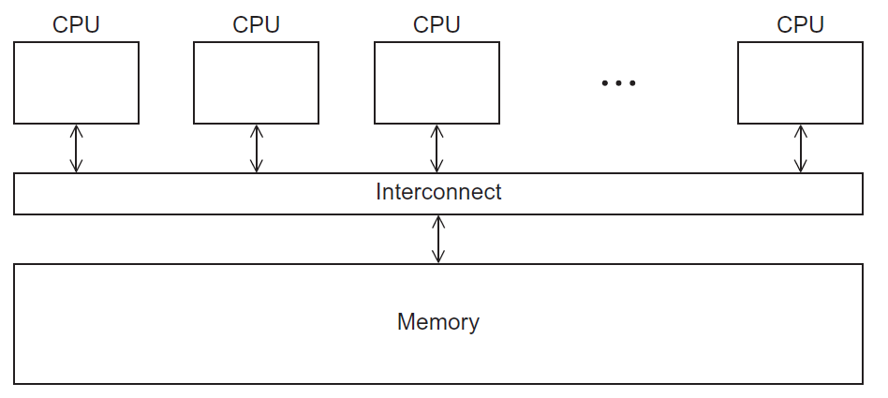
Shared Memory System
Figure 2.3

Slide 75
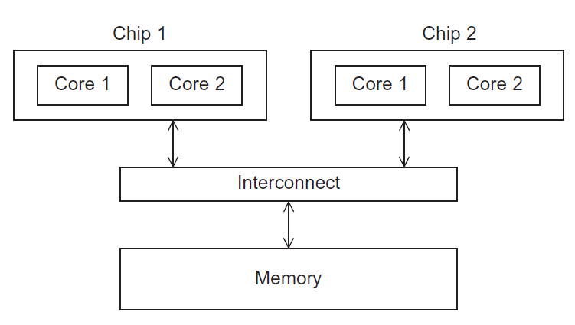
UMA一致内存访问 multicore system
Time to access all
the memory locations
will be the same for
all the cores.
Figure 2.5

Slide 76
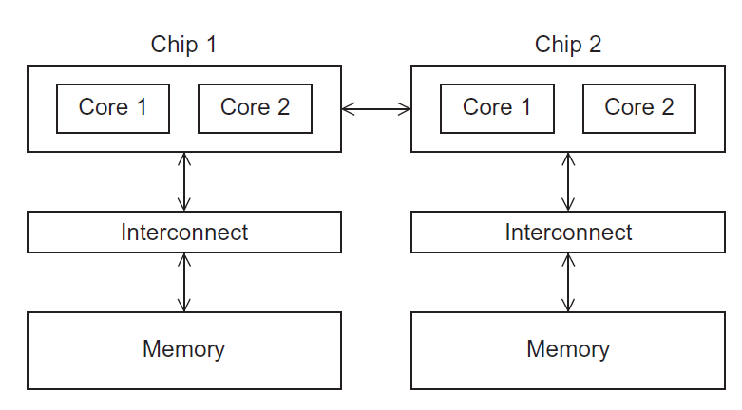
NUMA multicore system
A memory location a core is directly connected to can be accessed faster than a memory location that must be accessed through another chip.

Slide 77
Distributed Memory System
Clusters (most popular)
  A collection of commodity systems.
  Connected by a commodity interconnection network.
Nodes of a cluster are individual computations units joined by a communication network.
Data exchanged through messages
  HPC cluster using MPI
  Hadoop or Spark Cluster
  Special purpose clusters (e.g. WebTier , database)
Networks
  Ethernet, Infiniband , Intel Omnipath
  Many topologies possible (common in cloud data center is Fat tree)
a.k.a. hybrid systems

Slide 78
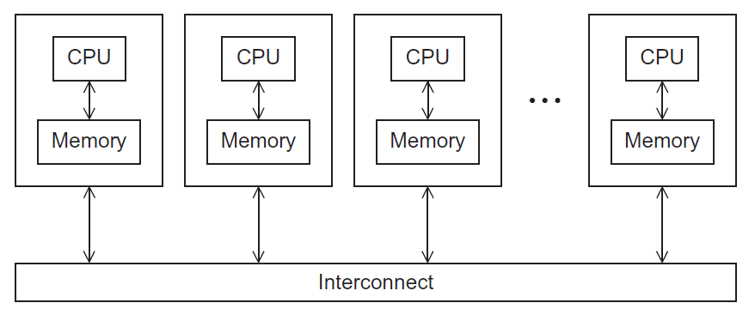
Distributed Memory System
Figure 2.4

Slide 79
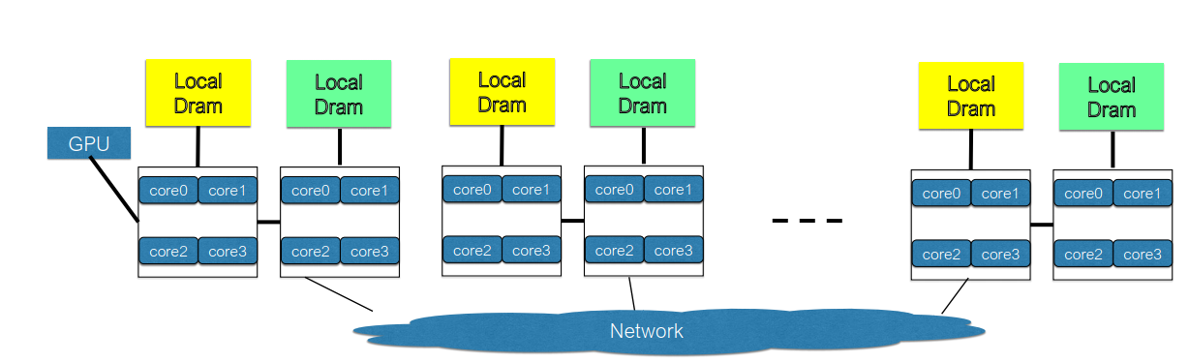
Hybrid
Most all clusters today are mixture of both shared memory and distributed memory
  Very common to use 2 socket server nodes connected by high speed network
Local (intra server) communication can be done with shared memory

Slide 80
Interconnection networks 互连网络
Affects performance of both distributed and shared memory systems.
Two categories:
  Shared memory interconnects
  Distributed memory interconnects

Slide 81
Shared memory interconnects
Bus interconnect
  A collection of parallel communication wires together with some hardware that controls access to the bus.
  Communication wires are shared by the devices that are connected to it.
  As the number of devices connected to the bus increases, contention for use of the bus increases, and performance decreases.

Slide 82
Shared memory interconnects
Switched interconnect
  Uses switches to control the routing of data among the connected devices.
  Crossbar 交叉开关矩阵 –
    Allows simultaneous communication among different devices.
    Faster than buses.
    But the cost of the switches and links is relatively high.

Slide 83
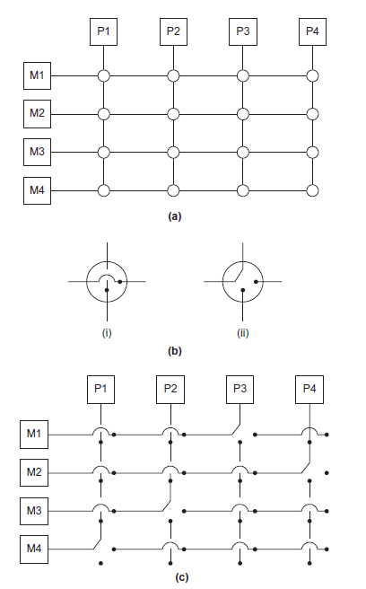
Figure 2.7
(a)
A crossbar switch connecting 4 processors (Pi) and 4 memory modules (Mj)
(b)
Configuration of internal switches in a crossbar
(c) Simultaneous memory accesses by the processors
Figure 2.7

Slide 84
Distributed memory interconnects
Two groups
  Direct interconnect 直接互连
    Each switch is directly connected to a computing node and the switches are connected to each other.
  Indirect interconnect 间接互连
    Switches may not be directly connected to a computing node.

Slide 85
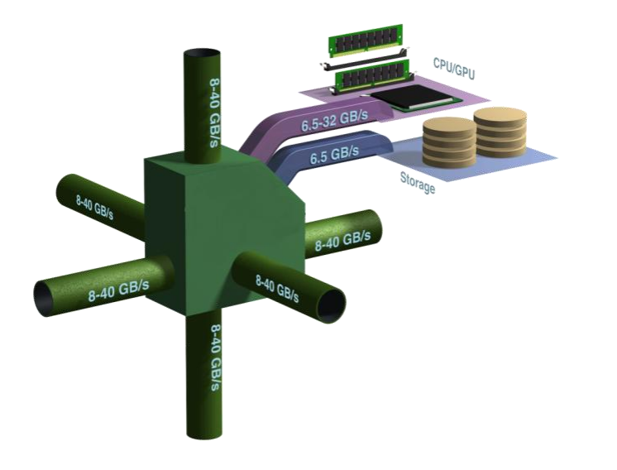
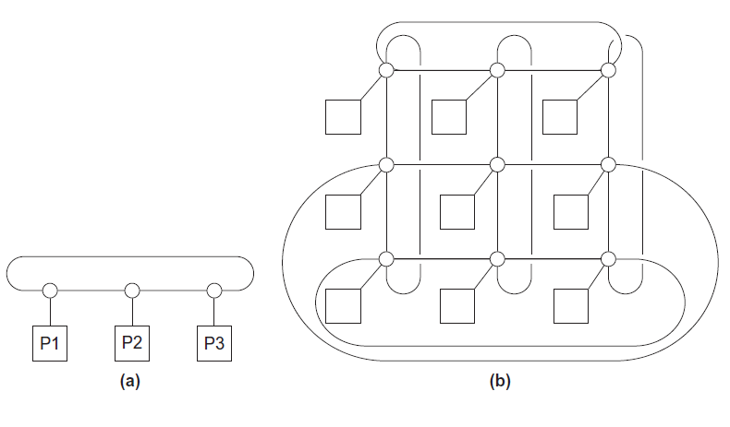
Direct interconnect
ring
toroidal mesh

Slide 86

Bisection width （等分宽度）
A measure of “number of simultaneous communications” or “connectivity”.
How many simultaneous communications can take place “across the divide” between the halves?
Bisection width is defined by the worst case

Slide 87
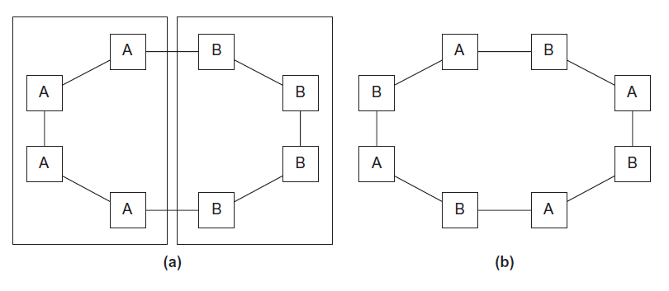
Two bisections of a ring
Figure 2.9

Slide 88
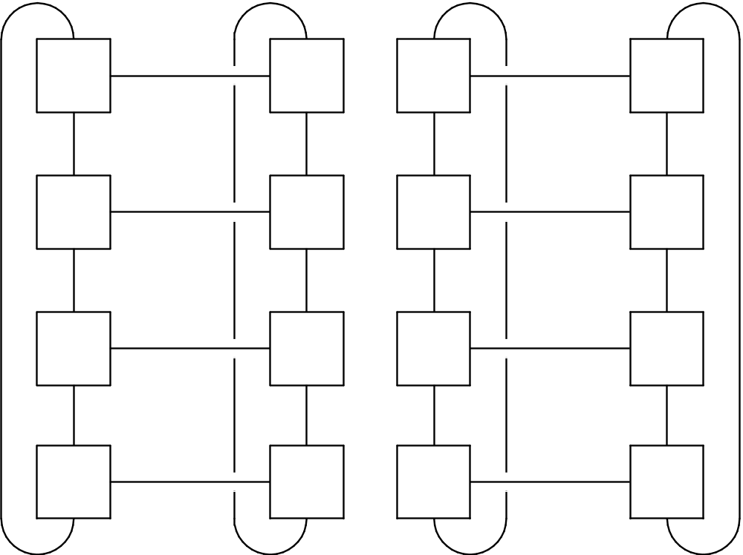
A bisection of a toroidal mesh
Figure 2.10

Slide 89
Definitions
Bandwidth （Bytes/s）
  The rate at which a link can transmit data.
  Usually given in megabits or megabytes per second.
Bisection bandwidth
  A measure of network quality.
  Instead of counting the number of links joining the halves, it sums the bandwidth of the links.

Slide 90
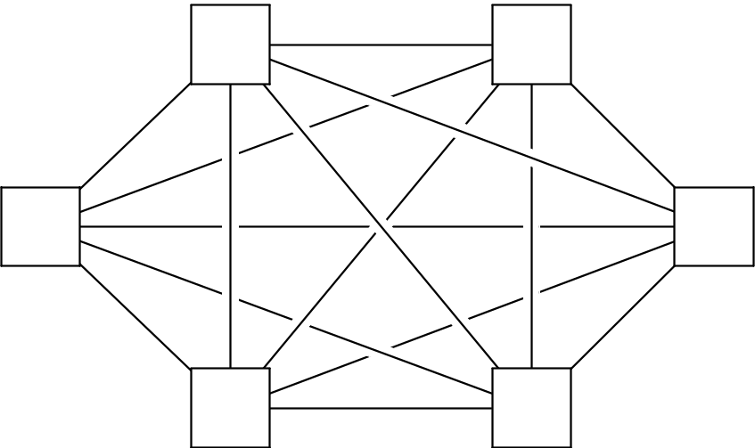
Fully connected network
Each switch is directly connected to every other switch.
impractical
bisection width = p²/4
Figure 2.11

Slide 91
Hypercube 超立方体
  Highly connected direct interconnect.
    每个交换机（switch）与一个处理器和d个交换机（switch）直接相连（d维超立方体）
Built inductively:
  A one-dimensional hypercube is a fully-connected system with two processors.
  A two-dimensional hypercube is built from two one-dimensional hypercubes by joining “corresponding” switches.
  Similarly a three-dimensional hypercube is built from two two-dimensional hypercubes.

Slide 92
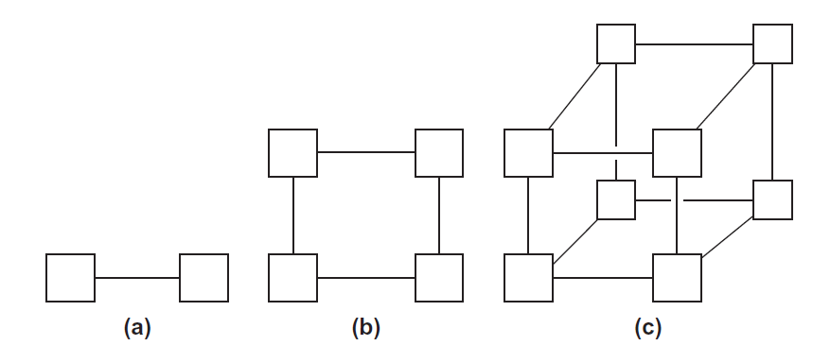
Hypercubes
Figure 2.12
one-
two-
three-dimensional

Slide 93
Indirect interconnects
Simple examples of indirect networks:
  Crossbar
  Omega network
  Fat-tree network
  Dragonfly
Often shown with unidirectional links and a collection of processors, each of which has an outgoing and an incoming link, and a switching network.

Slide 94
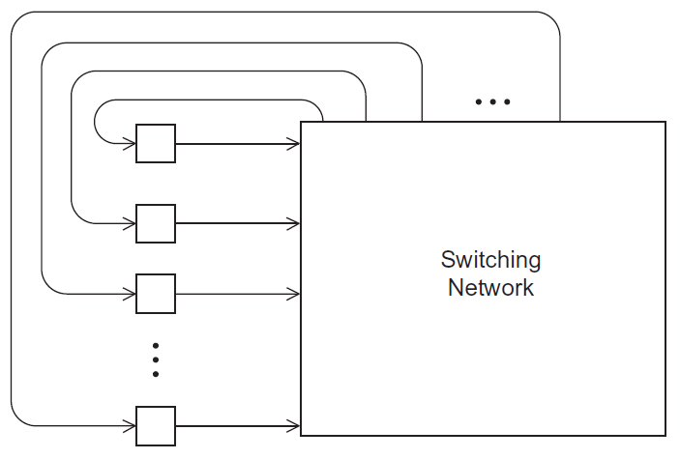
A generic indirect network
Figure 2.13

Slide 95
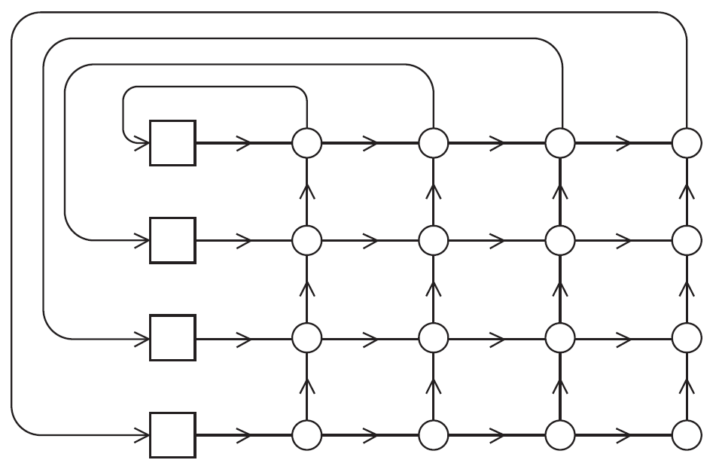
Crossbar interconnect for distributed memory
Figure 2.14

Slide 96
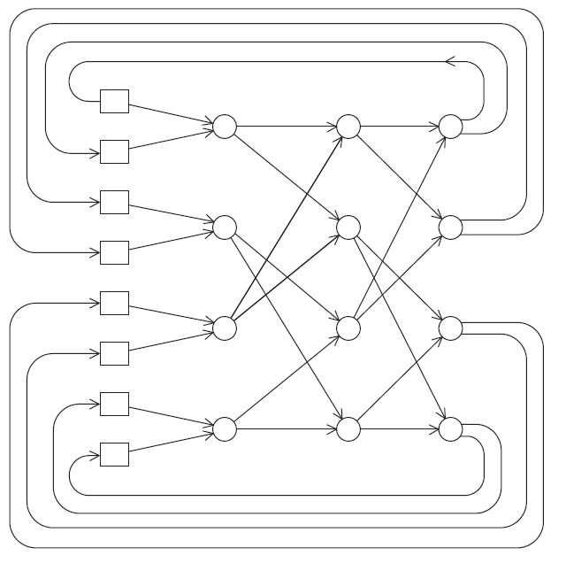
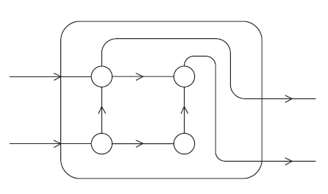
An omega network
0
6
A switch in an omega network
7

Slide 97
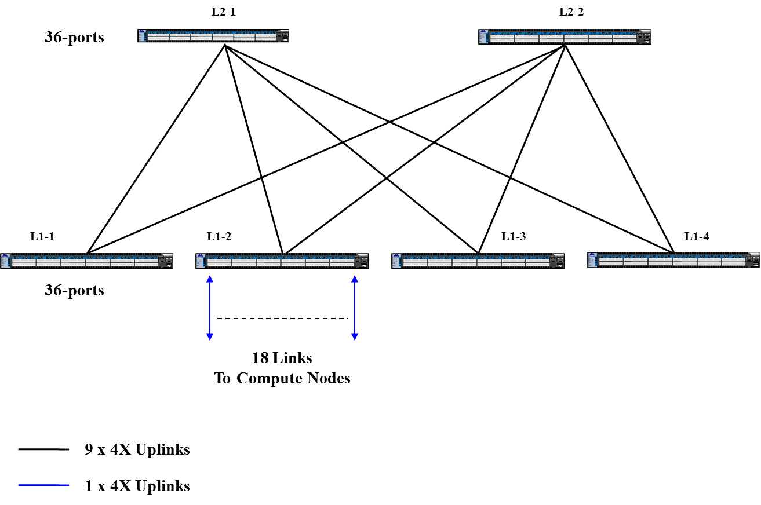
A fat-tree network
Hierarchical tree-based topology
Links near the root have a higher bandwidth

Slide 98
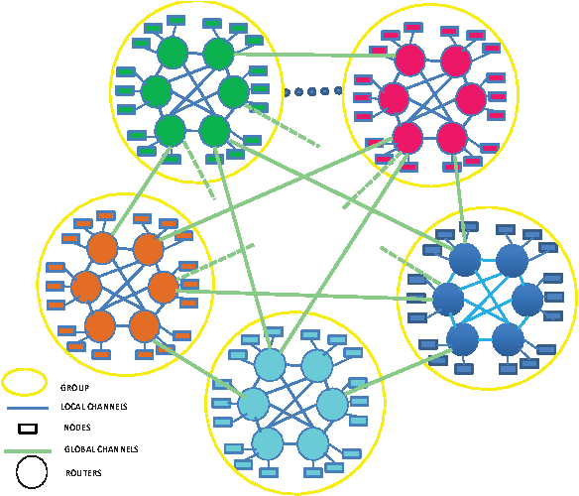
A dragonfly network
The dragonfly topology is mostly used within Cray systems.
A number of switch groups, a direct one-to-one connection between each group.
In a group, switches are connected via a common topology like torus or fat tree

Slide 99

HPC interconnect technologies
Ethernet: 10/100 Mbps – 100 Gbps
  Early versions used shared-medium coaxial cable
  Newer versions use twisted pair or fiber optic with hubs or switches
InfiniBand (IB): 24-300 Gbps w/ 0.5μs latency
  Packet-based switched fabric (bus, fat tree, or mesh/torus)
  Very loose API; more formal spec provided by OpenFabrics Alliance
  Used on many current high-performance clusters
  Vendors: Mellanox, Intel, and Oracle
OmniPath (Intel) or Aries / Slingshot (Cray)
  Proprietary interconnects for HPC machines
TH Express-2主干拓扑结构网络连接（天河二号）

Slide 100
More definitions
Any time data is transmitted, we’re interested in how long it will take for the data to reach its destination.
Latency
  The time that elapses between the source’s beginning to transmit the data and the destination’s starting to receive the first byte.
Bandwidth
  The rate at which the destination receives data after it has started to receive the first byte.

Slide 101
Message transmission time = l + n / b
latency (seconds)
length of message (bytes)
bandwidth (bytes per second)

Slide 102
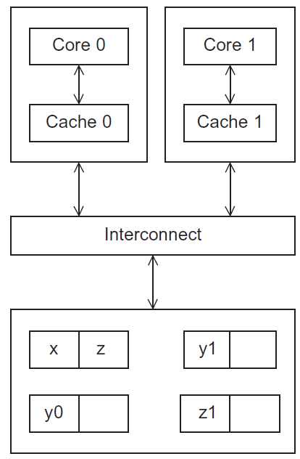
Cache coherence
Programmers have no
control over caches
and when they get updated.
Figure 2.17
A shared memory system with two cores and two caches

Slide 103
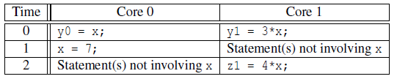
Cache coherence
y0 privately owned by Core 0
y1 and z1 privately owned by Core 1
x = 2; /* shared variable */
y0 eventually ends up = 2
z1 = ???

Slide 104
Snooping Cache Coherence
The cores share a bus .
Any signal transmitted on the bus can be “seen” by all cores connected to the bus.
When core 0 updates the copy of x stored in its cache it also broadcasts this information across the bus.
If core 1 is “snooping” the bus, it will see that x has been updated and it can mark its copy of x as invalid.
Snooping is high cost in multi-core or many-core CPU

Slide 105
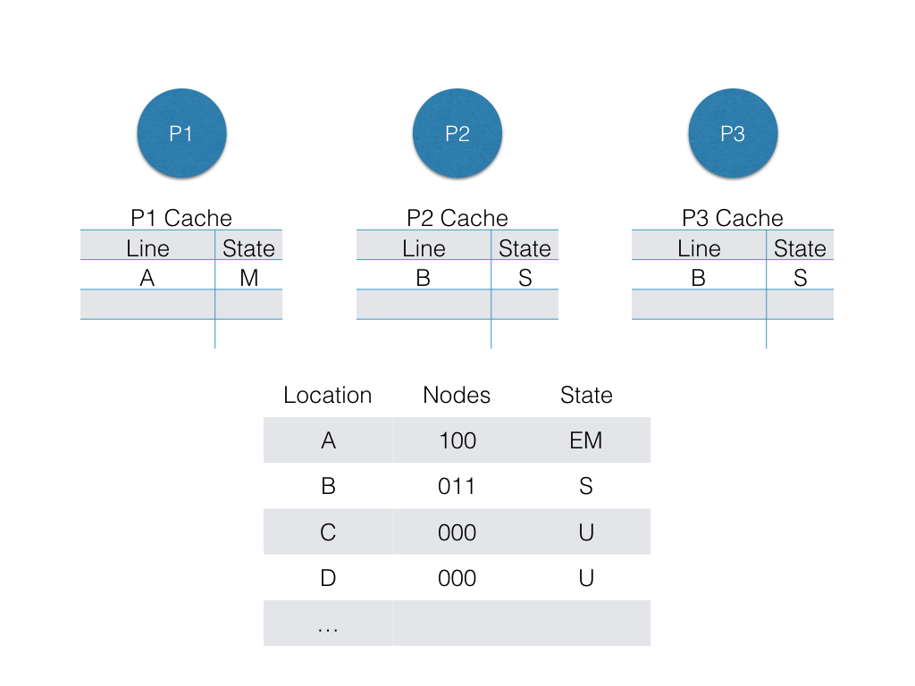
Directory Based Cache Coherence
Uses a data structure called a directory that stores the status of each cache line.
  In a directory based scheme, participating caches do not broadcast requests to all other sharing caches of the block in order to locate cached copies
  Instead it queries the directory to retrieve the information about which block have cached copies and sends only to those particular processors and hence traffic saving compared to a snoopy protocol is large.
Diagram of full bit vector directory format, where E=Exclusive, S=Shared, M=Modified, and U=Uncached

Slide 106

Parallel software

Slide 107
The burden is on software
从硬件到软件，我们需要注意什么？
Hardware and compilers can keep up the pace needed.
From now on…
  In shared memory programs:
    Start a single process and fork threads.
    Threads carry out tasks.
  In distributed memory programs:
    Start multiple processes.
    Processes carry out tasks.

Slide 108
SPMD – single program multiple data
A SPMD programs consists of a single executable that can behave as if it were multiple different programs through the use of conditional branches.
if (I’m thread process i)
do this;
else
do that;

Slide 109
Writing Parallel Programs
Divide the work among the
processes/threads
  so each process/thread
  gets roughly the same
  amount of work
  and communication is
  minimized.
Arrange for the processes/threads to synchronize.
Arrange for communication among processes/threads.
double x[n], y[n];
…
for (i = 0; i < n; i++)
x[i] += y[i];

Slide 110
Shared Memory
Dynamic threads
  Master thread waits for work, forks new threads, and when threads are done, they terminate
  Efficient use of resources, but thread creation and termination is time consuming.
Static threads
  Pool of threads created and are allocated work, but do not terminate until cleanup.
  Better performance, but potential waste of system resources.
Suppose that a system pursuing extremely high throughput and low latency services, which mode it should select?

Slide 111

Nondeterminism 非确定性
. . .
printf ( "Thread %d > my_val = %d\n" ,
my_tid , my_x ) ;
. . .
Thread 0 > my_val = 7
Thread 1 > my_val = 19
Thread 1 > my_val = 19
Thread 0 > my_val = 7

Slide 112
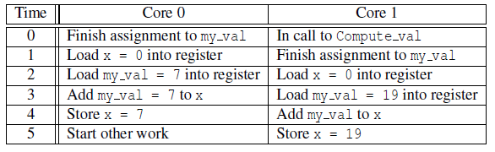
Nondeterminism
my_val = Compute_val ( my_rank ) ;
x += my_val ; // x is global variable

Slide 113
Nondeterminism
Race condition
Critical section
Mutually exclusive
Mutual exclusion lock (mutex, or simply lock)
my_val = Compute_val ( my_rank ) ;
Lock(&add_my_val_lock ) ;
x += my_val ;
Unlock(&add_my_val_lock ) ;

Slide 114
busy-waiting 忙等待
my_val = Compute_val ( my_rank ) ;
i f ( my_rank == 1)
whi l e ( ! ok_for_1 ) ; /* Busy−wait loop */
x += my_val ; /* Critical section */
i f ( my_rank == 0)
ok_for_1 = true ; /* Let thread 1 update x */

Slide 115
message-passing 消息传递
char message [ 1 0 0 ] ;
. . .
my_rank = Get_rank ( ) ;
i f ( my_rank == 1) {
sprintf ( message , "Greetings from process 1" ) ;
Send ( message , MSG_CHAR , 100 , 0 ) ;
} e l s e i f ( my_rank == 0) {
Receive ( message , MSG_CHAR , 100 , 1 ) ;
printf ( "Process 0 > Received: %s\n" , message ) ;
}

Slide 116
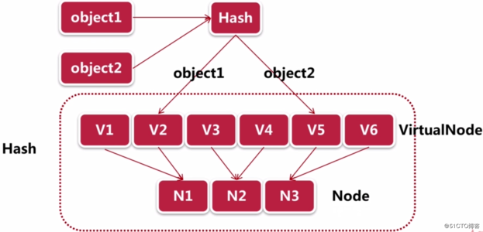
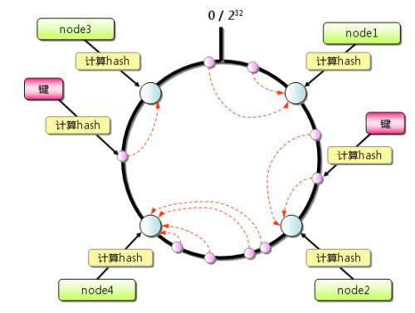
Partitioned Global Address Space Languages
shared i n t n = . . . ;
shared double x [ n ] , y [ n ] ;
private int i , my_first_element , my_last_element ;
my_first_element = . . . ;
my_last_element = . . . ;
/ * Initialize x and y */
. . .
f o r ( i = my_first_element ; i <= my_last_element ; i++)
x [ i ] += y [ i ] ;
Distributed Hash Table: Amazon DynamoDB

Slide 117
Input and Output
In distributed memory programs, only process 0 will access stdin. In shared memory programs, only the master thread or thread 0 will access stdin.
In both distributed memory and shared memory programs all the processes/threads can access stdout and stderr.

Slide 118
Input and Output
However, because of the indeterminacy of the order of output to stdout, in most cases only a single process/thread will be used for all output to stdout other than debugging output.
Debug output should always include the rank or id of the process/thread that’s generating the output.
  Printf(“Rank %d, access wrong memory address”, rank_id).

Slide 119
Input and Output
Only a single process/thread will attempt to access any single file other than stdin, stdout, or stderr. So, for example, each process/thread can open its own, private file for reading or writing, but no two processes/threads will open the same file.
（高性能计算文件系统会详细介绍）

Slide 120

Performance

Slide 121

Speedup
Number of cores = p
Serial run-time = T_{serial}
Parallel run-time = T_{parallel}
T_{serial}
Speedup (S) =
T_{parallel}

Slide 122
Efficiency of a parallel program
T_{serial}
S
T_{parallel}
T_{serial}
E =
=
=
p
p
p T_{parallel}

Slide 123

Speedups and efficiencies of a parallel program
Perfect

Slide 124
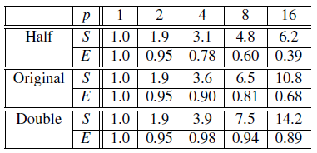
Speedups and efficiencies of parallel program on different problem sizes
e.g.
Original: sum of 1000 elements
Half: sum of 500 elements
Double: sum of 2000 elements

Slide 125
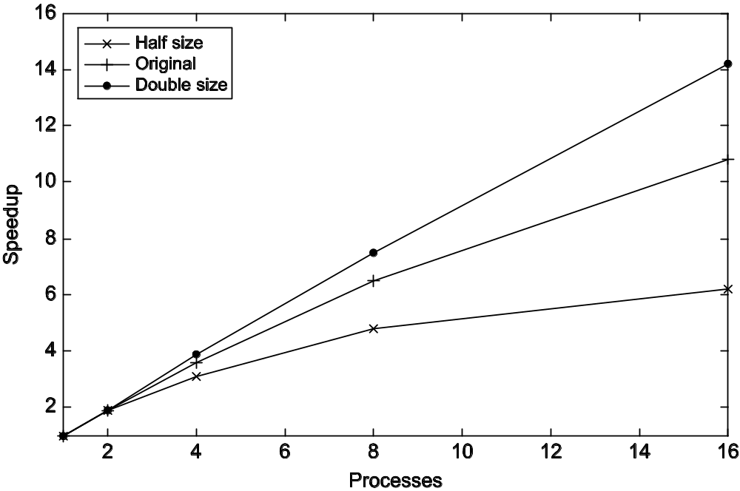
Speedup

Slide 126
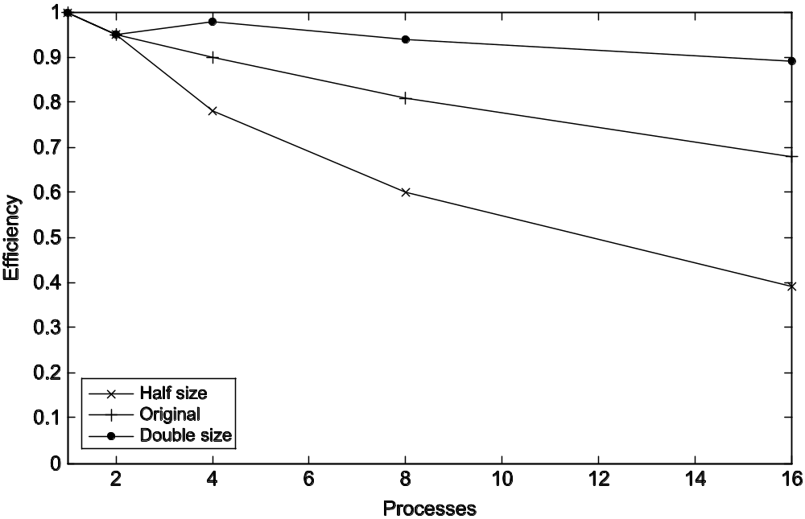
Efficiency

Slide 127
Effect of overhead
T_{parallel} = T_{parallizable} / p + T_{overhead}
Input & preprocess
reduce & output
One core
Four cores

Slide 128
Example
We can parallelize 90% of a serial program.
Parallelization is “perfect” regardless of the number of cores p we use.
T_{serial} = 20 seconds
Runtime of parallelizable part is
0.9 x T_{serial} / p = 18 / p

Slide 129
Example (cont.)
Runtime of “unparallelizable” part is
Overall parallel run-time is
0.1 x T_{serial} = 2
T_{parallel} = 0.9 x T_{serial} / p + 0.1 x T_{serial} = 18 / p + 2

Slide 130
Example (cont.)
Speed up
T_{serial}
20
S =
=
0.9 x T_{serial} / p + 0.1 x T_{serial}
18 / p + 2

Slide 131
Scalability 可扩展性分析（定性）
Qualitative or Quantitative Analysis
In general, a method/algorithm is scalable if it can handle ever increasing problem sizes.
If we increase the number of processes/threads and keep the efficiency fixed without increasing problem size, the problem is strongly scalable. 定性分析
If we keep the efficiency fixed by increasing the problem size at the same rate as we increase the number of processes/threads, the problem is weakly scalable.定性分析
在强扩展的情况下和弱扩展情况下，并行程序扩展性（E）与理想情况的对比

Slide 132
Perfect scalability vs strong or weak scalability
speedup
speedup
Perfect
Perfect
Program1
Program1
Program2
Program2
Cores/processes
Cores/processes
Strong scalability evaluation,
Keep problem size fixed
Weak scalability evaluation,
Increase problem size with the cores/processes at the same rate

Slide 133
Limits to Parallelism
Amdahl’s Law
  "the overall performance improvement gained by optimizing a single part of a system is limited by the fraction of time that the improved part is actually used".
Besides Amdahl’s Law, here are some other limits
Parallelism overheads include:
  cost of creating parallelism (starting a thread/process)
  cost of communicating shared data
  cost of synchronizing
  extra (redundant) computation
Notes:
Ex: nxn matmul, so n^3 processors could do n^3 multiplies at same time.
But would be dominated by overheads

Slide 134
Limits to Performance
(Single Processor Memory Hierarchy)
Large memories are slow; fast memories are small
Most programs have a things nearby previous accesses
  temporal locality: reusing an item that was previously accessed
Memory hierarchy use this to improve average case
processor
control
Second level cache (SRAM)
Main memory
(DRAM)
Secondary storage (Disk)
Tertiary storage
(Tape/Cloud)
arithmetic
registers
on-chip cache
Speed | 1ns | 10ns | 100ns | 10ms | 10sec
Size | KB | MB | GB | TB | PB
Notes:
Caches may make latency (worst case) even worse
Robot loading tapes at supercomputer center
Latest change: “nonvolative memory” (NVM), like Flash
In your cell phone, which doesn’t need power to remember
data that is written (just read it), But writing can take 2x - 10x
longer than reading. Intel and Micro just announced 3DXpoint
memory using this technology, to appear in coming year(s).

Slide 135

Taking Timings 计时
What is time?
Start to finish?
A program segment of interest?
CPU time?
Wall clock time?

Slide 136
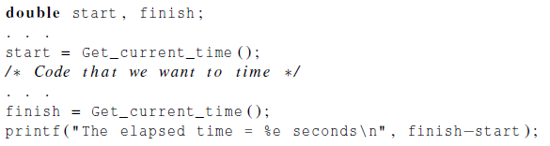
Taking Timings
theoretical
function
omp_get_wtime
MPI_Wtime

Slide 137

Taking Timings

Slide 138

Taking Timings

Slide 139

Parallel program design

Slide 140
Foster’s methodology
Partitioning: divide the computation to be performed and the data operated on by the computation into small tasks.
The focus here should be on identifying tasks that can be executed in parallel.

Slide 141

Foster’s methodology
Communication: determine what communication needs to be carried out among the tasks identified in the previous step.

Slide 142
Foster’s methodology
Agglomeration or aggregation: combine tasks and communications identified in the first step into larger tasks.
For example, if task A must be executed before task B can be executed, it may make sense to aggregate them into a single composite task.

Slide 143
Foster’s methodology
Mapping: assign the composite tasks identified in the previous step to processes/threads.
This should be done so that communication is minimized, and each process/thread gets roughly the same amount of work.

Slide 144

Example - histogram
1.3,2.9,0.4,0.3,1.3,4.4,1.7,0.4,3.2,0.3,4.9,2.4,3.1,4.4,3.9,0.4,4.2,4.5,4.9,0.9

Slide 145
Serial program - input
The number of measurements: data_count
An array of data_count floats: data
The minimum value for the bin containing the smallest values: min_meas
The maximum value for the bin containing the largest values: max_meas
The number of bins: bin_count

Slide 146
Serial program - output
bin_maxes : an array of bin_count floats, 每个桶的上界
bin_counts : an array of bin_count ints，每个桶的数据个数

Slide 147

First two stages of Foster’s Methodology
Global variable: bin_counts[], data[]

Slide 148

Alternative definition of tasks and communication
Global variable: bin_counts[], data[]
Local variable: loc_bin_cts[]

Slide 149

Adding the local arrays

Slide 150
Concluding Remarks (2)
Serial systems
  The standard model of computer hardware has been the von Neumann architecture.
Parallel hardware
  Flynn’s taxonomy.
Parallel software
  We focus on software for homogeneous MIMD systems, consisting of a single program that obtains parallelism by branching.
  SPMD programs.

Slide 151
Concluding Remarks (3)
Input and Output
  We’ll write programs in which one process or thread can access stdin, and all processes can access stdout and stderr.
  However, because of nondeterminism, except for debug output we’ll usually have a single process or thread accessing stdout.

Slide 152
Concluding Remarks (3)
Performance
  Speedup
  Efficiency
  Amdahl’s law
  Scalability
Parallel Program Design
  Foster’s methodology

