Slide 1
并行程序设计
任课教师：黄聃（Huang，Dan）
Based on the slides of Steve Leak
NERSC User Engagement Group

Slide 2
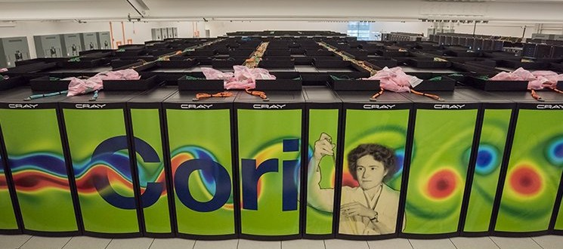
NERSC Cori
34 double-width cabinets
9,688 KNL + 2,388 Haswell nodes on Aries High-Speed Network
658,784 KNL cores + 76,416
Haswell cores
Top500 #6 (June 2017)

Slide 3
Agenda
Cori overview, logging in
Run a simple job
Building and running applications on Cori
  Serial
  Parallel (MPI)
  Multithreaded (OpenMP)
What aﬀects performance?
  Bottlenecks
  Task placement and aﬃnity
Preparing for performance analysis

Slide 4
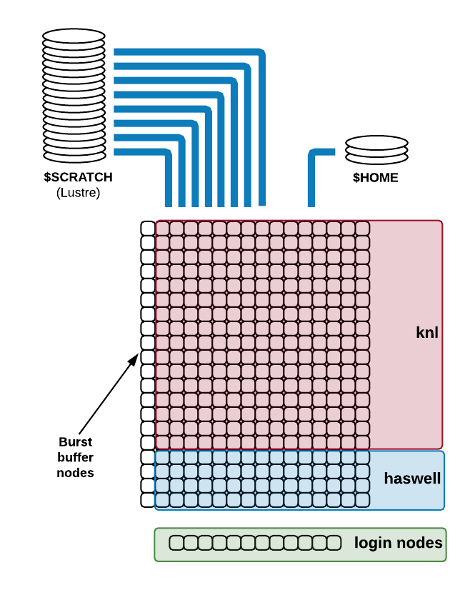

Cori Overview
Login and compute nodes are distinct
Large, fast, parallel
$SCRATCH ﬁlesystem for running jobs
Smaller $HOME, conﬁgured for building code
Burst buﬀer ﬁlesystem integrated, on high-speed network

Slide 5
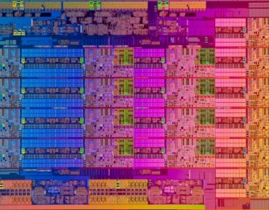


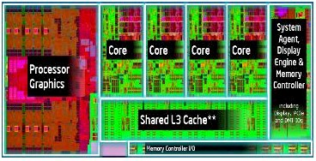

What's so special about it?
Your quad-core desktop CPU looks something like this:
Compared to a Cori Haswell node:
16 cores
x 2 sockets, 128GB RAM
Images courtesy of Google Image Search, Intel, EnterpriseTech.com, NextPlaQorm.com

Slide 6


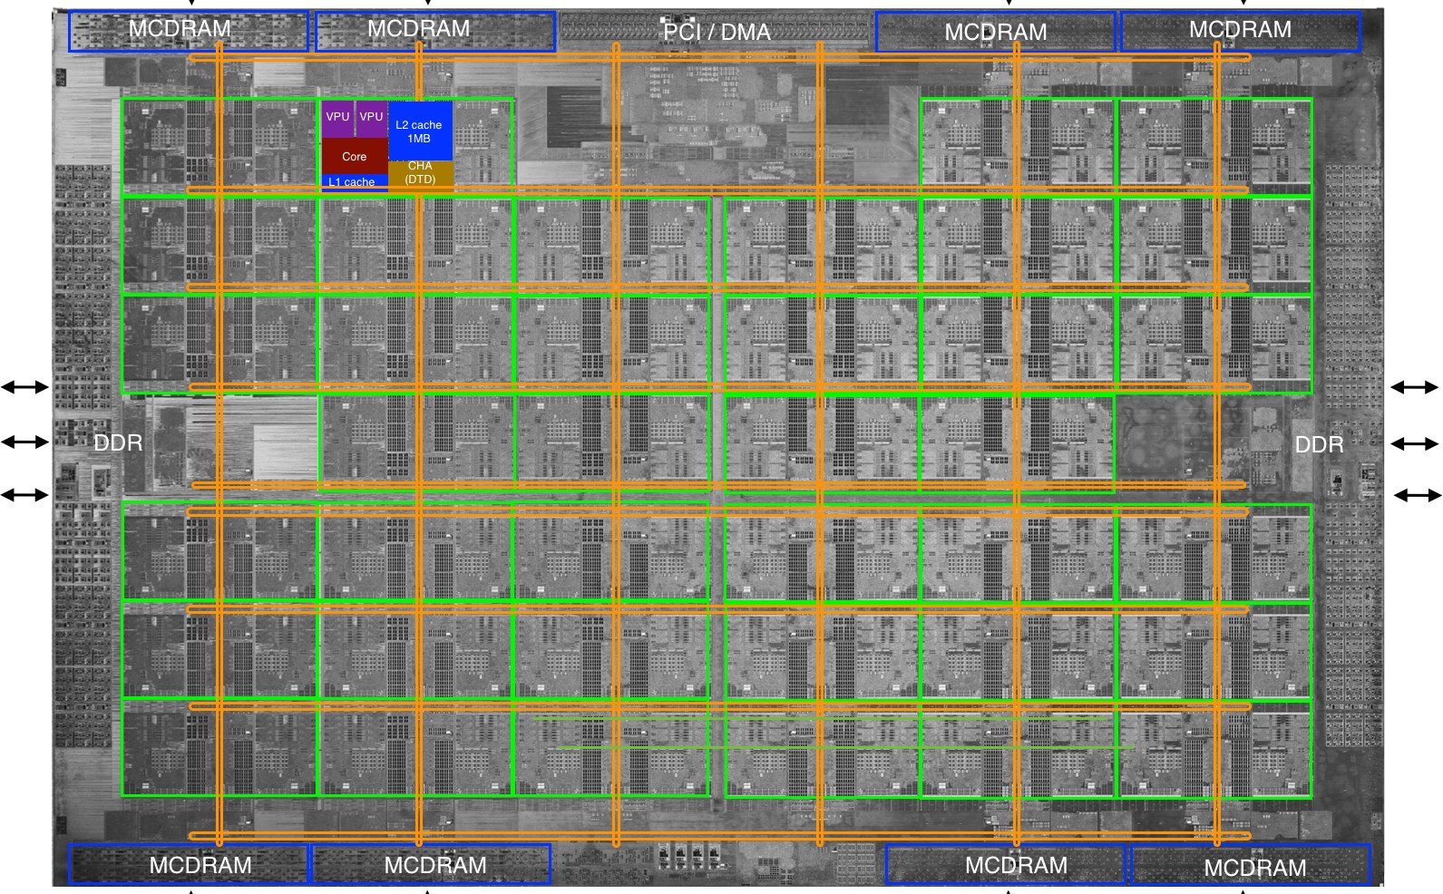

What's so special about it?
And then there are the KNL nodes (68 cores, MCDRAM, …)

Slide 7
What's so special about it?
But high-end（高端） CPUs don’t make a supercomputer
  High speed interconnects between them
  Lightweight compute node OS
  Very large (28,000 TB) fast parallel ﬁlesystem
…and a diﬀerent usage model
  Subset of nodes dedicated to a single task, run via batch system (no interactive GUI / desktop)

Slide 8
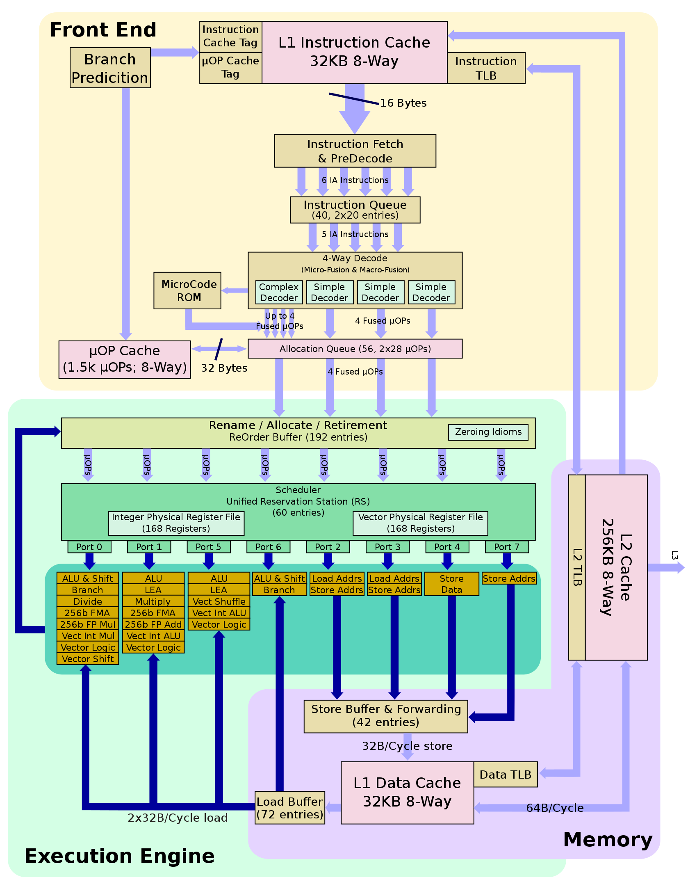









What's so special about KNL?
Diﬀerent choice of compromise between die space allocated to diﬀerent parts of the CPU
Instruction fetch-and- decode, hyperthreading, branching (important for eg compiling, GUI applications)
ILP and CPI
Memory access – keeps execution engine busy
Arithmetic, vector and ﬂoating point units – the actual FLOPS

Slide 9
















What's so special about KNL?
Xeon (eg Haswell), multicore
Xeon Phi (KNL), manycore
Large and fast
- Power, hungry, hot
Small and slow, cool, eﬃcient
Big wide vectors
Smaller space, shorter vectors
Large L2 cache, no L3 (but MCDRAM)

Slide 10
Why?
Exascale challenges – power and heat
  CPU frequency plateaued ~15 years ago
  Transistor density, feature size reaching fundamental limits
  Power consumption and heat dissipation are now the key constraints for supercomputing
  … we can’t get there from here!
KNL emphasizes vectorization and parallelism at lower power
  Targets scientiﬁc computing
Intel takes on NVIDIA with Knights landing launching.
  https://www.top500.org/news/intel-takes-on-nvidia-with-knights-landing-launch/
  https://www.hpcwire.com/2016/06/18/knights-landing-not/

Slide 11
Cori Overview
Login and compute nodes are distinct
Large, fast, parallel $SCRATCH ﬁlesystem for running jobs
Smaller $HOME, conﬁgured for building code
Burst buﬀer ﬁlesystem integrated, on high-speed network

Slide 12
Connecting to Cori
If you have a UNIX-like computer, you can directly contact NERSC with your built-in SSH client
  Open a new terminal
  % ssh –Y -l <training_acct_username> cori.nersc.gov
    -Y Enables trusted X11 forwarding.
Many SSH clients exist for Windows
A very popular one is putty
  hZp://www.putty.org/
Advanced users might prefer to use SSH directly within mintty (from Cygwin distribution)
- 14 -

Slide 13
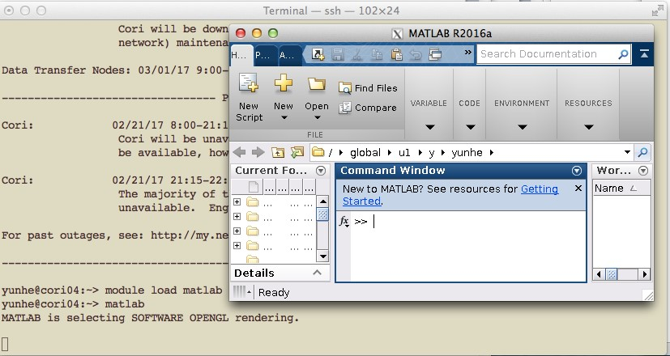
X-forwarding
Allows you to access GUI programs remotely
Example:
localhost% ssh –Y -l elvis cori.nersc.gov
…
e/elvis> module load matlab e/elvis> matlab
<MATLAB starts up>
- 15 -

Slide 14



Example Session
localhost:~elvis> ssh –Y -l <training_account_name> cori.nersc.gov
*****************************************************************
* *
* *
* *
* *
Lawrence Berkeley National Laboratory operates this *
computer system under contract to the U.S. Department of *
Energy. This computer system is the property of the United *
States Government and is for authorized use only. *Users *
(authorized or unauthorized) have no explicit or implicit *
expectation of privacy.* *
* *
* *
* *
* *
* *
* *
* *
* *
* *
* *
* *
* *
* *
* *
* *
* *
* *
* *
Prompt on local system
NOTICE TO USERS
---------------
Notiﬁcation of acceptable use.
Any or all uses of this system and all files on this system may be intercepted, monitored, recorded, copied, audited, inspected, and disclosed to site, Department of Energy, and law enforcement personnel, as well as authorized officials of other agencies, both domestic and foreign. *By using this system, the user consents to such interception, monitoring, recording, copying, auditing, inspection, and disclosure at the discretion of authorized site or Department of Energy personnel.*
*Unauthorized or improper use of this system may result in administrative disciplinary action and civil and criminal penalties. _By continuing to use this system you indicate your awareness of and consent to these terms and conditions of use. LOG OFF IMMEDIATELY if you do not agree to the conditions stated in this warning._*
*****************************************************************
Password: <enter your training account password here>
Password prompt
- 16 -

Slide 15
After logging in…
On a login node
  cori01, cori02, …
  Shared by many users
  Not necessarily the same one each time!
  But same access to ﬁlesystems
No direct access to compute nodes
  Only via batch system (salloc, sbatch)
Haswell (Xeon) architecture

Slide 16
Agenda
Cori overview, logging in
Run a simple job
Building and running applications on Cori
  Serial
  Parallel (MPI)
  Multithreaded (OpenMP)
What aﬀects performance?
  Bottlenecks
  Task placement and aﬃnity
Preparing for performance analysis

Slide 17
Running jobs – key points
HPC work is via batch system
  Dedicated subset of compute resources
  Login nodes are shared resource for building code, editing scripts, etc. Use batch jobs for real work
Key commands:
  sbatch / salloc - submit a job
  srun - start an (optionally MPI) application within a job
  sqs - check the queue for my job status
For today, we have a reservation
  #SBATCH –reservation=csgrrain
https://docs.nersc.gov/jobs/

Slide 18
Running jobs – key points
HPC work is via batch system
  Dedicated subset of compute resources
  Login nodes are shared resource for building code, editing scripts, etc. Use batch jobs for real work
Key commands:
All of this is
– sbatch / salloc - submit a job
on the web!
srun - start an (optionally MPI) application within a job
sqs - check the queue for my job status
For today, we have a reservation
– #SBATCH –reservation=csgrrain
https://docs.nersc.gov/jobs/

Slide 19
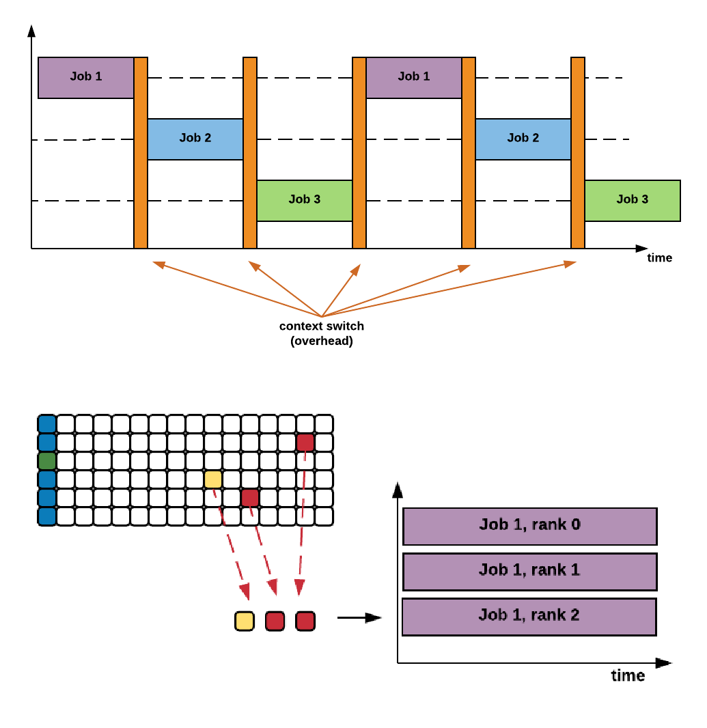
How jobs work
Desktop / login node
Timeslicing
core shared by multiple tasks
Works when the
computer is mostly waiting for you
HPC
You are waiting for the computer
Subset of pooled resources dedicated to one job

Slide 20
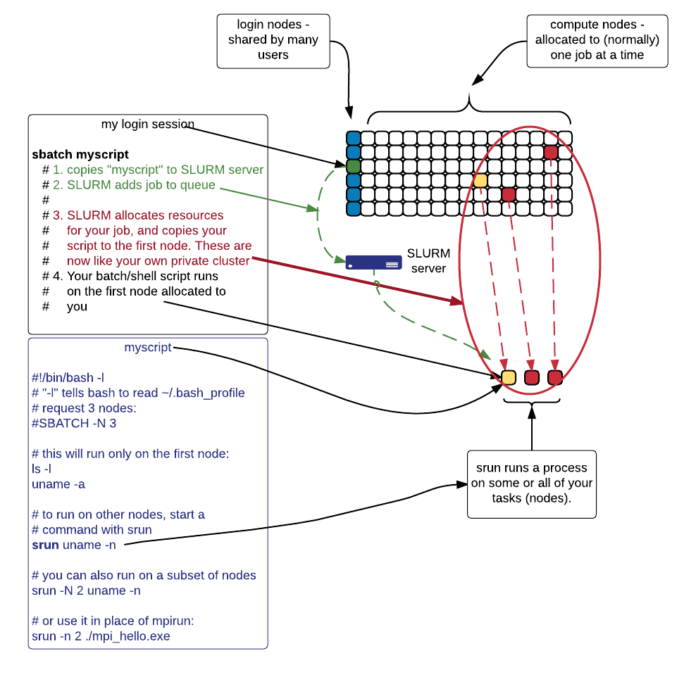
How jobs work (whole procedure)
Start on login node
  shared by many users,
not for computational work
Access compute nodes with sbatch or salloc
Batch script
  Copied to queue
  Has directives for SLURM, and shell
commands to perform on ﬁrst compute node
Access your allocated nodes and start jobs with srun
stdout, stderr saved to ﬁle
  (when running in batch mode)

Slide 21
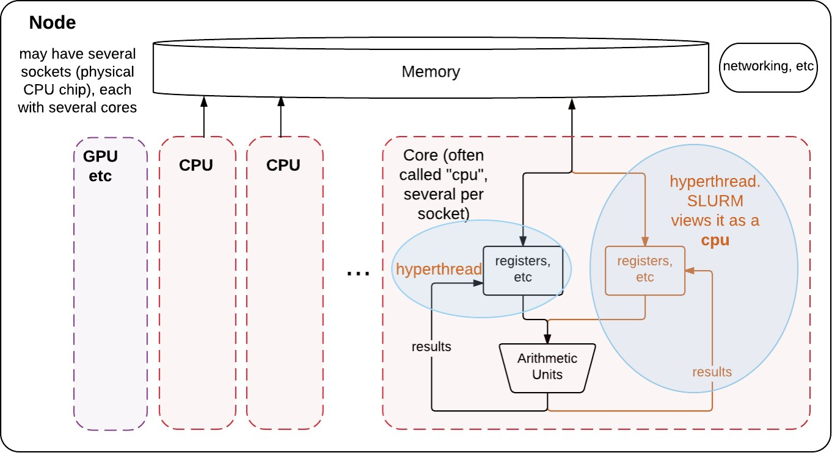
Nodes, cores, CPUs, threads, tasks - some definitions
Node is the basic unit of allocation at NERSC
  Think “one host” or “one server”
  Single memory space, multiple CPU cores (24 or 32 or 68 ...
    And a core might support hyperthreading

Slide 22
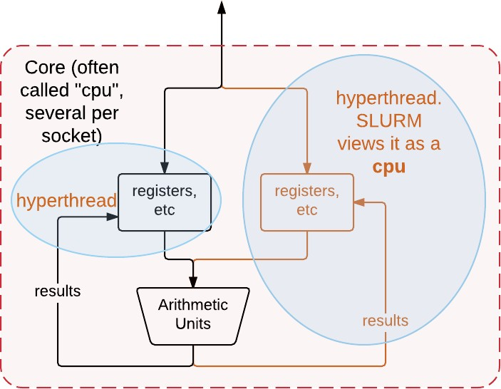
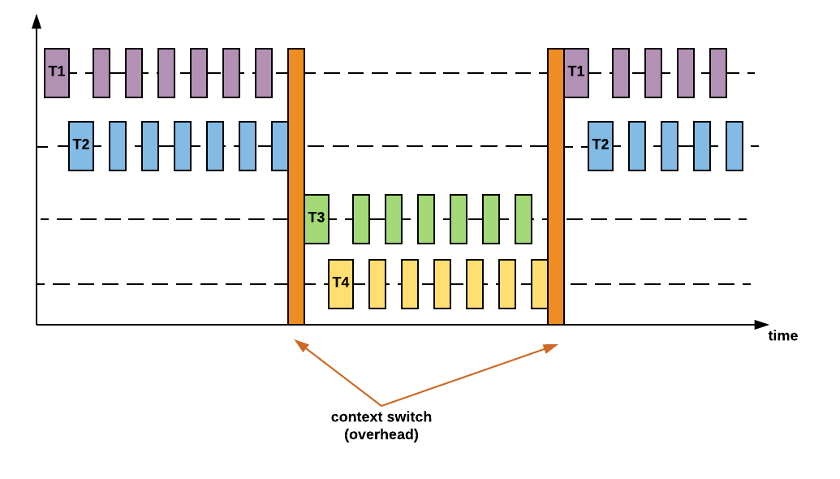
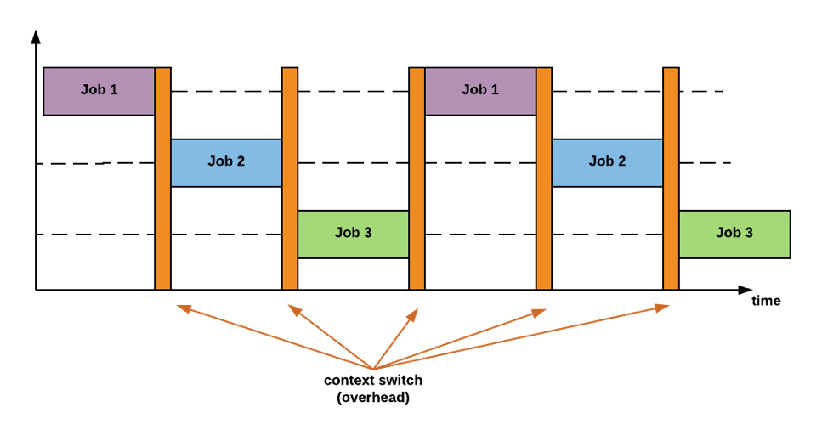
Nodes, cores, CPUs, threads, tasks - some definitions
Hyperthreading (超线程、vcpu)
Fast timeslicing
– Good when arithmetic units frequently wait on memory
Core holds state of 2 (4 on KNL) processes, they share arithmetic units
SLURM views each hyperthread as a CPU
But most HPC jobs perform best when not sharing a core!
Usually best to reserve 2 (or 4) CPUs / core
Without hyperthreading
With hyperthreading

Slide 23
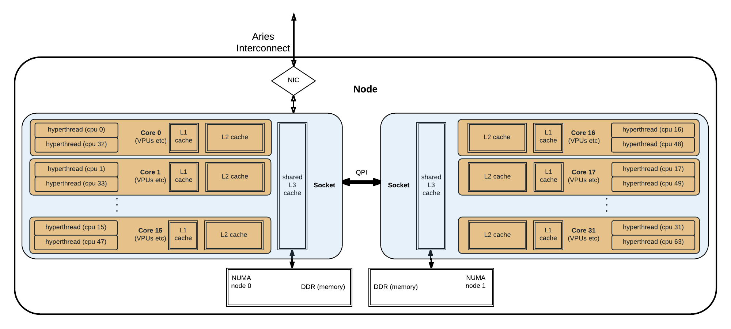
Slurm tasks
First, a block diagram of how hyperthreads, cores, cache, and sockets relate within a (haswell) node

Slide 24
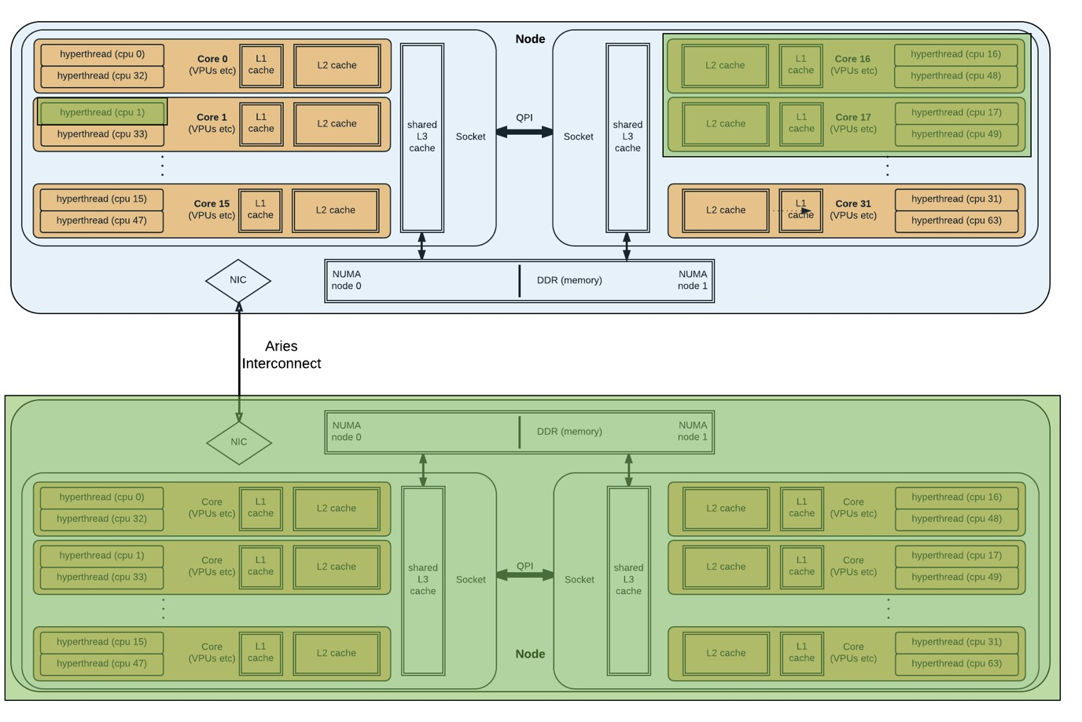
Slurm tasks
A SLURM task is a reservation of CPUs and memory, up to one full node
  A job has many tasks
  1 task typically
corresponds to 1 MPI rank
srun -n <ntasks> ..
Eg: 3 possible tasks on 2 nodes

Slide 25
So what must I request for my job?
What the batch system needs to know:
How many nodes (or CPUs or tasks) does this job need?
For how long does it need them?
  Wallclock time limit
NERSC-speciﬁc extras:
What type of CPU? (-C …)
  KNL or Xeon (haswell/ivybridge)?
Which ﬁlesystems will this job use? (-L …)
  Usually SCRATCH

Slide 26
Requesting nodes or tasks
#SBATCH -N 64
srun -N 32 ./my_app
# request 64 nodes
# start ./my_app on 32 of them # (default: 1 per node)
srun -n 128 ./my_app # start 128 instances of ./my_app,
# across my 64 nodes (default is # to evenly distribute them in # block fashion)
Task 0: ./my_app
Task 1: ./my_app
Node 0
Task 2: ./my_app
Task 3: ./my_app
Node 1
Task 126: ./my_app
Task 127: ./my_app
Node 63
One MPI rank generally corresponds to one SLURM Task

Slide 27
Requesting time
#SBATCH | -t | 30 | # | 30 minutes
#SBATCH | -t | 30:00 | # | 30 minutes
#SBATCH | -t | 1:00:00 | # | 1 hour
#SBATCH | -t | 1-0 | # | 1 day
#SBATCH | -t | 1-12 | # | 1.5 days
Wallclock time, ie real elapsed time
Aper this much time, SLURM can kill this job

Slide 28
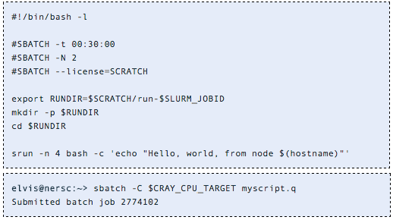
Hands-on exercise: My first job
A SLURM job script has two sections:
Directives telling SLURM what you would like it to do with this job
The script itself - shell commands to run on the ﬁrst compute node
For how long?
How many nodes?
$SCRATCH
ﬁlesystem
Xeon nodes on current cluster (set by craype-
{haswell,ivybridge}
module)
Note: cannot use env vars in directives - but directives have

Slide 29
Hands-on exercise: My first job
A SLURM job script has two sections:
Directives telling SLURM what you would like it to do with this job
The script itself - shell commands to run on the ﬁrst compute node
Make starting environment like my login environment
Run from
$SCRATCH
Start 4 tasks across my nodes
“sbatch” submits a job script

Slide 30
Running jobs – key points
HPC work is via batch system
  Dedicated subset of compute resources
  Login nodes are shared resource for building code, editing scripts, etc. Use batch jobs for real work
Key commands:
  sbatch / salloc - submit a job
  srun - start an (optionally MPI) application within a job
  sqs - check the queue for my job status
https://docs.nersc.gov/jobs/

Slide 31
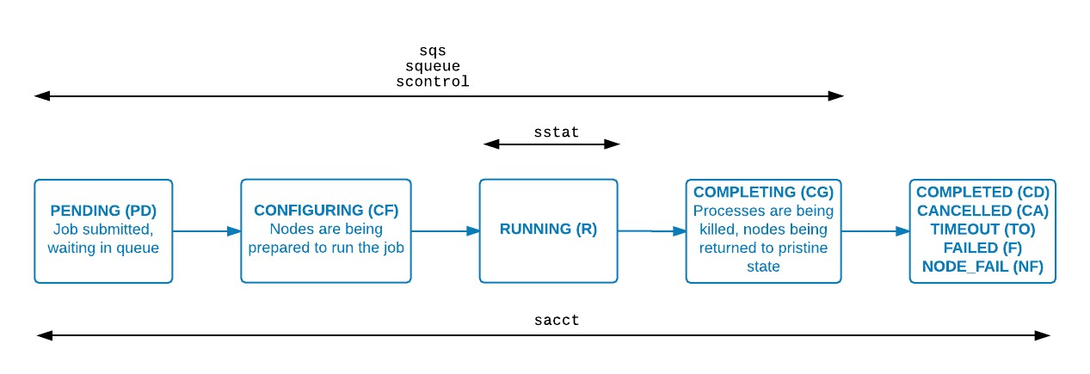
Where is my job?
elvis@nersc:~> sqs
JOBID ST REASON USER NAME
NODES USED REQUESTED ...
2774102 R Prolog elvis myscript.q 2 0:00 30:00
... SUBMIT PARTITION RANK_P RANK_BF
2016-11-18T11:24:20 debug N/A
elvis@nersc:~> ls -lt total 11280
-rw-r----- 1 elvis elvis 132 Nov 18 11:24 slurm-2774102.out
-rw-r----- 1 elvis elvis 208 Nov 18 11:24 myscript.q
N/A

Slide 32
Agenda
Cori overview, logging in
Run a simple job
Building and running applications on Cori
  Serial
  Parallel (MPI)
  Multithreaded (OpenMP)
What aﬀects performance?
  Bottlenecks
  Task placement and aﬃnity
Preparing for performance analysis

Slide 33
Cray compiler wrappers, ftn, cc and CC
Building code optimally for Cori requires a complex set of compiler option and libraries
  eg, static linking by default (important for performance at scale)
Compiler wrappers ftn, cc and CC manage this complexity for you
  Using environment variables set by the modules you have loaded
Also provide MPI (e.g. mpicc is not required)
- 39 -

Slide 34
Environment Modules
Software on Cori (and most HPC systems) is managed with “environment modules”
Why?
  Cori is a shared resource
  Diﬀerent people need diﬀerent combinations of sorware, at diﬀerent versions, with diﬀerent dependencies (and for diﬀerent jobs)
Loading and unloading a module updates environment variables (eg $PATH,
$LD_LIBRARY_PATH) to make a package available

Slide 35
Module Commands
module load <modulename>
Add the module from your environment
module unload <modulename>
Remove the module from your environment
module swap <module1> <module2>
Unload one module and replace it with another
% module swap intel intel/16.0.3.210 (replace current default to a speciﬁc version)
module list
See what modules you have loaded right now
module show <modulename>
See what the module actually does
module display <modulename>
Show module details
module help <modulename>
Get more information about the software
https://modules.readthedocs.io/en/latest/
- 41 -

Slide 36
Key modules for compiling
PrgEnv-intel / PrgEnv-cray / PrgEnv-gnu
  Which underlying compiler the wrappers should invoke
craype-haswell / craype-mic-knl
  Remember, login nodes are haswell, but we are building for KNL!
module swap craype-haswell craype-mic-knl
  Wrappers manage cross-compiling
Important for today!

Slide 37
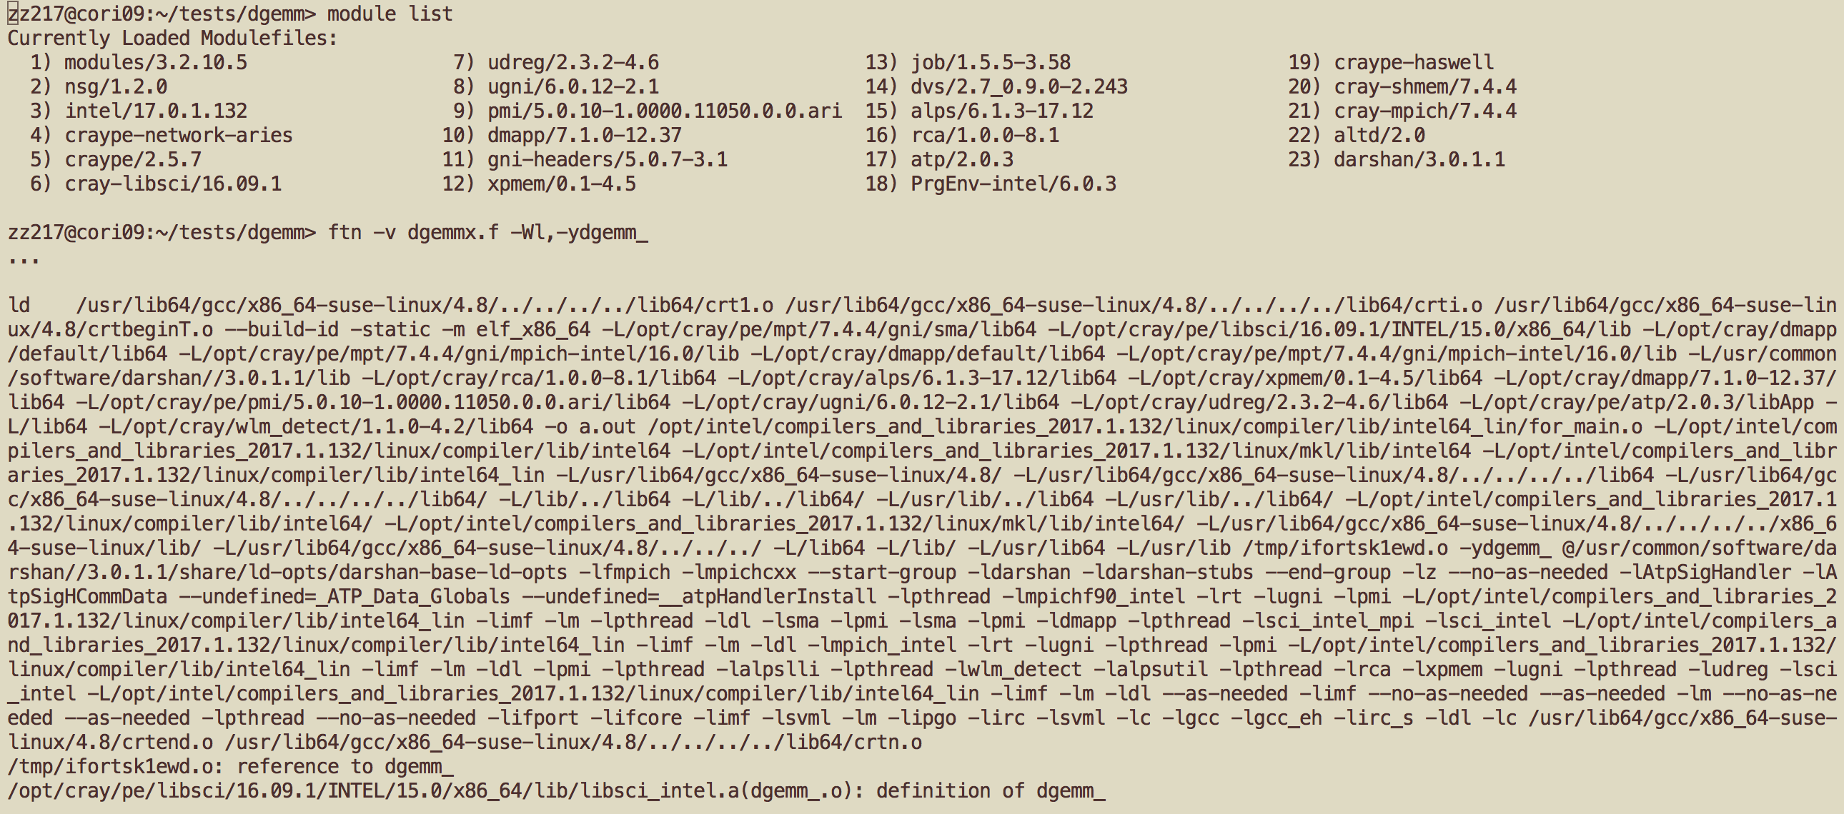
What do compiler wrappers link by default?
Depending on the modules loaded, MPI, LAPACK/BLAS/ ScaLAPACK libraries, and more
- 43 -

Slide 38
Compiling code
Very similar to regular Linux, but using CC / cc / ftn
Do this bit once:
module swap craype-haswell craype-mic-knl
Then:
cc –c hack-a-kernel.c
cc –o hack-a-kernel.ex hack-a-kernel.o
Note that the module looks aper CPU target!

Slide 39
Compiling parallel code
Compiler wrappers give you MPI “for free”
CC –c hello-mpi.c++
CC –o hello-mpi.ex hello-mpi.o
(Cray MPICH – optimized for Aries HSN)
OpenMP: with PrgEnv-intel (NERSC default):
cc | –qopenmp | –c | hello-omp.c
cc | –qopenmp | –o | hello-omp.ex | hello-omp.o

Slide 40
MPI vs OpenMP
MPI provides explicit communication between separate processes
  Optionally on separate nodes – ie packets over a network
  Most parallel development in last 2 decades has used this approach
OpenMP provides work-sharing and synchronization between threads in a single process
  Threads share the same memory image
  To make the most of a KNL node, most applications will need to use OpenMP

Slide 41
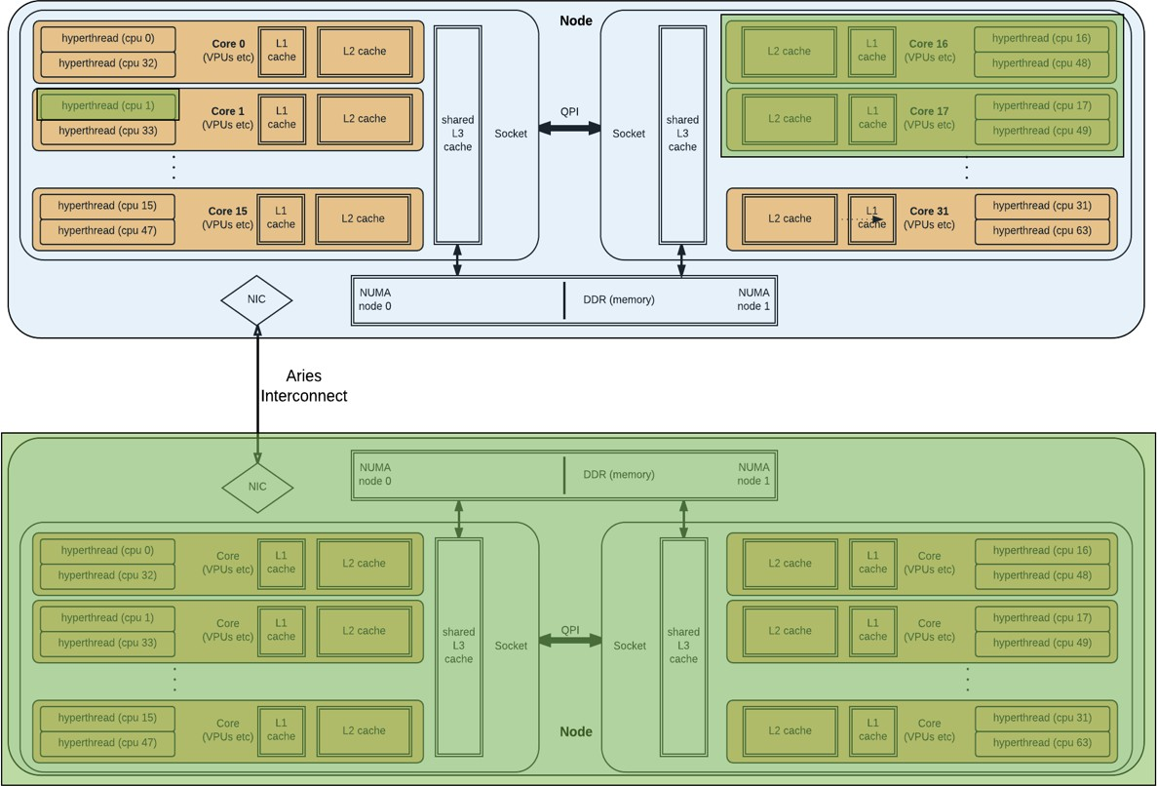
MPI vs OpenMP
An MPI application can have processes on more than one node
An OpenMP application exists entirely within 1 node
OpenMP thread 0
OpenMP thread 1
MPI rank 0
MPI rank 1

Slide 42
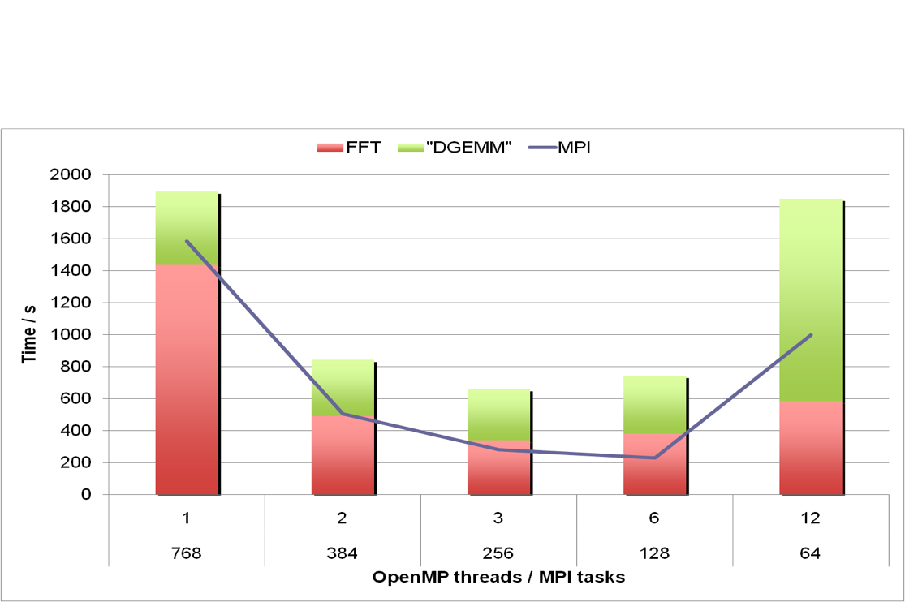
Why do we suddenly need OpenMP?
Multi-level parallelism
  At very large scale, the overheads of MPI (or any parallel approach) become excessively costly
  Combining (nesting) parallel approaches allows us to operate each at lower scale
    Sweet spot for best overall eﬃciency
  MPI -> OpenMP -> Vectorization

Slide 43
Why do we suddenly need OpenMP?
Memory-per-core is trending downwards
  Cori Haswell: 128GB for 32 cores
  Cori KNL: 96GB for 68 cores (16GB MCDRAM for 68 cores)
  Parallelism within same memory footprint is necessary

Slide 44
Agenda
Cori overview, logging in
Run a simple job
Building and running applications on Cori
  Serial
  Parallel (MPI)
  Multithreaded (OpenMP)
What aﬀects performance?
  Bottlenecks
  Task placement and aﬃnity
Preparing for performance analysis

Slide 45
Performance bottlenecks
Any point at which some component of the system or application is stalled, waiting on some other component, is a bottleneck
Eg waiting for MPI call to complete
  Load imbalance or communication overhead is a bottleneck
BUT for today we are interested in KNL speciﬁcs
  Bottlenecks within the node

Slide 46
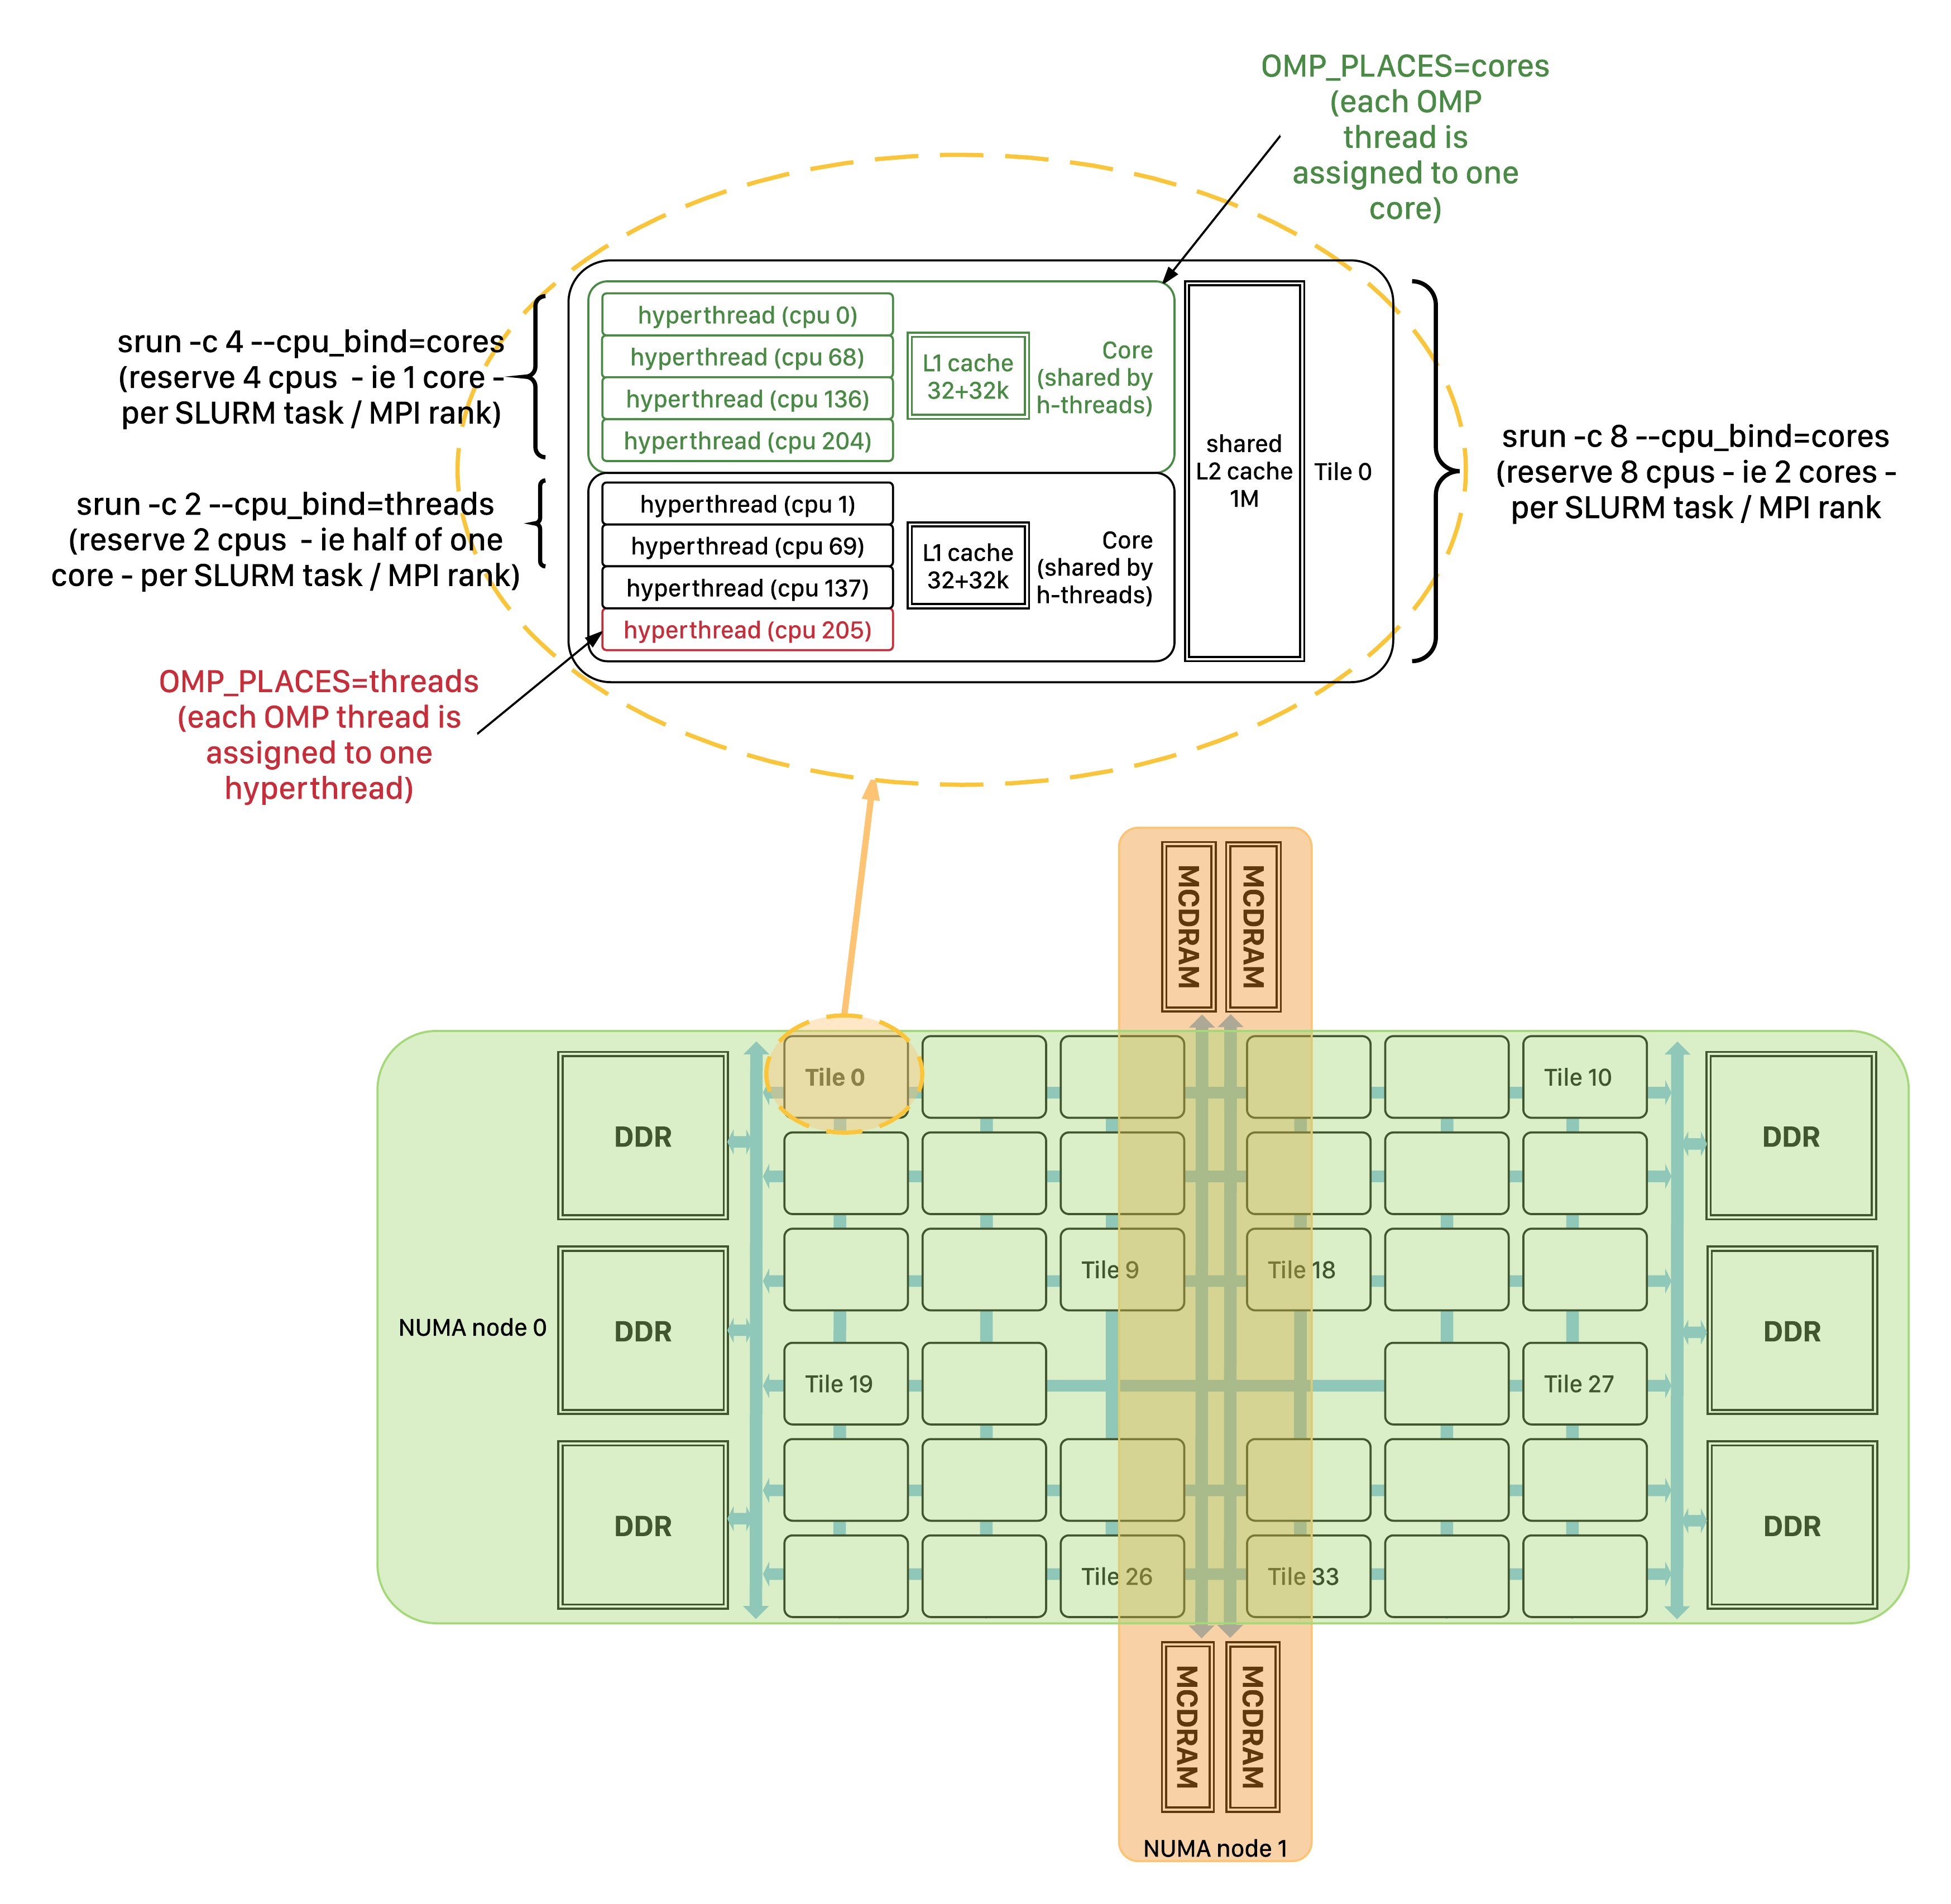
Bottlenecks within the node – Affinity issues
Firstly: Am I running it right?
  Cori KNL has 68 cores per node, arranged on a mesh of 34 tiles
  Each tile has 2 cores and a shared L2 cache
  Each core has 4 hyperthreads sharing L1 cache

Slide 47
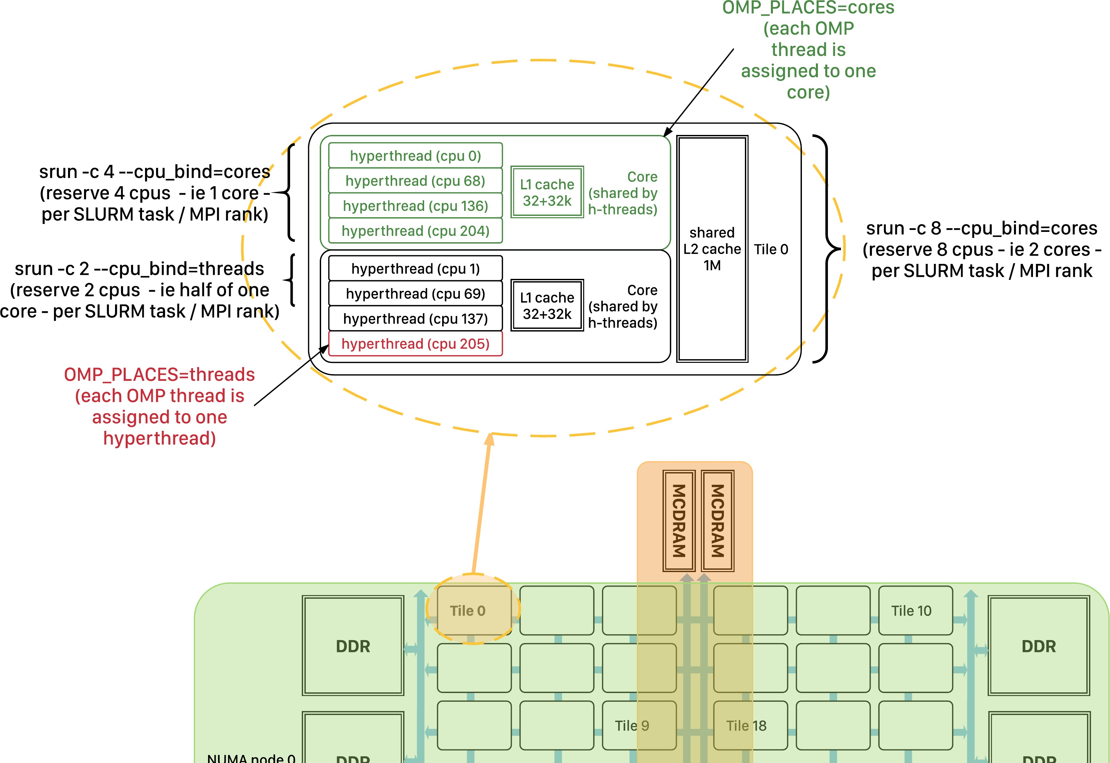
Bottlenecks within the node – Affinity issues
Where are my threads?
  Is each using a diﬀerent core at least?
Linux does not always choose best placement
  Use srun options to ensure optimal thread/process placement

Slide 48
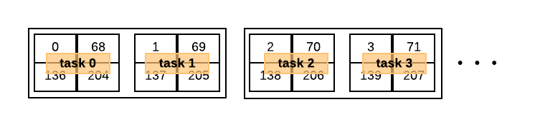
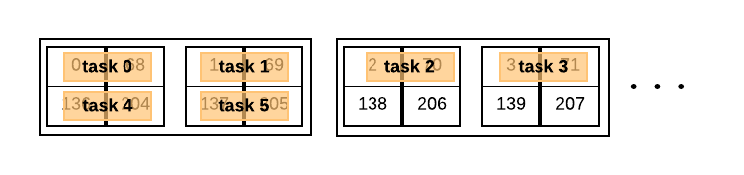
Process (task) affinity
Solution: use --cpu_bind:
srun –n 64 -c 4 --cpu_bind=verbose,cores ./my_exec
srun -n 128 -c 2 --cpu_bind=verbose,threads ./my_exec
Controls what a task (MPI rank) is bound to
– If no more than 1 MPI rank per core: --cpu_bind=cores
– If more than 1 MPI rank per core: --cpu_bind=threads

Slide 49
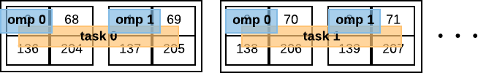
Thread affinity (OpenMP)
export OMP_NUM_THREADS=2
export OMP_PROC_BIND=spread export OMP_PLACES=cores
# or close
# or threads, or sockets
srun -n 32 -c 8 --cpu_bind=verbose,cores ./my_exec
...If using hyperthreads, use OMP_PLACES=threads

Slide 50
Bottlenecks within the node – Affinity issues
OMP_PROC_BIND=true OMP_PLACES=cores (threads) srun -c 4 --cpu_bind=cores …

Slide 51
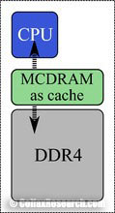
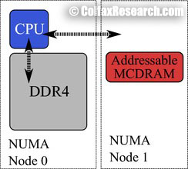
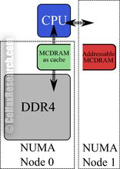
Memory affinity
Linux default behavior is to allocate to closest NUMA- node, if possible
Not always optimal:
KNL nodes: DDR is “closer” than MCDRAM
#SBATCH -C knl,quad,flat export OMP_NUM_THREADS=4
srun -n16 -c16 --cpu_bind=cores --mem_bind=map_mem:1 ./a.out
NUMA node 1 is MCDRAM in quad,ﬂat mode
“Mandatory” mapping: if using >16GB, malloc will fail
ttps://colfaxresearch.com/knl-mcdram/
Cache
mode
Flat
mode
Hybrid
mode
Usage modes of HBM in Kights Landing processors.

Slide 52




Bottlenecks within the node
Performance tends to be dominated by:
Doing arithmetic operations
(# FLOPS/cycle)
Moving data between arithmetic units and memory
Bottlenecks are usually due to one of these parts waiting on the other

Slide 53
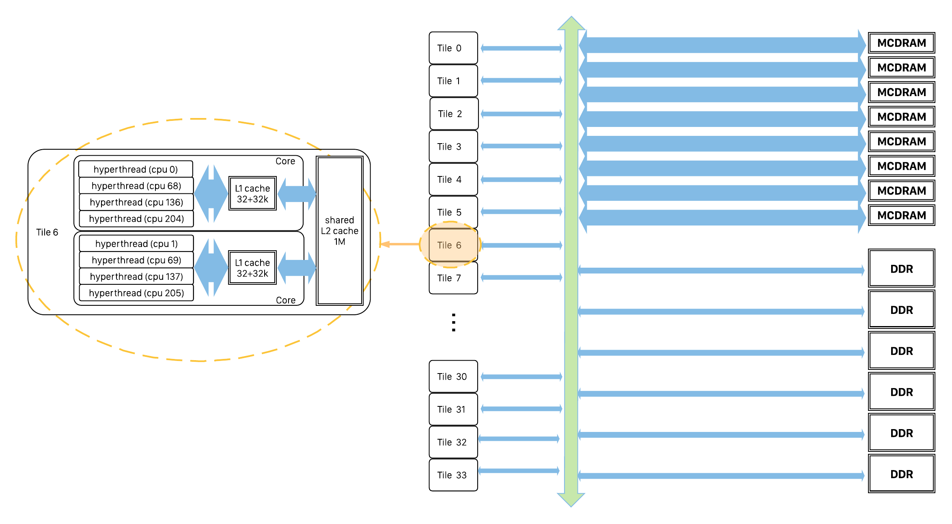
Bottlenecks within the node
Bandwidth!
  MCDRAM is very high bandwidth (~450 GB/s)
  .. But aggregate bandwidth is not the same as bandwidth to each core!

Slide 54
Agenda
Cori overview, logging in
Run a simple job
Building and running applications on Cori
  Serial
  Parallel (MPI)
  Multithreaded (OpenMP)
What aﬀects performance?
  Bottlenecks
  Task placement and aﬃnity
Preparing for performance analysis

Slide 55





Profiling prerequisite
A small, short, but representative test case for your application
  Proﬁling tends to be costly
    Runtime overhead
    Size of data collected
  BUT: must cover same paths through code as “real” example (or at least, the diﬀerences must be understood)
    What could go wrong with this test case?
Real run:
time-stepping
setup
output
Test case for proﬁling:
1 timestep
- 65 -

Slide 56
…But my application just is big!
Start with a low-overhead proﬁling method
  Eg sampling-based (gprof, TAU, CrayPat, …)
  Identify hotspots
Only proﬁle part of a run
  Some tools (eg Vtune) allow you to start the run “paused” and “resume collection” via an API call
Only proﬁle 1 MPI rank
  Via srun options, eg run Vtune on one rank, not others (beyond today’s scope)
Luckily, our hack-a-kernel is already small! ☺

Slide 57
Performance Analysis
Many tools require dynamically-linked executable
  Including Vtune
  NERSC/Cray: applications are statically linked by default, must use “-dynamic” at compile time
“Uncore” (eg memory related) performance counters usually require special permissions (eg kernel module)
  NERSC/Slurm supports this with #SBATCH –perf=vtune directive

