Slide 1
并行程序设计
任课教师：黄聃（Huang，Dan）

Slide 2
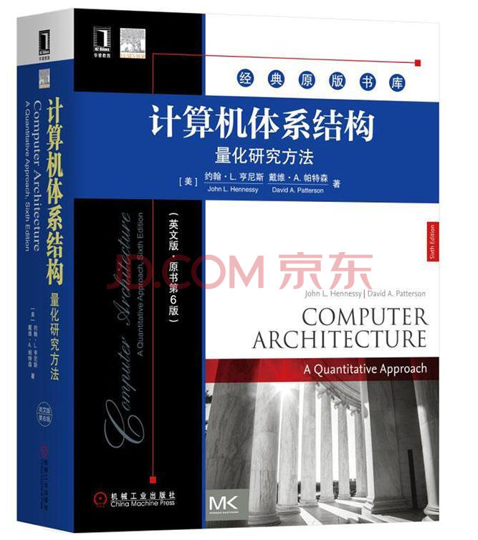


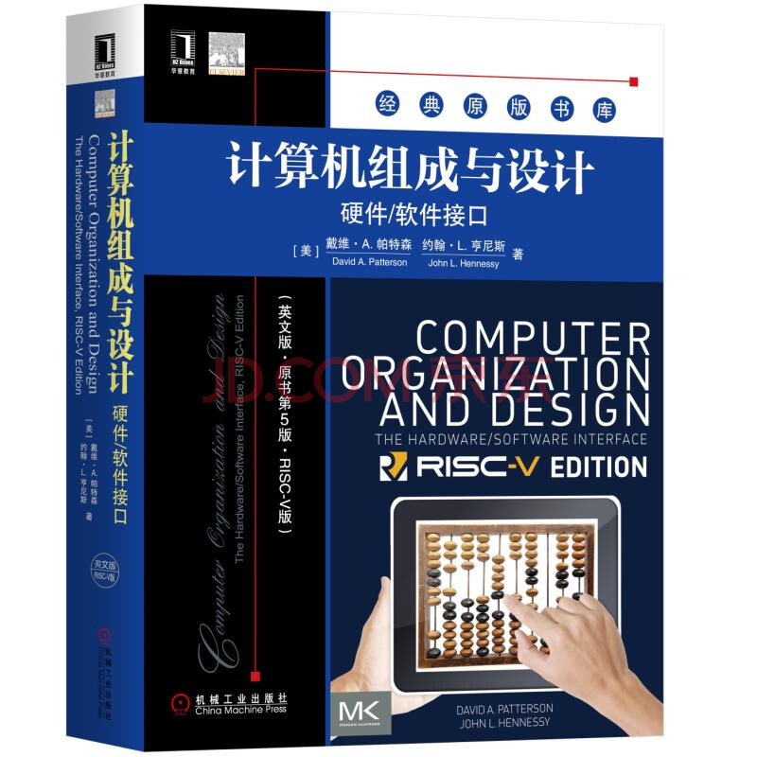
Data-Level Parallelism in Vector, SIMD, and GPU Architectures (Chapter 4)
Based on the slides of Computer Architecture, a Quantitative Approach, 6th Edition.
2

Slide 3

Data-Level Parallelism in Vector, SIMD, and GPU Architectures (Chapter 4)
Based on the slides of Computer Architecture, a Quantitative Approach, 6th Edition.
3

Slide 4
Contents
SIMD architecture
Vector architectures optimizations: Multiple Lanes, Vector Length Registers, Vector Mask Registers, Memory Banks, Stride, Scatter-Gather,
Programming Vector Architectures
SIMD extensions for media apps
GPUs – Graphical Processing Units
Fermi architecture innovations
Examples of loop-level parallelism
Fallacies
4

Slide 5
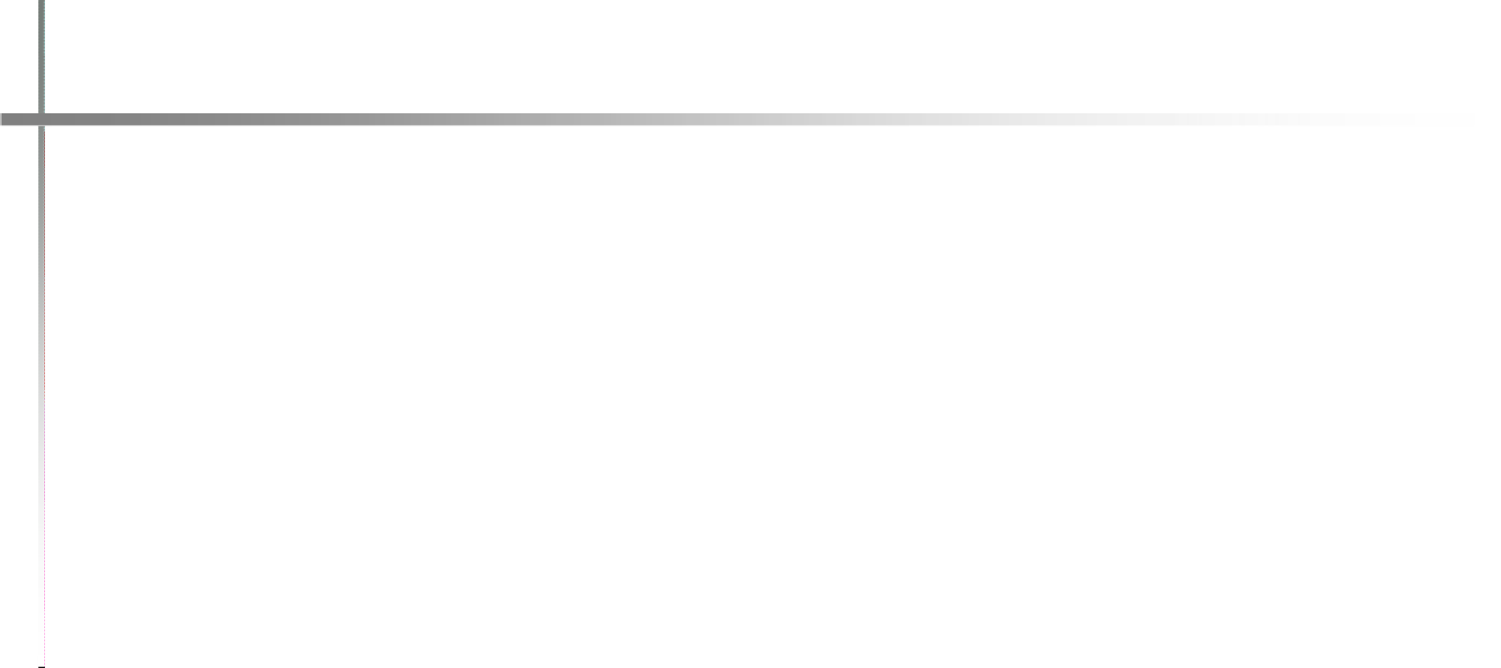
Flynn's Taxonomy
Classes of Computers
SISD - Single instruction stream, single data stream
SIMD - Single instruction stream, multiple data streams
  Extend pipelined execution of many data operations, superscalar
  Simultaneous parallel data operations in most instruction set. E.g. SSE( streaming SIMD extensions), AVX
  New: SIMT – Single Instruction Multiple Threads (for GPUs)
MISD - Multiple instruction streams, single data stream
  No commercial implementation
MIMD - Multiple instruction streams, multiple data streams
  Tightly-coupled MIMD (shared memory, NUMAs), OpenMP and Pthreads
  Loosely-coupled MIMD (distributed memory system, e.g. cluster), MPI
5

Slide 6
Advantages of SIMD architectures
Introduction
Can exploit significant data-level parallelism for:
  A set of applications has significant data-level parallelism
Matrix-oriented scientific computing
Media-oriented image and sound processors
Tensor-oriented AI applications (training, inference)
More energy efficient than MIMD
1. Only needs to fetch one instruction per multiple data operations, rather than one instr. per data op.
2. Makes SIMD attractive for personal mobile devices
Allows programmers to continue thinking sequentially
6

Slide 7
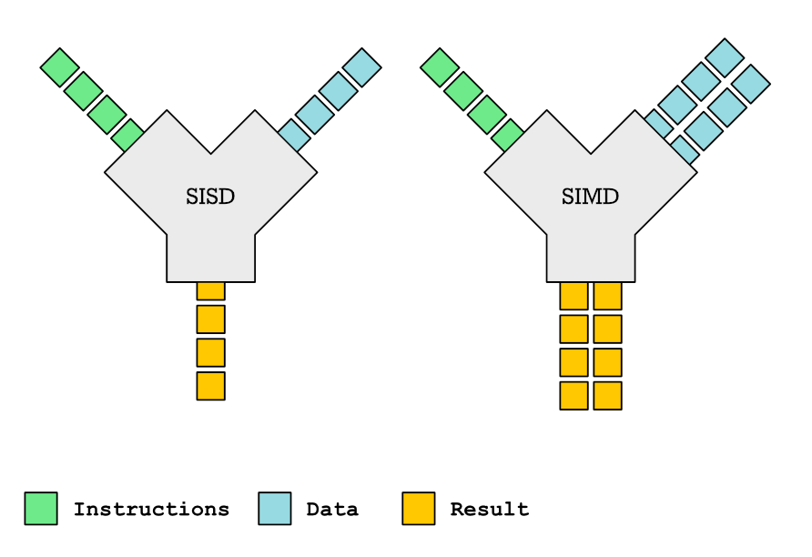
SIMD parallelism
Introduction
SIMD architectures
  A. Vector architectures, extends pipelined execution (SI) of many data operations (MD).
    SIMD extensions for mobile systems and multimedia applications, multimedia extensions (MMX) in 1996, streaming SIMD extensions (SSE), advanced vector extensions (AVX)
  B. Graphics Processor Units (SIMT, GPUs)
7

Slide 8
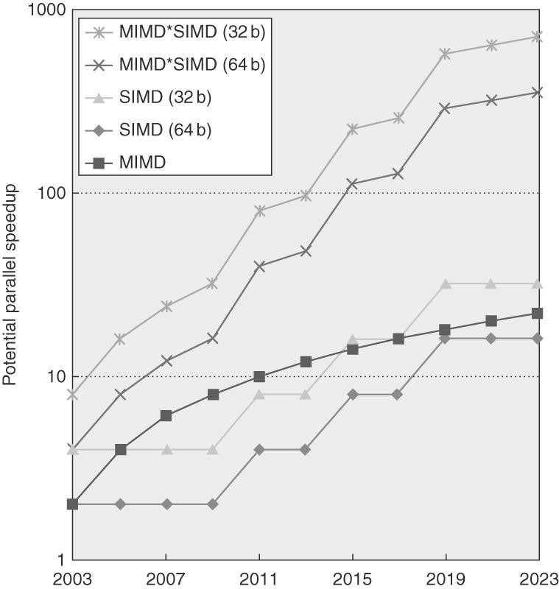
SIMD/MIMD comparison. Potential speedup for SIMD twice that from MIMD!
  x86 multicore processors → expect two additional cores per chip per year
  SIMD → width to double every four years
Figure 4.1 Potential speedup via parallelism from MIMD, SIMD, and both MIMD and SIMD over time for x86 computers. This figure assumes that two cores per chip for MIMD will be added every two years and the number of operations for SIMD will double every four years.
6

Slide 9
A. Vector architectures
Vector Architectures
Basic idea:
  Read sets of data elements into “vector registers”
  Operate on those registers
  Disperse the results back into memory
  A single instruction works on vectors of data, which results in dozens of register-register operations on independent data elements.
Registers are controlled by compiler
  Used to hide memory latency
  Leverage memory bandwidth
  Reason: vector loads and stores are deeply pipelined and overlapped with computations, the program endeavors to pay the long memory latency only once per vector load or store, rather than once per element, thus amortizing the latency, e.g., 32 elements.
  Overall, vector programs strive to keep the memory busy.
Target on memory wall challenges
9

Slide 10

Cray-1 (1976)
RISC vector instruction set extension

Slide 11
Example of vector architecture
Vector Architectures
RV64V → RV64G, RV64V extended RV64G with vector instructions, here RV (RISC-V)
  RISC-V (pronounced "risk-five") is an open standard instruction set architecture (ISA) based on established reduced instruction set computer (RISC) principles.
Vector registers
  Each register holds a 32-element, 64 bits/element vector
  Register file has 16 read ports and 8 write ports, A register file is an array of processor registers in a central processing unit (CPU).
Vector functional units – FP add and multiply
  Fully pipelined
  Data and control hazards are detected
Vector load-store unit
  Fully pipelined
  One word per clock cycle after initial latency
Scalar registers
  31 general-purpose registers
  32 floating-point registers
  Provide data as input to the vector functional units
  Compute addresses to pass to the vector load/store unit
11

Slide 12
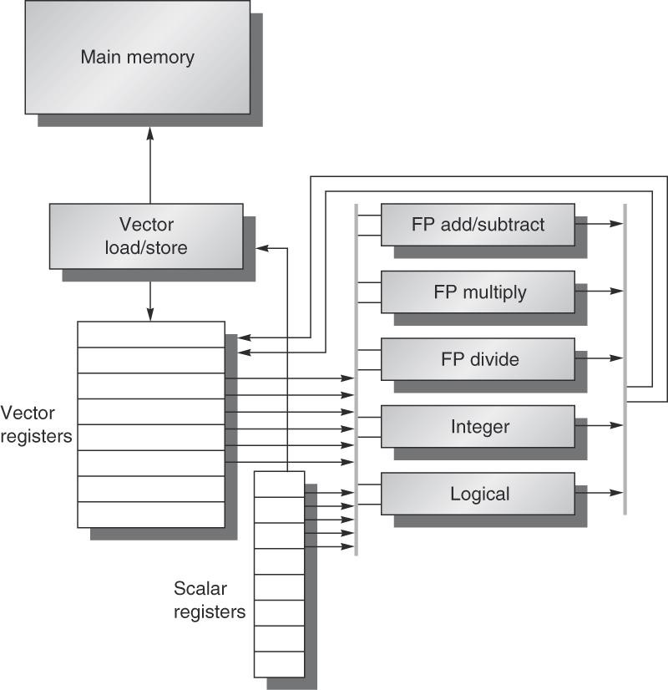
Figure 4.2 The basic structure of a vector architecture, RV64V, which includes a RISC-V scalar architecture. There are also 32 vector registers, and all the functional units are vector functional units. The vector and scalar registers have a significant number of read and write ports to allow multiple simultaneous vector operations. A set of crossbar switches (thick gray lines) connects these ports to the inputs and outputs of the vector functional units.
9

Slide 13
Cray-1 (1976)
Vector Architectures
Novel design
V0
V_{i}
V. Mask
V1
V_{j}
64 Element Vector Registers
V2
V. Length
V3
V_{k}
Single Port
Memory
16 banks of 64-bit words
+
8-bit SECDED单错纠正双错检测
80MW/sec data load/store
320MW/sec instruction
buffer refill
V4
V5
V6
V7
FP Add
S0
S_{j}
FP Mul
( (A_{h}) + j k m )
S1
S2
S_{k}
FP Recip
64
T Regs
S_{i}
S3
(A₀)
S4
S_{i}
Int Add
T_{jk}
S5
S6
Int Logic
S7
Int Shift
( (A_{h}) + j k m )
A0
Pop Cnt
A1
A_{i}
A2
A_{j}
(A₀)
64
B Regs
A3
A_{k}
Addr Add
B_{jk}
A4
A5
A_{i}
Addr Mul
A6
A7
64-bitx16
NIP
CIP
4 Instruction Buffers
LIP
memory bank cycle 50 ns processor cycle 12.5 ns (80MHz)
13

Slide 14
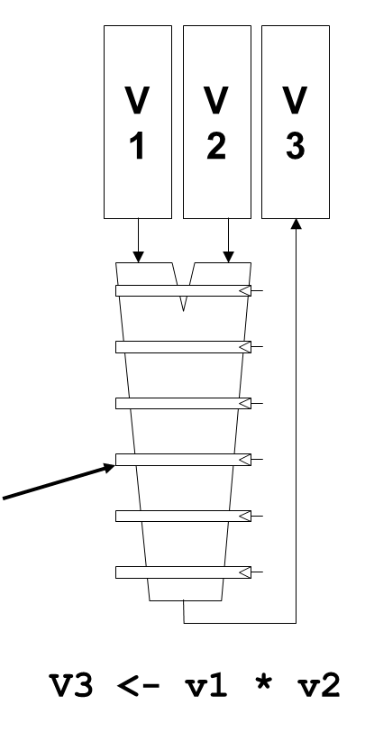
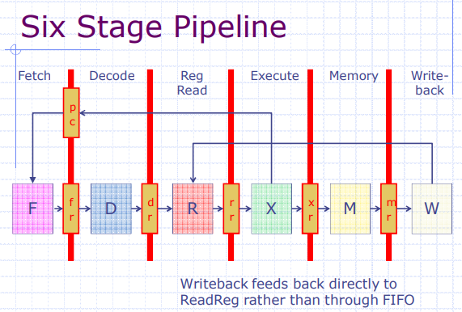
Vector Arithmetic Execution
Use deep pipeline to execute element operations
Simplify control of deep pipeline, since elements in vector are more independent and consistent, compared to general instruction pipelines.
Six stage
Multiply
pipeline

Slide 15
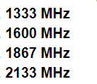
Vector Memory System
Cray-1, 16 banks, 4 cycle bank busy time, 12 start-up cycle latency
  Bank busy time: Cycles between accesses to same bank
  Start-up cycle latency: Cycles to access the first byte on a memory bank
Base
Stride
Vector Registers
Memory bus
about 1 cycle
Address Generator
+
0
1
2
3
4
5
6
7
8
9
A
B
C
D
E
F
Memory Banks

Slide 16
RV64V instructions
Vector Architectures
vadd : add two vectors.
vld/vst: vector load and vector store from address
  x5 → the address of vector X
  x6 → the address of vector Y
Example: DAXPY (double precision a*X+Y) → 6 instructions
vsetdcfg 4*FP64 # Enable 4 DP FP vregs
fld f0,a # Load scalar a
vld v0,x5 # Load vector X
vmul v1,v0,f0 # Vector-scalar mult
vld v2,x6 # Load vector Y
vadd v3,v1,v2 # Vector-vector add
vst v3,x6 # Store the sum
vdisable # Disable vector regs
Assumption: the vector length matches the number of vector operations – no loop necessary.

Slide 17
DAXPY using RV64G instructions
Vector Architectures
Example: DAXPY (double precision a*X+Y)
fld f0,a # Load scalar a
addi x28,x5, #256 # Last address to load
Loop: fld f1,0(x5) # Load X[i]
fmul.d f1,f1,f0 # a * X[i]
fld f2,0(x6) # Load Y[i]
fadd.d f2,f2,f1 # a * X[i] + Y[i]
fsd f2,0(x6) # Store into Y[i]
addi x5,x5,#8 # Increment index to X
addi x6,x6,#8 # Increment index to Y
bne x28,x5,Loop # Check if done
Requires almost 258 RV64G ops when the vectors have 32 elements→ 32 elements of a vector, 8 ops
258=2+32*8

Slide 18
Execution time – pipelined vector instructions
Vector Architectures
How to quantify the run time of vector instructions.
  E.g. vld-> vmul -> vadd
Load
Mul
Time
Add
Or
Load
Expected pipelined execution.
However there are hazards to avoid
Mul
Add
Time

Slide 19
Execution time – pipelined vector instructions
Vector Architectures
Pipelined vector execution time depends on:
  Length of operand vectors
  Structural hazards (结构风险), A structural hazard occurs when two (or more) instructions that are already in pipeline need the same resource, e.g. conflicts on memory controller
  Data dependencies
RV64V functional unit consumes one element per clock cycle
→ Execution time is approximately the vector length
Convoy （护航指令组） → Set of vector instructions without structural hazards that could potentially execute together, how to take advantage of pipeline?
  No structural hazards, if have, the instructions must be serialized and initiated in different convoy

Slide 20
Chaining and chimes
Vector Architectures
Chaining （链接操作）
  Allows a vector operation to start as soon as the individual elements of its vector source operand become available
Chime （钟鸣，计时单位）
  Unit of time to execute one convey
  Assuming processing one element consuming one clock
    m conveys executes in m chimes
    For vector length of n, requires m x n clock cycles
    Ignore the start-up time, that is the latency in clock cycles until the pipeline is full.
    The chime ignores some processor-specific overheads, many of which are dependent on vector length.
Sequences with read-after-write dependency hazards can be in the same convey via chaining

Slide 21
Vector Chaining
Vector version of register bypassing
  introduced with Cray-1
V1
V2
V3
V4
V5
LV v1
MULV v3,v1,v2
ADDV v5, v3, v4
Chain
Chain
Load Unit
Mult.
Add
Memory

Slide 22
Vector Chaining Advantage
Without chaining, must wait for last element of result to be written before starting dependent instruction
Load
Mul
Time
Add
With chaining, can start dependent instruction as soon as first result (element) appears
Load
Mul
Add

Slide 23
Example – one functional unit
Vector Architectures
vld v0,x5 # Load vector X
vmul v1,v0,f0 # Vector-scalar multiply
vld v2,x6 # Load vector Y
vadd v3,v1,v2 # Vector-vector add
vst v3,x6 # Store the sum
3 convoys (护航指令组)
3 chimes (钟鸣)
32 elements
vld
Chaining
Three convoys:
vmul
1. vld vmul
2. vld vadd
3. vst
vld
Chaining
vadd
vst
Time
For 32 element vectors, requires 32 x 3 = 96 clock cycles
3 chimes (3 clocks per element), 2 FP ops per element,
cycles per FLOP = 96 / (32 * 2) = 1.5
Overheads ignored: 1) vector instruction issue time, 2) vector startup time: the latency in clock cycles until the pipeline is full.

Slide 24
Cray-1 (1976)
Vector Architectures
V0
V_{i}
V. Mask
V1
V_{j}
64 Element Vector Registers
V2
V. Length
V3
V_{k}
Single Port
Memory
16 banks of 64-bit words
+
8-bit SECDED单错纠正双错检测
80MW/sec data load/store
320MW/sec instruction
buffer refill
V4
V5
V6
V7
FP Add
S0
S_{j}
FP Mul
( (A_{h}) + j k m )
S1
S2
S_{k}
FP Recip
64
T Regs
S_{i}
S3
(A₀)
S4
S_{i}
Int Add
T_{jk}
S5
S6
Int Logic
S7
Int Shift
( (A_{h}) + j k m )
A0
Pop Cnt
A1
A_{i}
A2
A_{j}
(A₀)
64
B Regs
A3
A_{k}
Addr Add
B_{jk}
A4
A5
A_{i}
Addr Mul
A6
A7
64-bitx16
NIP
CIP
4 Instruction Buffers
LIP
memory bank cycle 50 ns processor cycle 12.5 ns (80MHz)
24

Slide 25
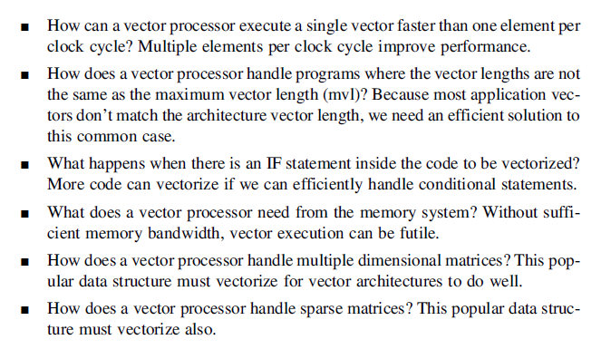

Problems motivate optimization on vector processor

Slide 26
Optimizations
Multiple Lanes （多条车道）→ processing more than one element per clock cycle
Vector Length Registers （向量长度寄存器）→ handling non-32 wide vectors
Vector Mask Registers （向量遮罩寄存器）→ handling IF statements in vector code
Memory Banks （内存组）→ memory system optimizations to support vector processors
Stride （步幅）→ handling multi-dimensional arrays
Scatter-Gather （分散-集中）→ handling sparse matrices
Programming Vector Architectures （向量体系结构编程）→ program structures affecting performance
Question: how these optimizations map to MPI and OpenMP?

Slide 27
Optimizations
Multiple Lanes （多条车道）→ processing more than one element per clock cycle
Vector Length Registers （向量长度寄存器）→ handling non-32 wide vectors
Vector Mask Registers （向量遮罩寄存器）→ handling IF statements in vector code
Memory Banks （内存组）→ memory system optimizations to support vector processors
Stride （步幅）→ handling multi-dimensional arrays
Scatter-Gather （分散-集中）→ handling sparse matrices
Programming Vector Architectures （向量体系结构编程）→ program structures affecting performance
Question: how these optimizations map to MPI and OpenMP?

Slide 28
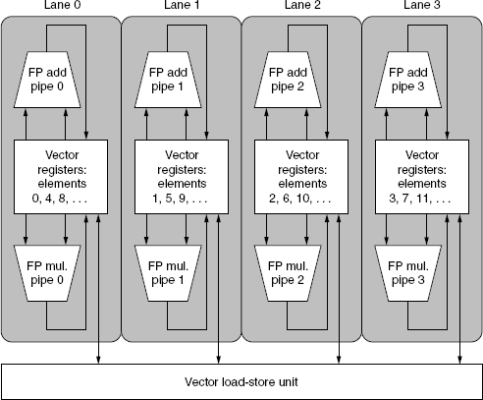
1. A four lane vector unit
RV64V instructions only allo element N of one vector to take part in operations involving element N from other vector registers→ this simplifies the construction of a highly parallel vector unit
  Lane → contains one portion of the vector register elements and one execution pipeline from each functional unit
  Analog with a highway
with multiple lanes!!
w

Slide 29
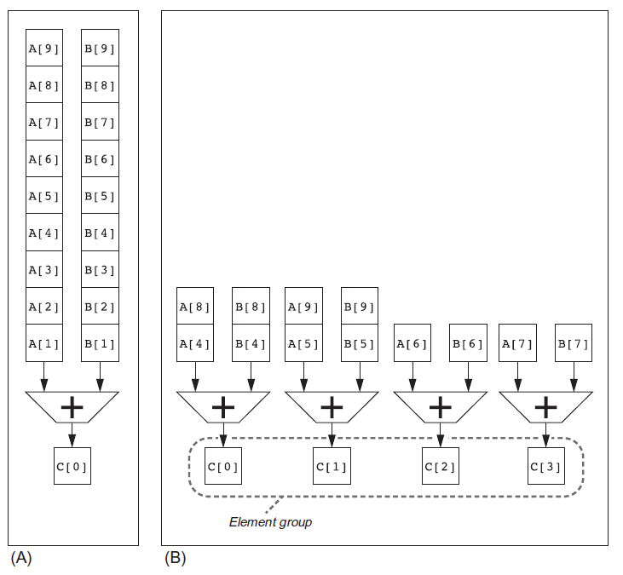
Single versus multiple add pipelines
C= A+B
One versus four additions per
clock cycle
Each pipe adds the corresponding elements of the two vectors
C(i) = A(i) + B(i)

Slide 30
Vector Instruction Execution
ADDV C,A,B
Execution using one pipelined functional unit
Execution using four pipelined functional units
A[6]
B[6]
A[24]
B[24]
A[25]
B[25]
A[26]
B[26]
A[27]
B[27]
A[5]
B[5]
A[20]
B[20]
A[21]
B[21]
A[22]
B[22]
A[23]
B[23]
A[4]
B[4]
A[16]
B[16]
A[17]
B[17]
A[18]
B[18]
A[19]
B[19]
A[3]
B[3]
A[12]
B[12]
A[13]
B[13]
A[14]
B[14]
A[15]
B[15]
C[2]
C[8]
C[9]
C[10]
C[11]
C[1]
C[4]
C[5]
C[6]
C[7]
C[0]
C[0]
C[1]
C[2]
C[3]

Slide 31
Automatic Code Vectorization
for (i=0; i < N; i++)
C[i] = A[i] + B[i];
Scalar Sequential Code
Vectorized Code
load
load
load
Iter. 1
load
load
load
Time
add
add
add
store
store
store
load
Iter. 1
Iter. 2
Iter. 2
load
Vector Instruction
Vectorization is a massive compile-time reordering of operation sequencing
⇒ requires extensive loop dependence analysis
add
store

Slide 32
Vector Programming Model
Vector Architectures
Scalar Registers
Vector Registers
r15
v15
r0
v0
[0]
[1]
[2]
[VLRMAX-1]
Vector Length Register
VLR
v1
Vector Arithmetic Instructions
ADDV v3, v1, v2
v2
+
+
+
+
+
+
v3
[0]
[1]
[VLR-1]
Vector Load and Store Instructions
LV v1, r1, r2
Vector Register
v1
Memory
Base, r1
Stride, r2
32
32

Slide 33
Optimizations
Multiple Lanes （多条车道）→ processing more than one element per clock cycle
Vector Length Registers （向量长度寄存器）→ handling non-32 wide vectors
Vector Mask Registers （向量遮罩寄存器）→ handling IF statements in vector code
Memory Banks （内存组）→ memory system optimizations to support vector processors
Stride （步幅）→ handling multi-dimensional arrays
Scatter-Gather （分散-集中）→ handling sparse matrices
Programming Vector Architectures （向量体系结构编程）→ program structures affecting performance
Question: how these optimizations map to MPI and OpenMP?

Slide 34

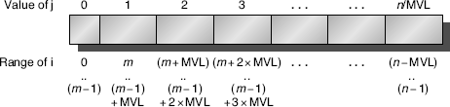
2. VLR and MVL: handling loops not equal to 32
Vector Architectures
VLR →Vector Length Register; MVL → Max Vector Length
Vector length:
  Not known at compile time?
  Not multiple of 32?
Use strip mining for vectors over the maximum length:
low = 0; VL = (n % MVL);
for (j = 0; j <= (n/MVL); j=j+1) {
for (i = low; i < (low+VL); i=i+1)
Y[i] = a * X[i] + Y[i] ;
low = low + VL;
VL = MVL;
}
/*find odd-size piece using modulo op % */
/*outer loop*/
/*runs for length VL*/
/*main operation*/
/*start of next vector*/
/*reset length to maximum vector length*/
If n%MVL != 0, how to unroll loops?

Slide 35
Optimizations
Multiple Lanes （多条车道）→ processing more than one element per clock cycle
Vector Length Registers （向量长度寄存器）→ handling non-32 wide vectors
Vector Mask Registers （向量遮罩寄存器）→ handling IF statements in vector code
Memory Banks （内存组）→ memory system optimizations to support vector processors
Stride （步幅）→ handling multi-dimensional arrays
Scatter-Gather （分散-集中）→ handling sparse matrices
Programming Vector Architectures （向量体系结构编程）→ program structures affecting performance
Question: how these optimizations map to MPI and OpenMP?

Slide 36
3. Vector mask registers
Handling IF statements in a loop
for (i = 0; i < 64; i=i+1) if (X[i] != 0)
X[i] = X[i] – Y[i];
If conversion →use vector mask register to “disable/select” vector elements.
When the predicate register p0 is set, all following vector instructions operate only on the vector elements whose corresponding entries in the predicate register are 1.
vsetdcfg 2*FP64 # Enable 2 64-bit FP vector regs
vsetpcfgi 1 # Enable 1 predicate register
vld v0,x5 # Load vector X into v0
vld v1,x6 # Load vector Y into v1
fmv.d.x f0,x0 # Put (FP) zero into f0
vpne p0,v0,f0 # Set p0(i) to 1 if v0(i)!=f0
vsub v0,v0,v1 # Subtract under vector mask
vst v0,x5 # Store the result in X
vdisable # Disable vector registers
vpdisable # Disable predicate registers

Slide 37
Masked Vector Instructions
Simple Implementation
  execute all N operations, turn off result writeback according to mask
Density-Time Implementation
  scan mask vector and only execute elements with non-zero masks
P[7]=1
A[7]
B[7]
P[7]=1
P[6]=0
A[6]
B[6]
P[6]=0
A[7]
B[7]
P[5]=1
A[5]
B[5]
P[5]=1
P[4]=1
A[4]
B[4]
P[4]=1
P[3]=0
A[3]
B[3]
P[3]=0
C[5]
P[2]=0
C[4]
P[1]=1
P[2]=0
C[2]
P[0]=0
P[1]=1
C[1]
C[1]
Write data port
P[0]=0
C[0]
Write Disable
Write data port

Slide 38
Optimizations
Multiple Lanes （多条车道）→ processing more than one element per clock cycle
Vector Length Registers （向量长度寄存器）→ handling non-32 wide vectors
Vector Mask Registers （向量遮罩寄存器）→ handling IF statements in vector code
Memory Banks （内存组）→ memory system optimizations to support vector processors
Stride （步幅）→ handling multi-dimensional arrays
Scatter-Gather （分散-集中）→ handling sparse matrices
Programming Vector Architectures （向量体系结构编程）→ program structures affecting performance
Question: how these optimizations map to MPI and OpenMP?

Slide 39
4. Memory banks
Memory system must be designed to support high bandwidth for vector loads and stores
  Memory start-up time: get the first word from memory in to a register
Spread accesses across multiple banks
  Control bank addresses independently
  Load or store non-sequential words
  Support multiple vector processors sharing the same memory
Example:
  32 processors, each generating 4 loads and 2 stores/cycle
  Processor cycle time is 2.167 ns, DRAM bank busy time (and bank latency) is 15 ns or about 67 M per second.
  How many minimum memory banks needed to allow all processors to run at the full memory bandwidth (no bank conflicts)?
    32 processors x 6 =192 memory accesses,
    15ns DRAM cycle /2.167ns processor cycle≈7 processor cycles
    7 x 192 →1344!

Slide 40
Memory Banks & Full Memory Bandwidth
No bank conflict is a critical condition for achieving full memory bandwidth.
Cycle 1
192 requests
Cycle 2
192 requests
Need at least 192x7 = 1344 banks without bank conflicts.
Assuming that requests are distributed as evenly as possible on banks.
Cycle 3
192 requests
Cycle 4
192 requests
Cycle 5
192 requests
Cycle 6
192 requests
Data transferred after bank busy time
Cycle 7
192 requests
Cycle 8
192 requests*
192 requests
Available banks 1344
(busy time 7 cycles)

Slide 41
Example for bank conflict
Assuming total 1280 banks, and the dark gray memory only contains 128 banks, when coming into 192 requests, resulting in 64 bank conflicts.
Cycle 1
192 requests
(1)
Cycle 2
128 requests
64
(2)
(7)
Cycle 3
192 requests
Waiting for
available banks
Cycle 4
192 requests
Cycle 5
192 requests
Cycle 6
192 requests
Data transferred
Cycle 7
192 requests
Cycle 8
192 requests *
192 requests
.
.
.
(8)
Cycle 9
64 + 64 requests*
128*
128 requests
Available banks 1280
(busy time 7 cycles)
Cycle 15

Slide 42
Theoretical Memory Bandwidth
DRAM clock frequency
Number of data transfers per clock: Two, in the case of "double data rate" (DDR, DDR2, DDR3, DDR4) memory.
Memory bus (interface) width: Each DDR, DDR2, or DDR3 memory interface is 64 bits wide. Those 64 bits are sometimes referred to as a "line."
Number of interfaces: Modern personal computers typically use two memory interfaces (dual-channel mode) for an effective 128-bit bus width.
For example, a computer with dual-channel memory and one DDR2-800 module per channel running at 400 MHz would have a theoretical maximum memory bandwidth of:
400,000,000 clocks per second × 2 transfers per clock × 64 bits per line × 2 interfaces = 102,400,000,000 (102.4 billion) bits per second (in bytes, 12,800 MB/s or 12.8 GB/s)

Slide 43
Memory operations
Load/store operations move groups of data between registers and memory
Three types of addressing
  Unit stride
    Contiguous block of information in memory
    Fastest: always possible to optimize this
  Non-unit (constant) stride
    Harder to optimize memory system for all possible strides
    Prime number of data banks makes it easier to support different strides at full bandwidth
  Indexed (gather-scatter)
    Vector equivalent of register indirect
    Good for sparse arrays of data
    Increases number of programs that vectorize

Slide 44
Memory Layout
Vector Processor
Unpipelined
DRAM
Unpipelined
DRAM
Unpipelined
DRAM
Unpipelined
DRAM
Unpipelined
DRAM
Unpipelined
DRAM
Unpipelined
DRAM
Unpipelined
DRAM
Addr
Mod 8
= 0
Addr
Mod 8
= 1
Addr
Mod 8
= 2
Addr
Mod 8
= 3
Addr
Mod 8
= 4
Addr
Mod 8
= 5
Addr
Mod 8
= 6
Addr
Mod 8
= 7
Great for unit stride:
  Contiguous elements in different DRAMs
  Startup time for vector operation is latency of single read
What about non-unit stride?
  Above good for strides that are relatively prime to 8
  Bad for: 2, 4, 8 (worst)
  Better: prime number of banks…!

Slide 45
Optimizations
Multiple Lanes （多条车道）→ processing more than one element per clock cycle
Vector Length Registers （向量长度寄存器）→ handling non-32 wide vectors
Vector Mask Registers （向量遮罩寄存器）→ handling IF statements in vector code
Memory Banks （内存组）→ memory system optimizations to support vector processors
Stride （步幅）→ handling multi-dimensional arrays
Scatter-Gather （分散-集中）→ handling sparse matrices
Programming Vector Architectures （向量体系结构编程）→ program structures affecting performance
Question: how these optimizations map to MPI and OpenMP?

Slide 46
5. Stride 跨步访问 → multiple dimensional arrays
Vector Architectures
Technique to fetch vector elements that are not adjacent in memory
Stride → the distance between elements to be gathered in one register.
Example (Assume that the arrays are stored in row major order!!)
for (i = 0; i < 100; i=i+1) // A = B * D, 100*100 matrix
for (j = 0; j < 100; j=j+1) {
A[i][j] = 0.0;
for (k = 0; k < 100; k=k+1) A[i][j] = A[i][j] + B[i][k] * D[k][j];
}
Must vectorize multiplication of rows of B with columns of D
Use non-unit stride; D’s stride is 100 double words (800 bytes); B’s
stride is one double word (8 bytes)
Bank conflict (stall) occurs when the same bank is hit faster than bank busy time:
  #banks / GCD(stride, #banks) < bank busy time (in # of cycles)

Slide 47
Stride example
Vector Architectures
Given
  8 memory banks, requests are sequentially sent to banks with a fixed time interval (e.g. one cycle)
  memory start-up latency of 12 cycles.
  bank busy time of 6 cycles
  bank busy time: the busy time is the time the bank is occupied with one request
Questions: How long will it take to complete a 64-element vector load
1. With a stride of 1?
2. With a stride of 32?
Answers:
1. Stride of 1: number of banks is greater than the bank busy time, so it takes 12 + 64 = 76 clock cycles → 76/64 = 1.2 cycle for each vector element
2. Stride of 32: the worst case scenario happens when the stride value is a multiple of the number of banks, which this is! Every access to memory will collide with the previous one! Thus, the total time will be:
12 + 1 + 6 * 63 = 391 clock cycles→ 391/64 = 6.1 clock cycles per vector
element!

Slide 48
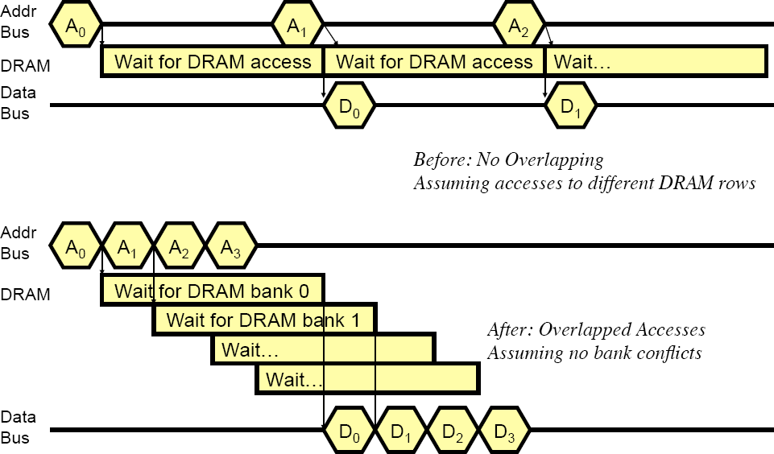
How Multiple Banks Help, e.g. 8 banks
Start-up Mem latency, Stride 32
Bank conflicts
Bank busy time
Start-up Mem latency, Stride 1
in the same bank

Slide 49
Optimizations
Multiple Lanes （多条车道）→ processing more than one element per clock cycle
Vector Length Registers （向量长度寄存器）→ handling non-32 wide vectors
Vector Mask Registers （向量遮罩寄存器）→ handling IF statements in vector code
Memory Banks （内存组）→ memory system optimizations to support vector processors
Stride （步幅）→ handling multi-dimensional arrays
Scatter-Gather （分散-集中）→ handling sparse matrices
Programming Vector Architectures （向量体系结构编程）→ program structures affecting performance
Question: how these optimizations map to MPI and OpenMP?

Slide 50
6 Scatter-gather
Vector Architectures
Support moving between compressed representation and normal representation of a sparse matrix or vector.
Consider sparse vectors A & C and vector indices K & M. A and C have the same number (n) of non-zeros:
for (i = 0; i < n; i=i+1)
A[K[i]] = A[K[i]] + C[M[i]];
x7, x5, x28 and x6 the starting addresses of vectors
Use index vector:
vsetdcfg 4*FP64 # 4 64b FP vector registers
vld v0, x7 # Load K[]
vldi v1, x5, v0) # Load A[K[]]
vld v2, x28 # Load M[]
vldi v3, x6, v2) # Load C[M[]]
vadd v1, v1, v3 # Add them
vsti v1, x5, v0) # Store A[K[]]
vdisable # Disable vector registers

Slide 51
Optimizations
Multiple Lanes （多条车道）→ processing more than one element per clock cycle
Vector Length Registers （向量长度寄存器）→ handling non-32 wide vectors
Vector Mask Registers （向量遮罩寄存器）→ handling IF statements in vector code
Memory Banks （内存组）→ memory system optimizations to support vector processors
Stride （步幅）→ handling multi-dimensional arrays
Scatter-Gather （分散-集中）→ handling sparse matrices
Programming Vector Architectures （向量体系结构编程）→ program structures affecting performance
Question: how these optimizations map to MPI and OpenMP?

Slide 52
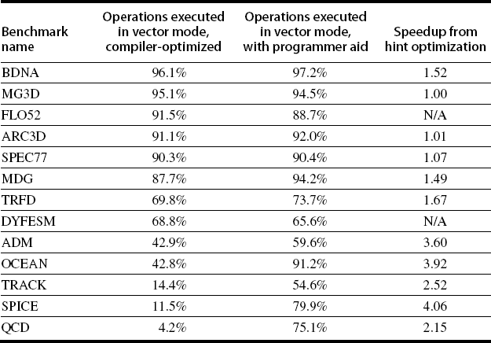
7 Programming vector architectures
Vector Architectures
Compilers can provide feedback to programmers
Programmers can provide hints to compiler
  https://software.intel.com/content/www/us/en/develop/articles/vectorization-with-the-intel-compilers-part-i.html
the percentage of operations executed in vector mode

Slide 53
Summary of vector architecture
Vector Architectures
Optimizations:
  Multiple Lanes: > 1 element per clock cycle
  Vector Length Registers: Non-64 wide vectors
  Vector Mask Registers: IF statements in vector code
  Memory Banks: Memory system optimizations to support vector processors
  Stride: Multiple dimensional matrices
  Scatter-Gather: Sparse matrices
  Programming Vector Architectures: Program
structures affecting performance

Slide 54
B. SIMD extensions for media apps
Media applications operate on data types narrower than the native word size.
  Graphics: 3x8-bit colors, 8-bit for transparency
  Audio: 8/16/24 bit/sample
Disconnect carry (进位) chains to “partition” adder.
  Example: a 256 adder can be partitioned to perform simultaneously:
    32 x 8-bit additions
    16 x 16-bit additions
    8 x 32-bit additions
    4 x 64-bit additions
Limitations, compared to vector instructions:
  Unlike vector machines with large register files e.g. the RV64V, thirty-two 64-bit elements in each of 32 vector registers
  Number of data operands encoded into op code
  No sophisticated addressing modes (strided, scatter-gather)
  No mask registers

Slide 55
Intel SIMD extension to x86-64 implementations
SIMD Instruction Set Extensions for Multimedia
Intel MMX (1996)
  Eight 8-bit integer ops or four 16-bit integer ops
Streaming SIMD Extensions: (SSE) (1999), SSE3 (2004),SSE4 (2007)
  Eight 16-bit integer ops
  Four 32-bit integer/fp ops or two 64-bit integer/fp ops
Advanced Vector Extensions (AVE) (2010)
  Four 64-bit integer/fp ops
Operands must be consecutive and at aligned memory locations
Generally designed to accelerate carefully written libraries rather
than for compilers.
Advantages over vector architecture:
  Cost little to add to the standard ALU
  Easy to implement
  Require little extra state → easy for context-switching
  Require little extra memory bandwidth
  No virtual memory problem of cross-page access and page-fault

Slide 56
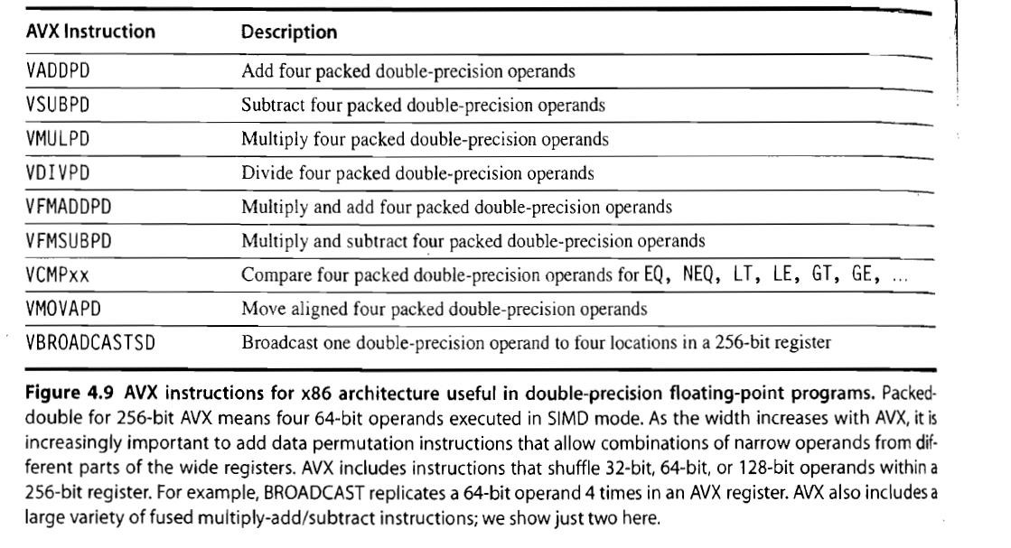

Slide 57
Example: SIMD code for DXPY; Y = Y + a X
SIMD Instruction Set Extensions for Multimedia
256 – bit SIMD multimedia instructions added to RISC-V.
.4D → instructions operating on 4 double precision operands at once.
fld f0,a #Load scalar a
splat.4D f0,f0 #Make 4 copies of a
addi x28,x5,#256 #Last address to load
Loop: fld.4D f1,0(x5) #Load X[i] ... X[i+3]
fmul.4D f1,f1,f0 #a*X[i] ... A*X[i+3]
fld.4D f2,0(x6) #Load Y[i] ... Y[i+3]
fadd.4D f2,f2,f1 # a*X[i]+Y[i]...
# a*X[i+3]+Y[i+3]
fsd.4D f2,0(x6) #Store Y[i]... Y[i+3]
addi x5,x5,#32 #Increment index to X
addi x6,x6,#32 #Increment index to Y
bne x28,x5,Loop #Check if done

Slide 58
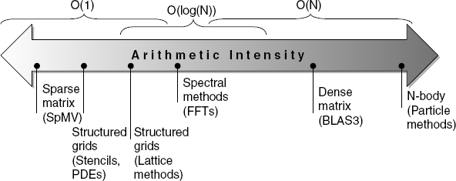
Roofline performance model
Basic idea:
  Peak floating-point performance as a function of arithmetic intensity
  Ties together floating-point performance and memory performance
Arithmetic intensity (计算密度、计算访存比)→ Floating-point operations per byte read
Max Attainable GFLOPs/sec = Min (Peak Memory BW × Arithmetic Intensity, Peak Floating Point Performance)
Stream is a benchmark for memory performance
c
Dense matrix operations scale with problem size but sparse matrix operations do not!!

Slide 59
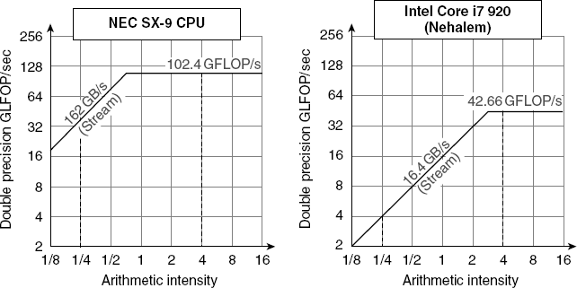
Examples
Roofline: on the sloped portion of the roof the performance is limited by the memory bandwidth, on the flat portion it is limited by peak floating point performance
Mem BW
162*(1/8)=20.25
Mem BW
102.4/162=0.632
42.66/16.4=2.6
16.4*(1/8)=2.05

Slide 60
C. Graphical Processing Unit - GPU
Graphical Processing Units
Given the hardware invested to do graphics well, how can it be supplemented to improve performance of a wider range of applications (General-purpose GPU)?
Basic idea:
  Heterogeneous execution model
    CPU is the host, GPU is the device
  Develop a C-like programming language for GPU
    Compute Unified Device Architecture (CUDA)
    OpenCL for vendor-independent language
  Unify all forms of GPU parallelism as CUDA thread
  Programming model: “Single Instruction Multiple Thread” (SIMT)

Slide 61
Threads, blocks, and grid (CUDA terminology)
A CUDA thread is associated with each data element
  CUDA threads ➔ thousands of threads are utilized to various styles of
parallelism: multithreading, SIMD, MIMD, ILP
CUDA threads with index are organized into thread blocks
  Thread Blocks: groups of up to 512 elements
  Executed on Multithreaded SIMD Processor: hardware that executes a whole thread block (32 elements executed per SIMD thread at a time)
Thread Blocks with index are organized into a grid
  Blocks are executed independently and in any order
  Different blocks cannot communicate directly but can coordinate using atomic memory operations in Global Memory
CUDA thread management handled by GPU hardware and CUDA runtime not by applications or OS
  A multiprocessor composed of multithreaded SIMD processors
  A Thread Block Scheduler (Hardware)

Slide 62
NVIDIA GPU architecture
Similarities to vector machines:
  Works well with data-level parallel problems
  Scatter-gather transfers
  Mask registers
  Large register
Differences:
  No scalar processor
  Uses multithreading to hide memory latency
  Has many functional units, as opposed to a few deeply pipelined units like a vector processor

Slide 63
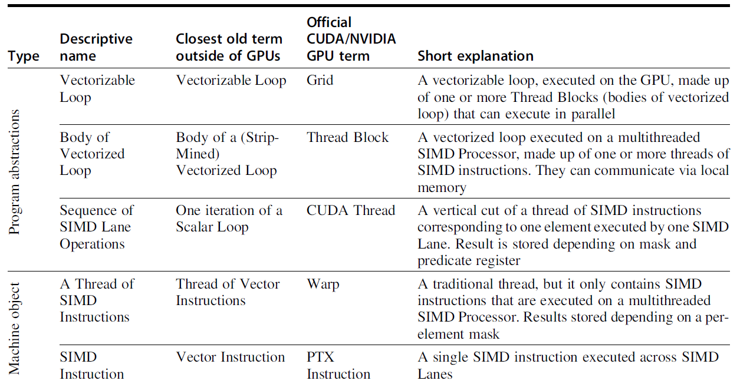
Terms used in this chapter to official NVIDIA/CUDA
Graphical Processing Units
Academic
Industry
(SIMD Thread)

Slide 64
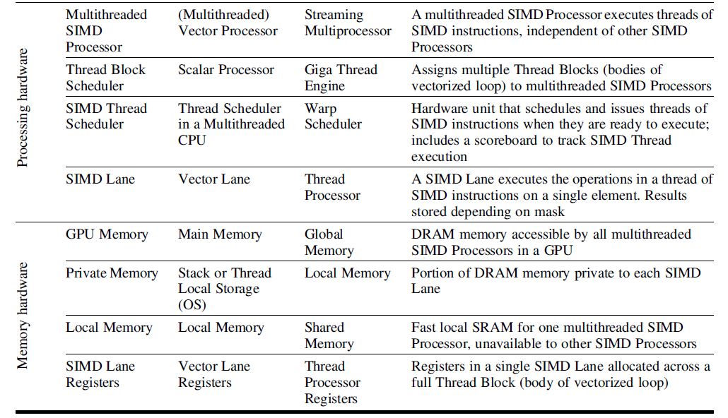
Terms used in this chapter to official NVIDIA/CUDA
Graphical Processing Units

Slide 65
Example: multiply two vectors of length 8192
Graphical Processing Units
Q: Principle differences between C SIMD and CUDA SIMT?
C code version:
// Invoke DAXPY
daxpy(n, 2.0, x, y);
// DAXPY in C
void daxpy(int n = 8192, double a, double *A, double *B, double *C)
{
for (int i = 0; i < n; ++i)
A[i] = B[i] * C[i];
}
// Invoke DAXPY with 512 threads per Thread Block
// code in C
int nblocks = (n+ 511) / 512;
daxpy<<<nblocks, 512 >>>(n, 2.0, A, B, C);
// DAXPY in CUDA
__global__ void daxpy (int n, double a, double *A,
double *B, double *C)
{
int i = blockIdx.x*blockDim.x + threadIdx.x;
if (i < n)
A[i] = B[i] * C[i];
}
CUDA version:
It seems that we are programming on a CUDA thread at element level. (Abstraction: SIMT)

Slide 66

Example: multiply two vectors of length 8192
Graphical Processing Units
Grid → Code that works over all elements
Thread block→ analogous to a vector loop with a vector length of typically up to 512. Breaks down the vectorized loop into manageable set (warp) of 32 CUDA threads
32 elements (CUDA threads) per SIMD thread (Warp) x 16 SIMD threads=512 elements per thread block
→ 512 elements (CUDA threads) per thread block, SIMD instruction executes 32 elements at a time
Grid size = 8192 vector elements / 512 elements per block = 16 thread blocks
Thread block scheduler → assigns a thread block to a
multithreaded SIMD processor
Current-generation GPUs (Pascal P100) have 56 multithreaded SIMD processors (Streaming processors)

Slide 67
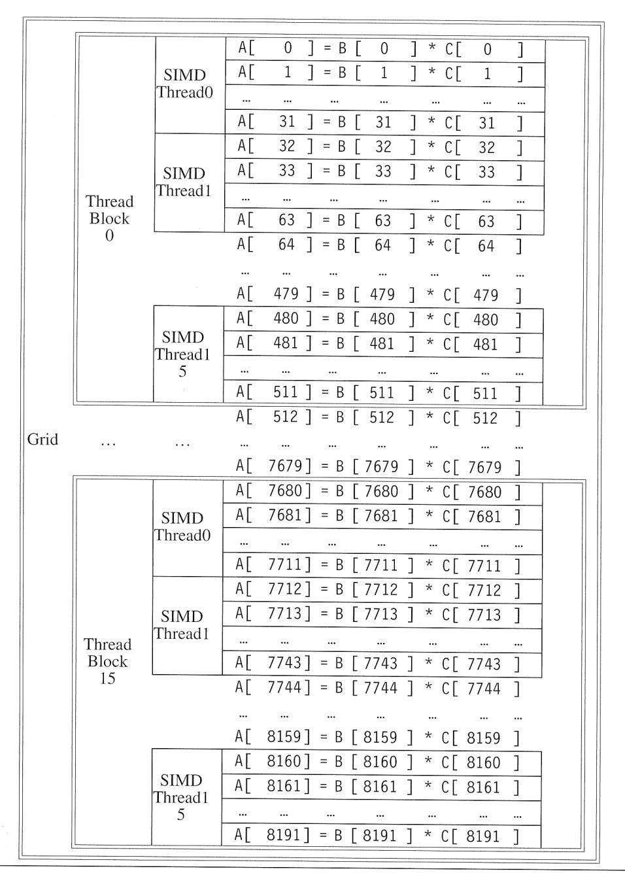
Threads, blocks, and grid example
Graphical Processing Units
Thread
block
scheduler
SIMD thread scheduler
SIMD
Thread (Warp) 15

Slide 68
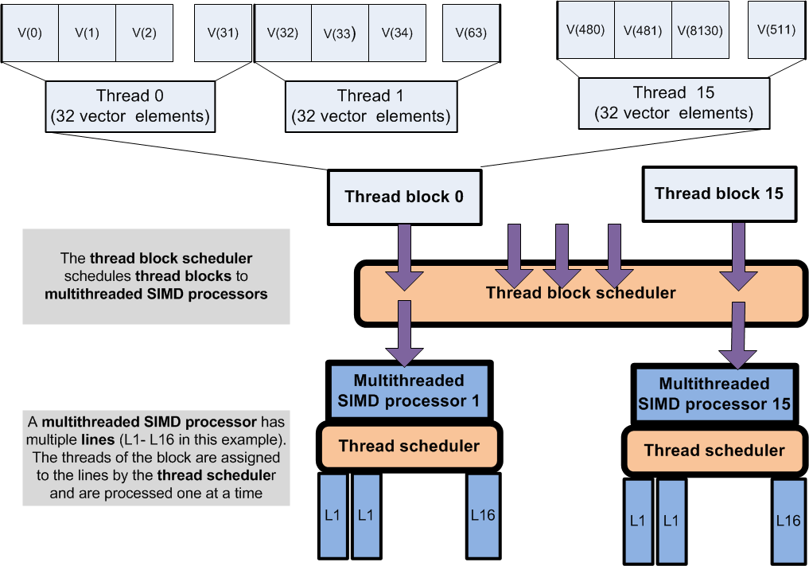
SIMD
SIMD
SIMD
32 vector elements map to
the term “warp” in CUDA
A multithreaded SIMD processor has multiple SIMD lanes (L1-L16 in this example). The CUDA threads of the thread block are assigned to the lanes by the thread scheduler and are processed one at a time.
SIMD
Thread
SIMD
Thread

Slide 69
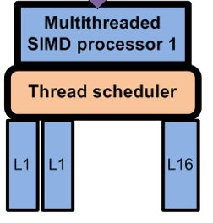
Terms in CUDA Prog. Model vs GPU Architecture
GPU
Thread block scheduler
SIMD
processor
CUDA Grid contains 4 thread blocks
CUDA
Thread
Block
Warps of a CUDA thread block can be viewed as SIMD threads in GPU architecture concurrently running on a SIMD processor and scheduled by SIMD thread scheduler.
split
CUDA
Warps
SIMD
Thread
CUDA Thread
SIMD processor’s lane

Slide 70
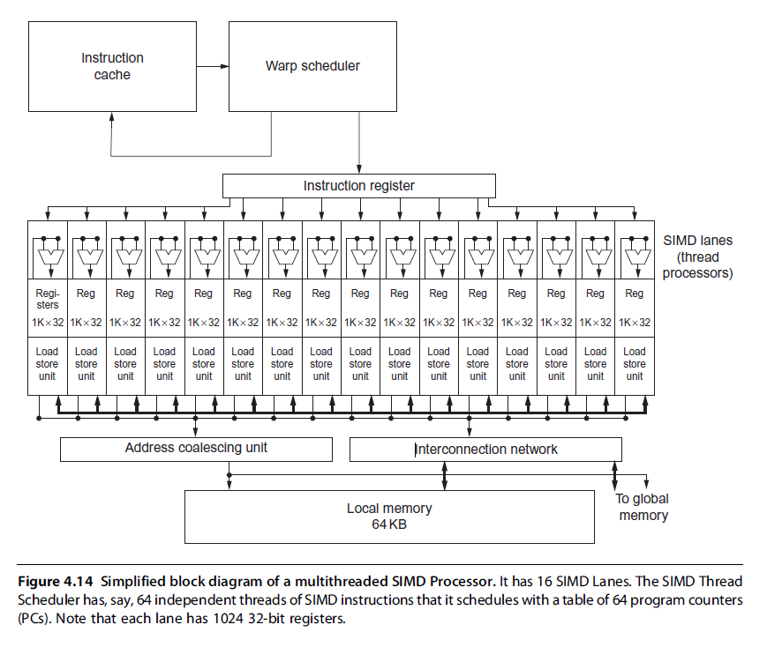
Threads, blocks, and grid example
SIMD thread scheduler (Warp scheduler)

Slide 71
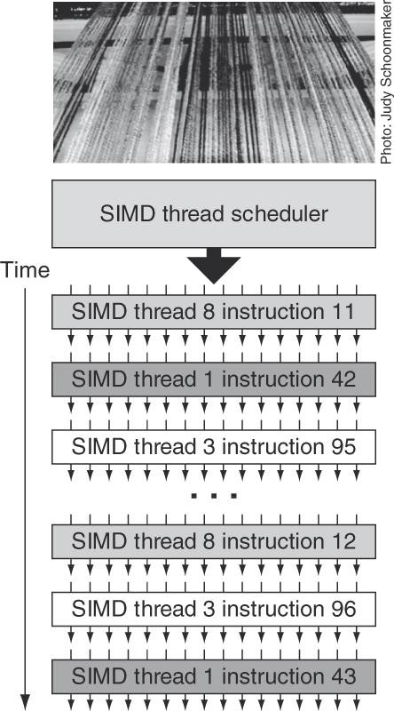
Figure 4.16 Scheduling of threads of SIMD instructions. The scheduler selects a ready thread of SIMD instructions and issues an instruction synchronously to all the SIMD Lanes executing the SIMD thread. Because threads of SIMD instructions are independent, the scheduler may select a different SIMD thread each time.
42

Slide 72
NVIDIA GPU memory structures
Graphical Processing Units
Each SIMD Lane (CUDA Thread) has private section of off-chip DRAM
  “Private memory”, not shared by any other lanes (CUDA Thread)
  Contains stack frame, register spilling, and private variables that don’t fit in the registers.
  Recent GPUs cache this private memory in L1 and L2 caches
Each multithreaded SIMD processor also has local memory (Shared Memory) that is on-chip
  Shared by SIMD lanes / threads within a block only
  Latency is 100x lower than GPU Memory.
  Threads can access data in local memory loaded from global memory by other threads within the same thread block
The off-chip memory shared by SIMD processors is GPU
memory (Global memory)
  Host can read and write GPU memory
72

Slide 73
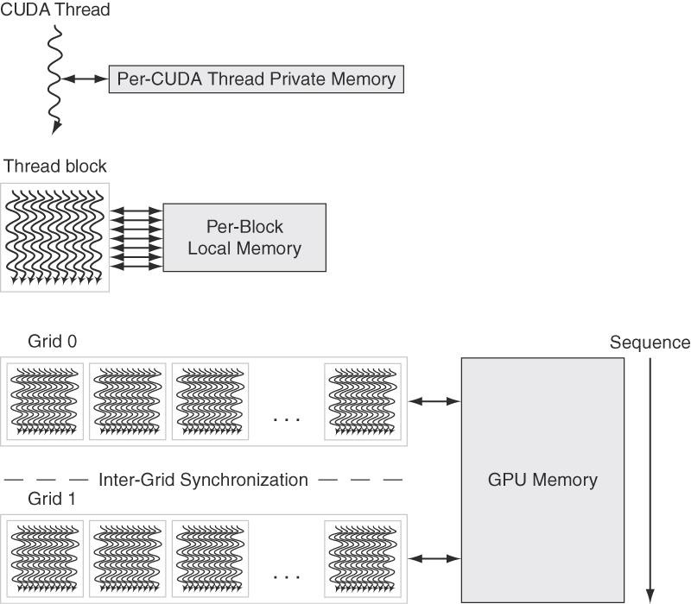
Figure 4.18 GPU Memory structures.
GPU Memory (Global Memory)→ shared by all Grids (vectorized loops),
Local Memory (Shared Memory) → shared by all threads of SIMD instructions within a thread block (body of a vectorized loop).
Private Memory →private to a single CUDA thread.
55
Notes:
Not all variables are in use (or "live") at the same time, so, over the lifetime of a program, a given register may be used to hold different variables. However, two variables in use at the same time cannot be assigned to the same register without corrupting one of the variables. If there are not enough registers to hold all the variables, some variables may be moved to and from RAM. This process is called "spilling" the registers.^{[4]} Over the lifetime of a program, a variable can be both spilled and stored in registers: this variable is then considered as "split".^{[5]} Accessing RAM is significantly slower than accessing registers ^{[6]} and so a compiled program runs slower. Therefore, an optimizing compiler aims to assign as many variables to registers as possible. A high "Register pressure" is a technical term that means that more spills and reloads are needed; it is defined by Braun et al. as "the number of simultaneously live variables at an instruction".^{[7]}
We call the on-chip memory that is local to each multithreaded SIMD Processor
local memory. It is a small scratchpad memory with low latency (a few dozen
clocks) and high bandwidth (128 bytes/clock) where the programmer can store
data that needs to be reused, either by the same thread or another thread in the same
Thread Block. Local memory is limited in size, typically to 48 KiB. It carries no
state between Thread Blocks executed on the same processor. It is shared by the
SIMD Lanes within a multithreaded SIMD Processor, but this memory is not
shared between multithreaded SIMD Processors. The multithreaded SIMD
Processor dynamically allocates portions of the local memory to a Thread Block
when it creates the Thread Block, and frees the memory when all the threads of the
Thread Block exit. That portion of local memory is private to that Thread Block.
Finally, we call the off-chip DRAM shared by the whole GPU and all Thread
Blocks GPU Memory. Our vector multiply example used only GPU Memory.
The system processor, called the host, can read or write GPU Memory. Local
memory is unavailable to the host, as it is private to each multithreaded SIMD
Processor. Private memories are unavailable to the host as well.

Slide 74
Terminology (GPU hardware)
Threads of SIMD instructions
  Each has its own PC
  Thread scheduler uses scoreboard to dispatch
  No data dependencies between threads!
  Keeps track of up to e.g. 48 threads of SIMD instructions
    Hides memory latency
Thread block scheduler
  Schedule thread blocks to SIMD processors, each thread block is split to manageable sets (warps) (e.g. 32 CUDA threads / warp) and assigned to SIMD threads running on a SIMD processor.
Within each SIMD processor:
  16 or 32 SIMD lanes
  Wide and shallow compared to vector processors

Slide 75
Example
Graphical Processing Units
NVIDIA GPU has 32,768 registers
  Divided into lanes
  A SIMD thread has up to:
    64 vector registers of 32 32-bit elements
    32 vector registers of 32 64-bit elements
Fermi has 16 physical SIMD lanes, each containing 2048 registers (2048 x 16 = 32,768)

Slide 76
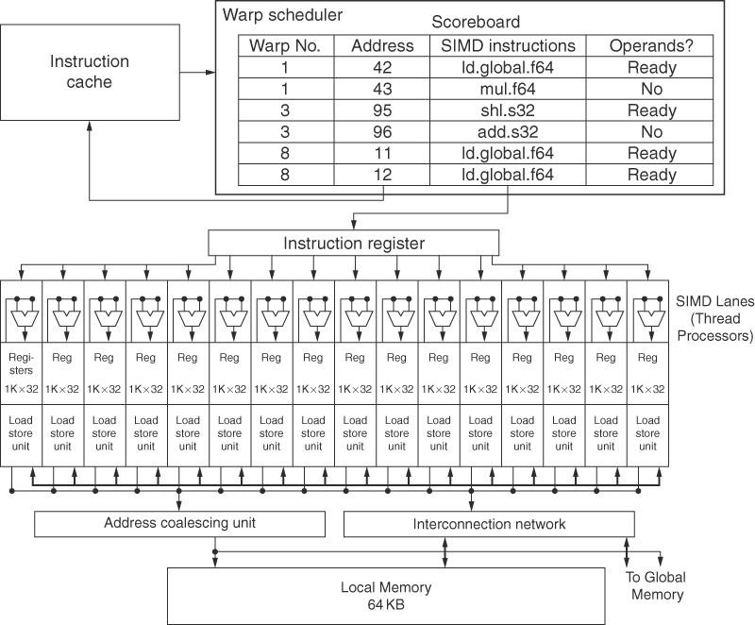
SIMD thread scheduler
Figure 4.14 Simplified block diagram of a Multithreaded SIMD Processor with 16 SIMD lanes. The SIMD Thread Scheduler has, say, 48 independent threads of SIMD instructions that it schedules with a table of 48 PCs.
47

Slide 77
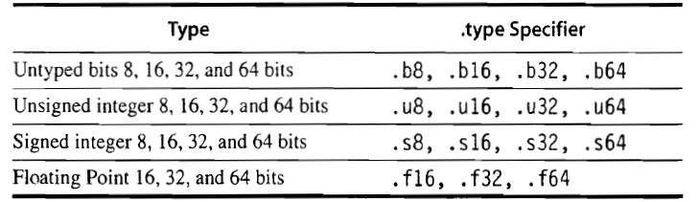
NVIDIA ISA -- PTX
Graphical Processing Units
PTX → Parallel Thread Execution
A PTX instruction describes the operation of a single CUDA thread!!
Like x86 instructions PTX instructions translate to an internal format
  X86 → translation done by hardware at execution time
  PTX → translation done by software at compile time.
The format of a PTX instruction: opcode.type d,a,b,c
  d → destination operand
  a, b, c → source operands
Use virtual registers
NVIDIA act as co-processors. Similar to I/O units
48

Slide 78
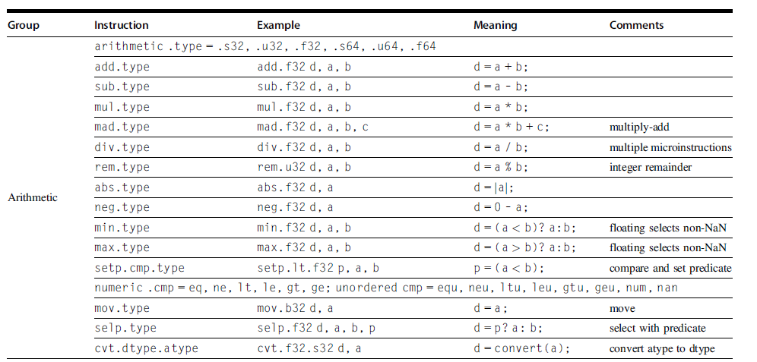
PTX arithmetic instructions
49

Slide 79
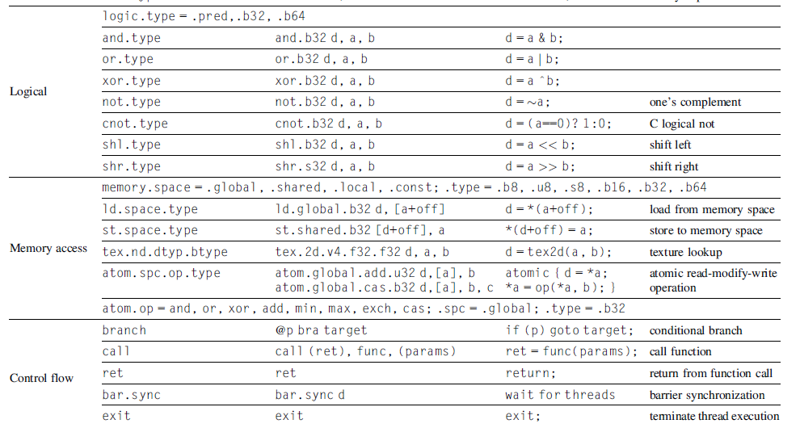
PTX logical, memory access, and control flow

Slide 80
Parallel Thread Execution (PTX) example
Graphical Processing Units
The following code is one CUDA thread, and 8192 of these created.
shl.s32 add.s32
R8, blockIdx, 9 ; Thread Block ID * Block size (512 or 2⁹)
R8, R8, threadIdx ; R8 = i = my CUDA thread ID
ld.global.f64 RD0, [X+R8] ld.global.f64 RD2, [Y+R8]
mul.f64 RD0, RD0, RD4
add.f64 RD0, RD0, RD2
st.global.f64 [Y+R8], RD0
; RD0 = X[i]
; RD2 = Y[i]
; Product in RD0 = RD0 * RD4 (scalar a)
; Sum in RD0 = RD0 + RD2 (Y[i])
; Y[i] = sum (X[i]*a + Y[i])

Slide 81
Conditional branching
Graphical Processing Units
GPU branch hardware uses:
  Internal mask registers
  Branch synchronization stack
    Entries consist of masks for each SIMD lane
    i.e. which threads commit their results (all threads execute)
  Instruction markers to manage when a branch diverges into multiple execution paths
    Push on divergent branch
  …and when paths converge
    Act as barriers
    Pops stack
Per-thread-lane 1-bit predicate register, specified by programmer
Notes:
A GPU set predicate instruction (setp in Figure 4.17) evaluates the conditional
part of the IF statement. The PTX branch instruction then depends on that
predicate. If the PTX assembler generates predicated instructions with no GPU
branch instructions, it uses a per-lane predicate register to enable or disable each
SIMD Lane for each instruction. The SIMD instructions in the threads inside the
THEN part of the IF statement broadcast operations to all the SIMD Lanes. Those
lanes with the predicate set to 1 perform the operation and store the result, and the
other SIMD Lanes don’t perform an operation or store a result. For the ELSE
statement, the instructions use the complement of the predicate (relative to the
THEN statement), so the SIMD Lanes that were idle now perform the operation
and store the result while their formerly active siblings don’t. At the end of
the ELSE statement, the instructions are unpredicated so the original computation
can proceed. Thus, for equal length paths, an IF-THEN-ELSE operates at 50%
efficiency or less.
IF statements can be nested, thus the use of a stack, and the PTX assembler
typically generates a mix of predicated instructions and GPU branch and special
synchronization instructions for complex control flow. Note that deep nesting
can mean that most SIMD Lanes are idle during execution of nested conditional
statements. Thus, doubly nested IF statements with equal-length paths run at
25% efficiency, triply nested at 12.5% efficiency, and so on. The analogous
case would be a vector processor operating where only a few of the mask bits
are ones.

Slide 82
Example
with *Push, *Comp, *Pop indicating
the branch synchronization markers inserted by the PTX assembler that push the old mask, complement the current mask, and pop to restore the old mask
Graphical Processing Units
if (X[i] != 0)
X[i] = X[i] – Y[i];
else
X[i] = Z[i];
ld.global.f64 setp.neq.s32 @!P1, bra | RD0, [X+R8] P1, RD0, #0 ELSE1, *Push | ; RD0 = X[i] ; P1 is predicate register 1 ; Push old mask, set new mask bits
 |  | ; if P1 false, go to ELSE1
ld.global.f64 | RD2, [Y+R8] | ; RD2 = Y[i]
sub.f64 | RD0, RD0, RD2 | ; Difference in RD0
st.global.f64 | [X+R8], RD0 | ; X[i] = RD0
@P1, bra | ENDIF1, *Comp | ;bitwise complement mask bits
 |  | ; if P1 true, go to ENDIF1
ELSE1: | ld.global.f64 RD0, [Z+R8] | ; RD0 = Z[i]
 | st.global.f64 [X+R8], RD0 | ; X[i] = RD0
Q. How the PTX codes are executed on GPU?
SIMT
ENDIF1: <next instruction>, *Pop ; pop to restore old mask
Note: a thread has 64 vector components, each a 32 bit floating point
Notes:
Once again, normally all instructions in the IF-THEN-ELSE statement are executed
by a SIMD Processor. It’s just that only some of the SIMD Lanes are enabled
for the THEN instructions and some lanes for the ELSE instructions. As previously
mentioned, in the surprisingly common case that the individual lanes agree on the
predicated branch—such as branching on a parameter value that is the same for all
lanes so that all active mask bits are 0s or all are 1s—the branch skips the THEN
instructions or the ELSE instructions.
This flexibility makes it appear that an element has its own program counter;
however, in the slowest case, only one SIMD Lane could store its result every 2
clock cycles, with the rest idle. The analogous slowest case for vector architectures
is operating with only one mask bit set to 1. This flexibility can lead naive
GPU programmers to poor performance, but it can be helpful in the early stages
of program development. Keep in mind, however, that the only choice for a
SIMD Lane in a clock cycle is to perform the operation specified in the PTX
instruction or be idle; two SIMD Lanes cannot simultaneously execute different
instructions.

Slide 83
Example
with *Push, *Comp, *Pop indicating
the branch synchronization markers inserted by the PTX assembler that push the old mask, complement the current mask, and pop to restore the old mask
Graphical Processing Units
if (X[i] != 0)
X[i] = X[i] – Y[i];
else
X[i] = Z[i];
X[ ]
1, 2, 3, 4, 5, 6, 7, 8
0, 0, 0, 0
True
False
Q. How the PTX codes are executed on GPU?
Mask
1, 1, 1, 1, 1, 1, 1, 1 0, 0, 0, 0
0, 0, 0, 0, 0, 0, 0, 0 1, 1, 1, 1
X[ ]
1, 2, 3, 4, 5, 6, 7, 8
0, 0, 0, 0
1, 2, 3, 4, 5, 6, 7, 8
0, 0, 0, 0
Y[ ]
5, 4, 3, 9
SIMT
3, 3, 3, 3, 3, 3, 3, 3
Z[ ]
Notes:
Once again, normally all instructions in the IF-THEN-ELSE statement are executed
by a SIMD Processor. It’s just that only some of the SIMD Lanes are enabled
for the THEN instructions and some lanes for the ELSE instructions. As previously
mentioned, in the surprisingly common case that the individual lanes agree on the
predicated branch—such as branching on a parameter value that is the same for all
lanes so that all active mask bits are 0s or all are 1s—the branch skips the THEN
instructions or the ELSE instructions.
This flexibility makes it appear that an element has its own program counter;
however, in the slowest case, only one SIMD Lane could store its result every 2
clock cycles, with the rest idle. The analogous slowest case for vector architectures
is operating with only one mask bit set to 1. This flexibility can lead naive
GPU programmers to poor performance, but it can be helpful in the early stages
of program development. Keep in mind, however, that the only choice for a
SIMD Lane in a clock cycle is to perform the operation specified in the PTX
instruction or be idle; two SIMD Lanes cannot simultaneously execute different
instructions.

Slide 84
Pascal architecture innovations
Graphical Processing Units
Each SIMD processor has
  Two SIMD thread schedulers, two instruction dispatch units
  Two sets of 16 SIMD lanes (SIMD instruction width=32, chime=2 cycles), 16 load-store units, 4 special function units
  Thus, two threads of SIMD instructions are scheduled every two clock cycles
Fast single-precision, double-precision, and half-precision floating-point arithmetic: The single precision floating-point is up to 10 TeraFLOP/s. Double-precision is at 5 TeraFLOP/s, and half-precision is about at 20 TeraFLOP/s when expressed as 2-element vectors.
High-bandwidth memory: Stacked, high-bandwidth memory (HBM2) has a wide bus with 4096 data wires running at 0.7 GHz offering a peak bandwidth of 732 GB/s, which is more than twice as fast as previous GPUs.
High-speed chip-to-chip interconnect: Pascal GP100 introduces the NVLink communication channel that supports data transfers of up to 20 GB/s in each direction.
56

Slide 85
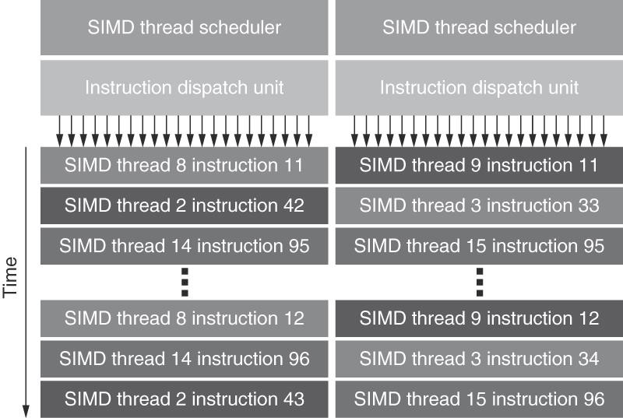
Figure 4.19 Block Diagram of Fermi’s Dual SIMD Thread Scheduler.
Compare this design to the single SIMD Thread Design in Figure 4.16.
57

Slide 86
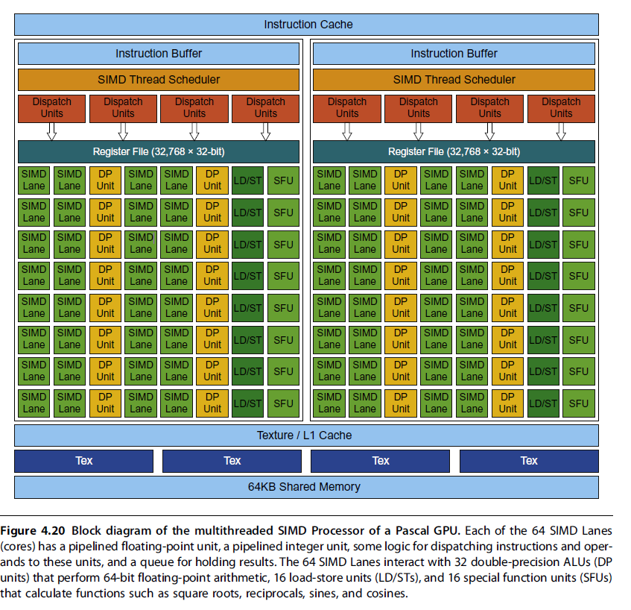
Pascal
GPU
Graphical Processing Units

Slide 87
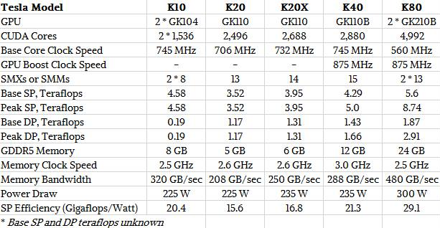
NVIDIA Kepler Architecture

Slide 88

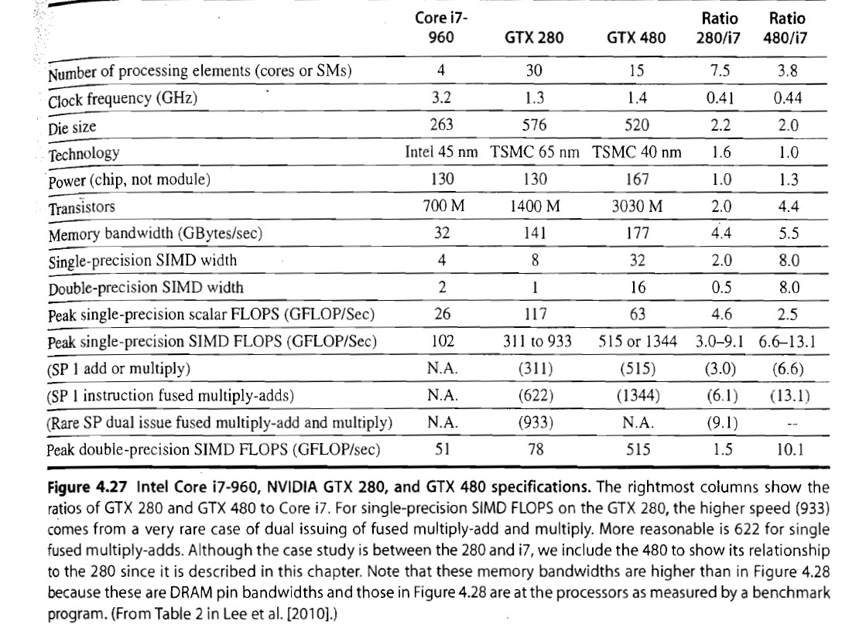

Slide 89
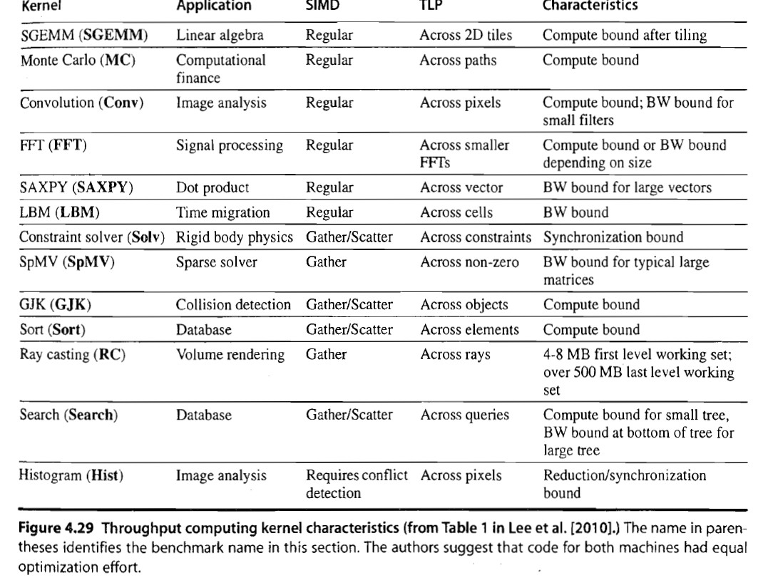

₆₀

Slide 90
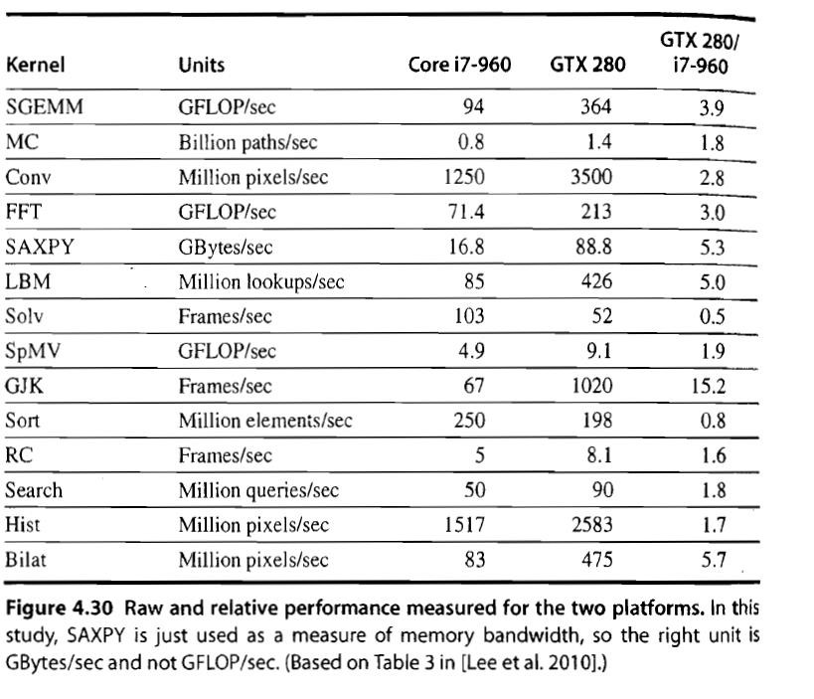

Slide 91
Loop-level parallelism
Detecting and Enhancing Loop-Level Parallelism
Focuses on determining whether data accesses in later iterations are dependent on data values produced in earlier iterations
  Loop-carried dependence
Example 1:
for (i=999; i>=0; i=i-1) x[i] = x[i] + s;
No loop-carried dependence

Slide 92
Loop-level parallelism example 2
Detecting and Enhancing Loop-Level Parallelism
for (i=0; i<100; i=i+1) {
A[i+1] = A[i] + C[i]; /* S1 */ B[i+1] = B[i] + A[i+1]; /* S2 */
}
S1 and S2 use values computed by S1 in previous iteration
S2 uses value computed by S1 in same iteration
There are two different dependences:
1. S1 uses a value computed by S1 in an earlier iteration, because iteration i computes A[i+1], which is read in iteration i+1. The same is true of S2 for B[i] and B[i+1]. (loop-carried)
2. S2 uses the value A[i+1] computed by S1 in the same iteration. (no loop-carried)
Notes:
There are two different dependences:
1. S1 uses a value computed by S1 in an earlier iteration, because iteration i computes
A[i+1], which is read in iteration i+1. The same is true of S2 for B[i] and
B[i+1].
2. S2 uses the value A[i+1] computed by S1 in the same iteration.
These two dependences are distinct and have different effects. To see how they
differ, let’s assume that only one of these dependences exists at a time. Because
the dependence of statement S1 is on an earlier iteration of S1, this dependence
is loop-carried. This dependence forces successive iterations of this loop to execute
in series.
The second dependence (S2 depending on S1) is within an iteration
and is not loop-carried. Thus, if this were the only dependence, multiple iterations
of the loop would execute in parallel, as long as each pair of statements
in an iteration were kept in order. We saw this type of dependence
in an example in Section 2.2, where unrolling could expose the parallelism.
These intra-loop dependences are common; for example, a sequence of vector
instructions that uses chaining exhibits exactly this sort of dependence.
It is also possible to have a loop-carried dependence that does not prevent
parallelism, as the next example shows.

Slide 93
Loop-level parallelism example 3
Detecting and Enhancing Loop-Level Parallelism
for (i=0; i<100; i=i+1) {
A[i] = A[i] + B[i]; /* S1 */
B[i+1] = C[i] + D[i]; /* S2 */
}
S1 uses value computed by S2 in previous iteration but dependence
is not circular，neither statement depends on itself, and although S1 depends on S2, S2 does not depend on S1. A loop is parallel if it can be written without a cycle in the dependences because the absence of a cycle means that the dependences give a partial ordering on the statements. so loop is parallel. Transform to:
A[0] = A[0] + B[0];
for (i=0; i<99; i=i+1) { B[i+1] = C[i] + D[i];
A[i+1] = A[i+1] + B[i+1];
}
B[100] = C[99] + D[99];
Notes:
Statement S1 uses the value assigned in the previous iteration by statement S2, so
there is a loop-carried dependence between S2 and S1. Despite this loop-carried
dependence, this loop can be made parallel. Unlike the earlier loop, this dependence
is not circular; neither statement depends on itself, and although S1 depends
on S2, S2 does not depend on S1. A loop is parallel if it can be written without a
cycle in the dependences because the absence of a cycle means that the dependences
give a partial ordering on the statements.
Although there are no circular dependences in the preceding loop, it must be
transformed to conform to the partial ordering and expose the parallelism. Two
observations are critical to this transformation:
1. There is no dependence from S1 to S2. If there were, then there would be a
cycle in the dependences and the loop would not be parallel. Because this other
dependence is absent, interchanging the two statements will not affect the execution
of S2.
2. On the first iteration of the loop, statement S2 depends on the value of B[0]
computed prior to initiating the loop.
These two observations allow us to replace the

Slide 94
Loop-level parallelism examples 4 and 5
Detecting and Enhancing Loop-Level Parallelism
for (i=0;i<100;i=i+1) { A[i] = B[i] + C[i];
D[i] = A[i] * E[i];
}
No loop-carried dependence
for (i=1;i<100;i=i+1) { Y[i] = Y[i-1] + Y[i];
}
Loop-carried dependence in the form of recurrence

Slide 95
Finding dependencies
Detecting and Enhancing Loop-Level Parallelism
Assume that a 1-D array index i is affine:
  a * i + b (with constants a and b)
An n-D array index is affine if it is affine in each dimension
Assume:
  Store to a * i + b, then
  Load from c * i + d
  i runs from m to n
  Dependence exists if:
    Given j, k such that m ≤ j ≤ n, m ≤ k ≤ n
    Store to a x j + b, load from c x k + d, and a * j + b = c * k + d

Slide 96
Finding dependencies
Detecting and Enhancing Loop-Level Parallelism
Generally cannot determine at compile time
Test for absence of a dependence:
  GCD test:
    If a dependency exists, GCD(c,a) must evenly divide (d-b)
Example:
for (i=0; i<100; i=i+1) { X[2*i+3] = X[2*i] * 5.0;
}
Answer: a=2, b=3, c=2, d=0 →GCD(c,a)=2, d-b=-3 → no dependence possible.

Slide 97
Reductions
Detecting and Enhancing Loop-Level Parallelism
Reduction Operation: for (i=9999; i>=0; i=i-1)
sum = sum + x[i] * y[i];
Transform to…
for (i=9999; i>=0; i=i-1) sum [i] = x[i] * y[i];
for (i=9999; i>=0; i=i-1)
finalsum = finalsum + sum[i];
Do on p processors:
for (i=999; i>=0; i=i-1)
finalsum[p] = finalsum[p] + sum[i+1000*p];
Note: assumes associativity!
For (i=0; i < p; i++)
finalsumall = finalsum[i] + finalsumall;

Slide 98
Fallacies
GPUs suffer from being co-processors.
The I/O device nature of GPUs creates a level of indirection between the compiler and the hardware and gives more flexibility to GPU architects who can try new innovations and drop them if not successful. For example, the Fermi architecture changed the hardware instruction set without disturbing the NVIDIA software stack:
(1) from memory-oriented as x86 to register-oriented like RV64V;
(2) from 32-bit to 64-bit addressing
One can get good performance without providing good memory bandwidth.
Add more threads to improve performance.
If memory accesses of CUDA threads are scattered or not correlated the memory system will get progressively slower. The CUDA threads must enjoy locality of memory access.

Slide 99
The DRAM Subsystem The Top Down View
(Appendix A)

Slide 100
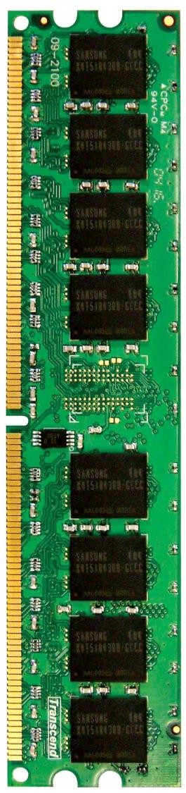
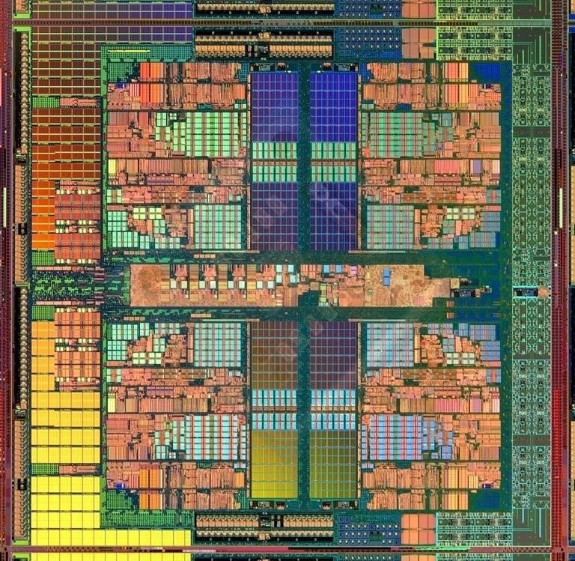
Main Memory in the System
DRAM BANKS
L2 CACHE 0
L2 CACHE 1
SHARED L3 CACHE
DRAM INTERFACE
CORE 0
CORE 1
DRAM MEMORY CONTROLLER
L2 CACHE 2
L2 CACHE 3
CORE 2
CORE 3
72

Slide 101
DRAM Subsystem Organization
Channel
DIMM
Rank
Chip
Bank
Row/Column
72

Slide 102
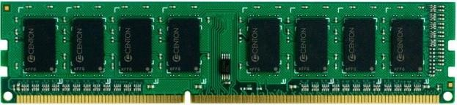


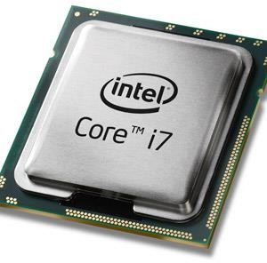
The DRAM subsystem
“Channel”
DIMM (Dual in-line memory module)
Processor
Memory channel
Memory channel

Slide 103
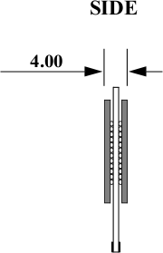
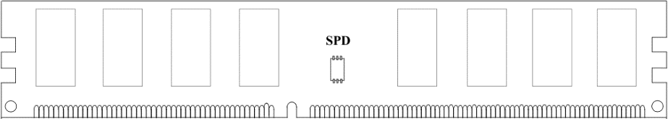
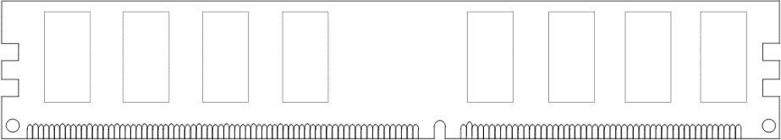
Breaking down a DIMM
DIMM (Dual in-line memory module)
Side view
Front of DIMM
Back of DIMM

Slide 104
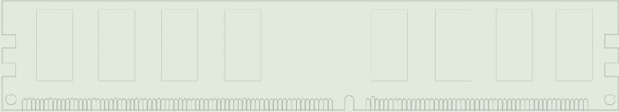
Breaking down a DIMM
双列直插内存模块
DIMM (Dual in-line memory module)
Side view
Front of DIMM
Back of DIMM
Rank 0: collection of 8 chips
Rank 1

Slide 105



Ranks
Rank 0 (Front)
Rank 1 (Back)
<0:63>
<0:63>
Addr/Cmd
CS<0:1>
(chip select)
Data <0:63>
Memory channel

Slide 106

Breaking down a Rank
. . .
Chip 0
Chip 1
Chip 7
Rank 0
<0:7>
<8:15>
<56:63>
<0:63>
Data <0:63>

Slide 107

Breaking down a Chip
Chip 0
<0:7>
<0:7>
<0:7>
...
<0:7>
<0:7>

Slide 108




Breaking down a Bank
2kB
1B (column)
row
16k-1
...
row 0
<0:7>
1B
1B
1B
...
<0:7>

Slide 109
DRAM Subsystem Organization
Channel
DIMM
Rank
Chip
Bank
Row/Column
80

Slide 110
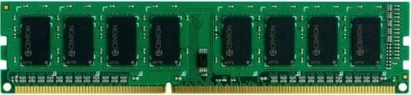





Example: Transferring a cache block
Physical memory space
0xFFFF…F
Channel 0
...
DIMM 0
0x40
Rank 0
64B
cache block
0x00

Slide 111

Example: Transferring a cache block
Physical memory space
Chip 0 Chip 1
Rank 0
Chip 7
0xFFFF…F
. . .
...
<0:7>
<8:15>
<56:63>
0x40
64B
cache block
Data <0:63>
0x00

Slide 112
Example: Transferring a cache block
Physical memory space
Chip 0 Chip 1
Rank 0
Chip 7
0xFFFF…F
. . .
Row 0
Col 0
...
<0:7>
<8:15>
<56:63>
0x40
64B
cache block
Data <0:63>
0x00

Slide 113
Example: Transferring a cache block
Physical memory space
Chip 0 Chip 1
Rank 0
Chip 7
0xFFFF…F
8B
. . .
Row 0
Col 0
...
<0:7>
<8:15>
<56:63>
0x40
64B
cache block
Data <0:63>
0x00
8B

Slide 114
Example: Transferring a cache block
Physical memory space
Chip 0 Chip 1
Rank 0
Chip 7
0xFFFF…F
8B
. . .
Row 0
Col 1
...
<0:7>
<8:15>
<56:63>
0x40
64B
cache block
Data <0:63>
0x00

Slide 115
Example: Transferring a cache block
Physical memory space
Chip 0 Chip 1
Rank 0
Chip 7
0xFFFF…F
8B
8B
. . .
Row 0
Col 1
...
<0:7>
<8:15>
<56:63>
0x40
64B
cache block
Data <0:63>
0x00
8B

Slide 116
Example: Transferring a cache block
Physical memory space
Chip 0 Chip 1
Rank 0
Chip 7
0xFFFF…F
8B
8B
. . .
Row 0
Col 1
...
<0:7>
<8:15>
<56:63>
0x40
64B
cache block
Data <0:63>
0x00
A 64B cache block takes 8 I/O cycles to transfer.
During the process, 8 columns are read sequentially.

Slide 117
Latency Components: Basic DRAM Operation
CPU → controller transfer time
Controller latency
  Queuing & scheduling delay at the controller
  Access converted to basic commands
Controller → DRAM transfer time
DRAM bank busy time
  Simple CAS (column address strobe) if row is “open” OR
  RAS (row address strobe) + CAS if array precharged OR
  PRE + RAS + CAS (worst case)
DRAM → Controller transfer time
  Bus latency (BL)
Controller to CPU transfer time

Slide 118
Multiple Banks (Interleaving) and Channels
Multiple banks
  Enable concurrent DRAM accesses
  Bits in address determine which bank an address resides in
Multiple independent channels serve the same purpose
  But they are even better because they have separate data buses
  Increased bus bandwidth
Enabling more concurrency requires reducing
  Bank conflicts
  Channel conflicts

Slide 119
How Multiple Banks Help
Bank start-up latency
Bank conflicts
Bank busy time
Mem latency
in the same bank

