Slide 1
Chapter 1: Introduction
Notes:
https://www.modb.pro/db/1713735941356593152

Slide 2
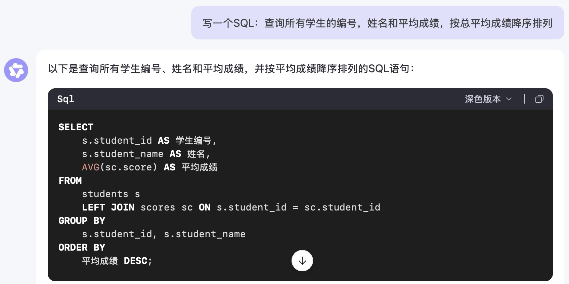
Challenges
讨论：大模型时代为什么要学数据库？

Slide 3
Database Applications Examples
Enterprise Information
  Sales: customers, products, purchases
  Accounting: payments, receipts, assets
  Human Resources: Information about employees, salaries, payroll taxes.
Manufacturing: management of production, inventory, orders, supply chain.
Banking and finance
  customer information, accounts, loans, and banking transactions.
  Credit card transactions
  Finance: sales and purchases of financial instruments (e.g., stocks and bonds; storing real-time market data
Universities: registration, grades

Slide 4
Database Applications Examples (Cont.)
Airlines: reservations, schedules
Telecommunication: records of calls, texts, and data usage, generating monthly bills, maintaining balances on prepaid calling cards
Web-based services
  Online retailers: order tracking, customized recommendations
  Online advertisements
Document databases
Navigation systems: For maintaining the locations of varies places of interest along with the exact routes of roads, train systems, buses, etc.

Slide 5
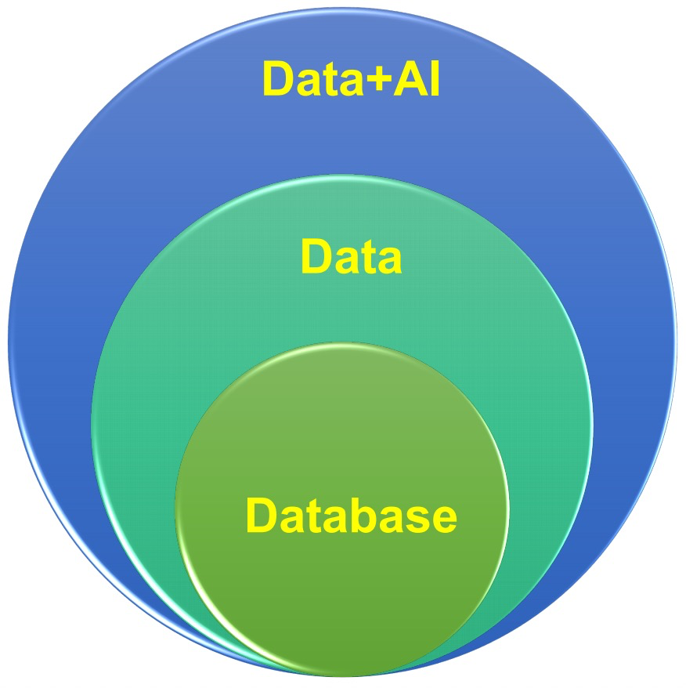
Database to Data Systems to Data + AI
NDBC 2025 Keynote on Data Agent.清华大学李国良教授

Slide 6
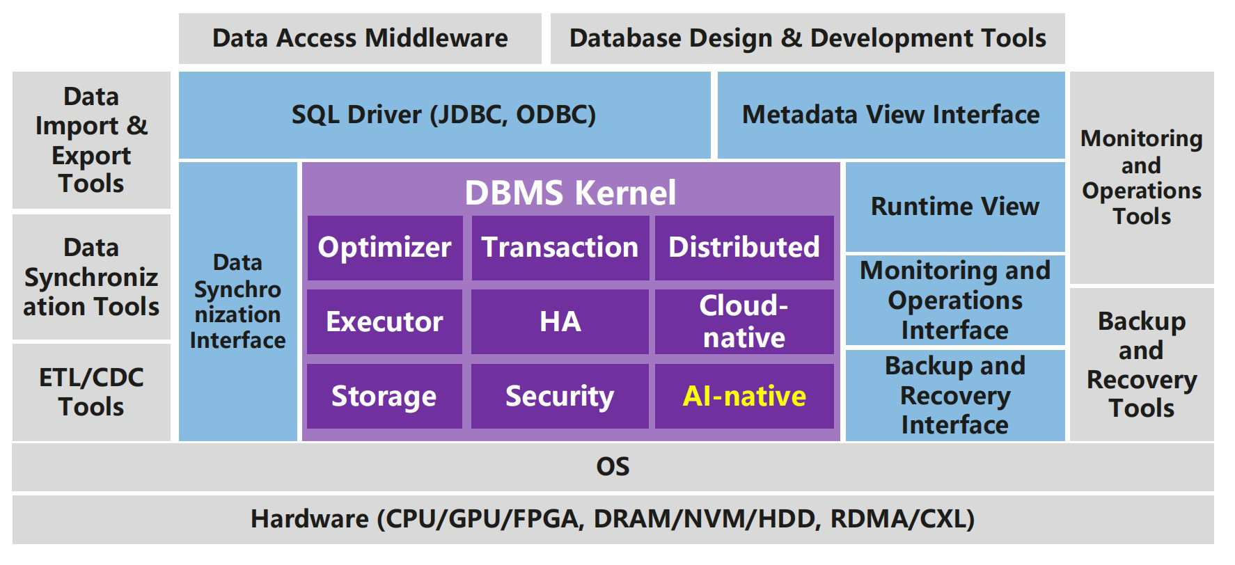
Database
NDBC 2025 Keynote on Data Agent.清华大学李国良教授

Slide 7
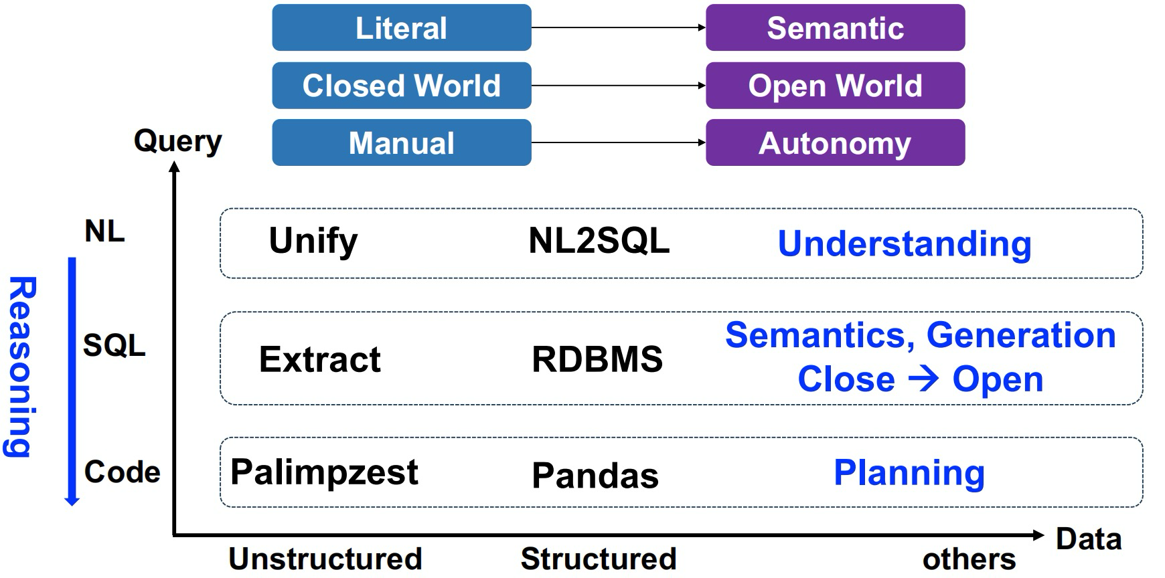
Database to Data Systems
NDBC 2025 Keynote on Data Agent.清华大学李国良教授

Slide 8
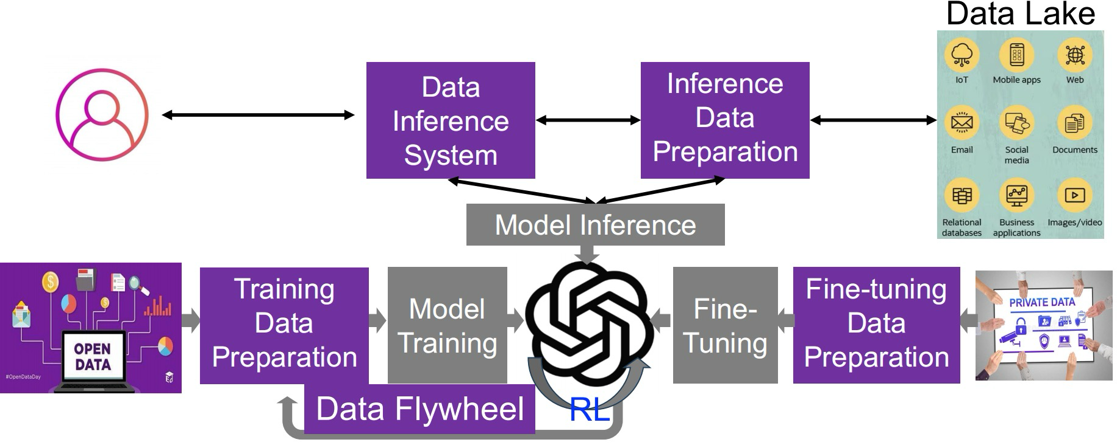
Data to Data + AI
NDBC 2025 Keynote on Data Agent.清华大学李国良教授

Slide 9
Outline
Data
  What is Data?
  View of Data
Database Systems

Slide 10
数据
示例1：93
  语义1：学生某门课的成绩
  语义2：某人的体重
  语义3：计算机2025级学生人数
  语义4：请同学给出…
Notes:
93是一个数据，给它很多解释，也就是语义

Slide 11
数据
示例2：一幅黑白图像
  数据——黑白点阵
  语义——脸谱
Notes:
93是一个数据，给它很多解释，也就是语义

Slide 12
数据
数据
  对现实世界中客观事物的符号表示
  可以是数值数据，也可以是非数值数据，如声音、图像等
  计算机中数据
    能输入计算机，并能为其处理的符号序列
  信息与数据的联系
    数据是信息的符号表示，或称载体
    信息是数据的内涵，是数据的语义解释
    数据是符号化的信息
    信息是语义化的数据
Notes:
音频数据通过播放器的解释变成音乐，信息

Slide 13
View of Data
A major purpose of a database system is to provide users with an abstract view of the data.
  Data abstraction
    Hide the complexity of data structures to represent data in the database from users through several levels of data abstraction.
    Data models
      A collection of conceptual tools for describing data, data relationships, data semantics, and consistency constraints.

Slide 14
Data Abstraction
数据抽象
  数据库系统是面向计算机的，而应用是面向现实世界的，两个世界存在着很大差异，要直接将现实世界中的语义映射到计算机世界是十分困难的，因此引入一个信息世界作为现实世界通向计算机实现的桥梁
  一方面，信息世界是对现实世界的抽象，从纷繁的现实世界中抽取出能反映现实本质的概念和基本关系;另一方面，信息世界中的概念和关系，要以一定的方式映射到计算机世界中去，在计算机系统上最终实现。信息世界起到了承上启下的作用

Slide 15
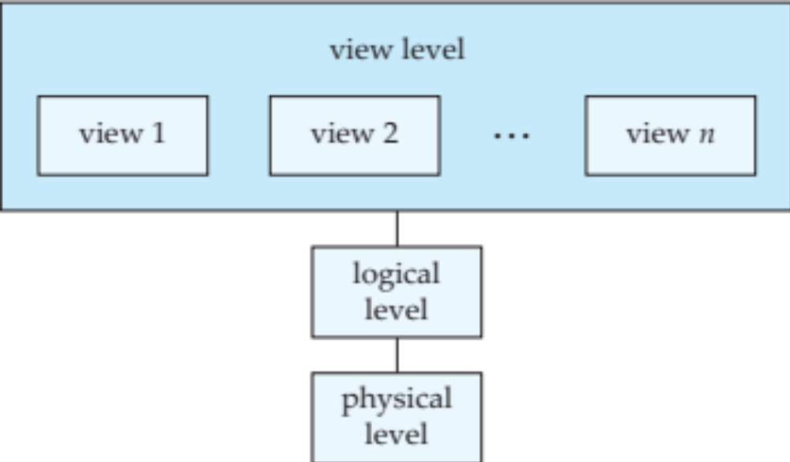
View of Data
An architecture for a database system： three levels of data abstraction

Slide 16
Levels of Abstraction
Physical level: describes how a record (e.g., instructor) is stored.
Logical level: describes data stored in database, and the relationships among the data.
  type instructor = record
  ID : string;
  name : string;
  dept_name : string;
  salary : integer;
        end;
View level: application programs hide details of data types. Views can also hide information (such as an employee’s salary) for security purposes.

Slide 17
Data Models（数据模型）的三个层面
概念数据模型
逻辑数据模型
物理数据模型

Slide 18
概念数据模型
按用户的观点来对数据和信息建模
用于组织信息世界的概念，表现从现实世界中抽象出来的事物以及它们之间的联系
这类模型强调其语义表达能力，概念简单、清晰，易于用户理解
它是现实世界到信息世界的抽象，是用户与数据库设计人员之间进行交流的语言
如E-R模型
Notes:
其他如ODL模型

Slide 19
概念数据模型： E-R模型
历史
  Ｅ-Ｒ模型：Entity-Relationship Model
  1976年，P.P.S.Chen提出Ｅ-Ｒ模型，用Ｅ-Ｒ图来描述概念模型
观点
  世界是由一组称作实体的基本对象和这些对象之间的联系构成的

Slide 20
概念数据模型：E-R模型
实体(Entity)
  客观存在并可相互区分的事物叫实体
  如学生张三、工人李四、计算机系、数据库概论
属性(Attribute)
  实体所具有的某一特性
  一个实体可以由若干个属性来刻画
  例如，学生可由学号、姓名、年龄、系等组成
域(Domain)
  属性的取值范围
  例如，性别的域为（男、女），月份的域为１到１２的整数

Slide 21
概念数据模型：E-R模型
例：学生选修课程
用椭圆表示实体的属性
姓名
学号
系别
课程名
先修课
学分
选修
学生
m
n
课程
用无向边把实体与其属性连接起来
联系的
数量
将参与联系的实体用线段连接
成绩
用矩形表示实体集，在框内写上实体名
用菱形表示实体间的联系
Notes:
表示要规范、考试常考、毕业设计也常用到，连线都是无向边1:1，1:n, m:n

Slide 22
逻辑数据模型
从计算机实现的观点来对数据建模
是信息世界中的概念和联系在计算机世界中的表示方法
一般有严格的形式化定义，以便于在计算机上实现
如层次模型、网状模型、关系模型、面向对象模型

Slide 23
逻辑数据模型的三要素
数据结构
  描述系统的静态特性，即组成数据库的对象类型
  数据本身
    类型、内容、性质。如网状模型中的数据项、记录，关系模型中的域、属性，关系等
  数据之间的联系
    例如网状模型中的联系型，关系模型中的外码
  在数据库系统中一般按数据结构的类型来命名数据模型

Slide 24
逻辑数据模型的三要素
数据操作
  描述系统的动态特性，即对数据库中对象的实例允许执行的操作的集合，包括操作及操作规则
  一般有检索、更新（插入、删除、修改）操作
  数据模型要定义操作含义、操作符号、操作规则，以及实现操作的语言
数据的约束条件
  数据的约束条件是完整性规则的集合，规定数据库状态及状态变化所应满足的条件，以保证数据的正确、有效、相容

Slide 25
逻辑数据模型：关系模型
关系模型(relational model)
  用二维表来表示实体及其相互联系
属性
元组
学号
姓名
年龄
性别
系号
S01
张军
21
男
D01
S02
李红
22
女
D01
S03
王伟
19
男
D02

Slide 26

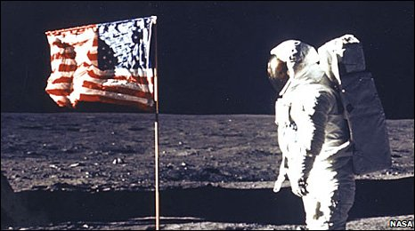
A Little History
Relational model due to Edgar “Ted” Codd, a mathematician at IBM in 1970
    A Relational Model of Data for Large Shared Data Banks. Communications of the ACM 13 (6): 377–387
IBM didn’t want to use relational model (take money from IMS)
    Apparently used in the moon landing…
Won Turing award 1981
Notes:
IMS apparently used in the moonshot (http://www-01.ibm.com/software/data/ims/benchmark.html) and still boasts high #s
1）In his article, Codd proposed a completely new idea: modeling data with the mathematical notion of relations. (Today, we call them tables.)
2）Codd’s model was not immediately successful. IBM was not eager to implement his suggestions. At the time, they had IMS, a very successful hierarchical database. They didn't want to undermine their revenue from IMS by building a competing product. (IMS is still developed today, which shows how successful it was.)

Slide 27
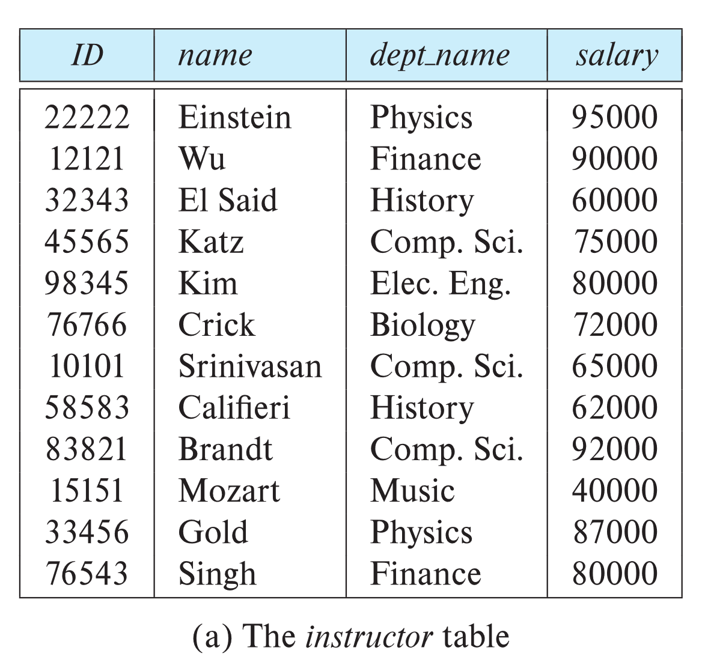

Relational Model
All the data is stored in various tables.
Example of tabular data in the relational model
Columns
Rows
Ted Codd
Turing Award 1981

Slide 28
Outline
Data
Database Systems
  Purpose of Database Systems
    Database Users and Administrators
  Database Languages
  Database Design
  Database Architecture
  History of Database Systems

Slide 29
Database Systems
DBMS contains information about a particular enterprise
  Collection of interrelated data
  Set of programs to access the data
  An environment that is both convenient and efficient to use
Database systems are used to manage collections of data that are:
  Highly valuable
  Relatively large
  Accessed by multiple users and applications, often at the same time.
A modern database system is a complex software system whose task is to manage a large, complex collection of data.
Databases touch all aspects of our lives

Slide 30
Purpose of Database Systems
In the early days, database applications were built directly on top of file systems, which leads to:
Data redundancy and inconsistency: data is stored in multiple file formats resulting induplication of information in different files
Difficulty in accessing data
  Need to write a new program to carry out each new task
Data isolation
  Multiple files and formats
Integrity problems
  Integrity constraints (e.g., account balance > 0) become “buried” in program code rather than being stated explicitly
  Hard to add new constraints or change existing ones

Slide 31
Purpose of Database Systems (Cont.)
Atomicity of updates
  Failures may leave database in an inconsistent state with partial updates carried out
  Example: Transfer of funds from one account to another should either complete or not happen at all
Concurrent access by multiple users
  Concurrent access needed for performance
  Uncontrolled concurrent accesses can lead to inconsistencies
    Ex: Two people reading a balance (say 100) and updating it by withdrawing money (say 50 each) at the same time
Security problems
  Hard to provide user access to some, but not all, data
Database systems offer solutions to all the above problems

Slide 32

数据库系统阶段
数据库观点
  数据不是依赖于处理过程的附属品，而是现实世界中独立存在的对象
程序2
程序1
程序n
统一存取
数据1
数据2
数据n

Slide 33
数据库系统的特点
具有较高的数据和程序的独立性
  把数据库的定义和描述从应用程序中分离出去
  数据描述是分级的（全局逻辑、局部逻辑、存储）
  数据的存取由系统管理，用户不必考虑存取路径等细节，从而简化了应用程序

Slide 34
概念
数据库系统DBS
  带有数据库的整个计算机系统，包括硬件、软件、数据、人员

Slide 35
数据库系统的主要成分
硬件 hardware
  大内存，放得下OS，DBMS核心，系统缓冲区，用户工作区等
  大容量、直接存取的外存设备
  作数据备份的磁带
软件 software
  OS，DBMS，高级语言编译系统及其与数据库的接口，应用开发工具，应用系统
数据 data
  目标数据：数据本身
  描述数据：对数据的说明信息
Notes:
用户工作区：应用程序的事务、应用变量等内容
Raid1-6 磁盘阵列
Sysobjects，Syscolumns

Slide 36
数据库系统的主要成分
用户
  最终用户(naive users)
    通过应用系统的用户接口（菜单等）使用数据库
  应用程序员(application programmers)
    基于外模式来编写应用程序
  系统分析员(system analysts)
    负责应用系统的需求分析和规范定义，确定系统的软硬件配置，参与数据库模式设计
  数据库管理员DBA(database administrator)
    负责数据库的全面管理和控制

Slide 37
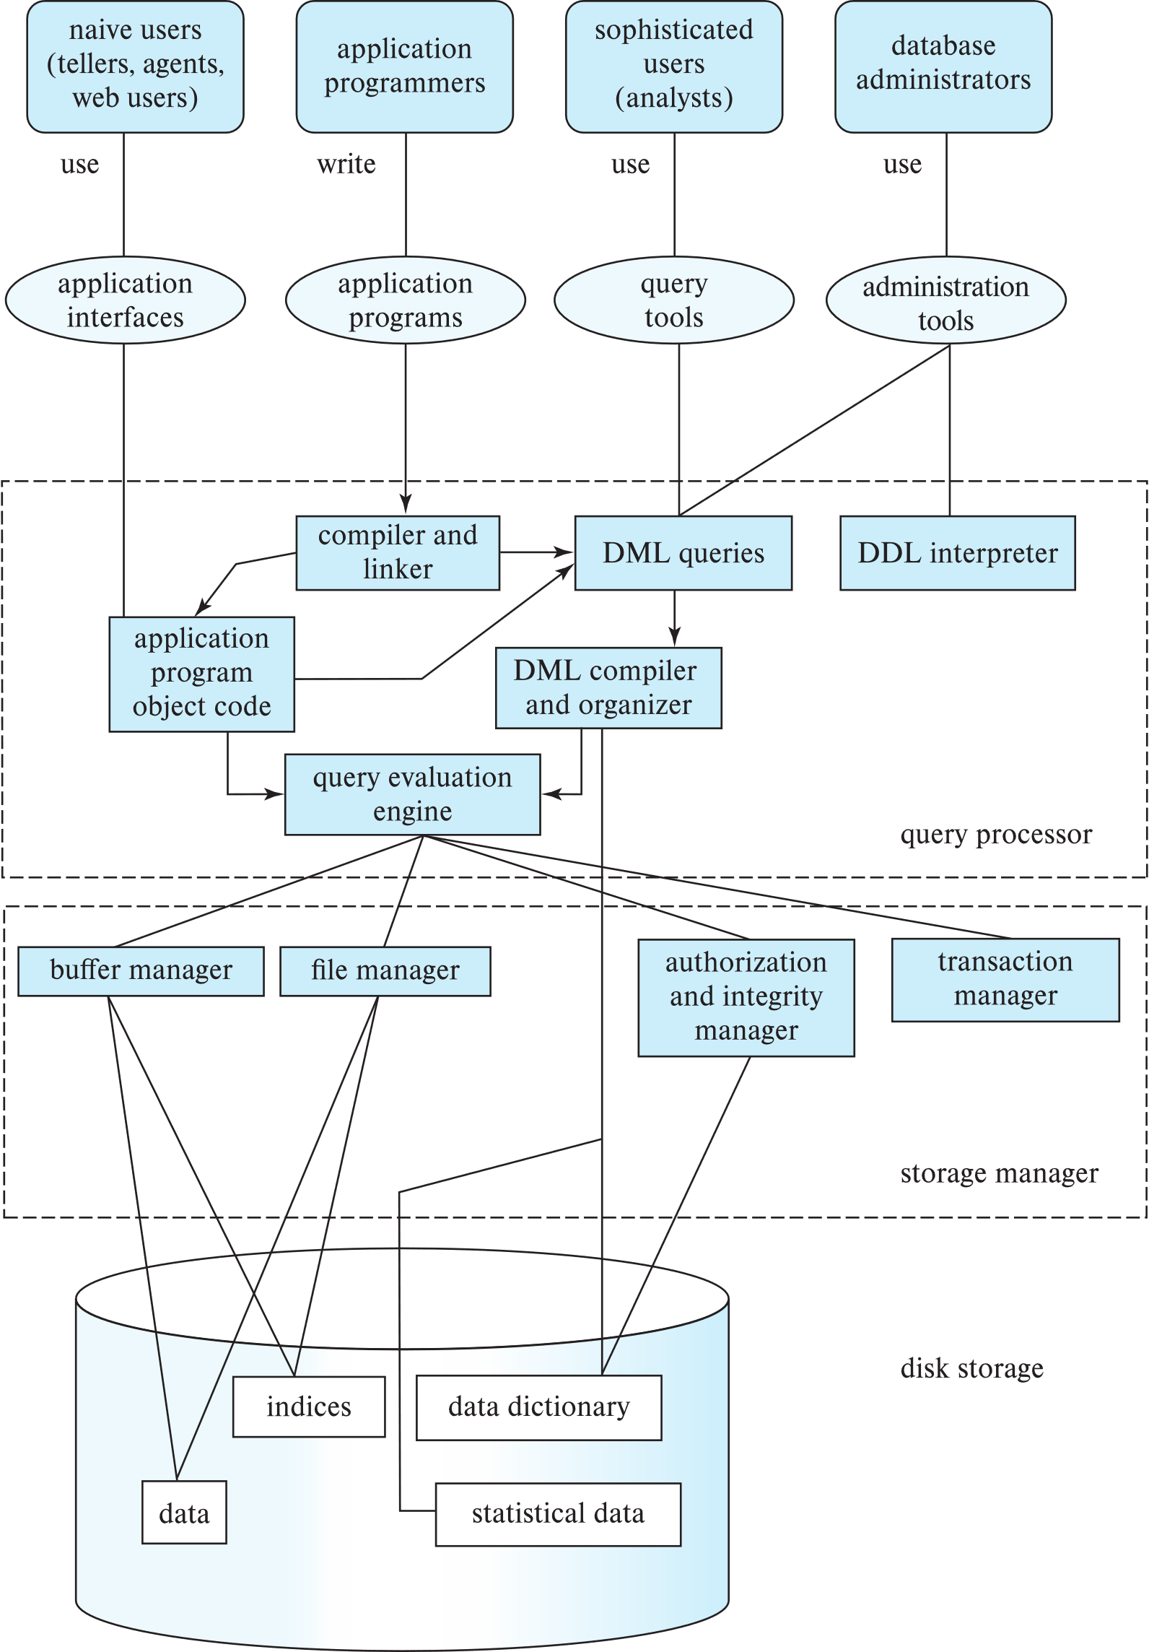
Database Users

Slide 38
Database Administrator
A person who has central control over the system is called a database administrator (DBA). Functions of a DBA include:
Schema definition
Storage structure and access-method definition
Schema and physical-organization modification
Granting of authorization for data access
Routine maintenance
Periodically backing up the database
Ensuring that enough free disk space is available for normal operations, and upgrading disk space as required
Monitoring jobs running on the database

Slide 39
Database Languages
数据库定义功能
  DDL语言（Data-Definition Language）
数据存取功能
  DML语言（Data-manipulation language）
    对数据库进行检索、插入、修改、删除
Notes:
DDL 定义数据结构

Slide 40
Data Definition Language (DDL)
Specification notation for defining the database schema
  Example: create table instructor (
  ID char(5),
  name varchar(20),
  dept_name varchar(20),
  salary numeric(8,2))
DDL compiler generates a set of table templates stored in a data dictionary
Data dictionary contains metadata (i.e., data about data)
  Database schema
  Integrity constraints
    Primary key (ID uniquely identifies instructors)
  Authorization
    Who can access what

Slide 41
Data Manipulation Language (DML)
Language for accessing and updating the data organized by the appropriate data model
  DML also known as query language
There are basically two types of data-manipulation language
  Procedural DML -- require a user to specify what data are needed and how to get those data.
  Declarative DML -- require a user to specify what data are needed without specifying how to get those data.
Declarative DMLs are usually easier to learn and use than are procedural DMLs.
Declarative DMLs are also referred to as non-procedural DMLs
The portion of a DML that involves information retrieval is called a query language.

Slide 42
SQL Query Language
SQL query language is nonprocedural. A query takes as input several tables (possibly only one) and always returns a single table.
Example to find all instructors in Comp. Sci. dept
select name
from instructor
where dept_name = 'Comp. Sci.'
To be able to compute complex functions SQL is usually embedded in some higher-level language
Application programs generally access databases through one of
  Language extensions to allow embedded SQL
  Application program interface (e.g., ODBC/JDBC) which allow SQL queries to be sent to a database

Slide 43
Database Access from Application Program
Non-procedural query languages such as SQL are not as powerful as a universal Turing machine.
SQL does not support actions such as input from users, output to displays, or communication over the network.
Such computations and actions must be written in a host language, such as C/C++, Java or Python, with embedded SQL queries that access the data in the database.
Application programs -- are programs that are used to interact with the database in this fashion.

Slide 44
Database Design
The process of designing the general structure of the database:
Logical Design – Deciding on the database schema. Database design requires that we find a “good” collection of relation schemas.
  Business decision – What attributes should we record in the database?
  Computer Science decision – What relation schemas should we have and how should the attributes be distributed among the various relation schemas?
Physical Design – Deciding on the physical layout of the database

Slide 45
Instances and Schemas（模式）
Similar to types and variables in programming languages
Logical Schema – the overall logical structure of the database
  Example: The database consists of information about a set of customers and accounts in a bank and the relationship between them
    Analogous to type information of a variable in a program
Physical schema – the overall physical structure of the database
Instance – the actual content of the database at a particular point in time
  Analogous to the value of a variable

Slide 46
Database Engine
A database system is partitioned into modules that deal with each of the responsibilities of the overall system.
The functional components of a database system can be divided into
  The storage manager,
  The query processor component,
  The transaction management component.

Slide 47
Storage Manager
A program module that provides the interface between the low-level data stored in the database and the application programs and queries submitted to the system.
The storage manager is responsible to the following tasks:
  Interaction with the OS file manager
  Efficient storing, retrieving and updating of data
The storage manager components include:
  Authorization and integrity manager
  Transaction manager
  File manager
  Buffer manager

Slide 48
Storage Manager (Cont.)
The storage manager implements several data structures as part of the physical system implementation:
  Data files -- store the database itself
  Data dictionary -- stores metadata about the structure of the database, in particular the schema of the database.
  Indices -- can provide fast access to data items. A database index provides pointers to those data items that hold a particular value.

Slide 49
Query Processor
The query processor components include:
  DDL interpreter -- interprets DDL statements and records the definitions in the data dictionary.
  DML compiler -- translates DML statements in a query language into an evaluation plan consisting of low-level instructions that the query evaluation engine understands.
    The DML compiler performs query optimization; that is, it picks the lowest cost evaluation plan from among the various alternatives.
  Query evaluation engine -- executes low-level instructions generated by the DML compiler.

Slide 50
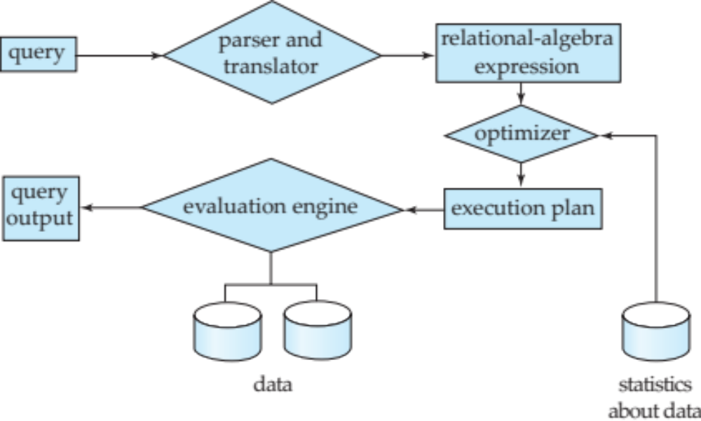
Query Processing
1. Parsing and translation
2. Optimization
3. Evaluation

Slide 51
Transaction Management
A transaction is a collection of operations that performs a single logical function in a database application
Transaction-management component ensures that the database remains in a consistent (correct) state despite system failures (e.g., power failures and operating system crashes) and transaction failures.
Concurrency-control manager controls the interaction among the concurrent transactions, to ensure the consistency of the database.

Slide 52
Database Architecture
Centralized databases
  One to a few cores, shared memory
Client-server,
  One server machine executes work on behalf of multiple client machines.
Parallel databases
  Many core shared memory
  Shared disk
  Shared nothing
Distributed databases
  Geographical distribution
  Schema/data heterogeneity

Slide 53
Database Architecture
(Centralized/Shared-Memory)

Slide 54
Database Applications
Database applications are usually partitioned into two or three parts
Two-tier architecture -- the application resides at the client machine, where it invokes database system functionality at the server machine
Three-tier architecture -- the client machine acts as a front end and does not contain any direct database calls.
  The client end communicates with an application server, usually through a forms interface.
  The application server in turn communicates with a database system to access data.

Slide 55
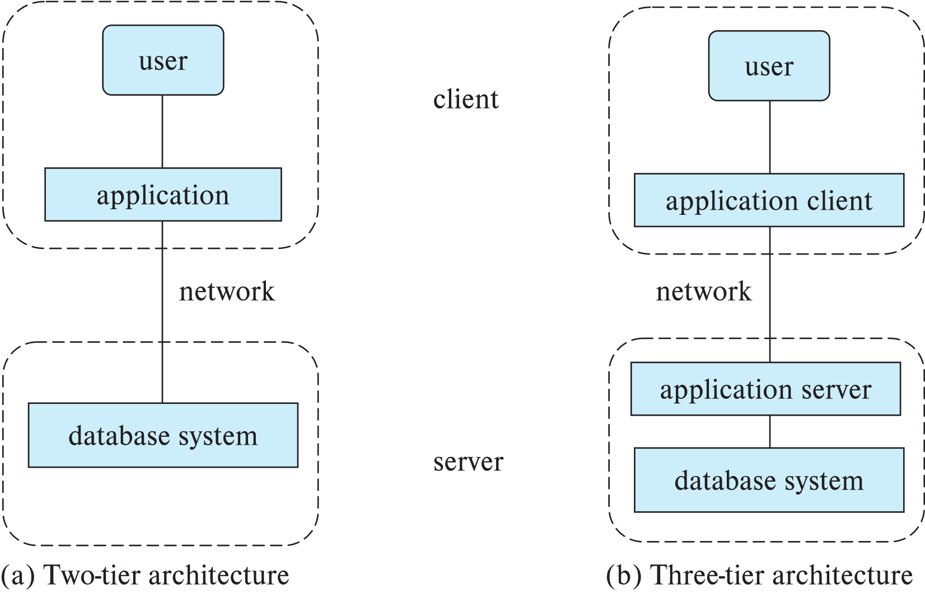
Two-tier and three-tier architectures

Slide 56
History of Database Systems
1950s and early 1960s:
  Data processing using magnetic tapes for storage
    Tapes provided only sequential access
  Punched cards for input
Late 1960s and 1970s:
  Hard disks allowed direct access to data
  Network and hierarchical data models in widespread use
  Ted Codd defines the relational data model
    Would win the ACM Turing Award for this work
    IBM Research begins System R prototype
    UC Berkeley (Michael Stonebraker) begins Ingres prototype
    Oracle releases first commercial relational database
  High-performance (for the era) transaction processing

Slide 57
History of Database Systems (Cont.)
1980s:
  Research relational prototypes evolve into commercial systems
    SQL becomes industrial standard
  Parallel and distributed database systems
    Wisconsin, IBM, Teradata
  Object-oriented database systems
1990s:
  Large decision support and data-mining applications
  Large multi-terabyte data warehouses
  Emergence of Web commerce

Slide 58
History of Database Systems (Cont.)
2000s
  Big data storage systems
    Google BigTable, Yahoo PNuts, Amazon,
    “NoSQL” systems.
  Big data analysis: beyond SQL
    Map reduce and friends
2010s
  SQL reloaded
    SQL front end to Map Reduce systems
    Massively parallel database systems
    Multi-core main-memory databases

Slide 59
End of Chapter 1

